Slide 1


CS440/ECE448 Lecture 16: Parameter and Structure Learning for Bayesian Networks
By Mark Hasegawa-Johnson, 2/2020
With some slides by Svetlana Lazebnik, 9/2017
License: CC-BY 4.0
You may redistribute or remix if you cite the source.

Slide 2
Parameter and Structure Learning for Bayesian Networks
Parameter Learning
from Fully Observed data: Maximum Likelihood
from Partially Observed data: Expectation Maximization
Structure Learning
The usual method: knowledge engineering
An interesting recent method: causal analysis

Slide 3
Outline
Parameter Learning
from Fully Observed data: Maximum Likelihood
from Partially Observed data: Expectation Maximization
Structure Learning
The usual method: knowledge engineering
An interesting recent method: causal analysis

Slide 4
Flying cows
The scenario:
Central Illinois has recently had a problem with flying cows.
Farmers have called the university to complain that their cows flew away.

Slide 5
Flying cows
The university dispatched a team of expert vaccavolatologists. They determined that almost all flying cows were explained by one or both of the following causes:
Smart cows. The cows learned how to fly, on their own, without help.
Alien intervention. UFOs taught the cows how to fly.

Slide 6
Flying cows
The vaccavolatologists created a Bayes net, to help them predict any future instances of cow flying:
P(A) = Probability that aliens teach the cow.
P(S) = Probability that a cow is smart enough to figure out how to fly on its own.
P(F|S,A) = Probability that a cow learns to fly.
A
S
F

Slide 7
Flying cows
A
S
F
Day | A | S | F
1
2 |  | T | T
3
4 | T | T | T
5 | T
6
7 | T |  | T
8
9 |  |  | T
10
They went out to watch a nearby pasture for ten days.
They reported the number of days on which A, S, and/or F occurred.
Their results are shown in the table at left (True is marked as “T”; False is shown with a blank).

Slide 8
Flying cows
A
S
F
Day | A | S | F
1
2 |  | T | T
3
4 | T | T | T
5 | T
6
7 | T |  | T
8
9 |  |  | T
10
The vaccavolatologists now wish to estimate the parameters of their Bayes net
P(A)
P(S)
P(F|S,A)
…so that they will be better able to testify before Congress about the relative dangers of aliens versus smart cows.

Slide 9
Outline
Parameter Learning
from Fully Observed data: Maximum Likelihood
from Partially Observed data: Expectation Maximization
Structure Learning
The usual method: knowledge engineering
An interesting recent method: causal analysis

Slide 10
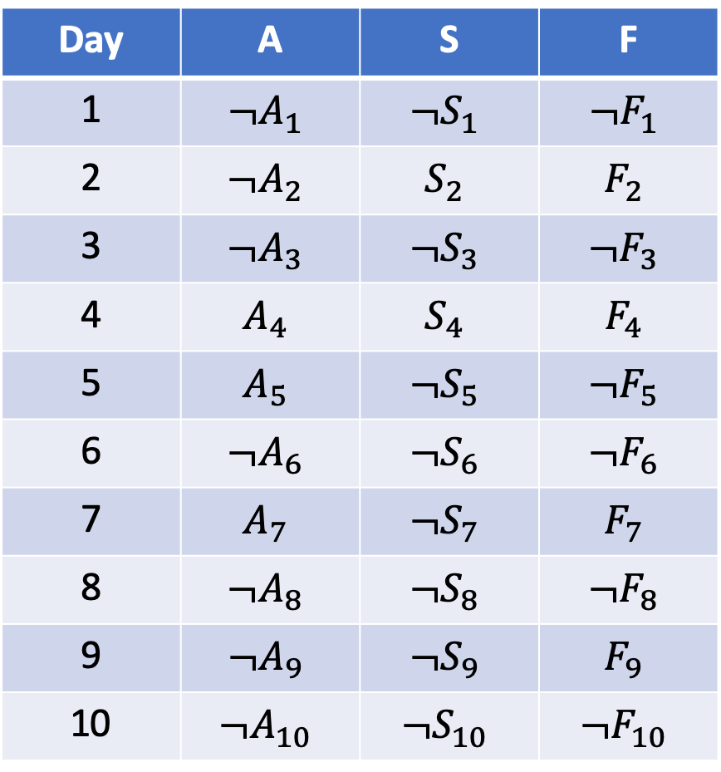
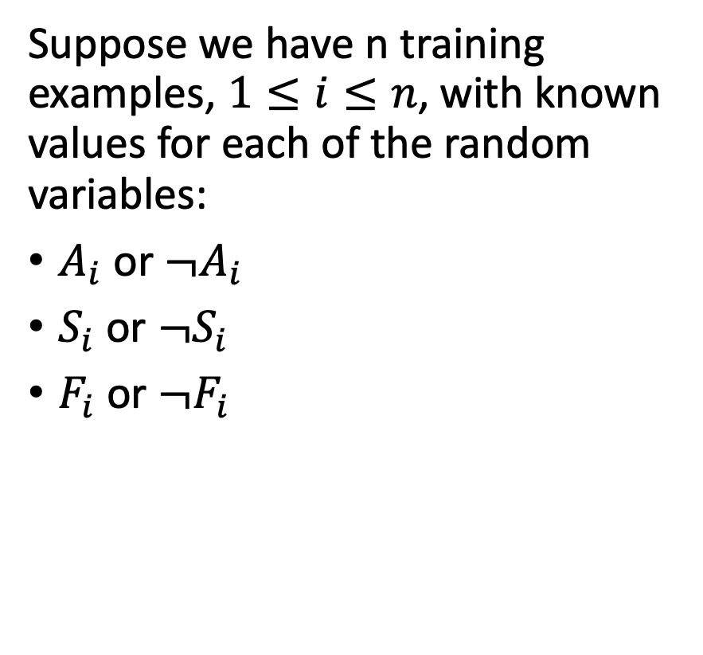
Maximum Likelihood Estimation
A
S
F
Day | A | S | F
1 | $${¬A}_{1}$$ | $${¬S}_{1}$$ | $${¬F}_{1}$$
2 | $${¬A}_{2}$$ | $$S_{2}$$ | $$F_{2}$$
3 | $${¬A}_{3}$$ | $$¬S_{3}$$ | $${¬F}_{3}$$
4 | $$A_{4}$$ | $$S_{4}$$ | $$F_{4}$$
5 | $$A_{5}$$ | $$¬S_{5}$$ | $${¬F}_{5}$$
6 | $${¬A}_{6}$$ | $${¬S}_{6}$$ | $${¬F}_{6}$$
7 | $$A_{7}$$ | $${¬S}_{7}$$ | $$F_{7}$$
8 | $${¬A}_{8}$$ | $${¬S}_{8}$$ | $${¬F}_{8}$$
9 | $${¬A}_{9}$$ | $${¬S}_{9}$$ | $$F_{9}$$
10 | $${¬A}_{10}$$ | $${¬S}_{10}$$ | $${¬F}_{10}$$
Suppose we have n training examples, $1≤i≤n$, with known values for each of the random variables:
$A_{i}$ or ${¬A}_{i}$
$S_{i}$ or ${¬S}_{i}$
$F_{i}$ or ${¬F}_{i}$

Slide 11
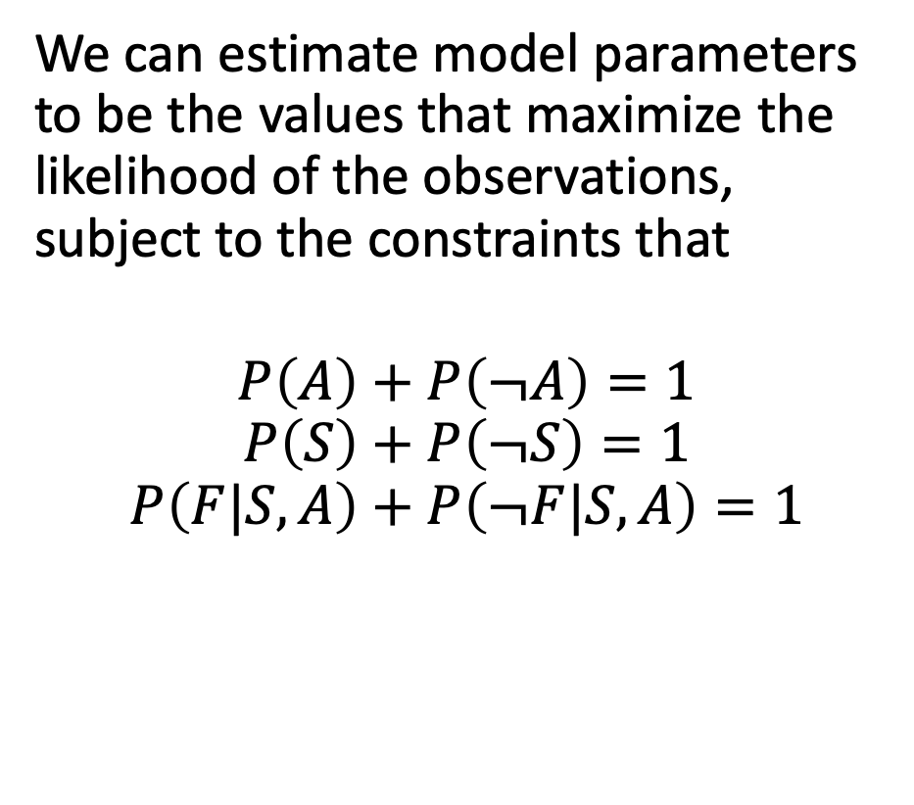
Maximum Likelihood Estimation
A
S
F
Day | A | S | F
1 | $${¬A}_{1}$$ | $${¬S}_{1}$$ | $${¬F}_{1}$$
2 | $${¬A}_{2}$$ | $$S_{2}$$ | $$F_{2}$$
3 | $${¬A}_{3}$$ | $$¬S_{3}$$ | $${¬F}_{3}$$
4 | $$A_{4}$$ | $$S_{4}$$ | $$F_{4}$$
5 | $$A_{5}$$ | $$¬S_{5}$$ | $${¬F}_{5}$$
6 | $${¬A}_{6}$$ | $${¬S}_{6}$$ | $${¬F}_{6}$$
7 | $$A_{7}$$ | $${¬S}_{7}$$ | $$F_{7}$$
8 | $${¬A}_{8}$$ | $${¬S}_{8}$$ | $${¬F}_{8}$$
9 | $${¬A}_{9}$$ | $${¬S}_{9}$$ | $$F_{9}$$
10 | $${¬A}_{10}$$ | $${¬S}_{10}$$ | $${¬F}_{10}$$
We can estimate model parameters to be the values that maximize the likelihood of the observations, subject to the constraints that
$$P\left(A\right)+P\left(¬A\right)=1$$
$$P\left(S\right)+P\left(¬S\right)=1$$
$$P\left(F|S,A\right)+P\left(¬F|S,A\right)=1$$

Slide 12
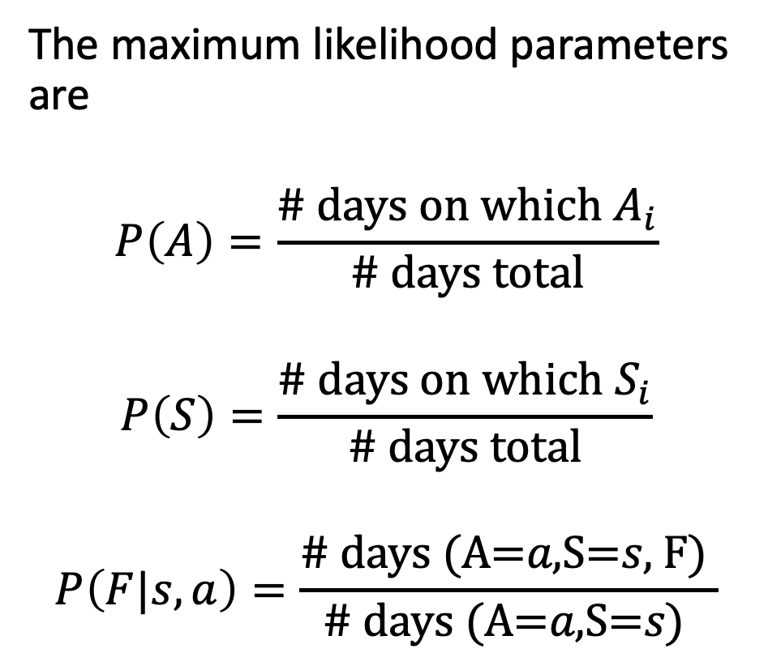
Maximum Likelihood Estimation
A
S
F
Day | A | S | F
1 | $${¬A}_{1}$$ | $${¬S}_{1}$$ | $${¬F}_{1}$$
2 | $${¬A}_{2}$$ | $$S_{2}$$ | $$F_{2}$$
3 | $${¬A}_{3}$$ | $$¬S_{3}$$ | $${¬F}_{3}$$
4 | $$A_{4}$$ | $$S_{4}$$ | $$F_{4}$$
5 | $$A_{5}$$ | $$¬S_{5}$$ | $${¬F}_{5}$$
6 | $${¬A}_{6}$$ | $${¬S}_{6}$$ | $${¬F}_{6}$$
7 | $$A_{7}$$ | $${¬S}_{7}$$ | $$F_{7}$$
8 | $${¬A}_{8}$$ | $${¬S}_{8}$$ | $${¬F}_{8}$$
9 | $${¬A}_{9}$$ | $${¬S}_{9}$$ | $$F_{9}$$
10 | $${¬A}_{10}$$ | $${¬S}_{10}$$ | $${¬F}_{10}$$
The maximum likelihood parameters are
$$P\left(A\right)=\frac{\# \text{days} \text{on} \text{which} A_{i}}{\# \text{days} \text{total}}$$
$$P\left(S\right)=\frac{\# \text{days} \text{on} \text{which} S_{i}}{\# \text{days} \text{total}}$$
$$P\left(F|s,a\right)=\frac{\text{\# }\text{days} \text{(}\text{A}\text{=}a\text{,}\text{S}\text{=}s\text{, }\text{F}\text{) }}{\text{\# }\text{days} \text{(}\text{A}\text{=}a\text{,}\text{S}\text{=}s\text{)} }$$

Slide 13
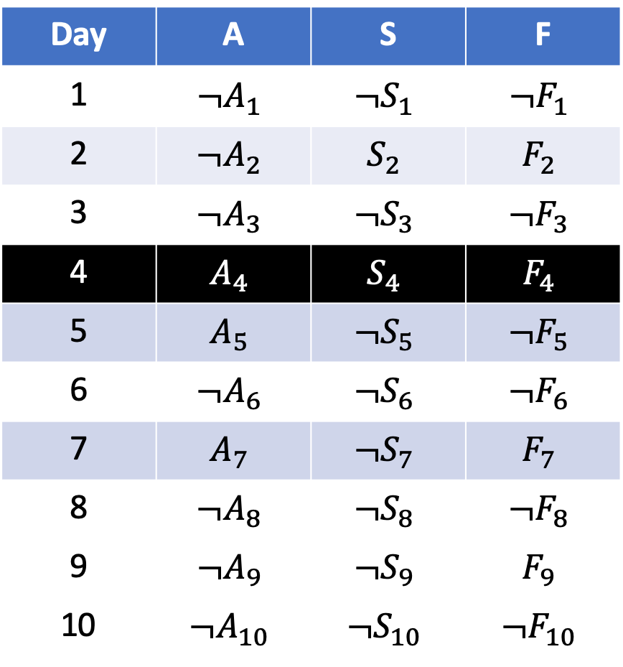
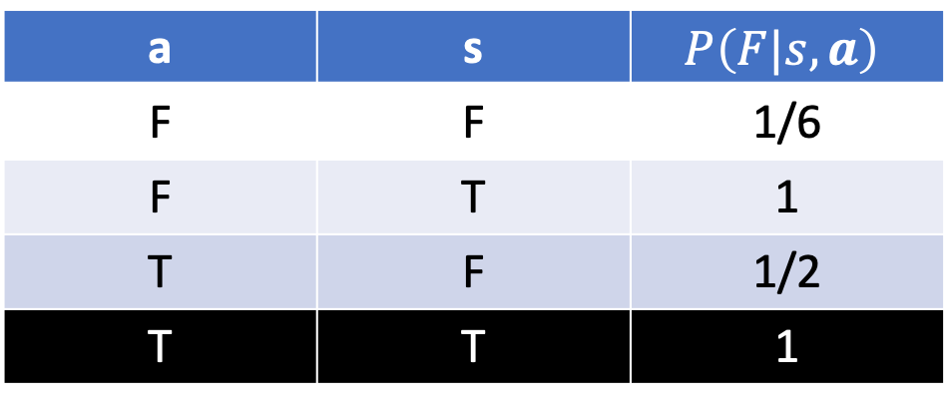
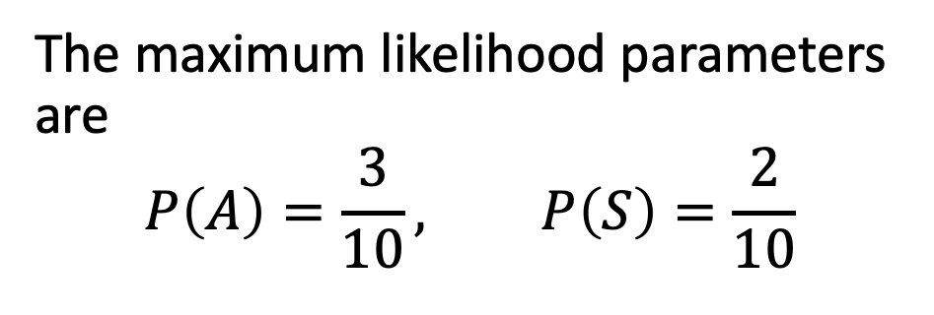
Maximum Likelihood Estimation
A
S
F
Day | A | S | F
1 | $${¬A}_{1}$$ | $${¬S}_{1}$$ | $${¬F}_{1}$$
2 | $${¬A}_{2}$$ | $$S_{2}$$ | $$F_{2}$$
3 | $${¬A}_{3}$$ | $$¬S_{3}$$ | $${¬F}_{3}$$
4 | $$A_{4}$$ | $$S_{4}$$ | $$F_{4}$$
5 | $$A_{5}$$ | $$¬S_{5}$$ | $${¬F}_{5}$$
6 | $${¬A}_{6}$$ | $${¬S}_{6}$$ | $${¬F}_{6}$$
7 | $$A_{7}$$ | $${¬S}_{7}$$ | $$F_{7}$$
8 | $${¬A}_{8}$$ | $${¬S}_{8}$$ | $${¬F}_{8}$$
9 | $${¬A}_{9}$$ | $${¬S}_{9}$$ | $$F_{9}$$
10 | $${¬A}_{10}$$ | $${¬S}_{10}$$ | $${¬F}_{10}$$
The maximum likelihood parameters are
$$P\left(A\right)=\frac{3}{10}, P\left(S\right)=\frac{2}{10}$$
a | s | $$P\left(F|s,a\right)$$
F | F | 1/6
F | T | 1
T | F | 1/2
T | T | 1

Slide 14
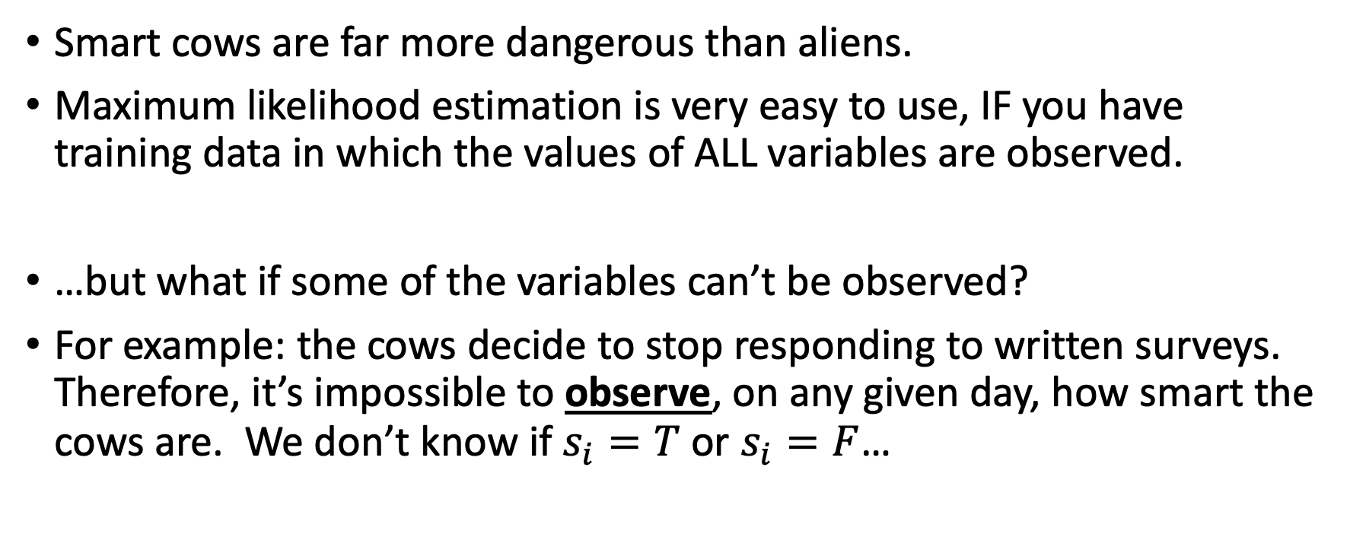
Conclusions: maximum likelihood estimation
Smart cows are far more dangerous than aliens.
Maximum likelihood estimation is very easy to use, IF you have training data in which the values of ALL variables are observed.
…but what if some of the variables can’t be observed?
For example: the cows decide to stop responding to written surveys. Therefore, it’s impossible to observe, on any given day, how smart the cows are. We don’t know if $s_{i}=T$ or $s_{i}=F$…

Slide 15
Outline
Parameter Learning
from Fully Observed data: Maximum Likelihood
from Partially Observed data: Expectation Maximization
Structure Learning
The usual method: knowledge engineering
An interesting recent method: causal analysis

Slide 16
Partially observed data
A
S
F
Day | A | S | F
1 |  | ?
2 |  | ? | T
3 |  | ?
4 | T | ? | T
5 | T | ?
6 |  | ?
7 | T | ? | T
8 |  | ?
9 |  | ? | T
10 |  | ?
Suppose that we have the following observations:
We know whether A=True or False.
We know whether F=True or False.
We don’t know whether S is True or False (shown as ”?”).

Slide 17
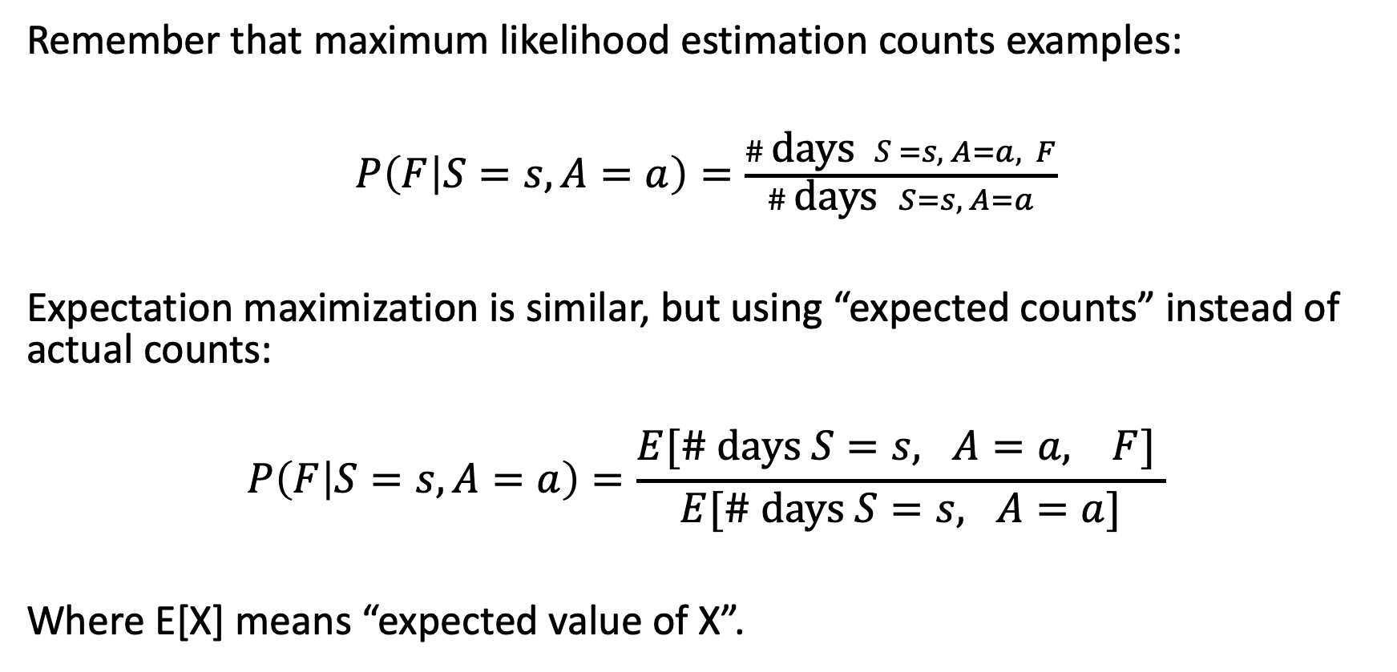
Expectation Maximization (EM): Main idea
Remember that maximum likelihood estimation counts examples:
$P\left(F | S=s,A=a\right)=\frac{\# \text{days} S=s, A=a, F}{\# \text{days} S=s, A=a}$
Expectation maximization is similar, but using “expected counts” instead of actual counts:
$$P\left(F | S=s,A=a\right)=\frac{E[\# \text{days} S=s, A=a, F] }{E[\# \text{days} S=s, A=a]}$$
Where E[X] means “expected value of X”.

Slide 18
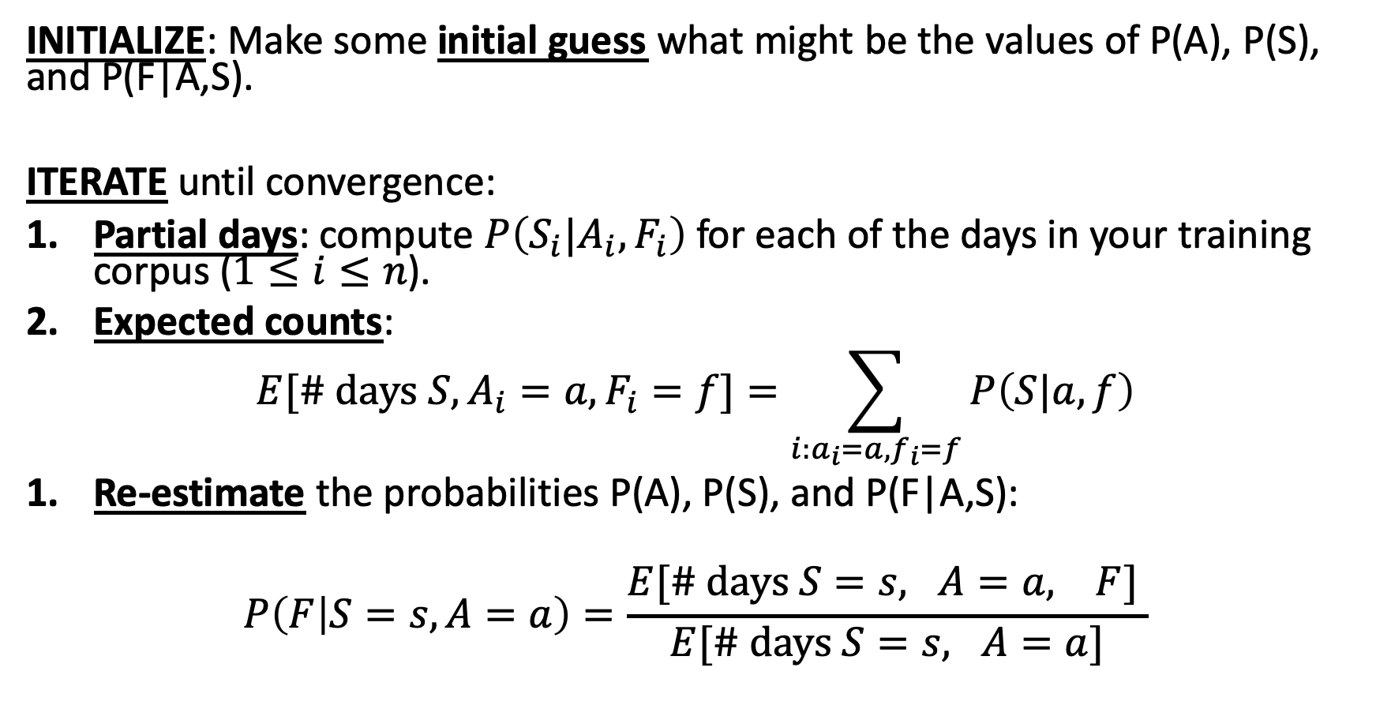
Expectation Maximization (EM): overview
INITIALIZE: Make some initial guess what might be the values of P(A), P(S), and P(F|A,S).
ITERATE until convergence:
Partial days: compute $P\left(S_{i}|A_{i},F_{i}\right)$ for each of the days in your training corpus ($1≤i≤n$).
Expected counts:
$$E[\# \text{days} S,A_{i}=a,F_{i}=f]=\sum_{i:a_{i}=a,f_{i}=f}{P\left(S|a,f\right)}$$
Re-estimate the probabilities P(A), P(S), and P(F|A,S):
$$P\left(F | S=s,A=a\right)=\frac{E[\# \text{days} S=s, A=a, F] }{E[\# \text{days} S=s, A=a]}$$

Slide 19
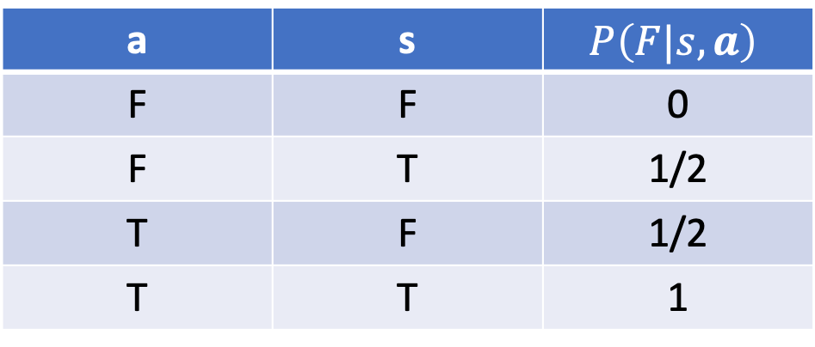

Example: Initialize
A
S
F
Marilyn Modigliani is a professional vaccavolatologist. She gives us these initial guesses about the possible model parameters (her guesses are probably not quite right, but they are as good a guess as anybody else’s):
$$P\left(A\right)=\frac{1}{4}, P\left(S\right)=\frac{1}{4}$$
a | s | $$P\left(F|s,a\right)$$
F | F | 0
F | T | 1/2
T | F | 1/2
T | T | 1

Slide 20
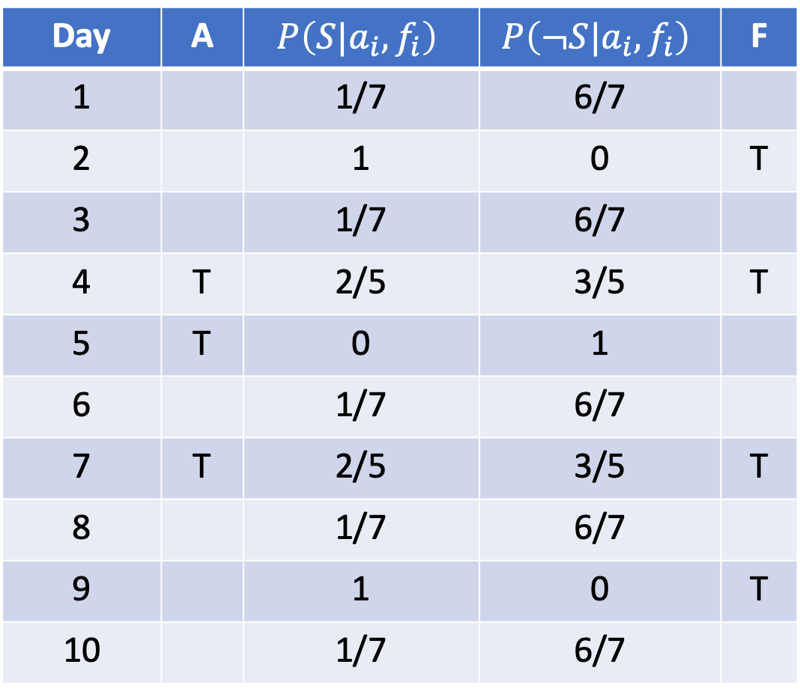

Partial days
A
S
F
Day | A | $$P\left(S|a_{i},f_{i}\right)$$ | $$P\left(¬S|a_{i},f_{i}\right)$$ | F
1 |  | 1/7 | 6/7
2 |  | 1 | 0 | T
3 |  | 1/7 | 6/7
4 | T | 2/5 | 3/5 | T
5 | T | 0 | 1
6 |  | 1/7 | 6/7
7 | T | 2/5 | 3/5 | T
8 |  | 1/7 | 6/7
9 |  | 1 | 0 | T
10 |  | 1/7 | 6/7
Based on Marilyn’s model, we calculate $P\left(S=s|a_{i},f_{i}\right)$ for each day, as shown in the table at right.

Slide 21
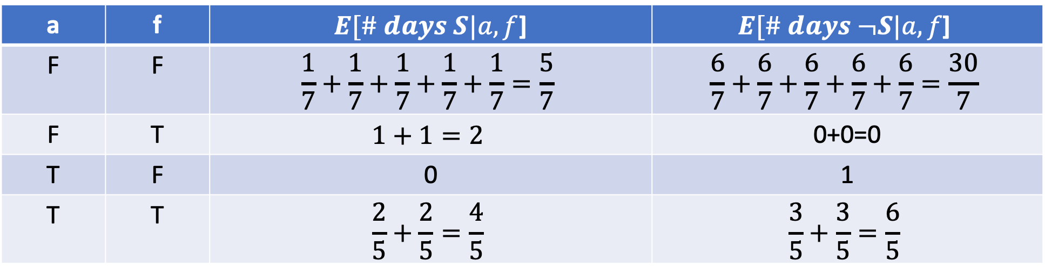
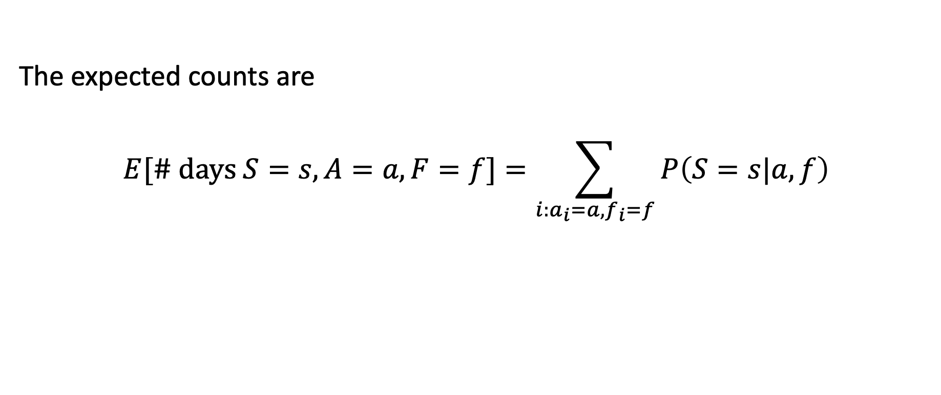
Expected counts
A
S
F
The expected counts are
$$E[\# \text{days} S=s,A=a, F=f]=\sum_{i:a_{i}=a,f_{i}=f}{P\left(S=s|a,f\right)}$$
a | f | $E[\# days S|a,f$] | $$E[\# days ¬S|a,f\text{]}$$
F | F | $$\frac{1}{7}+\frac{1}{7}+\frac{1}{7}+\frac{1}{7}+\frac{1}{7}=\frac{5}{7}$$ | $$\frac{6}{7}+\frac{6}{7}+\frac{6}{7}+\frac{6}{7}+\frac{6}{7}=\frac{30}{7}$$
F | T | $$1+1=2$$ | 0+0=0
T | F | 0 | 1
T | T | $$\frac{2}{5}+\frac{2}{5}=\frac{4}{5}$$ | $$\frac{3}{5}+\frac{3}{5}=\frac{6}{5}$$

Slide 22
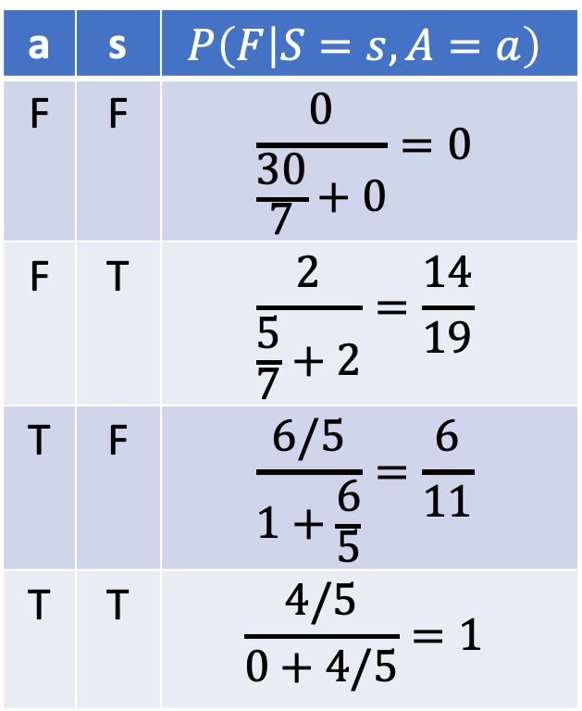
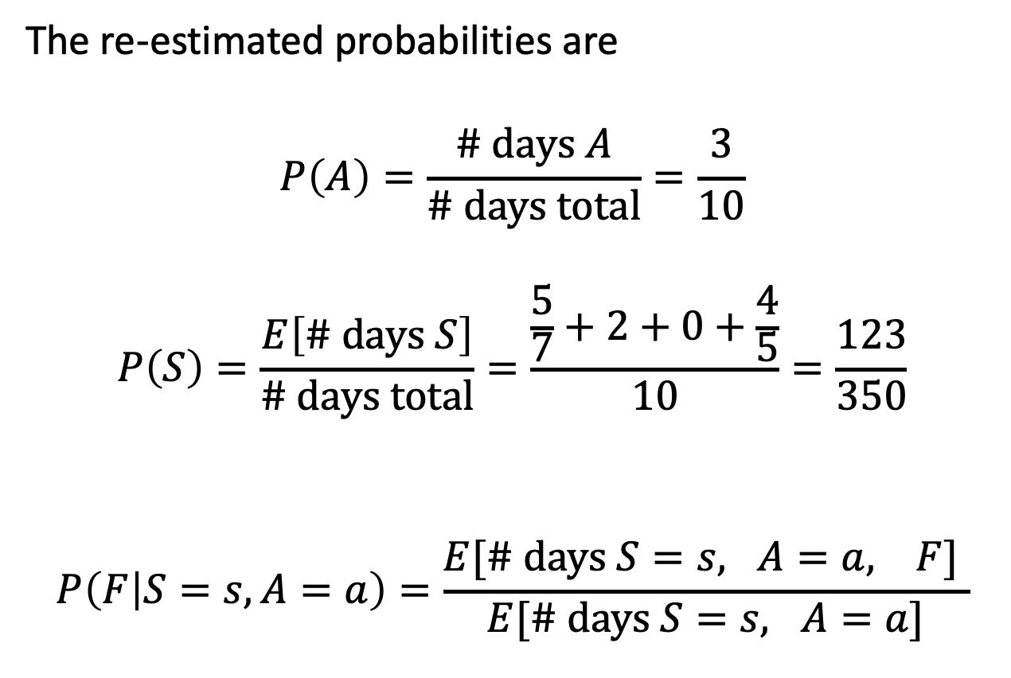
Re-estimated probabilities
A
S
F
The re-estimated probabilities are
$$P\left(A\right)=\frac{\# \text{days} A}{\# \text{days} \text{total}}=\frac{3}{10}$$
$$P\left(S\right)=\frac{E\left[\# \text{days} S\right]}{\# \text{days} \text{total}}=\frac{\frac{5}{7}+2+0+\frac{4}{5}}{10}=\frac{123}{350}$$
$$P\left(F | S=s,A=a\right)=\frac{E[\# \text{days} S=s, A=a, F] }{E[\# \text{days} S=s, A=a]}$$
a | s | $$P\left(F | S=s,A=a\right)$$
F | F | $$\frac{0}{\frac{30}{7}+0}=0$$
F | T | $$\frac{2}{\frac{5}{7}+2}=\frac{14}{19}$$
T | F | $$\frac{6/5}{1+\frac{6}{5}}=\frac{6}{11}$$
T | T | $$\frac{4/5}{0+4/5}=1$$

Slide 23
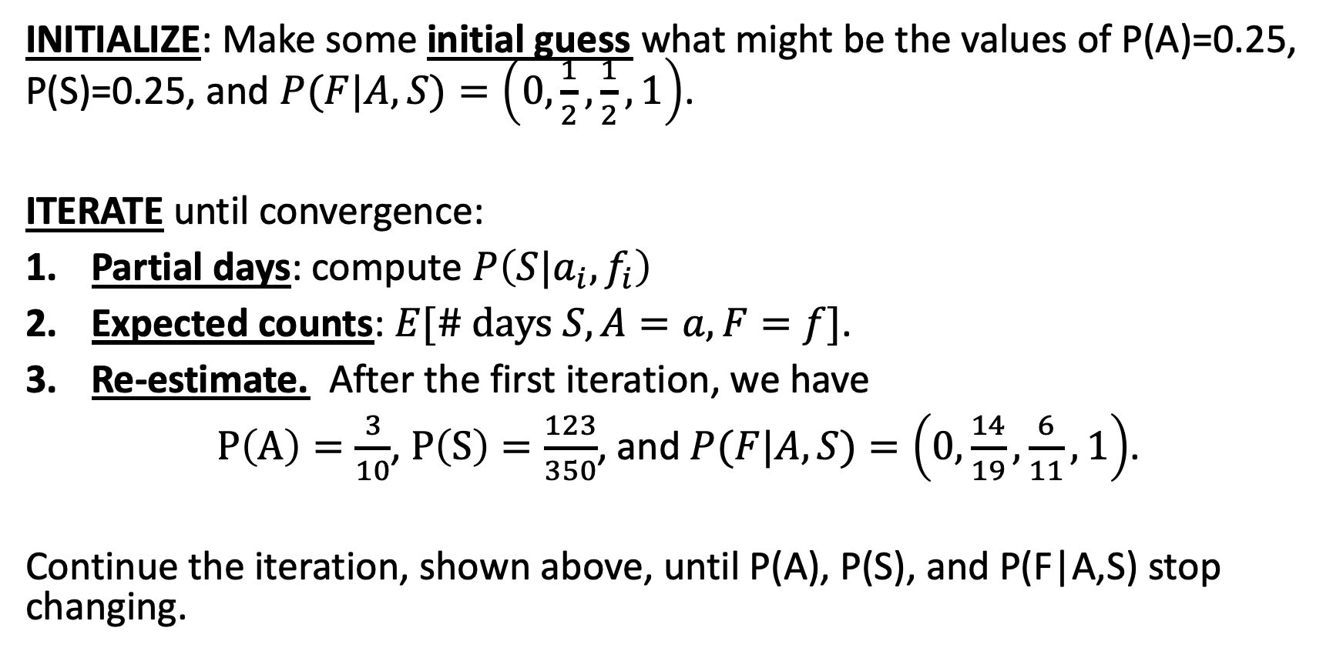
Expectation Maximization (EM): review
INITIALIZE: Make some initial guess what might be the values of P(A)=0.25, P(S)=0.25, and $P(F|A,S)=\left(0,\frac{1}{2},\frac{1}{2},1\right)$.
ITERATE until convergence:
Partial days: compute $P\left(S|a_{i},f_{i}\right)$
Expected counts: $E[\# \text{days} S,A=a, F=f]$.
Re-estimate. After the first iteration, we have
$P\left(A\right)=\frac{3}{10}$, $P\left(S\right)=\frac{123}{350}$, and $P(F|A,S)=\left(0,\frac{14}{19},\frac{6}{11},1\right)$.
Continue the iteration, shown above, until P(A), P(S), and P(F|A,S) stop changing.

Slide 24
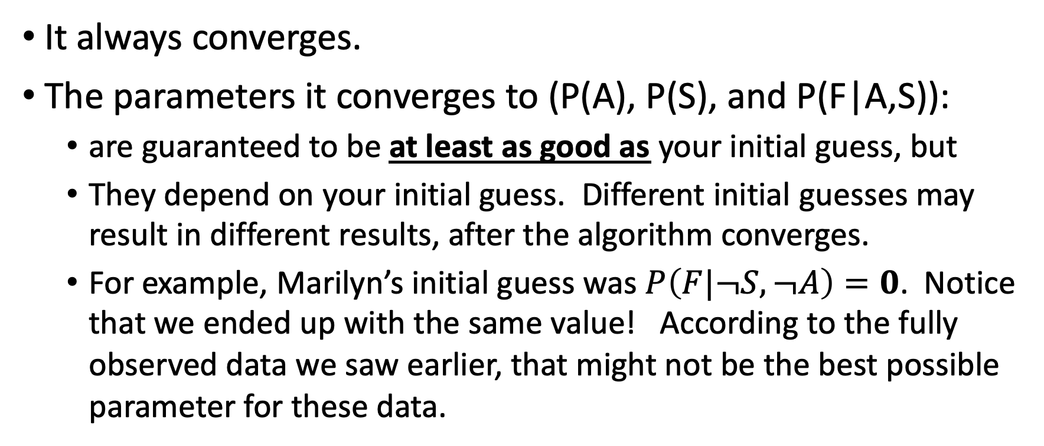
Properties of the EM algorithm
It always converges.
The parameters it converges to (P(A), P(S), and P(F|A,S)):
are guaranteed to be at least as good as your initial guess, but
They depend on your initial guess. Different initial guesses may result in different results, after the algorithm converges.
For example, Marilyn’s initial guess was $P\left(F|¬S,¬A\right)=0$. Notice that we ended up with the same value! According to the fully observed data we saw earlier, that might not be the best possible parameter for these data.

Slide 25
Outline
Parameter Learning
from Fully Observed data: Maximum Likelihood
from Partially Observed data: Expectation Maximization
Structure Learning
The usual method: knowledge engineering
An interesting recent method: causal analysis

Slide 26
Knowledge engineering
Find somebody who knows a lot about the problem you’re trying to model (flying cows, or burglars in Los Angeles, or whatever).
Get her to tell you which variables depend on which others.
Draw corresponding circles and arrows.
Done! Proceed to parameter estimation.

Slide 27
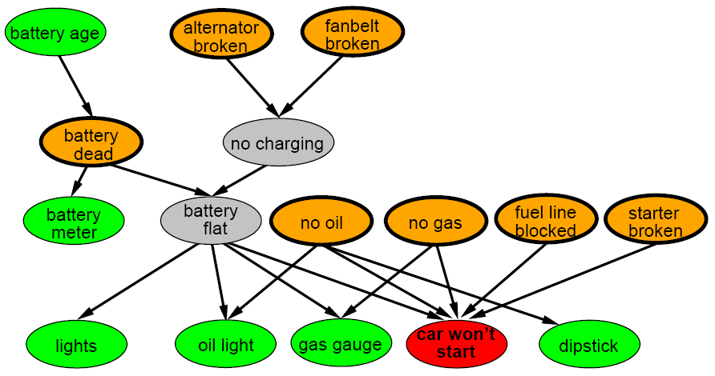
Example Bayes Network: Car diagnosis
Initial observation: car won’t start
Orange: “broken, so fix it” nodes
Green: testable evidence
Gray: “hidden variables” to ensure sparse structure, reduce parameters

Slide 28
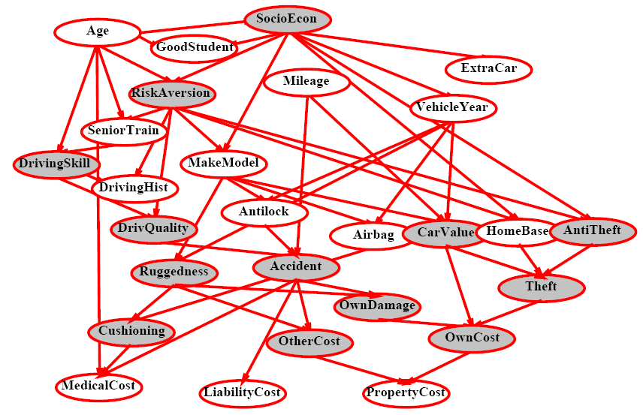
Example Bayes Network: Cost of Car insurance

Slide 29
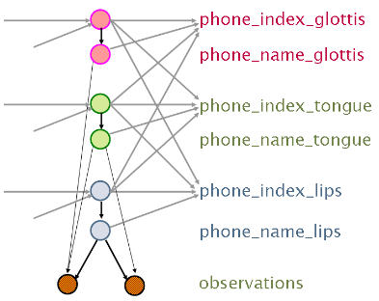
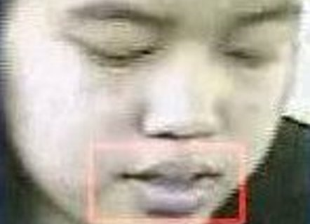
Example Bayes Network: speech acoustics and speech appearance depend on glottis, tongue, and lip positions
Audiovisual Speech Recognition with Articulator Positions as Hidden Variables
Mark Hasegawa-Johnson, Karen Livescu, Partha Lal and Kate Saenko
International Congress on Phonetic Sciences 1719:299-302, 2007

Slide 30
Outline
Parameter Learning
from Fully Observed data: Maximum Likelihood
from Partially Observed data: Expectation Maximization
Structure Learning
The usual method: knowledge engineering
An interesting recent method: causal analysis

Slide 31
Causal analysis
Suppose you know that you have V variables X₁, … ,X_{V}, but you don’t know which variables depend on which others. You can learn this from the data:
For every possible ordering of the variables (there are V! possible orderings):
Create a blank initial network
For each variable in this ordering, i = 1 to V:
add variable X_{i} to the network
Check your training data. If there is any variable X₁, … ,X_{i-1} that CHANGES the probability of X_{i}=1, then add that variable to the set Parents(X_{i}) such that P(X_{i} | Parents(X_{i})) = P(X_{i} | X₁, ... X_{i-1})
Count the number of edges in the graph with this ordering.
Choose the graph with the smallest number of edges.

Slide 32
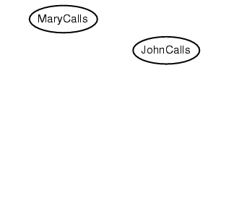
Example: The Los Angeles burglar alarm
Suppose we choose the ordering M, J, A, B, E

Slide 33
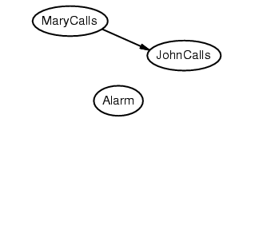
Example: The Los Angeles burglar alarm
Suppose we choose the ordering M, J, A, B, E

Slide 34
Example: The Los Angeles burglar alarm
Suppose we choose the ordering M, J, A, B, E

Slide 35
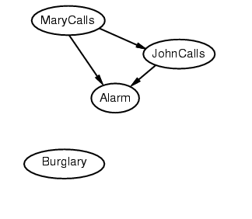
Example: The Los Angeles burglar alarm
Suppose we choose the ordering M, J, A, B, E

Slide 36
Example: The Los Angeles burglar alarm
Suppose we choose the ordering M, J, A, B, E

Slide 37
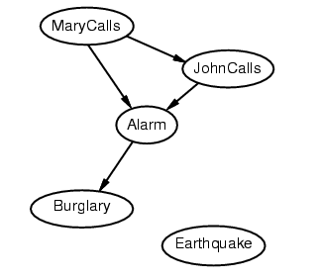
Example: The Los Angeles burglar alarm
Suppose we choose the ordering M, J, A, B, E

Slide 38
Example: The Los Angeles burglar alarm
Suppose we choose the ordering M, J, A, B, E

Slide 39
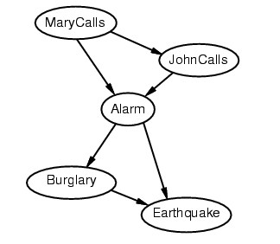
Example: The Los Angeles burglar alarm
Suppose we choose the ordering M, J, A, B, E

Slide 40
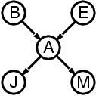
Example: The Los Angeles burglar alarm
Deciding conditional independence is hard in noncausal directions
The causal direction seems much more natural
Network is less compact: 1 + 2 + 4 + 2 + 4 = 13 numbers needed (vs. 1+1+4+2+2=10 for the causal ordering)
versus

Slide 41
Why store it in causal order? A: Saves memory
Suppose we have a Boolean variable X_{i} with k Boolean parents. How many rows does its conditional probability table have?
2^{k} rows for all the combinations of parent values
Each row requires one number for P(X_{i} = true | parent values)
If each variable has no more than k parents, how many numbers does the complete network require?
O(n · 2^{k}) numbers – vs. O(2^{n}) for the full joint distribution
How many nodes for the burglary network?
1 + 1 + 4 + 2 + 2 = 10 numbers (vs. 2⁵-1 = 31)

Slide 42
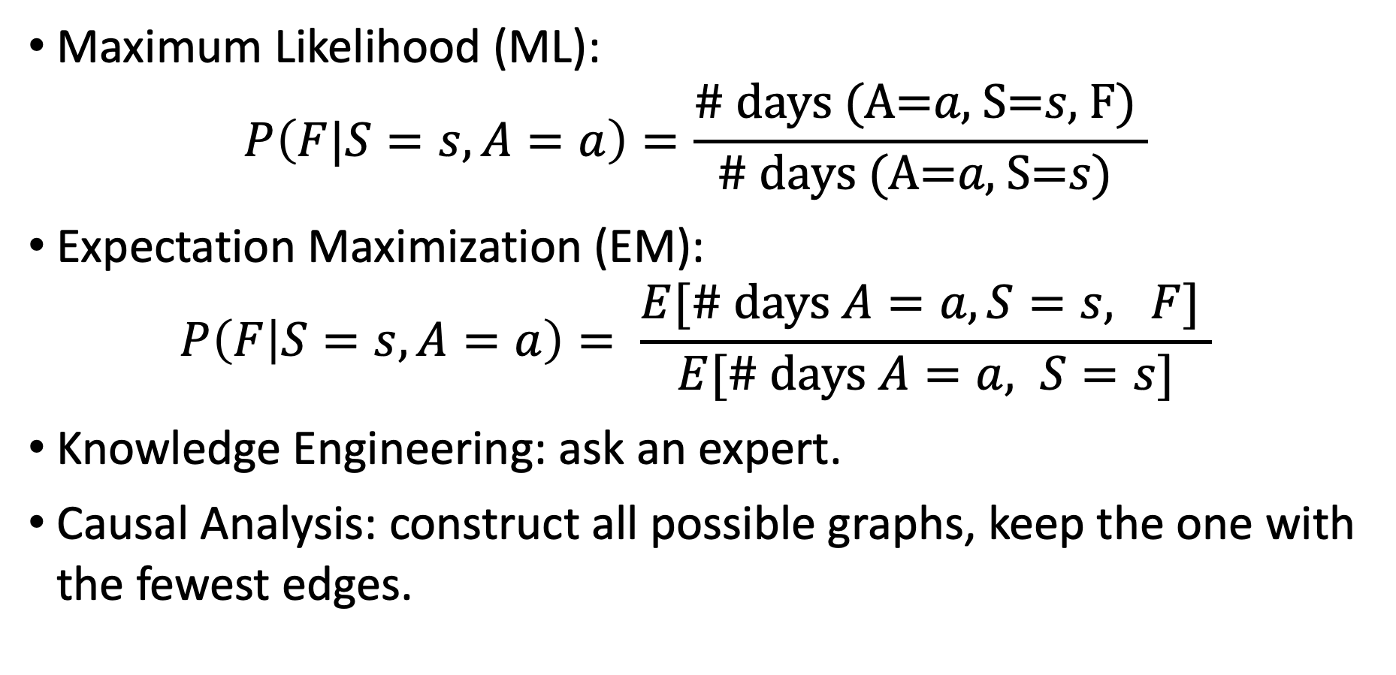
Parameter and Structure Learning for Bayesian Networks
Maximum Likelihood (ML):
$$P\left(F|S=s,A=a\right)=\frac{\text{\# }\text{days} \text{(}\text{A}\text{=}a\text{,} \text{S}\text{=}s\text{,} \text{F}\text{) }}{\text{\# }\text{days} \text{(}\text{A}\text{=}a\text{,} \text{S}\text{=}s\text{)} }$$
Expectation Maximization (EM):
$$P\left(F | S=s,A=a\right)= \frac{E[\# \text{days} A=a, S=s, F] }{E[\# \text{days} A=a, S=s]}$$
Knowledge Engineering: ask an expert.
Causal Analysis: construct all possible graphs, keep the one with the fewest edges.

