Slide 1
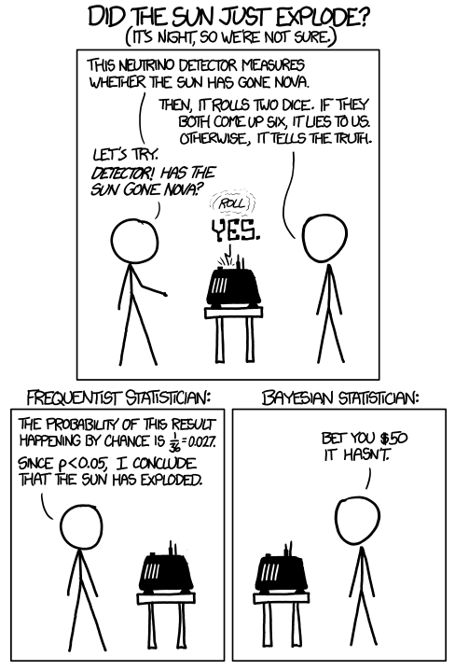
CS440/ECE448 Lecture 14: Naïve Bayes
Mark Hasegawa-Johnson, 2/2020
Including slides by Svetlana Lazebnik, 9/2016
License: CC-BY 4.0
You are free to redistribute or remix if you give attribution
https://www.xkcd.com/1132/

Slide 2
Bayesian Inference and Bayesian Learning
Bayes Rule
Bayesian Inference
Misdiagnosis
The Bayesian “Decision”
The “Naïve Bayesian” Assumption
Bag of Words (BoW)
Bigrams
Bayesian Learning
Maximum Likelihood estimation of parameters
Maximum A Posteriori estimation of parameters
Laplace Smoothing

Slide 3
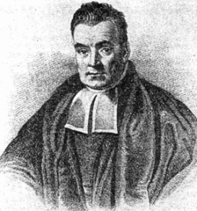
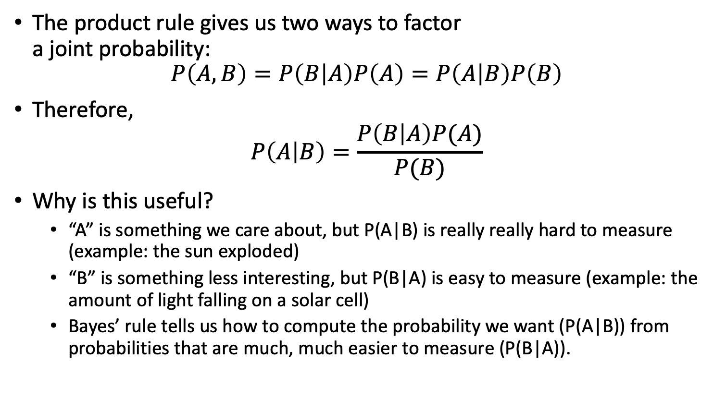
Bayes’ Rule
By Unknown - [2][3], Public Domain, https://commons.wikimedia.org/w/index.php?curid=14532025
Rev. Thomas Bayes (1702-1761)
The product rule gives us two ways to factor a joint probability:
$$P\left(A,B\right)=P\left(B | A\right)P\left(A\right)=P\left(A | B\right)P\left(B\right)$$
Therefore,
$$P\left(A | B\right)=\frac{P\left(B | A\right)P(A)}{P(B)}$$
Why is this useful?
“A” is something we care about, but P(A|B) is really really hard to measure (example: the sun exploded)
“B” is something less interesting, but P(B|A) is easy to measure (example: the amount of light falling on a solar cell)
Bayes’ rule tells us how to compute the probability we want (P(A|B)) from probabilities that are much, much easier to measure (P(B|A)).
Notes:
A: some unobservable aspect of the world that we are trying to predict (query variable)
B: observable evidence

Slide 4
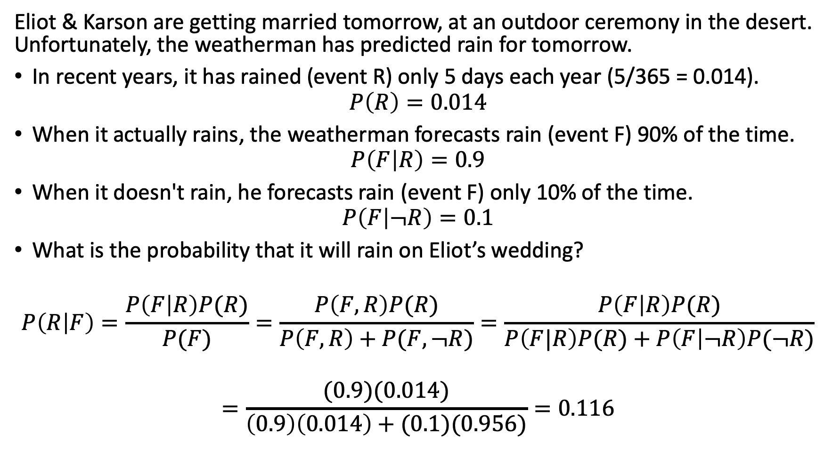
Bayes Rule example
Eliot & Karson are getting married tomorrow, at an outdoor ceremony in the desert. Unfortunately, the weatherman has predicted rain for tomorrow.
In recent years, it has rained (event R) only 5 days each year (5/365 = 0.014).
$$P\left(R\right)=0.014$$
When it actually rains, the weatherman forecasts rain (event F) 90% of the time.
$$P\left(F | R\right)=0.9$$
When it doesn't rain, he forecasts rain (event F) only 10% of the time.
$$P\left(F | ¬R\right)=0.1$$
What is the probability that it will rain on Eliot’s wedding?
$$P\left(R | F\right)=\frac{P\left(F | R\right)P(R)}{P(F)}=\frac{P\left(F,R\right)P(R)}{P\left(F,R\right)+P(F,¬R)}=\frac{P\left(F | R\right)P(R)}{P\left(F|R\right)P(R)+P\left(F | ¬R\right)P(¬R)}$$
$$=\frac{(0.9)(0.014)}{\left(0.9\right)\left(0.014\right)+(0.1)(0.956)}=0.116$$

Slide 5
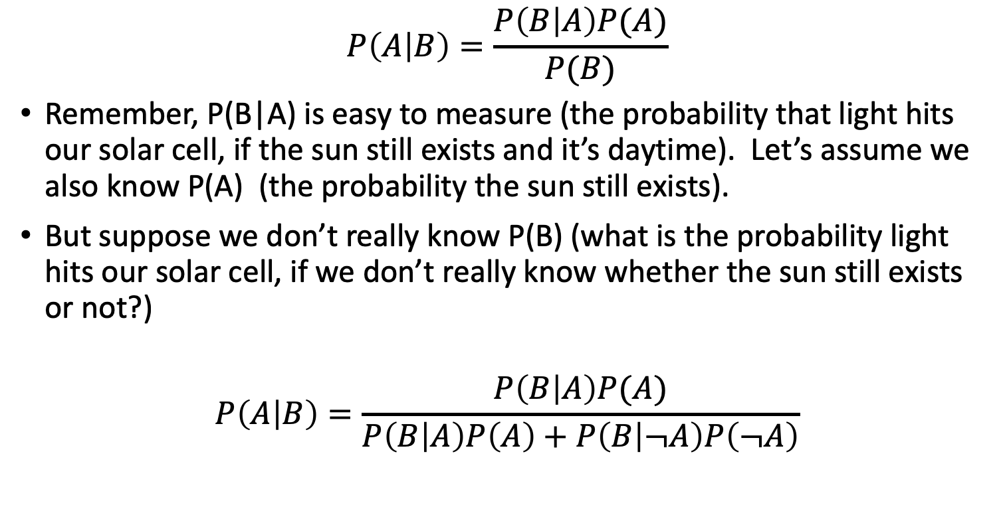
The More Useful Version of Bayes’ Rule
By Unknown - [2][3], Public Domain, https://commons.wikimedia.org/w/index.php?curid=14532025
Rev. Thomas Bayes (1702-1761)
This version is what you
memorize.
$$P\left(A | B\right)=\frac{P\left(B | A\right)P(A)}{P(B)}$$
Remember, P(B|A) is easy to measure (the probability that light hits our solar cell, if the sun still exists and it’s daytime). Let’s assume we also know P(A) (the probability the sun still exists).
But suppose we don’t really know P(B) (what is the probability light hits our solar cell, if we don’t really know whether the sun still exists or not?)
$$P\left(A | B\right)=\frac{P\left(B | A\right)P(A)}{P\left(B | A\right)P\left(A\right)+P\left(B | ¬A\right)P\left(¬A\right)}$$
This version is what you
actually use.
Notes:
A: some unobservable aspect of the world that we are trying to predict (query variable)
B: observable evidence

Slide 6
Bayesian Inference and Bayesian Learning
Bayes Rule
Bayesian Inference
Misdiagnosis
The Bayesian “Decision”
The “Naïve Bayesian” Assumption
Bag of Words (BoW)
Bigrams
Bayesian Learning
Maximum Likelihood estimation of parameters
Maximum A Posteriori estimation of parameters
Laplace Smoothing

Slide 7
The Misdiagnosis Problem
1% of women at age forty who participate in routine screening have breast cancer. 80% of women with breast cancer will get positive mammographies. 9.6% of women without breast cancer will also get positive mammographies. A woman in this age group had a positive mammography in a routine screening. What is the probability that she actually has breast cancer?

Slide 9
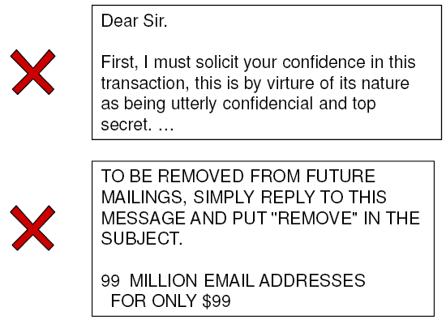
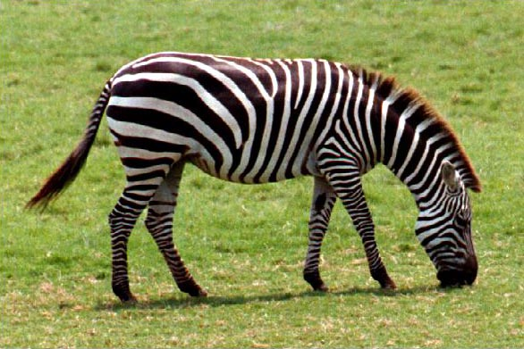
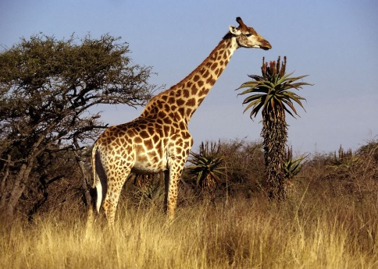
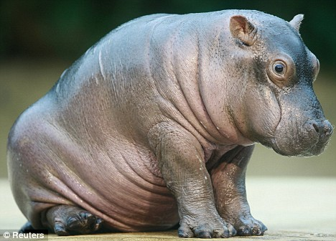
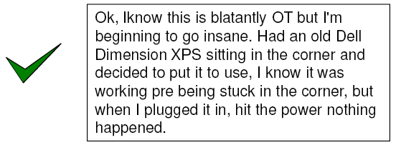
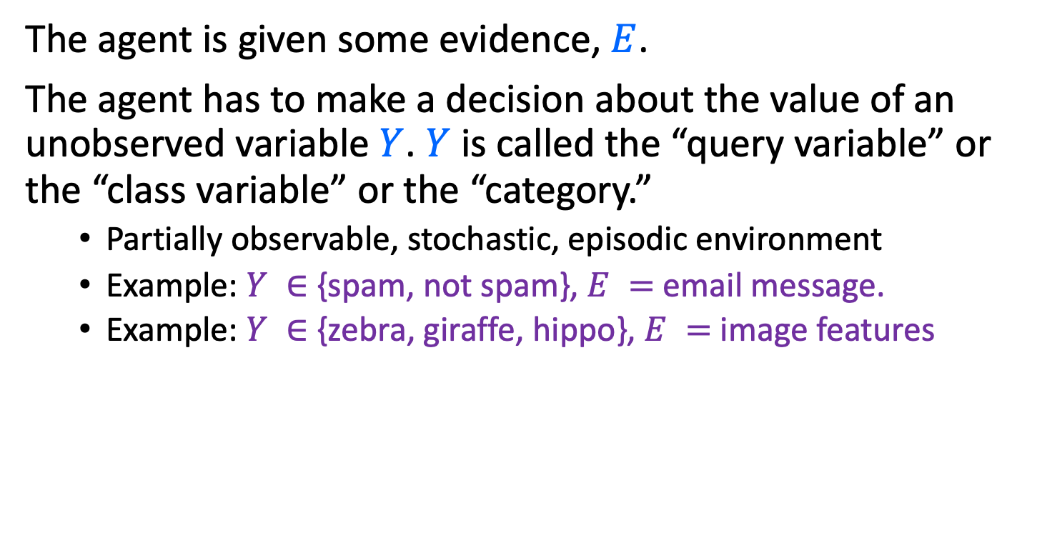
The Bayesian Decision
The agent is given some evidence, $E$.
The agent has to make a decision about the value of an unobserved variable $Y$. $Y$ is called the “query variable” or the “class variable” or the “category.”
Partially observable, stochastic, episodic environment
Example: $Y ∈$ {spam, not spam}, $E =$ email message.
Example: $Y ∈$ {zebra, giraffe, hippo}, $E =$ image features
Notes:
Expected loss of a decision: P(decision is correct) * 0 + P(decision is wrong) * 1

Slide 10
Bayesian Inference and Bayesian Learning
Bayes Rule
Bayesian Inference
Misdiagnosis
The Bayesian “Decision”
The “Naïve Bayesian” Assumption
Bag of Words (BoW)
Bigrams
Bayesian Learning
Maximum Likelihood estimation of parameters
Maximum A Posteriori estimation of parameters
Laplace Smoothing

Slide 11
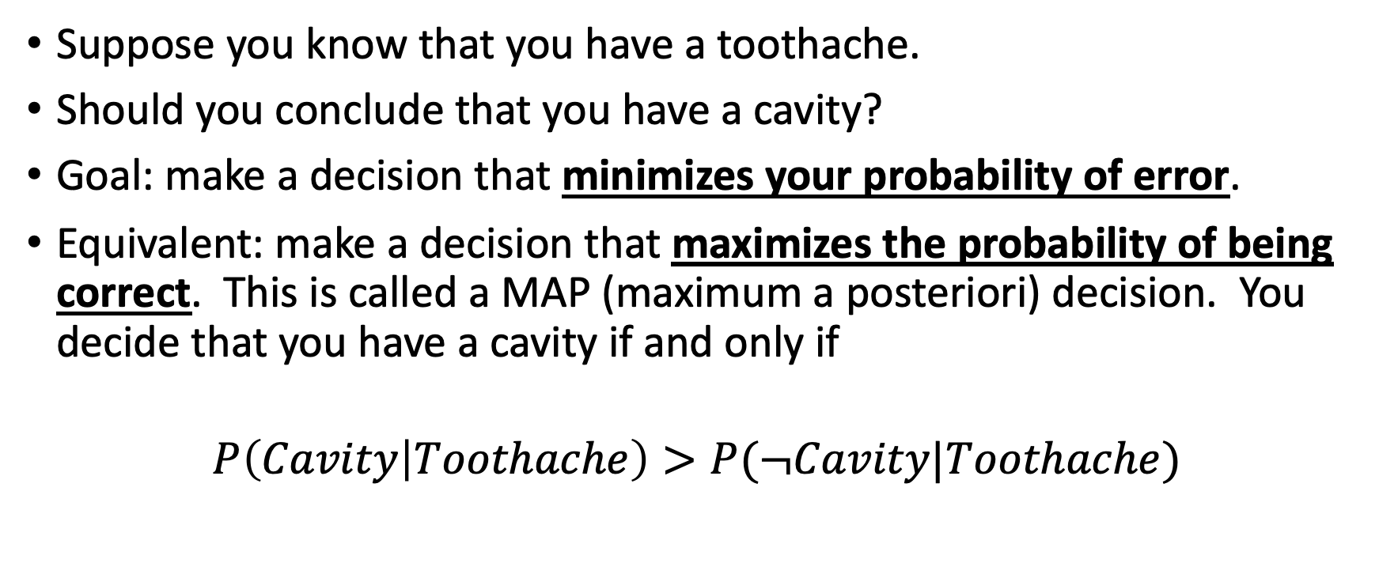
Classification using probabilities
Suppose you know that you have a toothache.
Should you conclude that you have a cavity?
Goal: make a decision that minimizes your probability of error.
Equivalent: make a decision that maximizes the probability of being correct. This is called a MAP (maximum a posteriori) decision. You decide that you have a cavity if and only if
$$P\left(Cavity | Toothache\right)>P(¬Cavity|Toothache)$$

Slide 12
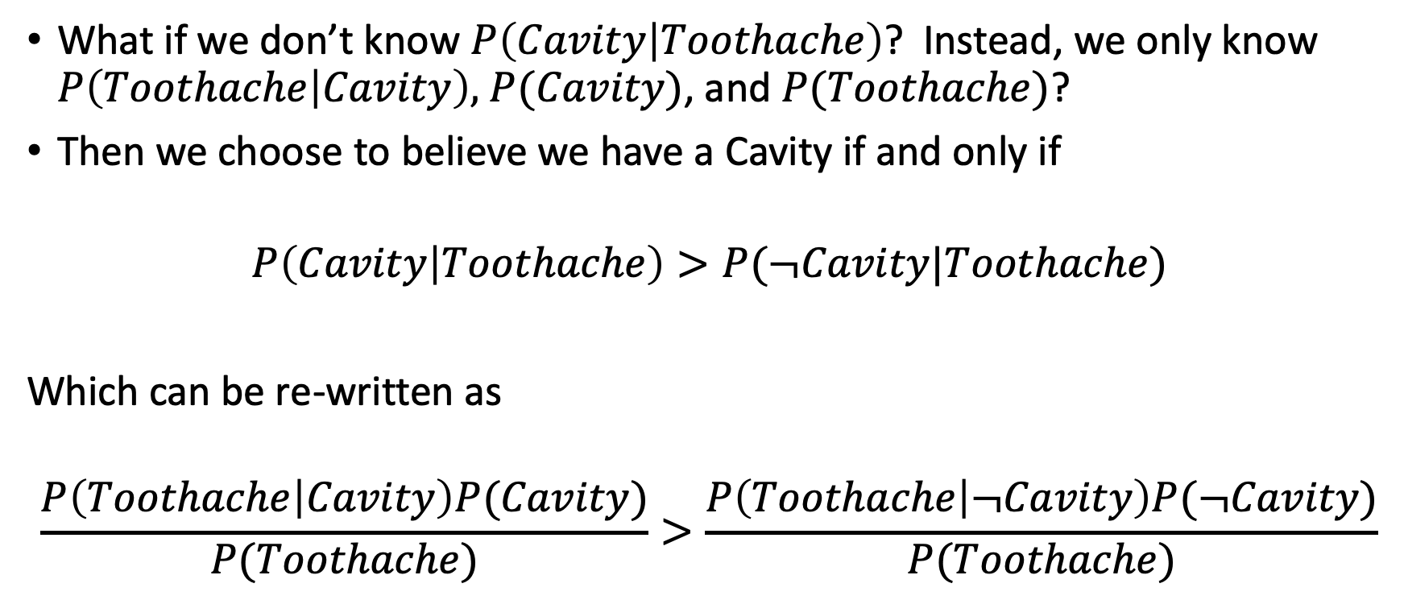
Bayesian Decisions
What if we don’t know $P\left(Cavity | Toothache\right)$? Instead, we only know $P\left(Toothache | Cavity\right),$ $P(Cavity)$, and $P(Toothache)$?
Then we choose to believe we have a Cavity if and only if
$$P\left(Cavity | Toothache\right)>P(¬Cavity|Toothache)$$
Which can be re-written as
$$\frac{P\left(Toothache | Cavity\right)P(Cavity)}{P(Toothache)}>\frac{P\left(Toothache | ¬Cavity\right)P(¬Cavity)}{P(Toothache)}$$

Slide 13

MAP decision
The action, “a”, should be the value of C that has the highest posterior probability given the observation E=e:
$$a=argmaxP\left(Y=a | E=e\right)=argmax\frac{P\left(E=e | Y=a\right)P(Y=a)}{P(E=e)}$$
$$=argmaxP\left(E=e | Y=a\right)P(Y=a)$$
$$P\left(Y=a | E=e\right)∝P\left(E=e | Y=a\right)P(Y=a)$$
posterior
likelihood
prior
Notes:
Expected loss of a decision: P(decision is correct) * 0 + P(decision is wrong) * 1

Slide 14
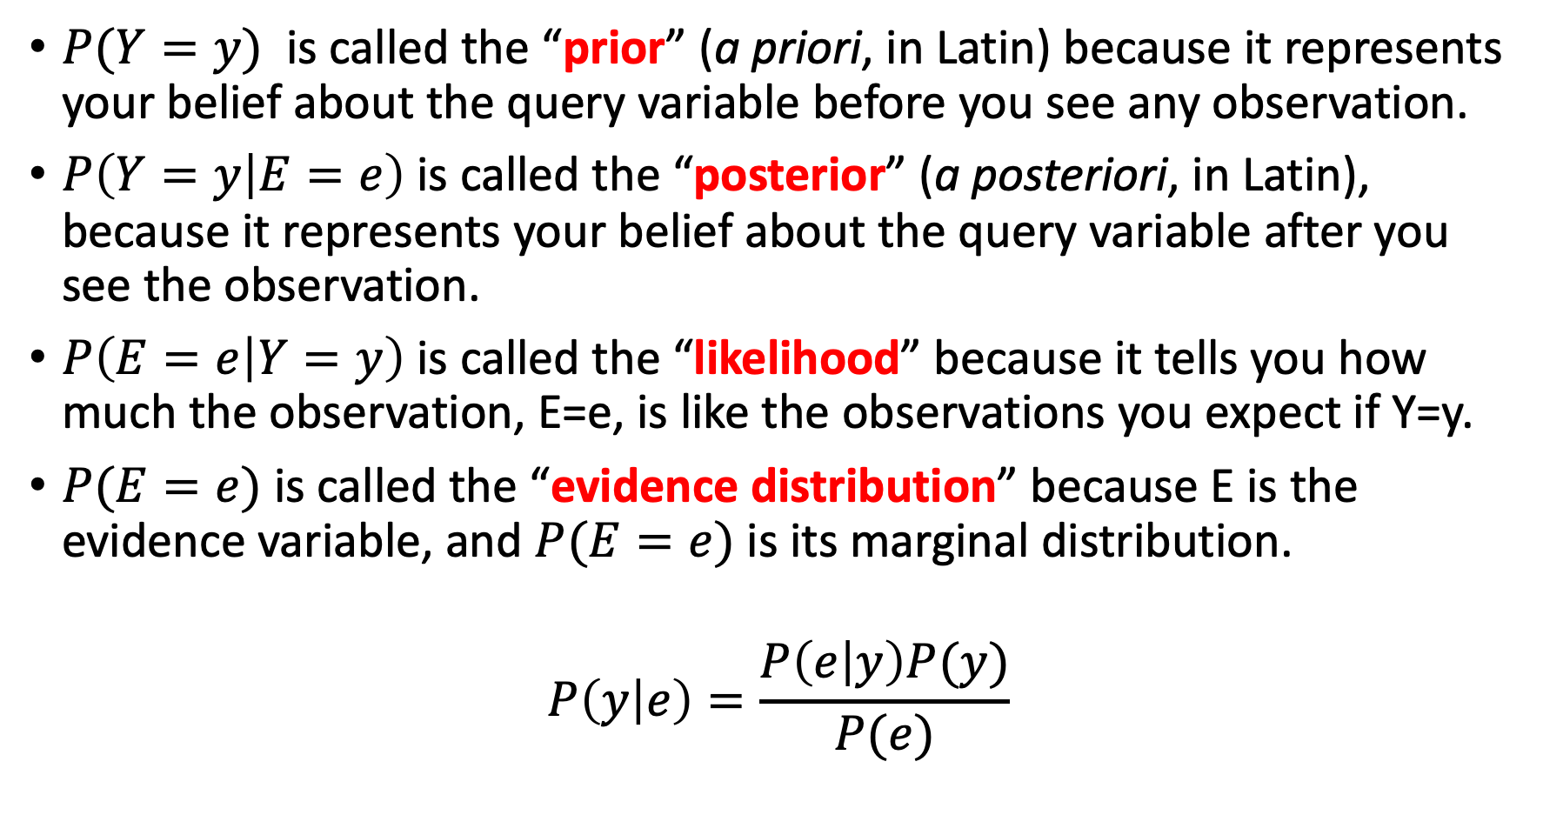
The Bayesian Terms
$P(Y=y)$ is called the “prior” (a priori, in Latin) because it represents your belief about the query variable before you see any observation.
$P\left(Y=y | E=e\right)$ is called the “posterior” (a posteriori, in Latin), because it represents your belief about the query variable after you see the observation.
$P\left(E=e | Y=y\right)$ is called the “likelihood” because it tells you how much the observation, E=e, is like the observations you expect if Y=y.
$P(E=e)$ is called the “evidence distribution” because E is the evidence variable, and $P(E=e)$ is its marginal distribution.
$$P\left(y | e\right)=\frac{P\left(e | y\right)P(y)}{P(e)}$$

Slide 15
Bayesian Inference and Bayesian Learning
Bayes Rule
Bayesian Inference
Misdiagnosis
The Bayesian “Decision”
The “Naïve Bayesian” Assumption
Bag of Words (BoW)
Bigrams
Bayesian Learning
Maximum Likelihood estimation of parameters
Maximum A Posteriori estimation of parameters
Laplace Smoothing

Slide 16
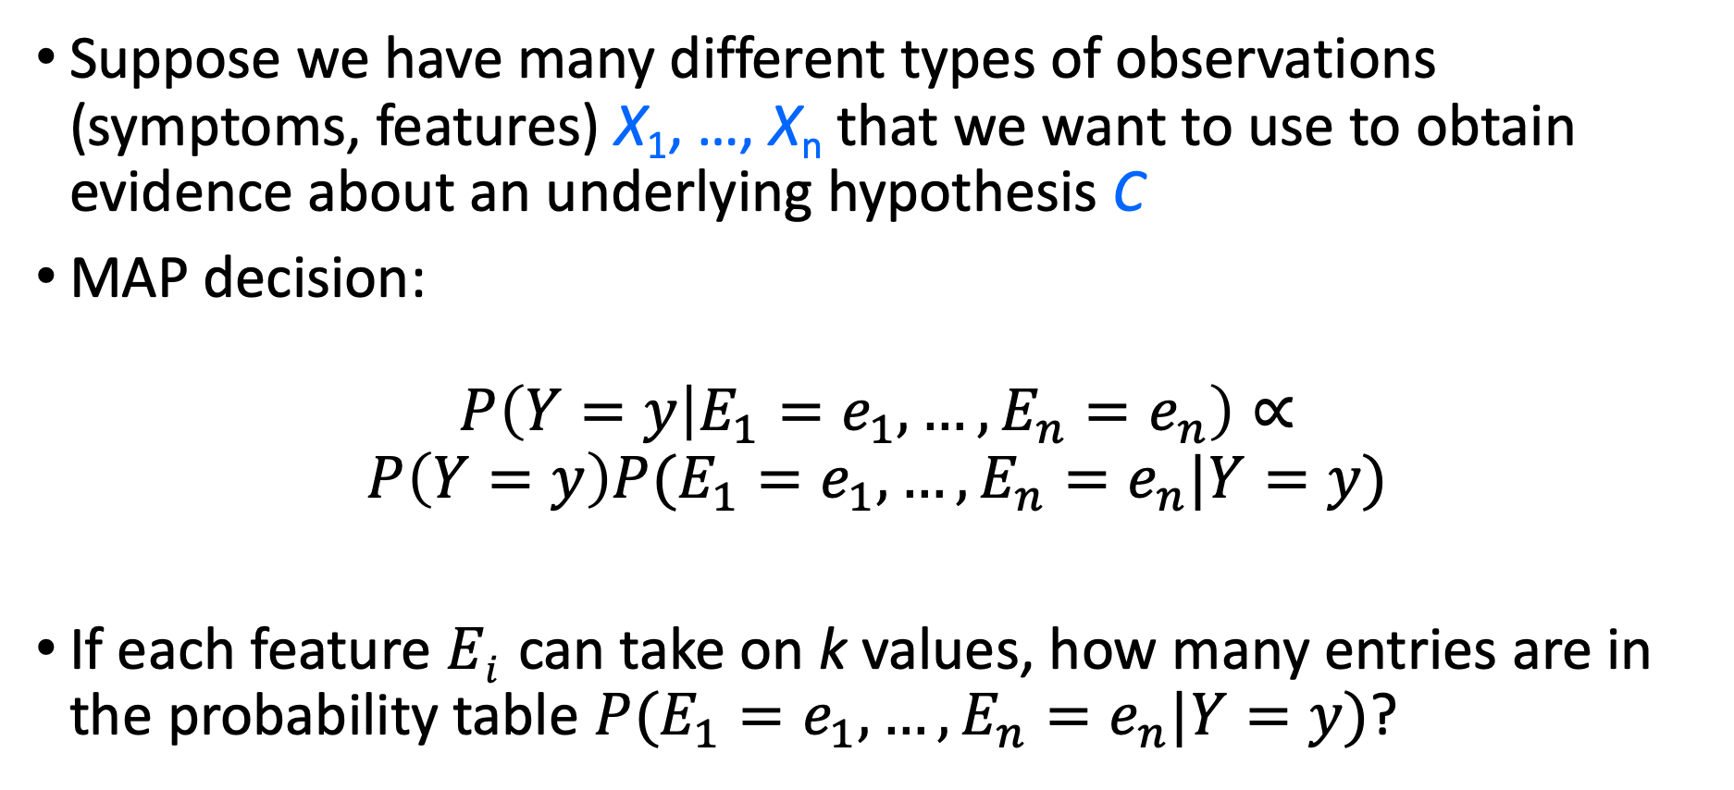
Naïve Bayes model
Suppose we have many different types of observations (symptoms, features) X₁, …, X_{n} that we want to use to obtain evidence about an underlying hypothesis C
MAP decision:
$$P\left(Y=y | E_{1}=e_{1},…,E_{n}=e_{n}\right)∝$$
$$P\left(Y=y\right)P(E_{1}=e_{1},…,E_{n}=e_{n}|Y=y)$$
If each feature $Ei$ can take on k values, how many entries are in the probability table $P(E_{1}=e_{1},…,E_{n}=e_{n}|Y=y)$?

Slide 17
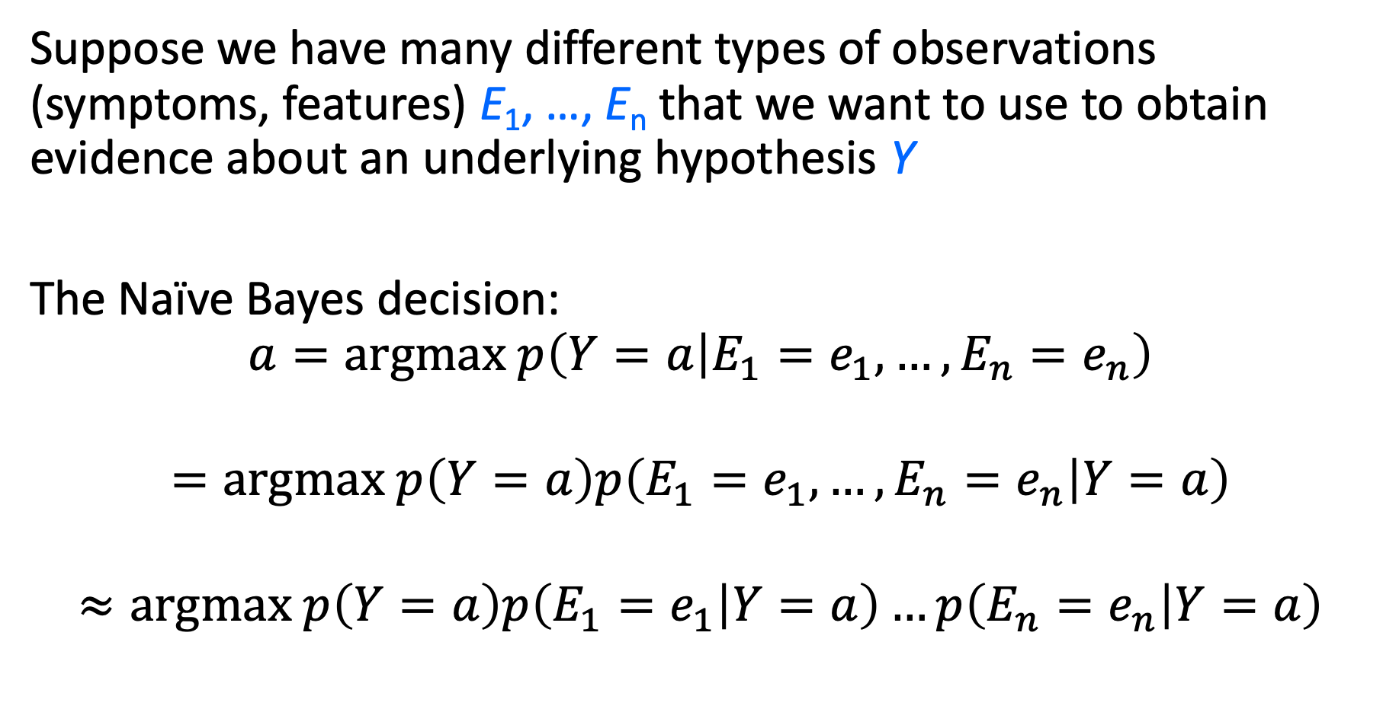
Naïve Bayes model
Suppose we have many different types of observations (symptoms, features) E₁, …, E_{n} that we want to use to obtain evidence about an underlying hypothesis Y
The Naïve Bayes decision: $$a=argmax p\left(Y=a | E_{1}=e_{1},…,E_{n}=e_{n}\right)$$
$$=argmax p\left(Y=a\right)p\left(E_{1}=e_{1},…,E_{n}=e_{n} | Y=a\right)$$
$$≈argmax p\left(Y=a\right)p\left(E_{1}=e_{1} | Y=a\right)…p\left(E_{n}=e_{n} | Y=a\right)$$

Slide 18
Case study: Text document classification
MAP decision: assign a document to the class with the highest posterior P(class | document)
Example: spam classification
Classify a message as spam if P(spam | message) > P(¬spam | message)

Slide 19
Case study: Text document classification
MAP decision: assign a document to the class with the highest posterior P(class | document)
We have P(class | document) ∝ P(document | class)P(class)
To enable classification, we need to be able to estimate the likelihoods P(document | class) for all classes and priors P(class)

Slide 20
Bayesian Inference and Bayesian Learning
Bayes Rule
Bayesian Inference
Misdiagnosis
The Bayesian “Decision”
The “Naïve Bayesian” Assumption
Bag of Words (BoW)
Bigrams
Bayesian Learning
Maximum Likelihood estimation of parameters
Maximum A Posteriori estimation of parameters
Laplace Smoothing

Slide 21
Naïve Bayes Representation
Goal: estimate likelihoods P(document | class) and priors P(class)
Likelihood: bag of words representation
The document is a sequence of words (w₁, …, w_{n})
The order of the words in the document is not important
Each word is conditionally independent of the others given document class

Slide 22
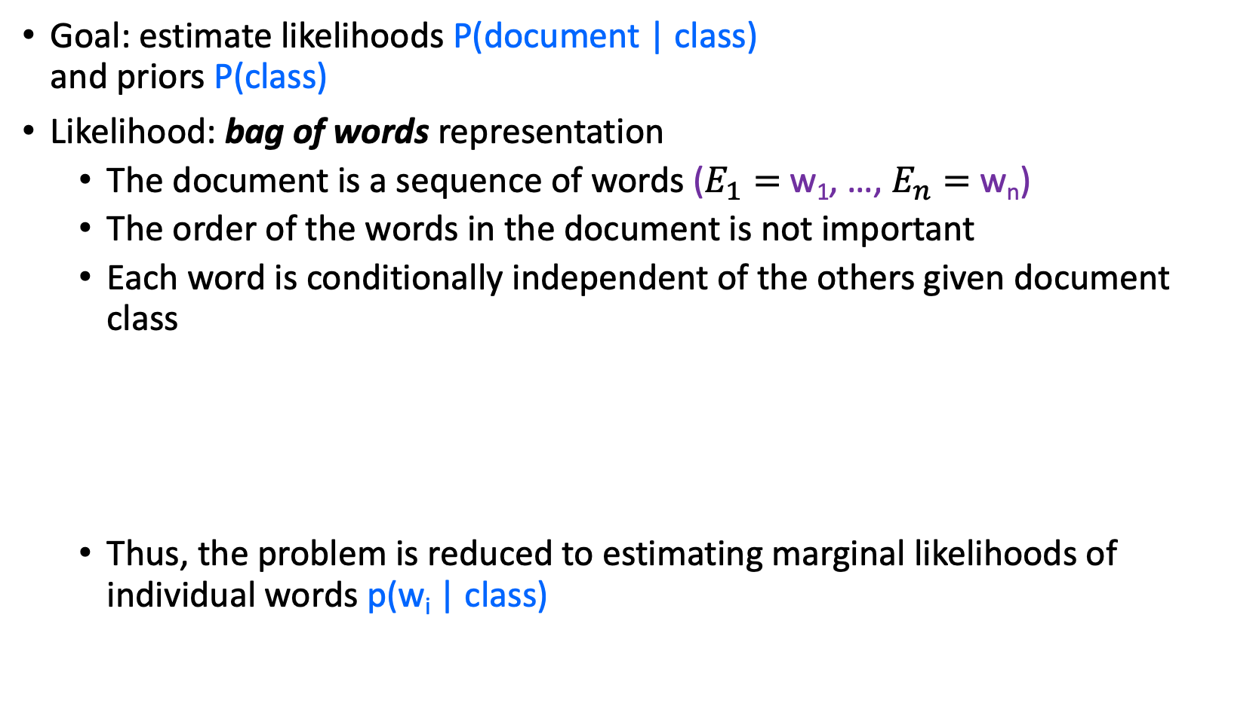
Naïve Bayes Representation
Goal: estimate likelihoods P(document | class) and priors P(class)
Likelihood: bag of words representation
The document is a sequence of words ($E_{1}=$w₁, …, $E_{n}=$w_{n})
The order of the words in the document is not important
Each word is conditionally independent of the others given document class
Thus, the problem is reduced to estimating marginal likelihoods of individual words p(w_{i} | class)

Slide 23
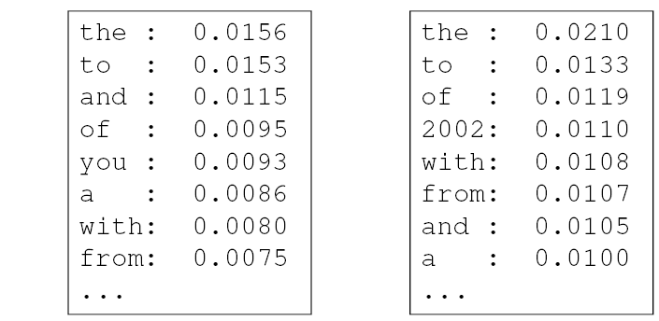
Parameter estimation
Model parameters: feature likelihoods p(word | class) and priors p(class)
How do we obtain the values of these parameters?
prior
P(word | spam)
P(word | ¬spam)
spam: 0.33
¬spam: 0.67

Slide 24
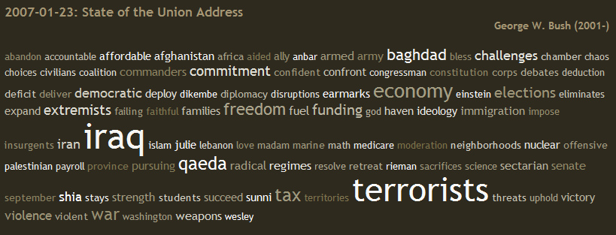
Bag of words illustration
US Presidential Speeches Tag Cloud http://chir.ag/projects/preztags/

Slide 25
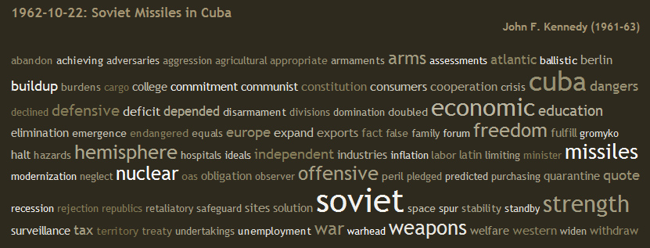
Bag of words illustration
US Presidential Speeches Tag Cloud http://chir.ag/projects/preztags/

Slide 26
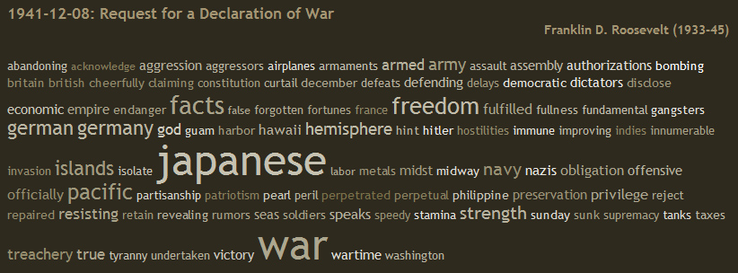
Bag of words illustration
US Presidential Speeches Tag Cloud http://chir.ag/projects/preztags/

Slide 27
Bayesian Inference and Bayesian Learning
Bayes Rule
Bayesian Inference
Misdiagnosis
The Bayesian “Decision”
The “Naïve Bayesian” Assumption
Bag of Words (BoW)
Bigrams
Bayesian Learning
Maximum Likelihood estimation of parameters
Maximum A Posteriori estimation of parameters
Laplace Smoothing

Slide 28
Bag of words representation of a document
Word | # times it occurs
I’m | 1
it’s | 1
pathetic | 1
pretty | 1
warning | 1
you | 1
(every other word) | 0
Consider the following movie review (8114_3.txt in your dataset):
I’m warning you, it’s pretty pathetic
What is its BoW representation?
“pathetic” probably means it’s a negative review.
…but “pretty” means it’s a positive review, right?

Slide 29
Bigram representation of a document
Word | # times it occurs
I’m warning | 1
it’s pretty | 1
pretty pathetic | 1
warning you | 1
you it’s | 1
(every other bigram) | 0
A “bigram” is just a pair of words that occur together, in sequence. For example, the following review has the bigrams shown at left:
I’m warning you, it’s pretty pathetic
{ ”I’m warning”, “warning you”, “pretty pathetic” } == negative
{ “it’s pretty” } == positive, but maybe we can ignore that.

Slide 30
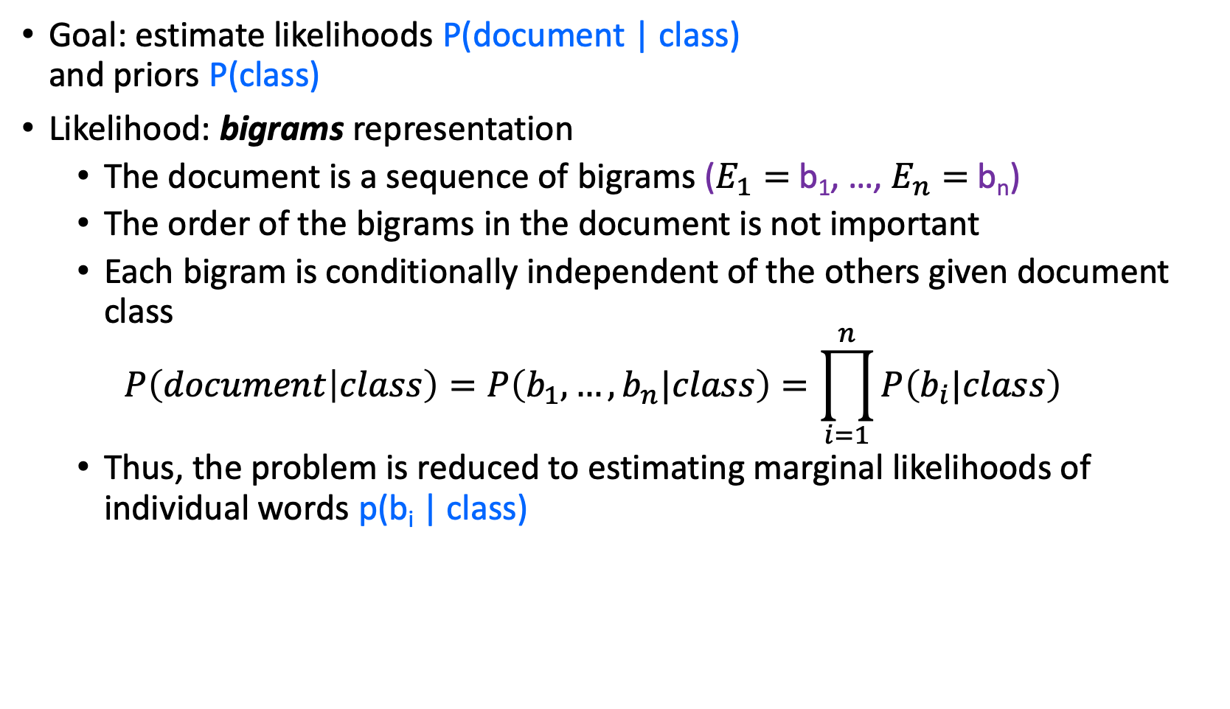
Naïve Bayes with Bigrams
Goal: estimate likelihoods P(document | class) and priors P(class)
Likelihood: bigrams representation
The document is a sequence of bigrams ($E_{1}=$b₁, …, $E_{n}=$b_{n})
The order of the bigrams in the document is not important
Each bigram is conditionally independent of the others given document class
$$P\left(document | class\right)=P\left(b_{1},…,b_{n}|class\right)=\prod_{i=1}^{n}{P\left(b_{i}|class\right)}$$
Thus, the problem is reduced to estimating marginal likelihoods of individual words p(b_{i} | class)

Slide 31
Bayesian Inference and Bayesian Learning
Bayes Rule
Bayesian Inference
Misdiagnosis
The Bayesian “Decision”
The “Naïve Bayesian” Assumption
Bag of Words (BoW)
Bigrams
Bayesian Learning
Maximum Likelihood estimation of parameters
Laplace Smoothing

Slide 32
Bayesian Learning
Model parameters: feature likelihoods P(word | class) and priors P(class)
How do we obtain the values of these parameters?
Need training set of labeled samples from both classes
This is the maximum likelihood (ML) estimate. It is the estimate that maximizes the probability of the training data, which is defined as:
# of occurrences of this word in docs from this class
P(word | class) =
total # of words in docs from this class
d: index of training document, i: index of a word

Slide 33
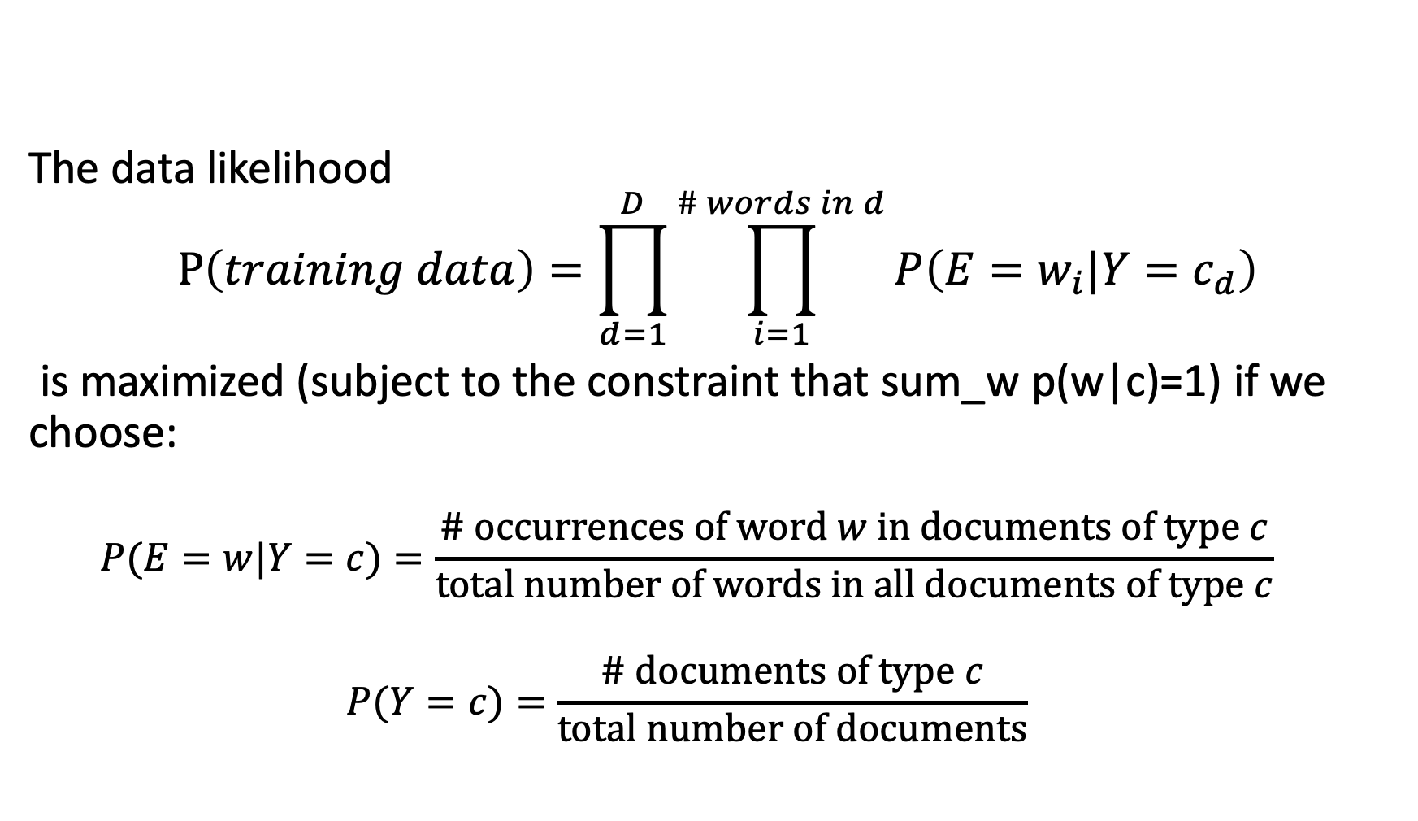
Bayesian Learning
The data likelihood
$$P\left(training data\right)=\prod_{d=1}^{D}{\prod_{i=1}^{\# words in d}{P\left(E=w_{i}|Y=c_{d}\right)}}$$
is maximized (subject to the constraint that sum_w p(w|c)=1) if we choose:
$$P(E=w|Y=c)=\frac{\# occurrences of word w in documents of type c}{total number of words in all documents of type c}$$
$$P(Y=c)=\frac{\# documents of type c}{total number of documents}$$

Slide 34
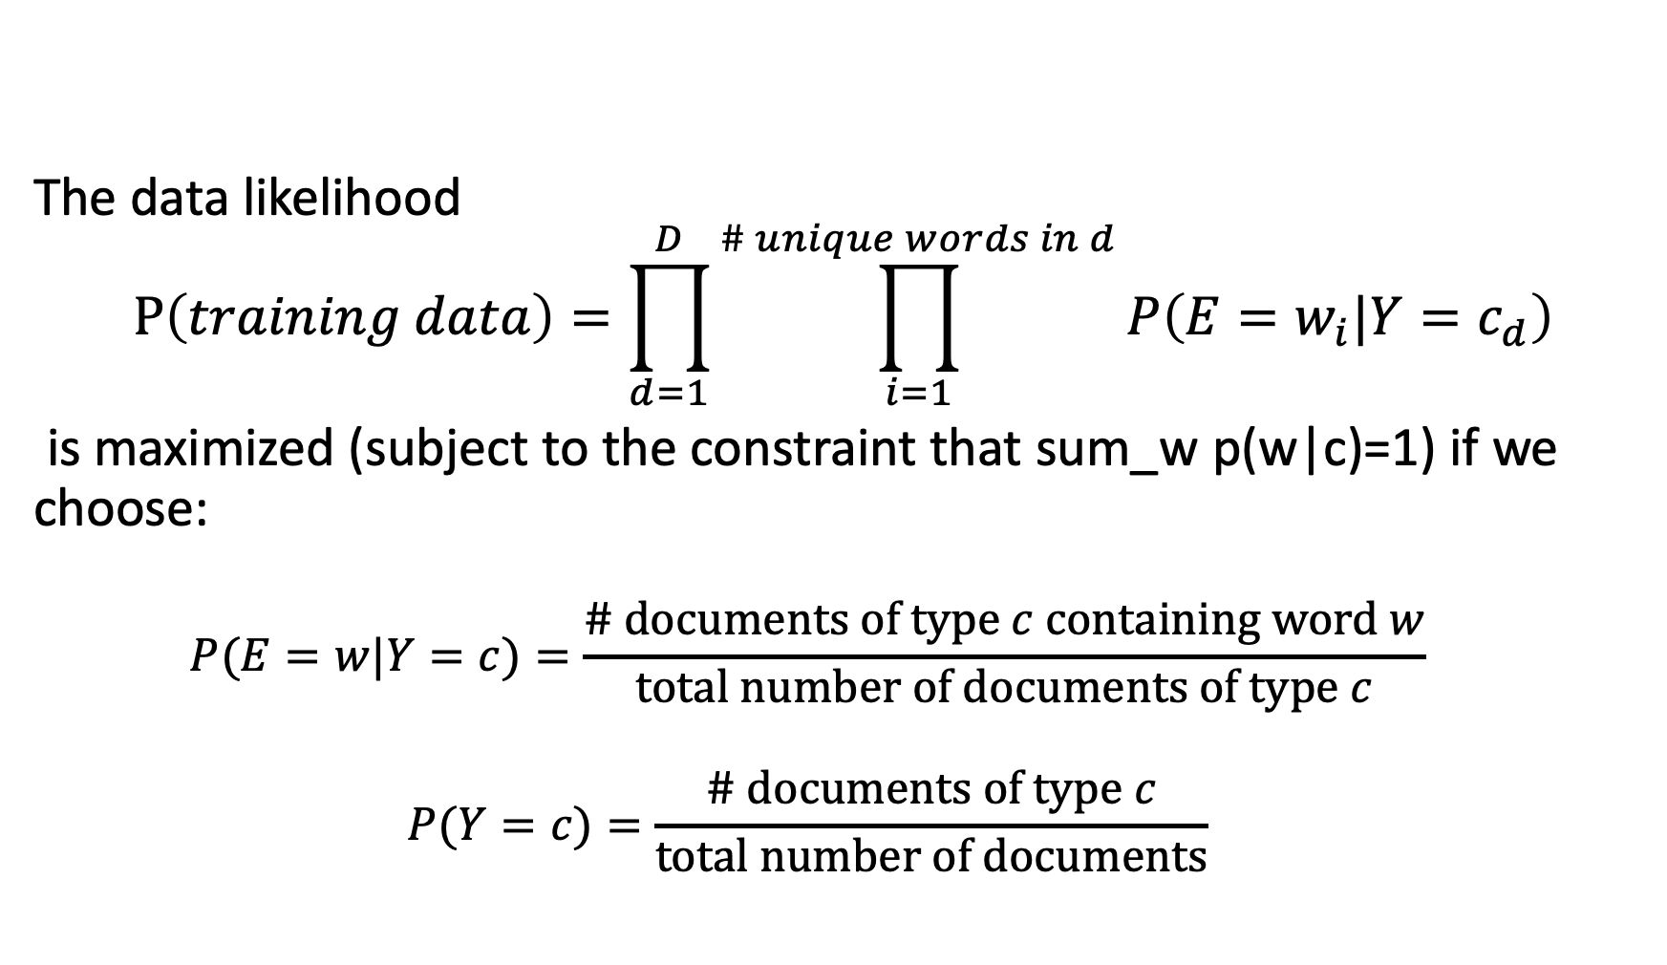
Bayesian Learning
The data likelihood
$$P\left(training data\right)=\prod_{d=1}^{D}{\prod_{i=1}^{\# unique words in d}{P\left(E=w_{i}|Y=c_{d}\right)}}$$
is maximized (subject to the constraint that sum_w p(w|c)=1) if we choose:
$$P(E=w|Y=c)=\frac{\# documents of type c containing word w}{total number of documents of type c}$$
$$P(Y=c)=\frac{\# documents of type c}{total number of documents}$$

Slide 35
Bayesian Inference and Bayesian Learning
Bayes Rule
Bayesian Inference
Misdiagnosis
The Bayesian “Decision”
The “Naïve Bayesian” Assumption
Bag of Words (BoW)
Bigrams
Bayesian Learning
Maximum Likelihood estimation of parameters
Laplace Smoothing

Slide 36
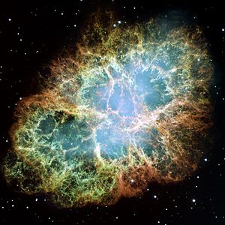

What is the probability that the sun will fail to rise tomorrow?
# times we have observed the sun to rise = 100,000,000
# times we have observed the sun not to rise = 0
Estimated probability the sun will not rise = $\frac{0}{0+100,000,000}=0$
Oops….

Slide 37
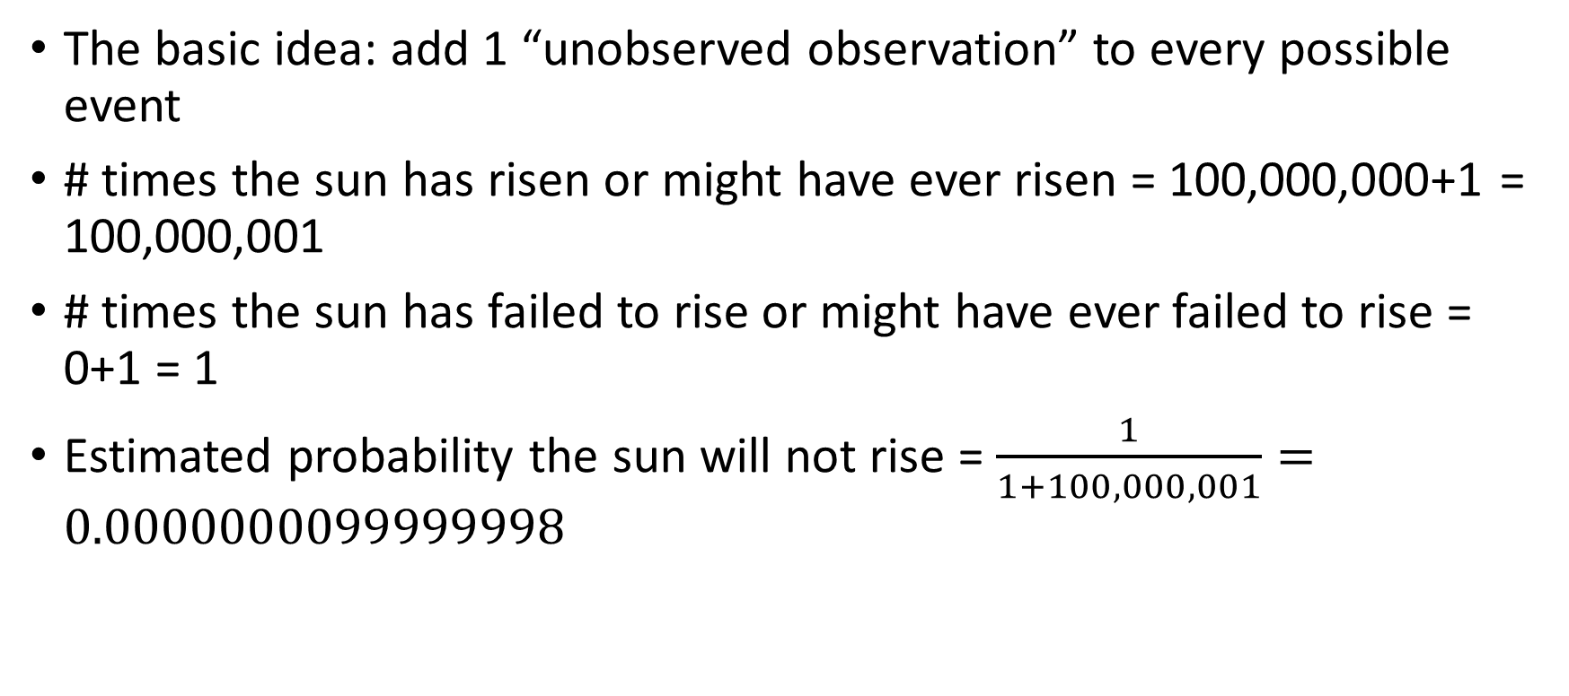
Laplace Smoothing
The basic idea: add 1 “unobserved observation” to every possible event
# times the sun has risen or might have ever risen = 100,000,000+1 = 100,000,001
# times the sun has failed to rise or might have ever failed to rise = 0+1 = 1
Estimated probability the sun will not rise = $\frac{1}{1+100,000,001}=0.0000000099999998$

Slide 38
Parameter estimation
ML (Maximum Likelihood) parameter estimate:
Laplacian Smoothing estimate
How can you estimate the probability of a word you never saw in the training set? (Hint: what happens if you give it probability 0, then it actually occurs in a test document?)
Laplacian smoothing: pretend you have seen every vocabulary word one more time than you actually did
# of occurrences of this word in docs from this class
P(word | class) =
total # of words in docs from this class
# of occurrences of this word in docs from this class + 1
P(word | class) =
total # of words in docs from this class + V
(V: total number of unique words)

Slide 39
Summary: Naïve Bayes for Document Classification
Naïve Bayes model: assign the document to the class with the highest posterior
Model parameters:
Likelihood
of class 1
Likelihood
of class K
prior
P(w₁ | class₁)
P(w₂ | class₁)
…
P(w_{n} | class₁)
P(w₁ | class_{K})
P(w₂ | class_{K})
…
P(w_{n} | class_{K})
P(class₁)
…
P(class_{K})
…

Slide 40
Review: Bayesian decision making
Suppose the agent has to make decisions about the value of an unobserved query variable Y based on the values of an observed evidence variable E
Inference problem: given some observation E = e, what is P(Y | E=e)?
Learning problem: estimate the parameters of the probabilistic model P(y | e) given a training sample {(e₁,y₁), …, (e_{n},y_{n})}

