Slide 1
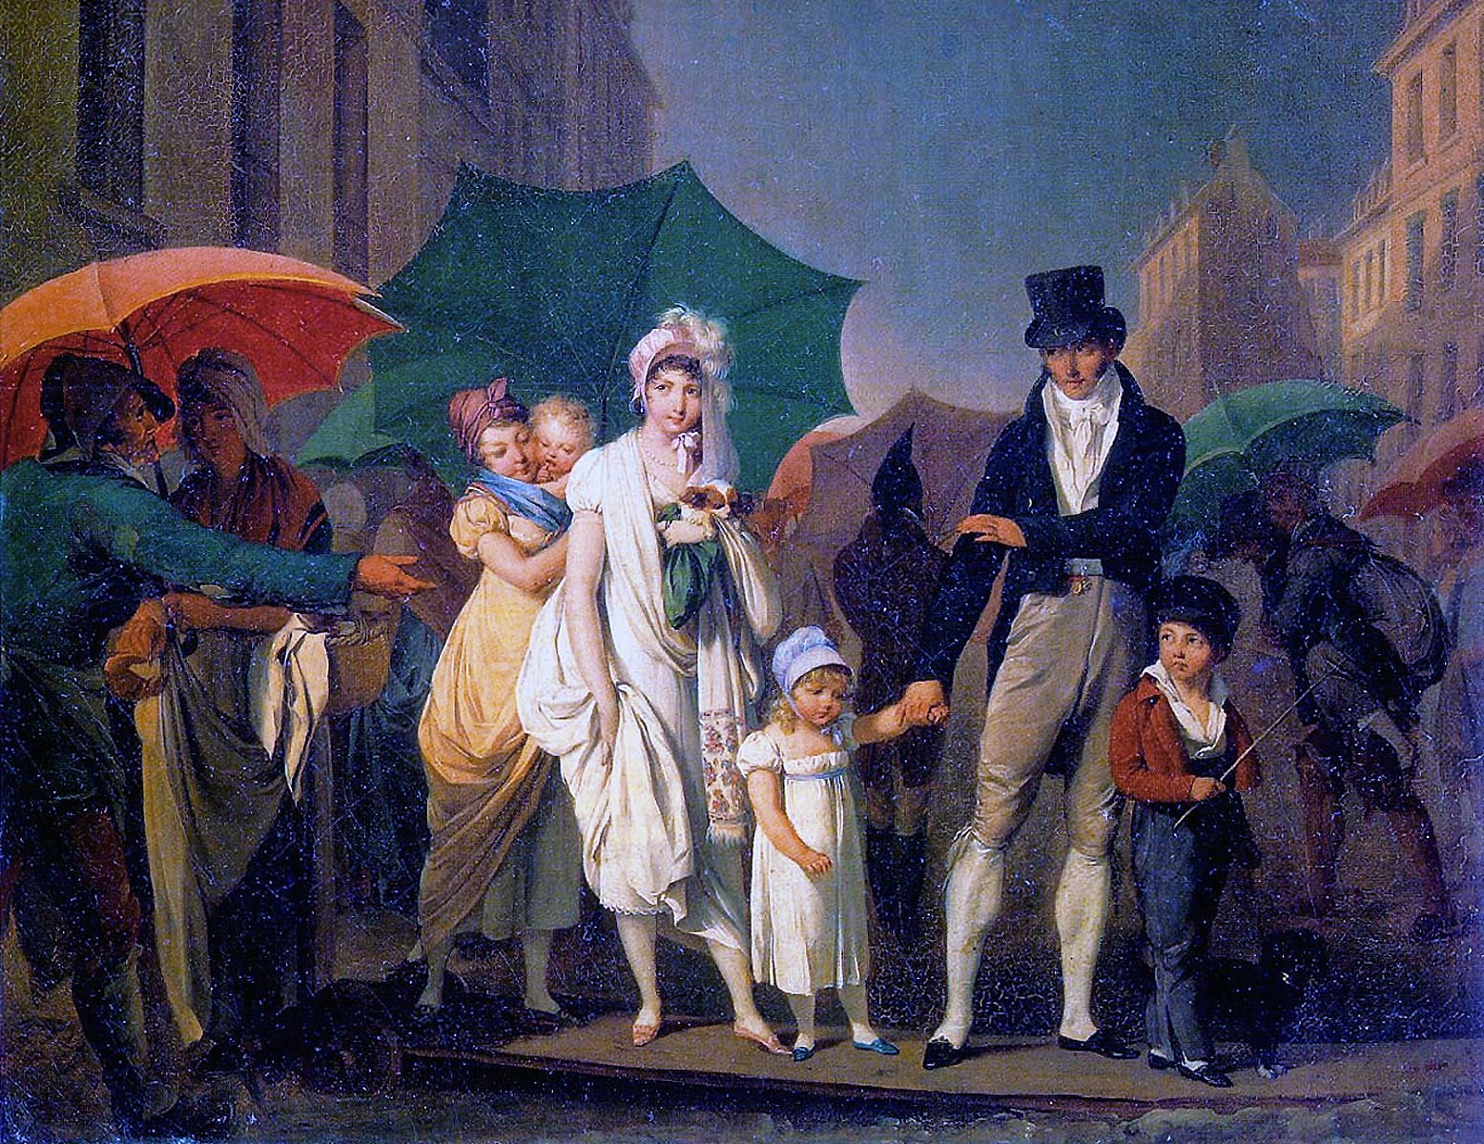
CS440/ECE448 Lecture 19: The Forward Algorithm and the Viterbi Algorithm
Mark Hasegawa-Johnson, 3/2020
CC-BY 3.0: You may remix or redistribute if you cite the source.
Louis-Leopold Boilly, Passer Payez, 1803. Public domain work of art, https://en.wikipedia.org/wiki/Umbrella

Slide 2
Outline
Inference by Enumeration in an HMM
Filtering using the Forward Algorithm
Decoding using the Viterbi Algorithm

Slide 3
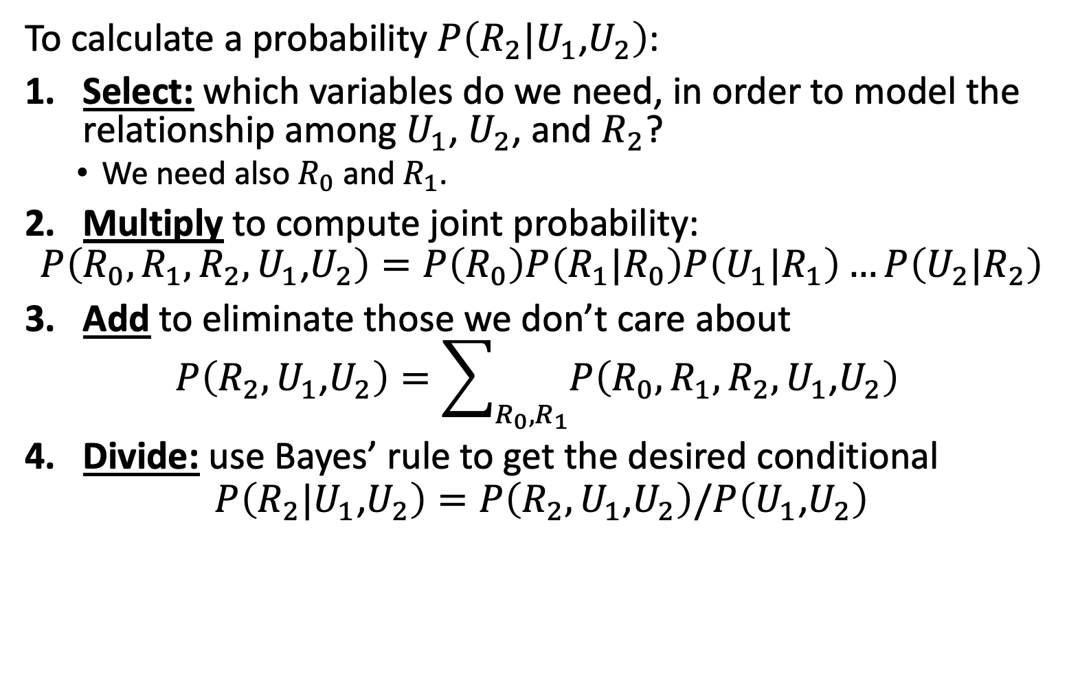
Inference by Enumeration
To calculate a probability $P\left(R_{2}|U_{1}\text{,}U_{2}\right)$:
Select: which variables do we need, in order to model the relationship among $U_{1}$, $U_{2}$, and $R_{2}$?
We need also $R_{0}$ and $R_{1}$.
Multiply to compute joint probability:
$$P\left(R_{0},R_{1},R_{2},U_{1}\text{,}U_{2}\right)=P\left(R_{0}\right)P\left(R_{1}|R_{0}\right)P\left(U_{1}|R_{1}\right)…P\left(U_{2}|R_{2}\right)$$
Add to eliminate those we don’t care about
$$P\left(R_{2},U_{1}\text{,}U_{2}\right)=\sum_{R_{0},R_{1}}{P\left(R_{0},R_{1},R_{2},U_{1}\text{,}U_{2}\right)}$$
Divide: use Bayes’ rule to get the desired conditional
$$P\left(R_{2}|U_{1}\text{,}U_{2}\right)=P\left(R_{2},U_{1}\text{,}U_{2}\right)/P\left(U_{1}\text{,}U_{2}\right)$$
…
R₀
R₁
R₂
R_{T-1}
R_{T}
U₁
U₂
U_{T-1}
U_{T}

Slide 4

Computational Complexity of “Inference by Enumeration”
Russell & Norvig call this “inference by enumeration” because you have to enumerate every possible combination of $R_{0},R_{1},R_{2},U_{1}\text{,}U_{2}$, for $R_{0}∈\left\{t,f\right\}$.
The complexity comes from this enumeration: if there are $2^{5}$ possible combinations, then the complexity can’t be less than $2^{5}$!

Slide 5

First simplification for HMMs: only enumerate the values of the hidden variables
Notice: we don’t really need to calculate $P\left(R_{0},¬R_{1},R_{2},¬U_{1}\text{,}¬U_{2}\right)$ if we have already observed that $U_{2}$ is True!
First computational simplification for HMMs:
Only enumerate the possible values of the hidden variables.
Set the observed variables to their observed values.

Slide 6
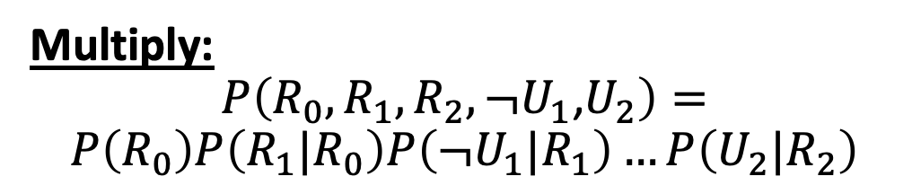
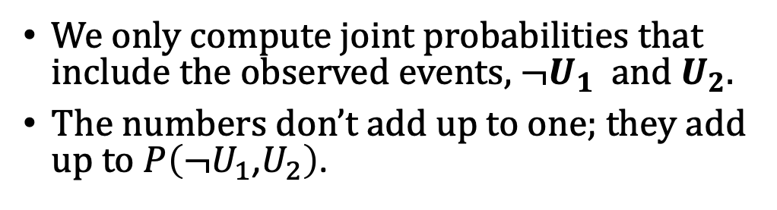
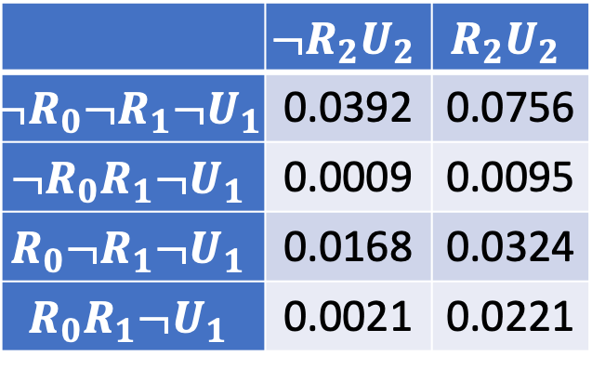
Inference by Enumerating only the Hidden Variables
Multiply:
$$P\left(R_{0},R_{1},R_{2},¬U_{1}\text{,}U_{2}\right)=$$
$$P\left(R_{0}\right)P\left(R_{1}|R_{0}\right)P\left(¬U_{1}|R_{1}\right)…P\left(U_{2}|R_{2}\right)$$
Transition model
 | $$¬R_{2}U_{2}$$ | $$R_{2}U_{2}$$
$$¬R_{0}¬R_{1}{¬U}_{1}$$ | 0.0392 | 0.0756
$$¬R_{0}R_{1}¬U_{1}$$ | 0.0009 | 0.0095
$$R_{0}¬R_{1}¬U_{1}$$ | 0.0168 | 0.0324
$$R_{0}R_{1}¬U_{1}$$ | 0.0021 | 0.0221
state
R₀
R₁
R₂
observation
U₁
U₂
Transition probabilities
Observation probabilities
 | R_{t} = T | R_{t} = F
R_{t-1} = T | 0.7 | 0.3
R_{t-1} = F | 0.3 | 0.7
 | U_{t} = T | U_{t} = F
R_{t} = T | 0.9 | 0.1
R_{t} = F | 0.2 | 0.8
We only compute joint probabilities that include the observed events, $¬U_{1}$ and $U_{2}$.
The numbers don’t add up to one; they add up to $P\left(¬U_{1}\text{,}U_{2}\right)$.
Notes:
The example is described in Section 15.1.1

Slide 7
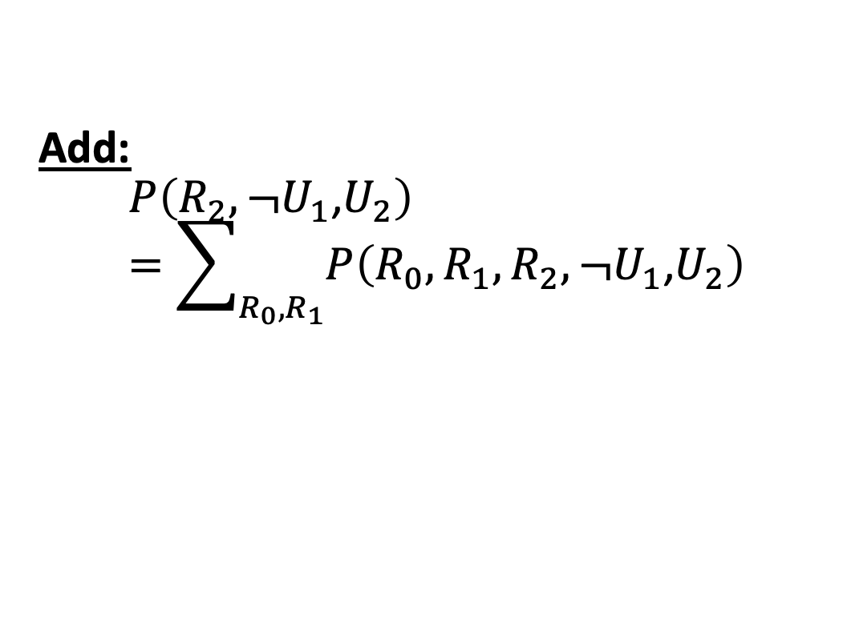
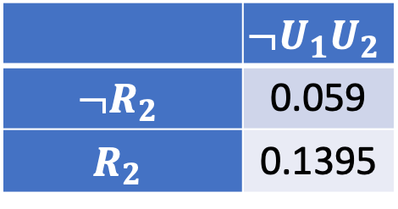
Inference by Enumerating only the Hidden Variables
Add:
$$P\left(R_{2},¬U_{1}\text{,}U_{2}\right)=\sum_{R_{0},R_{1}}{P\left(R_{0},R_{1},R_{2},¬U_{1}\text{,}U_{2}\right)}$$
Transition model
state
R₀
R₁
R₂
 | $$¬U_{1}U_{2}$$
$$¬R_{2}$$ | 0.059
$$R_{2}$$ | 0.1395
observation
U₁
U₂
Transition probabilities
Observation probabilities
 | R_{t} = T | R_{t} = F
R_{t-1} = T | 0.7 | 0.3
R_{t-1} = F | 0.3 | 0.7
 | U_{t} = T | U_{t} = F
R_{t} = T | 0.9 | 0.1
R_{t} = F | 0.2 | 0.8
We only compute joint probabilities that include the observed events, $¬U_{1}$ and $U_{2}$.
The numbers don’t add up to one; they add up to $P\left(¬U_{1}\text{,}U_{2}\right)$.
Notes:
The example is described in Section 15.1.1

Slide 8
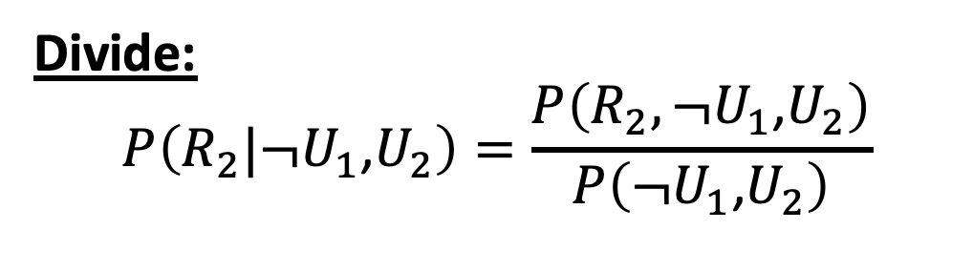
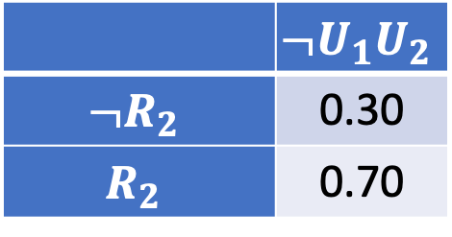
Inference by Enumerating only the Hidden Variables
Divide:
$$P\left(R_{2}|¬U_{1}\text{,}U_{2}\right)=\frac{P\left(R_{2},¬U_{1}\text{,}U_{2}\right)}{P\left(¬U_{1}\text{,}U_{2}\right)}$$
Transition model
state
R₀
R₁
R₂
 | $$¬U_{1}U_{2}$$
$$¬R_{2}$$ | 0.30
$$R_{2}$$ | 0.70
observation
U₁
U₂
Transition probabilities
Observation probabilities
 | R_{t} = T | R_{t} = F
R_{t-1} = T | 0.7 | 0.3
R_{t-1} = F | 0.3 | 0.7
 | U_{t} = T | U_{t} = F
R_{t} = T | 0.9 | 0.1
R_{t} = F | 0.2 | 0.8
Normalize, so that the column sums to one.
Notes:
The example is described in Section 15.1.1

Slide 9
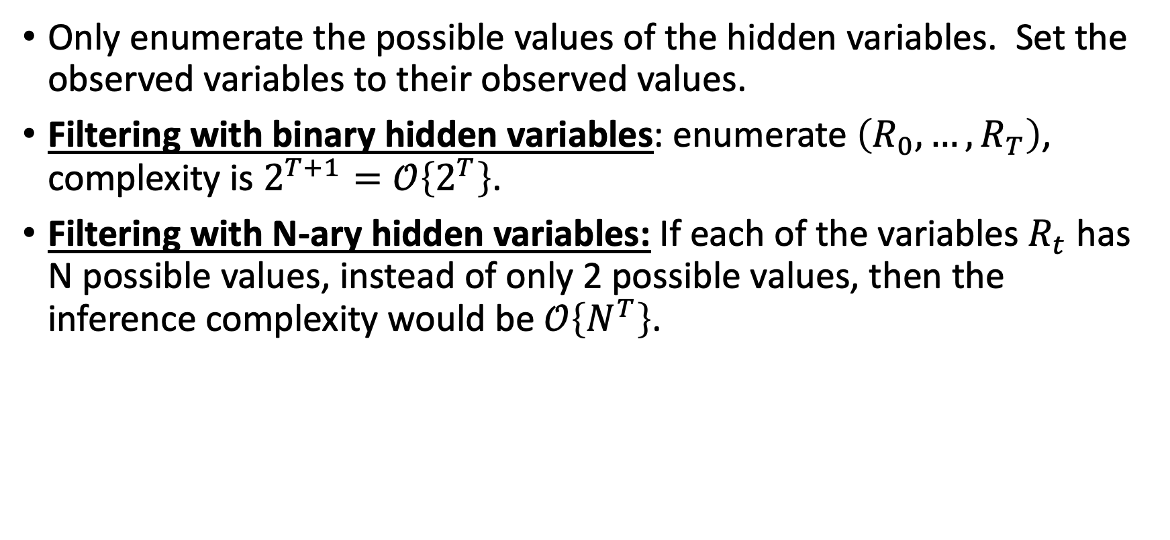
First simplification for HMMs: only enumerate the values of the hidden variables
Only enumerate the possible values of the hidden variables. Set the observed variables to their observed values.
Filtering with binary hidden variables: enumerate $\left(R_{0},…,R_{T}\right)$, complexity is $2^{T+1}=𝒪\left\{2^{T}\right\}$.
Filtering with N-ary hidden variables: If each of the variables $R_{t}$ has N possible values, instead of only 2 possible values, then the inference complexity would be $𝒪\left\{N^{T}\right\}$.

Slide 10
Outline
Inference by Enumeration in an HMM
Filtering using the Forward Algorithm
Decoding using the Viterbi Algorithm

Slide 11

Inference complexity in an HMM
$𝒪\left\{N^{T}\right\}$ is still a lot. Can we do better?
For a general Bayes net, no. Bayes net inference, in an arbitrary Bayes net, is NP-complete.
For an HMM, yes, we can do better.

Slide 12
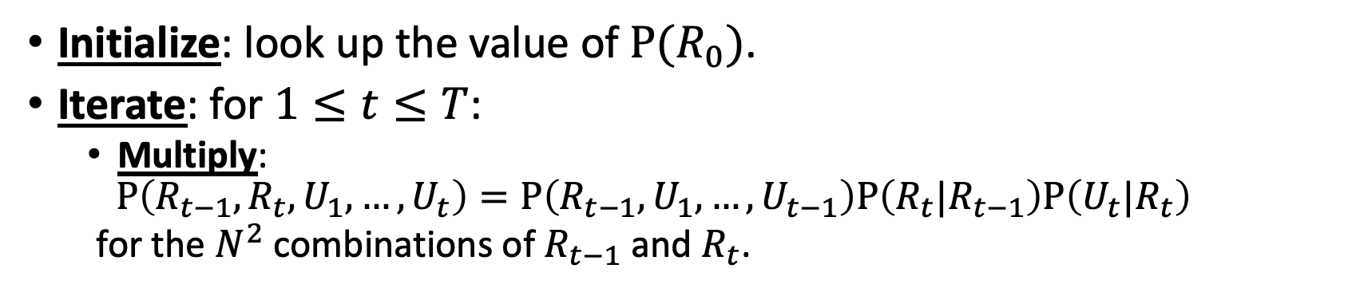
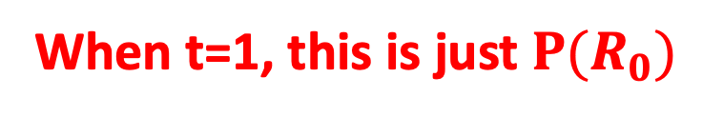
The Forward Algorithm
Initialize: look up the value of $P(R_{0})$.
Iterate: for $1≤t≤T$:
Multiply:
$$P\left(R_{t−1},R_{t},U_{1},…,U_{t}\right)=P\left(R_{t−1}, U_{1},…,U_{t−1}\right)P\left(R_{t}|R_{t−1}\right)P\left(U_{t}|R_{t}\right)$$
for the $N^{2}$ combinations of $R_{t−1}$ and $R_{t}$.
When t=1, this is just $P(R_{0})$
…
…
R₀
R₁
R₂
R_{t-1}
R_{t}
R_{t+1}
R_{T-1}
R_{T}
U₁
U₂
U_{t-1}
U_{t}
U_{t+1}
U_{T-1}
U_{T}

Slide 13
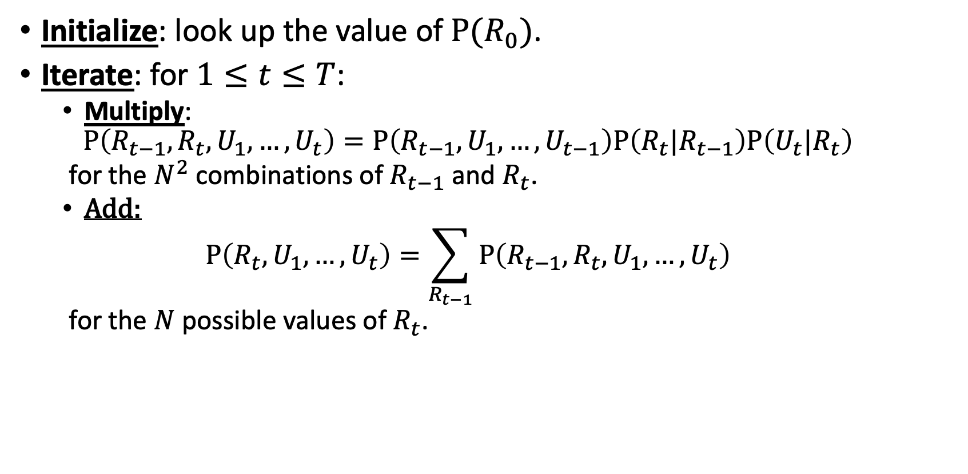
The Forward Algorithm
Initialize: look up the value of $P(R_{0})$.
Iterate: for $1≤t≤T$:
Multiply:
$$P\left(R_{t−1},R_{t},U_{1},…,U_{t}\right)=P\left(R_{t−1}, U_{1},…,U_{t−1}\right)P\left(R_{t}|R_{t−1}\right)P\left(U_{t}|R_{t}\right)$$
for the $N^{2}$ combinations of $R_{t−1}$ and $R_{t}$.
Add:
$$P\left(R_{t},U_{1},…,U_{t}\right)=\sum_{R_{t−1}}{P\left(R_{t−1},R_{t},U_{1},…,U_{t}\right)}$$
for the $N$ possible values of $R_{t}$.
…
…
R₀
R₁
R₂
R_{t-1}
R_{t}
R_{t+1}
R_{T-1}
R_{T}
U₁
U₂
U_{t-1}
U_{t}
U_{t+1}
U_{T-1}
U_{T}

Slide 14
The Forward Algorithm
Initialize: look up the value of $P(R_{0})$.
Iterate: for $1≤t≤T$:
Multiply:
$$P\left(R_{t−1},R_{t},U_{1},…,U_{t}\right)=P\left(R_{t−1}, U_{1},…,U_{t−1}\right)P\left(R_{t}|R_{t−1}\right)P\left(U_{t}|R_{t}\right)$$
for the $N^{2}$ combinations of $R_{t−1}$ and $R_{t}$.
Add:
$$P\left(R_{t},U_{1},…,U_{t}\right)=\sum_{R_{t−1}}{P\left(R_{t−1},R_{t},U_{1},…,U_{t}\right)}$$
for the $N$ possible values of $R_{t}$.
When we move to the next value of t…
…
…
R₀
R₁
R₂
R_{t-1}
R_{t}
R_{t+1}
R_{T-1}
R_{T}
U₁
U₂
U_{t-1}
U_{t}
U_{t+1}
U_{T-1}
U_{T}

Slide 15
The Forward Algorithm
Initialize: look up the value of $P(R_{0})$.
Iterate: for $1≤t≤T$:
Multiply:
$$P\left(R_{t−1},R_{t},U_{1},…,U_{t}\right)=P\left(R_{t−1}, U_{1},…,U_{t−1}\right)P\left(R_{t}|R_{t−1}\right)P\left(U_{t}|R_{t}\right)$$
for the $N^{2}$ combinations of $R_{t−1}$ and $R_{t}$.
Add:
$$P\left(R_{t},U_{1},…,U_{t}\right)=\sum_{R_{t−1}}{P\left(R_{t−1},R_{t},U_{1},…,U_{t}\right)}$$
for the $N$ possible values of $R_{t}$.
… and so on, until we reach t=T…
…
…
R₀
R₁
R₂
R_{t-1}
R_{t}
R_{t+1}
R_{T-1}
R_{T}
U₁
U₂
U_{t-1}
U_{t}
U_{t+1}
U_{T-1}
U_{T}

Slide 16
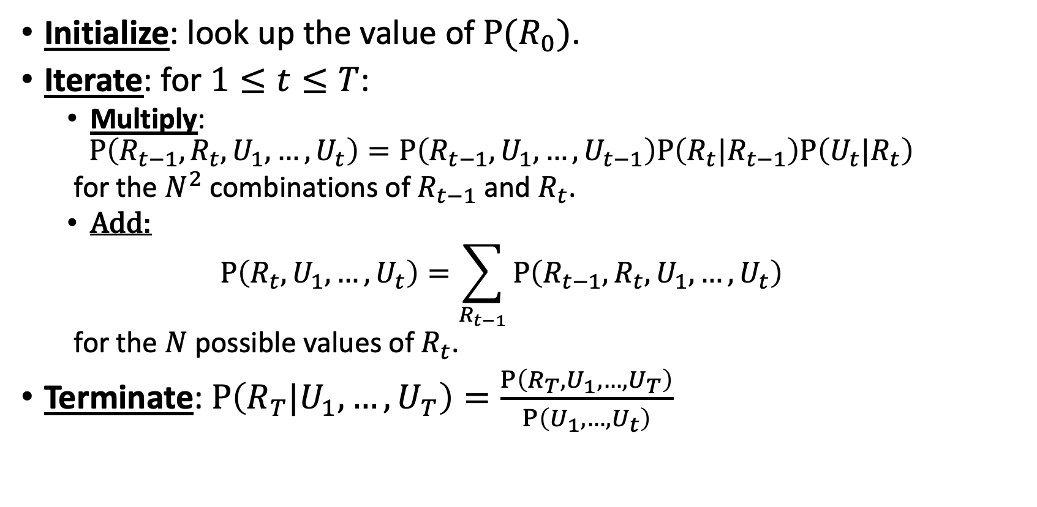
The Forward Algorithm
Initialize: look up the value of $P(R_{0})$.
Iterate: for $1≤t≤T$:
Multiply:
$$P\left(R_{t−1},R_{t},U_{1},…,U_{t}\right)=P\left(R_{t−1}, U_{1},…,U_{t−1}\right)P\left(R_{t}|R_{t−1}\right)P\left(U_{t}|R_{t}\right)$$
for the $N^{2}$ combinations of $R_{t−1}$ and $R_{t}$.
Add:
$$P\left(R_{t},U_{1},…,U_{t}\right)=\sum_{R_{t−1}}{P\left(R_{t−1},R_{t},U_{1},…,U_{t}\right)}$$
for the $N$ possible values of $R_{t}$.
Terminate: $P\left(R_{T}|U_{1},…,U_{T}\right)=\frac{P\left(R_{T},U_{1},…,U_{T}\right)}{P\left(U_{1},…,U_{t}\right)}$
…
…
R₀
R₁
R₂
R_{t-1}
R_{t}
R_{t+1}
R_{T-1}
R_{T}
U₁
U₂
U_{t-1}
U_{t}
U_{t+1}
U_{T-1}
U_{T}

Slide 17




The Forward Algorithm
Complexity
$$𝒪\left\{N\right\}$$
Initialize: look up the value of $P(R_{0})$.
Iterate: for $1≤t≤T$:
Multiply:
$$P\left(R_{t−1},R_{t},U_{1},…,U_{t}\right)=P\left(R_{t−1}, U_{1},…,U_{t−1}\right)P\left(R_{t}|R_{t−1}\right)P\left(U_{t}|R_{t}\right)$$
for the $N^{2}$ combinations of $R_{t−1}$ and $R_{t}$.
Add:
$$P\left(R_{t},U_{1},…,U_{t}\right)=\sum_{R_{t−1}}{P\left(R_{t−1},R_{t},U_{1},…,U_{t}\right)}$$
for the $N$ possible values of $R_{t}$.
Terminate: $P\left(R_{T}|U_{1},…,U_{T}\right)=\frac{P\left(R_{T},U_{1},…,U_{T}\right)}{P\left(U_{1},…,U_{t}\right)}$
$$𝒪\left\{N^{2}T\right\}$$
$$𝒪\left\{N^{2}T\right\}$$
$$𝒪\left\{N\right\}$$
…
…
R₀
R₁
R₂
R_{t-1}
R_{t}
R_{t+1}
R_{T-1}
R_{T}
U₁
U₂
U_{t-1}
U_{t}
U_{t+1}
U_{T-1}
U_{T}

Slide 18
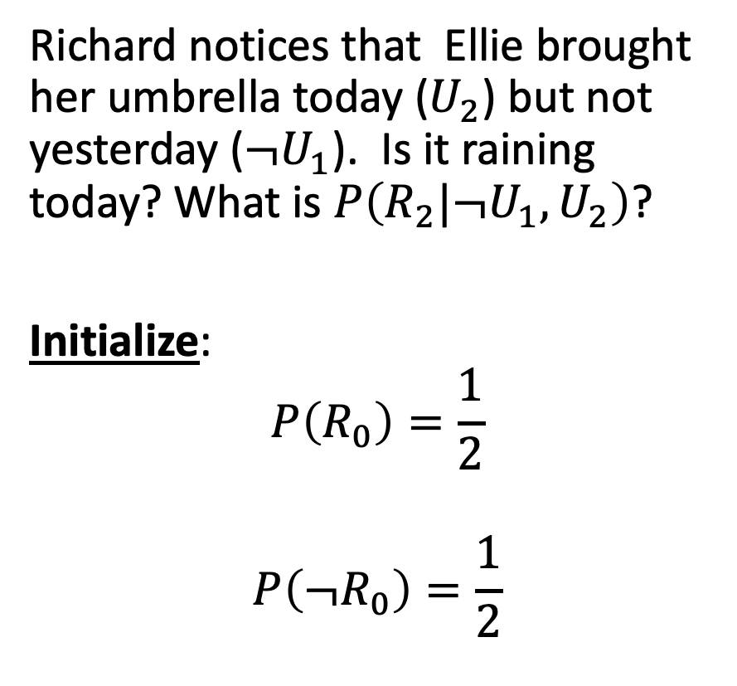
Example: Filtering in UmbrellaWorld
Richard notices that Ellie brought her umbrella today ($U_{2}$) but not yesterday ($¬U_{1}$). Is it raining today? What is $P\left(R_{2}|¬U_{1},U_{2}\right)$?
Initialize:
$$P\left(R_{0}\right)=\frac{1}{2}$$
$$P\left({¬R}_{0}\right)=\frac{1}{2}$$
Transition model
state
R₀
R₁
R₂
observation
U₁
U₂
Transition probabilities
Observation probabilities
 | R_{t} = T | R_{t} = F
R_{t-1} = T | 0.7 | 0.3
R_{t-1} = F | 0.3 | 0.7
 | U_{t} = T | U_{t} = F
R_{t} = T | 0.9 | 0.1
R_{t} = F | 0.2 | 0.8
Notes:
The example is described in Section 15.1.1

Slide 19
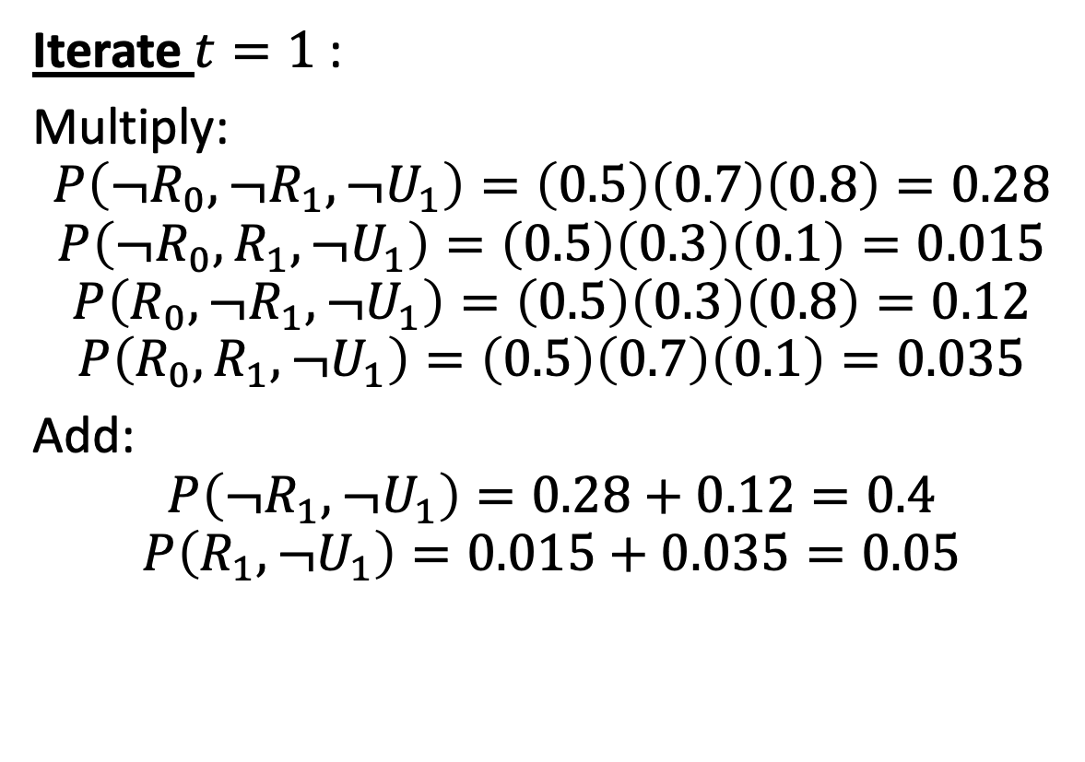
Example: Filtering in UmbrellaWorld
Iterate $t=1$:
Multiply:
$$P\left(¬R_{0},¬R_{1},¬U_{1}\right)=\left(0.5\right)\left(0.7\right)\left(0.8\right)=0.28$$
$$P\left(¬R_{0}, R_{1},¬U_{1}\right)=\left(0.5\right)\left(0.3\right)\left(0.1\right)=0.015$$
$$P\left(R_{0},¬R_{1},¬U_{1}\right)=\left(0.5\right)\left(0.3\right)\left(0.8\right)=0.12$$
$$P\left(R_{0}, R_{1},¬U_{1}\right)=\left(0.5\right)\left(0.7\right)\left(0.1\right)=0.035$$
Add:
$$P\left(¬R_{1},¬U_{1}\right)=0.28+0.12=0.4$$
$$P\left(R_{1},¬U_{1}\right)=0.015+0.035=0.05$$
Transition model
state
R₀
R₁
R₂
observation
U₁
U₂
Transition probabilities
Observation probabilities
 | R_{t} = T | R_{t} = F
R_{t-1} = T | 0.7 | 0.3
R_{t-1} = F | 0.3 | 0.7
 | U_{t} = T | U_{t} = F
R_{t} = T | 0.9 | 0.1
R_{t} = F | 0.2 | 0.8
Notes:
The example is described in Section 15.1.1

Slide 20
Forward Algorithm: The Trellis
We can visualize the forward algorithm using a TRELLIS:
Node = a value of the hidden variable at a given time
Numerical value of the node = probability that the hidden variable takes that value
0.5
?
?
T
…
Value of the hidden variable
0.5
?
?
F
0
U1=F
U2=T
Time

Slide 21
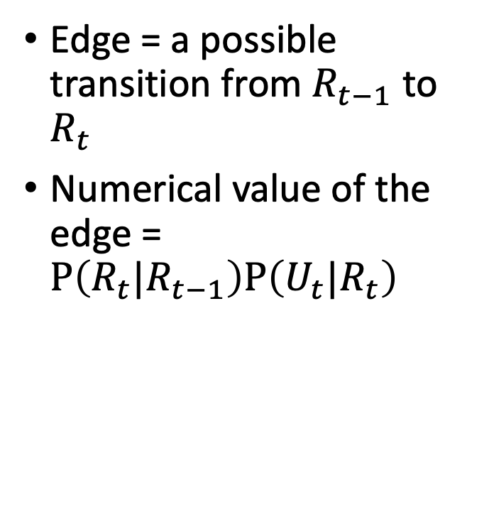
Forward Algorithm: The Trellis
Edge = a possible transition from $R_{t−1}$ to $R_{t}$
Numerical value of the edge = $P\left(R_{t}|R_{t−1}\right)P\left(U_{t}|R_{t}\right)$
0.5
?
?
T
0.07
0.63
0.24
0.06
…
Value of the hidden variable
0.03
0.27
0.5
?
?
F
0.56
0.14
0
U1=F
U2=T
Time

Slide 22
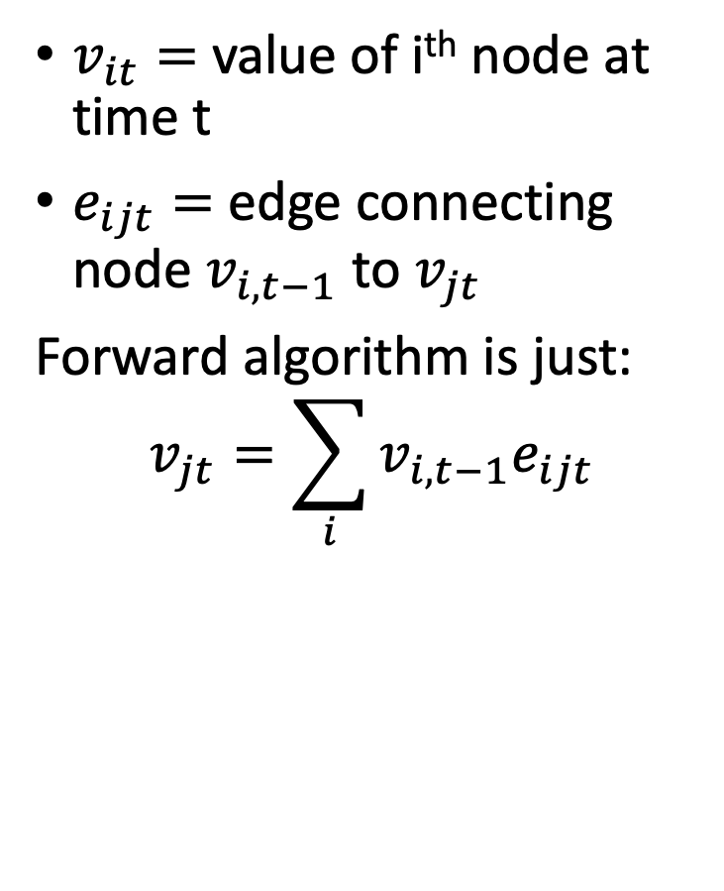
Forward Algorithm: The Trellis
$v_{it}=$ value of i^{th} node at time t
$e_{ijt}=$ edge connecting node $v_{i,t−1}$ to $v_{jt}$
Forward algorithm is just:
$$v_{jt}=\sum_{i}{v_{i,t−1}e_{ijt}}$$
0.5
0.05
0.1395
T
0.07
0.63
0.24
0.06
…
Value of the hidden variable
0.03
0.27
0.5
0.4
0.059
F
0.56
0.14
0
U1=F
U2=T
Time

Slide 23
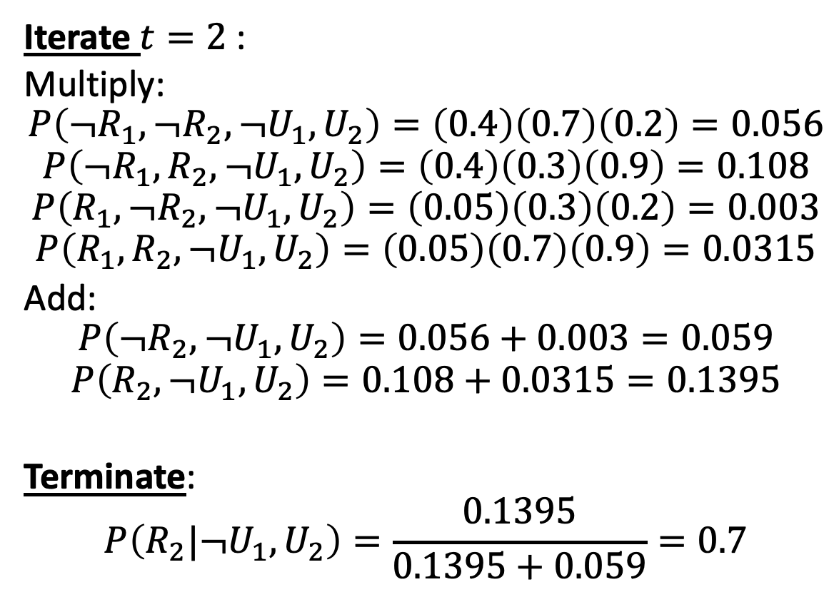
Example: Filtering in UmbrellaWorld
Iterate $t=2$:
Multiply:
$$P\left(¬R_{1},¬R_{2},¬U_{1},U_{2}\right)=\left(0.4\right)\left(0.7\right)\left(0.2\right)=0.056$$
$$P\left(¬R_{1}, R_{2},¬U_{1},U_{2}\right)=\left(0.4\right)\left(0.3\right)\left(0.9\right)=0.108$$
$$P\left(R_{1},¬R_{2},¬U_{1},U_{2}\right)=\left(0.05\right)\left(0.3\right)\left(0.2\right)=0.003$$
$$P\left(R_{1}, R_{2},¬U_{1},U_{2}\right)=\left(0.05\right)\left(0.7\right)\left(0.9\right)=0.0315$$
Add:
$$P\left(¬R_{2},¬U_{1},U_{2}\right)=0.056+0.003=0.059$$
$$P\left(R_{2},¬U_{1},U_{2}\right)=0.108+0.0315=0.1395$$
Terminate:
$$P\left(R_{2}|¬U_{1},U_{2}\right)=\frac{0.1395}{0.1395+0.059}=0.7$$
Transition model
state
R₀
R₁
R₂
observation
U₁
U₂
Transition probabilities
Observation probabilities
 | R_{t} = T | R_{t} = F
R_{t-1} = T | 0.7 | 0.3
R_{t-1} = F | 0.3 | 0.7
 | U_{t} = T | U_{t} = F
R_{t} = T | 0.9 | 0.1
R_{t} = F | 0.2 | 0.8
Notes:
The example is described in Section 15.1.1

Slide 24
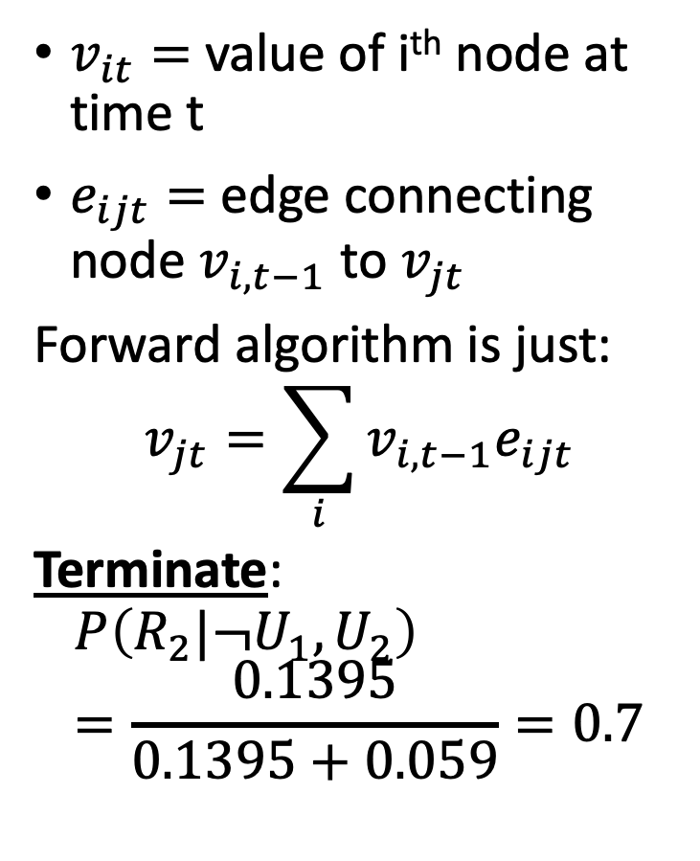
Forward Algorithm: The Trellis
$v_{it}=$ value of i^{th} node at time t
$e_{ijt}=$ edge connecting node $v_{i,t−1}$ to $v_{jt}$
Forward algorithm is just:
$$v_{jt}=\sum_{i}{v_{i,t−1}e_{ijt}}$$
Terminate:
$$P\left(R_{2}|¬U_{1},U_{2}\right)=\frac{0.1395}{0.1395+0.059}=0.7$$
0.5
0.05
0.1395
T
0.07
0.63
0.24
0.06
…
Value of the hidden variable
0.03
0.27
0.5
0.4
0.059
F
0.56
0.14
0
U1=F
U2=T
Time

Slide 25
HMM inference tasks
✅
Filtering: what is the distribution over the current state X_{t} given all the evidence so far, E_{1:t}
Smoothing: what is the distribution of some state X_{k} (k<t) given the entire observation sequence E_{1:t}?
Evaluation: compute the probability of a given observation sequence E_{1:t}
Decoding: what is the most likely state sequence X_{0:t} given the observation sequence E_{1:t}? (example: what’s the weather every day?)
--- use the Forward Algorithm, complexity $𝓞\left\{N^{2}T\right\}$
❌
--- Forward-Backward Algorithm
✅
--- Forward Algorithm computes this!
🆘
--- let’s solve this problem next.
…
…
X₀
X₁
X_{k}
X_{t-1}
X_{t}
E₁
E_{k}
E_{t-1}
E_{t}

Slide 26
Outline
Inference by Enumeration in an HMM
Filtering using the Forward Algorithm
Decoding using the Viterbi Algorithm

Slide 27
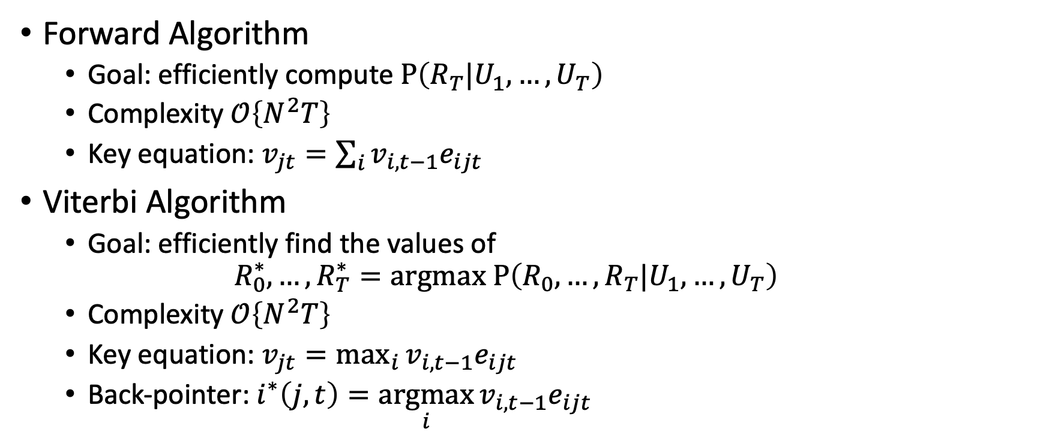
Forward Algorithm vs. Viterbi Algorithm
Forward Algorithm
Goal: efficiently compute $P\left(R_{T}|U_{1},…,U_{T}\right)$
Complexity $𝒪\left\{N^{2}T\right\}$
Key equation: $v_{jt}=\sum_{i}{v_{i,t−1}e_{ijt}}$
Viterbi Algorithm
Goal: efficiently find the values of
$$R_{0}^{∗},…,R_{T}^{∗}=argmax P\left(R_{0},…,R_{T}|U_{1},…,U_{T}\right)$$
Complexity $𝒪\left\{N^{2}T\right\}$
Key equation: $v_{jt}=\max_{i}{v_{i,t−1}e_{ijt}}$
Back-pointer: $i^{∗}\left(j,t\right)=\underset{i}{argmax}{v_{i,t−1}e_{ijt}}$

Slide 28
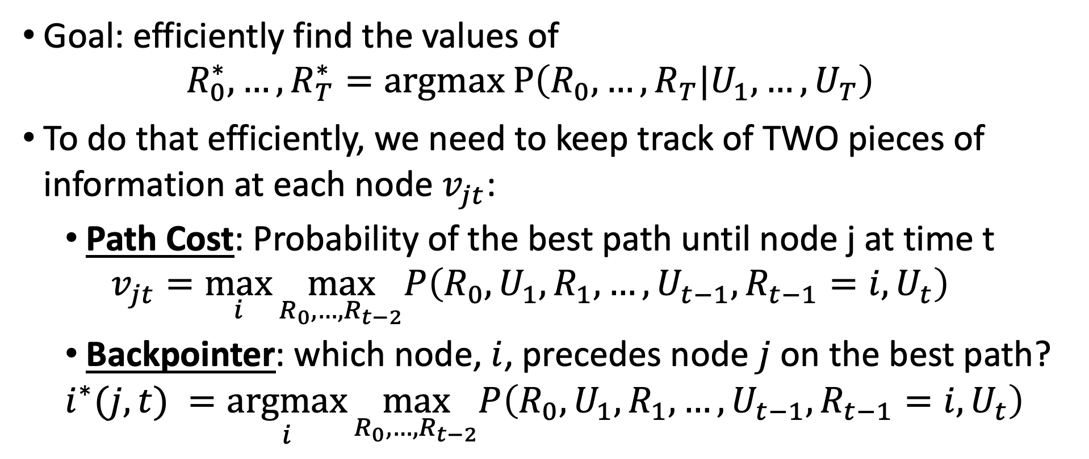
Viterbi Algorithm: Key concepts
Goal: efficiently find the values of
$$R_{0}^{∗},…,R_{T}^{∗}=argmax P\left(R_{0},…,R_{T}|U_{1},…,U_{T}\right)$$
To do that efficiently, we need to keep track of TWO pieces of information at each node $v_{jt}$:
Path Cost: Probability of the best path until node j at time t
$$v_{jt}=\max_{i}{\max_{R_{0},…,R_{t−2}}P\left(R_{0},U_{1},R_{1},…,U_{t−1},R_{t−1}=i,U_{t}\right)}$$
Backpointer: which node, $i$, precedes node $j$ on the best path?
$$i^{∗}(j,t) =\underset{i}{argmax}{\max_{R_{0},…,R_{t−2}}P\left(R_{0},U_{1},R_{1},…,U_{t−1},R_{t−1}=i,U_{t}\right)}$$

Slide 29
Viterbi Algorithm: The Trellis
We can visualize the Viterbi algorithm using a TRELLIS:
Node = a value of the hidden variable at a given time
Numerical value of the node = probability that the hidden variable takes that value
0.5
?
?
T
…
Value of the hidden variable
0.5
?
?
F
0
U1=F
U2=T
Time

Slide 30
Viterbi Algorithm: The Trellis
Edge = a possible transition from $R_{t−1}$ to $R_{t}$
Numerical value of the edge = $P\left(R_{t}|R_{t−1}\right)P\left(U_{t}|R_{t}\right)$
0.5
?
?
T
0.07
0.63
0.24
0.06
…
Value of the hidden variable
0.03
0.27
0.5
?
?
F
0.56
0.14
0
U1=F
U2=T
Time

Slide 31
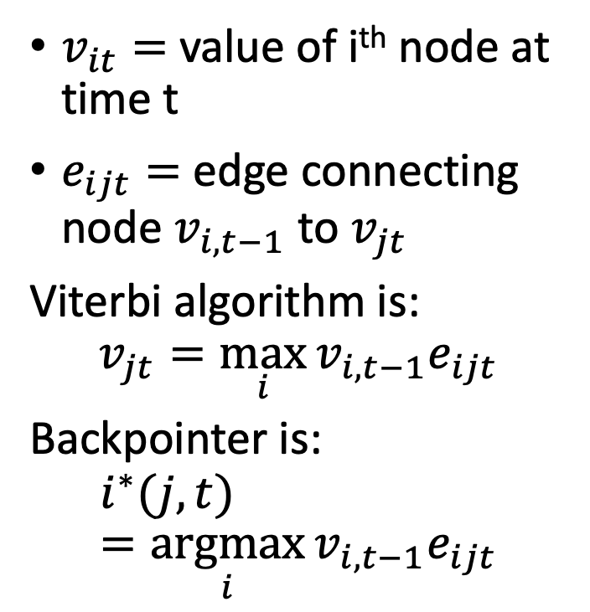
Viterbi Algorithm: The Trellis
$v_{it}=$ value of i^{th} node at time t
$e_{ijt}=$ edge connecting node $v_{i,t−1}$ to $v_{jt}$
Viterbi algorithm is:
$$v_{jt}=\max_{i}{v_{i,t−1}e_{ijt}}$$
Backpointer is:
$$i^{∗}(j,t) =\underset{i}{argmax}{v_{i,t−1}e_{ijt}}$$
0.5
0.035
0.0756
T
0.07
0.63
0.24
0.06
…
Value of the hidden variable
0.03
0.27
0.5
0.28
0.0392
F
0.56
0.14
0
U1=F
U2=T
Time

Slide 32

Viterbi Algorithm: Termination
Choose the node with the largest final value
$$\max_{j}{v_{jT}}=\max_{R_{0},…,R_{T}}P\left(R_{0},U_{1},…,U_{T},R_{T}\right)$$
Trace its backpointers to find
$$R_{0}^{∗},…,R_{T}^{∗}$$

Slide 33
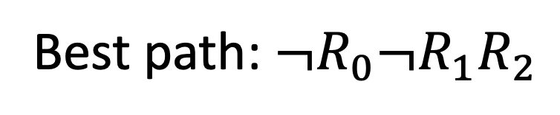

Viterbi Algorithm: Termination
Best path probability = 0.0756
0.0756
0.5
0.035
T
0.07
0.63
0.24
0.06
…
Value of the hidden variable
0.03
0.27
0.5
0.28
0.0392
Best path: $¬R_{0}¬R_{1}R_{2}$
F
0.56
0.14
0
U1=F
U2=T
Time

Slide 34
HMM inference tasks
✅
Filtering: what is the distribution over the current state X_{t} given all the evidence so far, E_{1:t}
Smoothing: what is the distribution of some state X_{k} (k<t) given the entire observation sequence E_{1:t}?
Evaluation: compute the probability of a given observation sequence E_{1:t}
Decoding: what is the most likely state sequence X_{0:t} given the observation sequence E_{1:t}? (example: what’s the weather every day?)
--- use the Forward Algorithm, complexity $𝓞\left\{N^{2}T\right\}$
❌
--- Forward-Backward Algorithm
✅
--- Forward Algorithm computes this!
✅
--- use the Viterbi Algorithm, complexity $𝓞\left\{N^{2}T\right\}$
…
…
X₀
X₁
X_{k}
X_{t-1}
X_{t}
E₁
E_{k}
E_{t-1}
E_{t}

