Slide 1
Economic Inequality &
Political Power in America
Martin Gilens
Princeton University
Notes:
Revised 9-19-2014

Slide 4
Ezra Kline:
The most unsettling line in American politics

Slide 6
Notes:
…amount of influence..avg citizens…
Not HEIGHT…SLOPE

Slide 7
Notes:
explain SLIDE…
…whether strong opposed…strongly favored
matters not whit
when take other actors into account
average… no independent influence…
----
Where line come from?

Slide 8
2,000 survey questions

Slide 9
2,000 survey questions
…1980s

Slide 10
2,000 survey questions
…1980s, 1990s

Slide 11
2,000 survey questions
…1980s, 1990s, 2000s
Notes:
2000
1980s, 1990s, 2000s
all areas of fed policy

Slide 12
- Should we raise the federal minimum wage to
$6.75 hour?

Slide 13
- Should we raise the federal minimum wage to
$6.75 hour?
- Should America send troops to fight in Bosnia?

Slide 14
- Should we raise the federal minimum wage to
$6.75 hour?
- Should America send troops to fight in Bosnia?
- Do you support or oppose the proposed NAFTA
free trade agreement?

Slide 15
- Should we raise the federal minimum wage to
$6.75 hour?
- Should America send troops to fight in Bosnia?
- Do you support or oppose the proposed NAFTA
free trade agreement?
- Would you favor or oppose letting homosexuals
serve in the military?

Slide 16
For each question in the dataset:
- Percent Favor: Median income
- Percent Favor: High income
- Net Interest Group Alignment
- Was policy adopted?
Notes:
Median
High
“net IG alignment” = # groups (list most powerful)…
A significant endeavor (2000 Q’s, many decades)
result: more comprehensive dataset
…allowed…to measure influences on government policymaking…new ways

Slide 17
Policy outcome = α
+ β1 * average citizens’ preferences
+ β2 * Economic Elites’ preferences
+ β3 * Interest group alignments
+ e
Notes:
model: predict policy outcomes…INDEPENDENT influence

Slide 18
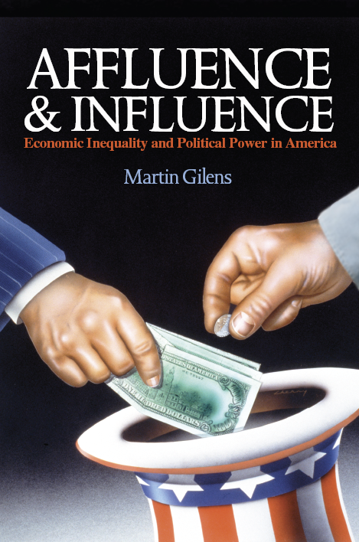
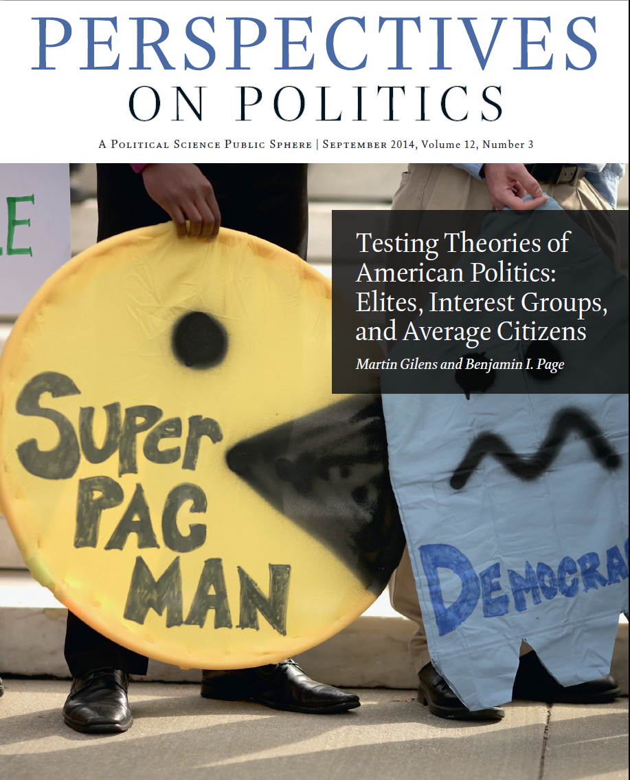
Notes:
details methods/results : book; this month’s issue…
(list of references and sources for more information related to my talk
on symposium’s website

Slide 19
Average Citizens
Economic Elites
Interest Groups
Notes:
SLIDE…
core finding: unsettling line … deeply disturbing
implication: our society is a democracy in name only
this is not what most Americans think America should be
maybe not even what most Americans think America is
these graphs depict a society where powerful call shots
average citizens reduced to bystanders

Slide 20
So?
Notes:
So?
seems rather undemocratic
but what DIFFERENCE does it make?
Think about prominent policies…past decades
some idiosyncratic: wars Iraq, Afghanistan (less ideo….
some represented long-term trends

Slide 21
NAFTA
Notes:
NAFTA: North Am…
signed under 1st Pres Bush, ratified Clinton
decades long shift toward free trade

Slide 22
NAFTA
Bush tax cuts
Notes:
Bush tax: cuts early 2000s
long-term decline in top tax rates

Slide 23
NAFTA
Bush tax cuts
Repeal of Glass-Steagall
Notes:
Repeal of Glass-Steagall banking regulations
under Clinton
much broader deregulation of finance industry
decline of corporate reg. in general
ALL of these trends have in common is
- embraced by BOTH pol parties
- much more popular among high income Am’s
and CORP int grps
than middle-class or poor
------
looking across the 2,000…3 broad areas…

Slide 24
The preferences of the well-off differ on:
Redistributive policies
Gov’t regulation vs. “free market”
Moral/religious
Notes:
Across the 2,000 or so policies in my dataset
pref’s…well-off differ on:
Redistributive policies:
lower taxes on rich , less generous unemployment
Free market:
financial, corporate deregulation , school vouchers , Medicare HMOs
Moral/religious:
abortion , school prayer , gay rights (well-off more liberal
DIFF people will have DIFF opinions
which policies are most impt.
REDISTRIBUTIVE econ policies
that might ameliorate or exacerbate econ ineq.
certainly among them

Slide 25
wealthy public
Deficit is most impt problem 32% 13%
Unemployment is most impt problem 11% 26%
Gov’t must see that no one is without food, clothing or shelter 43 68
Minimum wage should be high enough … poverty line 40 78
Gov’t…see to it that everyone who wants to work can find a job 19 68
Notes:
Few more specific examples from diff study:
Deficit seen as MIP by substantial portion…
for Public as a whole…unemployment (affects lots of ordinary Am’s , but few wealthy
Gov’t must see that…
…high enough so that no family with a full-time worker falls below… (2x
…ought to see to it that… (3x
THE priorities of the public ARE CLEARLY not THE PRIORITIES OUT GOV’T HAS PURSUED
- not just since the Great Recession of 2008…
- but over the past decades as middle-class wages have stagnated
and econ ineq. has increased
----
Why…PERSIST?

Slide 26

Notes:
After all, elections every 2 years
candidates compete for votes
why don’t voters replace those who aren’t responsive to their needs?
-----
occasionally does happen
not all candidates same…more responsive…
but all (viable) candidates nat’l office are same in this regard:

Slide 27


Notes:
they all depend on people with money
…can’t run a viable campaign for federal office w/o access to vast sums

Slide 28
$1,000,000
Notes:
now costs
$1 million win House seat
(→ $1 million every two years

Slide 29
$1,000,000
$10,000,000
Notes:
$10 million win seat…Senate

Slide 30
$1,000,000
$10,000,000
$1,000,000,000
Notes:
in 2012, Obama / Romney teams spent
over $1 billion each presidential runs

Slide 31
? ? ? ?
? ? ? ?
$1,000,000
$10,000,000
$1,000,000,000
Notes:
where…come from?
increasingly, very very wealthy

Slide 32
Share of all contributions from top 0.01 percent of Americans
Notes:
Share…federal elections
% of all individual contributions to
candidates
parties
PACs
“independent expenditure” groups (527s)
Now over 40% of all campaign contributions

Slide 33
Share of all contributions from top 0.01 percent of Americans

Slide 34
Share of all contributions from top 0.01 percent of Americans

Slide 35
Share of all contributions from top 0.01 percent of Americans
1 out of every 10,000 adults
Notes:
…worry 1 of 2 Am’s vote in Pres Elect
1 of 3

Slide 36
Share of all contributions from top 0.01 percent of Americans
1 out of every 10,000 adults
1/10th of 1/10th of the 1%

Slide 37
2012 Contributions from the Top 0.01 Percent
Notes:
last election cycle: almost 2/3 went to REP’s

Slide 38
Democratic Fundraising Sources
(adjusted for inflation)
← Large donors (>$1,500)
← Smaller donors
Notes:
but the growth of “big donor” money to Democrats is terribly impt too
In 1980, small donors…
---
have TWO parties increasingly dependent on richest Americans for their campaign funds

Slide 39
Outside
Spending
Notes:
Another troubling development
campaign finance: growth of OUTSIDE SPENDING
ie, not spent directly by campaigns or parties
…other groups to influence elections

Slide 40
Outside
Spending
Notes:
slowly growing
but shot up in 2012 elections
to about $1billion
Q: what happened b/t 2008 & 2012 ?
A: Citizens United and Super PACs

Slide 41
Sources of Outside Spending, 2012
Super PACs
501c
PACs
Notes:
Super PACs - accept contrib’s any size; must disclose donors
“regular” PACs - subject to disclosure laws and donation limits $5,000
501c(4) and c(6) org’s - which can accept unlimited contrib’s
don’t need to disclose…donors
…. “dark money” tripled in size b/t 2008 and 2012
-----
tiny sliver…

Slide 42
Sources of Outside Spending, 2012
Unions
Super PACs
501c
PACs
Notes:
unions

Slide 43
? ? ? ?
? ? ? ?
Sources of Outside Spending, 2012
Super PACs
Notes:
Where Super PACs…?
from Super Rich

Slide 44
in 2012…
93% came from 3,318 people
or 1/10th of 1/10th of 1/10th of the 1%
Notes:
2012
93% came from 3,318 people
(who each gave AT LEAST $10,000)
that’s 1/10th of 1/10th of 1/10th of the 1%

Slide 45
in 2012…
93% came from 3,318 people
or 1/10th of 1/10th of 1/10th of the 1%
59% of Super PAC money
came from 159 people
Notes:
2012
59% (MAJORITY) of Super PAC money came from 159 donors
(who gave at least $1,000,000 each)
----- over time:
- Sources of campaign $ become more concentrated
- Cost of campaigns has increased dramatically
as candidates come to rely on paid media (ad’s)
and sophisticated targeting operations
less on “people power” supplied by unions, religious org’s, etc.
- Lobbying efforts (overwhelmingly by business org’s)
have expanded (over $3 billion PER YEAR)

Slide 46
What can be done?
Notes:
no silver bullet
need to work simultaneously…many areas

Slide 47
Camp finance reform: reduce court-imposed obstacles
adopt public financing w/ voluntary limits
require full disclosure
elect politicians who support reforms
Lobbying reform: close loopholes in disclosure, contribution laws
stop revolving door
bolster analytical capacity of gov’t
Electoral reform: make voting easier (not harder)
other countries: holiday, automatic registration
Strengthen civil society: unions, citizens groups, people like you!
Notes:
CFR must be at top…list
SLIDE…
> clean elections: John Sarbanes: “Gov’t by the People Act”
> voting: fight voter ID laws that put unnecessary obstacles…
----
Sig pol reforms…not be easy
been done before; can be done again

Slide 48
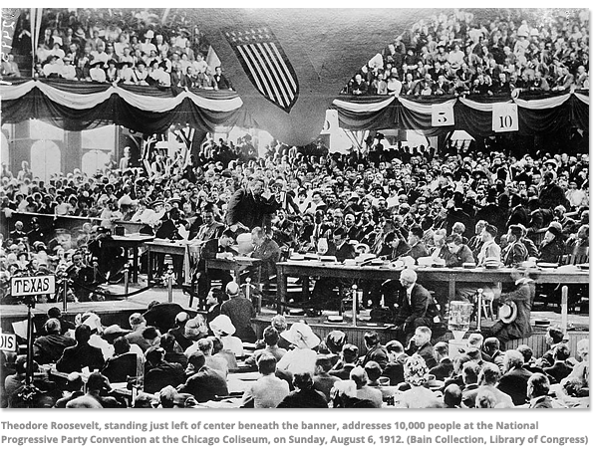
Notes:
In early decades of 20th cen
1st Gilded Age, Progressive mvmt. achieved sig reforms
( Prog Mvmt…not w/o it’s problems )
attacked: pol corruption, econ inequality,
public concern raised by muckraking journalism
reinforced by sympathetic business/pol elites
- direct election of Senators
- fed income tax (on highest earners
- women’s suffrage
- primary elections (reduce power of pol machines

Slide 49
The stakes are high
- Economic and educational systems under stress
- Infrastructure is decaying
- Planet is warming
- New global financial and military powers
Notes:
Our…
Our..
Our…
And we face…

Slide 50
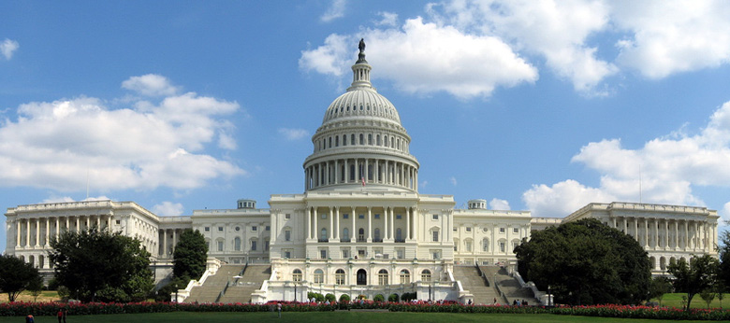
Notes:
How we respond to these challenges will depend on who government policymakers listen to
If enough people care enough, we can reform our political system
and break the vicious cycle in which political and economic power are increasingly concentrated
in the hands of fewer and fewer people
If not, we will have a gov’t that serves only the interests of the powerful few
and a democracy in name only [SOLD SLIDE]

Slide 51
SOLD

