Slide 1

BerryMe
Joonas Pussinen, Antti Neuvonen

Slide 2
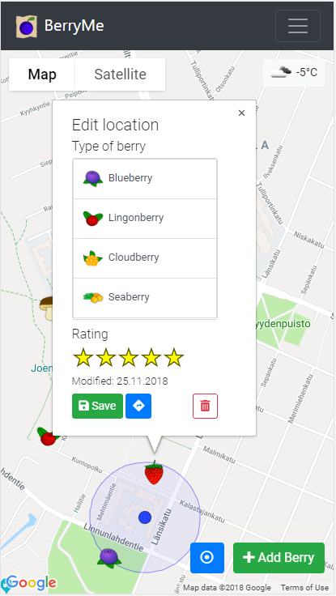
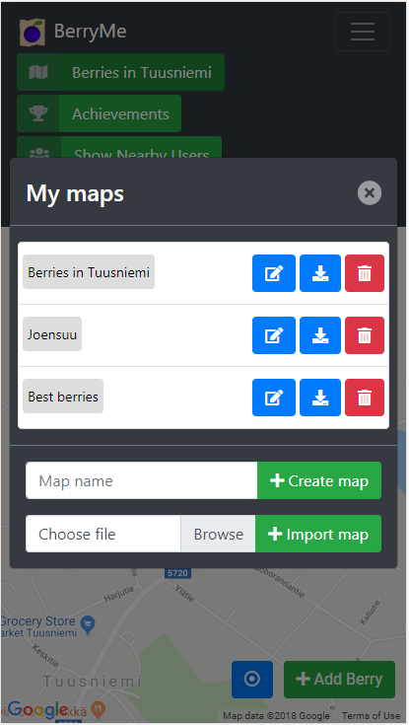
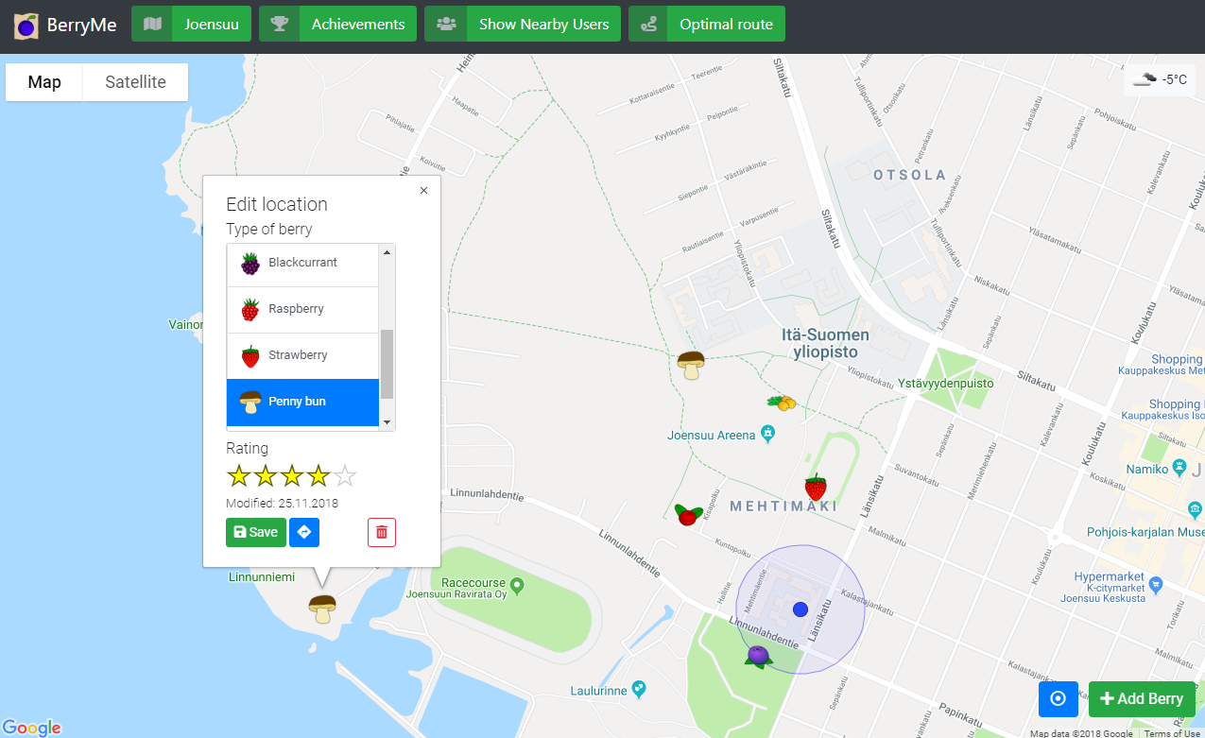
Keep track of your favorite berry places

Slide 3
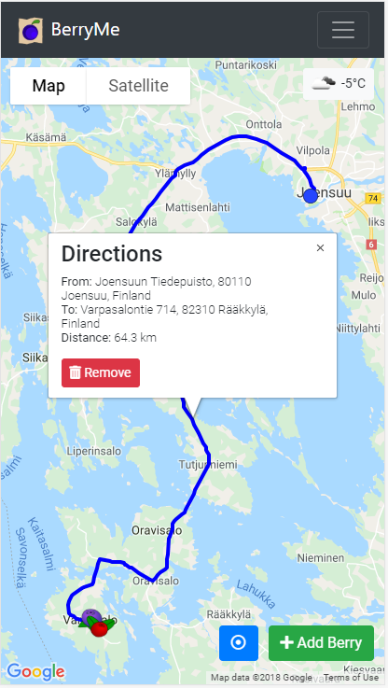
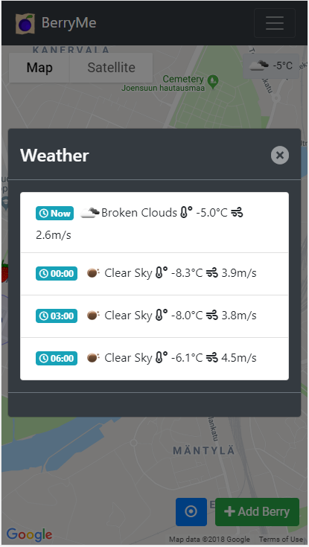
Features
Add and rate berry locations
Databases can be imported and exported
Show nearby users
Optimal route (TSP) and directions
Weather forecast
Achievements
Works on desktop and mobile

Slide 4
What we learned
(More) Web development
HTML5 features: localStorage, geolocation
User interface design
More Bootstrap
Mobile and desktop
Server-side APIs
Hosting on Heroku, OSRM, OpenWeatherMap, Mopsi

