Slide 1

Fake Instagram profile detection
Team Members
Reshma Shaik
Jeevan Kumar
Bindu Priya

Slide 2
Abstract
Launched in 2010, Instagram is a widely-used social media platform where users share photos, videos, and stories with their followers. With over a billion monthly users, it has become a key player in the social networking space.
Fake Profiles: Instagram is not immune to the proliferation of fake profiles. These are deceptive accounts created with various intentions, such as impersonation, spreading spam or scams, artificially boosting follower numbers, engaging in phishing, or promoting cyberbullying. The presence of fake profiles poses challenges to user trust, platform integrity, and online safety.
Addressing these challenges requires proactive measures, and leveraging artificial intelligence can play a pivotal role in detecting and mitigating fake profiles. In this project , with the use of AI various techniques and algorithms such as Artificial neural networks using MLP Classifiers ,Artificial Neural networks keras and Random Forest , we calculated the accuracy and error rate of classifiers by displaying the result of each in the form of Roc Curves and Confusion Matrix

Slide 3

Problem Statement & Business case
In the world of Instagram, many users struggle to organically gain followers due to the significant time investment it requires. This is particularly challenging for businesses and entrepreneurs with limited time resources. Fortunately, there is a solution: purchasing followers.
By purchasing Instagram followers, you can rapidly increase your follower count, which, in turn, enhances your brand's credibility and visibility. Moreover, the ripple effect of more followers attracting even more followers can be a significant advantage. Some businesses have successfully utilized this strategy to quickly boost their social media presence.

Slide 4
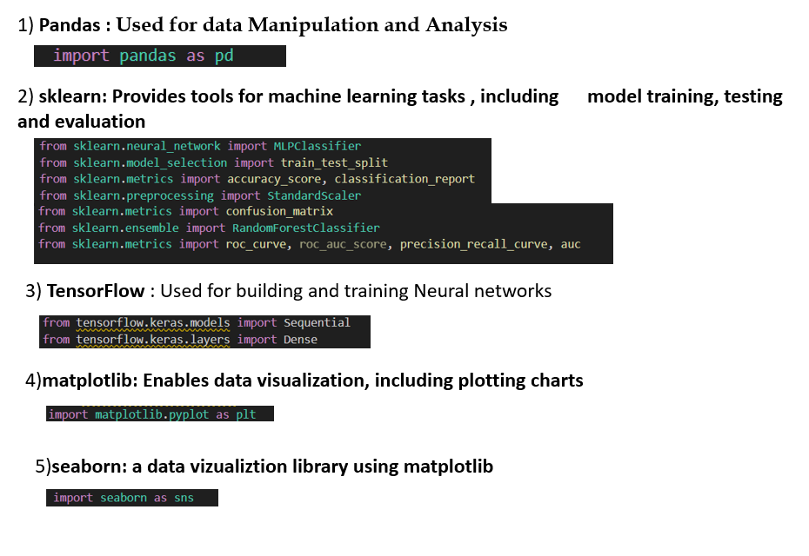
Pre-requisites

Slide 5

Technology & algorithms used
Artificial Neural Network MLP Classifier (scikit-learn) : Stands for Multi-Layer Perceptron, which is a type of artificial neural network. Used for classification tasks, where the goal is to predict the category or class of a given input. Trained using backpropagation and gradient descent. It learns to adjust the weights to minimize the error between predicted and actual outputs.
Artificial Neural Network in Keras (TensorFlow) : High-level neural networks API that runs on top of other frameworks like TensorFlow. Open-source machine learning framework developed by the Google Brain team. Keras provides a user-friendly interface for building and training neural networks, allowing users to define models layer by layer.
Random Forest Classifier (scikit-learn) : An ensemble learning method based on constructing a multitude of decision trees during training. Used for classification tasks. Combines predictions from multiple decision trees to improve overall performance and generalization. These are versatile and can be applied to various types of data, requiring less tuning compared to individual decision trees.

Slide 6
Basic Definitions
Keras Model: A deep learning framework for building neural networks commonly used in tasks like image and text classification.
MLP Classifier: A type of artificial neural network designed for classification tasks, featuring multiple layers of neurons.
Random Forest Classifier: An ensemble learning method using multiple decision trees for classification or regression tasks.
Confusion Matrix: A table showing the performance of a classification algorithm, detailing true positives, true negatives, false positives, and false negatives.
Classification Report: A summary report presenting key classification metrics such as precision, recall, and F1-score for a model's performance.
ROC Curve: A graphical representation of a model's ability to discriminate between classes, plotting the trade-off between true positive rate and false positive rate.
Precision Curve: A graphical representation of precision and recall trade-offs at various probability thresholds for binary classification models.

Slide 7
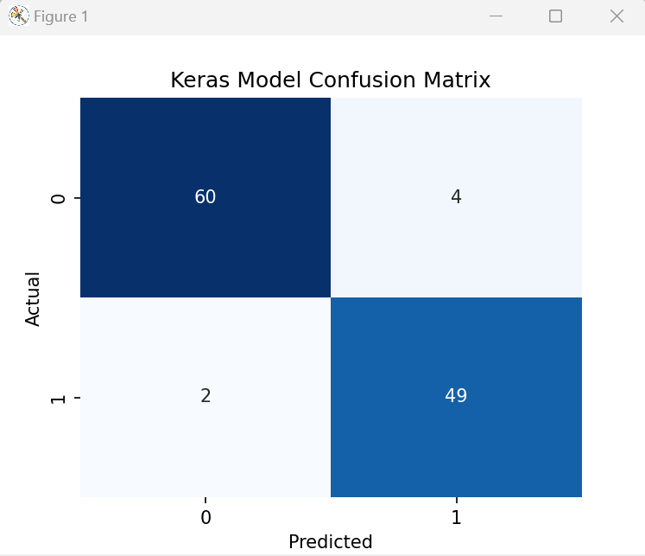
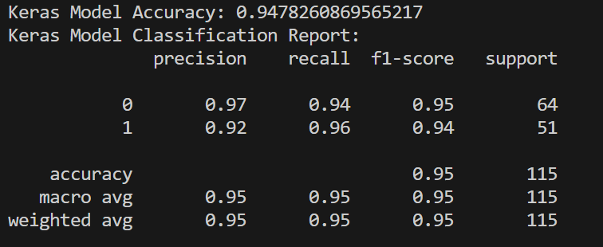
Keras Model Confusion matrix / Classification Report
Keras

Slide 8
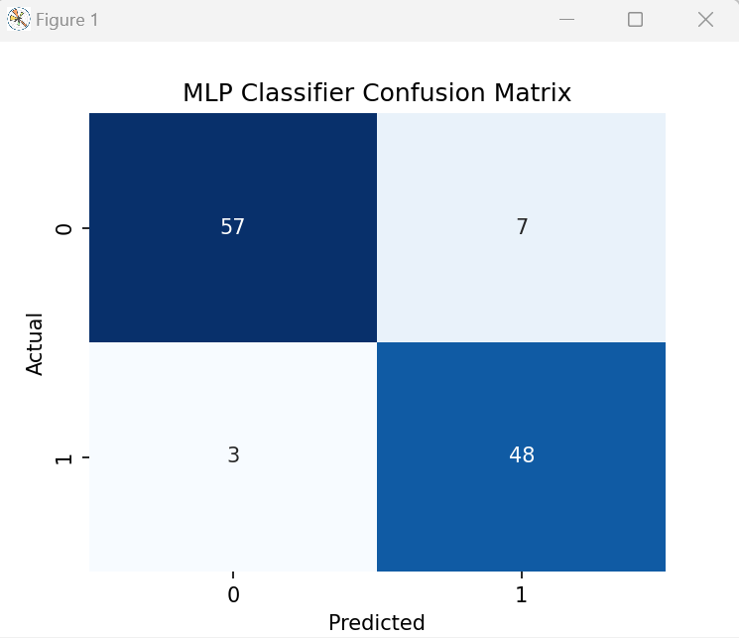
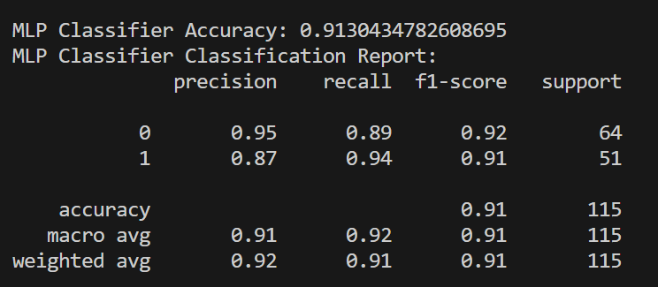
MLP classifier Confusion matrix / Classification Report
MLP

Slide 9
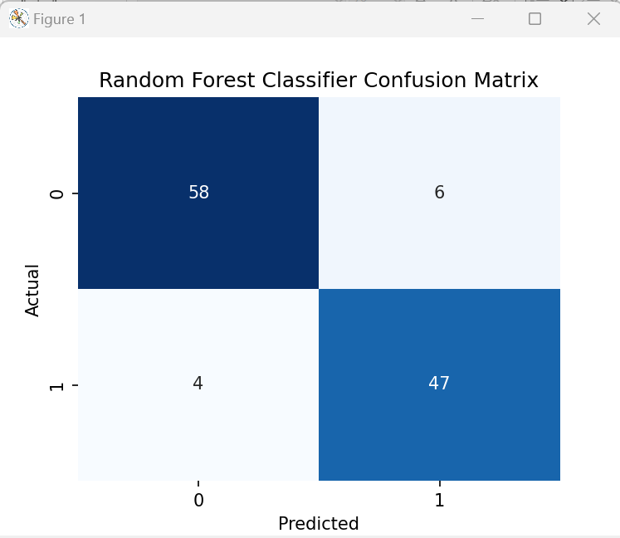
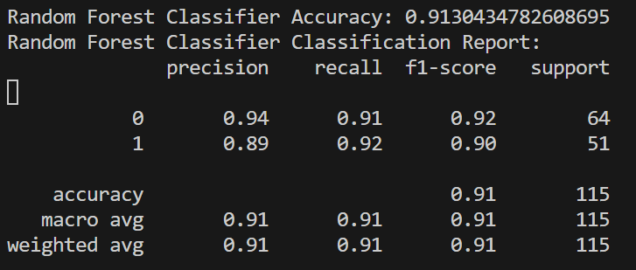
Random Forest classifier Confusion matrix / Classification Report
RF

Slide 10
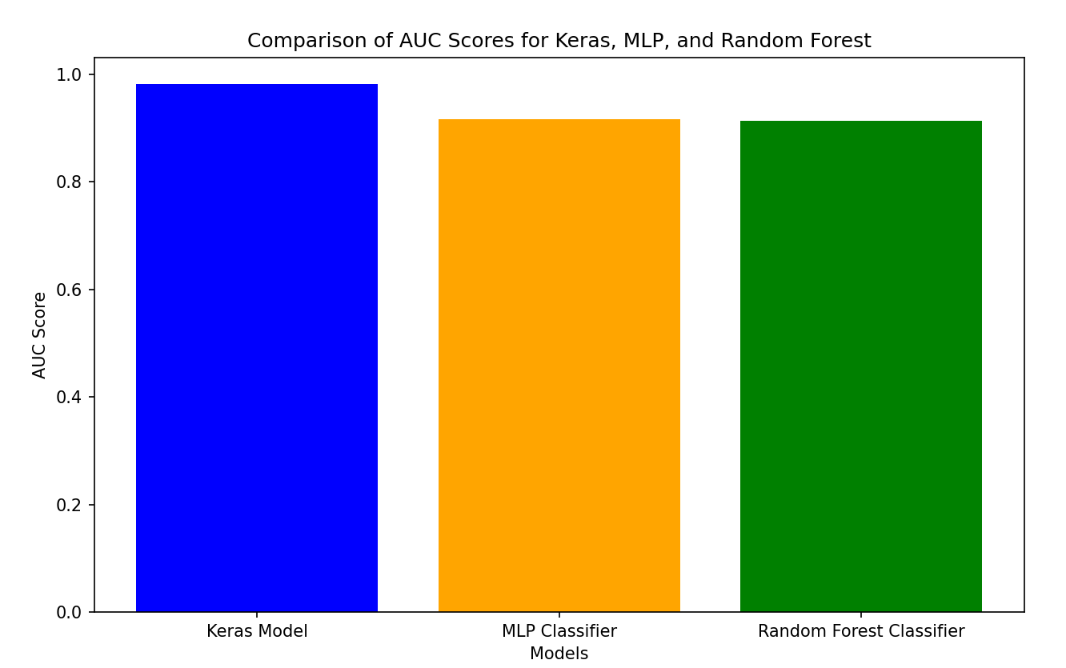
Comparison Graph

Slide 11
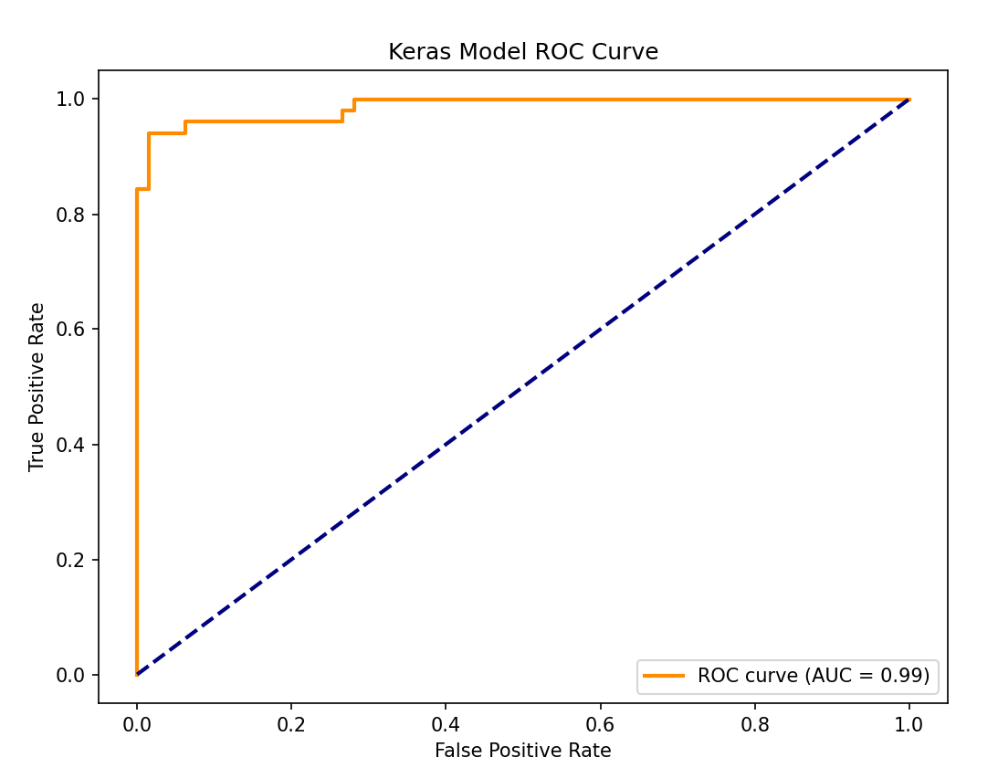
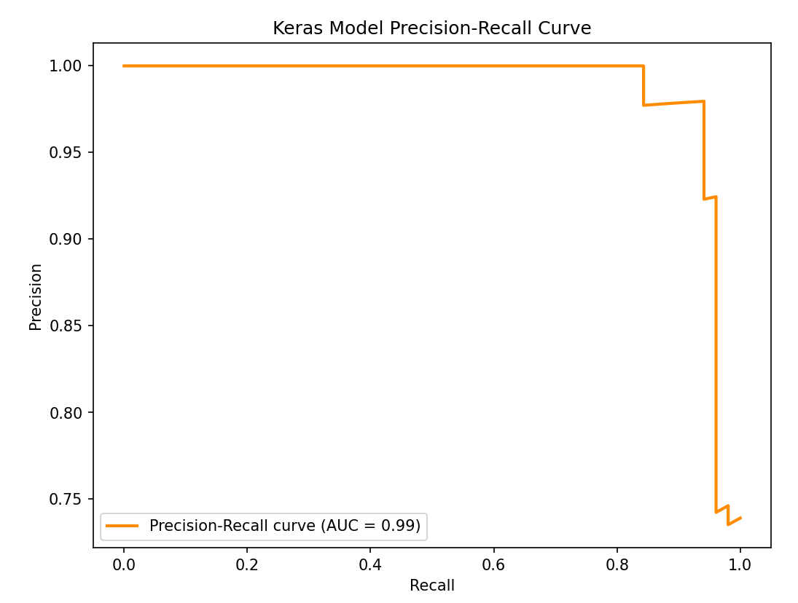
Keras Model ROC/Precision Curve

Slide 12
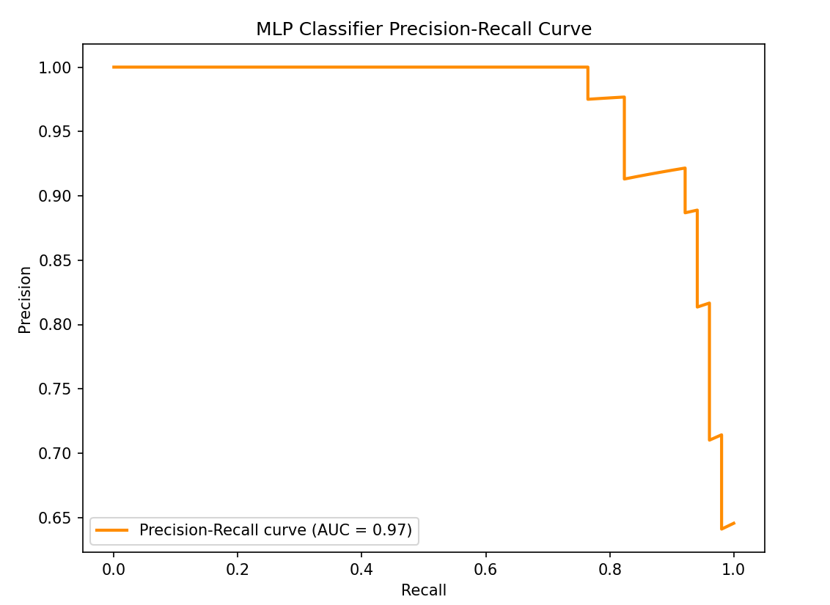
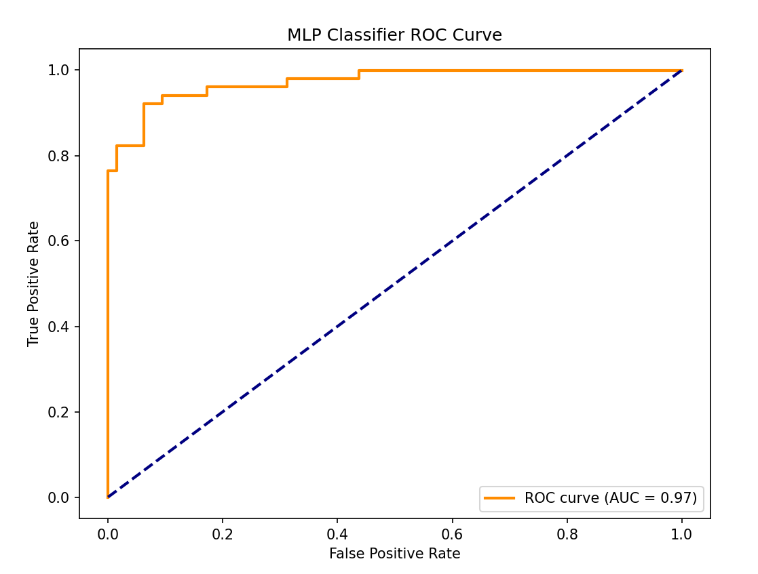
MLP Classifier ROC/Precision Curve

Slide 13
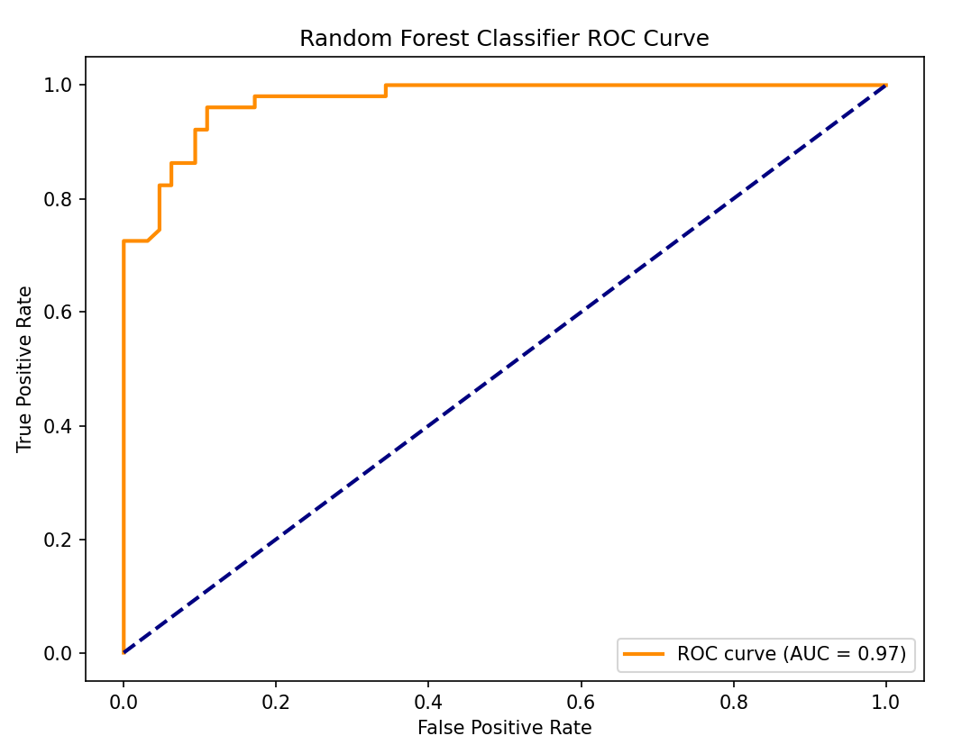
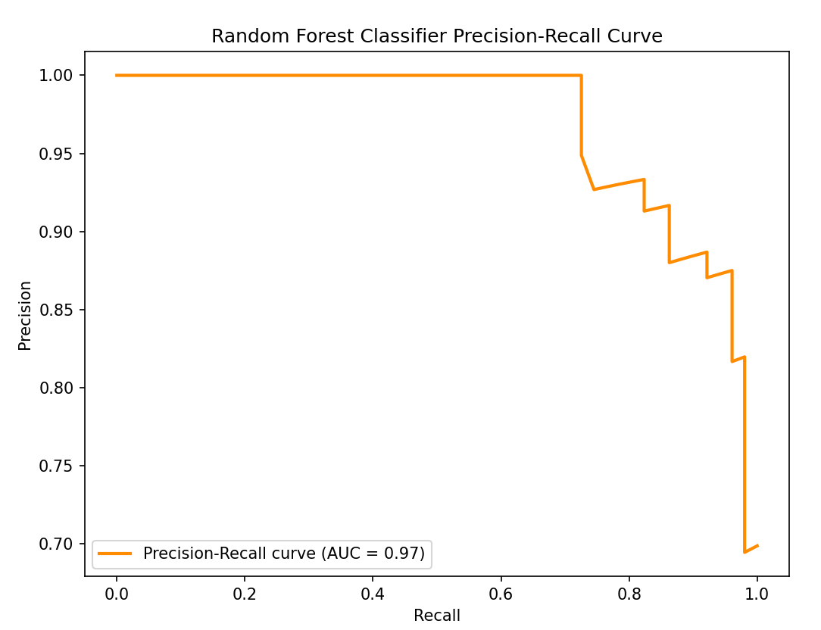
Random Forest Classifier ROC/Precision Curve

Slide 14
Implementation
Install python version 3 or above
Install Visual Studio Code
Install Libraries
Import the libraries
Fetch the Data to Train
Divide the data for Training and Testing(80% for Training ,20% for Testing)

Slide 15
Implementation
Preprocess the data(using Z-score Normalization)
Train the Artificial Neural Network Algorithm using keras library.
Train the MLPClassifier algorithm
Train Random Forest Tree algorithm
Display the Outputs of Algorithms
Plot ROC curve, Precision-Recall Curves
Validation: Predict for sample Input

Slide 16

Conclusion
All three models (Keras Neural Network, MLP Classifier, and Random Forest Classifier) demonstrate good performance in detecting fake Instagram accounts, with accuracy ranging from 91.30% to 93.91%.
The Keras Neural Network model appears to have a slightly better overall performance compared to the other models, as indicated by the higher accuracy and balanced precision-recall scores.
It's crucial to note that the performance of the models may vary based on the dataset and the specific features used for training.
Further analysis, such as examining misclassified instances, studying feature importance, and potentially tuning hyperparameters, could provide additional insights for model improvement.

