Slide 1
Tree (2)

Slide 2

목차
1
트리 순회
재귀
전위 순회
후위 순회

Slide 3
트리 순회
2
재귀(Recursion)
자신을 정의할 때 자기 자신을 재참조하는 방법
재귀 함수(Recursion Function)는 함수를 정의할 때 자기 자신이 포함됨
재귀 함수 설계 시, 무한 루프에 빠지지 않게 주의해야 한다.
main()
recursive(v);
return 0;
recursive(v)
print(v);
recursive(v);
return;
recursive(v)
print(v);
recursive(v);
return;
recursive(v)
forever…

Slide 4
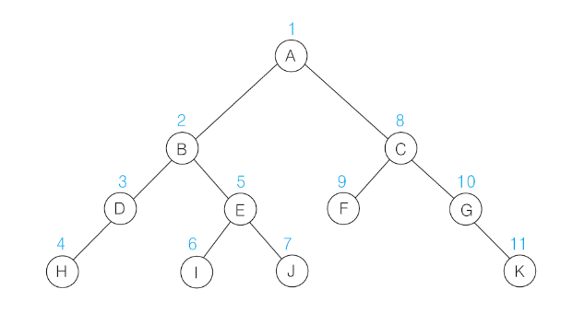
트리 순회
2
전위순회
자신을 방문한 후, 자식 노드를 순차적으로 방문
루트를 첫 번째로 방문 후, 자식 노드를 루트로 하는 서브 트리를 재귀적으로 순회
Algorithm preOrder(v)
visit(v)
for each child w of v:
preorder (w)
자손 탐색
노드 출력

Slide 5
트리 순회
출력
2
전위순회
Algorithm preOrder(a)
visit(a)
for each child of a:
preorder (child)
return;
a
b
c
d
e

Slide 6
트리 순회
출력
a
2
전위순회
Algorithm preOrder(a)
visit(a)
for each child of a:
preorder (child)
return;
a
b
c
d
e

Slide 7
트리 순회
출력
a
2
전위순회
Algorithm preOrder(a)
visit(a)
for each child of a:
preorder (child)
return;
a
Algorithm preOrder(b)
visit(b)
for each child of b:
preorder (child)
return;
b
c
d
e

Slide 8
트리 순회
출력
a b
2
전위순회
Algorithm preOrder(a)
visit(a)
for each child of a:
preorder (child)
return;
a
Algorithm preOrder(b)
visit(b)
for each child of b:
preorder (child)
return;
b
c
d
e

Slide 9
트리 순회
출력
a b
2
전위순회
Algorithm preOrder(a)
visit(a)
for each child of a:
preorder (child)
return;
a
Algorithm preOrder(b)
visit(b)
for each child of b:
preorder (child)
return;
b
c
d
e
Algorithm preOrder(e)
visit(e)
for each child of e:
preorder ()
return;

Slide 10
트리 순회
출력
a b e
2
전위순회
Algorithm preOrder(a)
visit(a)
for each child of a:
preorder (child)
return;
a
Algorithm preOrder(b)
visit(b)
for each child of b:
preorder (child)
return;
b
c
d
e
Algorithm preOrder(e)
visit(e)
for each child of e:
preorder ()
return;

Slide 11
트리 순회
출력
a b e
2
전위순회
Algorithm preOrder(a)
visit(a)
for each child of a:
preorder (child)
return;
a
Algorithm preOrder(b)
visit(b)
for each child of b:
preorder (child)
return;
b
c
d
e
Algorithm preOrder(e)
visit(e)
for each child of e:
preorder ()
return;

Slide 12
트리 순회
출력
a b e
2
전위순회
Algorithm preOrder(a)
visit(a)
for each child of a:
preorder (child)
return;
a
Algorithm preOrder(b)
visit(b)
for each child of b:
preorder (child)
return;
b
c
d
e
Algorithm preOrder(e)
visit(e)
for each child of e:
preorder ()
return;

Slide 13
트리 순회
출력
a b e
2
전위순회
Algorithm preOrder(a)
visit(a)
for each child of a:
preorder (child)
return;
a
Algorithm preOrder(b)
visit(b)
for each child of b:
preorder (child)
return;
Algorithm preOrder(c)
visit(c)
for each child of c:
preorder ()
return;
b
c
d
e
Algorithm preOrder(e)
visit(e)
for each child of e:
preorder ()
return;

Slide 14
트리 순회
출력
a b e c
2
전위순회
Algorithm preOrder(a)
visit(a)
for each child of a:
preorder (child)
return;
a
Algorithm preOrder(b)
visit(b)
for each child of b:
preorder (child)
return;
Algorithm preOrder(c)
visit(c)
for each child of c:
preorder ()
return;
b
c
d
e
Algorithm preOrder(e)
visit(e)
for each child of e:
preorder ()
return;

Slide 15
트리 순회
출력
a b e c
2
전위순회
Algorithm preOrder(a)
visit(a)
for each child of a:
preorder (child)
return;
a
Algorithm preOrder(b)
visit(b)
for each child of b:
preorder (child)
return;
Algorithm preOrder(c)
visit(c)
for each child of c:
preorder ()
return;
b
c
d
e
Algorithm preOrder(e)
visit(e)
for each child of e:
preorder ()
return;

Slide 16
트리 순회
출력
a b e c
2
전위순회
Algorithm preOrder(a)
visit(a)
for each child of a:
preorder (child)
return;
a
Algorithm preOrder(b)
visit(b)
for each child of b:
preorder (child)
return;
Algorithm preOrder(c)
visit(c)
for each child of c:
preorder ()
return;
Algorithm preOrder(d)
visit(d)
for each child of d:
preorder ()
return;
b
c
d
e
Algorithm preOrder(e)
visit(e)
for each child of e:
preorder ()
return;

Slide 17
트리 순회
출력
a b e c d
2
전위순회
Algorithm preOrder(a)
visit(a)
for each child of a:
preorder (child)
return;
a
Algorithm preOrder(b)
visit(b)
for each child of b:
preorder (child)
return;
Algorithm preOrder(c)
visit(c)
for each child of c:
preorder ()
return;
Algorithm preOrder(d)
visit(d)
for each child of d:
preorder ()
return;
b
c
d
e
Algorithm preOrder(e)
visit(e)
for each child of e:
preorder ()
return;

Slide 18
트리 순회
출력
a b e c d
2
전위순회
Algorithm preOrder(a)
visit(a)
for each child of a:
preorder (child)
return;
a
Algorithm preOrder(b)
visit(b)
for each child of b:
preorder (child)
return;
Algorithm preOrder(c)
visit(c)
for each child of c:
preorder ()
return;
Algorithm preOrder(d)
visit(d)
for each child of d:
preorder ()
return;
b
c
d
e
Algorithm preOrder(e)
visit(e)
for each child of e:
preorder ()
return;

Slide 19
트리 순회
출력
a b e c d
2
전위순회
Algorithm preOrder(a)
visit(a)
for each child of a:
preorder (child)
return;
a
Algorithm preOrder(b)
visit(b)
for each child of b:
preorder (child)
return;
Algorithm preOrder(c)
visit(c)
for each child of c:
preorder ()
return;
Algorithm preOrder(d)
visit(d)
for each child of d:
preorder ()
return;
b
c
d
e
Algorithm preOrder(e)
visit(e)
for each child of e:
preorder ()
return;

Slide 20
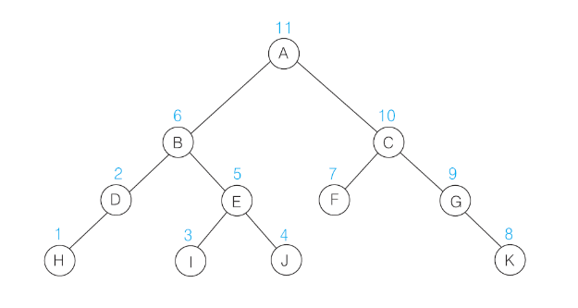
트리 순회
3
후위순회
자식 노드를 순차적으로 모두 방문한 후, 자신을 방문
루트의 자식 노드를 루트로 하는 서브 트리를 먼저 재귀적으로 순회한 후 루트를 방문
Algorithm postOrder(v)
for each child w of v:
postorder (w)
visit(v)
자손 탐색
노드 출력

Slide 21
트리 순회
출력
3
후위순회
Algorithm postOrder(a)
for each child of a:
postorder (child)
visit(a)
return;
a
b
c
d
e

Slide 22
트리 순회
출력
3
후위순회
Algorithm postOrder(a)
for each child of a:
postorder (child)
visit(a)
return;
a
Algorithm postOrder(b)
for each child of b:
postorder (child)
visit(b)
return;
b
c
d
e

Slide 23
트리 순회
출력
3
후위순회
Algorithm postOrder(a)
for each child of a:
postorder (child)
visit(a)
return;
a
Algorithm postOrder(b)
for each child of b:
postorder (child)
visit(b)
return;
b
c
d
e
Algorithm postOrder(e)
for each child of e:
postorder ()
visit(b)
return;

Slide 24
트리 순회
출력
e
3
후위순회
Algorithm postOrder(a)
for each child of a:
postorder (child)
visit(a)
return;
a
Algorithm postOrder(b)
for each child of b:
postorder (child)
visit(b)
return;
b
c
d
e
Algorithm postOrder(e)
for each child of e:
postorder ()
visit(e)
return;

Slide 25
트리 순회
출력
e
3
후위순회
Algorithm postOrder(a)
for each child of a:
postorder (child)
visit(a)
return;
a
Algorithm postOrder(b)
for each child of b:
postorder (child)
visit(b)
return;
b
c
d
e
Algorithm postOrder(e)
for each child of e:
postorder ()
visit(e)
return;

Slide 26
트리 순회
출력
e b
3
후위순회
Algorithm postOrder(a)
for each child of a:
postorder (child)
visit(a)
return;
a
Algorithm postOrder(b)
for each child of b:
postorder (child)
visit(b)
return;
b
c
d
e
Algorithm postOrder(e)
for each child of e:
postorder ()
visit(e)
return;

Slide 27
트리 순회
출력
e b
3
후위순회
Algorithm postOrder(a)
for each child of a:
postorder (child)
visit(a)
return;
a
Algorithm postOrder(b)
for each child of b:
postorder (child)
visit(b)
return;
b
c
d
e
Algorithm postOrder(e)
for each child of e:
postorder ()
visit(e)
return;

Slide 28
트리 순회
출력
e b
3
후위순회
Algorithm postOrder(a)
for each child of a:
postorder (child)
visit(a)
return;
a
Algorithm postOrder(b)
for each child of b:
postorder (child)
visit(b)
return;
Algorithm postOrder(c)
for each child of c:
postorder ()
visit(c)
return;
b
c
d
e
Algorithm postOrder(e)
for each child of e:
postorder ()
visit(e)
return;

Slide 29
트리 순회
출력
e b c
3
후위순회
Algorithm postOrder(a)
for each child of a:
postorder (child)
visit(a)
return;
a
Algorithm postOrder(b)
for each child of b:
postorder (child)
visit(b)
return;
Algorithm postOrder(c)
for each child of c:
postorder ()
visit(c)
return;
b
c
d
e
Algorithm postOrder(e)
for each child of e:
postorder ()
visit(e)
return;

Slide 30
트리 순회
출력
e b c
3
후위순회
Algorithm postOrder(a)
for each child of a:
postorder (child)
visit(a)
return;
a
Algorithm postOrder(b)
for each child of b:
postorder (child)
visit(b)
return;
Algorithm postOrder(c)
for each child of c:
postorder ()
visit(c)
return;
b
c
d
e
Algorithm postOrder(e)
for each child of e:
postorder ()
visit(e)
return;

Slide 31
트리 순회
출력
e b c
3
후위순회
Algorithm postOrder(a)
for each child of a:
postorder (child)
visit(a)
return;
a
Algorithm postOrder(b)
for each child of b:
postorder (child)
visit(b)
return;
Algorithm postOrder(c)
for each child of c:
postorder ()
visit(c)
return;
Algorithm postOrder(d)
for each child of d:
postorder ()
visit(d)
return;
b
c
d
e
Algorithm postOrder(e)
for each child of e:
postorder ()
visit(e)
return;

Slide 32
트리 순회
출력
e b c d
3
후위순회
Algorithm postOrder(a)
for each child of a:
postorder (child)
visit(a)
return;
a
Algorithm postOrder(b)
for each child of b:
postorder (child)
visit(b)
return;
Algorithm postOrder(c)
for each child of c:
postorder ()
visit(c)
return;
Algorithm postOrder(d)
for each child of d:
postorder ()
visit(d)
return;
b
c
d
e
Algorithm postOrder(e)
for each child of e:
postorder ()
visit(e)
return;

Slide 33
트리 순회
출력
e b c d
3
후위순회
Algorithm postOrder(a)
for each child of a:
postorder (child)
visit(a)
return;
a
Algorithm postOrder(b)
for each child of b:
postorder (child)
visit(b)
return;
Algorithm postOrder(c)
for each child of c:
postorder ()
visit(c)
return;
Algorithm postOrder(d)
for each child of d:
postorder ()
visit(d)
return;
b
c
d
e
Algorithm postOrder(e)
for each child of e:
postorder ()
visit(e)
return;

Slide 34
트리 순회
출력
e b c d a
3
후위순회
Algorithm postOrder(a)
for each child of a:
postorder (child)
visit(a)
return;
a
Algorithm postOrder(b)
for each child of b:
postorder (child)
visit(b)
return;
Algorithm postOrder(c)
for each child of c:
postorder ()
visit(c)
return;
Algorithm postOrder(d)
for each child of d:
postorder ()
visit(d)
return;
b
c
d
e
Algorithm postOrder(e)
for each child of e:
postorder ()
visit(e)
return;

Slide 35
트리 순회
출력
e b c d a
3
후위순회
Algorithm postOrder(a)
for each child of a:
postorder (child)
visit(a)
return;
a
Algorithm postOrder(b)
for each child of b:
postorder (child)
visit(b)
return;
Algorithm postOrder(c)
for each child of c:
postorder ()
visit(c)
return;
Algorithm postOrder(d)
for each child of d:
postorder ()
visit(d)
return;
b
c
d
e
Algorithm postOrder(e)
for each child of e:
postorder ()
visit(e)
return;

Slide 36
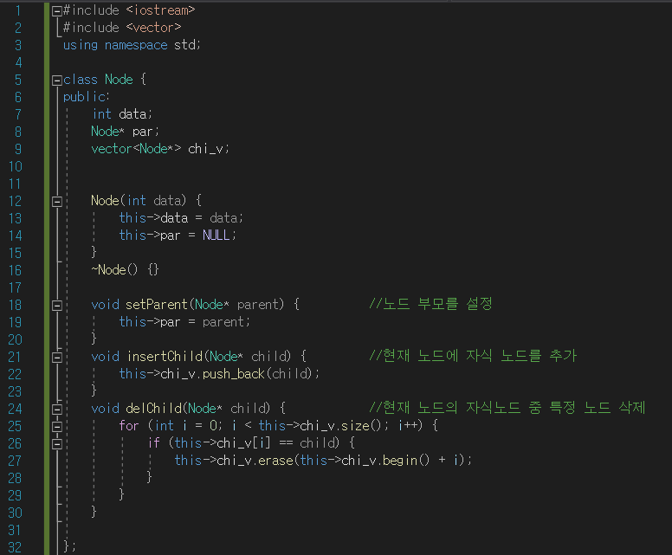
트리 순회

Slide 37
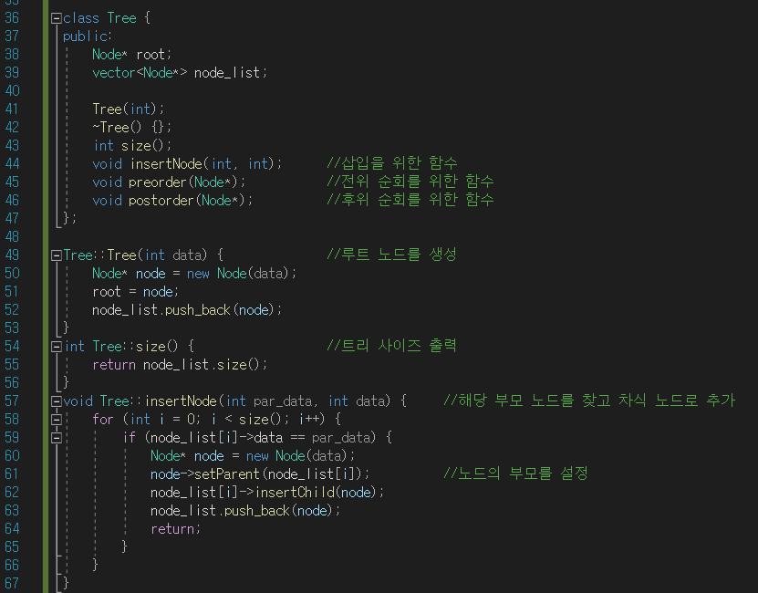
트리 순회

Slide 38
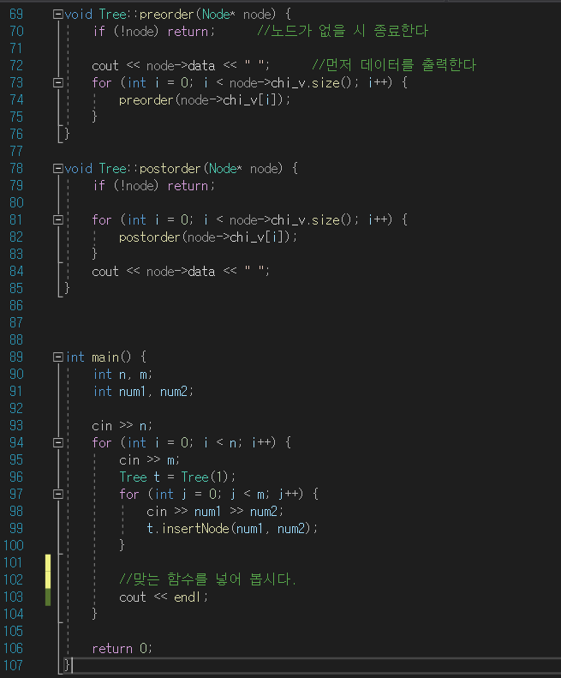
트리 순회

Slide 39
Thank you

