Slide 1
Bit-Flipping Attack Exploration and
Countermeasure in 5G Network
Joon Kim Chengwei Duan Sandip Ray
UC Berkeley
EECS
University of Florida
ECE
University of Florida
ECE

Slide 2
Main Contributions
Identified a Man-in-the-Middle bit-flipping attack on 5G network without integrity protection enabled
Proposed an alternative keystream-based shuffling protection against the bit-flipping attack
Proved that both the bit-flipping attack and the shuffling algorithm works with real datasets
Offense!
Defense!
Experiments!
Notes:
“Not understanding some of this is fine, we will cover it later”

Slide 3




Background: Why 5G Security?
5G is widely used for its low latency and high data rate
5G enables many layers of security measures, but time-sensitive applications have to consider the cost of employing them
ex) Cooperative Adaptive Cruise Control (CACC)
0101010101...
0101000101...
Compute Next Acc
Compute Next Acc…?
Preceding P
prec_acc
prec_vel
prec_pos
Following F
prec_acc
prec_vel
prec_pos
5G Network

Slide 4
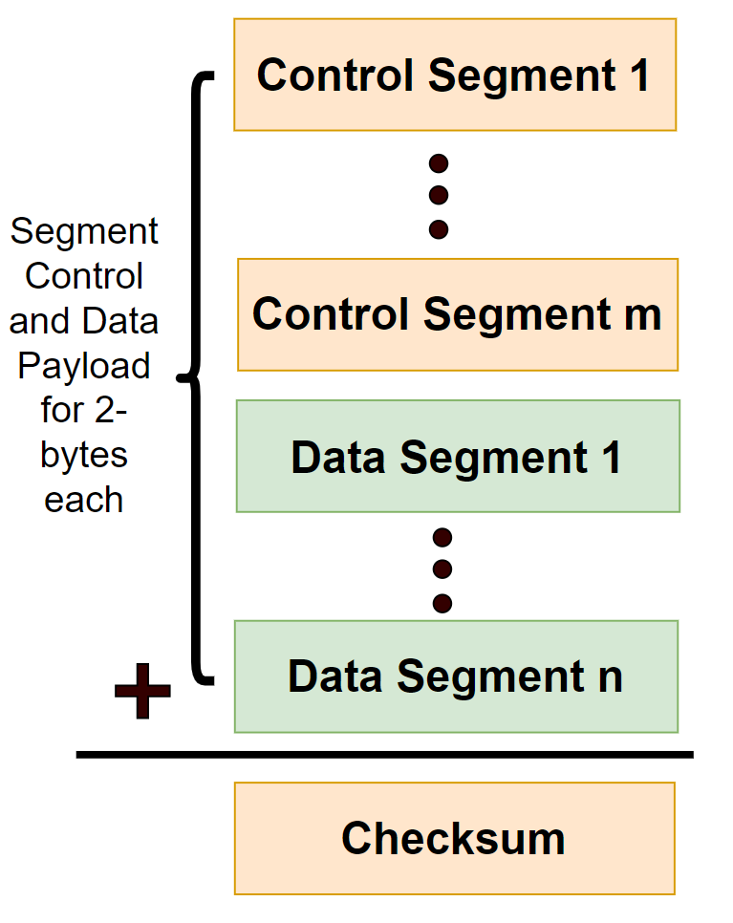
Background: Encryption and Integrity in 5G
Checksum: Bitwise addition of 2-byte words appended to the payload
For detecting corruption in network channels, not equipped to detect adversaries
NEA (Encryption): XORs the entire transmission with bit strings generated from a private seeded pseudorandom generating function
Requires consensus of choice of PRG function and initial seed
NIA (Integrity): Appends a 32-bit message generated by a cryptographic hash function with payload and a secret key as inputs
The overhead of appending 32 bits (4 bytes) can be performance critical to some time-sensitive real-time systems (we assume it is turned off)
Notes:
Only high level descriptions while explaining verbally

Slide 5
Main Contributions
Identified a Man-in-the-Middle bit-flipping attack on 5G network without integrity protection enabled
Proposed an alternative keystream-based shuffling protection against the bit-flipping attack
Proved that both the bit-flipping attack and the shuffling algorithm works with real datasets
Notes:
“Not understanding some of this is fine, we will cover it later”

Slide 6
Threat Model
0101000101...
Compute Next Acc
Compute Next Acc…?
Preceding P
prec_acc
prec_vel
prec_pos
Following F
prec_acc
prec_vel
prec_pos
5G Network
An adversary, A, acts as a Man-in-the-Middle (MITM) attacker between a sender (S) and a receiver (R).
A can:
Intercept the physical layer signal.
Reconstruct the encrypted PDCP-layer bitstream.
Flip any bits in the checksum and data payload fields.
Re-encode and forward the modified message to R.
A cannot:
Decrypt the NEA-encrypted ciphertext or know the secret key.

Slide 7
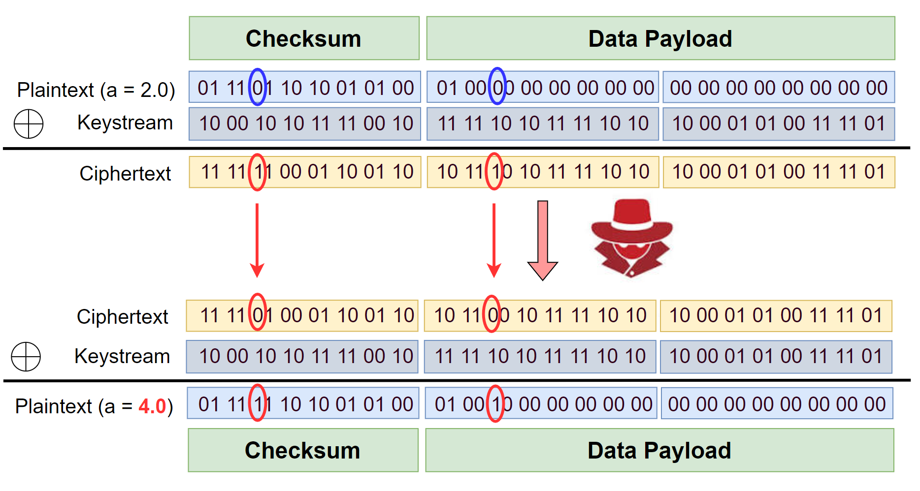
Bit-Flipping Attack
Bypasses Checksum+NEA protection without knowledge of the keystream!

Slide 8
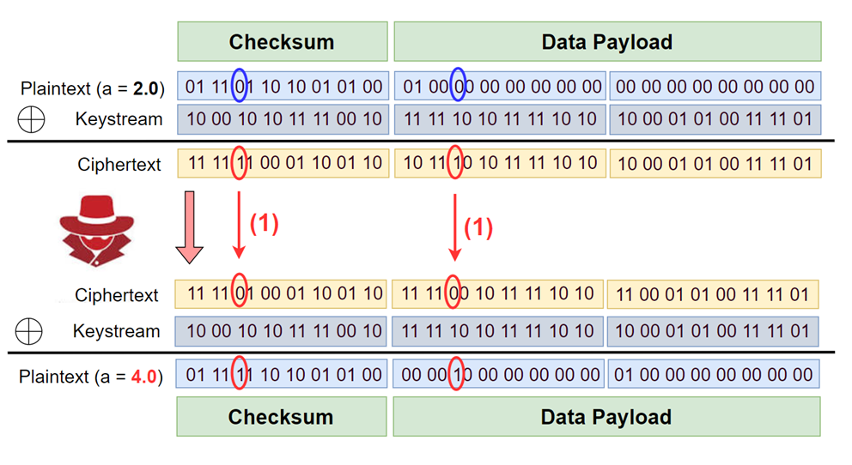
Checksum Bit-Flipping
The attacker flips two bits:
One bit in the data payload.
One bit in the checksum field at an aligned position. (i.e., in the same column when divided into 2-byte words for the checksum calculation).
When does it succeed?
The attack bypasses the checksum if the two flipped bits in the original plaintext have even parity (i.e., they are the same: 0 and 0, or 1 and 1).
Since the checksum is nearly independent of any single payload bit, this attack has a success rate of approximately 50%.
Notes:
FIt image into the slide

Slide 9
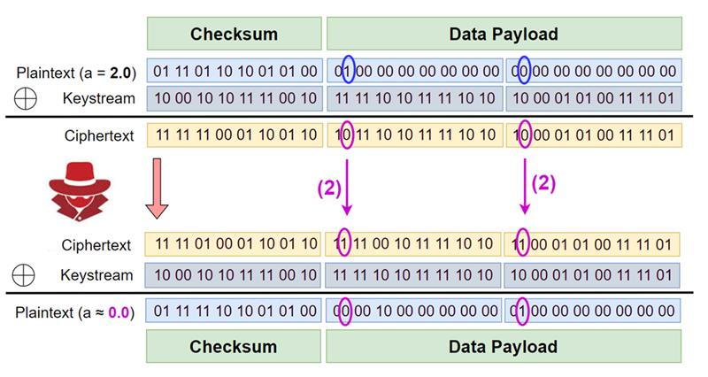
Payload Bit-Flipping
Motivation: checksum bit-flipping
can only affect one bit.
The attacker flips two aligned bits, both within the data payload.
When does it succeed?
The attack succeeds if the two flipped bits in the original plaintext have odd parity (i.e., they are different: 0 and 1, or 1 and 0).
The success of this attack is highly dependent on the specific data being transmitted, unlike the checksum attack.
Notes:
Fit image into the slide

Slide 10
Main Contributions
Identified a Man-in-the-Middle bit-flipping attack on 5G network without integrity protection enabled
Proposed an alternative keystream-based shuffling protection against the bit-flipping attack
Proved that both the bit-flipping attack and the shuffling algorithm works with real datasets
Notes:
“Not understanding some of this is fine, we will cover it later”

Slide 11
Playing Defense
The Problem: The attack works because the attacker knows the position of the bits they want to change (e.g., "the 5th bit of the acceleration value").
The Idea: What if we could shuffle the bits of the ciphertext unpredictably before sending it?
If the attacker tries to flip the 5th bit, they are no longer hitting a specific, targeted bit in the plaintext, but a random one.
We expect that multiple bit-flipping attacks in in differing positions will have an exponential decay in success rate. → Not too many flips!
abcdefg → dgfcabe → dgfcabe → abcdefg
“I’ll flip the fifth bit!”
Notes:
Add a toy example diagram to show the idea

Slide 12
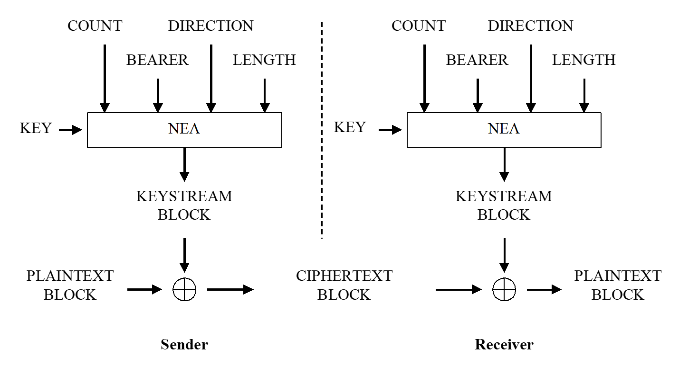
Playing Defense
The Challenge: How can the receiver deterministically unshuffle the bits?
(Or, how do we coordinate the randomness between sender & receiver?)
The Solution: Use the private keystream already implemented in NEA!
→ Use the keystream as seed for pseudorandom permutation (Fisher-Yates)

Slide 13
Keystream-Based Shuffling
Sender Side:
Generate the keystream K.
Encrypt the plaintext: C=P⊕K.
Use the keystream K as a seed to generate a permutation table T.
Shuffle the ciphertext C according to T to get C’​ and transmit it.
Receiver Side:
Generate the exact same keystream K and permutation table T.
Unshuffle the received ciphertext C’ using the inverse of T to recover C.
Decrypt: P=C⊕K.
Notes:
Potentially drop this slide b/c it can be repetitive

Slide 14
NIA vs Shuffling
 | NIA | Shuffling
Protection | Deterministic | Probabilistic (fail w.p. <4%)
Overhead | 32-bit MAC | Zero overhead
Coverage | General corruptions | Prevents targeted bit flips
Use NIA when the system cannot afford any integrity attacks and 32-bit overhead is not significant to the system performance
Use Shuffling when sporadic, rare attacks are acceptable but the 32-bit overhead from appending MAC is non-negligible. (CACC!)

Slide 15
Main Contributions
Identified a Man-in-the-Middle bit-flipping attack on 5G network without integrity protection enabled
Proposed an alternative keystream-based shuffling protection against the bit-flipping attack
Proved that both the bit-flipping attack and the shuffling algorithm works with real datasets
Notes:
“Not understanding some of this is fine, we will cover it later”

Slide 16
Setup
Platform: OpenAirInterface (OAI), a full-software 5G network simulation.
Attacks and defenses were implemented by modifying the PDCP layer source code.
Scenario: Simulated vehicular communication (V2X).
Transmitted Message: A vehicle's X-coordinate, velocity, and acceleration.
Data Source: Real-world vehicle trajectories from the NGSIM dataset.

Slide 17
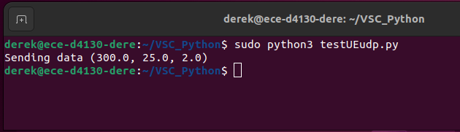
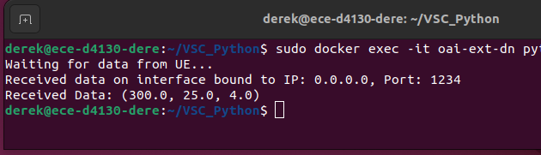
Result 1: Attack Feasibility
Flipping works as intended!
Notes:
Include a small statement that summarizes the experiment

Slide 18
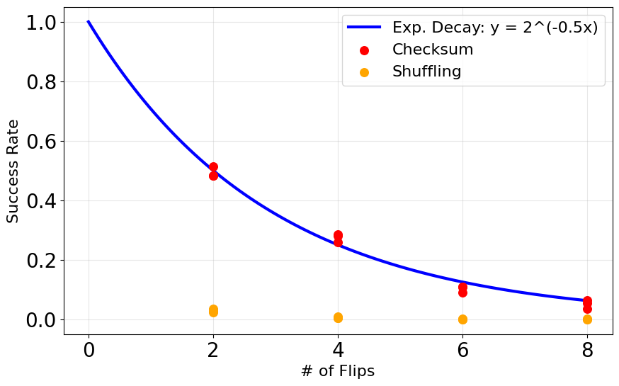
Result 2: Shuffling
“nearly” independent
~50%
~0%
~3%
Shuffling works as intended!
Notes:
Include a small statement that summarizes the experiment

Slide 19
Conclusion
We demonstrated that MITM bit-flipping attacks are a practical threat in 5G, even when the attacker does not know the plaintext.
Simple checksum-based attacks can achieve a ~50% success rate in mutating data while remaining valid.
We proposed a keystream-based shuffling defense that:
Requires no communication overhead, unlike NIA.
Effectively mitigates attacks by reducing the success rate to ~3%.
Prevents targeted manipulation by obfuscating bit positions.

