Slide 1
Mastering the game of Go
with deep neural networks and tree search
Lee Hojoon

Slide 2
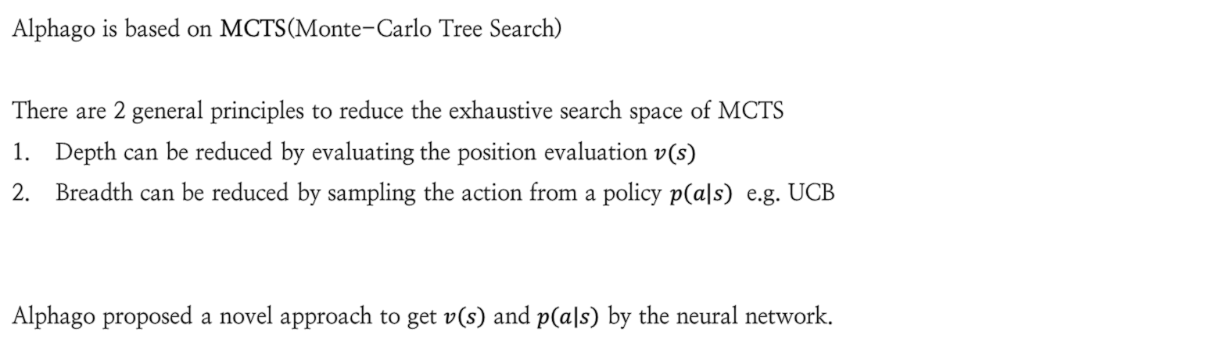
Introduction
1
Alphago is based on MCTS(Monte-Carlo Tree Search)
There are 2 general principles to reduce the exhaustive search space of MCTS
Depth can be reduced by evaluating the position evaluation $v(s)$
Breadth can be reduced by sampling the action from a policy $p\left(a | s\right)$ e.g. UCB
Alphago proposed a novel approach to get $v\left(s\right)$ and $p\left(a | s\right)$ by the neural network.

Slide 3
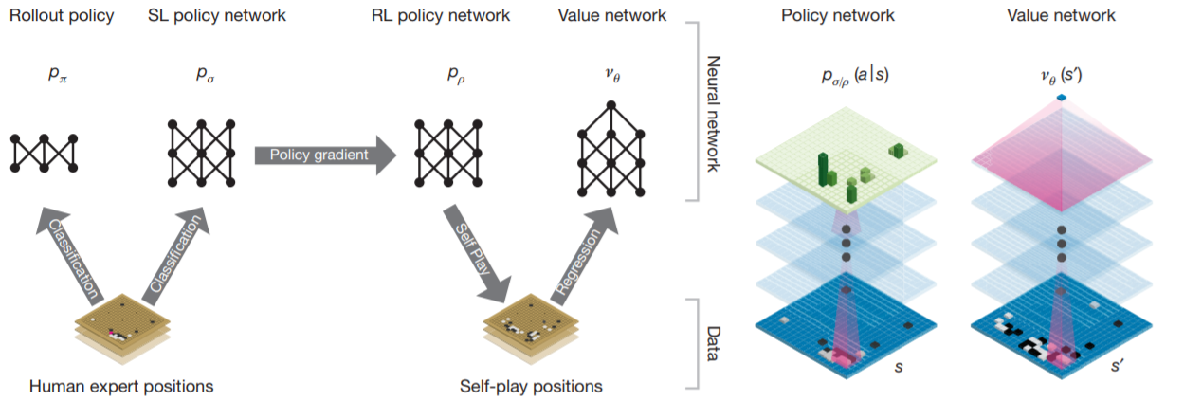
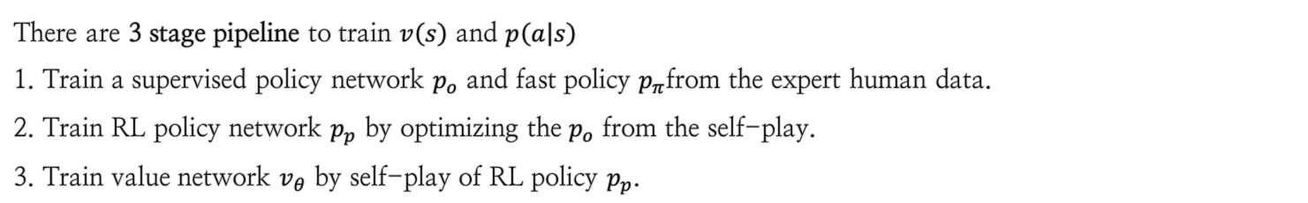
Training Pipelines
2
There are 3 stage pipeline to train $v\left(s\right)$ and $p\left(a | s\right)$
1. Train a supervised policy network $p_{o}$ and fast policy $p_{π}$from the expert human data.
2. Train RL policy network $p_{p}$ by optimizing the $p_{o}$ from the self-play.
3. Train value network $v_{θ}$ by self-play of RL policy $p_{p}$.

Slide 4

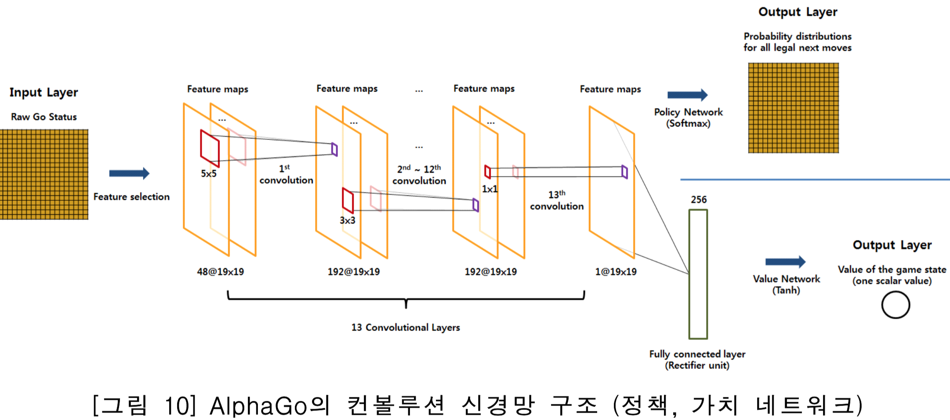

Supervised Learning of policy networks
2.1
Training
Policy network $p_{o}$ is trained to match the board status to the action of the expert player.
Network is 13-layer convolutional neural network with ReLU activations.
Network parameter $o$ is trained with back-propagation to maximize the likelihood.

Slide 5
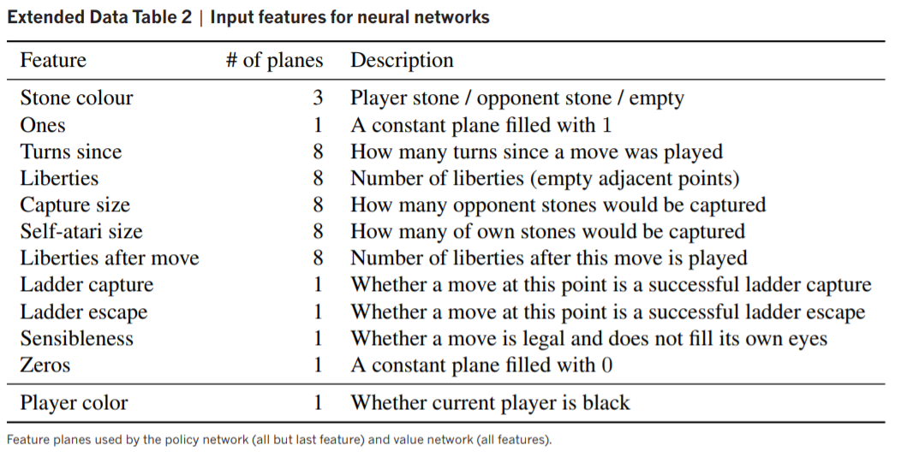
Supervised Learning of policy networks
2.1
Input
Input of the network is 19× 19 × 48 feature to represent the board.
Features are pretty simple without handcrafted features

Slide 6
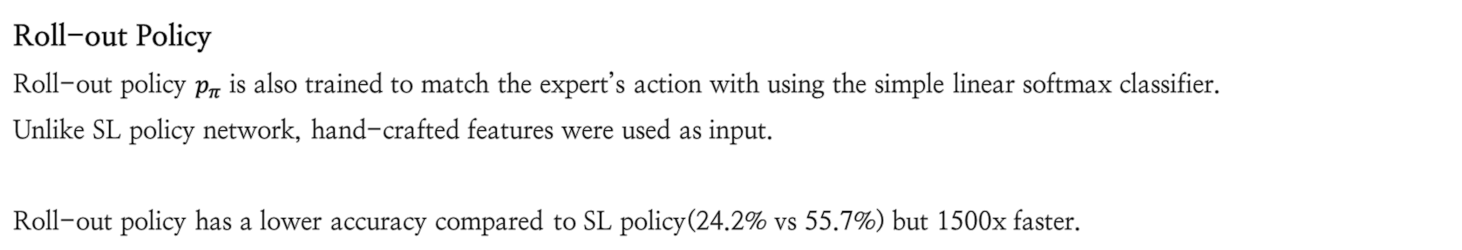
Supervised Learning of policy networks
2.1
Roll-out Policy
Roll-out policy $p_{π}$ is also trained to match the expert’s action with using the simple linear softmax classifier.
Unlike SL policy network, hand-crafted features were used as input.
Roll-out policy has a lower accuracy compared to SL policy(24.2% vs 55.7%) but 1500x faster.

Slide 7

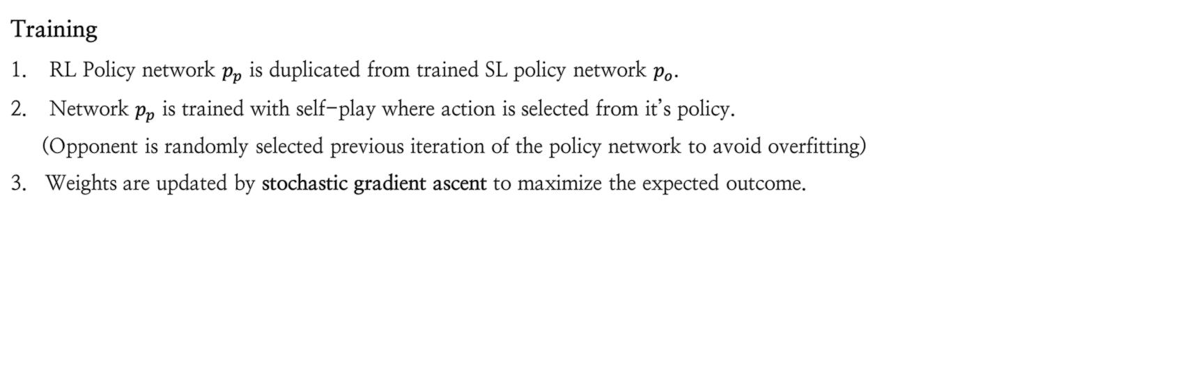
Reinforcement Learning of policy networks
2.2
Training
RL Policy network $p_{p}$ is duplicated from trained SL policy network $p_{o}$.
Network $p_{p}$ is trained with self-play where action is selected from it’s policy.
(Opponent is randomly selected previous iteration of the policy network to avoid overfitting)
3. Weights are updated by stochastic gradient ascent to maximize the expected outcome.
Advantageous reward (win: +1, lose: -1)
Log probability of the sampled action

Slide 8

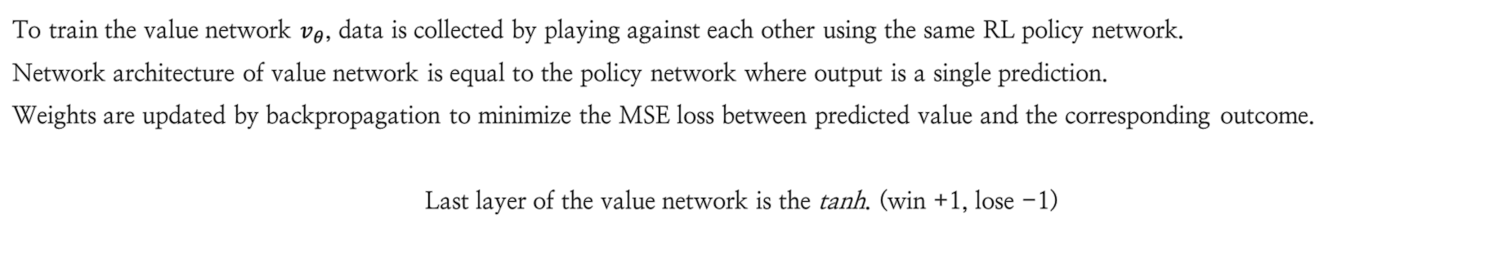
Reinforcement Learning of value networks
2.3
To train the value network $v_{θ}$, data is collected by playing against each other using the same RL policy network.
Network architecture of value network is equal to the policy network where output is a single prediction.
Weights are updated by backpropagation to minimize the MSE loss between predicted value and the corresponding outcome.
Last layer of the value network is the tanh. (win +1, lose -1)

Slide 9
In summary
2.4
Alphago is based on MCTS(Monte-Carlo Tree Search)
Policy network tells us which moves are promising, reducing the breadth of the search.
Value network tells us how good a board state is, reducing the depth of the search.

Slide 10
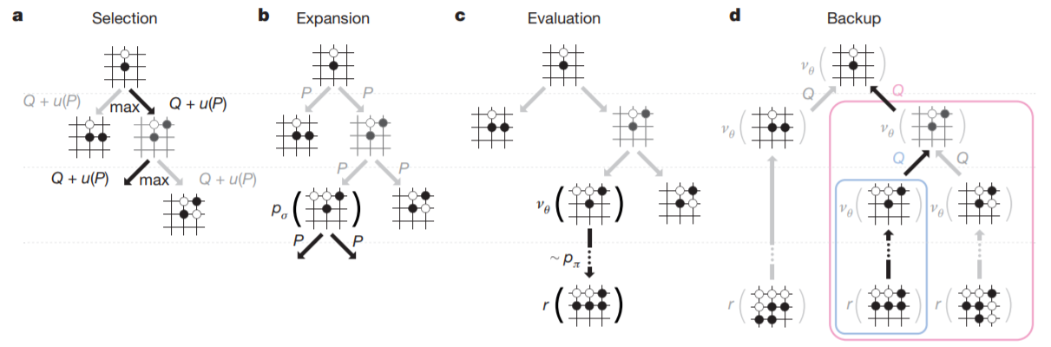
Monte Carlo Tree Search (MCTS)
3
While playing the game, action is chosen based on the results of the simulation.
MCTS is composed of 4 steps.

Slide 11
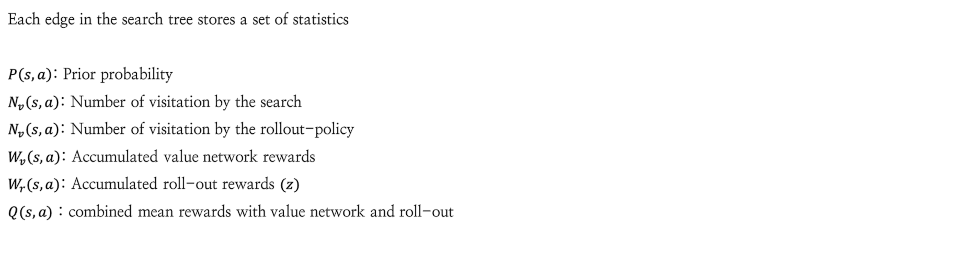
Monte Carlo Tree Search (MCTS)
3
Each edge in the search tree stores a set of statistics
$P\left(s,a\right)$: Prior probability
$N_{v}\left(s,a\right)$: Number of visitation by the search
$N_{v}\left(s,a\right)$: Number of visitation by the rollout-policy
$W_{v}\left(s,a\right)$: Accumulated value network rewards
$W_{r}(s,a)$: Accumulated roll-out rewards $(z)$
$Q(s,a)$ : combined mean rewards with value network and roll-out

Slide 12


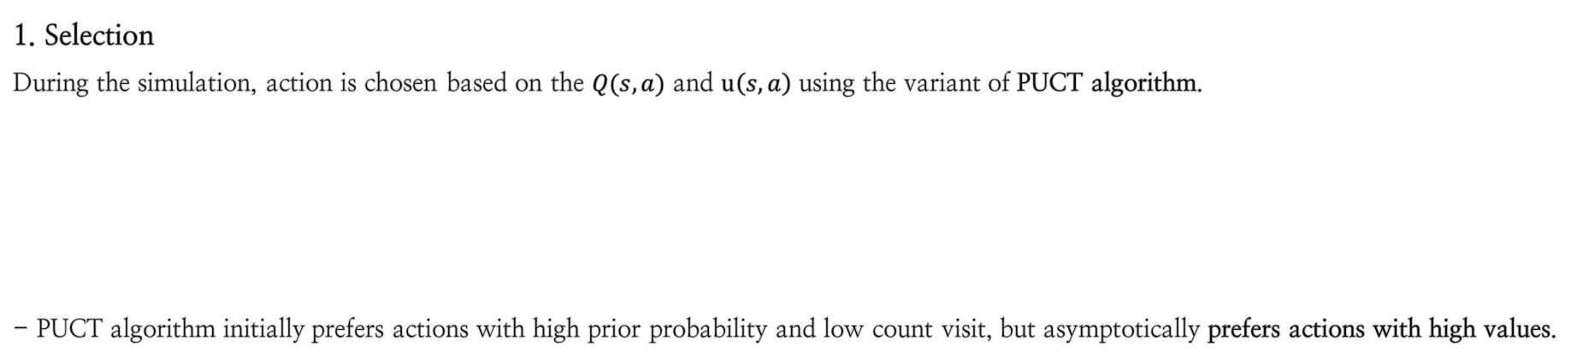
Monte Carlo Tree Search (MCTS)
3.1
1. Selection
During the simulation, action is chosen based on the $Q(s,a)$ and $u\left(s,a\right)$ using the variant of PUCT algorithm.
- PUCT algorithm initially prefers actions with high prior probability and low count visit, but asymptotically prefers actions with high values.

Slide 13
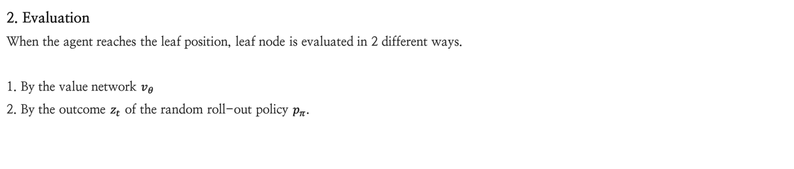
Monte Carlo Tree Search (MCTS)
3.2
2. Evaluation
When the agent reaches the leaf position, leaf node is evaluated in 2 different ways.
1. By the value network $v_{θ}$
2. By the outcome $z_{t}$ of the random roll-out policy $p_{π}$.

Slide 14

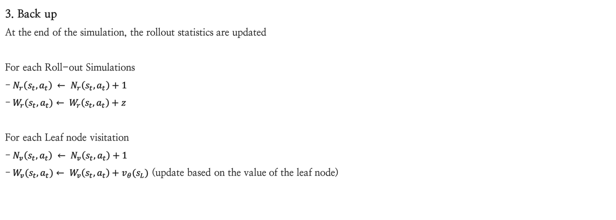
Monte Carlo Tree Search (MCTS)
3.3
3. Back up
At the end of the simulation, the rollout statistics are updated
For each Roll-out Simulations
- $N_{r}\left(s_{t},a_{t}\right) ← N_{r}\left(s_{t},a_{t}\right)+1$
- $W_{r}(s_{t},a_{t})$ $← W_{r}\left(s_{t},a_{t}\right)+z$
For each Leaf node visitation
- $N_{v}\left(s_{t},a_{t}\right) ← N_{v}\left(s_{t},a_{t}\right)+1$
- $W_{v}(s_{t},a_{t})$ $← W_{v}\left(s_{t},a_{t}\right)+v_{θ}(s_{L})$ (update based on the value of the leaf node)

Slide 15
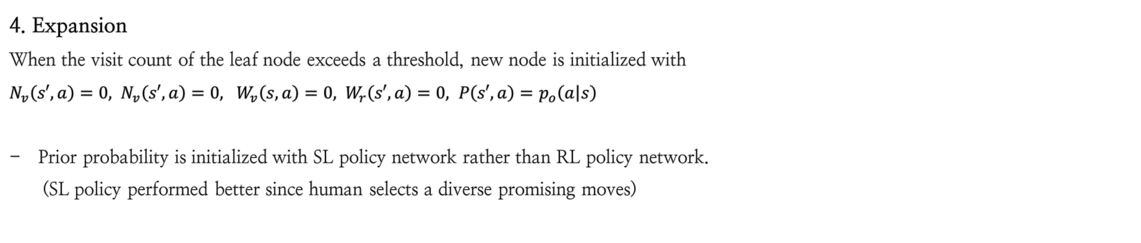
Monte Carlo Tree Search (MCTS)
3.4
4. Expansion
When the visit count of the leaf node exceeds a threshold, new node is initialized with
$N_{v}\left(s′,a\right)=0, N_{v}\left(s′,a\right)=0, W_{v}\left(s,a\right)=0, W_{r}\left(s′,a\right)=0, P\left(s′,a\right)=$ $p_{o}\left(a | s\right)$
Prior probability is initialized with SL policy network rather than RL policy network.
(SL policy performed better since human selects a diverse promising moves)

Slide 16
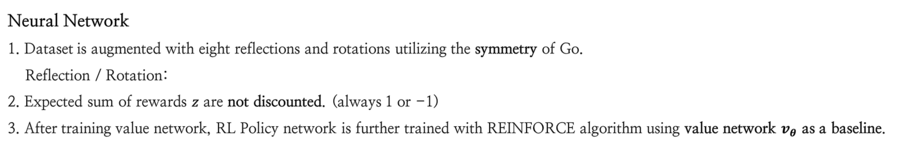
Implementation Detail
4
Neural Network
1. Dataset is augmented with eight reflections and rotations utilizing the symmetry of Go.
Reflection / Rotation:
2. Expected sum of rewards $z$ are not discounted. (always 1 or -1)
3. After training value network, RL Policy network is further trained with REINFORCE algorithm using value network $v_{θ}$ as a baseline.

Slide 17

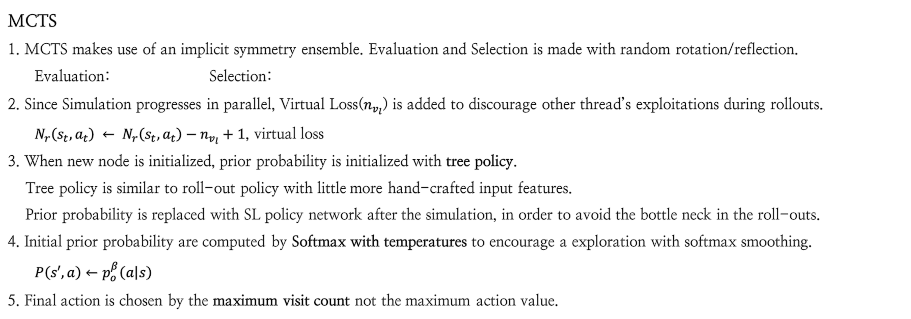
Implementation Detail
4
MCTS
1. MCTS makes use of an implicit symmetry ensemble. Evaluation and Selection is made with random rotation/reflection.
Evaluation: Selection:
2. Since Simulation progresses in parallel, Virtual Loss($n_{v_{l}}$) is added to discourage other thread’s exploitations during rollouts.
$N_{r}\left(s_{t},a_{t}\right) ← N_{r}\left(s_{t},a_{t}\right)−n_{v_{l}}+1$, virtual loss
3. When new node is initialized, prior probability is initialized with tree policy.
Tree policy is similar to roll-out policy with little more hand-crafted input features.
Prior probability is replaced with SL policy network after the simulation, in order to avoid the bottle neck in the roll-outs.
4. Initial prior probability are computed by Softmax with temperatures to encourage a exploration with softmax smoothing.
$P\left(s′,a\right)←$ $p_{o}^{β}\left(a | s\right)$
5. Final action is chosen by the maximum visit count not the maximum action value.

