Slide 1
(APT) Behavior From the Void: Unsupervised Active Pre-Training
Hao Liu and Pieter Abbeel, NeurIPS 2021
Presenter: Hojoon Lee 2022.05.18
Notes:
Good morning.
My name is Hojoon Lee.
Today I will introduce the paper called APT, behavior from the void: unsupervised active pre-training.
unsupervised reinforcement learning
which is from pieter abbeel's lab.

Slide 2
Contents
Related Works
Unsupervised Reinforcement Learning
Diversity is all you need
Method
Mutual Information Maximization
Contrastive Learning
Experiments
Limitations

Slide 3
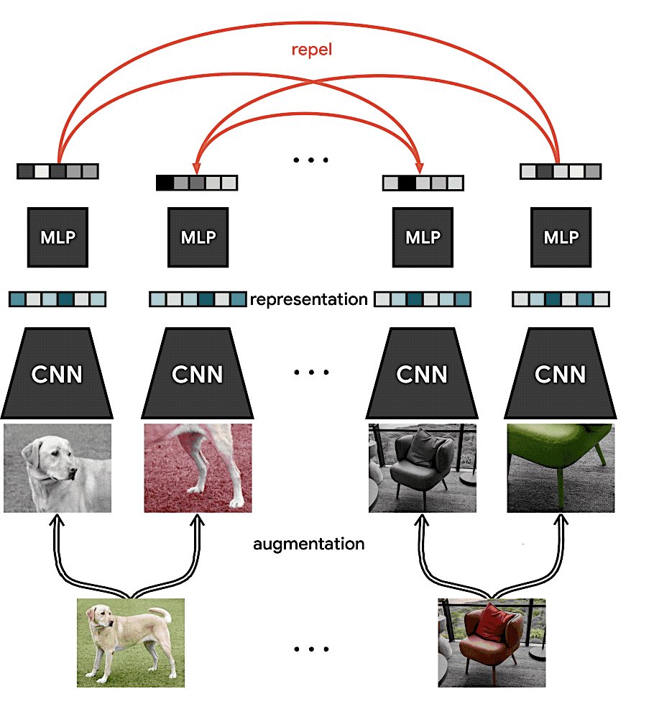
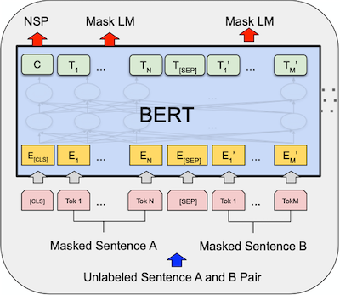
Success story of Unsupervised Pre-training
Unsupervised pre-training has obtained promising results in CV and NLP.
Success story of supervision: Pre-training
BERT
SimCLR
[1] A simple framework for contrastive learning of visual representations., Chen et al., ICML, 2020. [2] BERT: Pre-training of Deep Bidirectional Transformers for Language Understanding., Devlin et al., NAACL, 2019.
2
Notes:
As you may already know.
unsupervised pre-training has obtained promising results in both computer vision and natural langue processing tasks.
In computer vision, a notable work is SimCLR which learns representations by maximizing agreement between differently augmented views of the same data example via a contrastive loss in the latent space
In natural langue processing, BERT, learns the representations by filling the masked word in the sentence.

Slide 4
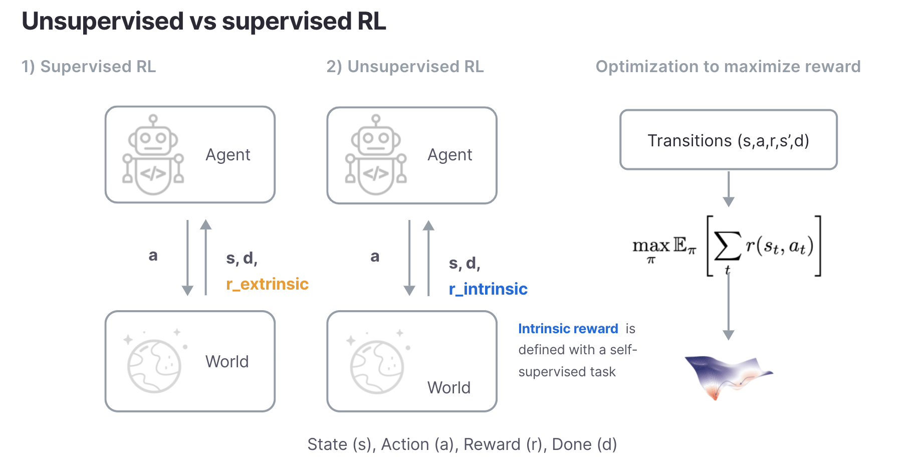
Unsupervised Pre-training in Reinforcement Learning
Supervised RL
Unsupervised RL
Finetuning
Success story of supervision: Pre-training
2
Notes:
Experimental protocol for the unsupervised pre-training in reinforcement learning.
supervised rl: extrinsic reward
unsupervised rl: agent has no access to the extrinsic reward. We don't have any knowledge about what will be the future task the agent would like to accomplish.
Therefore,r_intrinisic: reward from self-supervised task.
In other word, the agent is allowed to interact with the environment but does not receive reward from the environment.
At fine-tuning state, interacts with the environment
extrinsic reward.
To test whether the agent has learned the meaningful representation at the pre-training stage.

Slide 5





(Preliminary) DIAYN: Diversity is all you need
DIAYN: maximize the mutual information between policy-conditioned latent $(w)$ and state $(s)$
$\max{I\left(s;w\right)=\max{−H\left(w | s\right)+H(w)}}$
$$variational approximation$$
$I(s;w){≥E_{s,w}[{q_{θ}\left(w|s\right)−\log{p(w)}]}}$
policy latent should be distinguishable
policy latent should be diverse
$r_{intrinsic}(s,a)=q_{θ}\left(w | s\right)−\log{p\left(w\right)}$
$policy:π(a|s,w)$
[1] Diversity is all you need., Eysenbach et al., ICLR, 2018. [2] Explore, Discover and Learn: Unsupervised Discovery of State-Covering Skills., Campos et al., ICML, 2020.
2
Notes:
representative paper of unsupervised pre-training.
DIAYN's intrinsic reward is based on maximizing~~
first row: ~~
Since posterior distribution of the latent is intractable -> variational lower bound
q(w|s): distinguishalbe, p(w): diverse
Our goal is to obtain the policies that are distinguishable and diverse as possible conditioned on the policy latent w.

Slide 6

(Preliminary) DIAYN: Diversity is all you need
DIAYN: maximize the mutual information between policy-conditioned latent $(w)$ and state $(s)$
$\max{I\left(s;w\right)=\max{−H\left(w | s\right)+H(w)}}$
$$variational approximation$$
$I(s;w){≥E_{s,w}[{q_{θ}\left(w|s\right)−\log{p(w)}]}}$
policy latent should be distinguishable
policy latent should be diverse
$r_{intrinsic}\left(s,a\right)=q_{θ}\left(w | s\right)−\log{p\left(w\right)}$
$policy:π(a|s,w)$
Problem: Pessimistic Exploration
Agent asymptotically receives larger rewards for visiting known states than discovering unknown states as proven in [2].
[1] Diversity is all you need., Eysenbach et al., ICLR, 2018. [2] Explore, Discover and Learn: Unsupervised Discovery of State-Covering Skills., Campos et al., ICML, 2020.
2
Notes:
However, if

Slide 7
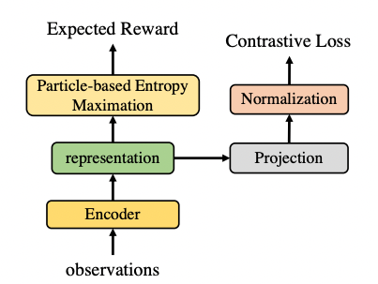
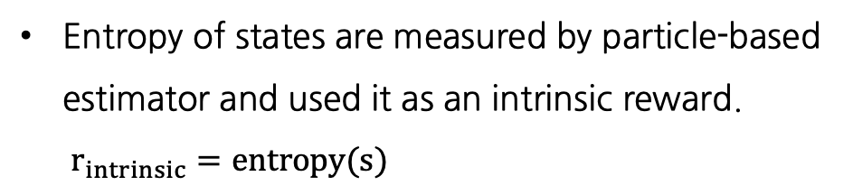
APT: Active Pre-Training for RL
To overcome the pessimistic exploration problem, incentivize the agent with a reward to maximize entropy in an abstract representation space.
Overview
The contrastive loss learns a mapping from state space to an abstract representation space.
Entropy of states are measured by particle-based estimator and used it as an intrinsic reward.
$r_{intrinsic}=entropy(s)$
2

Slide 8
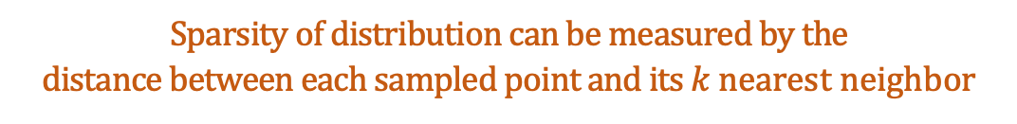
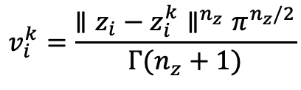
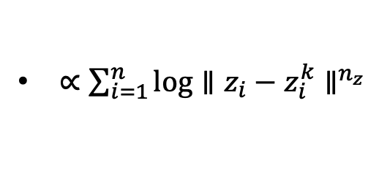
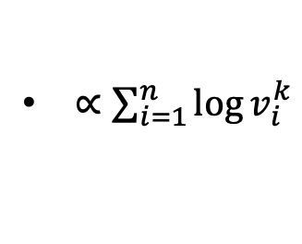
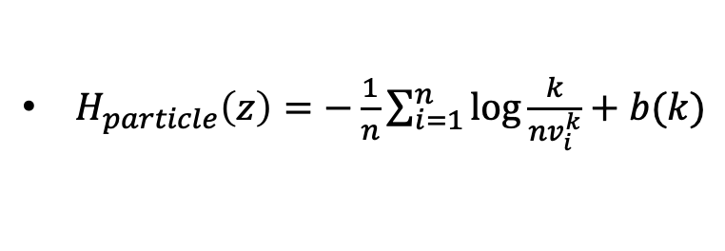

APT: Active Pre-Training for RL
Particle-based Entropy Estimation
Assume we have number of $n$ data points ${\left\{z\right\}}_{i=1}^{n}$ from unknown distribution.
$H_{particle}\left(z\right)=−\frac{1}{n}\sum_{i=1}^{n}{\log{\frac{k}{nv_{i}^{k}}}}+b(k)$
$k$ nearest neighbor of $z_{i}$
$∝\sum_{i=1}^{n}{\log{v_{i}^{k}}}$
$$v_{i}^{k}=\frac{{∥z_{i}−z_{i}^{k}∥}^{n_{z}}π^{n_{z}/2}}{Γ(n_{z}+1)}$$
$∝\sum_{i=1}^{n}{\log{∥z_{i}−z_{i}^{k}}∥^{n_{z}}}$
Sparsity of distribution can be measured by the distance between each sampled point and its $k$ nearest neighbor
2
Notes:
entropy(z) = blah blah
this is proportional to the volume of each data point.
The volume is defined by the distance between the data point and its k-nearest neighbor.
Removing the constant term, the entropy is proportional to the distance between each sampled point and its k nearest neighbor.

Slide 9
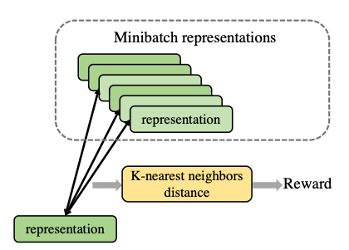
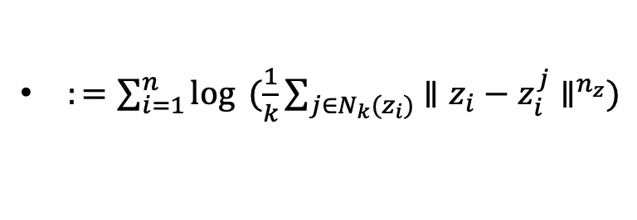
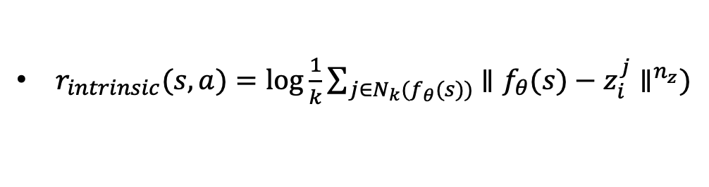
APT: Active Pre-Training for RL
Particle-based Entropy Estimation
Assume we have number of $n$ data points ${\left\{z\right\}}_{i=1}^{n}$ from unknown distribution.
$H_{particle}\left(z\right)=−\frac{1}{n}\sum_{i=1}^{n}{\log{\frac{k}{nv_{i}^{k}}}}+b(k)$
$k$ nearest neighbor of $z_{i}$
$∝\sum_{i=1}^{n}{\log{v_{i}^{k}}}$
$$v_{i}^{k}=\frac{{∥z_{i}−z_{i}^{k}∥}^{n_{z}}π^{n_{z}/2}}{Γ(n_{z}+1)}$$
$∝\sum_{i=1}^{n}{\log{∥z_{i}−z_{i}^{k}}∥^{n_{z}}}$
$:=\sum_{i=1}^{n}{\log{ (\frac{1}{k}\sum_{j∈N_{k}(z_{i})}{∥z_{i}−z_{i}^{j}∥^{n_{z}}}})}$
Average the distance over all $k$ nearest neighbor for stability
$r_{intrinsic}(s,a)=\log{\frac{1}{k}\sum_{j∈N_{k}(f_{θ}(s))}{∥f_{θ}(s)−z_{i}^{j}∥^{n_{z}}}})$
2

Slide 10


APT: Active Pre-Training for RL
Learning Contrastive Representation
Identical to the SimCLR objective
$s_{i}^{k}=aug\left(s_{i}\right), s_{i}^{v}=aug(s_{i})$
$ㅁ$
Notes:
SimCLR which learns representations by maximizing agreement between differently augmented views of the same data example via a contrastive loss in the latent space

Slide 11
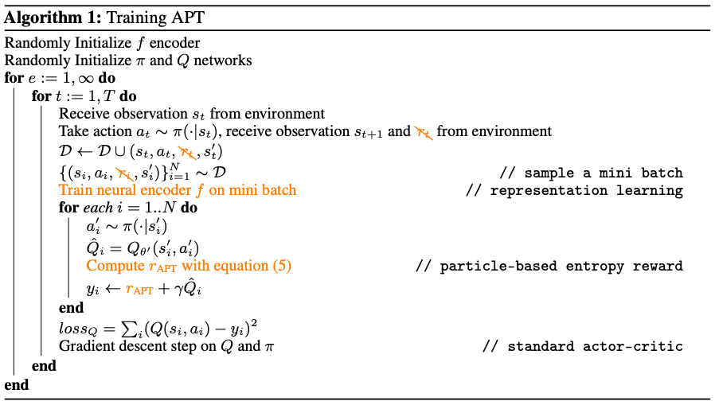
APT: Active Pre-Training for RL
Algorithm
Notes:
Training APT on actor-critic algorithm

Slide 12
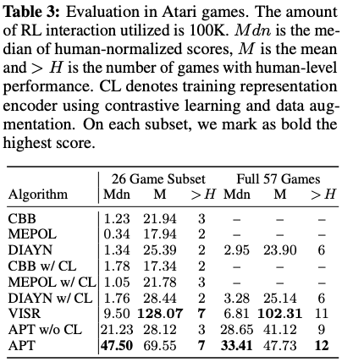
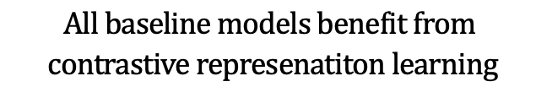
Experiments
ATARI benchmark (Pretrain: 250M, Finetune: 100k)
Comparison with Unsupervised RL baselines
$$All baseline models benefit from$$
$$contrastive represenatiton learning$$

Slide 13
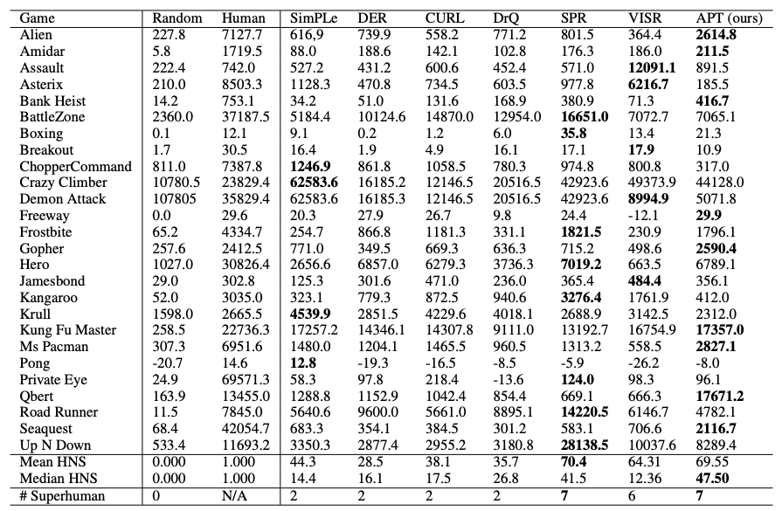
Experiments
ATARI benchmark (Pretrain: 250M, Finetune: 100k)
Comparison with Sample Efficient RL baselines
Notes:
Different from the previous slides, the sample efficient baselines are trained without pre-training.
The superior performance of the APT verifies the importance of pre-training in reinforcement learning agent

Slide 14
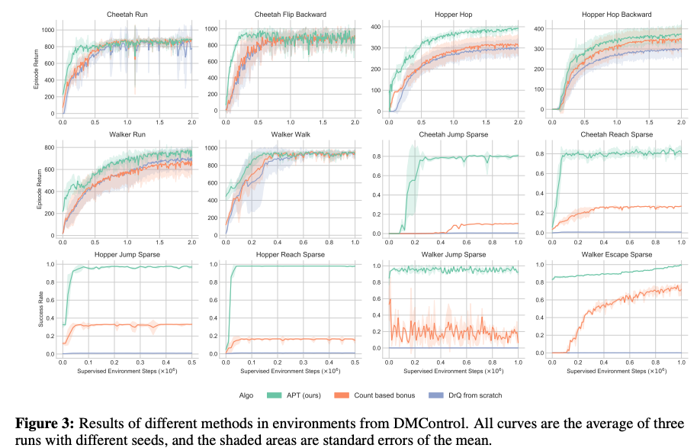
Experiments
Mujoco Benchmark (Pretrain: 5M, Finetune: 100k)
Comparison with Sample Efficient RL baselines
Notes:
Again,

Slide 15
Limitations
Exhaustive Pre-training time (250M)
→ Pre-training time should be restricted to a realistic number? (10M...?)
Is online pre-training realistic?
→ more realistic evaluation protocol for unsupervised reinforcement learning might be...
1. pre-train the model with offline data 2. evaluate with reward-based finetuning.
Representation Learning with 3-layer ConvNet?
→ Does the performance scales robustly with model size?

Slide 16
Q & A

