Slide 1
How to escape from local optima in
Deep Reinforcement Learning
Hojoon Lee
2022.11.04q

Slide 2
Table of Contents
Understanding and Preventing Capacity Loss in Reinforcement Learning
ICLR 2022 (spotlight)
Clare Lyle, Mark Rowland, and Will Dabney (Oxford & Deepmind)
The Primacy Bias in Deep Reinforcement Learning
ICML 2022
Evgenii Nikishin, Max Schwarzer (SPR, SGI), D’Oro, Bacon, Aaron Courville (MILA)

Slide 3
Understanding and Preventing Capacity Loss in Reinforcement Learning

Slide 4
Preliminaries
DQN with Target Network
Minimize the temporal difference between a predicted Q and the bootstrapped target.
Training Pipeline
Iterative process of data collection & optimization
Data collection: select action with maximum Q-value within an environment.
Optimization: minimize TD error.

Slide 5
Understanding and Preventing Capacity Loss in RL
Problem
Temporal difference learning is trained to predict non-stationary targets.
Due to the non-stationary targets, it is essential for the model to adapt to the new targets.
The authors reveal that the networks trained on a sequence of target values lose their ability to quickly update their predictions to new target values (=capacity loss).
Solution for Capacity Loss
Present a simple regularization loss, which regress a subspace of features towards its value at initial random model.
This simple regularization loss leads to a significant performance improvements in sparse-reward environments such as Montezuma’s Revenge.

Slide 6
Measuring Capacity Loss
Capacity Loss
A phenomenon which the model losses the ability to fit its prediction to new targets.
To validate Capacity Loss, we should first need the measure the Capacity.

Slide 7
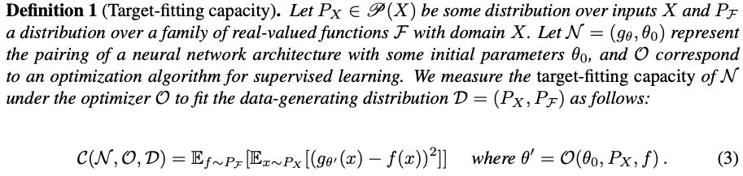
Measuring Capacity Loss
Measure 1: Target-Fitting Capacity
measures the ability of a network to reach a new set of targets.
However, cannot measure how quickly can network update their predictions.

Slide 8
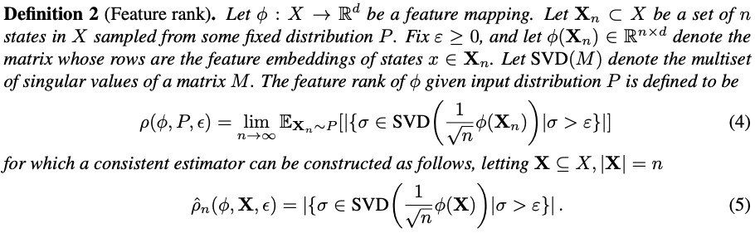
Measuring Capacity Loss
Measure 2: Feature Rank
Number of singular values of a matrix M = rank of matrix X
(I think) the authors assume that insufficient rank of matrix X induces a difficulty to adapt to changes in the target values (=capacity loss).

Slide 9
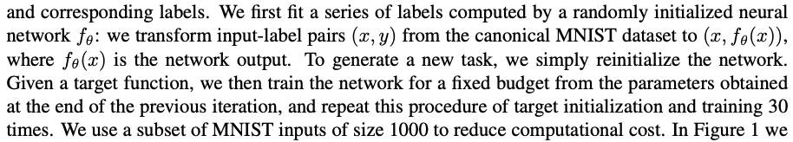
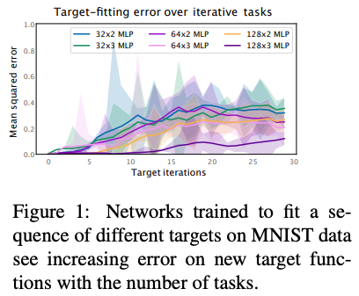
Validating Assumption: Does RL really suffers from Capacity Loss?
Validation 1: Target-Fitting Capacity of MNIST
Error = Target-Fitting Capacity
Target prediction iteration이 증가함에 따라 Target-fitting Capacity가 감소한다.
(Why?) (I think the network falls into sharp local optima).
It is interesting to see that a larger network exhibits a better Target-Fitting Capacity.

Slide 10
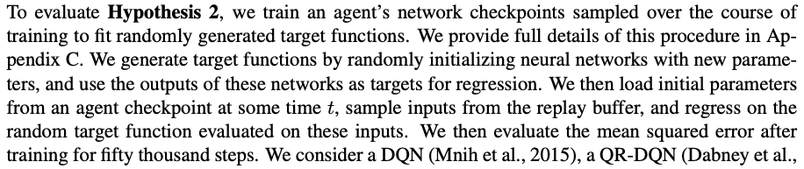
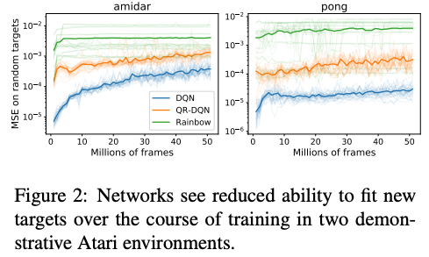
Validating Assumption: Does RL really suffers from Capacity Loss?
Validation 2: Target-Fitting Capacity of Atari
As training progresses, agents’ checkpoints on average get modestly worse at fitting the random targets.

Slide 11
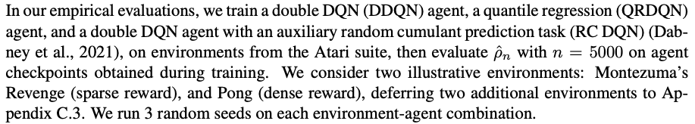
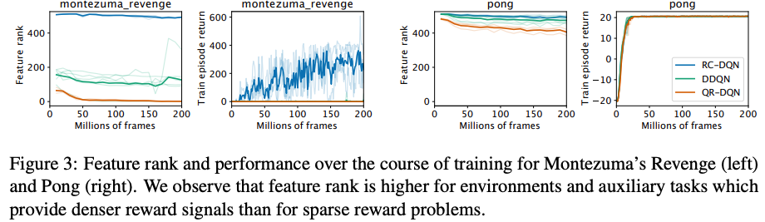
Validating Assumption: Does RL really suffers from Capacity Loss?
Validation 3: Feature Rank in Sparse vs Dense reward Environment

Slide 12
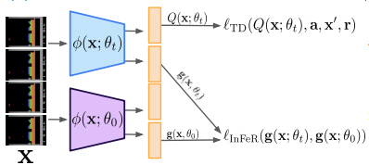

Mitigating Capacity Loss with Feature Regularization.
INFER: INitial FEature Regualrization
The authors assume that the randomly initialized network possess high capacity to regress to the new targets.
Therefore, add a regularization loss which regress a set of network outputs towards the output values at initialization.
In order to not overfit to a specific initialization point, modify the network architecture by adding k auxiliary linear prediction heads on top of the feature representation.

Slide 13
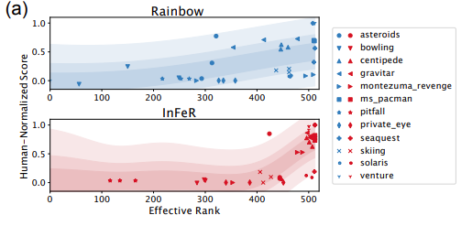
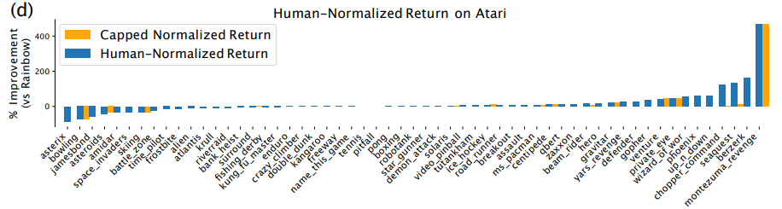
Results
While feature rank does not appear to solely determine agent performance ,there is a positive correlation between FR and HNS.
Using InFeR increases both FR and HNS.

Slide 14
Conclusion
Summary
DRL suffers from Capacity Loss due to the continual update + bootstrapped targets.
Capacity Loss is particularly salient in sparse-reward settings.
Feature space regularization can help the network to preserve plasticity which increases the agent’s performance, especially in sparse-reward environments.
Personal thoughts
Capacity Loss == Sharp Local Optima?
If the loss falls into sharp local minima, does the model losses the capacity (i.e., plasticity)?
Then, can Sharpness-Aware-Minimization or Data Augmentation help to reduce capacity loss?
InFeR is the best regularization objective?
What about Barlow Twins in SSL? (=Transposed Contrastive Loss)
Barlow Twins naturally incur the network’s output to be independent.

Slide 15
The Primacy Bias in Deep Reinforcement Learning

Slide 16
The Primacy Bias in Deep Reinforcement Learning
Problem
Because deep RL agent is trained on progressively growing datasets, deep RL agents can be easily overfitted to earlier experiences.
This overfitting negatively affects the rest of the learning process which the author refer to as primacy bias (중간의 것들보다 처음의 것을 잘 기억하는 인지적 현상).
(Personal Thought) Primacy Bias = Capacity Loss = Degenerate Solution
Solution for Primacy Bias
Periodically reset a part of the network.

Slide 17
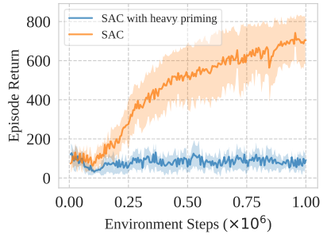
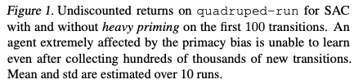
Validating Assumption: Does RL really suffers from Primacy Bias?
Validation 1: Heavy Primming.
Investigate whether heavily overfitting on a single batch of early data disrupt a learning process.
Environment: DMC quadruped-run.
Baseline: SAC.
Experiment group: SAC with heavy primming.
Before standard training, update the agent 10000 times using the initial 100 data points.

Slide 18
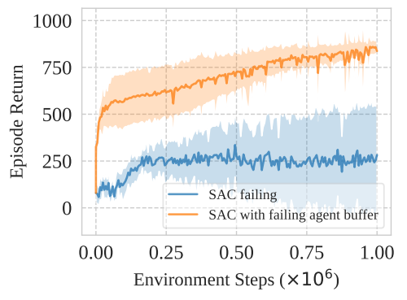
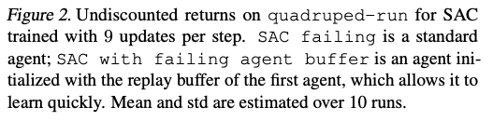
Validating Assumption: Does RL really suffers from Primacy Bias?
Validation 2: Primacy Bias occurs in data vs model.
Investigate whether non-diverse data incurs the primacy bias.
Generate data with poor performing agent.
Train agent with using collected data as its initial replay buffer.
The primacy bias is a failure to learn not a failure to collect proper data.

Slide 19
Mitigating Primacy Bias with resetting.
Resets
Since the model heavily overfits to the initial data, reset part of the neural network to mitigate the primacy bias in the model.
Experimental Setup (ATARI 100k)
Baseline: SPR
Number of resets: 4
Reset: (1/5)
Experimental Setup (DMC)
Baseline: SAC, DrQ
Number of resets: 10 (per 200,000 steps)
Reset: SAC (all), DrQ (3/7)

Slide 20
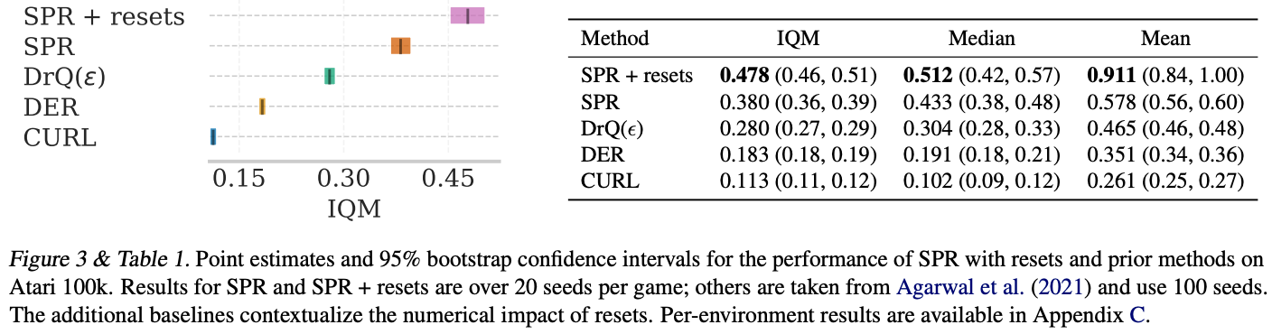
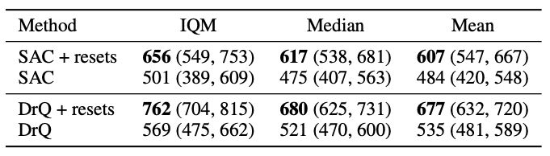
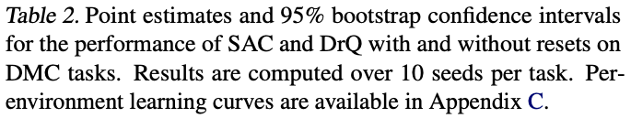
Main Experiment
ATARI 100k
DMC

Slide 21
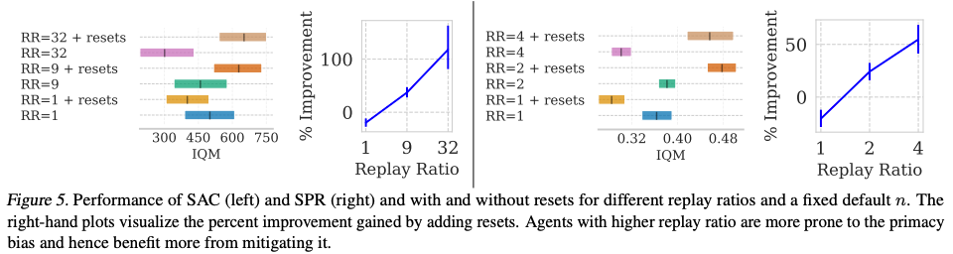
Ablation: Relationship between replay ratio & reset
ATARI 100k & DMC

Slide 22
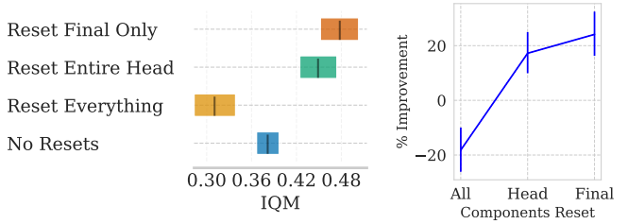
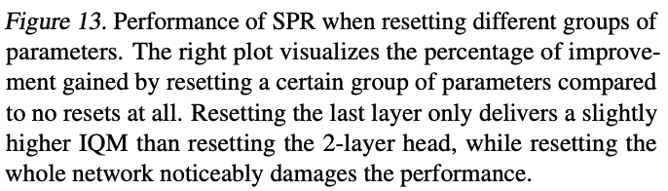
Ablation: where to reset?
ATARI 100k

Slide 23
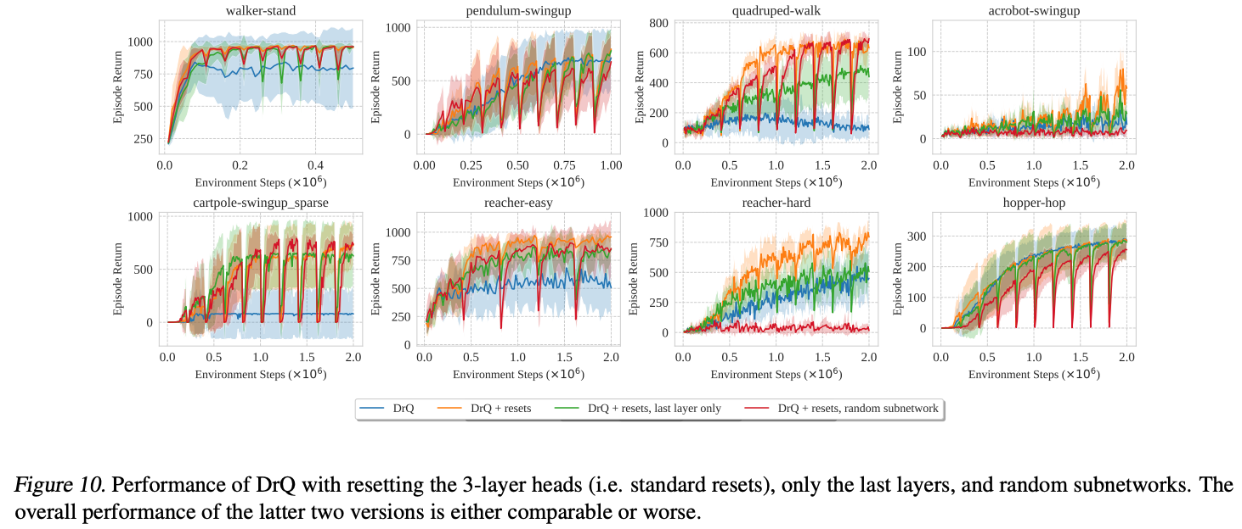
Ablation: where to reset?
DMC

Slide 24
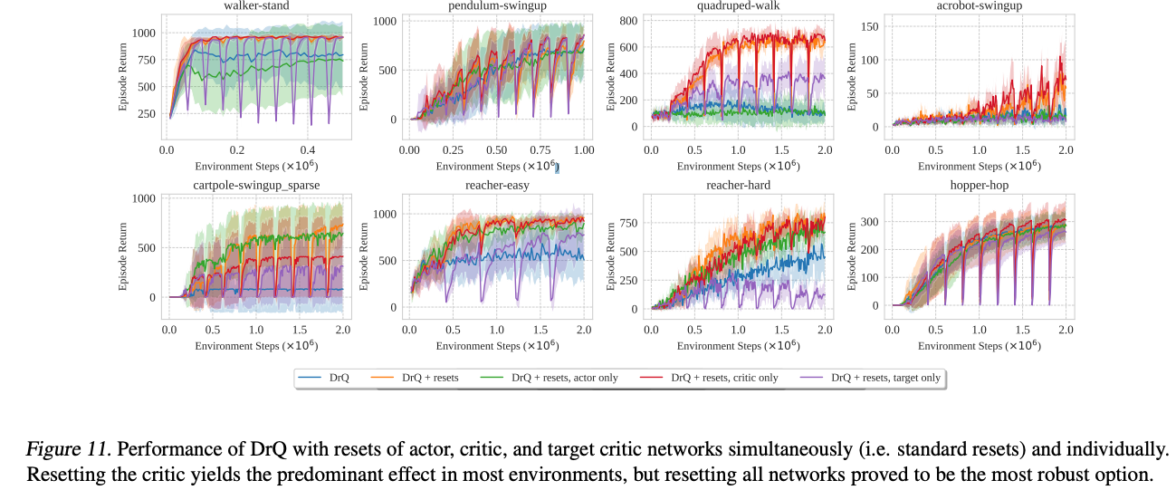
Ablation: what to reset?
DMC

Slide 25
Conclusion
Summary
DRL suffers from to adapt to new data due to the Primacy Bias.
Resetting part of the neural network helps to alleviate Primacy Bias issue.
Personal thoughts
Capacity Loss == Primacy Bias == Local Optima?
Plausible Solutions: (w/ a larger replay ratio).
Regularization Loss: InFeR or Barlow Twins.
Random network resets.
Data augmentation (augmentation leads to escape sharp local minima).
Is this the reason why augmentation provide a larger benefits in deep RL?
Sharpness-aware optimization.

Slide 26
Q & A

