Slide 1
Kaggle competition: advanced regression techniques on house prices of Ames Iowa
NYCDSA Machine learning project
Eda, missing value imputation, feature engineering, modeling & stacking
Team_Dummified[0:2] = [‘rudin ro’, ‘Gregory Fortunato’]

Slide 2
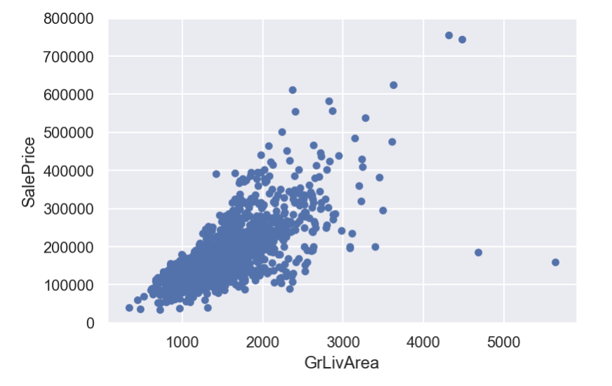
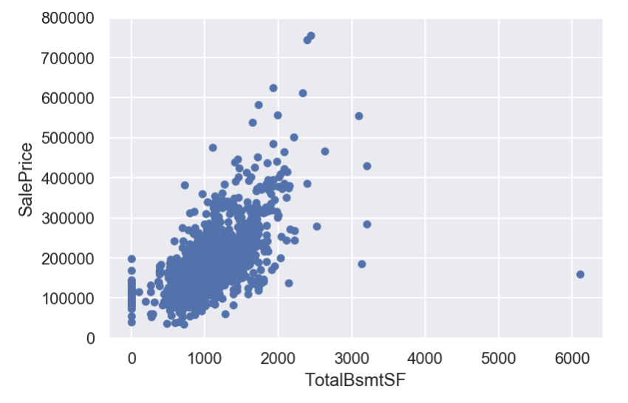
Basic eda

Slide 3
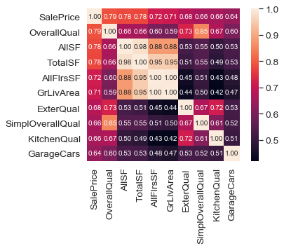
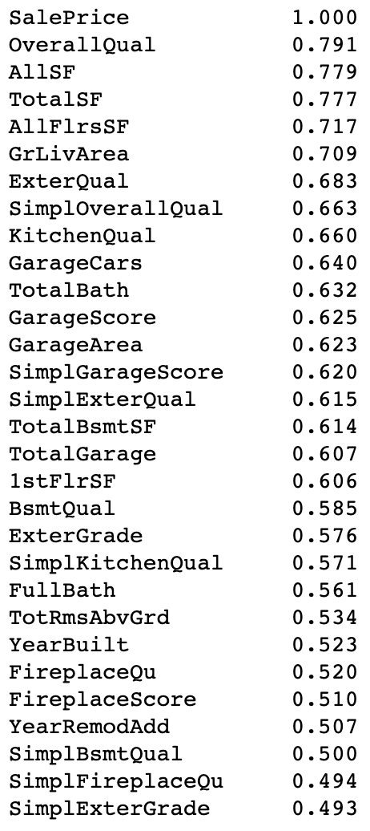
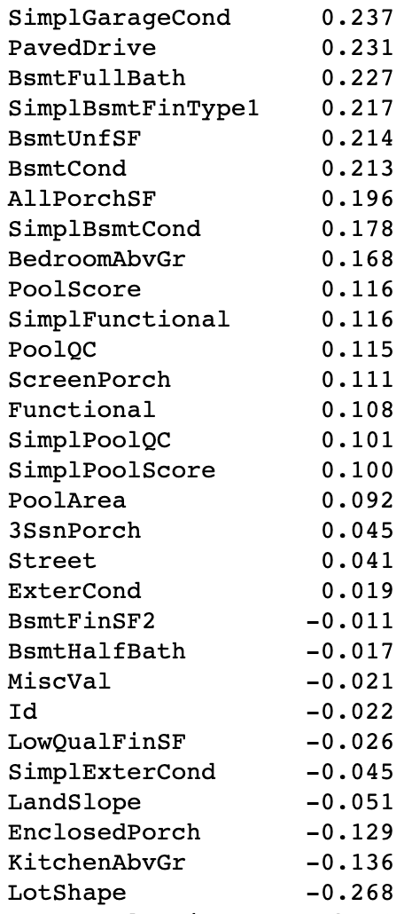
Basic eda

Slide 4
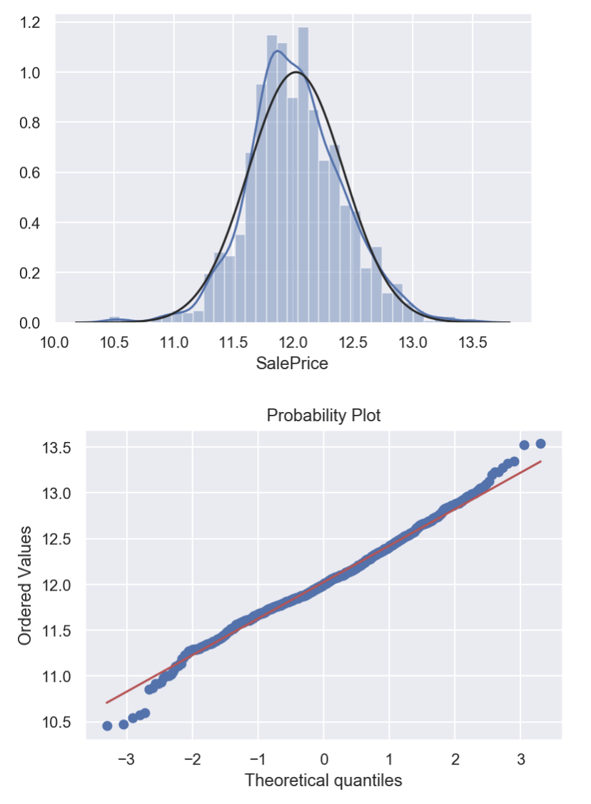
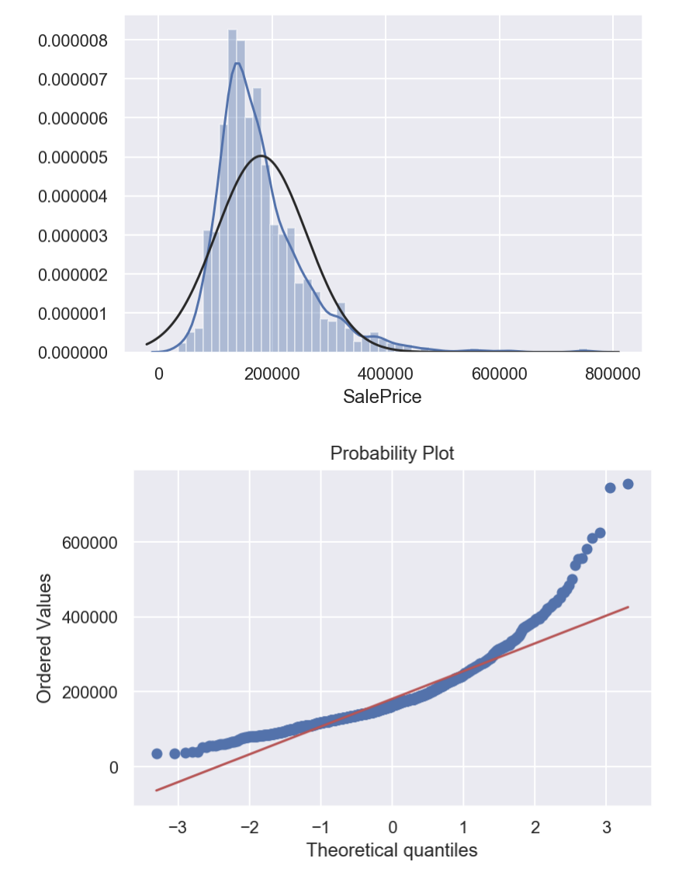
Basic EDA

Slide 5
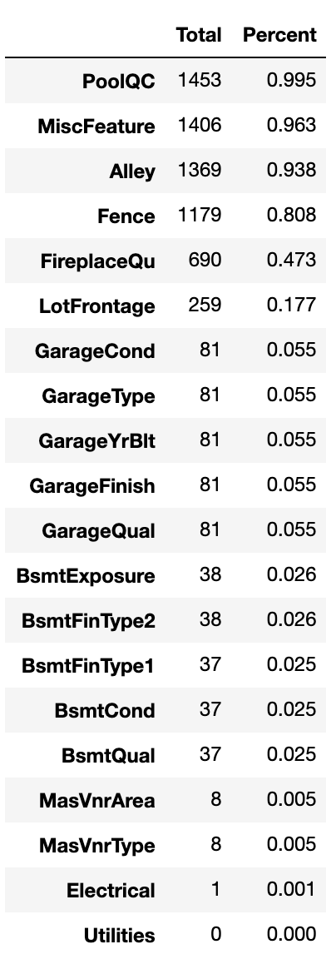
Missing Value imputation
NA
Na > None Na > 0 Na > Mode
PoolQC
MiscFeature
Alley
Fence
FirePlaceQu
GarageType
GarageFinish
GarageQual
GarageCond
BsmtQual
BsmtCond
BsmtExposure
BsmtFinType1
BsmtFinTyp2
MasVnrType
MSSubClass
GarageYrBlt
GarageArea
GarageCars
BsmtFinSF1
BsmtFinSF2
BsmtUnfSF
TotalBsmtSF
BsmtFullBath
BsmtHalfBath
MasVnrArea
MSZoning
Electrical
KitchenQual
Exterior1st
Exterior2nd
SaleType
NA > Group By Median: Lot Frontage

Slide 6
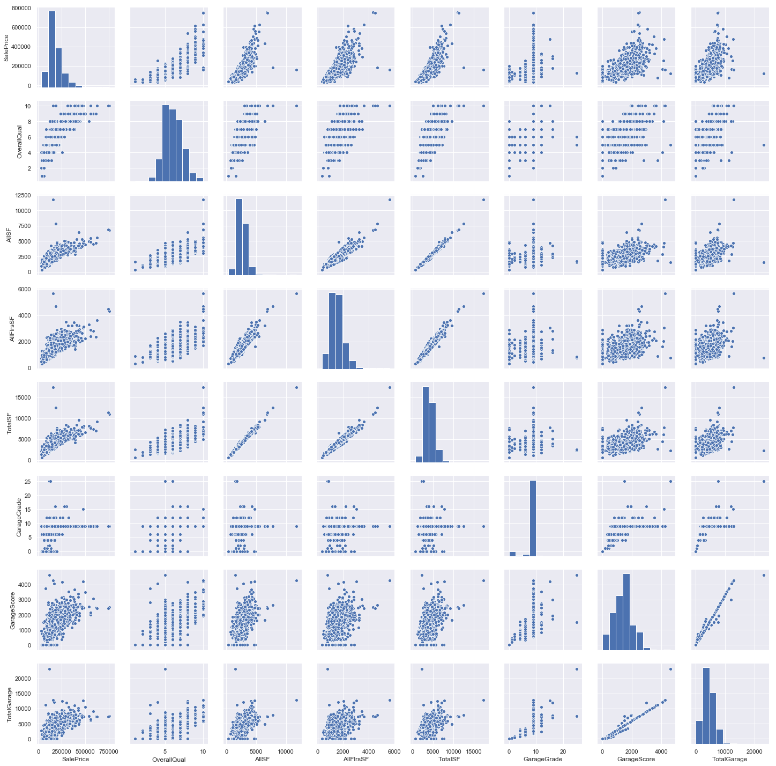
Feature engineering
Top 10 correlated
features >Polynomial regression
(Square, Cube)

Slide 7
Feature engineering
df_train["OverallGrade"] = df_train["OverallQual"] * df_train["OverallCond"]
df_train["GarageScore"] = df_train["GarageArea"] * df_train["GarageQual"]
df_train["ExterGrade"] = df_train["ExterQual"] * df_train["ExterCond"]
df_train["KitchenScore"] = df_train["KitchenAbvGr"] * df_train["KitchenQual"]
df_train["FireplaceScore"] = df_train["Fireplaces"] * df_train["FireplaceQu"]
df_train["PoolScore"] = df_train["PoolArea"] * df_train["PoolQC"]
df_train["TotalBath"] = df_train["BsmtFullBath"] + (0.5 * df_train["BsmtHalfBath"]) + df_train["FullBath"] + (0.5 * df_train["HalfBath"])
df_train["AllSF"] = df_train["GrLivArea"] + df_train["TotalBsmtSF"]

Slide 8
Feature engineering
Skew
MiscVal | 21.947
PoolArea | 16.898
LotArea | 12.822
LowQualFinSF | 12.089
3SsnPorch | 11.376
KitchenAbvGr | 4.302
BsmtFinSF2 | 4.145
EnclosedPorch | 4.004
ScreenPorch | 3.947
BsmtHalfBath | 3.930
Box Cox transformation of skewed variables: skewness over 0.75
Divided the data frame into categorical and numerical ones and dummified categorical features
Added them back together, create a new complete dataframe

Slide 9
Modeling – Model implementations
Stacking(Ensemble Learning Technique)
Simple average ensemble
Get predictions from the list of model input and get the average value of the predictions
Get rmse score using cross validation score function of Sklearn
Stacking with Meta-Model
Split the total training set into two disjoint sets (df_train and .holdout )
Train several base models on the first part (df_train)
Test these base models on the second part (holdout)
Use the predictions from 3) (out-of-folds predictions) as the inputs, and the correct responses (Sale Prices) as the outputs to train a higher level learner called meta-model.

Slide 10
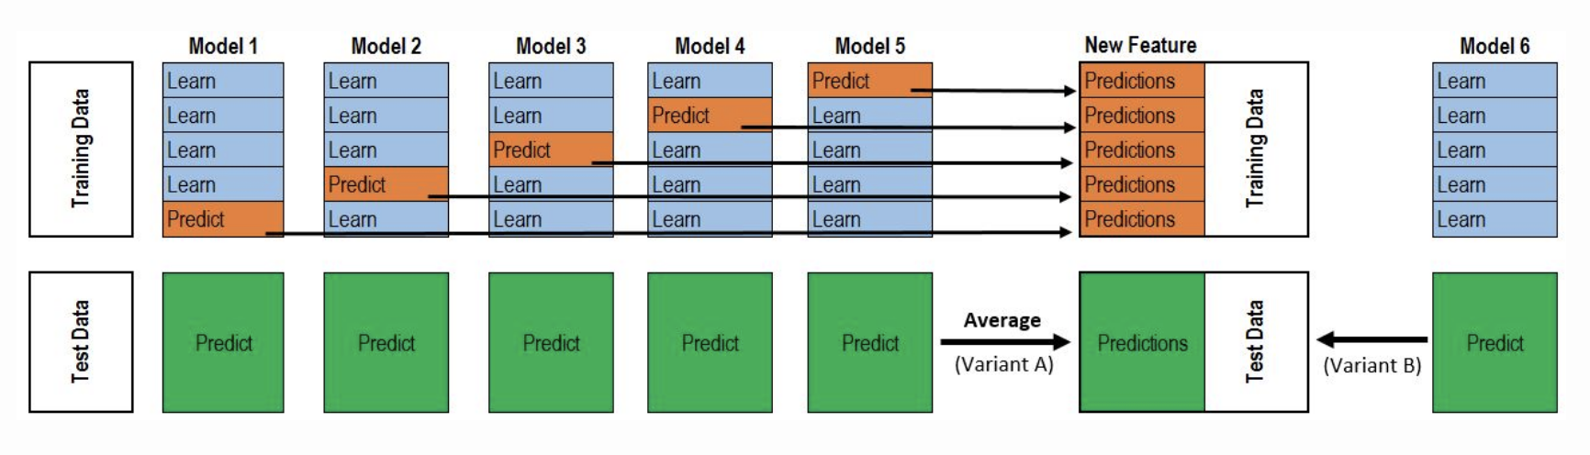
Modeling – Model implementations
The test set predictions from the 1st layer form a feature in the 2nd layer. It learns another model on the train predictions from layer 1 and predict another set of test predictions on the test predictions from layer 1. That becomes the final set of test predictions.

Slide 11
Modeling – Model implementations
RMSE scores of models without hyper-parameter tuning (Robust Regressor)
Ridge 0.1467
Lasso 0.1224
ElasticNet 0.1224
Gboost 0.1232
Xgboost 0.1219
Random Forrest 0.1419
ExtraTreeRegressor 0.1353

Slide 12
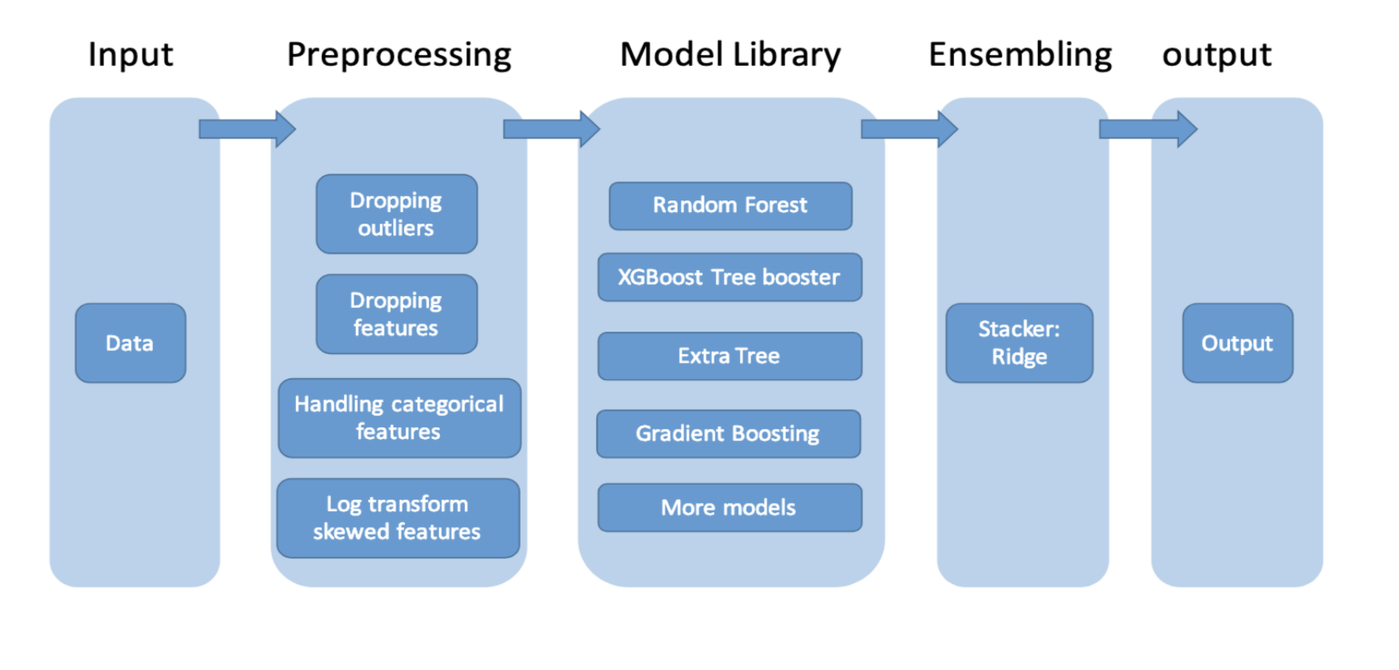
Modeling – Model implementations
Kaggle Score: 0.12623
Stacking with Meta Model

Slide 13
Modeling – Model implementations
Data
Pre-Processing
Model Library
Elastic Net, Gboost,
XGboost
Ensembling:
lasso
Output
Kaggle Score: 0.12469
Stacking with simple ensemble
Kaggle Score: 0.12320
Stacking with Meta Model

Slide 14
Modeling – Model implementations
RMSE scores of models after hyper-parameter tuning
Ridge 0.1380
Lasso 0.1224
ElasticNet 0.1224
Gboost 0.1228
Xgboost 0.1213

Slide 15
hyper-parameter tuning of XGboost
Baysian Optimization Package
After manual tuning of hyper-parameters of Elastic Net, Gboost, lasso
Kaggle Score with simple ensemble stacking model: 0.12342
Kaggle Score with stacking with meta model : 0.12212
Manual Tuning using GridSearchCV
Kaggle Score with stacking with meta model : 0.12378
Local rmse score went up tremendously
Stacking with metamodel: 0.0829281…
Xgboost_model alone: 06790322...
However...OVERFIT?
Kaggle Score with weight factors
0.7*stacked_model + 0.3*xgboost
Kaggle Score with stacking with meta model: 0.12298
Baysian Optimization Package gave the best result, but …
Rmse score of XGBoost itself improved from 0.1211 to 0.1191

Slide 16
Future work
More Experiments
Deeper understanding of Theories
Creative methods for feature engineering

