Slide 1
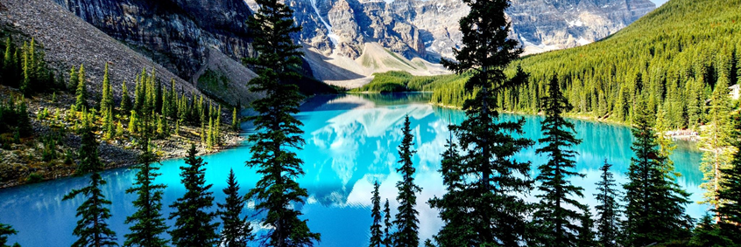
Black Mountain Resort
PROBLEM STATEMENT
It has been questioned whether Black Mountain is capitalizing on our facilities as much as it could. Currently, the price is set at $81/ticket.
Not having clear understanding of the importance of some facilities and how they add value to the resort is hampering their pricing and investment strategies.
Recently added new chair lift will increase our operating costs by $1,540,000 this season.

Slide 2
Black Mountain Resort
Recommendation and key findings
With the new operation cost added this season, our profit will be further decreased if we don’t come up with the new pricing and/or reduce other operation cost.
Features specific to states, such as the number of the resort in the state, do not seem to have effect on the ticket price, but certain resort features do.

Slide 3
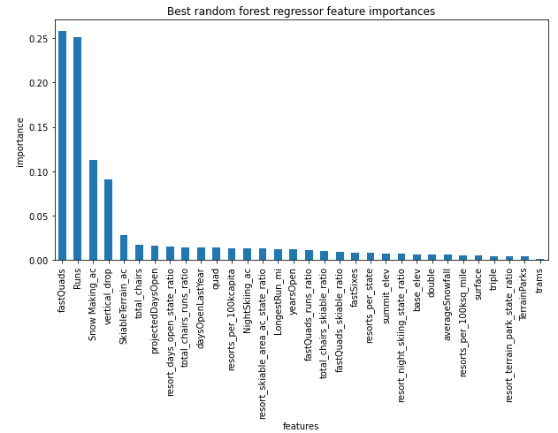
Black Mountain Resort
Modeling results and analysis
We ran our analysis with 276 other resorts throughout the US.
Our model revealed that four (4) top resort features that have most linear relationship to their ticket prices are:
number of fast four person chairs
number of runs on the resort
total area coverage by snow making machines
the vertical change in elevation from the summit to the base

Slide 4
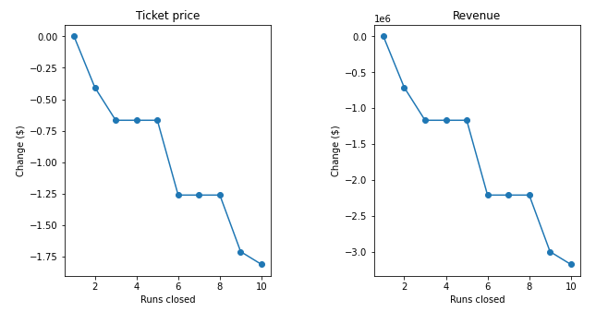
Black Montain Resot
Black Mountain Resort
Modeling results and analysis
As Black Mountain has been reviewing potential scenarios for either cutting costs or increasing revenue, we combined our findings and came up with four (4) scenarios.
SCENARIO 1 – close 10 least utilized runs
As seen on the graphs, closing 1 run will have no effect on the ticket price or revenue, but closing more gradually will have negative effect up to $1.75 per ticket.

Slide 5
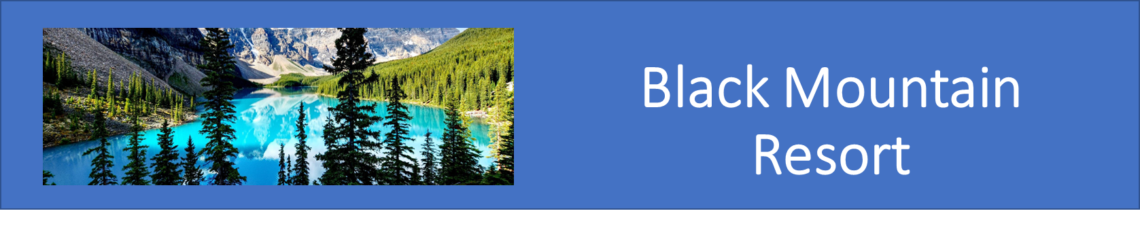
Black Mountain Resort
Modeling results and analysis
SCENARIO 2 – adding a run, increasing the vertical drop by 150 feet, and installing an additional chair lift.
This scenario increases support for ticket price by $8.61 Over the season, this could be expected to amount to $15,065,471.
SCENARIO 3 – same as Scenario 2, but adding 2 acres of snow making area.
This scenario increases support for ticket price by $9.90 Over the season, this could be expected to amount to $17,322,717.

Slide 6
Black Mountain Resort
Modeling results and analysis
SCENARIO 4 – increasing the longest run by .2 miles and guaranteeing its snow coverage by adding 4 acres of snow making capability.
No difference whatsoever. Although the longest run feature was used in the linear model, the random forest model (the one we chose because of its better performance) only has longest run way down in the feature importance list.

Slide 7
Black Mountain Resort
Summary and conclusion
For a starter, I think it’s safe to say that we can start increasing revenue almost immediately by closing one run that has the highest operation cost without having any negative impact to the value of the resort.
For Scenario 2 and 3, we need to start analyzing further by weighing how much we gain as versus to how much it cost to implement these changes.
Our model did not see any merit in Scenario 4, but I think there may be an opportunity that may need to be looked into further as the total coverage by snow making machine is the third most important feature of the resort.

