Slide 1


How Much Do You Expect to Pay for Health Insurance?
Junko Takasawa
Springboard - CapstoneThree Presentation
August, 2021

Slide 2
Business Objective
The United States has the highest healthcare expenditure per capita in the world. Wikipedia and other source show that it is more than $11,000 in 2019 (approx. $1,000/month) and is growing rapidly.
Having sufficient health insurance is crucial, but it is costly.
Identify what demographic features and living habits will affect the health insurance charge most.
Create a reliable machine learning model to predict the price of health insurance based on basic criteria.

Slide 3
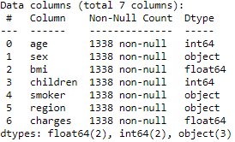
Dataset Acquisition
Obtained 1338 records of those insured, and their demographic features and habits from Kaggle
- Age
- Gender
- BMI (Body Mass Index)
- Number of Children
- Smoker
- Region
- Health Insurance Charges

Slide 4
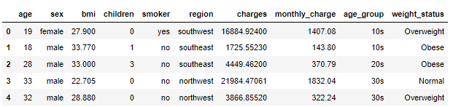
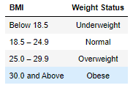
Data Wrangling
This was a fairly clean dataset with no missing values. However, I broke Age and BMI into groups and added them into additional columns (age_group and weight_status) to make it into more simple/familiar classifications. BMI, especially, is not a number that we are usually too familiar with.
I also added a column for monthly_charge as we tend to relate more to the monthly charge.

Slide 5
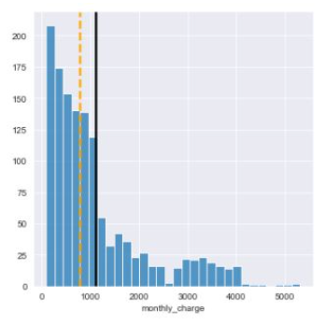
Exploratory Data Analysis
Average Monthly Charge : $1,105.87
(black line)
Median : $781.84
(yellow line)
There is a huge gap in health insurance charges. But in average, people are paying a little over $1000 per month.

Slide 6
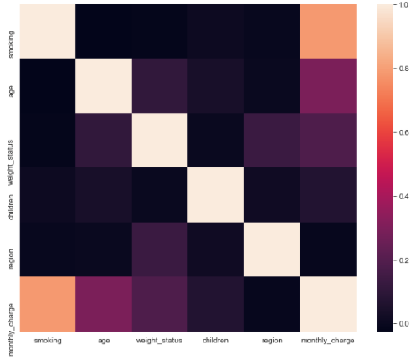
Exploratory Data Analysis (cont’d)
This heatmap shows that top three features that have the strongest correlations are:
- Smoking
- Age
- Weight status

Slide 7
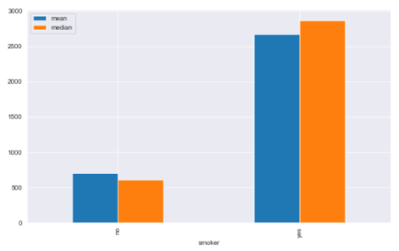
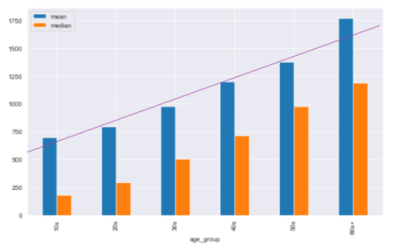
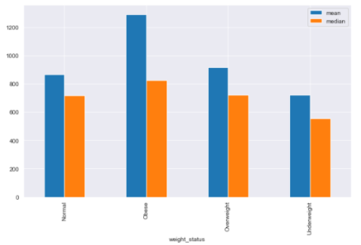

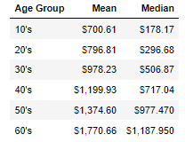
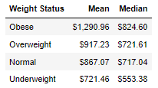
Exploratory Data Analysis (cont’d)
Smoking
Age
BMI / weight status
mean
median
mean
median
mean
median
Obese Overweight Normal Underweight
No Yes
10s 20s 30s 40s 50s 60s

Slide 8
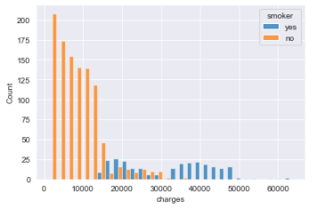
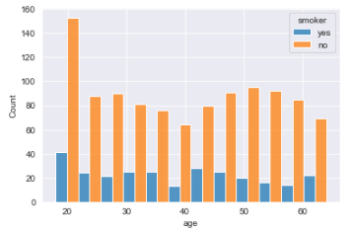
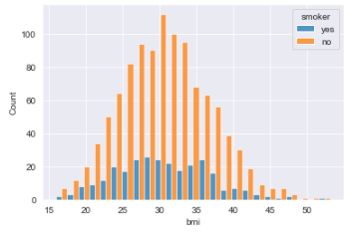
Exploratory Data Analysis (cont’d)
While majority of the people who pay higher health insurance fees are smokers, there are no apparent relationships between smokers vs age nor smokers vs BMI.

Slide 9
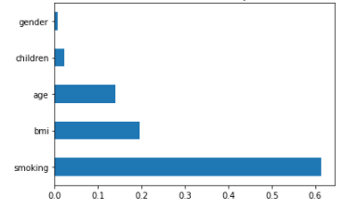
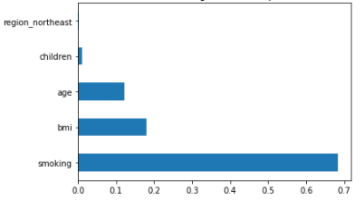
Machine Learning Models
Four machine learning models were applied:
- Random Forest - Gradient Boosting
- Linear Regression - KNN Regression
* Hyper parameter tuning was applied to each model.
Feature Importance
Random Forest
Gradient Boosting
* Top 3 important features are Smoking, BMI, and Age.

Slide 10
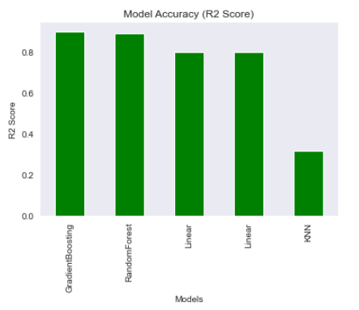
Machine Learning Models (cont’d)
Model | R2 Score | MSE | MAE
Gradient Boosting | 0.9013 | 109,038.20 | 198.64
Random Forest | 0.8911 | 120,261.95 | 210.62
Linear Regression | 0.7999 | 221,027.18 | 327.77
KNN | 0.3162 | 755,535.86 | 575.79
Of all four models, Gradient Boosting has the highest R2 Score and performed best.

Slide 11
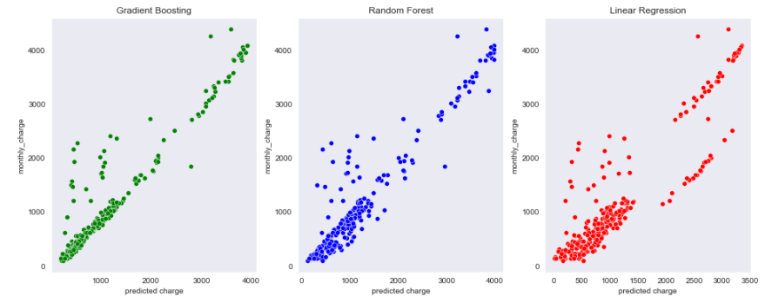
Machine Learning Models (cont’d)
Predicted charges can be visually confirmed to have the strongest linear relationship in the Gradient Boosting model.

Slide 12
Conclusion
Best Machine Learning Model to predict the health insurance charge is the Gradient Boosting Regression with approx. 90% accuracy.
Gradient Boosting model shows the three most important features are: 1. Smoking, 2. BMI (weight status) and 3. Age.
In this analysis, Gradient Boosting performed better than Random Forest, though difference in accuracy rate is little. I suppose hyperparameter tuning worked in our favor.

Slide 13
Future work
There is no doubt that the healthy lifestyle is the best prevention to become sick. However, having a good health care coverage to be able to receive proper medical care is essential for a long healthy life. We need to be able to receive preventative care, care for injuries, and some unpreventable sicknesses.
I would like to see the data that has more demographic/lifestyle features such as race, living style/habit (example: exercise habit), history of sickness, etc.. These questions are typically asked when we get a quote for insurance, and it would be interesting to see how they affect the health insurance charges.

Slide 14
References
Kaggle (Medical Cost Personal Datasets) https://www.kaggle.com/mirichoi0218/insurance/code
USA TODAY (U.S. leads among countries that spend the most on public health care) https://www.usatoday.com/story/money/2019/04/11/countries-that-spend-the-most-on-public-health/39307147/
Wikipedia (List of countries by total health expenditure per capita) https://en.wikipedia.org/wiki/List_of_countries_by_total_health_expenditure_per_capita
And special thanks to my Springboard mentor, David Lara Arango.

