Slide 1
Capstone Project SWE690 Final Submission
(backend part)
Joon Yi Koh (95273)

Slide 2
Backend
Parse Resume
Upload into Database
Generate Statistics
Learn and Predict Job Match

Slide 3
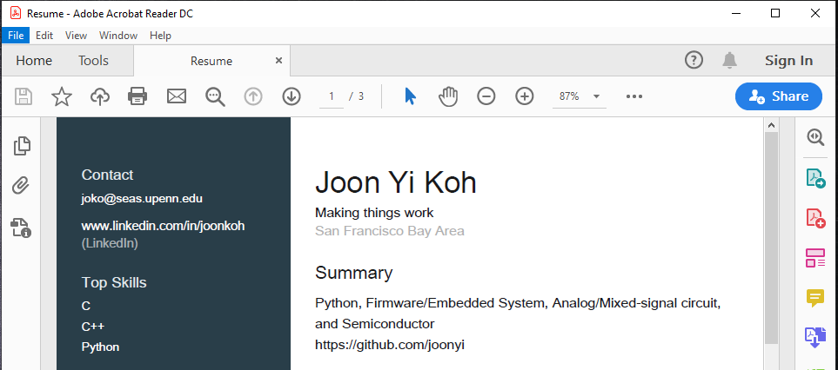
Resume Parser
Parse LinkedIn profile in pdf

Slide 4
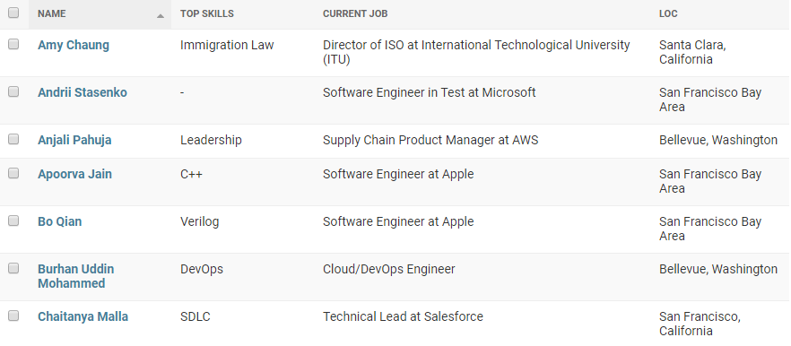
Resume Parser
Parse and store into database

Slide 5
Generate Statistics
From the data, we can answer the question like...
  What are the top ten companies recruiting from Jobhax?
    Count occurrence of companies
  What are the top ten skills for person who work in the company (ex: Google, Apple…)
    Count occurrence of skills in a specific company
  Top ten schools, top ten degrees, top ten languages...

Slide 6
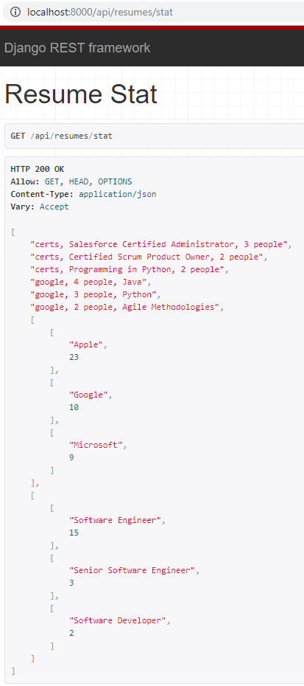
Generate Statistics
Top three certification
Top three skills in Google
Top three companies
Top three positions

Slide 7
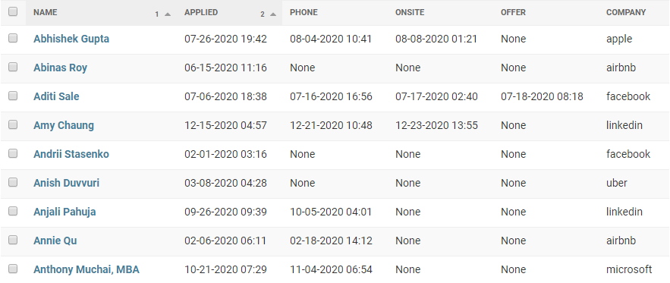
Date of Stages
Record the date of each stages

Slide 8
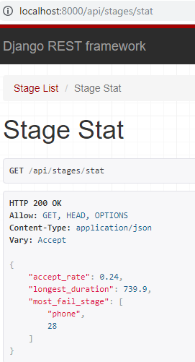
Generate Statistics
From the data, we can answer the question like...
  Percentage of candidates accepted/rejected
    accepted candidates / total candidates
  How long to complete a job recruiting process
    offer date – applied date
  Most candidates fail on which stage
    Count occurrence of fails

Slide 9
Job Match
Scikit-learn
  Machine learning in Python
Decision Tree Learning
  Predicts the value of a target variable by learning simple decision rules inferred from the data features
Support Vector Machine (SVM)

Slide 10
Decision Tree Learning
Assumption: Skills of a Google employee inferred the skills that Google needs.
{"name": "ABC", "top_skills": ["Python", "Java", "Django"], "current_job": ["Web Developer at Google"]} → labeled matched
More data ……
Test data: {"name": "DEF", "top_skills": ["SQL", "Microsoft Office", "MySQL"], "current_job": ["Java Developer at Apple"] → return unmatched

Slide 11
Support Vector Machine (SVM)
Kernel function: linear, polynomial, Radial Basis Function (rbf), sigmoid
  model = svm.SVC(kernel=kernel_name)
  model.fit(train_data)
  target_predict = model.predict(train_data)

Slide 12

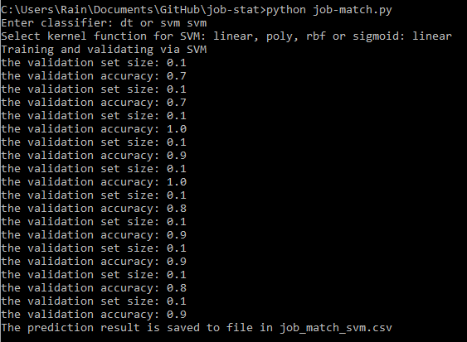
Example Output

Slide 13
Learning/Challenges
Resume parser
  How to parse resumes of various formats?
Upload to database
  Efficient data cleaning. Ex: International Technological University, ITU refers to the same school
Generate statistics
  What is the right question to ask?
  How to analyze the data to answer the question?
Learn and predict the job match
  How to choose a learning/predict model?

