Slide 1
Resume Parsing
Goal: Extract target information from resume
Challenges
  Resumes of various format require a very general algorithm
  When the code doesn’t give us good result
    The code has bugs?
    Employers are looking the wrong information?
    Candidates don’t know how to present themselves?

Slide 2
Types of resume
Story-based resume
  "Dedicated to helping people have a happy and fulfilled life," this is my guiding principle as a coach, counselor, teacher, and consultant. Most of my clients are people on the verge of an important life change. Examples include: making a career decision after graduating from university; thinking about starting a new business; opening new areas of business, deciding what to do next when the previous career is no longer possible; needing to change life circumstances; returning to work after a break for some reason ...
Point-based resume

Slide 3
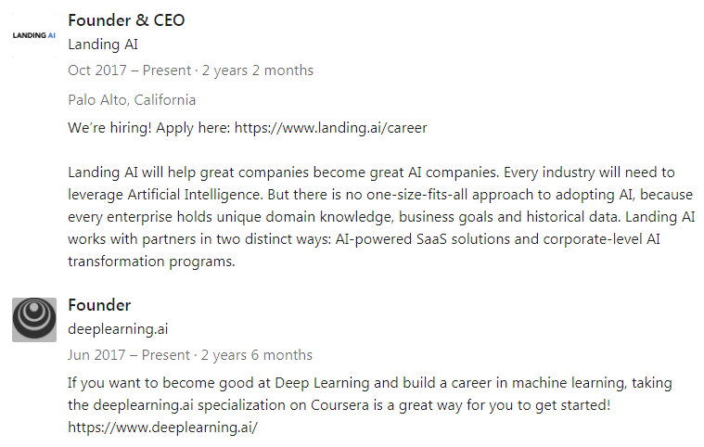
Story-based Resume

Slide 4
Selling What?
Landing AI → help great companies become great AI companies, AI-powered SaaS solutions, corporate-level AI transformation programs
Example before shows a resume which is more about selling the company than the candidate himself
How do the algorithm knows this is a “normal” resume or a resume that does sales for the company?
What if the candidate just submit a short story as his/her resumes?

Slide 5
Story-based Resume
Natural Language Processing: a subfield of linguistics, computer science, information engineering, and artificial intelligence concerned with the interactions between computers and human (natural) languages
NLTK: a leading platform for building Python programs to work with human language data
The library can help to find all noun, proper noun, and adjective associated to the name
Why nouns and adjectives? Because information employer look for are usually skills, working experiences and schools.

Slide 6
Point-based Resume
Most people want to highlight the keyword with larger font size, bold, and etc.
  Layout Processing. Parse the resume based on the layout
  But not necessary… some people just don’t know how to write their resumes
  There are thousands way to organize one’s resume
Look for the title keyword then get the content. Keyword Processing
  What if not in English?
  What if many word for the same meaning? Institute, university, college, school
  What if resume format different?
Find all education, companies and skills associated to the person using Natural Language Processing.
  Joonyi → ITU, Python, C++, InsightEDA...

