Slide 1


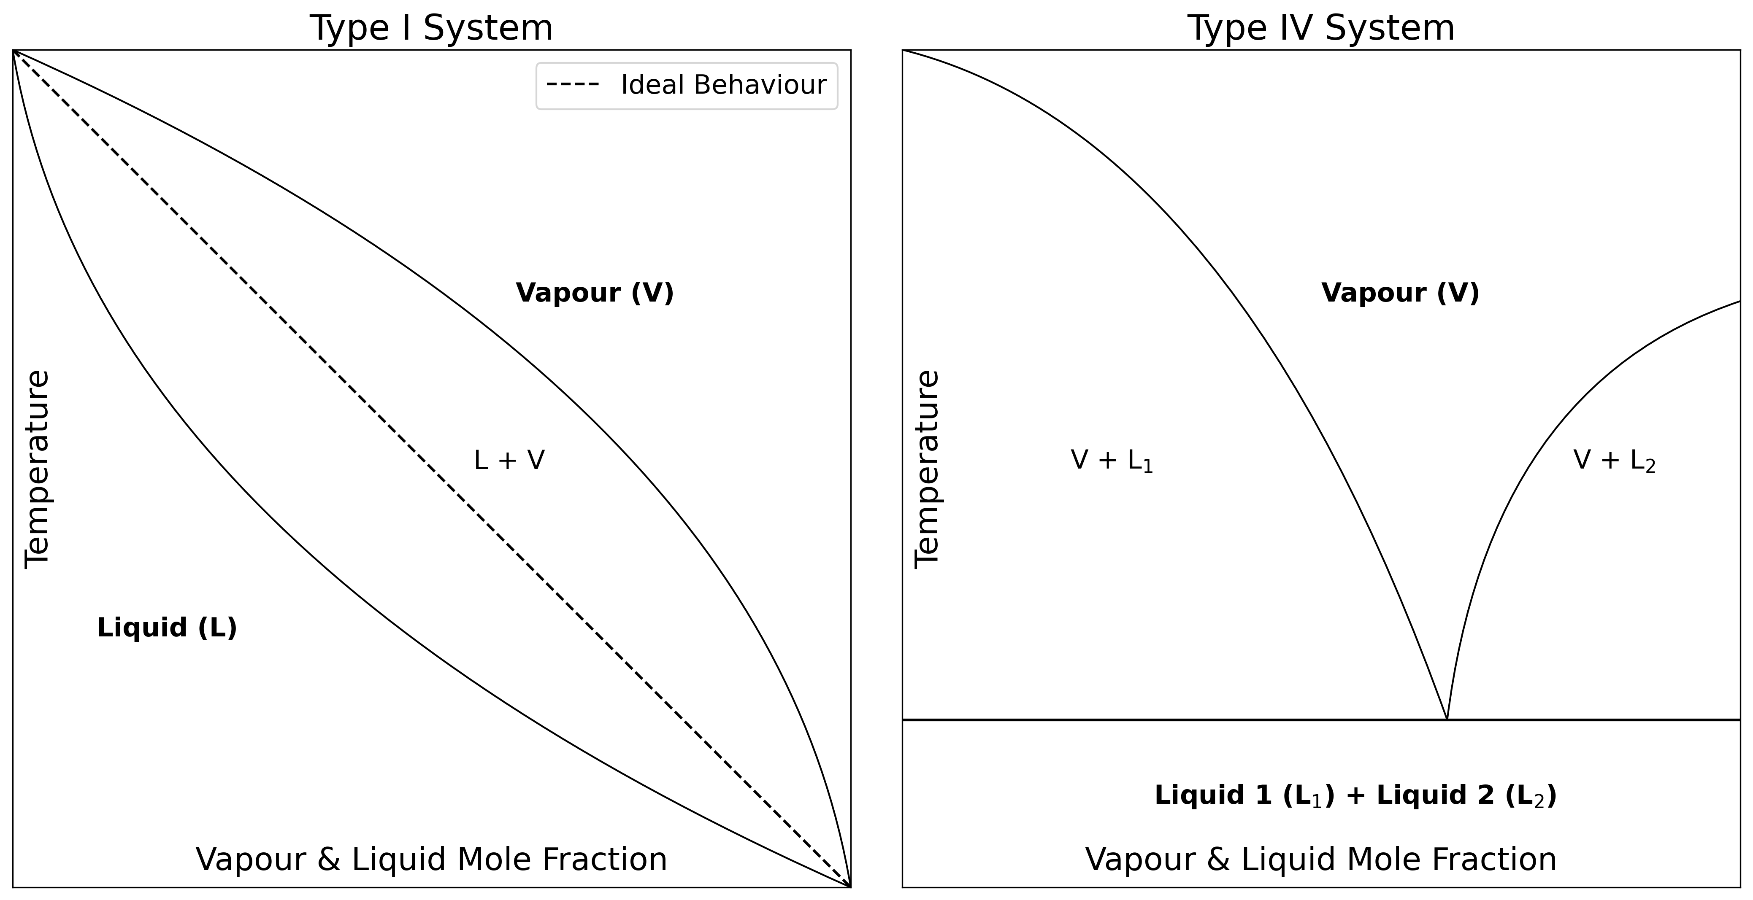
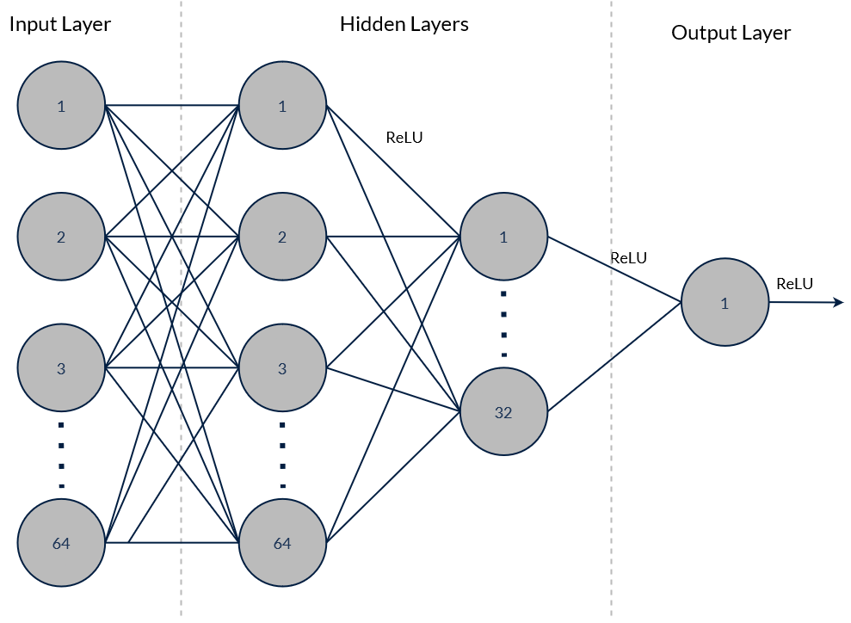
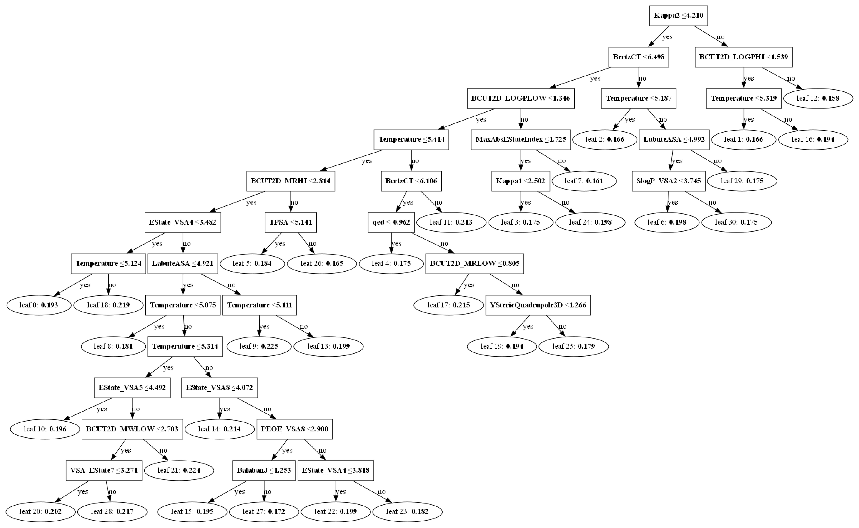
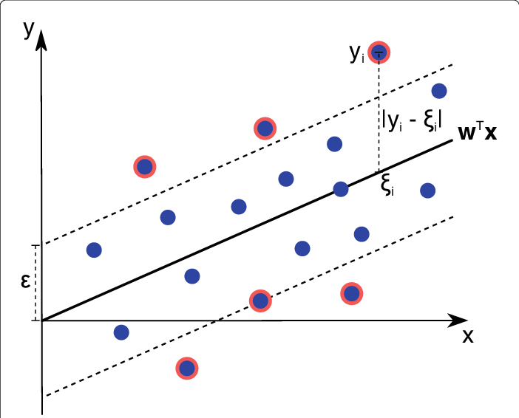
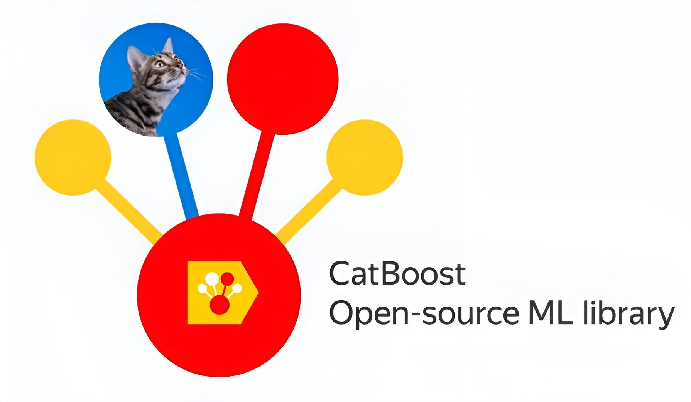
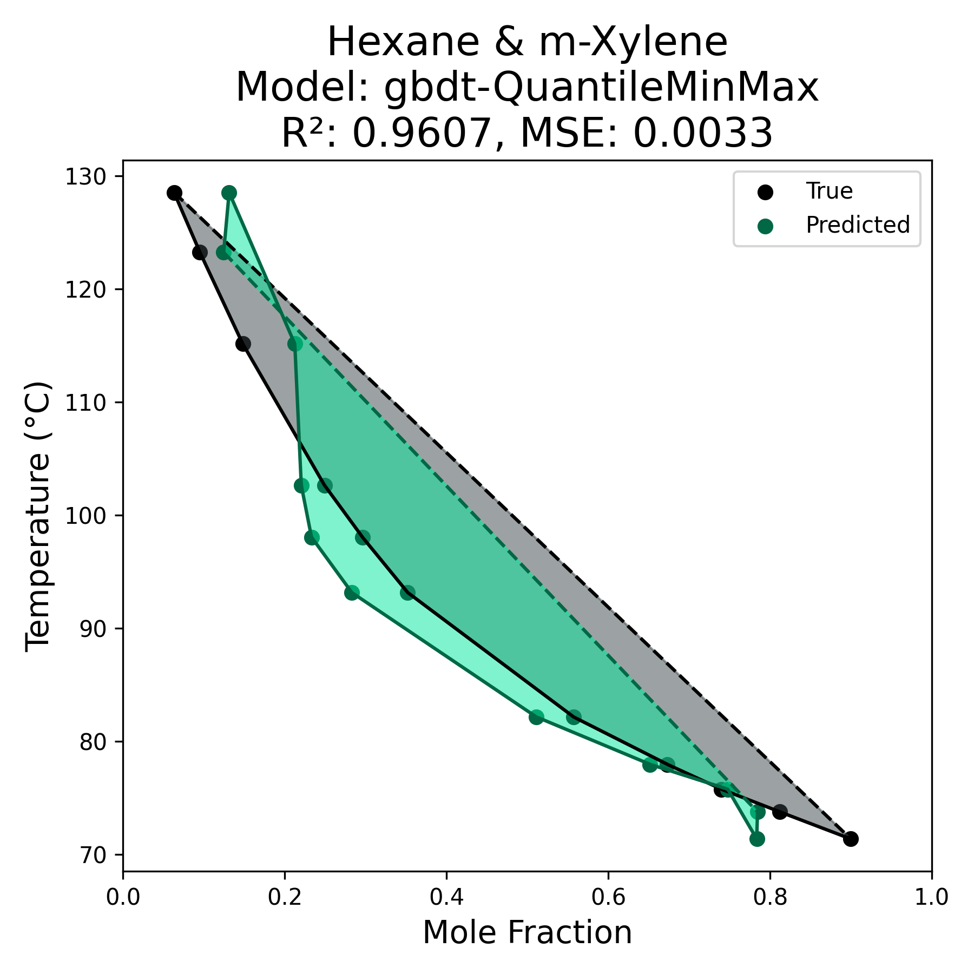
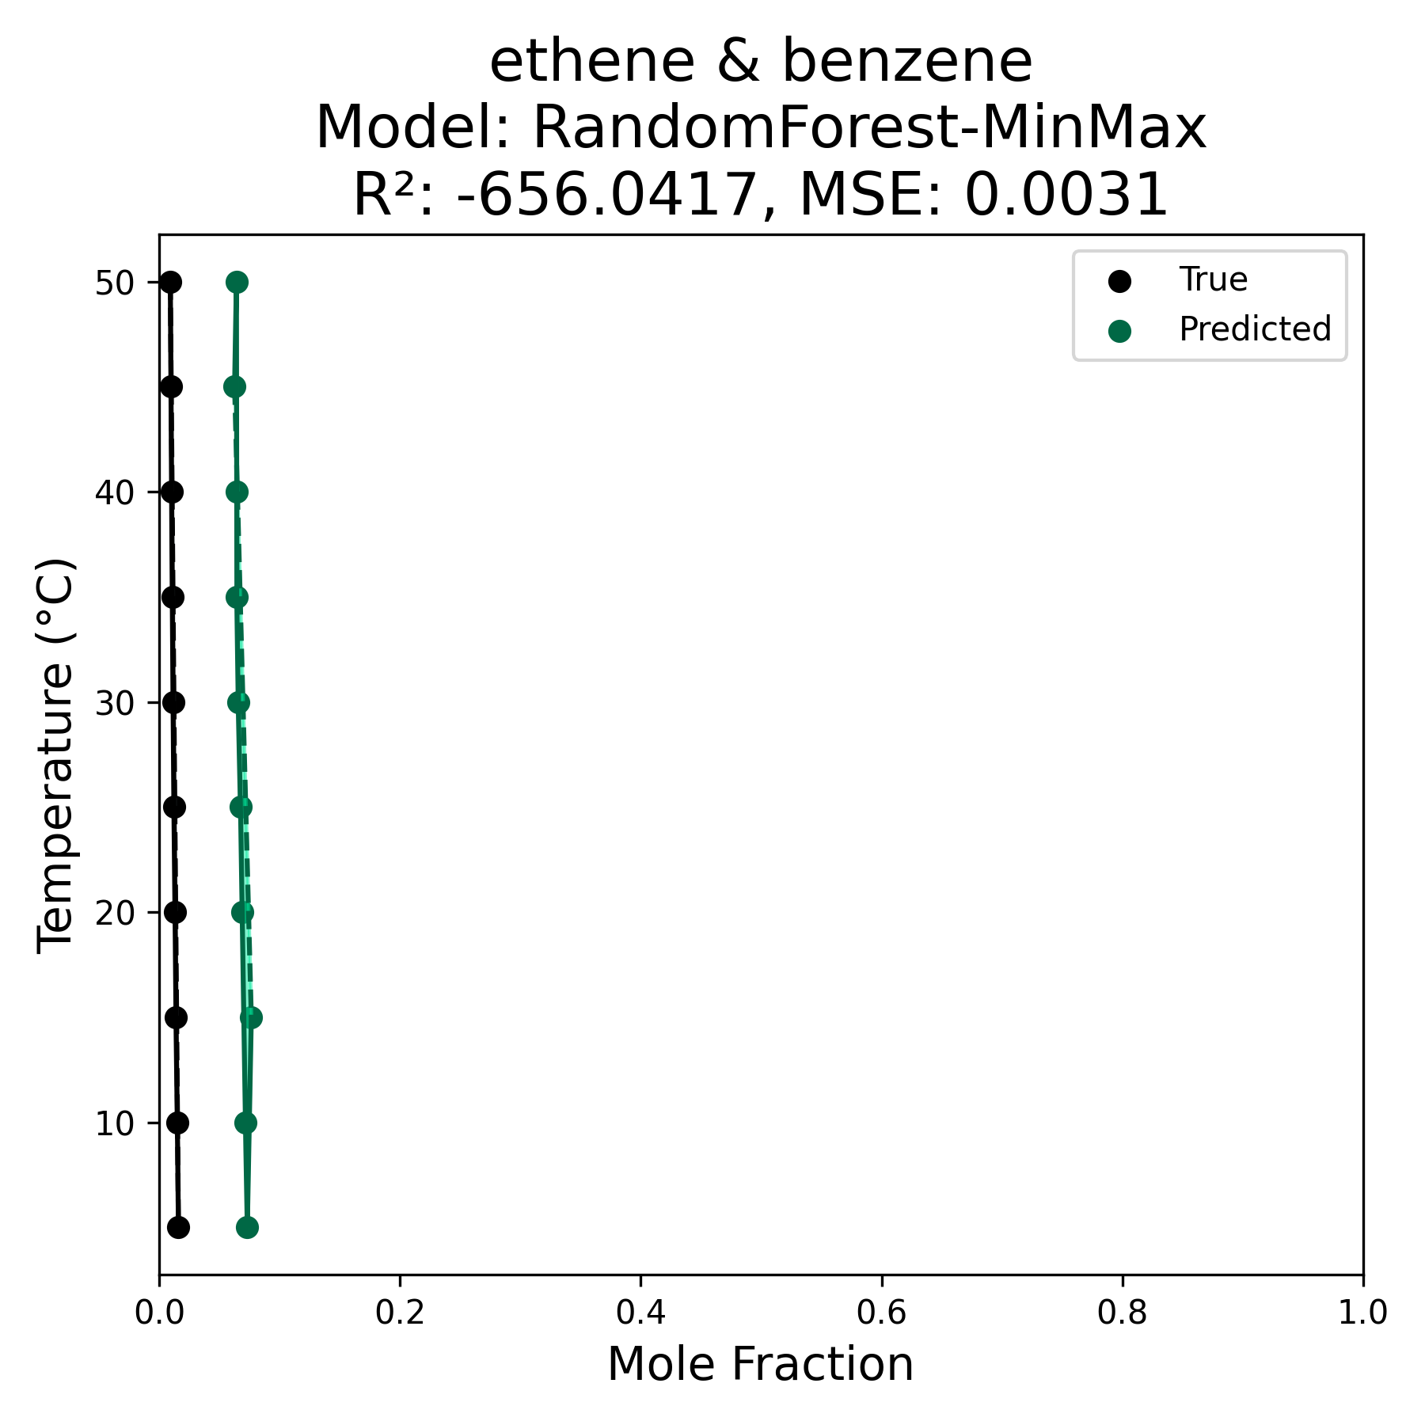
Modelling Miscibility Using Machine Learning
Joshua Cheung¹, Daniel Cançado², Thasmia Fathima³, Joanna Grundy², Samantha Kanza¹ and Jeremy Frey¹
University of Southampton ¹ Chemistry and Chemical Engineering, ² Electronics and Computer Science, ³ Engineering
Motivation
Miscibility is an important component of solubility, and has many applications, e.g. drug discovery, flow chemistry, polymer blends, and more
Traditionally modelled with quantum mechanics simulations, QSPR
Machine learning was used to model small molecule miscibility for a binary organic mixture
Huge wealth of data available, but not necessarily in an accessible format
Methodology
Collection and Retrieval
Data curated from AqSolDB, DDB VLE, IUPAC SDS
Feature Extraction
2D descriptors obtained from RDKit
Cleaning and Feature Selection
Features with < 50% distinct values, missing values removed
Scaling
Target log transformed, 5 different scaling methods (Log, MinMax, Quantile, Quantile MinMax, Log MinMax)
Data Curation and Processing
Machine Learning Models
Models tried:
RandomForest
Gradient Boosted Decision Trees (GOSS, DART, trad variants)
CatBoost
Neural Network (Input, 64 neurons with ReLU, 32 neurons with ReLU, Output with ReLU)
Support Vector Regression (SVR)
LightGBM Tree 0
Neural Network Architecture
SVR
Results
Overall, models using log transformed mole fractions performed much better than those with unscaled mole fractions (Max R² 0.93 vs 0.62, lowest MSE 2.80 vs 0.03)
Scaled mole fractions improve the overall results, but have no significant effect on results by compound pair (solvent and solute)
When comparing scores by compound pair (> 5 data points), some models appeared to vastly outperform others
Algorithms | Count |  | Total
 | Log Scaled Results | Unscaled Results
LightGBM (GOSS) | 16 | 20 | 36
LightGBM (Bagging) | 16 | 14 | 30
RandomForest | 9 | 15 | 24
Neural Network | 10 | 8 | 18
LightGBM (DART) | 6 | 5 | 11
2 of the predicted phase diagrams: Hexane and m-Xylene displaying high precision and accuracy, Ethene and Benzene illustrating high precision but low accuracy, both for type I systems
The model appeared to predict best for alkanes and carbonyls (including carboxylic acids in the carbonyl category)
Much higher proportion of those functional groups in the best predicted compound pairs (> 5 data points) than in the dataset
Conclusions and Future Work
It is possible to predict and plot liquid phase temperature-composition diagrams for a binary mixture of organic compounds using machine learning
Data scarcity and quality proved challenging, with issues such as unit conversion and data not being in an accessible format (16 968 data points in total, only 510 compound pairs with more than 4 data points); ideally, there would be more compound pairs with > 4 data points
Improving the size and quality of the dataset could lead to better model performance
Immiscible compounds (IV systems) were largely underrepresented in the dataset. Oversampling them could improve predictions.
Further expansion: building a secondary database of predicted phase diagrams, which can then be used to train a classifier.
Functional Group | % in top 20 compound pairs | % Train | % Test
Alkanes (unbranched, n > 3) | 42.1 | 10 | 13.1
Carbonyls (inc acids) | 36.8 | 23.6 | 25.6
Benzene Rings | 29 | 23.6 | 26.2
Carbonyls (excl acids) | 7.89 | 17.2 | 17.2
Furan Rings | 2.63 | 0.63 | 0.84
The percentage of compounds in each subset (top 20 highest scoring compound pairs, training set, test set) that contained a given functional group
Walas, S. M. (1985) ‘5 - Phase Diagrams’, in Walas, S. M. (ed.) Phase Equilibria in Chemical Engineering. Butterworth-Heinemann, pp. 245–297. doi: 10.1016/B978-0-409-95162-2.50013-0.
Ke, G. et al., 2017. Lightgbm: A highly efficient gradient boosting decision tree. Advances in neural information processing systems, 30, pp.3146–3154.
Breiman, L. (2001) ‘Random Forests’, Machine Learning, 45, pp. 5–32. doi: 10.1023/A:1010933404324.
Pedregosa, F. et al., 2011. Scikit-learn: Machine learning in Python. Journal of machine learning research, 12(Oct), pp.2825–2830.
Rosenbaum, Lars & Dörr, Alexander & Bauer, Matthias & Boeckler, Frank & Zell, Andreas. (2013). Inferring multi-target QSAR models with taxonomy-based multi-task learning. Journal of cheminformatics. 5. 33. 10.1186/1758-2946-5-33.
Sorkun, M. C., Khetan, A. and Er, S. (2019) ‘AqSolDB, a curated reference set of aqueous solubility and 2D descriptors for a diverse set of compounds’, Scientific Data. doi: 10.1038/s41597-019-0151-1.
Iupac (2023) Solubility Data Series. Available at: https://iupac.org/what-we-do/databases/solubility-data-series/.
‘RDKit: Open-Source Cheminformatics Software’ (2023). Available at: https://www.rdkit.org/.
This work was funded by EPSRC through grants EP/X032701/1, EP/X032663/1 and EP/W032252/1 – PSDI (Physical Sciences Data Infrastructure (PSDI) https://www.psdi.ac.uk/.

