Slide 1
DECISION-SUPPORT PROTOTYPE
Student Success Navigator
Earlier, fairer, supportive outreach after the first semester
A decision-support prototype built on one institution's public data (UCI, CC BY 4.0) — illustrative, not deployed.
model version 1.0.0
reports/model_card.md

Slide 2
THE OPPORTUNITY
02 / 10
Many students who leave show academic warning signs in their first semester
32%
Advisers have limited time to reach them. The opportunity is to prioritise voluntary, supportive conversations with the students most likely to benefit — within advisers' existing time.
of students in the historical dataset did not complete — 1,421 of 4,424.
WHAT THIS DECK DOES NOT CLAIM
MEASURED · THIS DATASET
That outreach reduces dropout. That is the hypothesis a pilot would test.
reports/tables/profile_target.csv

Slide 3
HOW IT WOULD BE USED
03 / 10
The adviser stays the decision-maker at every step
TRIGGER
MODEL
SHORTLIST
HUMAN
OUTCOME
End of semester 1
→
Support-priority score
→
Support Queue
→
Adviser reviews each record
→
Conversation, referral or dismiss
top-K list, supportive bands
The decision is recorded locally — nothing feeds back into the model.
SAFEGUARD 01
SAFEGUARD 02
SAFEGUARD 03
Human acknowledgement is required before any action is recorded.
No student identifiers and no outcome labels are shown to advisers.
Neutral academic language only.
specs/001-dropout-risk-navigator/contracts/app-pages.md

Slide 4
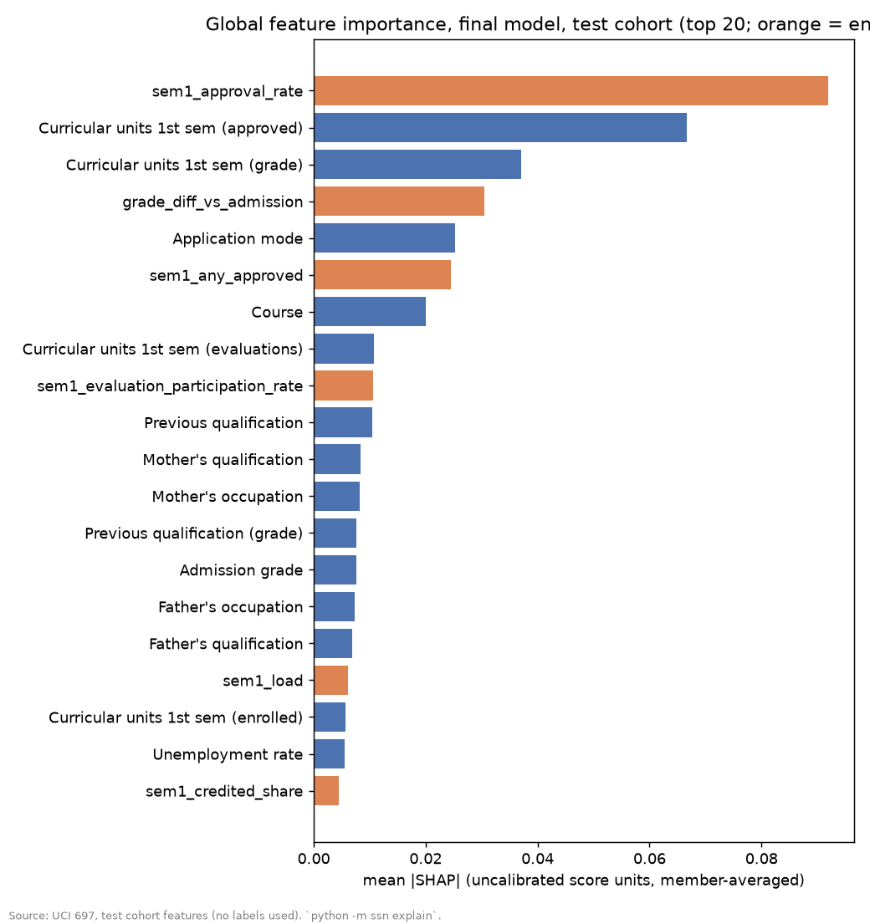
WHAT THE SCORE IS MADE OF
04 / 10
The score reflects how the first semester went, not who the student is
WHAT GOES IN
Enrollment details and first-semester results only — 21 columns plus 7 derived indicators, such as the share of first-semester units passed.
TOP DRIVERS · MEASURED, SHAP
01
sem1_approval_rate
02
Curricular units 1st sem (approved)
03
Curricular units 1st sem (grade)
04
grade_diff_vs_admission
NEVER INPUTS
Anything from the second semester · financial-status flags with unclear timing · gender, age, nationality, marital status, international status, special needs.
Full ranking: shap_global_importance.csv
reports/explainability/shap_global_importance.csv · reports/explainability/shap_global_bar.png

Slide 5
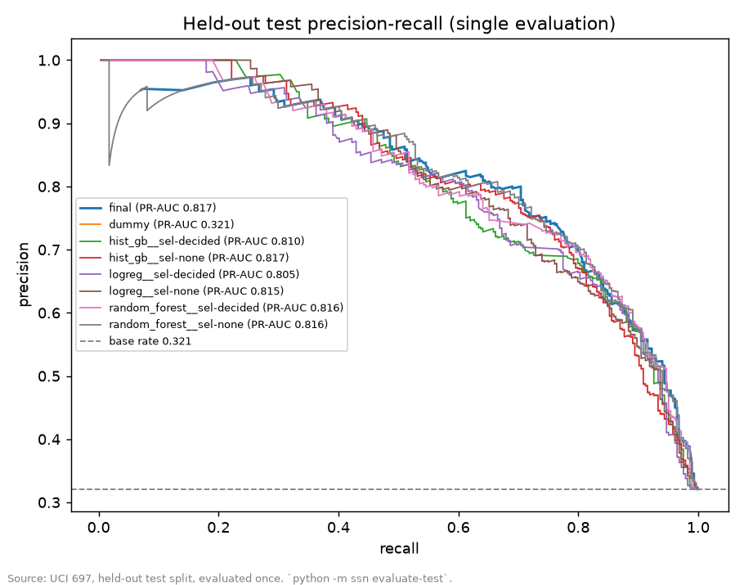
MEASURED PERFORMANCE
05 / 10
Held-out test cohort, evaluated once
885 students · 284 of them eventually dropped out
MEASURE | FINAL MODEL | CHANCE BASELINE
Ranking quality (PR-AUC) | 0.82 | 0.32
Of a top-50 list, later dropped out (Precision@K) | 96% | 42%
Calibration error (lower is better) | 0.034 | —
When the model puts a student on a 50-person list, about 96 in 100 later dropped out. For a random list it would be about 42 in 100.
Measured on one institution's historical data. A local pilot must re-measure.
reports/tables/test_metrics_all_models.csv · reports/figures/test_pr_curve.png

Slide 6
OUTREACH REACH
06 / 10
ILLUSTRATIVE ASSUMPTIONS
The two columns on the right are measured; the window and the number contacted are assumed.
Reach is limited by adviser time, not by the model
OUTREACH WINDOW illustrative | STUDENTS CONTACTED illustrative | SHARE OF EVENTUAL DROPOUTS REACHED measured recall | CONTACTED WHO DID DROP OUT measured precision
2 weeks | 20 | 7% | 95%
5 weeks | 50 | 17% | 96%
10 weeks | 100 | 33% | 93%
THE ASSUMPTION
10 conversations per adviser-week, over a 5-week window — 50 students from a cohort of 885. Illustrative assumption only.
DELIBERATELY ABSENT
No figure here is converted to money. No cost or saving data exists in this project, so none is presented.
More weeks, more students reached — and the list stays precise.
reports/tables/test_recall_precision_at_k.csv · 284 eventual dropouts in the 885-student test cohort

Slide 7
SAFEGUARDS
07 / 10
Four safeguards built into the design
Leakage-safe by construction
Sensitive attributes stay out
Only information available at the prediction point enters the model — the end of semester one. Enforced by tests.
Never model inputs and never shown as reasons. They are used only to audit outcomes by group. Enforced by tests.
A human decides, every time
A written non-use policy
Acknowledgement is required before any action is recorded. Advisers can dismiss or override. Actions stay local and never feed back into the model.
No automated or adverse decision on admission, enrollment, aid, grades, discipline or housing. Set out in the project constitution.
.specify/memory/constitution.md · reports/model_card.md

Slide 8
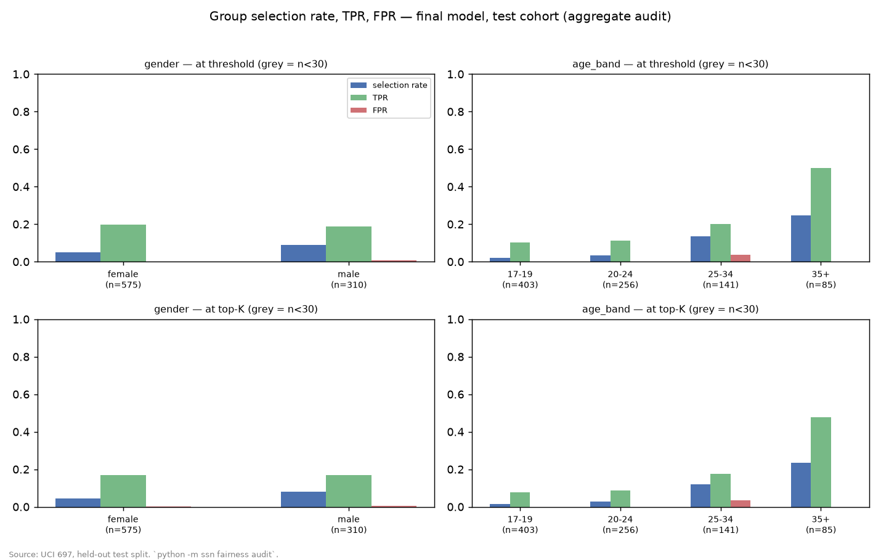
WHAT THE FAIRNESS AUDIT FOUND
08 / 10
Younger students who leave are under-reached
GROUP COMPARISON · HELD-OUT COHORT | SELECTION GAP | AMONG STUDENTS WHO DID DROP OUT, CHANCE OF BEING ON THE LIST
Women vs men | 5.0% vs 9.0% | 20% vs 19% — near equal
Age 17–19 vs 35+ | 2.0% vs 24.7% | 10% vs 50%
The list reflects historical patterns in the data. Younger students who leave are under-reached.
RECOMMENDED RESPONSE
An adviser-side rule — reserve part of the outreach list for first-years — rather than a change to the model.
reports/fairness/group_metrics.csv · reports/fairness/selection_rates.png · full discussion in reports/bias_fairness_analysis.md

Slide 9
RISKS AND GOVERNANCE
09 / 10
Risks, governance, and what a pilot would need
THE RISKS
ALREADY IN PLACE
WHAT A PILOT WOULD NEED
Historical bias in the recorded outcomes
A written constitution and a model card
Institutional approval
Proxy features — parental background, application route
A published fairness audit and a limitations statement
A local data agreement
Re-training and a fresh audit on local data
Single-institution scope
A reproducible pipeline — a fresh-environment re-run gives zero deltas
Adviser training
Small subgroups
CI on every change, and a version-checked artifact
A standing review cadence for the Equity Dashboard
Feedback loops, if the model were ever retrained on outreach data
A local action log
reports/limitations.md · reports/model_card.md · .specify/memory/constitution.md

Slide 10
NEXT STEPS AND THE ASK
10 / 10
Three decisions before any local build
01
Decide whether to pilot with local data
Under the governance set out on the previous slide — nothing here is a deployment decision.
02
Resolve the open data question with the data owner
The timing of the financial-status fields is unclear, so they are excluded today. That must be settled before any local build.
03
Design the pilot to measure what this project cannot
Whether outreach changes outcomes — the model does not show this — and how the list's composition by group moves each cycle.
THE ASK
Sponsorship for a time-boxed pilot with an equity review checkpoint — not a deployment decision.
reports/final_report.md · reports/model_card.md · model version 1.0.0

