Slide 1
TECHNICAL PRESENTATION
Fair and Explainable Student Dropout Risk Prediction for Early Academic Support
Question. At the end of a student's first semester, can we rank students so that a small, voluntary adviser outreach list reaches those most likely to leave, using only information available at that point, explainably and with a fairness audit?
Answer in one line. A calibrated random-forest pipeline on 21 enrollment-time and first-semester features reaches held-out PR-AUC 0.817 (base rate 0.321), fills an illustrative outreach list at 96% precision, and shows an equal-opportunity gap by age that advisers must compensate for.
Student Success Navigator · v1.0.0 · every number is read from files under reports/; nothing on these slides is typed by hand

Slide 2
PROBLEM FRAMING
02 / 12
Ranking for a fixed-capacity outreach list, not a verdict on a student
— Unit of analysis: one student enrollment record · Prediction point: end of first semester
— Task: binary classification, is_dropout = 1 where source Target = Dropout (Enrolled and Graduate = 0)
— Use: decision support for voluntary, supportive adviser outreach within a fixed capacity
— Non-use: no automated or adverse decision about admission, enrollment, aid, grades, discipline, housing
— Primary metric: PR-AUC (imbalance: positive rate 0.321) · Intervention metric: Recall@K and Precision@K
— Capacity assumption (ILLUSTRATIVE): 10 students/week × 5 weeks = K 50 per cohort of 885
— Governance: constitution with 12 principles and 10 quality gates; Spec Kit spec → plan → 94 tasks
specs/001-dropout-risk-navigator/ · .specify/memory/constitution.md · configs/base.yaml

Slide 3
DATASET
03 / 12
UCI 697 — one institution, 4,424 records, every code verified
— UCI ML Repository 697, Predict Students' Dropout and Academic Success (Realinho et al., 2021), CC BY 4.0, DOI 10.24432/C5MC89
— One Portuguese higher-education institution; 4,424 records × 36 features + Target; 0 missing, 0 duplicates, 0 undocumented codes
— Target: Graduate 2,209 · Dropout 1,421 · Enrolled 794 → positive rate 0.321
— Every categorical encoding copied from the UCI variables table and verified against observed codes (22 coded columns, including Gender 1 = male, 0 = female)
— Stratified 80/20 split, seed 42: train 3539 · test 885 (evaluated once)
Not representative of Philippine or other institutions; outcomes are historical and may encode institutional inequities.
reports/data_overview.md · reports/tables/profile_*.csv · configs/features.yaml

Slide 4
LEAKAGE CONTROLS
04 / 12
The feature-availability list decides what the model may see
CLASS | COLUMNS | MODEL INPUT?
Enrollment-time features | 15 | yes
First-semester features | 6 | yes
Second-semester (after prediction point) | 6 | no
Financial status, undocumented timing (Debtor, Tuition fees, Scholarship holder) | 3 | no (ambiguous)
Sensitive attributes (gender, age, nationality, international, marital, needs) | 6 | no (audit only)
— Enforced by configs/features.yaml, project_features / assert_frame_allowed, and tests that spy on every parquet read
— Cost of the guard, measured: including the 3 ambiguous columns would add 0.036–0.039 CV PR-AUC (ablation_ambiguous.csv) — a gain that may be leakage, so they stay out
— Excluding the 6 sensitive attributes costs at most 0.0065 PR-AUC (ablation_sensitive.csv)
configs/features.yaml · reports/tables/ablation_ambiguous.csv · ablation_sensitive.csv

Slide 5
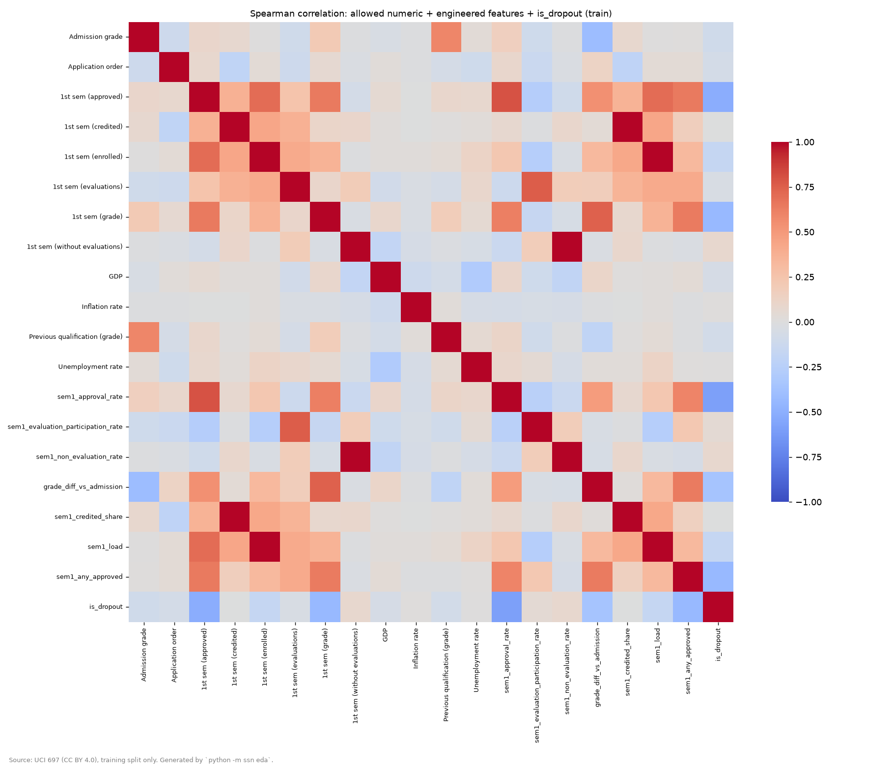
EDA (TRAINING SPLIT ONLY)
05 / 12
First-semester performance carries the signal
— First-semester approvals, approval rate and grade carry the strongest associations with dropout
— 138 training records have zero first-semester units enrolled (rate features undefined → imputed inside CV)
— Sensitive-group base rates differ widely (e.g. dropout rate 46.1% male vs 24.5% female on test): context for the audit, never a model input
reports/figures/eda_correlation_spearman.png · reports/eda_feature_engineering_report.md

Slide 6
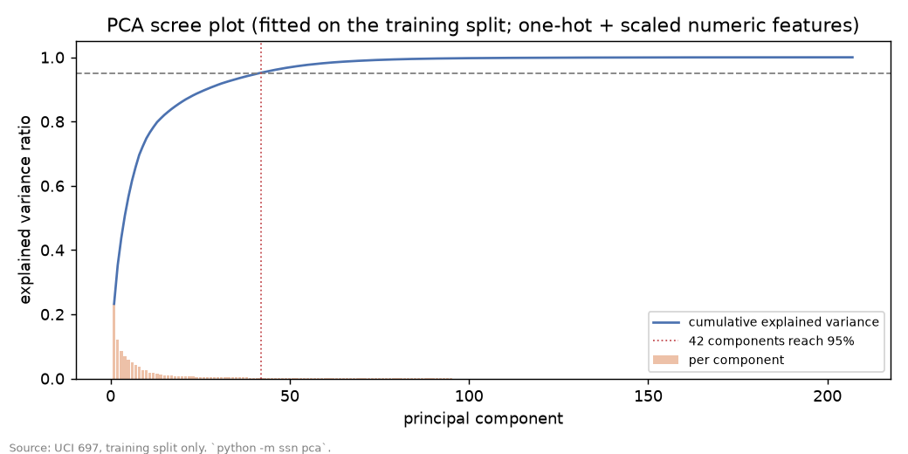
FEATURES, SELECTION, PCA
06 / 12
Selection and PCA were compared, then declined on evidence
— 7 stateless engineered features from allow-listed inputs: approval rate, evaluation participation rate, non-evaluation rate, grade change vs admission (scales matched), credited share, load, any-approved
— Preprocessing = median impute · scale · one-hot → 207 columns; all fitting inside CV folds
— Selection: mutual-information filter and L1-logistic embedded selectors over k ∈ {10…all}; keeping all 207 scored highest (0.818), embedded k = 30 within one std (0.811) → carried as a tuned variant, not imposed
— PCA: 42 components for 95% variance; PCA pipeline 0.801 vs 0.818 without → retained for analysis/visualisation only
reports/tables/selection_decision.json · pca_vs_nopca_cv.csv · reports/figures/pca_scree.png

Slide 7
MODEL COMPARISON
07 / 12
5-fold stratified CV, seed 42 — all three within one CV std
MODEL (CLASS-WEIGHTED, ALL FEATURES) | PR-AUC | ROC-AUC | PRECISION@K | BRIER | ECE
Dummy (prior) | 0.321 | 0.500 | 0.33 | 0.218 | 0.001
Logistic regression | 0.818 ± 0.017 | 0.878 | 0.97 | 0.134 | 0.096
Random forest | 0.807 ± 0.009 | 0.872 | 0.96 | 0.126 | 0.032
HistGradientBoosting | 0.811 ± 0.014 | 0.869 | 0.98 | 0.132 | 0.067
— SMOTENC lowered PR-AUC for both models it was tried on → class weighting kept
— After tuning (RandomizedSearchCV, PR-AUC), all three remain within one CV std → selection by documented rule: Recall@K, then calibration error, then fairness gap, then Brier, then fit time. Chosen: random forest, all features; isotonic calibration applied (ECE 0.054 → 0.017)
— Accuracy is reported but excluded from selection
reports/tables/cv_comparison.csv · selection_matrix_ranked.csv · calibration_decision.json

Slide 8
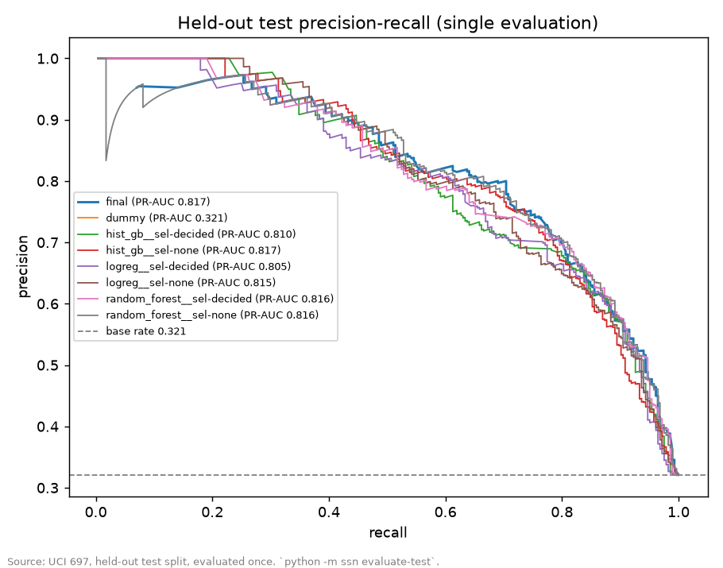
FINAL HELD-OUT EVALUATION
08 / 12
Evaluated once — `test_evaluations` = 1
 | PR-AUC | ROC-AUC | RECALL@K | PRECISION@K | BRIER | ECE
Final calibrated RF | 0.817 | 0.892 | 0.169 | 0.96 | 0.118 | 0.034
Dummy baseline | 0.321 | 0.500 | 0.074 | 0.42 | 0.218 | 0.000
— Threshold 0.9728 = OOF score at the capacity selection rate (200 of 3539); on test it selects 57 students at precision 0.965
— Recall@K is capacity-bound: K = 50 slots for 284 eventual dropouts → ceiling ≈ 0.176; a 10-week window reaches 0.327
— Test PR-AUC matches the CV estimate (0.808): no sign of selection overfitting
reports/tables/test_metrics_all_models.csv · threshold_and_bands.json · models/manifest.json

Slide 9
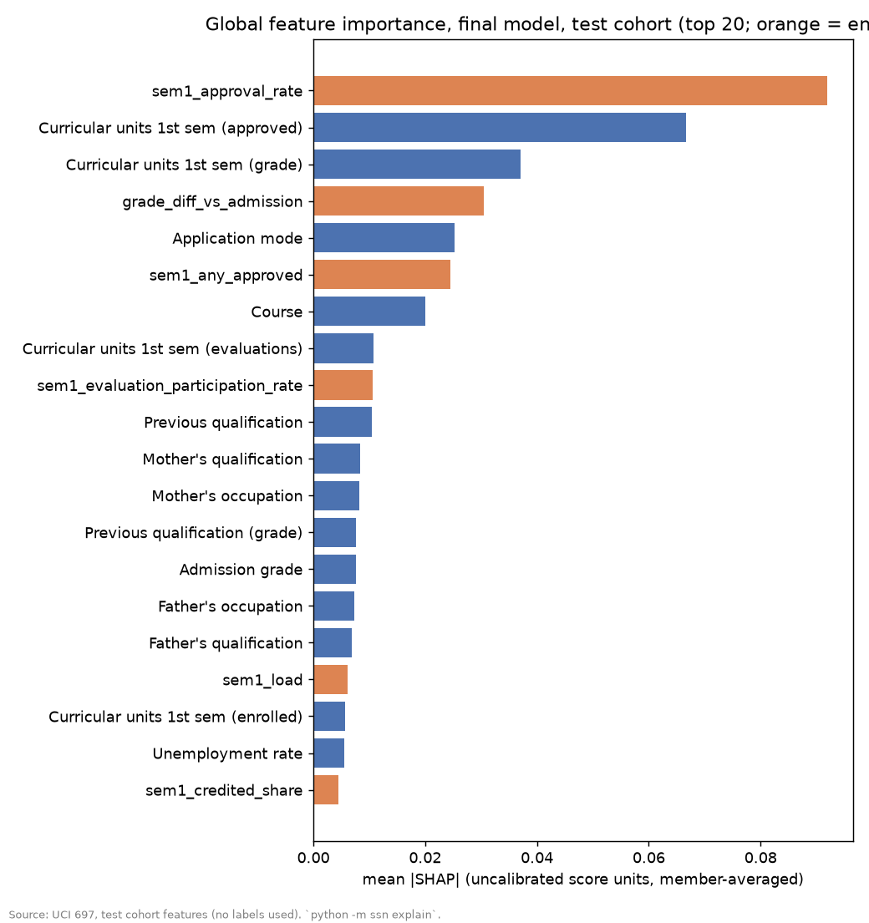
EXPLAINABILITY
09 / 12
Named features, adviser-readable reasons
— SHAP TreeExplainer on each of the 5 calibrated ensemble members, aggregated to source features, averaged; explains uncalibrated contributions
— Top drivers: sem1_approval_rate, Curricular units 1st sem (approved), Curricular units 1st sem (grade), grade_diff_vs_admission, Application mode
— Local TP / FP / FN / TN cases rendered into supportive adviser phrases (configs/language.yaml); sensitive attributes can never appear as reasons (tested)
— PDP/ICE for 9 continuous raw features; engineered features explained via SHAP only
reports/explainability/ · configs/language.yaml · tests/app/test_no_labels_rendered.py

Slide 10
FAIRNESS AUDIT
10 / 12
Gender is near-equal; age is the material finding
ATTRIBUTE | SELECTION-RATE GAP (DP) | DI RATIO | EQUAL-OPPORTUNITY GAP (TPR)
Gender (female n=575, male n=310) | 0.040 | 0.56 | 0.010
Age band (4 bands, smallest n=85) | 0.227 | 0.08 | 0.397
— Gender: list composition mirrors a two-fold base-rate difference; TPR nearly equal (0.189 vs 0.199); FPR < 1% both
— Age: the material finding. TPR 0.10 for 17–19 vs 0.50 for 35+: younger dropouts are under-reached through proxies (over-23 application route, programme, schedule)
— Mitigations on training OOF: reweighting (deployable; small parity gain, worse EO and calibration → not adopted); group thresholds (closes gender gap, needs gender at decision time → reported, not deployed)
— Recommended: adviser-side outreach-list allocation for younger bands; the Equity Dashboard shows the gap each cycle
reports/fairness/group_metrics.csv · mitigation_comparison.csv · bias_fairness_analysis.md

Slide 11
REPRODUCIBILITY AND ENGINEERING
11 / 12
Measured, not asserted — largest delta 0 on a fresh re-run
— Single seed (42), config-driven CLI (python -m ssn …), pinned requirements.txt, n_jobs=1 final fit
— Persisted pipeline + manifest: git SHA, config hash, pipeline SHA-256, library versions, exact 21-column input schema, threshold, bands, test counter
— Fresh-environment re-run: maximum absolute delta 0 across every compared table (docs/REPRODUCIBILITY.md)
— 215 automated tests: leakage (allow-list, fit isolation, parquet-read spies), privacy (no labels/sensitive columns in the demo cohort), metrics (hand-computed), artifact loading, language rules; CI on every push (lint, secrets scan, tests, language scan)
docs/REPRODUCIBILITY.md · models/manifest.json · .github/workflows/ci.yml

Slide 12
LIMITATIONS
12 / 12
What this does not establish
— Scope: one institution's history; no transfer to other institutions without re-training and re-auditing
— Proxies: parental qualification/occupation, application route, programme, schedule re-encode age and class
— Leakage guard cost: 3 excluded financial columns worth ≈ 0.037 PR-AUC; recording time still unverified (open item)
— Uncertainty: candidate differences are within CV noise; the choice rests on calibration and is documented as such
— Not causal, not production-ready, not a replacement for advisers: the tool proposes a short list; a qualified adviser decides, may override, and records the decision locally
— Full text: reports/limitations.md, reports/bias_fairness_analysis.md, reports/model_card.md
reports/limitations.md · reports/bias_fairness_analysis.md · reports/model_card.md

