Slide 1
LAT 42.34°N · LON 71.10°W · SENSOR: NAIP RGB
MASSACHUSETTS BUILT-PARCEL DETECTION
Parcel-Level Built / Not-Built
Classification from Aerial Imagery
A Convolutional Neural Network for screening municipal parcel records against current aerial imagery
DATE
APRIL 2026

Slide 2





Executive Summary
A parcel-level CNN that classifies built vs not built across three Massachusetts study areas
(Newton / Brookline, Framingham MetroWest, Worcester Edge).
Massachusetts assessors maintain ~90,000 parcel records manually. Aerial imagery offers an automatable cross-check that does not yet exist in their workflow.
Problem
A CNN that predicts whether a parcel appears built from a parcel-masked NAIP aerial crop. Output is P(built) per parcel.
Solution
Two architectures (an upgraded baseline CNN and a frozen MobileNetV2) trained on ~4,000 balanced high-confidence parcels across three Massachusetts study areas.
Approach
Both models reach the high 0.9s on AUC against the proxy labels. The upgraded baseline CNN edges MobileNetV2 on accuracy (0.948 vs 0.922) and matches it on AUC (0.989 vs 0.980).
Result
A working parcel-built classifier and an end-to-end pipeline. The originally proposed label-error screening queue is honest future work, contingent on a manually verified evaluation set.
Deliverable
02 / 19

Slide 3



Objective & Business Case
Manual parcel review is expensive. An accurate aerial classifier is the precondition for any downstream cross-check against the records.
The task:
Binary image classification: “Given a parcel-masked NAIP aerial crop, is the parcel built?”
THE STATUS QUO
Tax rolls, building values, and MA property classification codes are organized at the parcel level, so the unit of work for assessors is the parcel, not an arbitrary image tile.
Most parcels are uncontroversial.
A residential lot with a clearly visible house; an obviously empty lot. Reviewing every parcel by hand spends scarce assessor time on cases that do not need it.
Who benefits & how it is used
BENEFICIARIES
Municipal assessors, urban planners, GIS teams running periodic vacant-parcel audits.
SCOPE OF THIS PROJECT
DELIVERABLE
The supervised task is parcel-level built/not-built classification. Using model output as a label-error screening queue is a downstream use case that needs separate validation.
An accurate parcel-level classifier; honest scoping of what comes next.
Source: MA property classification codes; MassGIS public records
03 / 19

Slide 4



Data
Three public datasets, three Massachusetts study areas, ~4,000 balanced high-confidence labeled parcels
Data sources
Sampling funnel
90,409
Raw parcels collected
MassGIS Property Tax Parcels
Observation unit (one parcel = one example)
ArcGIS FeatureServer · public
72,665
After geometry cleaning
MassGIS Building Structures 2-D
67,136
High-confidence label filter
Source of proxy labels & QA overlays
ArcGIS FeatureServer · public domain
4,001
Sampled candidates (~50/50)
NAIP Aerial Imagery
RGB inputs, 0.6–1.0 m resolution
3,994
Usable masked crops
Microsoft Planetary Computer STAC API
built = 1 if building overlap ≥ 50 m²
Newton/Brookline (urban)
Proxy Label Rule
Framingham (suburban)
built = 0 if zero overlap and ≥ 5 m to nearest footprint
Worcester edge (lower density)
Source: MassGIS Property Tax Parcels & Building Structures 2-D; NAIP via Microsoft Planetary Computer STAC API
04 / 19

Slide 5
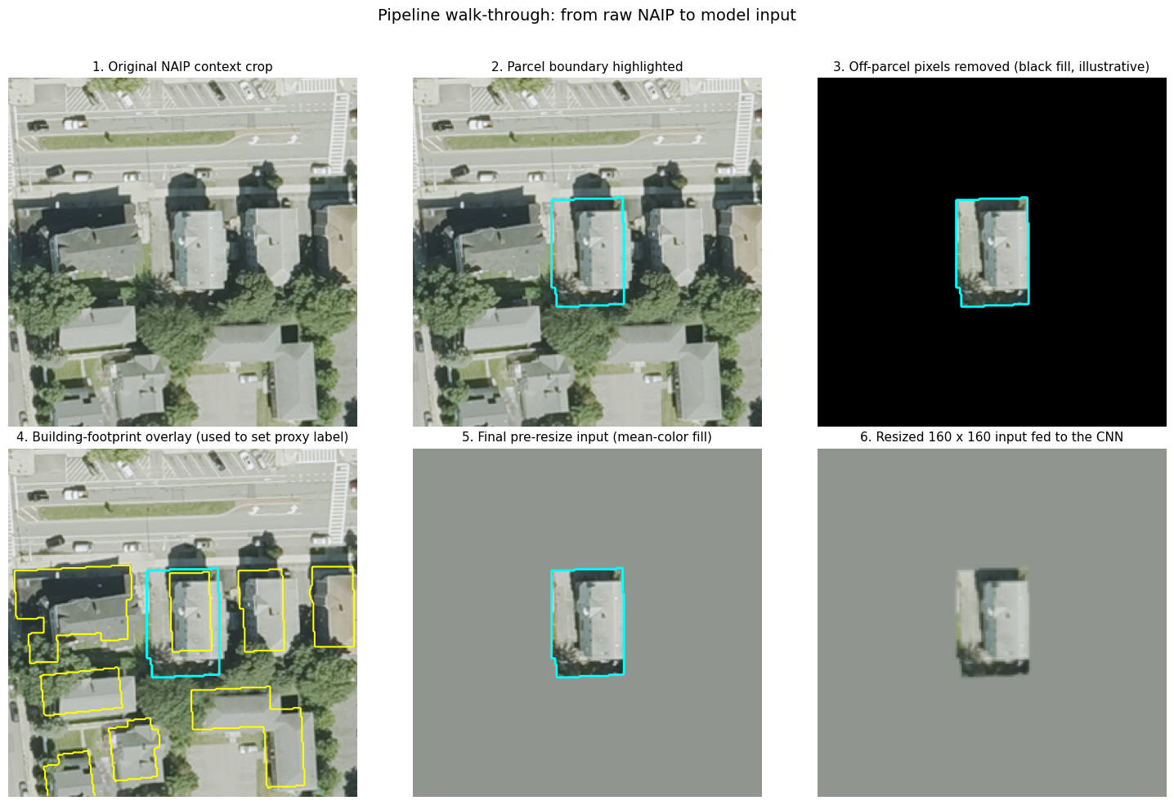
Pre-Processing Pipeline
Each parcel becomes a 160×160 masked aerial crop, with off-parcel pixels filled by the parcel mean color
1
2
3
4
5
Original NAIP context crop
Parcel boundary highlighted
Building overlay → proxy label
Mean-color fill (model input)
Resized 160×160 input tensor
Aerial RGB tile around the parcel
Vector geometry overlaid in cyan
Footprint overlap defines the label
Off-parcel pixels filled with original tile’s mean RGB
Final tensor fed to the CNN
Five deterministic steps. One 160×160 RGB tensor per parcel. Off-parcel pixels are filled with the parcel mean color rather than black so the model cannot use the parcel outline as a free shortcut feature.
Mean-color fill applied to off-parcel pixels; final input resized to 160×160
06 / 19

Slide 6
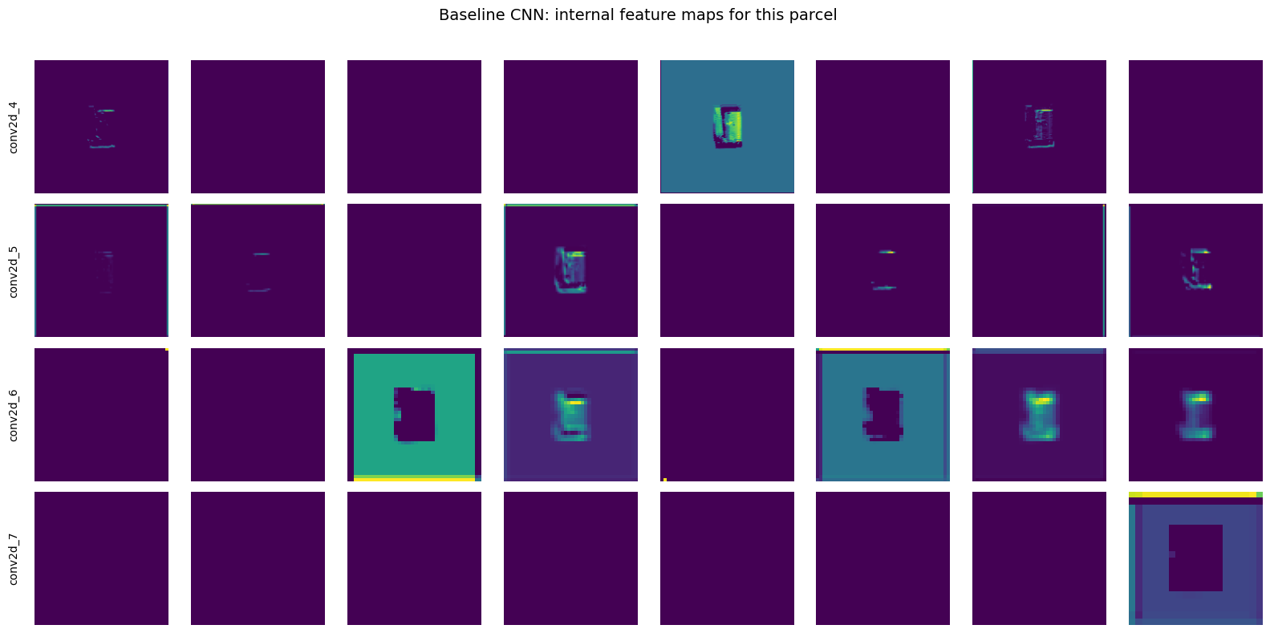
Baseline CNN Architecture
A four-block CNN with BatchNorm, channel doubling, global average pooling, and a sigmoid output
Built-in augmentation
Flip H+V · Rot/Zoom/Contrast 0.10
Input
Conv 32
Conv 64
GAP
Conv 128
Dense
ReLU
Conv 256
σ
P(built)
0–1
160 × 160 × 3
80 × 80 × 32
40 × 40 × 64
20 × 20 × 128
10 × 10 × 256
256
128
ARCHITECTURE CHOICES
FEATURE MAP EVOLUTION
Activations from one test parcel, sampled at each conv depth. The network learns to localise the structure in shallow layers and abstract its silhouette in deep layers.
01
02
03
Channel doubling + spatial halving
Global Average Pooling ✔ Flatten ✘
Binary cross-entropy + sigmoid
Each block 2X filter count (32→256) while 0.5X spatial size (160→10). Shallow layers detect edges; deep layers compose abstract structural cues.
GAP collapses 10×10×256 to a 256-vector by averaging each channel. Drops ~25K params vs. Flatten+Dense, reduces overfit, and adds translation invariance.
Loss penalises confident wrong predictions > uncertain ones, which matters with proxy labels. Sigmoid output is continuous P(built).
Input
Conv 32
Conv 64
Conv 128
Conv 256
shallow ← representational depth → deep
Architecture: 4 × (Conv2D 3×3 + BN + ReLU + MaxPool) → GAP → Dense 128 (L2) → Dropout 0.40 → Sigmoid · ~422K parameters · Implemented in Keras / TensorFlow 2.19
08 / 19

Slide 7


Transferred Learning Across a Pre-Trained Model
MobileNetV2: pretrained ImageNet backbone (frozen) with a trainable head of ~82K parameters
FROZEN
TRAINABLE
Input
MobileNetV2
GAP
Dense
Sigmoid
σ
160×160×3
Pretrained on ImageNet · Feature extractor
~2.34M parameters · not trained
~82K parameters · the only thing that learns
P(built)
Trainable share: 82,049 / 2,340,033 ≈ 3.5% of total parameters
Hyperparameters & training setup (both models)
OPTIMIZER
BATCH SIZE
EPOCHS
CALLBACKS
Adam, lr = 1e-3
32
30 (baseline) / 15 (MobileNet)
EarlyStopping & ModelCheckpoint on val_auc (patience 5)
CLASS WEIGHTING
TRAIN / VAL / TEST SPLIT
LOSS
AUGMENTATION
~1.0 / ~1.0 · sample is balanced 50/50
70 / 15 / 15 · stratified, fixed seed
Binary cross-entropy
Baseline: Flip H+V · Rot/Zoom/Contrast 0.10 · MobileNet: Flip H · Rot 0.05
MobileNetV2 backbone pretrained on ImageNet; convolutional base frozen
09 / 19

Slide 8
Performance
Both models reach 0.92+ accuracy and ~0.99 AUC; the upgraded baseline edges MobileNetV2 on most metrics
Model
Accuracy
AUC
Precision
Recall
TAKEAWAY
Naive (majority class)
0.50
0.50
0.50
1.00
The upgraded baseline CNN matches or beats MobileNetV2 on every metric except recall.
Baseline CNN
0.95
0.99
0.97
0.93
MobileNetV2
0.92
0.98
0.91
0.93
BatchNorm, stronger augmentation, L2 weight decay, and the now-balanced training set close the gap to MobileNetV2 and slightly surpass it on accuracy and precision.
MobileNetV2's recall edge is essentially a tie (0.933 vs 0.930), and it comes at the cost of more false positives. Either model is usable for the parcel-built classification task.
Test set: 599 parcels, stratified 15% holdout (~50% built / ~50% not built). Best checkpoint per val_auc.
ACCURACY (TEST SET, 599 PARCELS)
Naive (majority class)
0.50
Baseline CNN
0.95
MobileNetV2
0.92
Same 599-parcel held-out test set; threshold P(built) ≥ 0.5 for all three.
Test set: 599 parcels (15% stratified holdout). Decision threshold: P(built) ≥ 0.5
11 / 19

Slide 9
Confusion Matrices
The upgraded baseline CNN holds false positives to 10 of 599; both models keep recall in the low 0.930s
Baseline CNN
MobileNetV2
10 false positives · 21 false negatives
27 false positives · 20 false negatives
PREDICTED
PREDICTED
not built
built
not built
built
not built
289
10
not built
272
27
built
21
279
built
20
280
What this means: Both matrices are roughly symmetric around the diagonal. The baseline is more conservative about predicting "built" (only 10 false positives), MobileNetV2 is slightly more eager (27). Errors at this scale (47 total for baseline, 47 for MobileNetV2) are tractable for follow-up analysis.
Test set: 599 parcels. Decision threshold: P(built) ≥ 0.5
12 / 19

Slide 10
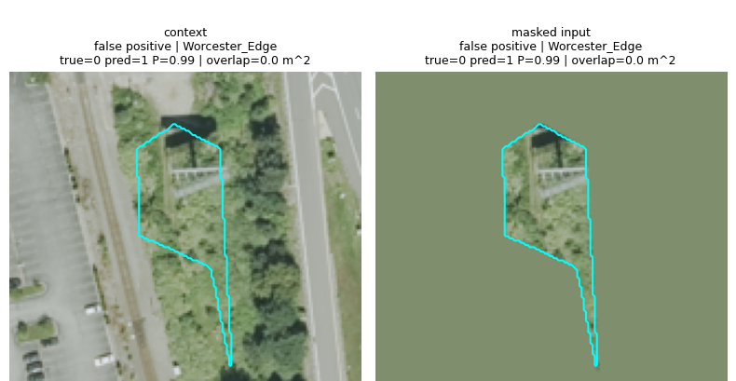
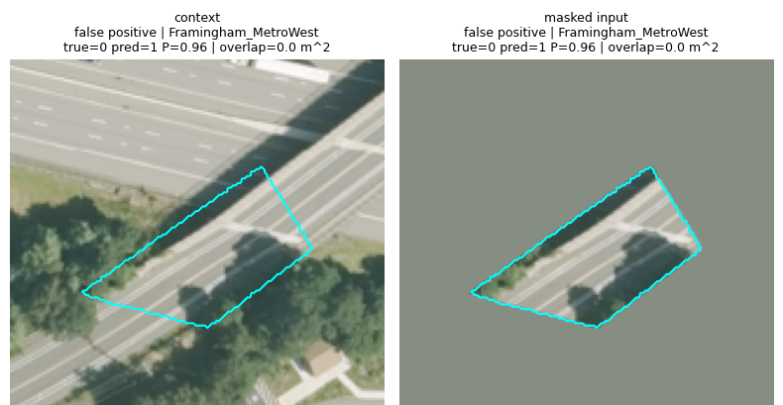
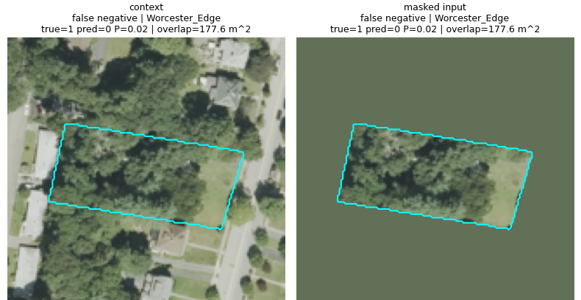
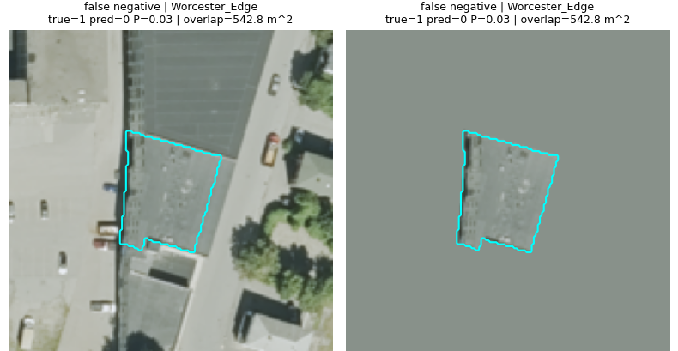
Error Analysis
High-confidence model errors found by manual inspection of the disagreement set
FALSE POSITIVE
FALSE POSITIVE
FALSE NEGATIVE
FALSE NEGATIVE
TRUE
0 (not built)
TRUE
0 (not built)
TRUE
1 (built)
TRUE
1 (built)
PRED
1 (built)
PRED
1 (built)
PRED
0 (not built)
PRED
0 (not built)
CONFIDENCE
P = 0.99
CONFIDENCE
P = 0.96
CONFIDENCE
P = 0.02
CONFIDENCE
P = 0.03
Open land. Model over-predicts built from neighboring built-up context.
Paved or vegetated parcel. Shared roof patterns bleed in despite the mask.
Building present but small or partially occluded by tree canopy.
Building visible to a human eye, but model misses it from this angle.
The model is the side that is wrong on these high-confidence disagreements. The originally proposed label-error screening queue assumed disagreements would surface label errors. They surface model errors instead. Validating the screening use case requires a manually verified evaluation set.
Confidences shown are MobileNetV2 output P(built); high-confidence disagreements only
14 / 19

Slide 11
Real-World Implementation
Proposed pipeline. Routing model disagreements as a reviewer queue requires validating the screener use case first.
01
02
03
04
INGEST
SCORE
FLAG
REVIEW
Pull current parcel inventory and latest NAIP imagery via STAC API on a quarterly schedule.
Run the trained classifier over each masked parcel crop. Output: P(built) ∈ [0,1] for every parcel.
Compare model prediction to record. Disagreements are candidates for downstream validation, not yet a verified reviewer queue.
Assessor reviews the queue in their existing GIS tool. Decisions feed the next training round.
AT PRODUCTION SCALE
~90K
<2 min
~5,500
PARCELS / RUN
INFERENCE TIME
MODEL DISAGREEMENTS
Across the three pilot study areas
On a single GPU at batch size 32
At ~7.8% disagreement (47/599 in test); not a reviewer queue without validation
DESIGN PRINCIPLE
Human-in-the-loop, never autonomous. The model never updates a record. It only changes which parcels reach a reviewer first, and only once we have evidence that those candidates are worth reviewing.
Production estimates extrapolated from the test-set disagreement rate (47/599 ≈ 7.8%); reviewer-queue validity pending
16 / 19

Slide 12
Conclusion, Recommendations & Next Steps

Slide 13



Conclusion
A working parcel-built classifier; the originally proposed screener use case is honest future work
94%
47
1
TEST ACCURACY
MODEL ERRORS / 599
STEP IN A LARGER WORKFLOW
Both the upgraded baseline CNN (0.948) and frozen MobileNetV2 (0.922) reach high-0.9s test accuracy and ~0.99 AUC against the proxy labels.
MobileNetV2 disagrees with the records on 47 of 599 test parcels (~7.8%). Manual inspection: these are model errors, not label errors.
The classifier is delivered. Validating it as a label-error screener requires a manually verified evaluation set (see Recommendations).
Limitations: labels are proxy (not verified ground truth); imagery and footprint capture dates can disagree; train/test splits are stratified by parcel, not by municipality; the screener use case was not empirically validated on this run. seasonal changes that can shift foliage color may confuse model. parcel level data difficult to extrapolate beyond MA
Proxy labels derived from MassGIS Building Structures 2-D footprint overlap
17 / 19

Slide 14









Recommendations & Next Steps
Three workstreams to mature the proof-of-concept
Data & Labeling
Model
Deployment
0-3 months
3-6 months
6-12 months
Collect a manually verified evaluation set to score the model against true labels, not just proxy labels
Fine-tune MobileNetV2's upper blocks after the head converges, to see how much ImageNet adapts to aerial
Treat the human-reviewed disagreement queue as second-stage labeled data
Run a by-municipality holdout (train on two areas, test on the third) to measure geographic generalisation
Add the NAIP near-infrared (NIR) band as a 4th input channel; vegetation-vs-built discrimination should improve
Train a dedicated inconsistency-flagging model on top of that reviewed data
Replace mean-color outside-parcel fill with a small context ring around the parcel
Surface results inside the assessor's existing GIS workflow rather than as a standalone tool
PHASED ROLLOUT
0-3 months
Establish ground truth
3-6 months
Iterate on the model
6-12 months
Deploy with assessor team
Phasing reflects relative effort, not committed timeline
18 / 19

Slide 15
Questions?
THANK YOU

