Slide 2
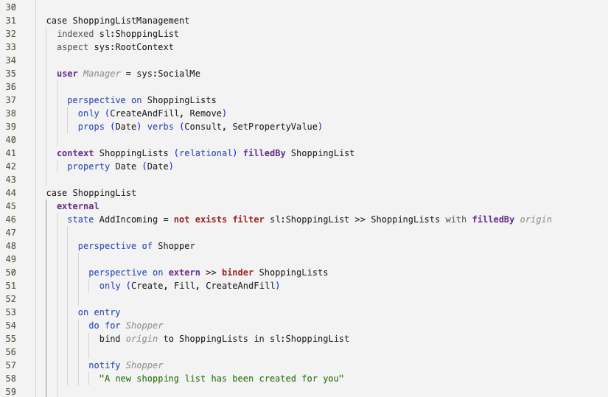
context = ShoppingListManagement
object =
ShoppingLists
subject = Manager
object = ShoppingLists
context = ShoppingList
object =
ShoppingLists
subject = Shopper
subject = Shopper
subject = Shopper

