Slide 1

Flutter and Friends
Cross-platform Mobile-App SDKs

Slide 2
Prequel
I am joining the ATOP team
Developing an application digitize professor evaluations

Slide 3
Outline
Introduction
Flutter
React
OutSystems
Conclusion

Slide 4
Introduction
What do we want?
Simple cross-platform development!
What is cross-platform development?
Why do we care?
Considering three tools: Flutter, React Native, OutSystems
To get out of the way…
Some we won’t consider: Ionic, PhoneGap
These are actually web apps that pretend to be native apps
Slower than native apps

Slide 5

Flutter
What is it?
Google’s new mobile app SDK
Uses Dart language, compiles down to native code
Pros
Dart is not Javascript
Most cutting-edge tool the space right now
Best iOS/Android support
Open-source project supported by Google
Hot-reload feature
Cons
Dart is not Javascript (or another familiar language)
Still quite new

Slide 6

React Native
What is it?
Facebook’s attempt at a cross-platform mobile SDK!
Based on the popular React Javascript framework
Around since 2015
Pros
Based on familiar React paradigm
By far the biggest player in the space – well-proven
Open-source project backed by Facebook
Cons
Flutter has better cross-compatibility with iOS
Uses Javascript in a space it’s not totally designed for

Slide 7
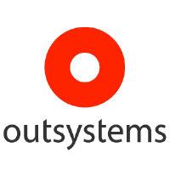
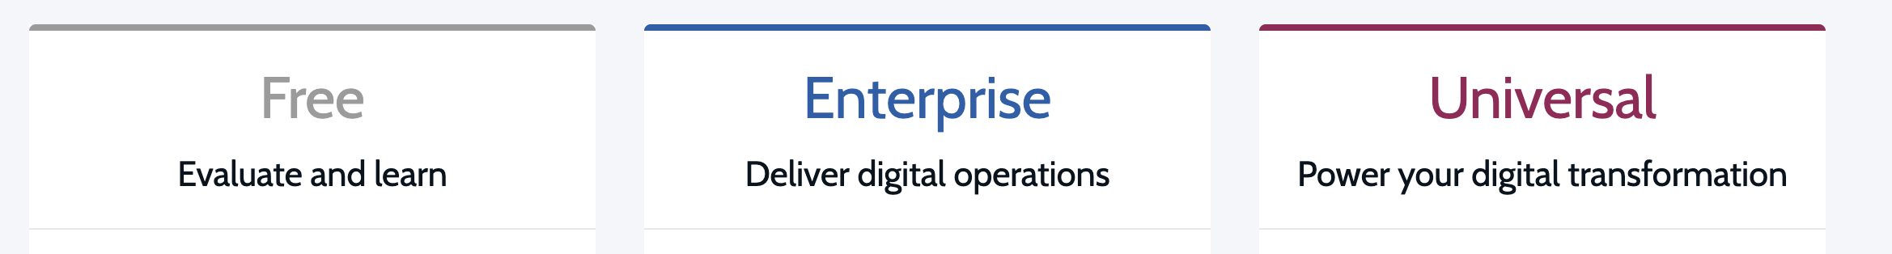

OutSystems
Low-code platform that allows really easy app-building
Three tiers:
Cost:

Slide 8
Conclusion
OutSystems
Targeted to people/corporations with a lot of money
React Native
Biggest player in the space
Excellent backing, track record
Flutter
Extremely cutting-edge
Doesn’t have a huge track record…
…but is backed by Google
Flutter is the disruptor in this space

Slide 9
Flutter it is!

Slide 10
Questions?

