Slide 1
ATOP (Assess the one who profess)
Jooseppi Luna Shraddha Kharche Shruti Jain

Slide 2
PROBLEM STATEMENT
Student Evaluation : paper pen
Steps:
Professor distributes evaluation
Students fills out evaluation
Evaluation submitted to authority

Slide 3
USER PERSONA
Chair of the Department/ Assistant to Chair
Faculty Members
Students

Slide 4
CASE STUDIES
Hybrid App vs Native App
Mobile App SDK’s
Flutter
React Native
Mobile Backend as a Service
Firebase
Apple Cloudkit
AWS

Slide 5
ARCHITECTURE

Slide 6
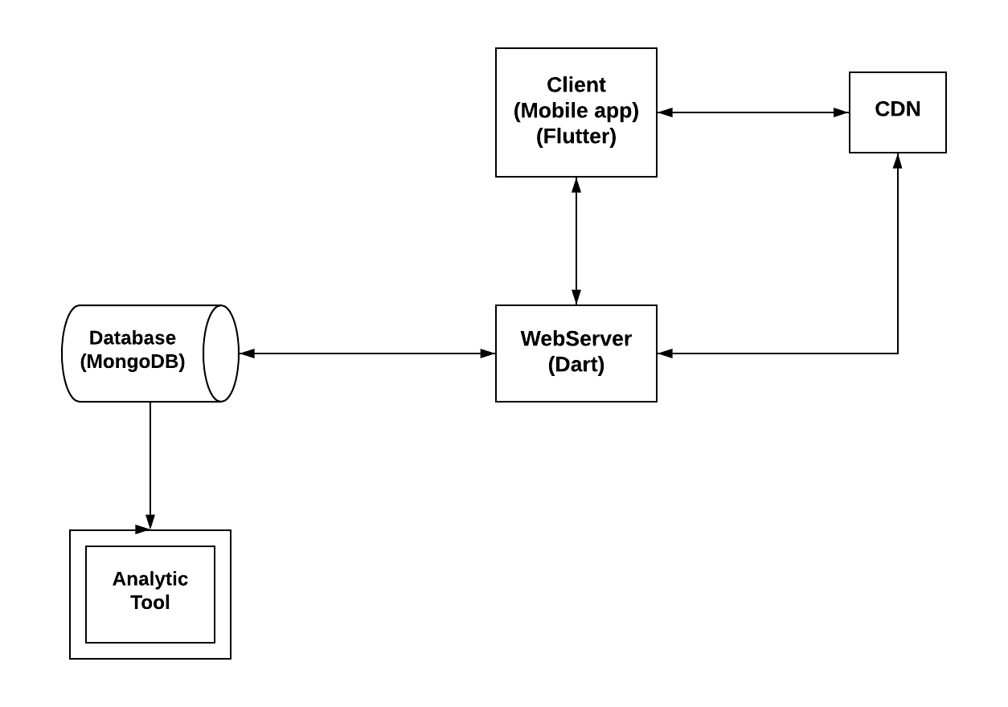
THE BEGINNING

Slide 7
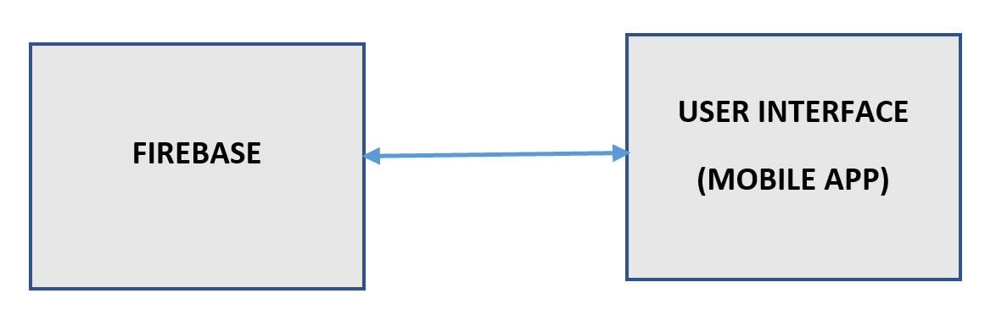
THE END

Slide 8
DEMO

Slide 9
FUTURE WORK
Authentication
Detailed Analysis
More intuitive UI

Slide 10
LEARNING CURVE
Framework: Flutter
Language: Dart
BaaS (Backend-as-a-Service): Firebase

Slide 11
THANK YOU

