Slide 1
Web advanced
PHP: forms

Slide 2
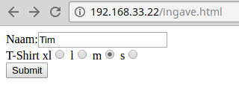
$_GET
... <form action="verwerking.php" method="get"> Naam:<input type="text" name="naam"></input><br/> T-Shirt xl<input type="radio" name="tshirt" value="xl"/> l<input type="radio" name="tshirt" value="l"/> m<input type="radio" name="tshirt" value="m"/> s<input type="radio" name="tshirt" value="s"/><br/> <input type="submit"> </form>
Notes:
*
07/16/96
*

Slide 3

$_GET
Naam:<?php print( $_GET['naam'] ); ?><br/> T-Shirt <?php print( $_GET['tshirt'] ); ?>
name, value
(form)
Notes:
*
07/16/96
*

Slide 4
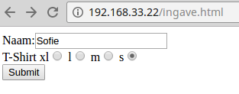
$_POST
... <form action="verwerking.php" method="post"> Naam:<input type="text" name="naam"></input><br/> T-Shirt xl<input type="radio" name="tshirt" value="xl"/> l<input type="radio" name="tshirt" value="l"/> m<input type="radio" name="tshirt" value="m"/> s<input type="radio" name="tshirt" value="s"/><br/> <input type="submit"> </form>
Notes:
*
07/16/96
*

Slide 5
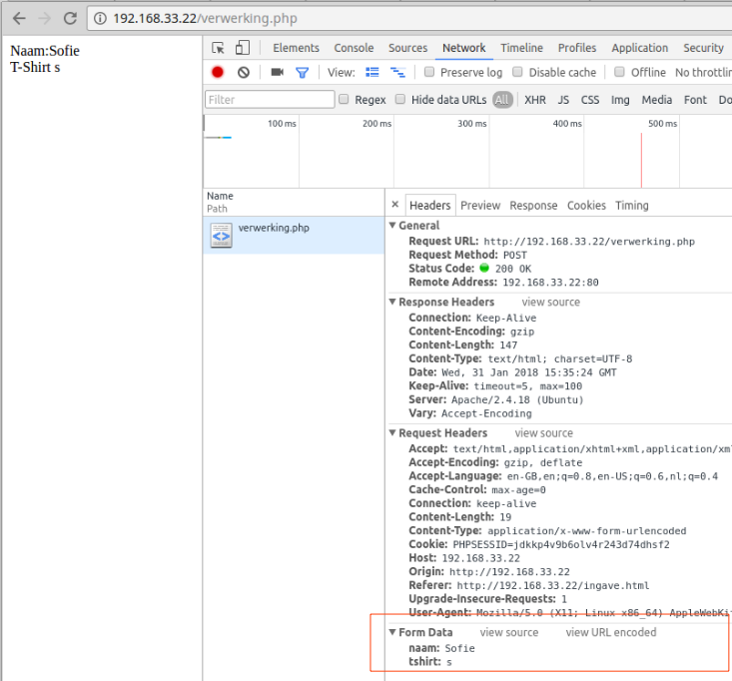
$_POST
Naam:<?php print( $_POST['naam'] ); ?><br/> T-Shirt <?php print( $_POST['tshirt'] ); ?>
chrome developer tools (ctrl-shift-i)
Notes:
*
07/16/96
*

Slide 6
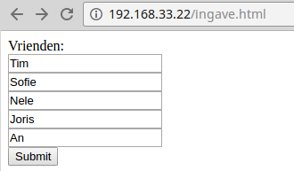
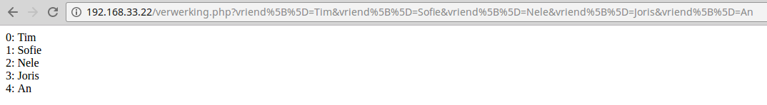
Array van waarden
<form action="bevestig.php" method="get">
Vrienden:<br/>
<input type="text" name="vriend[]"><br/>
<input type="text" name="vriend[]"><br/>
<input type="text" name="vriend[]"><br/>
<input type="text" name="vriend[]"><br/>
<input type="text" name="vriend[]"><br/>
<input type="submit">
</form>
urlencoding: %5B = [ %5D = ]
<?php
foreach ( $_GET['vriend'] as $index => $vriend ) {
print( $index. ': '. $vriend . '<br/>' );
}
?>
Notes:
*
07/16/96
*

Slide 7
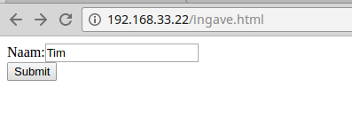
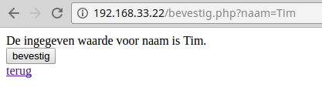

Hidden input
De ingegeven waarde voor naam is
<?php print($_GET['naam']);?>.
<form action="verwerking.php" method="get">
<input type="hidden" name="naam"
value="<?php print($_GET['naam']);?>"/>
<input type="submit" value="bevestig" />
</form>
Notes:
*
07/16/96
*

Slide 8
Cookies
<?php setcookie ('taal', 'NL', time() + 24 * 60 *60 ); ?> <!DOCTYPE html> <html lang="en"> <head> <meta charset="UTF-8"> <title>plaatscookie</title> </head> <body> Cookie geplaatst </body> </html>
Notes:
*
07/16/96
*

Slide 9
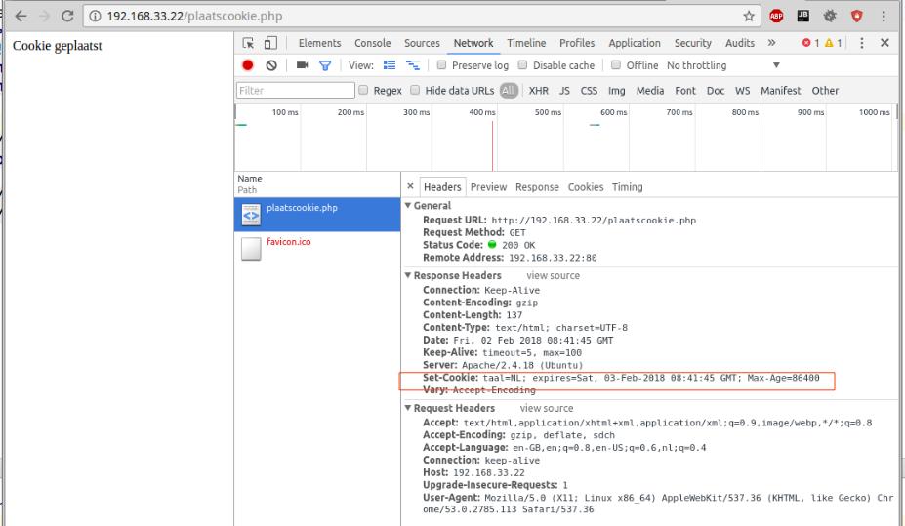
Cookies
Notes:
*
07/16/96
*

Slide 10
Cookies
<!DOCTYPE html> <html lang="en"> <head> <meta charset="UTF-8"> <title>leescookie</title> </head> <body> <?php foreach( $_COOKIE as $key => $value ) { print( $key. ' : '. $value ); } ?> </body> </html>
Notes:
*
07/16/96
*

Slide 11
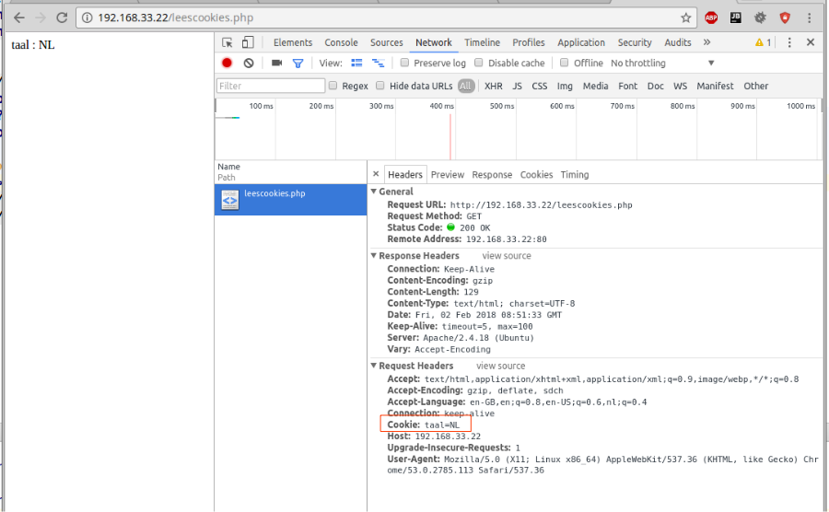
Cookies
Notes:
*
07/16/96
*

Slide 12
Sessions
Gegevens op server (ook cookie met session_id op client)
plaatsen:
<?php
session_start();
$_SESSION['name'] = 'Sofie';
uitlezen
<?php
session_start();
print( $_SESSION['name'] );
Notes:
*
07/16/96
*

