Slide 1

Technology Trends and Developer Demographics Analysis
Stack Overflow Developer Survey Data
Prepared by: Joost Kinnaer
Date: 23-01-2026

Slide 2


OUTLINE
Executive Summary
Introduction and Objectives
Methodology
Programming Language Trends
Database Trends
Dashboard Analysis
Key Insights and Implications
Conclusion

Slide 3

EXECUTIVE SUMMARY
Programming language usage concentrates around a small set of dominant programming languages.
Future preferences mirror today, with only limited but visible movement toward newer alternatives.
Databases remain relational, while interest in cloud-native and NoSQL options is steadily increasing.
Adoption patterns differ by age, region, and education level.
The dashboard brings together current usage, expected direction, and respondent characteristics in one view.

Slide 4

INTRODUCTION
Purpose:
• Understand technology trends shaping how software developers work now and next.
• Link developer profiles to adoption patterns to clarify who uses what, and why.
Audience:
• Technology decision-makers setting direction and priorities.
• Developers and students planning skills and career paths.
• Organizations making forward-looking technology investments.
Value:
• Clear, data-backed insight into how developer preferences are shifting.
• Practical guidance for skills planning and technology strategy decisions.

Slide 5

METHODOLOGY
Data Source:
• Stack Overflow Developer Survey dataset (survey_data_updated.csv)
Data Collection:
• Global survey of software developers
• Dataset provided as a structured CSV file
Data Preparation:
• Multi-choice responses were separated and summarized.
• Values split and aggregated using Python
• Technology usage counts computed in advance
• Aggregated dataset uploaded to IBM Cognos Analytics

Slide 6
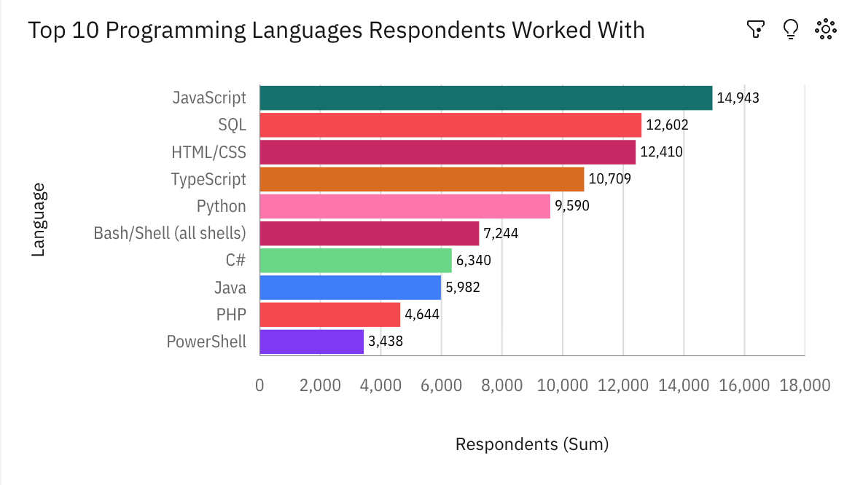
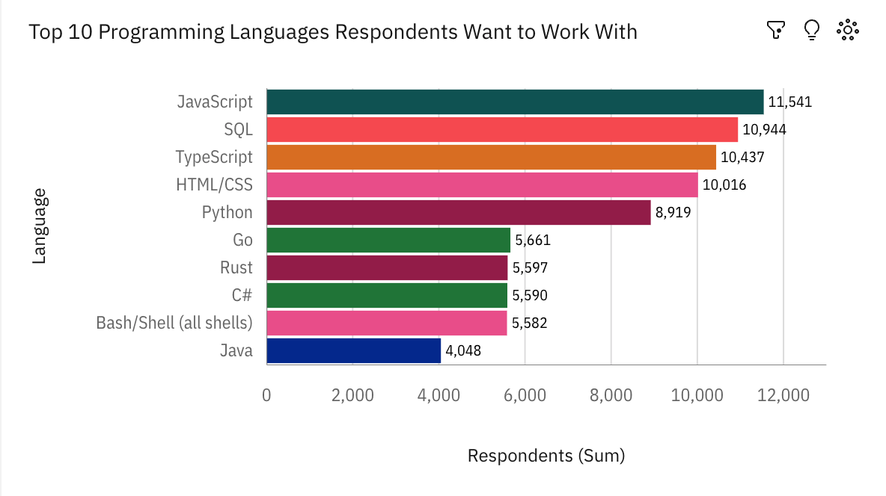
PROGRAMMING LANGUAGE TRENDS
Current Year
Next Year

Slide 7
PROGRAMMING LANGUAGE TRENDS - FINDINGS & IMPLICATIONS
Findings:
Usage concentrates in a small number of languages, which cover most current use and most stated future interest.
Future demand aligns with existing skills, pointing to gradual evolution rather than major shifts.
Emerging languages attract disproportionate interest compared with their current level of use.
Implications:
Core languages remain the main foundation of developer capability.
Skill updates will be needed to keep pace with newer or fast-evolving languages.
Training can focus on widely used languages, with targeted investment in selected emerging ones.

Slide 8
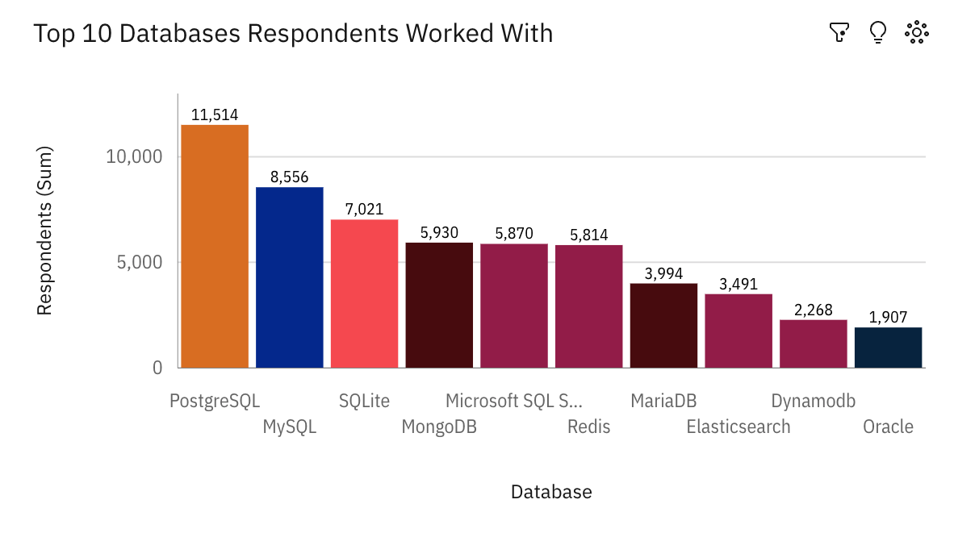
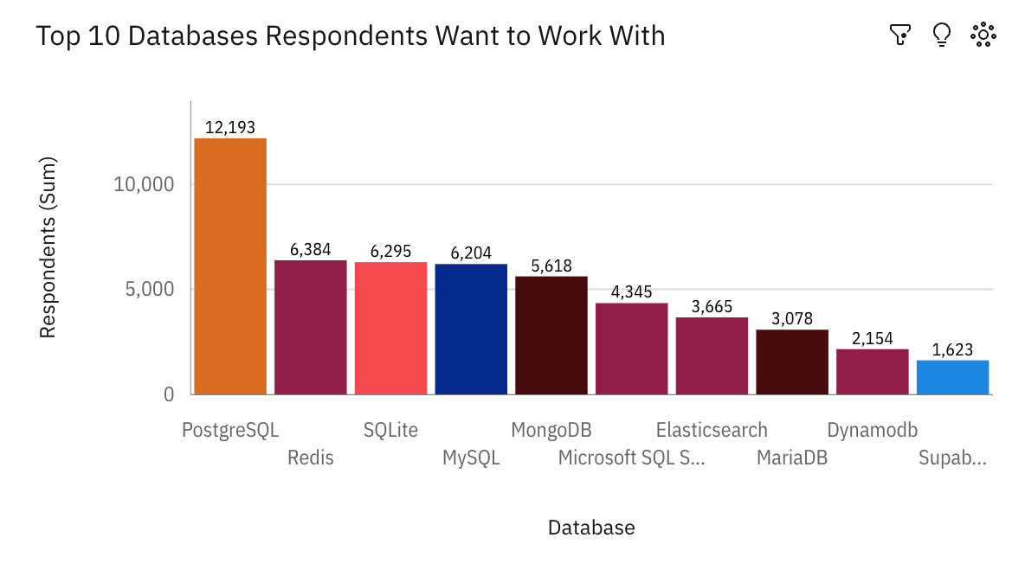
DATABASE TRENDS
Current Year
Next Year

Slide 9
DATABASE TRENDS: FINDINGS & IMPLICATIONS
Findings:
SQL and relational databases remain widely used across teams.
Interest is rising in cloud-based, scalable database solutions.
Developers work across both established and newer data platforms.
Implications:
SQL skills stay highly relevant.
Cloud-native database familiarity is growing in importance.
Platform choices should balance operational stability with selective adoption of newer technologies.

Slide 10

DASHBOARDS
Dashboard Overview:
Current Technology Usage
Future Technology Trends
Demographics

Slide 11
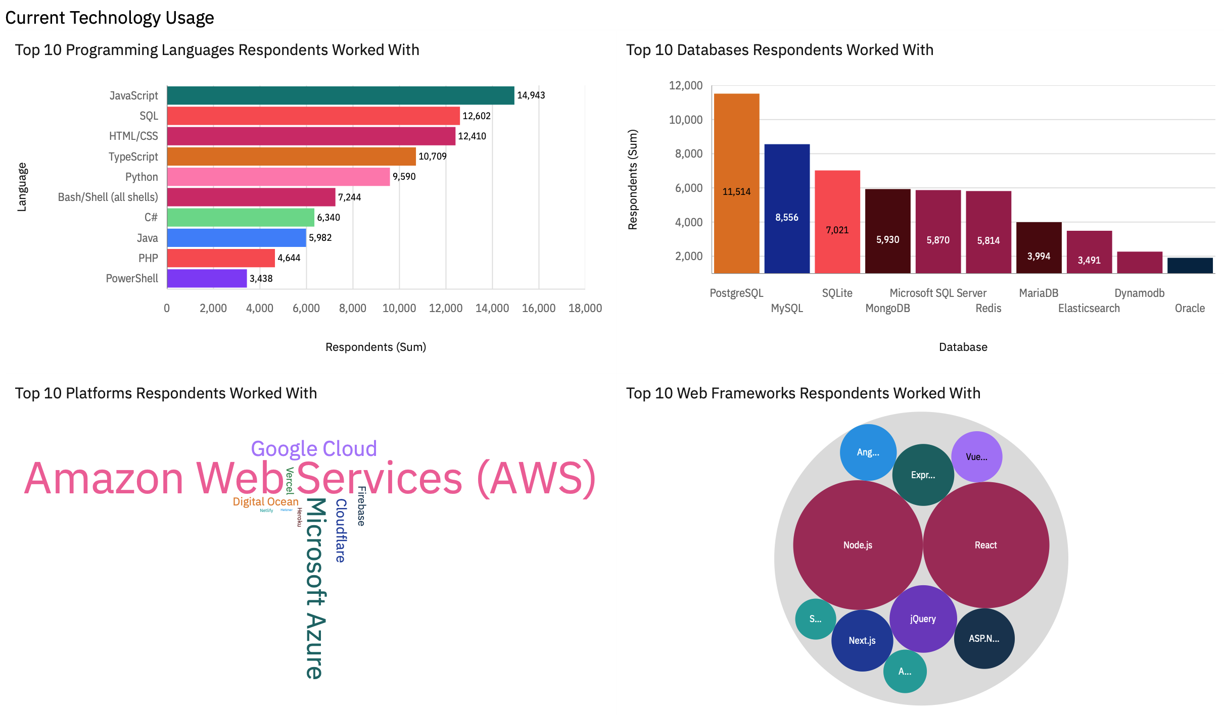
DASHBOARD: Current Technology Usage

Slide 12
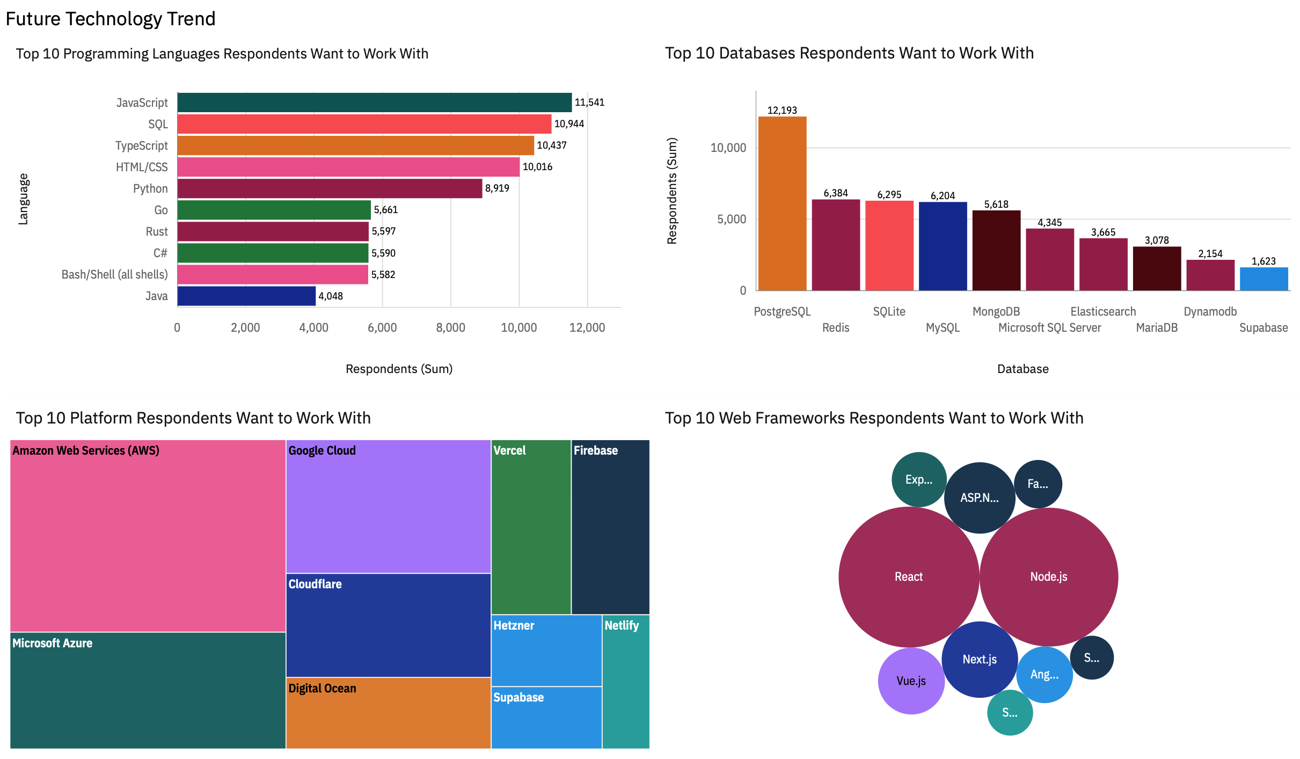
DASHBOARD: Future Technology Trends

Slide 13
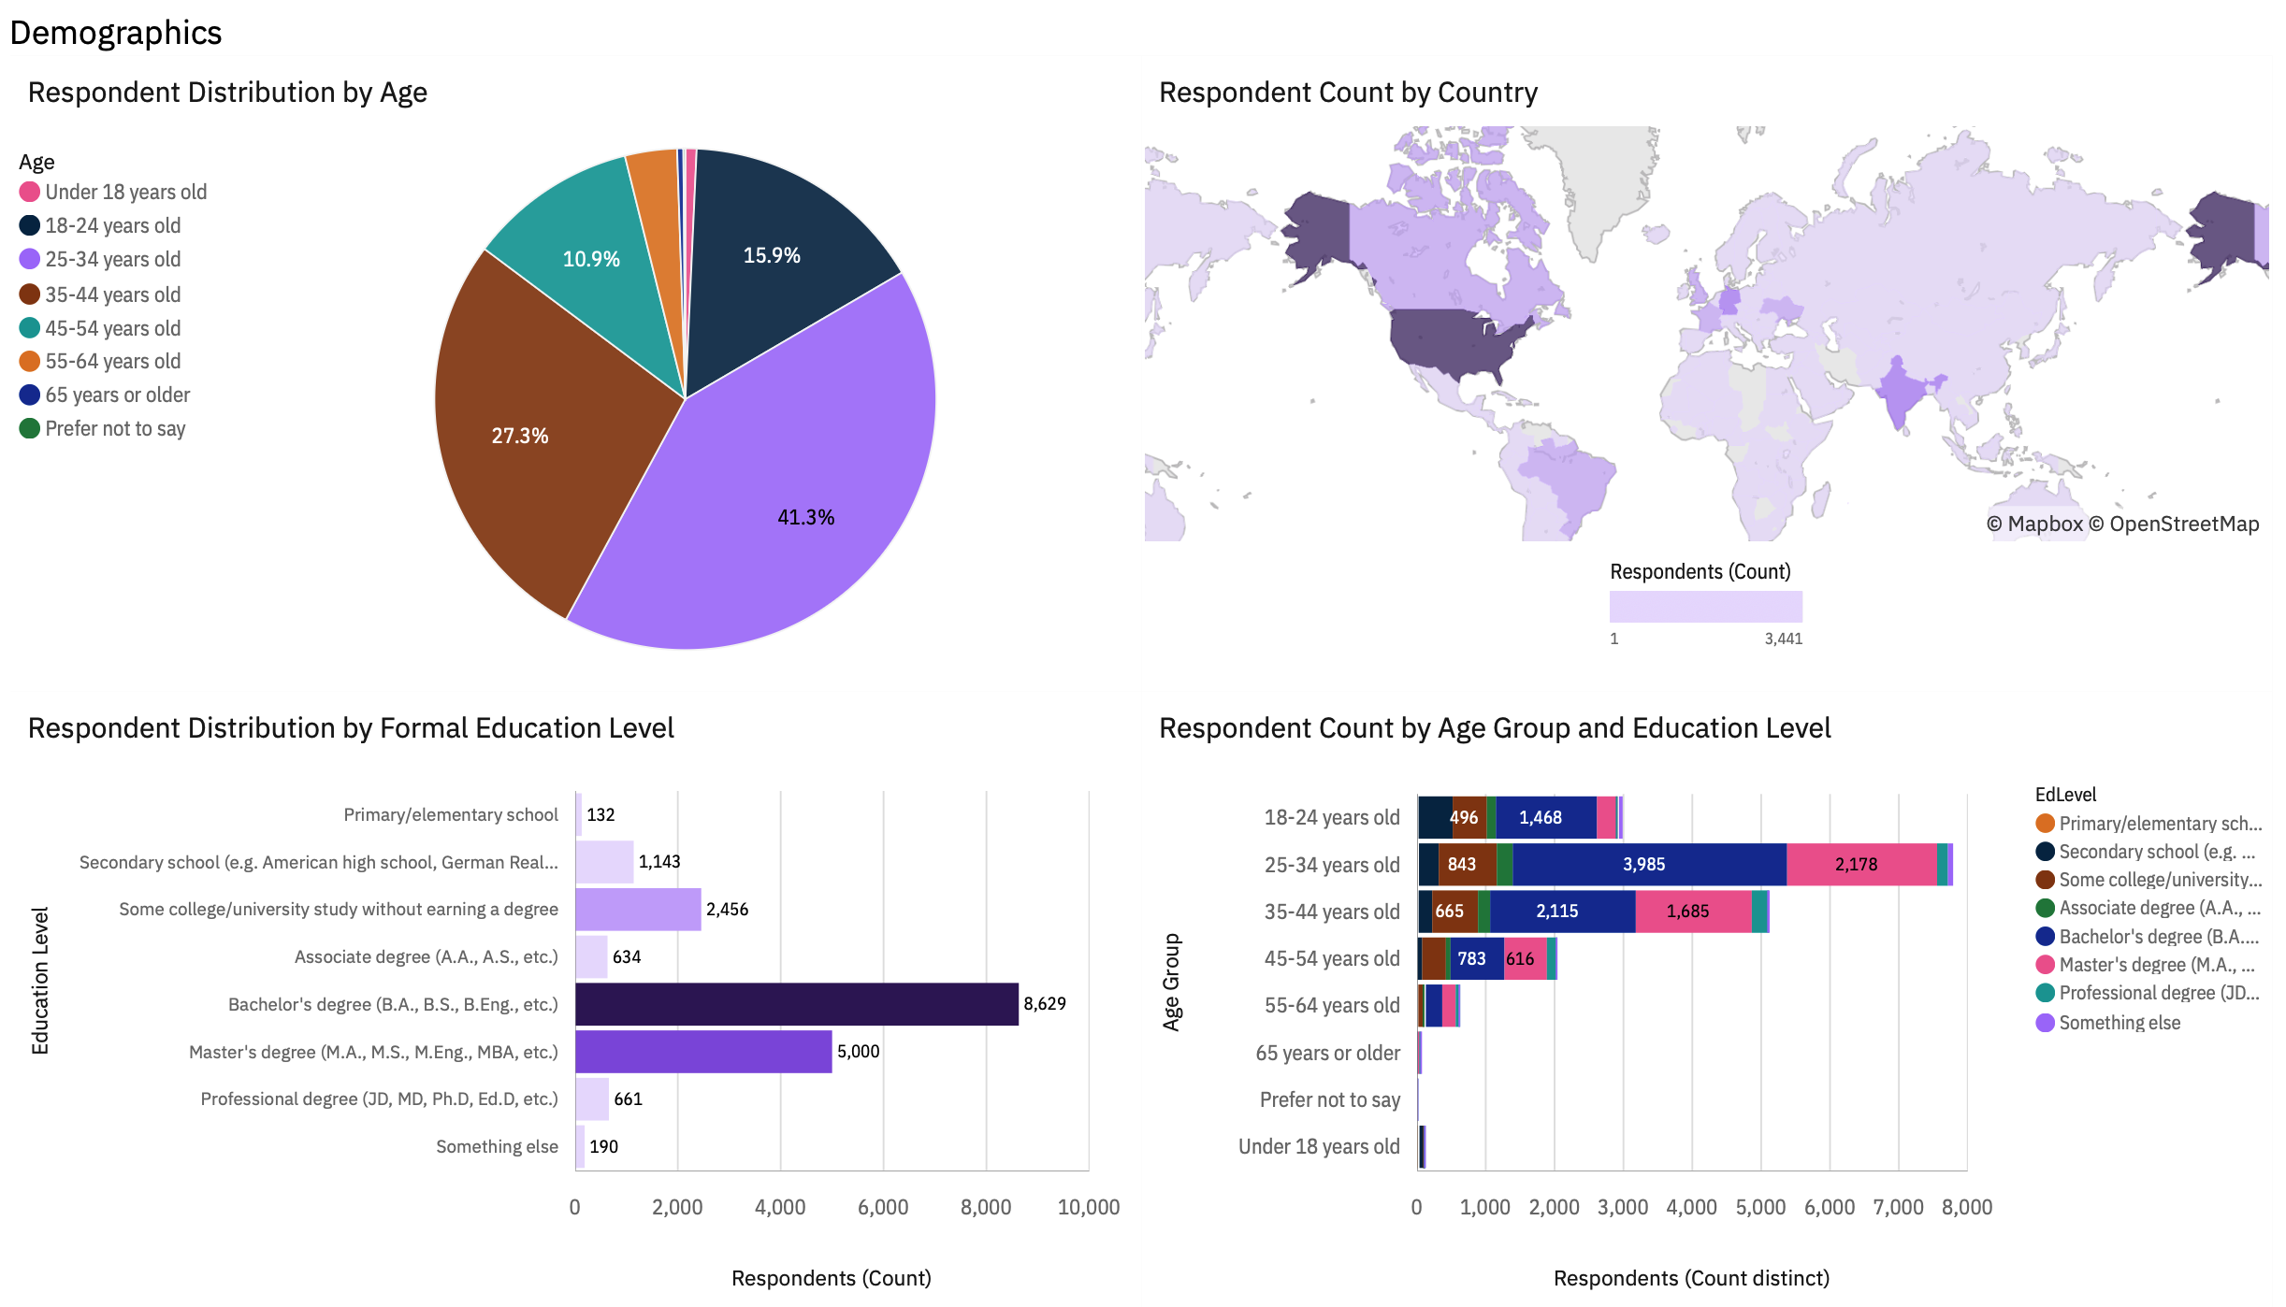
DASHBOARD: Demographics

Slide 14
Insights from Dashboard
PostgreSQL and AWS lead both current use and future interest, pointing to continuity rather than disruption.
Web frameworks rotate slightly, but preferences remain concentrated in the same leading technologies.
Future interest mirrors current adoption, suggesting gradual change instead of replacement.
Responses skew toward mid-career professionals with Bachelor’s or Master’s degrees, which shapes the overall pattern.
Geographic input is uneven, with the U.S. exerting outsized influence on the trends.

Slide 15
Overall Findings & Implications
Overall Findings:
Developer ecosystems balance stability with gradual change.
Core technologies stay dominant, while new tools gain adoption slowly.
Broader Implications:
Developers should build strong fundamentals while keeping an eye on emerging trends.
Organizations can use survey results to guide hiring and training choices.
Data-based insights support more informed long-term technology planning.

Slide 16

CONCLUSION
The analysis highlights key patterns in programming languages and databases.
Dashboards enable clear exploration of current and future technology use.
Demographic context adds meaning to the observed technology trends.
Overall, the findings support more informed decision-making in the technology sector.

