Slide 1



NHS Scotland - Semantic Report | by Joost Kinnaer
View in Power BI
Last data refresh:
17/02/2026 16:30:41 UTC
Downloaded at:
18/02/2026 10:03:22 UTC

Slide 2
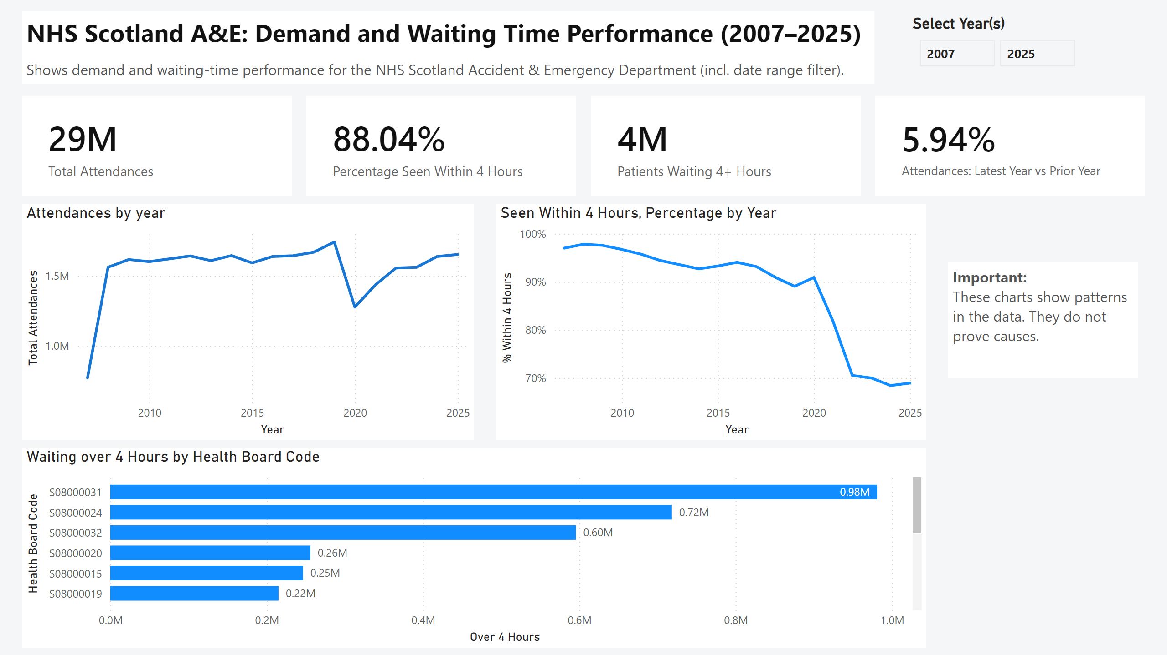
Executive Overview
Notes:
cardVisual
No alt text provided
cardVisual
No alt text provided
cardVisual
No alt text provided
Total Attendances
No alt text provided
textbox
No alt text provided
textbox
No alt text provided
Select Year(s)
No alt text provided
Waiting over 4 Hours by Health Board Code
No alt text provided
Seen Within 4 Hours, Percentage by Year
No alt text provided
Attendances by year
No alt text provided
textbox
No alt text provided

Slide 3
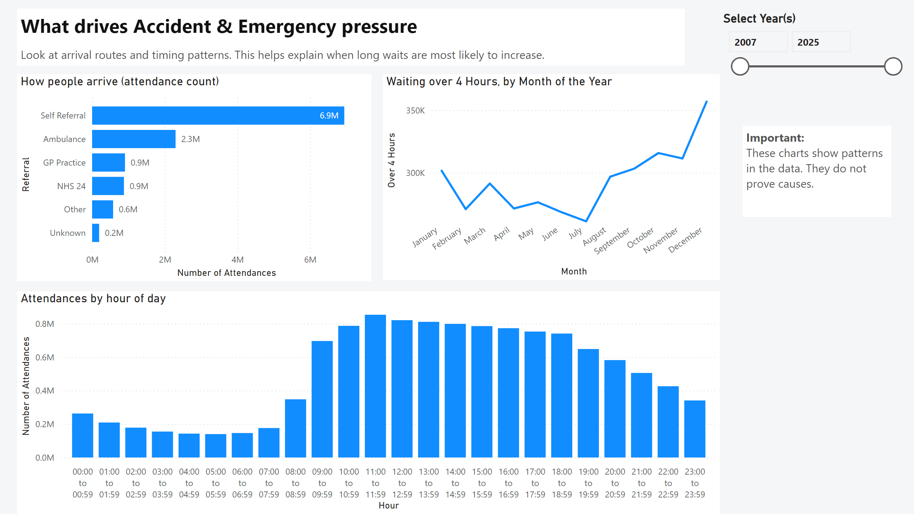
Drivers
Notes:
How people arrive (attendance count)
No alt text provided
Select Year(s)
No alt text provided
textbox
No alt text provided
textbox
No alt text provided
textbox
No alt text provided
Attendances by hour of day
No alt text provided
Waiting over 4 Hours, by Month of the Year
No alt text provided

Slide 4
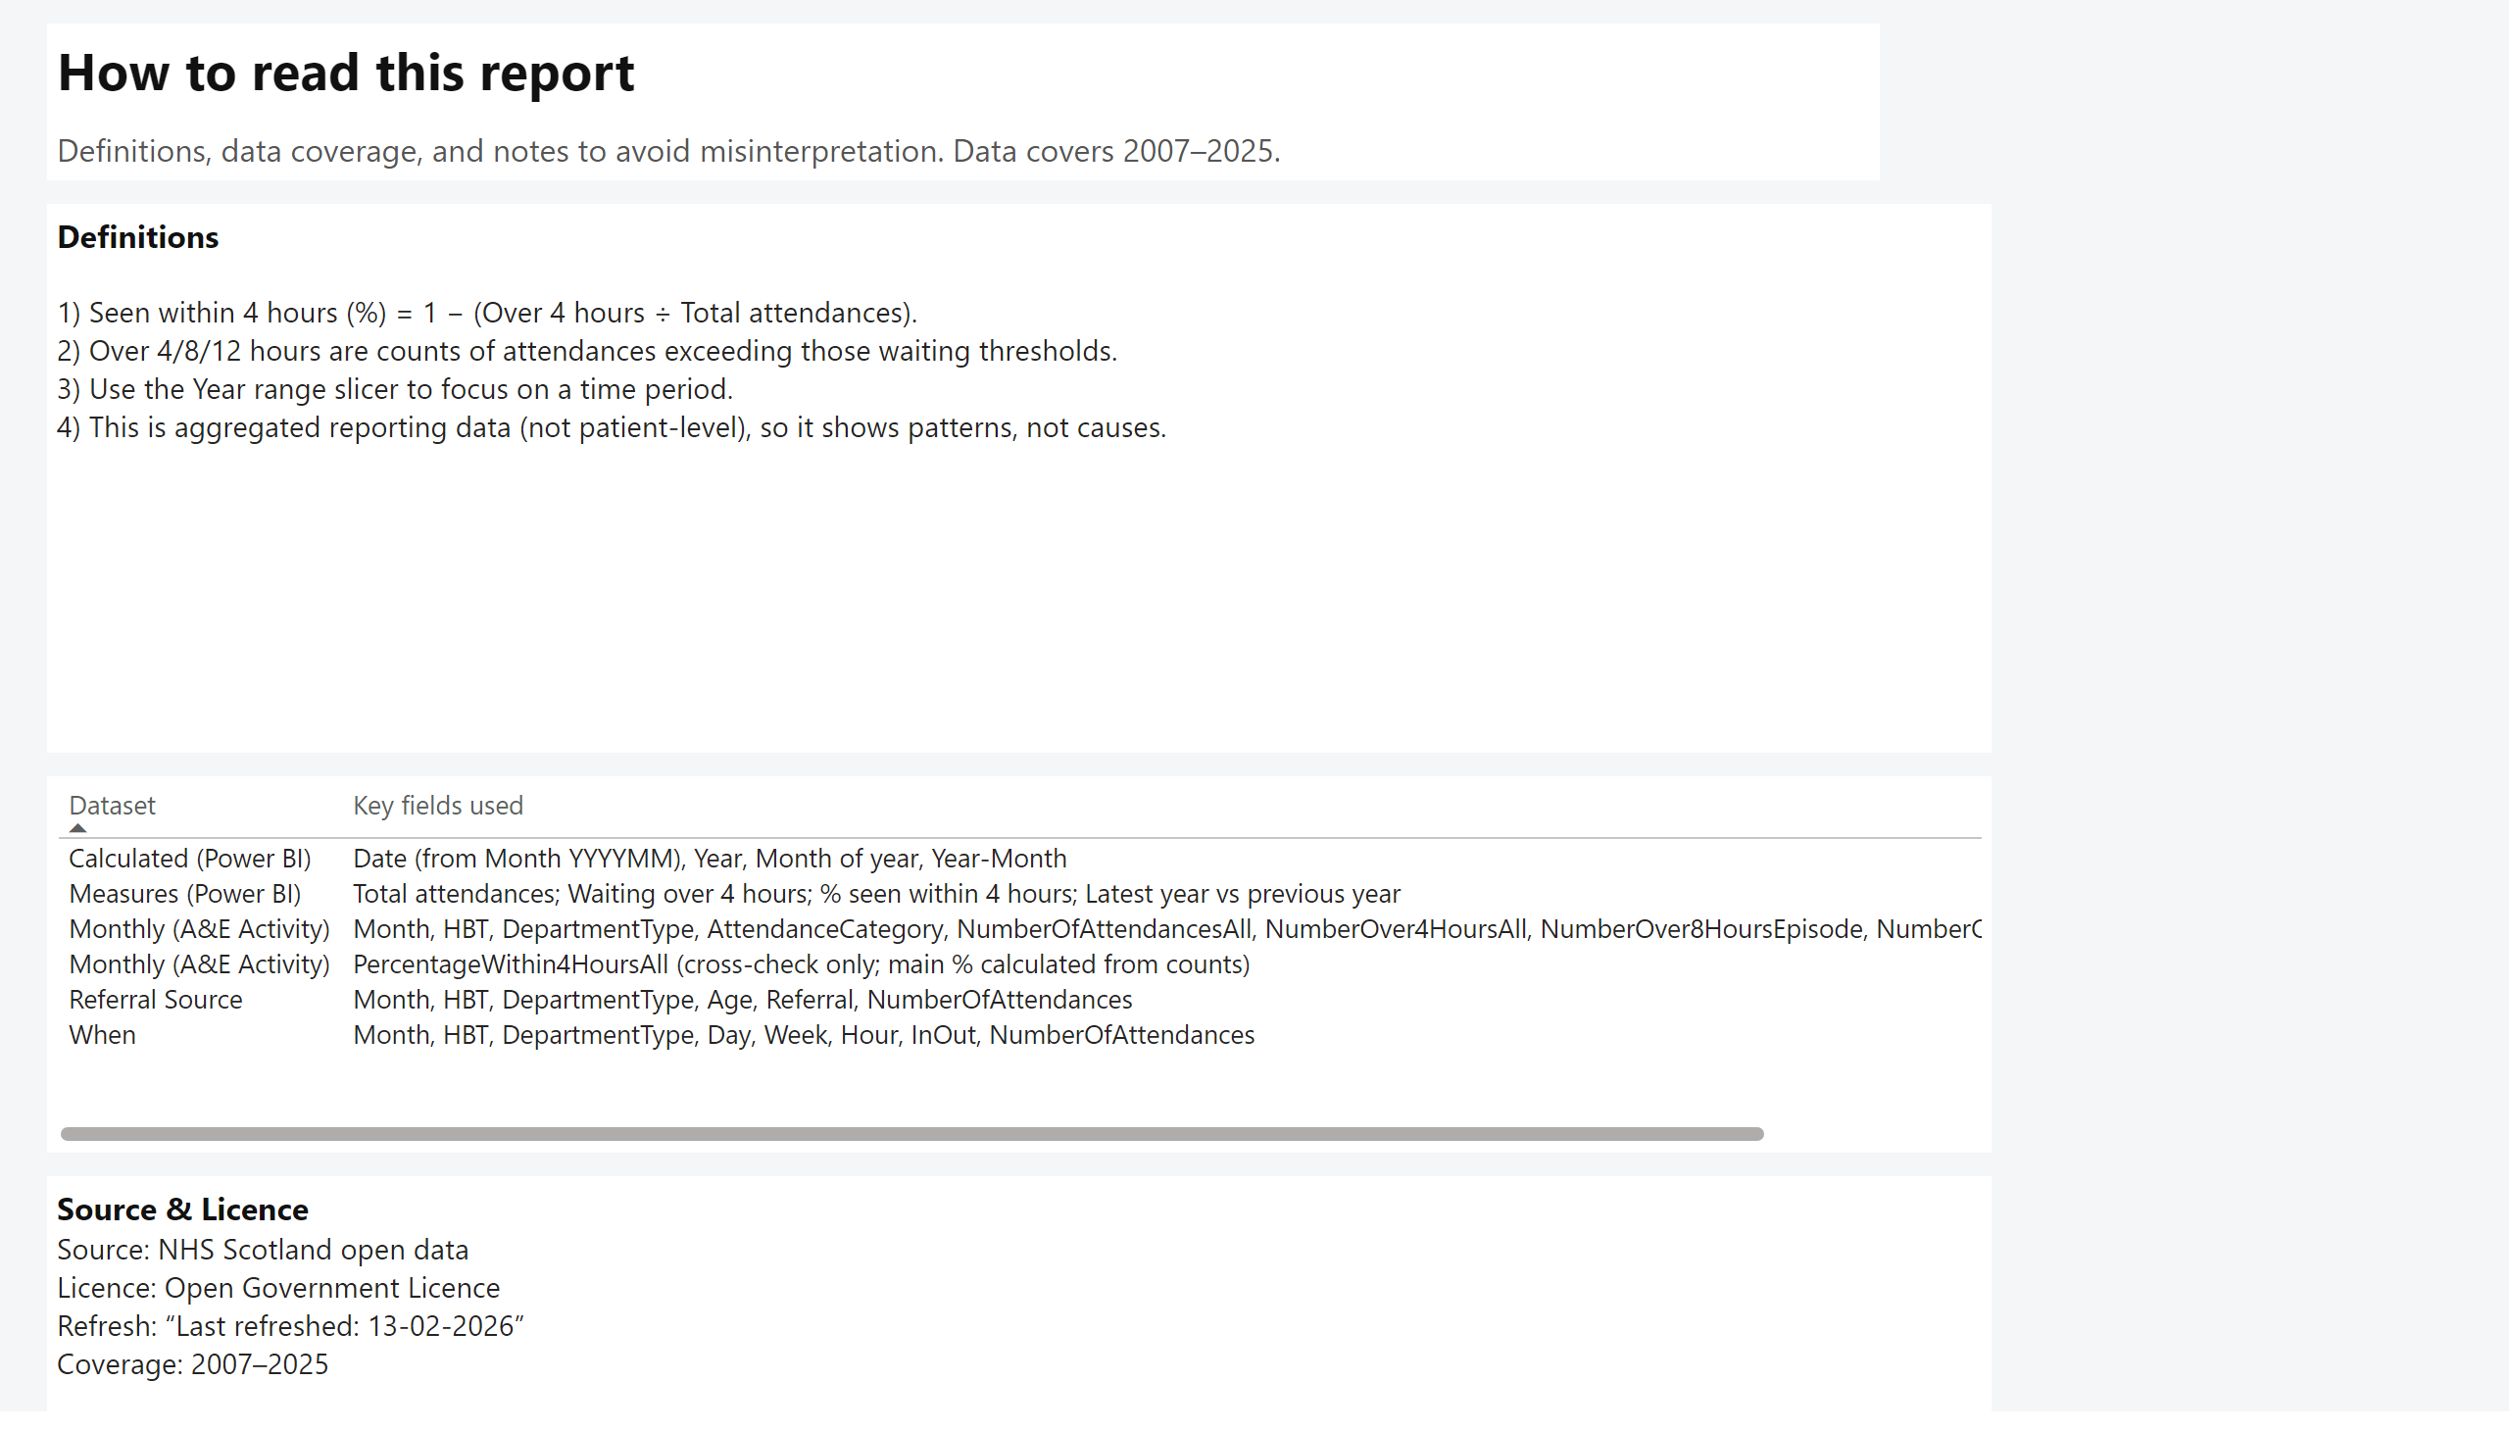
Definitions & Data Quality
Notes:
textbox
No alt text provided
textbox
No alt text provided
Data fields used
No alt text provided
textbox
No alt text provided
textbox
No alt text provided

