Slide 1



The Bitter Sum: Accounting for Racist Words in
Absalom, Absalom!
Johannes Burgers
Scotti Parrish
Assistant Professor of Digital Humanities and English, Ashoka University, New Delhi
Associate Director, Digital Yoknapatawpha,
University of Virginia
Arthur F. Thurnau Professor of English and Program in the Environment,
University of Michigan
Chair, Michigan Society of Fellows

Slide 2
Overview
Methodology
Statistical Overview
Merging Data sets
Character, Time, and Location Frequency analysis; or three ways of saying Thomas Sutpen

Slide 3
Thesis
A statistical overview of Absalom, Absalom! suggests that the use of the n-word is the most ubiquitous around Thomas Sutpen.
In particular, the events where the n-word is used the most are those surrounding his origin story in Tidewater, VA in the 1820s.
Importantly, Sutpen himself does not necessarily use the word, but instead Quentin does when he retells the story of Sutpen.

Slide 4
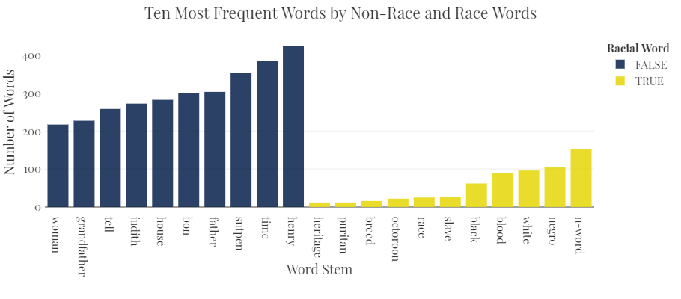
Racial and Non-Racial Words
Using a custom glossary, each word related to race was tagged as TRUE. The most frequently used racial word is the n-word (152).

Slide 5
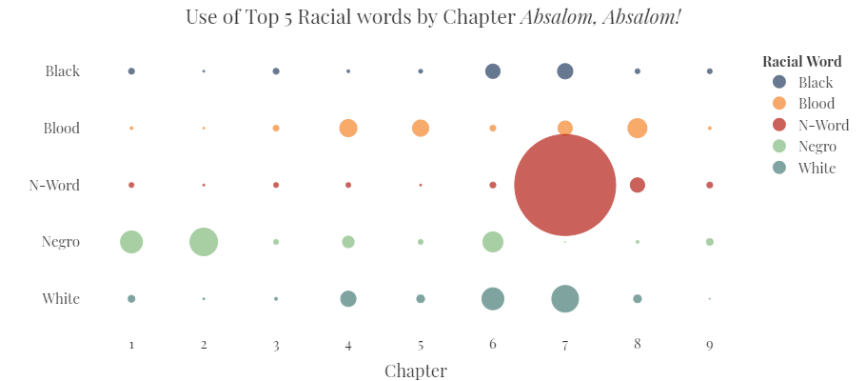
Sutpen’s Origins and the N-word
The n-word is not evenly distributed throughout the text. In fact, the most common word to describe Black characters for the majority of the text is “negro.” The exception to this rule is Chapter 7 where Sutpen’s origins are revealed.

Slide 6
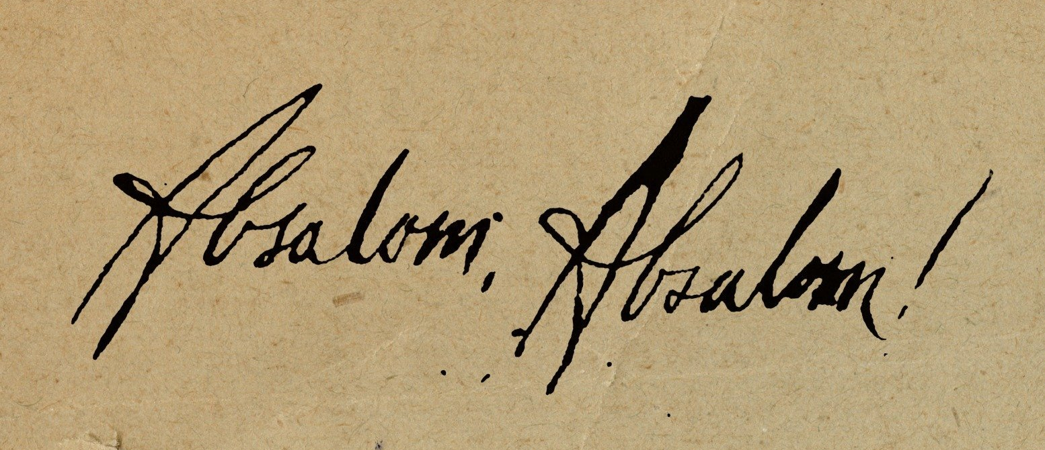
Merging Datasets
DIGITAL
Yoknapatawpha
Language use during events involving specific characters at specific locations
The Digital Yoknapatawpha data set decomposes each text down the characters and locations which cooccur at events. It only includes the first few words of an event. These first few words can be used to merge the all of the words of that event back onto the database using a txt copy of the text.
This results in a table that provides all of the words related to an event, where that event took place, what characters where present.

Slide 7
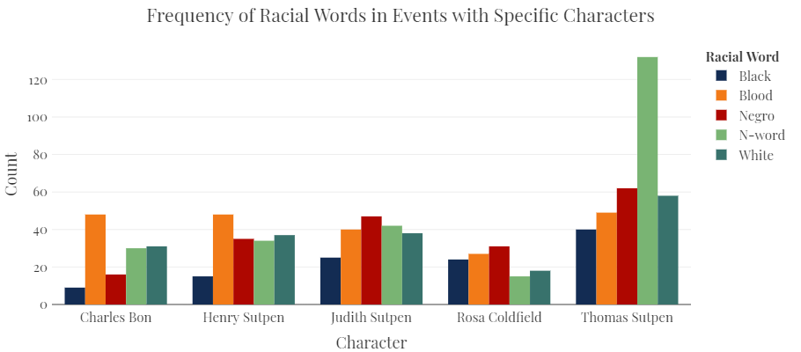
N-word at Events by Character
Thomas Sutpen is present in when the n-word occurs most often. The relative difference between the use of the n-word in events involving Sutpen is also significantly higher than the other major characters. Note, this does not mean that Sutpen is using the n-word.

Slide 8
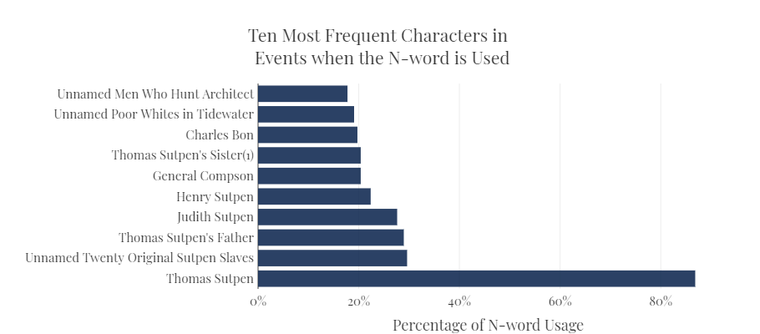
Sutpen and the n-word
Sutpen is present 88% of the time the n-word is used.
Notes:
Not sure if I like the layering of the legend over the paper background

Slide 9
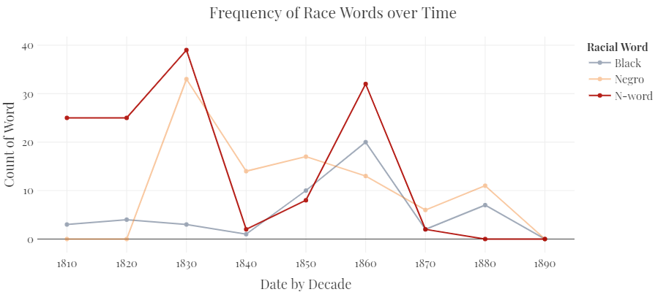
Sutpen’s Youth
The majority of the instances of the n-word occur during the retelling of Sutpen’s youth.

Slide 10
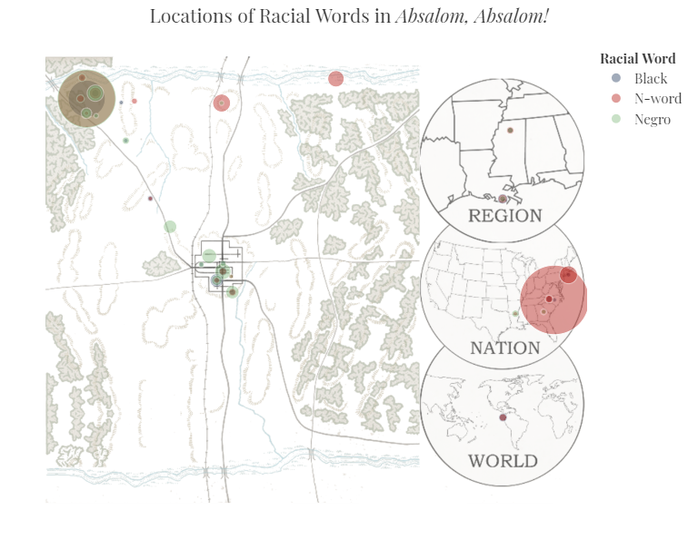
Tidewater and Sutpen’s Plantation
Sutpen’s Hundred
Tidewater, VA
The two locations that feature the use of the n-word most prominently are Tidewater, VA and Sutpen’s Hundred.

Slide 11
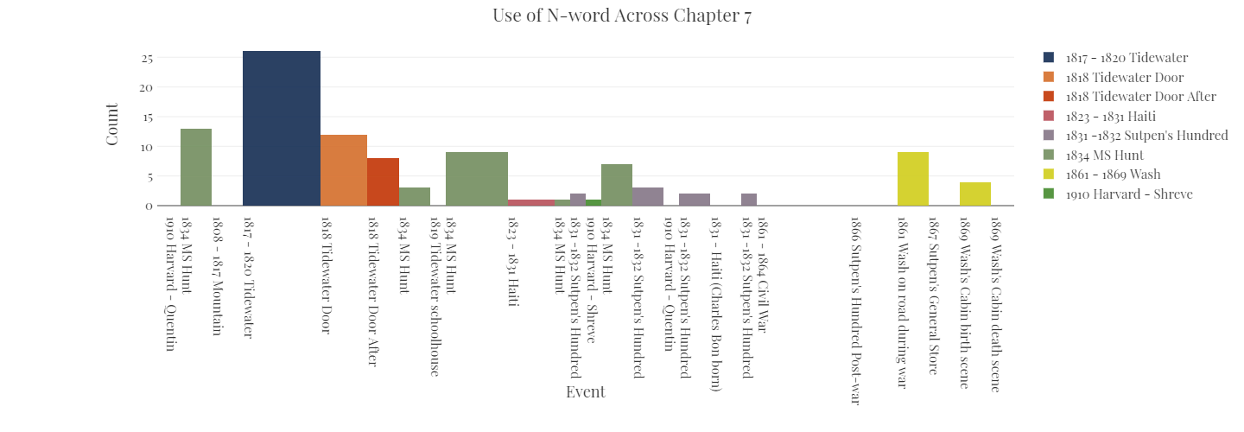
Use of the N-word Chapter 7
The use of the n-word fluctuates significantly across the chapter.

Slide 12
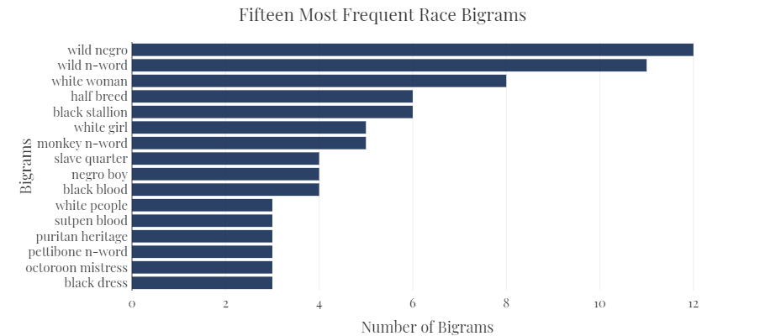
Racial word cooccurrence
When two words appear together this is called “cooccurrence.” The most frequent cooccurrences in the text are “wild negro” (12) and “wild n-word” (11).

Slide 13
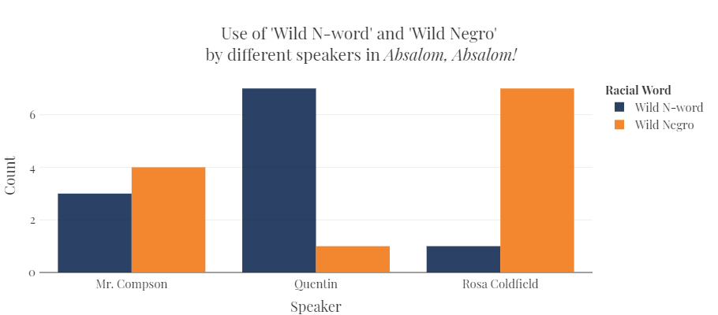
Echoes of Wild
The use of “wild negro” and wild n-word is unevenly distributed across the text. While Rosa Coldfield only says wild n-word once, Quentin repeats the phrase 7 times. In general, wild is a word that resonates throughout the text and is used 51 times, half of which are in relation to enslaved people.

