Slide 1

Caddy
Using Digital Yoknapatawpha to explore the world of chapter-less Caddy in William Faulkner’s The Sound and the Fury.
(Fine-print Warning: Like anything related to Faulkner, what we are about to do may result in more questions than answers!)

Slide 2
Part One
Faulkner and his Characters
Faulkner and Caddy

Slide 3
Goals and Objectives
The big ones: To use multiple investigative DY tools to explore the concept of digital humanities and the broad parameters of the DY site.
To try to imagine Caddy’s world and how it affects her and motivates her; to push ourselves inside her head with an ultimate goal of writing from her perspective.
But also:
To consider The Sound and the Fury not just as a novel in its entirety but as a collection of characters Faulkner reveals to us in different ways.
To consider how Faulkner limits us in understanding Caddy and to ask ourselves why she doesn’t have a voice.
To think more broadly about the conditions affecting southern women and black men and women in Faulkner’s time and how that may have influenced Faulkner’s depiction of them.

Slide 4

After living in Benjy’s, Quentin’s, and Jason’s heads, how do we learn about a character who has very little voice? To figure out more about Caddy, we have to look next to her, in front of her, and behind her. How can we try to do this?

Slide 5
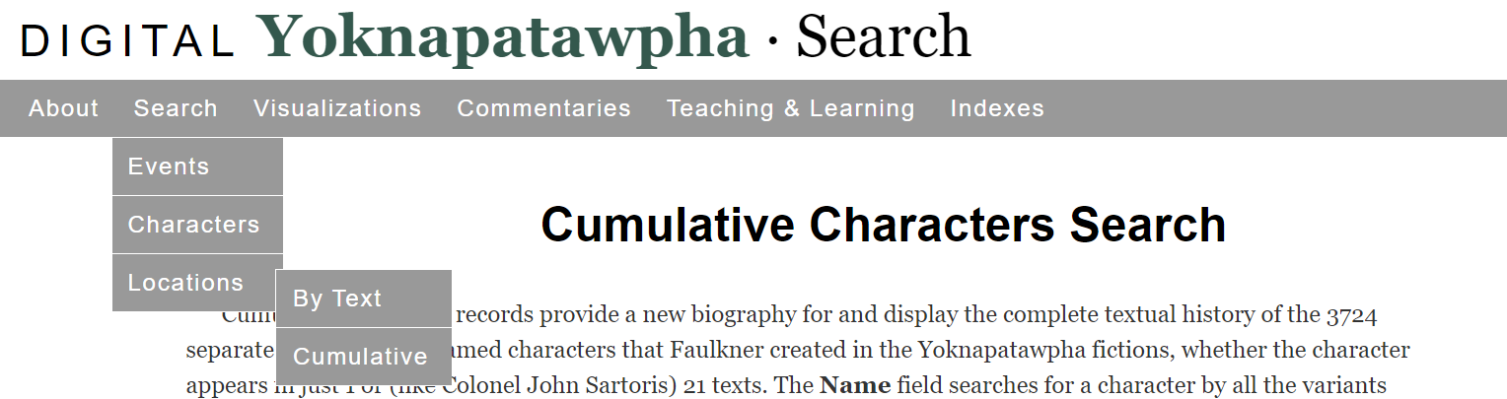
How does Faulkner Write his Characters?
Use Digital Yoknapatawpha’s Cumulative Character Search to find out who tells Faulkner’s stories.
(For reference, there are 3724 named and unnamed characters and roughly 80 “Major” characters in Faulkner’s works.)
From the DY home page, click on Search, then Characters, then Cumulative Select Gender: Female and Narrator: First Person; then search Select Gender: Female and Narrator: Stream of Consciousness; then search Select Gender: Female and Rank: Major; then search What do you find out? Compare your results if you change Gender to Male or Race to Black

Slide 6
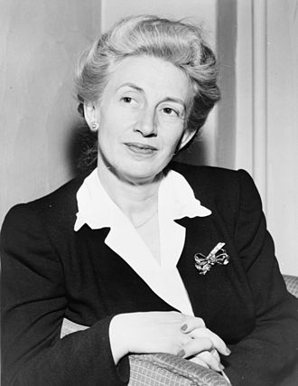
Lillian Smith 1897-1966
In her essay “Stay and Resist” published in the Oxford American, October 2016, Diane Roberts quotes Lillian Smith on William Faulkner: “There is no future in [his] books,” she said. “He never wrote about his equals. He has created no decent women; he loathes females and it shows in his work.”
Is this true? As we consider Caddy and the other women in The Sound and the Fury, let’s think about Lillian Smith’s opinion.

Slide 7
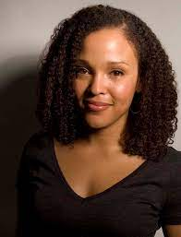
Jesmyn Ward 1977-
(we’re reading her next!)
“The first time I read As I Lay Dying, I was so awed I wanted to give up. I thought, ‘He’s done it, perfectly. Why the hell am I trying?’ But the failures of some of his black characters—the lack of imaginative vision regarding them, the way they don’t display the full range of human emotion, how they fail to live fully on the page—work against that awe and goad me to write.”
This from Elizabeth Hoover’s 2011 interview with Jesmyn Ward published in The Paris Review.
Is this true? Let’s think about this as we consider the black characters in The Sound and the Fury. And, really, all of Faulkner’s characters!

Slide 8

What does Faulkner think of Caddy?
After listening to the first two audio clips on DY’s Audio Files page for The Sound and the Fury, turn to the person next to you and consider the following questions before we discuss them as a class:
How do we learn about most characters in the novel?
How do we learn about Caddy?
What do you think Faulkner means by: “the proper tools” to “draw the picture of Caddy”...what are these tools, and do you agree with him?
In the Characters Search section of DY, Caddy is classified as a Major character in The Sound and the Fury? Is she? Why doesn’t she have a chapter?
How do Faulkner’s own words gel with the criticism from Smith and Ward?

Slide 9

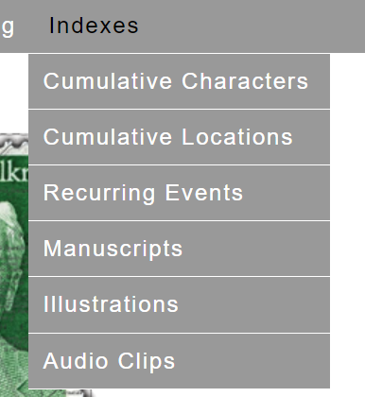
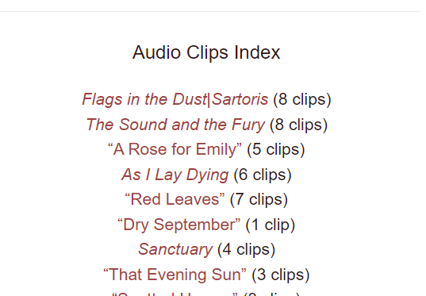
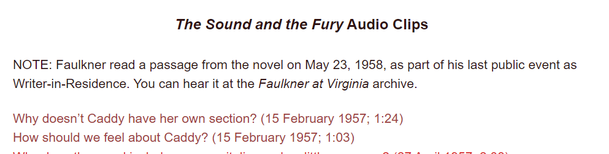
To get to audio files, s
To get to Audio Files: select “Indexes” from the main banner of the DY home page Then choose “Audio Clips” Then choose “The Sound and the Fury”
Then play

Slide 10
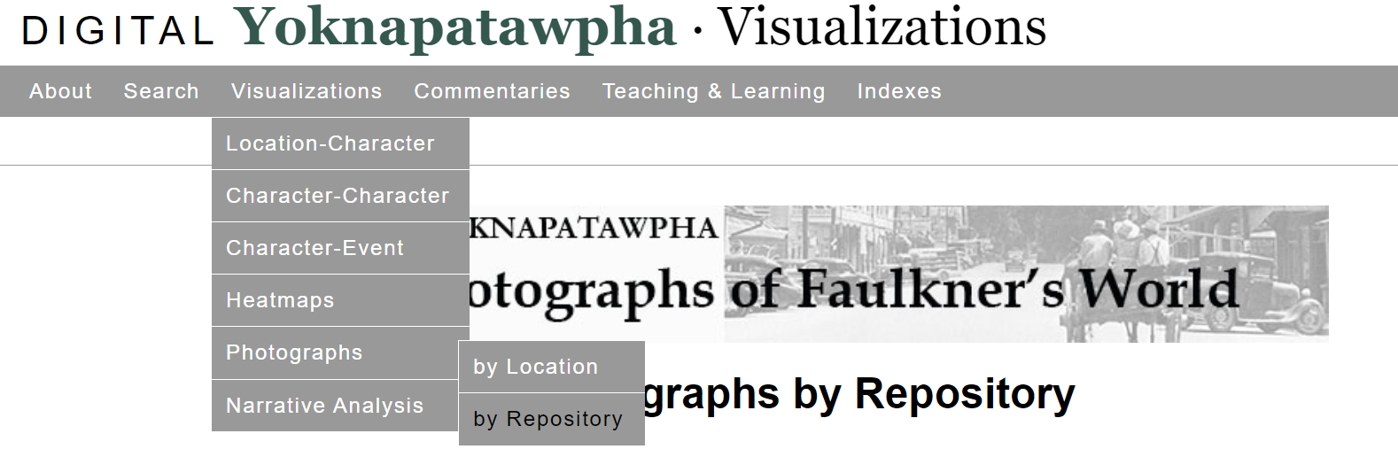
Where’s Waldo? (or Caddy) Or: Who are the People of Faulkner’s World?
Can you find Caddy in the archival pictures on the DY site? Select Visualizations, then Photographs, then by Repository. Flip through the six collections of Mississippi photographs.
Is she in there? Are the Compson’s in there?
You can also check out these collections: Let Us Now Praise Famous Men or You Have Seen Their Faces

Slide 11
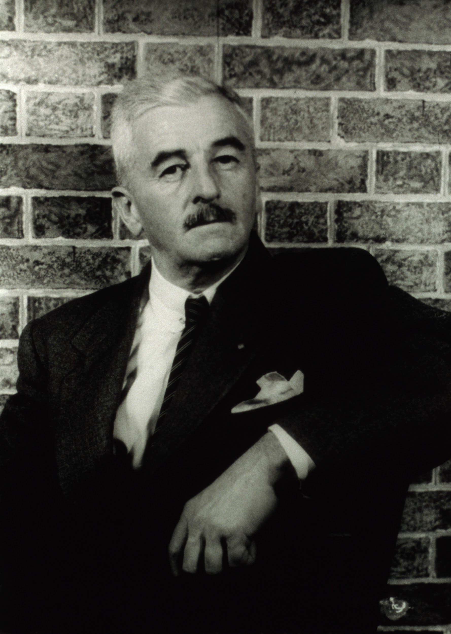
What are you now thinking about that you weren’t thinking about before?

Slide 12
Part Two
Caddy What do we know about her?
Do we know anything about her?

Slide 13
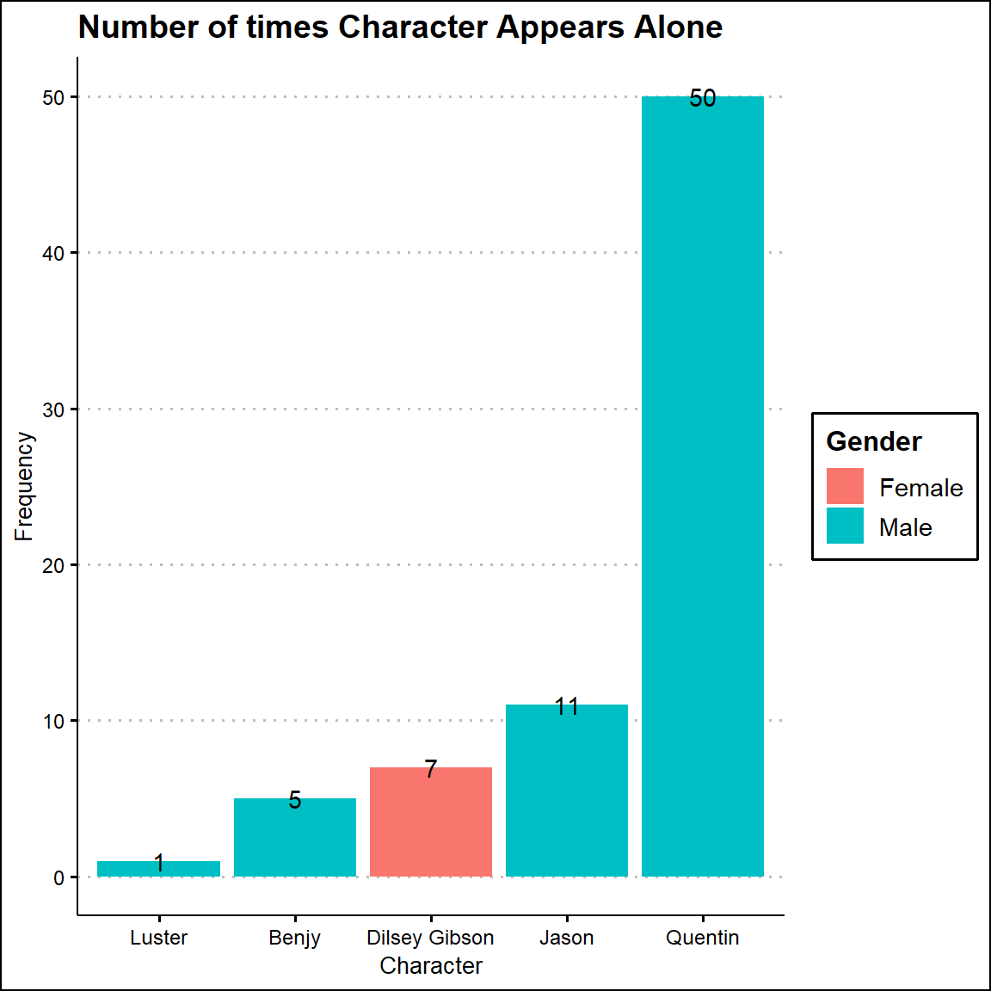
Let’s explore Caddy’s world.
Caddy is never alone in the novel. (Who else is never alone?)
If Caddy is never alone in the novel, then who is she with?
Who are the people who she interacts with the most?
https://joostburgers.github.io/dy_data_dog_breakfast/

Slide 14
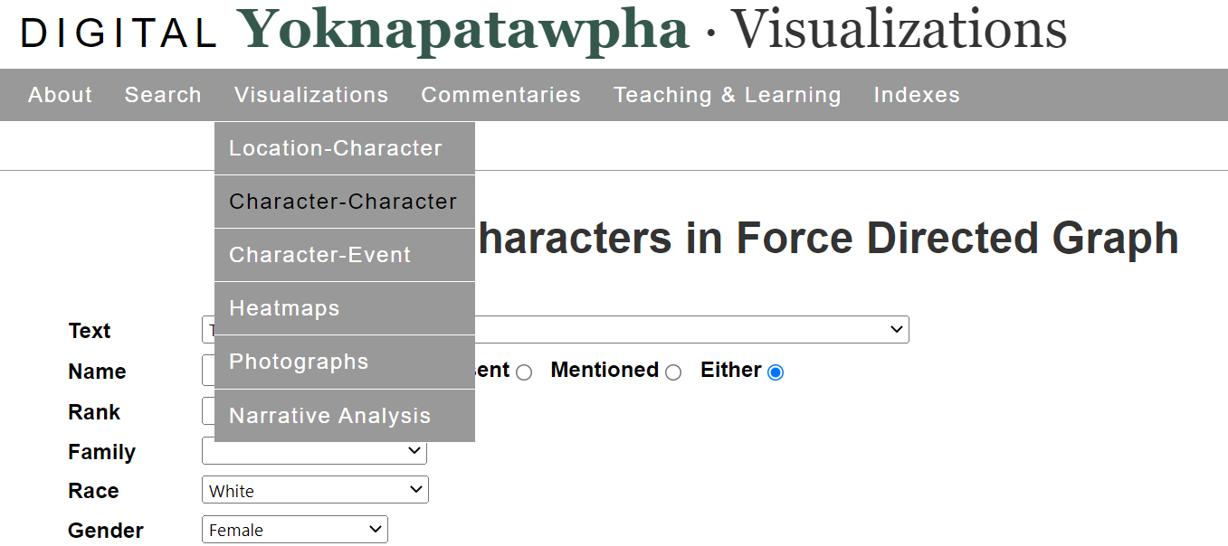
We can use DY to remind us: who are Caddy’s friends? From the DY Main Menu, choose Visualizations, then Character-Character, then Force Directed Graph, then The Sound and the Fury for Text
If we assume that Caddy is most likely to be friends with other white, upper-class, females, choose White for Race, Upper Class for Rank, and Female for Gender.
What do you see? (Hint: the boldest lines depict the strongest connections)

Slide 15
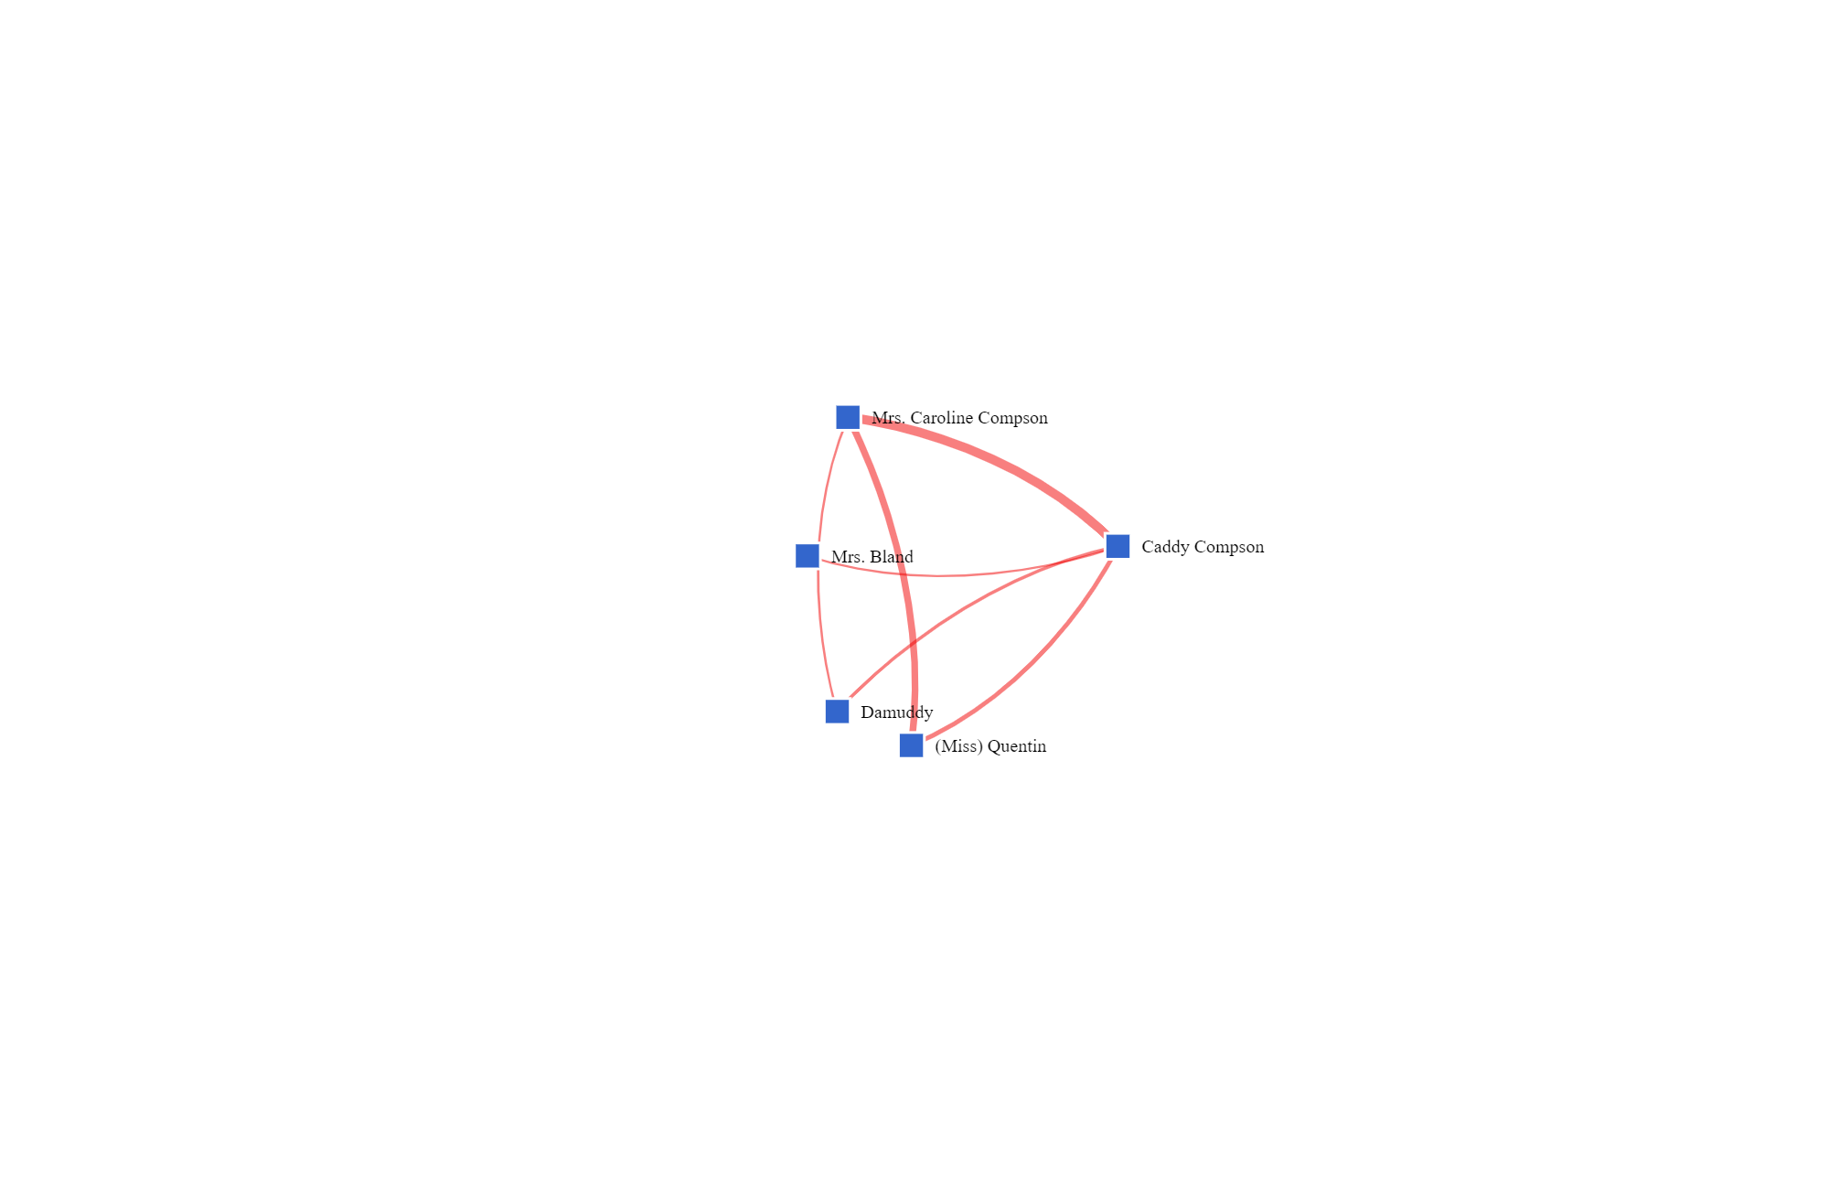

Slide 16
What did we just learn about Caddy’s world?
Let’s try that again, this time removing all search parameters except
Female What do you see?
And again, removing all search parameters except for
Text: The Sound and the Fury What do you see?
(this one is a bit overwhelming, but try to find the Caddy Compson square in the melee and click on it for a more concentrated graph)
Play around with this function for a few minutes, using search parameters of your choice.

Slide 17
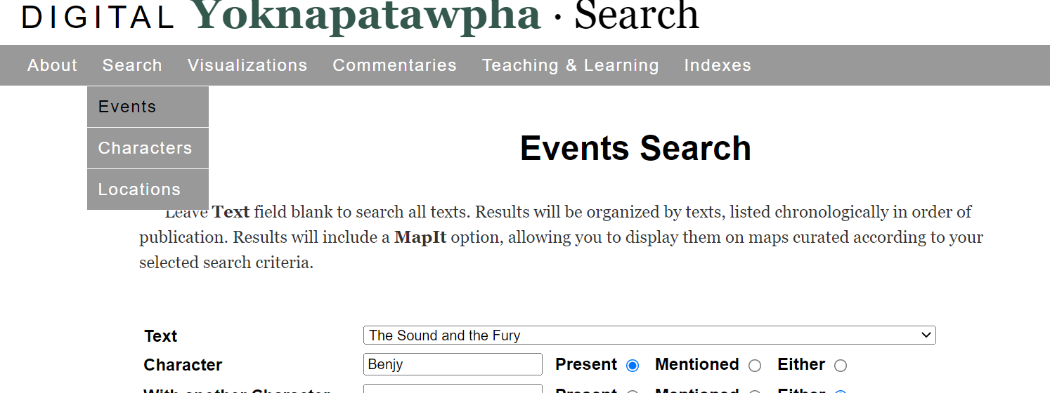
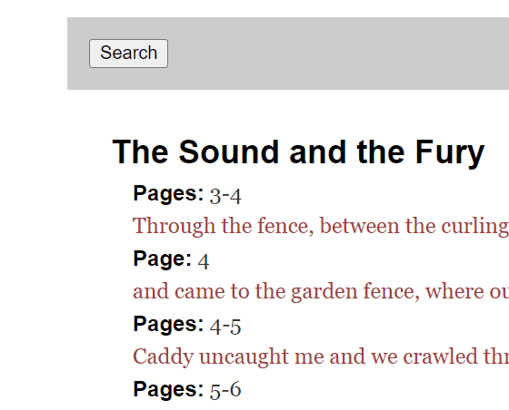

Now that we know who Caddy is with, let’s explore where she is and where she goes.
We can acknowledge that as a character, Benjy is confined, both physically and mentally. Using Benjy’s restricted movements as a comparison point, let’s map out the movements of some other characters using the Events Search.
Choose Search, then Events, then The Sound and the Fury, then the character, then “Present.” Press the Search button, then the Map It button. Voila!
Here’s where Benjy goes

Slide 18
In a Small Group, Map the Events of the Following Characters
Caroline Compson
“Mother’s sick, Father said. Dilsey will put you to bed” (62).
(Miss) Quentin
Goddamn you, Quentin said. Goddamn you. We could hear her (71).
Caddy “Are you going to look after Benjy and Father” (106).
Dilsey
I seed de beginning, en now I sees de endin'.
Jason
“Once a bitch always a bitch, what I say” (180).
Be prepared to explain to the other groups where your chosen character goes. What do we notice?

Slide 19
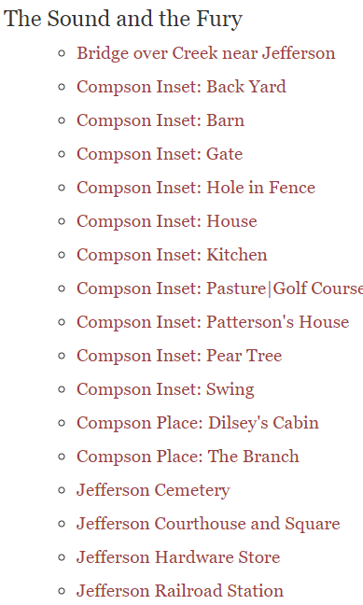
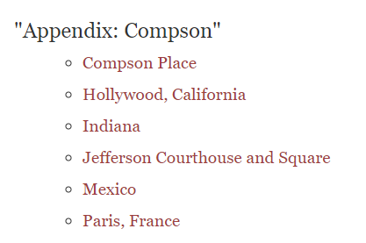
By doing a Cumulative Characters Search, you can find where the characters go/are in different stories. What do you notice about Caddy’s locations in The Sound and the Fury compared to her locations in the Appendix? How can you interpret this?

Slide 20
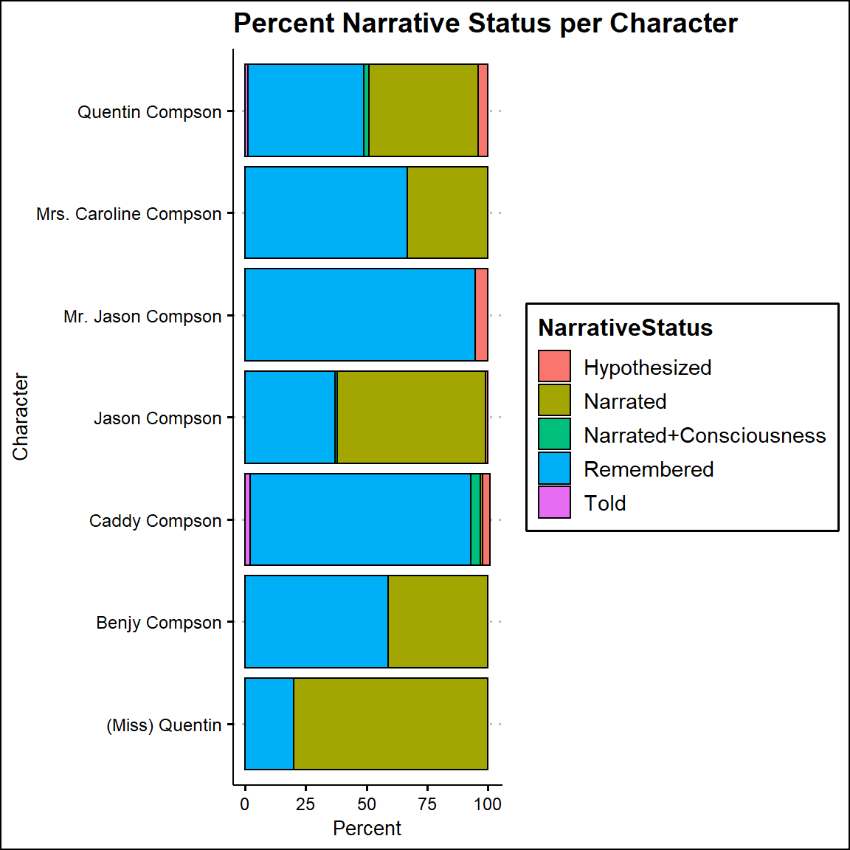
Of course much of The Sound and the Fury swirls around the past, but is there anything interesting about this table?
https://joostburgers.github.io/dy_data_dog_breakfast/

Slide 21
“because women so delicate so mysterious father”
–Quentin, The Sound and the Fury, 128

Slide 22

Caddy’s World
What are some conclusions you can make about what it is like to live Caddy’s life?
Is her world big or small?
How does she respond to that reality? Does her world affect the decisions she makes? What decisions does she make?
What are the “proper tools” that Faulkner uses to tell Caddy’s story? Do they work?
Does the relative insular world of the Compson family contribute to her brothers’ obsessions with her? How do other people affect her decisions?
What might it feel like to be Caddy?
Why does Faulkner make her difficult to get to know?

Slide 23
Part Three
Let’s Write

Slide 24
Assignment: Homework
We learn about characters in part by what they say, what they do, what they think, where they go, what others say about them.
The Narrative Status Graph shows us that we don’t learn much about Caddy directly from Caddy. How reliable is it to learn about her mostly from other character’s memories of her? Search the novel and find one quotation that gives us a direct characterization of Caddy and two quotations that illustrate how what other characters say about her, think about her, or how they react to her may affect, change, limit, or restrict her world (Hint you can use DY to search Events which may lead you to your quotations). What do we really know about Caddy?
What about Quentin, Jason, or Dilsey? Do they define themselves? Or do other characters or circumstances define them? Choose another character in the novel and discuss in a short paragraph how Faulkner reveals them to us. (Extra credit if you use a DY tool!)

Slide 25
Assignment: For your Weekly Journal Entry
More Lillian Smith!
From Killers of the Dream, 1949: “I do not remember how or when, but by the time I had learned that God is love, that Jesus is His Son and came to give us more abundant life, that all men are brothers with a common Father, I also knew that I was better than a Negro, that all black folks have their place and must be kept in it, that sex has its place and must be kept in it, that a terrifying disaster would befall the South if I ever treated a Negro as my social equal and as terrifying a disaster would befall my family if I were to have a baby outside marriage.”
How does this quotation, along with all that we have explored in DY, inform our understanding of Minnie in Dry September? Of Emily in A Rose for Emily? Or Caddie, Miss Quentin, Dilsey, or Caroline Compson in The Sound and the Fury? In a one-page journal entry, choose one female Faulkner character and discuss her in light of Smith’s commentary.

Slide 26
Assignment: Longer Term
Though she doesn’t have her own expressed point-of-view in the written words of the novel, Digital Yoknapatawpha gifts you the opportunity to consider Caddy’s world in more detail. What confines her? What liberates her? Who is she beyond the memories and interpretations of her maybe-unreliable brothers? She is, Faulkner says, “my heart’s darling.” Why? Considering some of the realities that DY has exposed, write the first 2-3 pages of Caddy’s chapter. You may use Faulknerian language and structure, or not, but whatever you do, give Caddy her voice.
Be prepared to share with the class where in the novel you would insert your Caddy chapter and why.

Slide 27
Part Four
More Questions

Slide 28
Way More Questions
Together, let’s read Caddy’s section of The Appendix.
?!?

