Slide 1
Linking user profiles to SO
How to find skillful people within the SO database

Slide 2
Recap
Detecting gender of SO users
Retrieve users with Facebook profile image
Store all data the Facebook API gives us
Analysis on different behavior male/female

Slide 3
Going further
StackOverflow profiles have “About Me” section and Personal Website URL
Scrape all Facebook, LinkedIn, Google+, GitHub links from there

Slide 4
More on Facebook
Also retrieve:
  Full name
  Age

Slide 5
Google+ data from SO users
Unfortunately only an age indication
But has:
  Full name
  Location
  Gender
  Linked profiles, like, again, Facebook
  Employers (and employment duration)

Slide 6
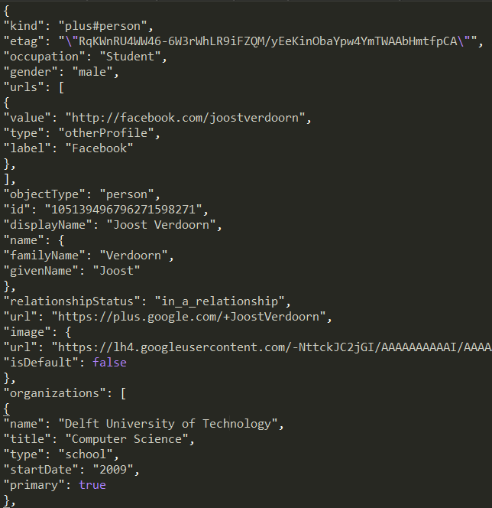
GitHub data from SO users
Find repositories contributed to
Detect languages and determine score based on #contributing users, size codebase, etc
→ Filter out people that farm reputation on SO without any real knowledge about a language

Slide 7
LinkedIn data from SO users
LinkedIn endorsements
Previous employers
Employment time

Slide 8
Analysing the data
Calculate score with retrieved data
Currently retrieving huge amounts of data

Slide 9
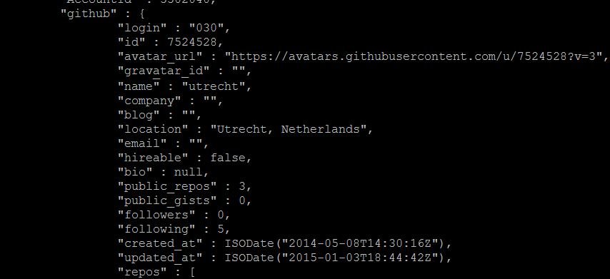
GitHub user data
Some personal information
Activity information
Employment interest
Repositories...

Slide 10
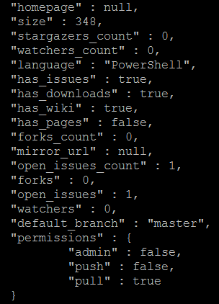
GitHub repository data
Size of codebas
# Watchers
# Followers
Issues
Wiki
Forks
...

