Slide 1
CI/CD & Azure Kubernetes services
Joost Went

Slide 3
To be determined

Slide 4
CI/CD and Azure Kubernetes Services
CI/CD and AKS
First steps towards deploying apps to AKS using DevOps Pipelines

Slide 5
Introduction
Joost Went
Capgemini newbie (joined in June)
.Net and Azure background
Find todays demo and slides at https://github.com/joostwent/techtalk-lunch

Slide 6
Azure Kubernetes Services
Kubernetes like you are used to
kubectl, helm, etc.
But it runs transparent on Azure Resources
VNet integration (VPN, NSG, etc.)
Application Gateway (SSL offloading, routing, WAF)
Virtual Machine Scalesets (Proximity Groups, Accelerated Networking)
Azure RBAC, managed identity
Azure Container Registry

Slide 7
From Code to Deployment
Create a dockerfile
Create a docker image and tag it
Push the docker image to a container registry
Grant AKS access to the container registry
Create and Deploy a Kubernetes deployment manifest

Slide 8
Service Connections
Git
Checkout
Build Agent
Azure Container Registry
Docker@2 buildAndPush
Pull
Azure Kubernetes Services
KubernetesManifest@0 deploy

Slide 10
GitOps
Git repositories are the truth of what is deployed
K8S monitors a branch and applies changes upon each diff
Move from Dev => Acc => Prod using Merges/Pull Request
Great Disaster Recovery (deployments/infrastructure as code)
Easy pipelines

Slide 11
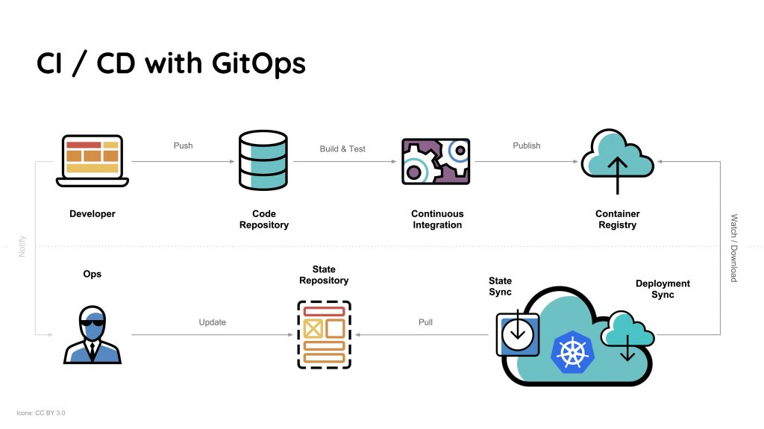

Slide 13
Takeaways
Pipelines or GitOps is a must have, never modify things manually (configuration drift)
The learning curve is at Kubernetes side, the pipelines are fairly easy
Great for multi/hybrid cloud; no Azure lock-in

