Slide 1
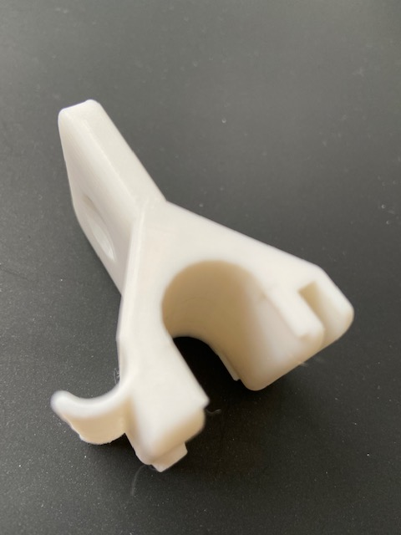
Lift seat
Turn key
Press door handle
Turn knob
Push button

