Slide 1



Capstone Design English Presentation
[2022-1] Kor-Eng NMT using Characteristics of Korean
This project aims to improve the performance of Korean-English translation by learning deep learning models reflecting the characteristics of Korean.
Our topic is to divide Korean into consonant and vowel units and train based on this to see if the performance improves or translates properly. In addition, we will also study whether the performance improves when all sentences in
the Korean corpus data are changed to informal or formal.
Jaemu Heo
Jeonghui Kim
Joowhan Kim

Slide 2


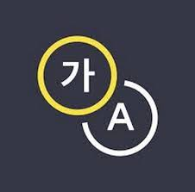
[2022-1] Kor-Eng NMT using Characteristics of Korean
Motivation
Presenter : Jaemu Heo

Slide 3
[2022-1] Kor-Eng NMT using Characteristics of Korean
Motivation
영흰 집에 간다.
1. Consisted by ‘Jamo’
영흰(영희는) -> ㅇㅕㅇㅎㅢㄴ
Young white goes home
I bought a pen yesterday. But it is broken.
2. the existence of grammatical honorifics
나는어제 펜을 구입했습니다. 하지만 그것은 부서졌다.
구입했습니다(Honorific)
부서졌다(informal)
Presenter : Jaemu Heo

Slide 4
[2022-1] Kor-Eng NMT using Characteristics of Korean
initial : ㅎ
medial : ㅏ
final : ㄴ
안녕. Kim이야.
한
ㅇㅏㄴㄴㅕㅇ. Kimㅇㅣ_야_.
Presenter : Jeonghui Kim

Slide 5
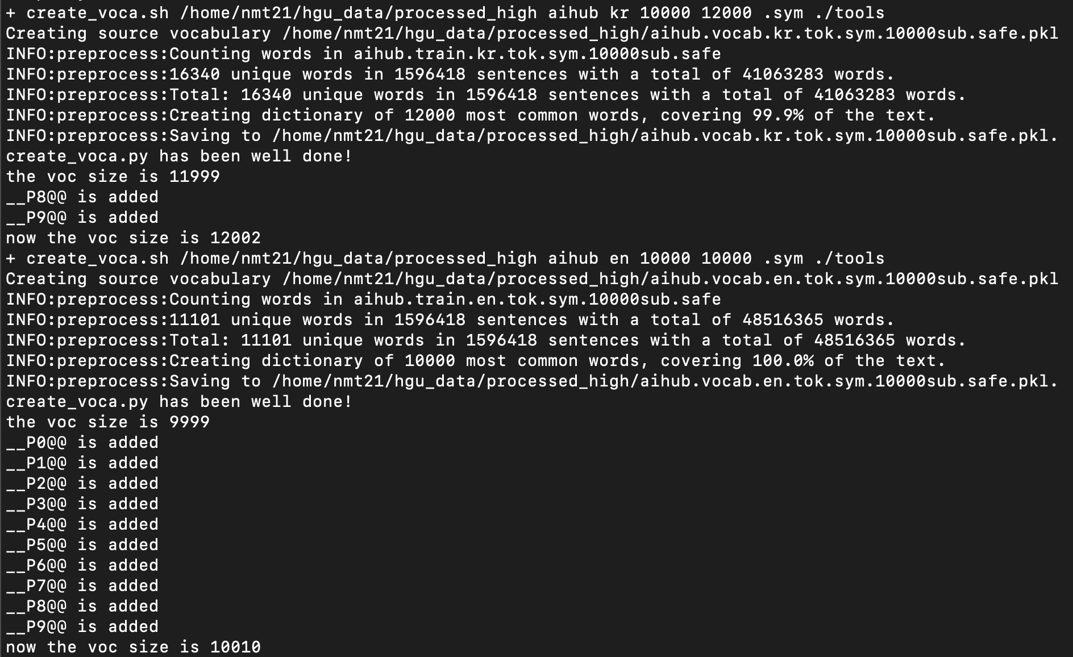
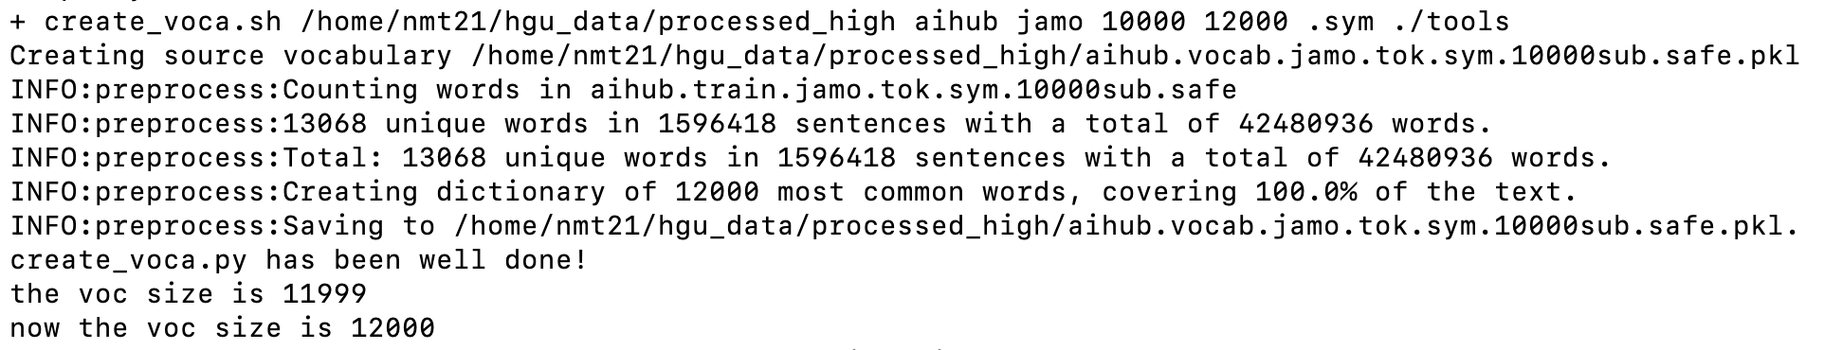
[2022-1] Kor-Eng NMT using Characteristics of Korean
1. Reduced Vocabulary Size
2. Create potential BPE
Subword
Subword : 영 , 흰
영흰 학교를 간다.
Jamo : ㅇ, ㅕ, ㅇ, ㅎ, ㅢ, ㄴ
Jamo
3. Examples of translation results according to BPE.
Input : 우리는 영흴 좋아한다.
BPE(Subword) : 우리는 영@@ 흴 좋아@@ 한다 .
Output(Subword) : We like Young-Som.
BPE(Jamo) : ㅇㅜ_ㄹㅣ_ㄴㅡㄴ ㅇㅕㅇ@@ ㅎㅢ@@ ㄹ ㅈㅗㅎㅇㅏ_@@ ㅎㅏㄴㄷㅏ_ .
Output(Jamo) : We like Younghee.
Input : 교횐 지금 축제의 분위기다.
BPE(Subword) : 교@@ 횐 지금 축@@ 제의 분위기@@ 다 .
Output(Subword) : Kyoto, the atmosphere of the festival is now.
BPE(Jamo) : ㄱㅛ_@@ ㅎㅚ@@ ㄴ ㅈㅣ_ㄱㅡㅁ ㅊㅜㄱ@@ ㅈㅔ_ㅇㅢ_ ㅂㅜㄴㅇㅟ_ㄱㅣ_@@ ㄷㅏ_ .
Output(Jamo) : The church is in the mood of the festival now.
Presenter : Jeonghui Kim

Slide 6


[2022-1] Kor-Eng NMT using Characteristics of Korean
Diversity of expression
“사랑해.”
“사랑해요.”
Which of these expressions should be used?
“I love you.”
“사랑합니다.”
Honorific
Data
Honorific and Informal Speech
밥을 먹어요.
어디 가세요?
끝났어요.
.
.
.
Korean Data
Informal
Data
Reduce the variety of expressions.
밥을 먹어.
어디 가세요?
끝났어.
.
.
.
Conversion
module
밥을 먹어.
어디 가?
끝났어.
.
.
.
Presenter : Joowhan Kim

Slide 7



[2022-1] Kor-Eng NMT using Characteristics of Korean
Pre-processing
Original Korean Sentences
Morphological
Analysis
Grammatical
transformation
Deep Learning Model
문을 미세요.
문/을 /미/세요.
문을 밀어.
Presenter : Joowhan Kim

