Slide 1
공프기 진행상황
Presentation
2021/10/019

Slide 2
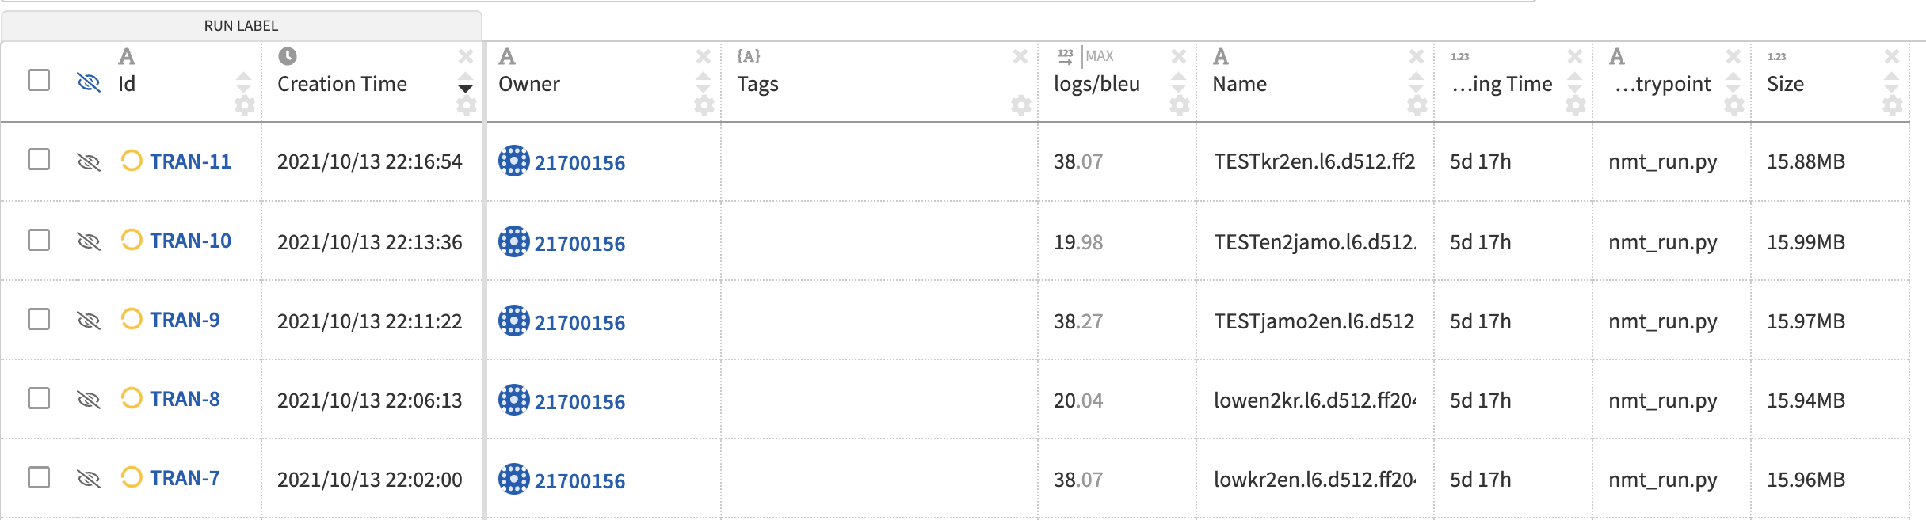
kr,jamo2en train
TRAN-11 : kr2en
TRAN-10 : en2jamo
TRAN-9 : jamo2en
TRAN-8 : en2low
TRAN-7 : low2en

Slide 3
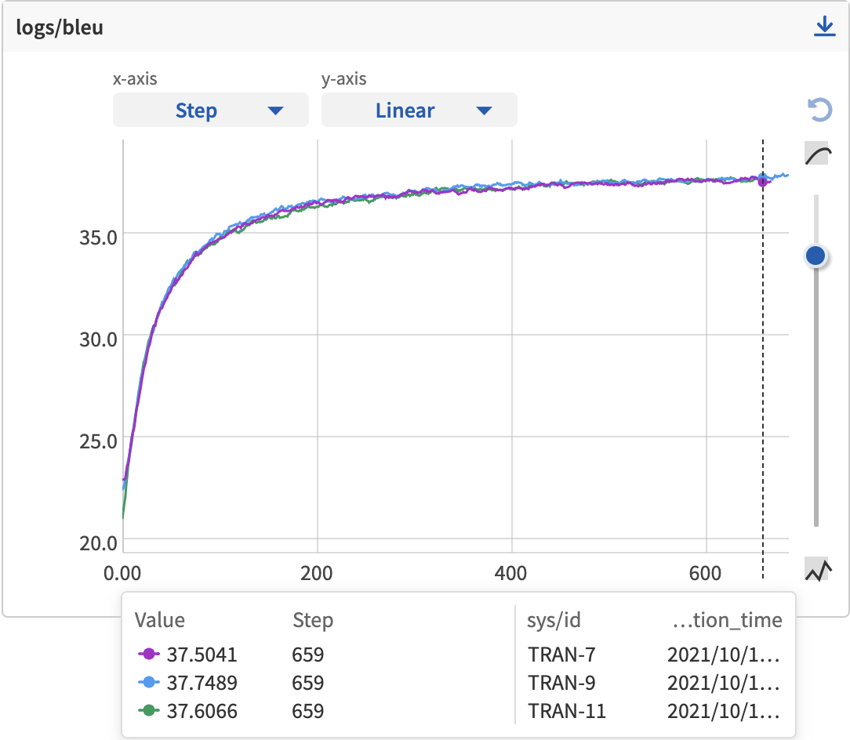
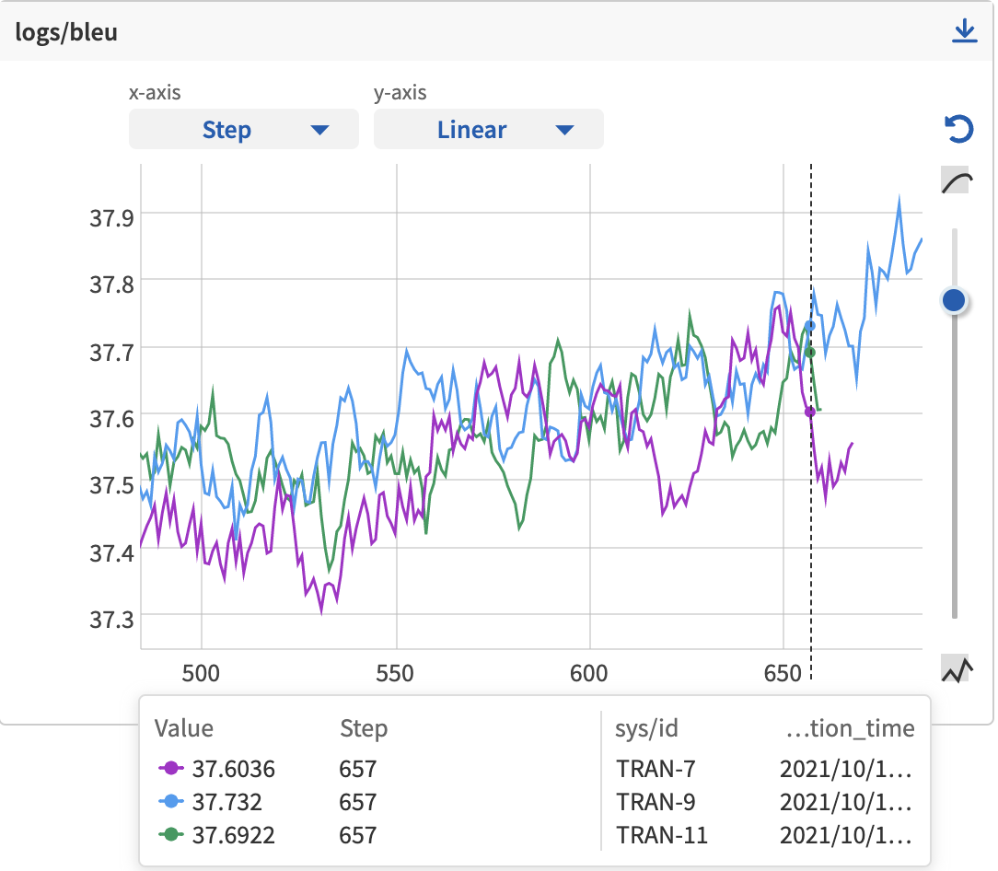
kr,jamo2en train
보라색 : low2en
파란색 : jamo2en
초록색 : kr2en

Slide 4
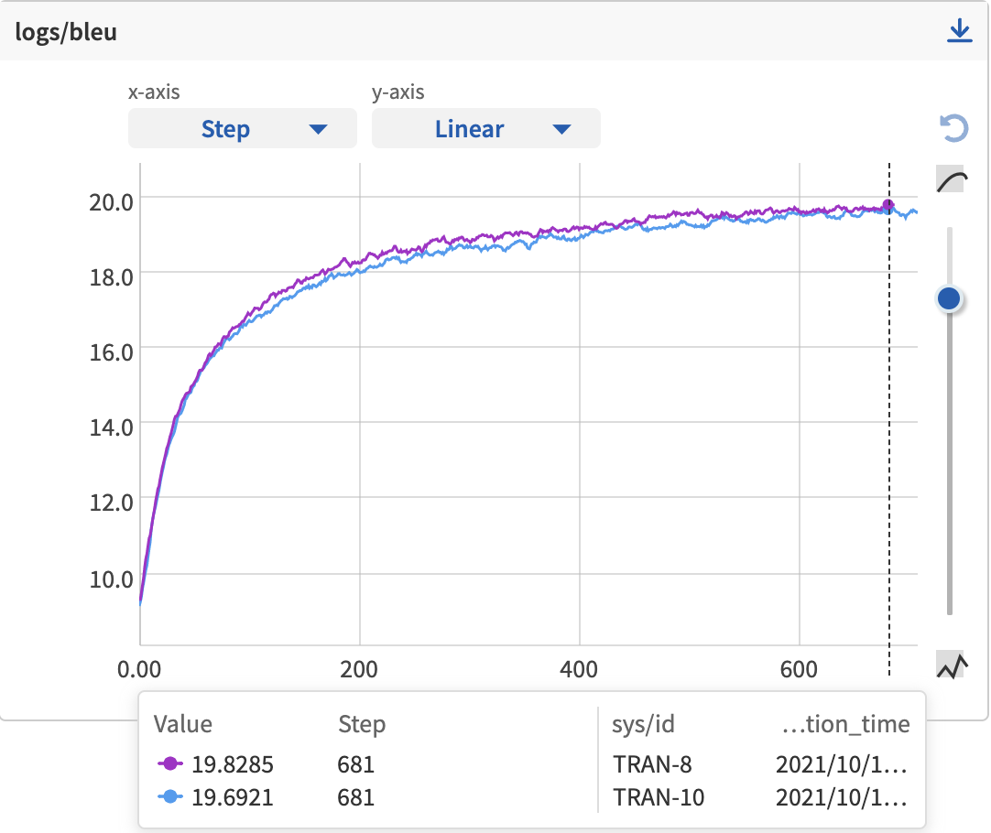
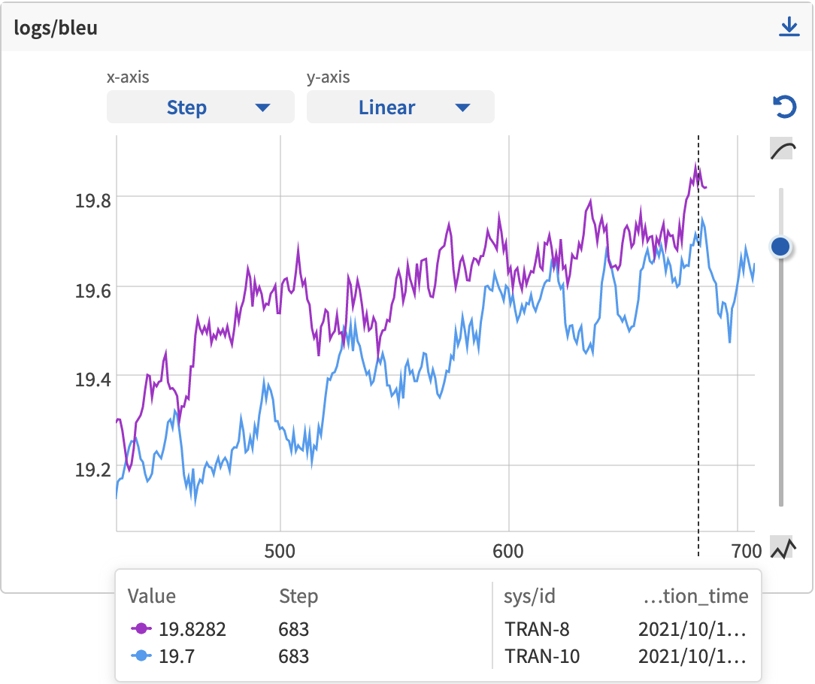
en2kr,jamo train
보라색 : en2low
파란색 : en2jamo

