Slide 1
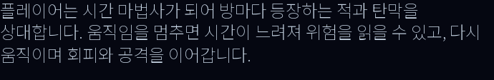



01 GAME OVERVIEW
CHRONO DUNGEON
Professor pitch
time-stop + bullet reading + room-clear growth
READ
DODGE
GROW
ONE SENTENCE
Stopping becomes strategy.
01 / 03

Slide 2




02 HOW TO PLAY
TIME RULE
STOP
MOVE
FIRE
WASD
MOUSE
SPACE
02 / 03

Slide 3
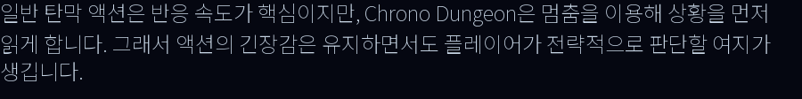





03 DESIGN INTENT
reaction first
read, choose, act
03 / 03

