Slide 1

Engineering Dynamics:
Particles and Rigid Bodies
Department of Mechanical Engineering
2026.09.30 (Wed)
Joo Yong Sim
Core summary of J. L. Meriam & L. G. Kraige, Engineering Mechanics: Dynamics

Slide 2

Lecture Goals: What Dynamics Is About
Dynamics = Kinematics (how a body moves) + Kinetics (why it moves)
Kinematics
+
Kinetics
Geometry of motion: $r, v, a, ω, α$
Forces and moments that cause the motion
Force–Acceleration
Work–Energy
Impulse–Momentum
$$∑F=ma$$
$$T_{1}+U_{1→2}=T_{2}$$
$$mv_{1}+∫F dt=mv_{2}$$
Particle : all mass concentrated at one point — size and rotation are ignored.
Rigid body : finite size, no deformation — rotation must always be included.
This lecture : apply kinematics and the three kinetics methods first to particles, then to rigid bodies.
Sookmyung Women’s Univ. Autonomous Mechanical Systems Lab
2

Slide 3
(Meriam) Dynamics: The Big Picture
The same four tools apply to both models — rigid bodies add rotation to each
Topic
Particle
Rigid Body
Kinematics
Position, velocity, acceleration
Translation + rotation ($ω, α$)
Force–Acceleration
$$∑F=ma$$
$$∑F=ma_{G}, ∑M_{G}=I_{G} α$$
Work–Energy
$$T_{1}+U_{1→2}=T_{2}$$
Translational KE + rotational KE
Impulse–Momentum
Linear momentum $mv$
Linear momentum + angular momentum $I_{G} ω$
The key difference : a particle never rotates; a rigid body always carries rotation — new quantities $ω, α, I$ and one extra equation, $∑M_{G}=I_{G} α$.
Strategy : master each tool on the particle first, then extend it by adding the rotational term.
Sookmyung Women’s Univ. Autonomous Mechanical Systems Lab
3

Slide 4
Particle Kinematics: Rectilinear Motion
Velocity and acceleration are successive time derivatives of position
General definitions
Constant acceleration, $a=\text{const}$
$$v=\frac{dr}{dt}, a=\frac{dv}{dt}=\frac{d^{2}r}{dt^{2}}$$
$$v=v_{0}+at$$
$$x=x_{0}+v_{0}t+\text{½}at^{2}$$
Straight-line motion
$$v^{2}=v_{0}^{2}+2a (x−x_{0})$$
$$v=\frac{dx}{dt}, a=\frac{dv}{dt}$$
Warning : these three equations hold only when $a$ is constant. For $a(t)$, $a(v)$ or $a(x)$, integrate the definitions directly.
$$a=v \frac{dv}{dx}$$
Why $a=v dv/dx$? : when $a$ is given as a function of position, this form eliminates time.
Sookmyung Women’s Univ. Autonomous Mechanical Systems Lab
4

Slide 5
Curvilinear Motion: Cartesian and n–t Coordinates
Choosing the coordinate system is the key step in curvilinear problems
Cartesian (x–y)
$$v=\dot{x} i+\dot{y} j, a=\ddot{x} i+\ddot{y} j$$
Normal–tangential (n–t)
$$e_{t}$$
$$a=a_{t} e_{t}+a_{n} e_{n}, a_{t}=\dot{v}$$
P
$$a_{n}=\frac{v^{2}}{ρ}$$
$$e_{n}$$
Circular motion ($ρ=r$) : $a_{n}=\frac{v^{2}}{r}=ω^{2}r$
$$ρ$$
C
Meaning of $a_{n}$ : even at constant speed, a change of direction is an acceleration.
C : centre of curvature, $ρ$ : radius of curvature
Sookmyung Women’s Univ. Autonomous Mechanical Systems Lab
5

Slide 6
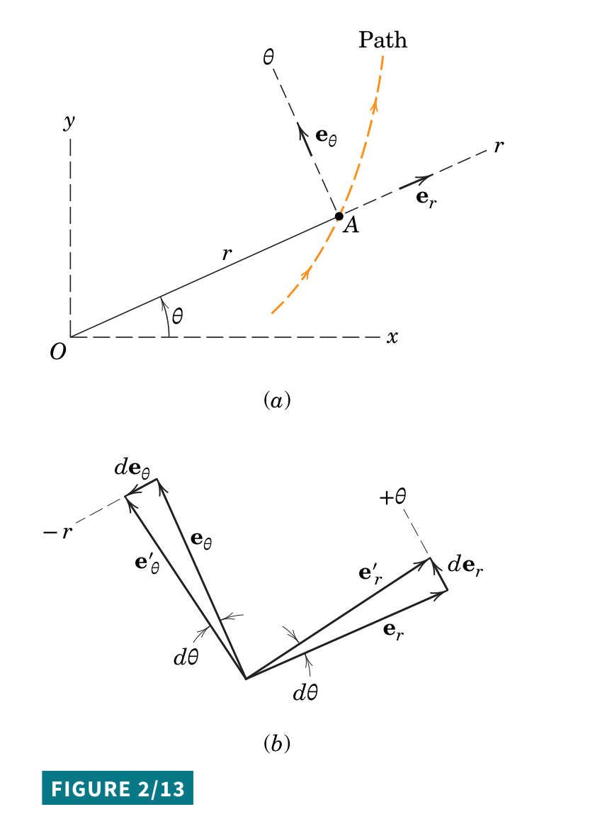
Polar Coordinates: r–θ Motion
For a body that moves while rotating, resolve along $e_{r}$ and $e_{θ}$
$$v=\dot{r} e_{r}+r\dot{θ} e_{θ}$$
$$a=\left(\ddot{r}−r{\dot{θ}}^{2}\right)e_{r}+\left(r\ddot{θ}+2\dot{r}\dot{θ}\right)e_{θ}$$
Term
Direction
Physical meaning
$$\ddot{r}$$
radial
Acceleration along the rotating line
$$−r{\dot{θ}}^{2}$$
radial (inward)
Centripetal acceleration from rotation
$$r\ddot{θ}$$
transverse
Angular acceleration of the line
$$2\dot{r}\dot{θ}$$
transverse
Coriolis-type term — $r$ and $θ$ change together
Meriam & Kraige, Fig. 2/13
Example : a bead sliding outward along a rotating rod — the rod must push it sideways, even at constant $\dot{θ}$, because of $2\dot{r}\dot{θ}$.
Sookmyung Women’s Univ. Autonomous Mechanical Systems Lab
6

Slide 7
Particle Kinetics: Newton's Second Law
Force → acceleration → motion: every kinetics problem starts from a free body diagram
Free Body Diagram
$$∑F=ma$$
Kinematics
all external forces
acceleration
integrate to $v(t), x(t)$
$$∑F=ma$$
n–t components (curved paths)
$$∑F_{t}=m\dot{v}, ∑F_{n}=m\frac{v^{2}}{ρ}$$
Cartesian : $∑F_{x}=m\ddot{x}, ∑F_{y}=m\ddot{y}$
Habit : draw the FBD before writing any equation — missing or duplicated forces are the most common source of error.
Sookmyung Women’s Univ. Autonomous Mechanical Systems Lab
7

Slide 8
Work–Energy Method
Relates position and speed directly — no time variable needed
$$T_{1}+U_{1→2}=T_{2}$$
Kinetic energy and work
Only conservative forces
$$T=\text{½}mv^{2}, U_{1→2}=\int_{1}^{2}{F}⋅dr$$
$$T_{1}+V_{1}=T_{2}+V_{2}$$
Scalar equation : no vector components and no reaction forces that do no work (normal force on a smooth path).
Potential energy
$$V_{g}=mgh, V_{e}=\text{½}kx^{2}$$
When to use : "find the speed, the distance is given, time is not needed" → try energy before Newton's law.
Sookmyung Women’s Univ. Autonomous Mechanical Systems Lab
8

Slide 9
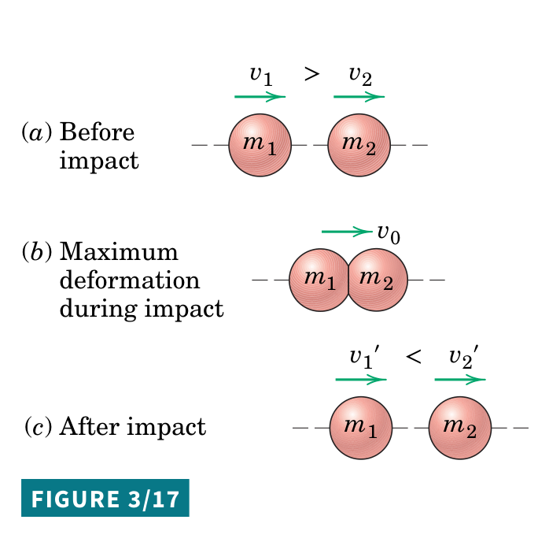
Impulse–Momentum Method
Short, large forces and collisions are handled with momentum
$$mv_{1}+\int_{t_{1}}^{t_{2}}{∑}F dt=mv_{2}$$
Definitions
Coefficient of restitution
Linear momentum : $p=mv$
$$e=\frac{v_{2}^{′}−v_{1}^{′}}{v_{1}−v_{2}}=\frac{\text{separation}}{\text{approach}}$$
Impulse : $\int_{t_{1}}^{t_{2}}{F} dt$
$e=1$ : perfectly elastic
$e=0$ : perfectly plastic
No external impulse
$$m_{1}v_{1}+m_{2}v_{2}=m_{1}v_{1}^{′}+m_{2}v_{2}^{′}$$
Meriam & Kraige, Fig. 3/17
Collision recipe : momentum conservation + restitution give two equations for $v_{1}^{′}$ and $v_{2}^{′}$.
Sookmyung Women’s Univ. Autonomous Mechanical Systems Lab
9

Slide 10
Rigid Body Motion: Translation + Rotation
A rigid body moves its mass centre and rotates about it at the same time
Translation of G
+
Rotation about G
Rigid Body Motion
=
$$v_{G}, a_{G} → ∑F=ma_{G}$$
$$ω, α → ∑M_{G}=I_{G} α$$
general plane motion
Translation ↔ rotation analogy
Inertia
Velocity
Acceleration
Cause
Equation
Kinetic energy
Momentum
Translation
$$m$$
$$v$$
$$a$$
$$F$$
$$∑F=ma$$
$$\text{½}mv^{2}$$
$$mv$$
Rotation
$$I_{G}$$
$$ω$$
$$α$$
$$M_{G}$$
$$∑M_{G}=I_{G}α$$
$$\text{½}I_{G}ω^{2}$$
$$I_{G} ω$$
Reading the table : every particle result has a rotational twin — replace $m$ by $I$, $F$ by $M$, $a$ by $α$.
Sookmyung Women’s Univ. Autonomous Mechanical Systems Lab
10

Slide 11
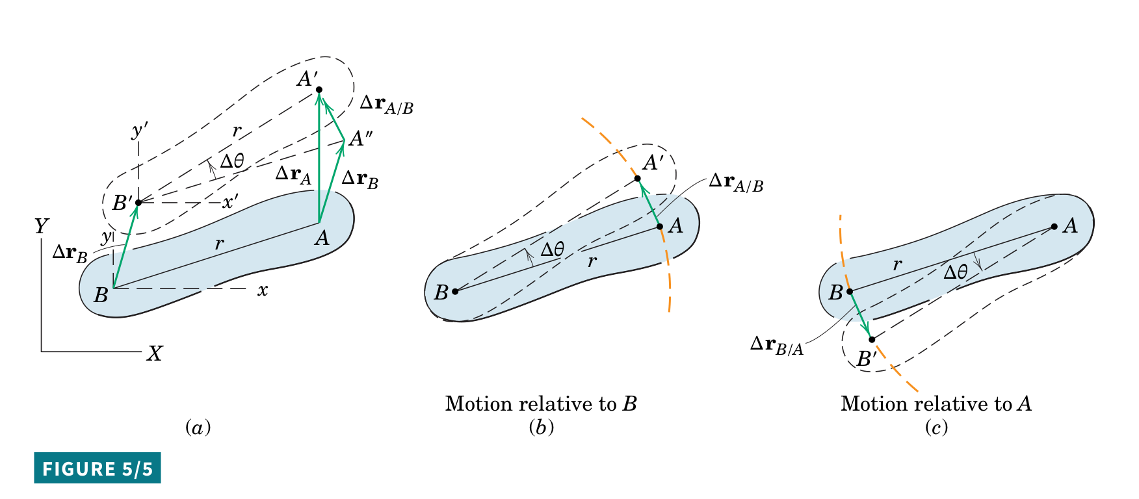
Rigid Body Kinematics: Relative Velocity
Velocity of B = velocity of A + rotation of B about A
$$v_{B}=v_{A}+ω×r_{B/A}$$
Two parts : translation with the reference point A, plus circular motion of B about A.
$v_{B/A}=ω×r_{B/A}$ : magnitude $rω$, perpendicular to $r_{B/A}$.
Meriam & Kraige, Fig. 5/5 — (a) displacement, (b) motion relative to B, (c) motion relative to A
Why it matters : this is the most used equation in rigid-body kinematics — linkages, wheels and gears all reduce to it.
Sookmyung Women’s Univ. Autonomous Mechanical Systems Lab
11

Slide 12
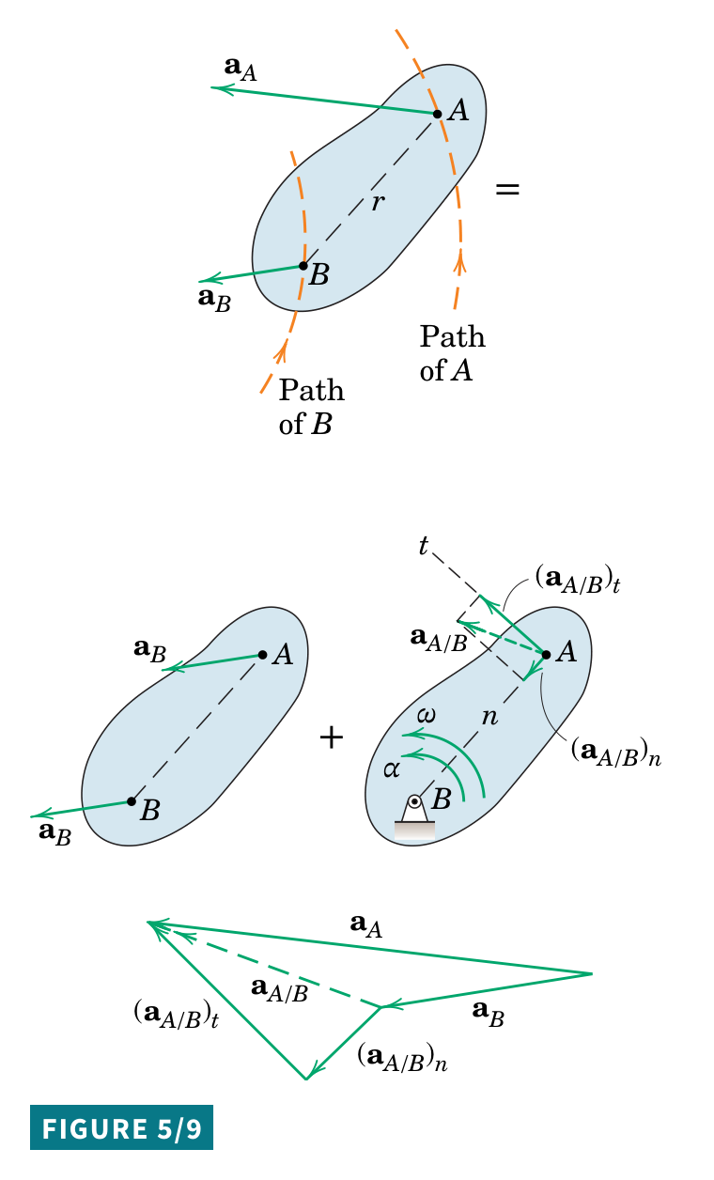
Rigid Body Kinematics: Relative Acceleration
Relative acceleration adds a tangential term $rα$ and a normal term $rω^{2}$
$$a_{B}=a_{A}+α×r_{B/A}+ω×\left(ω×r_{B/A}\right)$$
Plane motion
$$a_{B}=a_{A}+α×r_{B/A}−ω^{2} r_{B/A}$$
Term
Magnitude
Direction
$$α×r_{B/A}$$
$$rα$$
Tangential — perpendicular to $r_{B/A}$
$$−ω^{2} r_{B/A}$$
$$rω^{2}$$
Normal — from B toward A
Meriam & Kraige, Fig. 5/9
Solve it : sketch the vector polygon — known vectors first, unknown magnitudes close the polygon.
Sookmyung Women’s Univ. Autonomous Mechanical Systems Lab
12

Slide 13
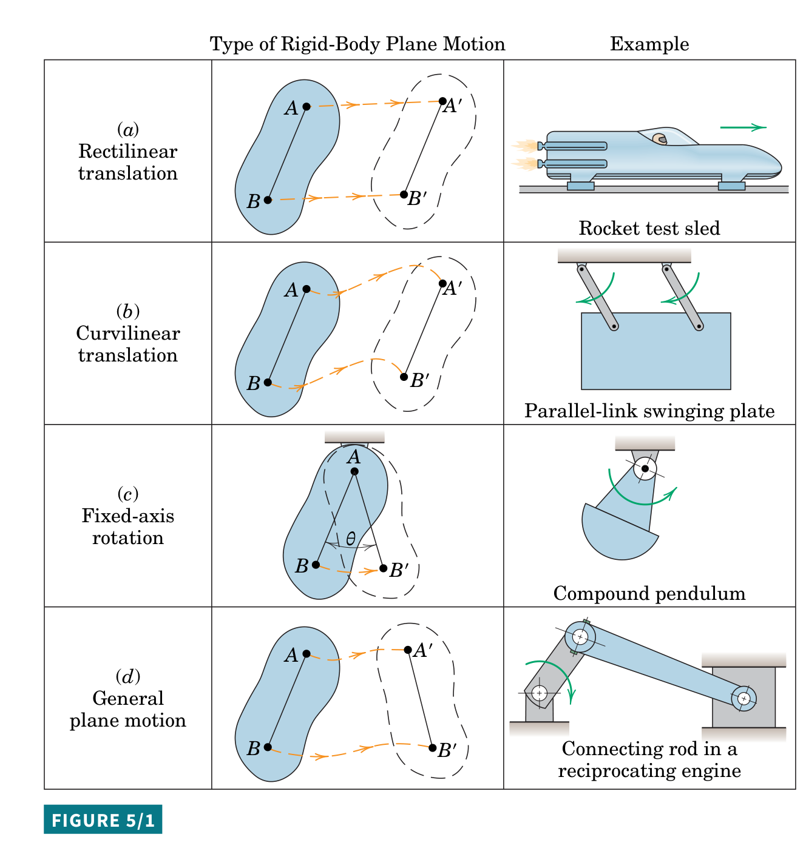
Three Types of Plane Motion
Classify the motion first — each type has its own simple relations
Translation
$$v_{A}=v_{B}, a_{A}=a_{B}$$
treat the body as a particle
(a), (b) — $ω=0$
Fixed-Axis Rotation
$$v=rω, a_{t}=rα, a_{n}=rω^{2}$$
pulleys, flywheels, pendulums
(c) — about fixed O
General Plane Motion
translation of $G$ + rotation about $G$
wheels, links, connecting rods
(d) — translation + rotation
Meriam & Kraige, Fig. 5/1
Priority : general plane motion is the most important case — most exam problems (wheels, linkages, disks) belong here.
Sookmyung Women’s Univ. Autonomous Mechanical Systems Lab
13

Slide 14
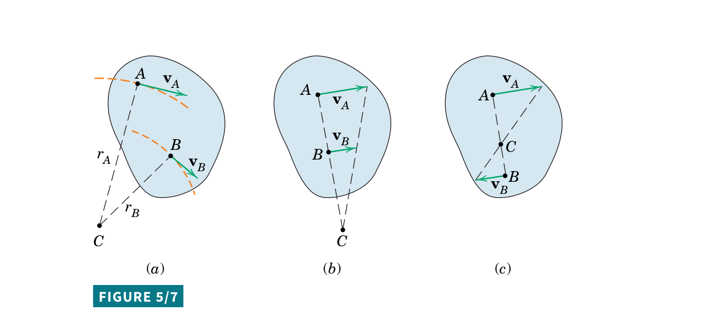
Instantaneous Center of Zero Velocity
At each instant, a body in plane motion rotates about one point C where $v_{C}=0$
$$v_{A}=ω r_{A/C}, v_{B}=ω r_{B/C}$$
$$ω=\frac{v_{A}}{r_{A/C}}=\frac{v_{B}}{r_{B/C}}$$
Meriam & Kraige, Fig. 5/7 — C lies on the normals to $v_{A}$ and $v_{B}$
Locating C : draw lines perpendicular to $v_{A}$ and $v_{B}$; they intersect at C (a). Parallel velocities: use their magnitudes (b), (c).
Benefit : the velocity of any point follows from one distance — no vector algebra.
Caution : the IC is for velocity only. C itself generally accelerates, so $a=ω^{2}r$ about C is wrong.
Sookmyung Women’s Univ. Autonomous Mechanical Systems Lab
14

Slide 15
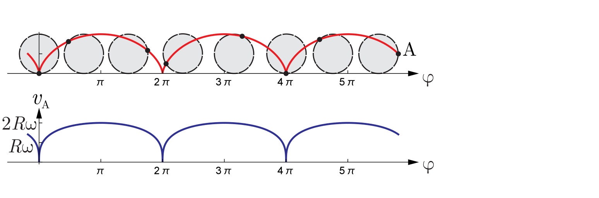
Rolling Without Slipping
The contact point has zero velocity, which ties the motion of G to $ω$
$$v_{G}=R ω, a_{G}=R α$$
$$ω$$
$$v_{G}$$
G
$$R$$
Kochmann, ETH Dynamics lecture notes, p. 84 — rim point traces a cycloid; its speed is 0 at contact, $2Rω$ at the top
$$a_{C}$$
Common trap : zero velocity at C does not mean zero acceleration. C accelerates toward G with $a_{C}=R ω^{2}$.
C $(v_{C}=0)$
Friction : static friction at C does no work, because C does not move at that instant.
Sookmyung Women’s Univ. Autonomous Mechanical Systems Lab
15

Slide 16
Mass Moment of Inertia
$I$ plays the role of mass in rotation — mass far from the axis counts more
Definition
Common bodies
$$I=∫r^{2} dm$$
Body
Axis
$$I$$
Solid disk
centre
$$\text{½}mR^{2}$$
Parallel-axis theorem
Thin ring
centre
$$mR^{2}$$
$$I_{O}=I_{G}+md^{2}$$
Slender rod
centre
$$\text{¹⁄₁₂}mL^{2}$$
$d$ : distance between the axis through G and the parallel axis through O.
Slender rod
end
$$\text{⅓}mL^{2}$$
Quick check : rod about its end, $\text{¹⁄₁₂}mL^{2}+m{\left(L/2\right)}^{2}=$$\text{⅓}mL^{2}$ — the table's last row follows from the parallel-axis theorem.
Sookmyung Women’s Univ. Autonomous Mechanical Systems Lab
16

Slide 17
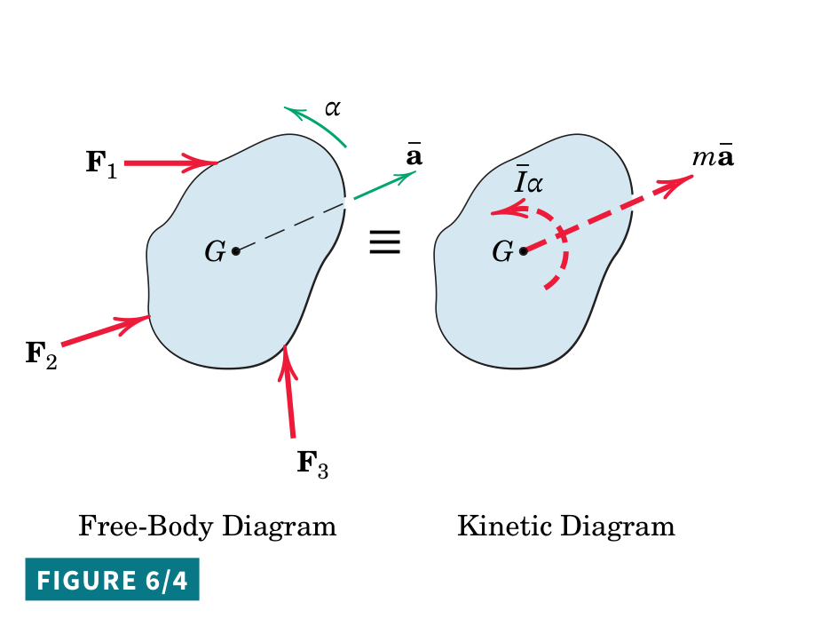
Rigid Body Kinetics: Force–Acceleration
Two equations used together — one for translation, one for rotation
Translation
$$∑F=m a_{G}$$
Rotation
$$∑M_{G}=I_{G} α$$
Plane motion: three scalar equations
$$∑F_{x}=m a_{Gx}, ∑F_{y}=m a_{Gy}, ∑M_{G}=I_{G} α$$
Fixed-axis rotation about O
$$∑M_{O}=I_{O} α$$
Procedure : FBD ≡ kinetic diagram → kinematic link (e.g. $a_{G}=Rα$) → solve.
Meriam & Kraige, Fig. 6/4 — forces on the FBD ≡ $m\overset{‾}{a}$ and $\overset{‾}{I}α$ on the kinetic diagram
Starting point : almost every rigid-body kinetics problem starts from these two equations.
Sookmyung Women’s Univ. Autonomous Mechanical Systems Lab
17

Slide 18
Rigid Body Work–Energy
Kinetic energy has two parts: translation of G and rotation about G
$$T=\text{½}mv_{G}^{2}+\text{½}I_{G} ω^{2}, T_{1}+U_{1→2}=T_{2}$$
Example: solid disk rolling from rest down a height $h$
$$T=\text{½}mv^{2}+\text{½}\left(\text{½}mR^{2}\right){\left(v/R\right)}^{2}=\text{¾}mv^{2}$$
$$mgh=\text{¾}mv^{2} ⇒ v=\sqrt{\text{⁴⁄₃} gh} \left(\text{sliding block: }v=\sqrt{2gh}\right)$$
Rolling recipe : $T=\text{½}mv_{G}^{2}+\text{½}I_{G}ω^{2}$ together with $v_{G}=Rω$ solves most rolling problems.
Interpretation : rotation stores part of the energy, so the rolling disk arrives slower than a frictionless sliding block.
Sookmyung Women’s Univ. Autonomous Mechanical Systems Lab
18

Slide 19
Rigid Body Impulse–Momentum
Rigid bodies need both linear and angular momentum
Linear
$$m v_{G1}+∫∑F dt=m v_{G2}$$
Angular (G)
$$I_{G} ω_{1}+∫∑M_{G} dt=I_{G} ω_{2}$$
No external moment impulse
Typical uses
$$I_{1} ω_{1}=I_{2} ω_{2}$$
Impacts on bars and pendulums, spinning bodies that change shape, coupled rotors.
A spinning skater pulls in the arms: $I$ drops, so $ω$ rises.
Conservation : with no external moment impulse, angular momentum is conserved — even when energy is not.
Sookmyung Women’s Univ. Autonomous Mechanical Systems Lab
19

Slide 20
Choosing the Method
Pick the method before searching for a formula
What the problem gives or asks
Method
Start from
Position, velocity, acceleration versus time
Kinematics
$$v=dx/dt, a=dv/dt$$
Forces linked directly to acceleration
Force–Acceleration
$$∑F=ma, ∑M_{G}=I_{G}α$$
Position ↔ speed, time not needed
Work–Energy
$$T_{1}+U_{1→2}=T_{2}$$
Impact, collision, large force over short time
Impulse–Momentum
$$mv_{1}+∫F dt=mv_{2}$$
Velocities of several points on a rigid body
Relative velocity / IC
$$v_{B}=v_{A}+ω×r_{B/A}$$
Rolling
Rolling constraint
$$v_{G}=Rω$$
Energy of a rigid body
Rigid-body KE
$$\text{½}mv_{G}^{2}+\text{½}I_{G}ω^{2}$$
Core skill : choosing the method matters more than recalling formulas — the right choice often removes an unknown entirely.
Sookmyung Women’s Univ. Autonomous Mechanical Systems Lab
20

Slide 21
Ten Equations to Remember
The minimum set to have ready before an exam
1
Newton's 2nd law
$$∑F=ma$$
6
Relative acceleration
$$a_{B}=a_{A}+α×r_{B/A}+ω×(ω×r_{B/A})$$
$$a_{n}=\frac{v^{2}}{ρ}$$
$$v_{G}=Rω$$
2
Normal acceleration
7
Rolling
3
Work–energy
$$T_{1}+U_{1→2}=T_{2}$$
8
Rigid body, translation
$$∑F=ma_{G}$$
4
Impulse–momentum
$$mv_{1}+∫F dt=mv_{2}$$
9
Rigid body, rotation
$$∑M_{G}=I_{G}α$$
5
Relative velocity
$$v_{B}=v_{A}+ω×r_{B/A}$$
10
Rigid-body KE
$$T=\text{½}mv_{G}^{2}+\text{½}I_{G}ω^{2}$$
Pattern : 1–4 are particle tools; 5–10 add rotation to the same ideas.
Sookmyung Women’s Univ. Autonomous Mechanical Systems Lab
21

Slide 22
Summary
Particle dynamics is $F=ma$ seen through motion, energy and momentum
•
Kinematics describes motion; kinetics explains it through forces and moments
→
Choose coordinates to fit the path: Cartesian, n–t, or r–θ
•
Three kinetics methods for a particle
→
$∑F=ma$ · $T_{1}+U_{1→2}=T_{2}$ · $mv_{1}+∫F dt=mv_{2}$
•
Rigid-body dynamics adds rotation: $ω, α, I$ and $∑M_{G}=I_{G}α$
→
Kinematics: $v_{B}=v_{A}+ω×r_{B/A}$, IC, rolling $v_{G}=Rω$
→
Energy and momentum each gain a rotational term: $\text{½}I_{G}ω^{2}$, $I_{G} ω$
•
Decide the method first, then write the equation
Sookmyung Women’s Univ. Autonomous Mechanical Systems Lab
22

