Slide 1

Learning to Push:
Imitation Learning and RL on PushT
Department of Mechanical Engineering
2026.10.07 (Wed)
Joo Yong Sim
Step-by-step edition: from basic physics, learning and RL to the full PushT pipeline

Slide 2

Roadmap: From Newton's Law to PPO
Five parts — each one uses only what the parts before it built
Basic physics
PushT simulator
Learning from demos
Basic RL
Results
Steps 1–7
contact code
Steps 8–11
Steps 12–18
paired evaluation
Part
Key question
Tutorial file
Basic physics
How does a computer move a rigid body and resolve a collision?
pusht_mini_sim.py
PushT simulator
Which line of code is which equation?
pusht_keyboard_sim.py
Learning from demos
How does a network copy a demonstrator?
pusht_imitation.py
Basic RL
How does an agent improve from reward alone?
pusht_rl.py
Results
Which policy works best, and why?
pusht_rl_eval.py
Prerequisites : $∑F=ma$ and impulse–momentum from the dynamics lecture, vectors and matrices, basic Python.
Sookmyung Women’s Univ. Autonomous Mechanical Systems Lab
2

Slide 3
Lecture Goals: From Physics to Policy
The PushT simulator from the dynamics lecture becomes a training ground
Physics
Demonstrations
Imitation
RL fine-tuning
impulse · friction · walls
human or scripted expert
MLP-BC · Diffusion Policy
PPO, started from BC
Three questions answered with experiments in this lecture
Q1 — Data : how many demonstrations do we need to collect?
Q2 — Model : which network should learn from them — a regressor or a generative model?
Q3 — Beyond imitation : can reinforcement learning do better, from scratch or starting from the imitation policy?
Pipeline : demonstrations $D=\{(o_{t},a_{t})\}$ → dataset → policy $π_{ϕ}(a∣o)$ → closed-loop success rate on unseen tasks
Sookmyung Women’s Univ. Autonomous Mechanical Systems Lab
3

Slide 4
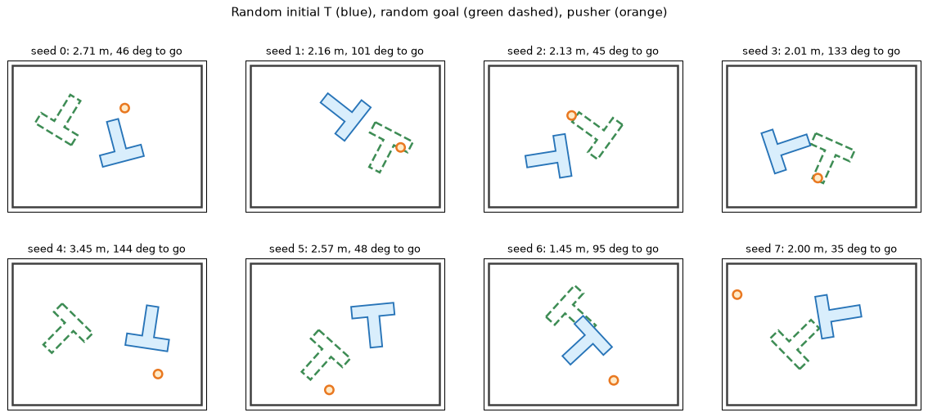
The PushT Task: Random Start, Random Goal
One seed fixes the initial T pose, the goal pose and the pusher position
What
Distribution
T start pose
$$x∼U(−2,2), y∼U(−1,1), θ∼U(−π,π)$$
Goal pose
same; redrawn if too easy ($<1$ m and $<{45}^{∘}$)
Pusher
uniform in the arena, $≥1.6$ from the T
Success
$$\left\|x_{G}−x_{g}\right\|<0.15 \text{m} \text{and} |θ−θ_{g}|<{10}^{∘}$$
Blue: T start · green dashed: goal · orange: pusher (seeds 0–7)
Seeds : demos use 100000+ (expert) and 200000+ (human); evaluation uses 0, 1, 2, … — tasks never seen in training.
Sookmyung Women’s Univ. Autonomous Mechanical Systems Lab
4

Slide 5
Control Loop and Demonstration Data
The policy moves the pusher's target at 10 Hz; the physics runs 20 substeps in between
State (8 numbers — what a human sees)
One episode, saved to .npz
$$s_{t}=\left(\underset{\text{pusher}}{\underset{⏟}{x_{P}, y_{P}}}, \underset{\text{T}}{\underset{⏟}{x_{G}, y_{G}, θ}}, \underset{\text{goal}}{\underset{⏟}{x_{g}, y_{g}, θ_{g}}}\right)$$
$$τ=\left((s_{0},a_{0}),(s_{1},a_{1}),…,(s_{T−1},a_{T−1})\right)$$
Array
Shape
Meaning
Action
states
(N, 8)
$$s_{t}$$
$$a_{t}=(x^{*}, y^{*}) \text{= pusher target}, Δt=0.1 \text{s}$$
actions
(N, 2)
$a_{t}$ = target
episode_ends
(E,)
where each episode ends
A PD controller pulls the pusher toward the target; contact with the T is the impulse model of the dynamics lecture.
seeds
(E,)
re-creates the start
Only successful episodes are saved : imitating a failure teaches failure (filtered behavior cloning). Same format as the Diffusion Policy / LeRobot PushT data.
Sookmyung Women’s Univ. Autonomous Mechanical Systems Lab
5

Slide 6
Step 1 · Newton's Law in Discrete Time
A computer cannot integrate continuously — it advances the state in small steps $Δt$
Continuous
Generic loop · pusht_keyboard_sim.py : substep
$$m\frac{dv}{dt}=∑F, \frac{dx}{dt}=v$$
# a particle under a force, step by step
dt = 0.005
for k in range(n_steps):
Discrete: semi-implicit Euler
a = force(x, v) / m # Newton: a = F / m
v = v + a * dt # velocity first
$$v_{k+1}=v_{k}+\frac{∑F}{m} Δt$$
x = x + v * dt # then position
# the same two lines for the PushT pusher
P.vel += acc * dt
$$x_{k+1}=x_{k}+v_{k+1} Δt$$
P.pos += P.vel * dt
Semi-implicit : the position uses the new velocity — stable for springs and PD controllers where explicit Euler gains energy.
Step size : PushT uses $Δt=5$ ms. Smaller is more accurate but slower — accuracy vs. speed matters again when RL needs millions of steps.
Sookmyung Women’s Univ. Autonomous Mechanical Systems Lab
6

Slide 7
Step 2 · Friction Slows a Sliding Body
The floor removes momentum — model it as a force proportional to velocity
Viscous floor friction
pusht_keyboard_sim.py : substep (step 2)
$$\frac{dv}{dt}=−c v ⇒ v(t)=v_{0} e^{−ct}$$
self.linear_damping = 3.0 # c_v [1/s]
self.angular_damping = 3.0 # c_w [1/s]
$$\text{slide distance}=\int_{0}^{∞}{v_{0}}e^{−ct}dt=\frac{v_{0}}{c}$$
T.vel *= math.exp(-self.linear_damping * dt)
T.omega *= math.exp(-self.angular_damping * dt)
Exact discrete update — stable for any $Δt$
$$v_{k+1}=v_{k} e^{−cΔt} \left(\text{Euler: }1−cΔt\right)$$
$v_{0}=1$ m/s, $c=3 {\text{s}}^{−1}$
Value
95 % of speed lost
$t=ln20/3≈1.0$ s
total slide
$0.33$ m
Two friction models : the floor uses this simple viscous law; the pusher–T contact uses Coulomb friction $|F_{t}|≤μF_{n}$ (later).
Sookmyung Women’s Univ. Autonomous Mechanical Systems Lab
7

Slide 8
Step 3 · A Rigid Body: Translation + Rotation
Three numbers place the T, $(x_{G},y_{G},θ)$; three more describe its motion, $(v_{G},ω)$
Equations of motion (plane)
pusht_keyboard_sim.py · pusht_imitation.py
@dataclass
$$∑F=m a_{G}, ∑M_{G}=I_{G} α$$
class TBody:
pos: np.ndarray # x_G, y_G
angle: float # theta
Where is a body point?
vel: np.ndarray # v_G
omega: float
$$p=x_{G}+R(θ) p_{\text{local}}, R(θ)=\left(\begin{matrix}cosθ & −sinθ \\ sinθ & cosθ\end{matrix}\right)$$
mass: float
inertia: float # I_G
vertices: np.ndarray # p_local, COM at 0
Rotation is integrated like translation
def rotation_matrix(theta):
$$ω_{k+1}=ω_{k}+αΔt, θ_{k+1}=θ_{k}+ω_{k+1}Δt$$
c, s = np.cos(theta), np.sin(theta)
return np.array([[c, -s], [s, c]])
def T_outline(pos, angle, vertices):
return pos + vertices @ rotation_matrix(angle).T
In PushT : apart from floor damping, every push reaches the T as an impulse — so $v_{G}$ and $ω$ change by jumps (Steps 5–6).
Sookmyung Women’s Univ. Autonomous Mechanical Systems Lab
8

Slide 9
Step 4 · Velocity of a Point on a Rigid Body
Every point shares $v_{G}$, plus a rotational part perpendicular to $r$
$$v_{C}=v_{G}+ω×r, r=x_{C}−x_{G}$$
pusht_keyboard_sim.py
def omega_cross_r(omega, r):
"""[0, 0, omega] x [rx, ry, 0]"""
In 2D, $ω=(0,0,ω)$
return np.array([-omega * r[1], omega * r[0]])
$$ω×r=(−ωr_{y}, ωr_{x}), r×F=r_{x}F_{y}−r_{y}F_{x}$$
def cross2(a, b):
"""2D cross product a x b -> scalar (z)"""
Worked example
return float(a[0] * b[1] - a[1] * b[0])
$v_{G}=(1,0)$ m/s, $ω=2$ rad/s, $r=(0, 0.5)$ m
# used for the contact point:
$$ω×r=(−1, 0) ⇒ v_{C}=(0, 0)$$
v_C = body.vel + omega_cross_r(body.omega, r)
That point is momentarily at rest — the instantaneous centre of the dynamics lecture.
Why it matters : a collision happens at the contact point, so its speed — not the COM speed — decides whether the bodies approach.
Sookmyung Women’s Univ. Autonomous Mechanical Systems Lab
9

Slide 10
Step 5 · Impulse: A Large Force for a Short Time
A collision force is huge and brief — integrate it once and change the velocity in a jump
$$J=\int_{t}^{t+ϵ}{F} dt$$
pusht_keyboard_sim.py : resolve_impulse
J = j_n * n
body.vel += J / body.mass
Linear and angular impulse–momentum
body.omega += cross2(r, J) / body.inertia
# back to a force for display (advance):
$$mv_{G}^{+}=mv_{G}^{−}+J$$
F = self._j_sum / (n * self.physics_dt)
$$I_{G} ω^{+}=I_{G} ω^{−}+r×J$$
Worked example (T: $m=1, I_{G}=0.434$)
$J=(0.5, 0)$ N·s at $r=(0, −0.5)$ m : $Δv_{G}=(0.5, 0)$ m/s, $r×J=0.25 ⇒ Δω=0.58$ rad/s
Why jump : the contact lasts milliseconds, positions barely move, and the force history is unknown — only its integral $J$ matters.
Sookmyung Women’s Univ. Autonomous Mechanical Systems Lab
10

Slide 11
Step 6 · A Collision: How Big Is the Impulse?
Start with a particle hitting a wall, then let the body rotate
Restitution law (normal direction)
$$e$$
After impact
$$v_{n}^{+}=−e v_{n}^{−}, 0≤e≤1$$
1
elastic: full bounce
Particle: $mv_{n}^{+}=mv_{n}^{−}+j$
0.5
half the approach speed
$$j=−(1+e) m v_{n}^{−}=−\frac{(1+e) v_{n}^{−}}{1/m}$$
0
plastic: no bounce (PushT)
Rigid body: rotation absorbs part of it
resolve_impulse
K_n = 1.0 / body.mass \
$$j=−\frac{(1+e) v_{n}^{−}}{K_{n}}, K_{n}=\frac{1}{m}+\frac{(r×n)^{2}}{I}$$
+ cross2(r, n) ** 2 / body.inertia
j_n = -(1.0 + restitution) * v_n / K_n
Same formula : $1/m$ becomes $K_{n}$, the "effective inverse mass" seen at the contact — derived in full a few slides later.
Sookmyung Women’s Univ. Autonomous Mechanical Systems Lab
11

Slide 12
Step 7 · A Simulation Loop with Contacts
Every rigid-body simulator repeats the same five stages in each time step
Forces
Integrate
Detect
Impulse
Correct
PD, damping
Steps 1–3
who touches whom
Steps 4–6
remove overlap
Stage
PushT
Code
Forces
PD pusher toward the target; floor damping on the T
substep, steps 1–2
Integrate
semi-implicit Euler for pusher and T
substep, step 3
Detect
circle vs. T polygon; T corners vs. walls
circle_vs_T, wall_contacts
Impulse
normal $j_{n}$ with $e=0$, Coulomb friction $j_{t}$
resolve_impulse
Correct
push the T out of any overlap
end of resolve_impulse
Next : the following slides open each stage of the PushT code and put the equations beside it.
Sookmyung Women’s Univ. Autonomous Mechanical Systems Lab
12

Slide 13
Physics Inside One Control Step
One env.step() = 0.1 s = 20 substeps of 5 ms, each with a 3-pass contact solver
Target
PD pusher
Contact
Impulse
T motion
$$a_{t}=(x^{*},y^{*})$$
$$x_{P}, v_{P}$$
point, $n$, depth
$$j_{n}, j_{t}$$
$$(v_{G},ω)→(x_{G},θ)$$
Time steps
pusht_imitation.py : PushTEnv.step · pusht_keyboard_sim.py : advance
$$n_{\text{sub}}=round\left(\frac{Δt_{\text{ctrl}}}{Δt_{\text{phys}}}\right)=\frac{0.1}{0.005}=20$$
def step(self, action):
self.sim.target = np.clip(action, [x_min, y_min], [x_max, y_max])
self.sim.advance(self.control_dt) # 0.1 s
self.t += 1
Average contact force
def advance(self, frame_dt):
F≈1Δtctrlsubsteps​J, J=∫F dt
n = max(1, int(round(frame_dt / self.physics_dt)))
self._j_sum[:] = 0.0
for _ in range(n):
self.substep(self.physics_dt) # 5 ms
F = self._j_sum / (n * self.physics_dt) # impulse / time
Sookmyung Women’s Univ. Autonomous Mechanical Systems Lab
13

Slide 14
Substep: PD Pusher, Damping, Integration
The pusher is a controlled kinematic body; the T coasts and slows down by floor friction
1. PD control of the pusher
pusht_keyboard_sim.py : KeyboardPushT.substep
# 1. pusher PD control toward the target
$$a_{P}=K_{p}(x^{*}−x_{P})−K_{d} v_{P}$$
acc = self.kp * (self.target - P.pos) - self.kd * P.vel
P.vel += acc * dt
speed = np.linalg.norm(P.vel)
$K_{p}=80, K_{d}=18$ : damping ratio $ζ=K_{d}/(2\sqrt{K_{p}})≈1$ — fast, no overshoot. Speed limited to $3$ m/s.
if speed > self.max_speed:
P.vel *= self.max_speed / speed
P.pos += P.vel * dt # new velocity first
# 2. damping 3. integrate the T
2. Floor friction as exponential decay
T.vel *= math.exp(-self.linear_damping * dt)
$$v_{G}←v_{G} e^{−c_{v}Δt}, ω←ω e^{−c_{ω}Δt}$$
T.omega *= math.exp(-self.angular_damping * dt)
T.pos += T.vel * dt
3. Semi-implicit Euler
T.angle += T.omega * dt
$$x_{G}←x_{G}+v_{G}Δt, θ←θ+ωΔt$$
Consequence : released at speed $v$, the T slides another $\int_{0}^{∞}{v}e^{−c_{v}t}dt=v/c_{v}$ — the expert slows down near the goal for this reason.
Sookmyung Women’s Univ. Autonomous Mechanical Systems Lab
14

Slide 15
T Geometry: Mass Moment of Inertia
Composite body: two rectangles, each shifted to the T's centre of mass
Centre of mass (mass ∝ area)
pusht_keyboard_sim.py : make_T_geometry
$$\overset{‾}{y}=\frac{A_{1}y_{1}+A_{2}y_{2}}{A_{1}+A_{2}}$$
top_area = W * top_t
stem_h = H - top_t
stem_area = stem_w * stem_h
Rectangle + parallel-axis theorem
total_area = top_area + stem_area
y_top, y_stem = H / 2 - top_t / 2, -top_t / 2
IG=i​mi12(ai2+bi2)+mi di2
y_com = (top_area * y_top + stem_area * y_stem) / total_area
m_top = mass * top_area / total_area
m_stem = mass * stem_area / total_area
Value ($m=1$)
Result
# own centre + parallel-axis shift to the COM
I_top = m_top * (W**2 + top_t**2) / 12 \
top bar
$$1.8×0.5$$
+ m_top * (y_top - y_com) ** 2
I_stem = m_stem * (stem_w**2 + stem_h**2) / 12 \
stem
$$0.5×1.3$$
+ m_stem * (y_stem - y_com) ** 2
vertices[:, 1] -= y_com # body origin = COM
COM below the top edge
0.627
$$I_{G}$$
0.434
Sookmyung Women’s Univ. Autonomous Mechanical Systems Lab
15

Slide 16
Contact Detection: Circle vs T
Work in the T's own frame: closest point on the 8 edges, then inside / outside
World → body frame
pusht_imitation.py : circle_vs_T_fast (all edges at once)
$$c=R(θ)^{​⊤}(x_{P}−x_{G})$$
R = rotation_matrix(body_angle)
c = R.T @ (circle_pos - body_pos) # world -> T
Closest point on edge $i$
A = vertices
AB = np.roll(vertices, -1, axis=0) - A
$$t_{i}=clip\left(\frac{(c−a_{i})⋅(b_{i}−a_{i})}{{\left\|b_{i}−a_{i}\right\|}^{2}},0,1\right)$$
t = np.clip(((c - A) * AB).sum(1) / (AB * AB).sum(1), 0, 1)
Q = A + t[:, None] * AB # closest points
d2 = ((Q - c) ** 2).sum(1)
$$q_{i}=a_{i}+t_{i}(b_{i}−a_{i}), i^{*}=arg\min_{i}\left\|q_{i}−c\right\|$$
i = int(np.argmin(d2))
d = math.sqrt(d2[i])
inside = ... # ray casting
Penetration (pusher radius $ρ$)
if not inside and d >= radius:
return None
$$δ=\left\{\begin{matrix}ρ−d & \text{outside} \\ ρ+d & \text{inside}\end{matrix}\right., n=R n_{\text{local}}$$
direction = (Q[i] - c) / d
n_local, pen = (-direction, radius + d) if inside \
else (direction, radius - d)
n = R @ n_local
return body_pos + R @ Q[i], n, pen
Speed : the numpy version replaces an 8-iteration Python loop — identical results on 2000 random cases, checked in the tutorial.
Sookmyung Women’s Univ. Autonomous Mechanical Systems Lab
16

Slide 17
Contact Velocity and Normal Impulse
Relative velocity says whether the bodies approach; an impulse stops them
Velocity of the contact point
pusht_keyboard_sim.py : resolve_impulse (part 1)
$$v_{C}=v_{G}+ω×r, ω×r=(−ωr_{y}, ωr_{x})$$
point, n, pen = contact
r = point - body.pos
$$v_{n}=(v_{C}−v_{P})⋅n <0 ⇒ \text{approaching}$$
v_rel = body.vel + omega_cross_r(body.omega, r) - other_vel
v_n = float(np.dot(v_rel, n))
Normal impulse
if v_n < 0: # approaching
$$K_{n}=\frac{1}{m}+\frac{(r×n)^{2}}{I}, j_{n}=−\frac{(1+e) v_{n}}{K_{n}}$$
K_n = 1.0 / body.mass + cross2(r, n) ** 2 / body.inertia
j_n = -(1.0 + restitution) * v_n / K_n
J = j_n * n
body.vel += J / body.mass
$$Δv_{G}=\frac{j_{n}n}{m}, Δω=\frac{r×j_{n}n}{I}$$
body.omega += cross2(r, J) / body.inertia
def cross2(a, b): # 2D cross product, z only
return a[0] * b[1] - a[1] * b[0]
Kinematic pusher : $1/m_{P}=0, 1/I_{P}=0$, so only the T's terms remain in $K_{n}$. PushT uses $e=0$ — after impact $v_{n}^{+}=0$.
Sookmyung Women’s Univ. Autonomous Mechanical Systems Lab
17

Slide 18
Why Contact Height Matters
The same push at a different height splits into translation and rotation differently
Derivation: normal velocity change at C
$$Δv_{n}=\left(\frac{jn}{m}+Δω×r\right)⋅n=j\left(\frac{1}{m}+\frac{(r×n)^{2}}{I}\right)=jK_{n}$$
$$v_{n}^{+}=v_{n}+jK_{n}=−e v_{n} ⇒ j=−\frac{(1+e)v_{n}}{K_{n}}$$
Height $y$
$$K_{n}$$
$$j_{n}$$
$$Δv_{x}$$
$$Δω$$
0 (COM)
1.000
1.000
1.000
0.000
Stem's left face ($x=−0.25$), $v_{P}=(1,0)$, $e=0, μ=0$ : $r×n=−y, K_{n}=1+y^{2}/I$
−0.5
1.576
0.634
0.634
0.731
−1.0
3.305
0.303
0.303
0.697
Output of resolve_impulse() — pusht_mini_sim.py, section 8
At the COM : pure translation. Far from the COM : smaller impulse, mostly rotation.
This is PushT : choosing the contact point chooses the motion — exactly what the scripted expert and the learned policies must do.
Sookmyung Women’s Univ. Autonomous Mechanical Systems Lab
18

Slide 19
Coulomb Friction Impulse
Cancel the sliding velocity at the contact, but never beyond $μ j_{n}$
Tangent direction
pusht_keyboard_sim.py : resolve_impulse (part 2)
$$n=(n_{x},n_{y}) ⇒ t=(−n_{y}, n_{x})$$
# friction, using the velocity after the normal impulse
t = np.array([-n[1], n[0]])
Impulse that stops sliding
v_rel = body.vel + omega_cross_r(body.omega, r) - other_vel
v_t = float(np.dot(v_rel, t))
$$v_{t}=v_{\text{rel}}⋅t, K_{t}=\frac{1}{m}+\frac{(r×t)^{2}}{I}$$
K_t = 1.0 / body.mass + cross2(r, t) ** 2 / body.inertia
j_t = float(np.clip(-v_t / K_t,
-friction * j_n, friction * j_n))
$$j_{t}^{*}=−\frac{v_{t}}{K_{t}}$$
Jt = j_t * t
body.vel += Jt / body.mass
body.omega += cross2(r, Jt) / body.inertia
Coulomb limit
$$j_{t}=clip\left(j_{t}^{*}, −μj_{n}, μj_{n}\right), μ=0.4$$
Effect : with friction the pusher can drag the T sideways and rotate it; with $μ=0$ it slips along the surface (try F in the keyboard demo).
Sookmyung Women’s Univ. Autonomous Mechanical Systems Lab
19

Slide 20
Walls and Penetration Correction
A wall is a kinematic body with zero velocity — the same impulse function handles it
Wall = pusher with $v=0$
pusht_keyboard_sim.py : wall_contacts · substep (step 4)
$$v_{\text{other}}=0, \frac{1}{m_{\text{wall}}}=0$$
world = body.pos + body.vertices @ rotation_matrix(body.angle).T
for p in world:
for depth, n in ((x_min - p[0], (1.0, 0.0)), ...):
Left wall: $δ=x_{min}−p_{i,x}>0, n=(1,0)$
if depth > 0:
contacts.append((p.copy(), np.array(n), depth))
Penetration correction
# 4. contact solver: pusher-T and wall-T
for _ in range(3):
$$x_{G}←x_{G}+0.8 max(δ−{10}^{−4},0) n$$
c = circle_vs_T(P.pos, P.radius, T.pos, T.angle, T.vertices)
if c is not None:
jn, jt = resolve_impulse(T, P.vel, c, e, mu)
Discrete time jumps $t→t+Δt$ leave overlaps that impulses alone cannot remove.
for w in wall_contacts(T):
resolve_impulse(T, np.zeros(2), w, e, mu)
# end of resolve_impulse
body.pos += 0.8 * max(pen - 1e-4, 0.0) * n
Sookmyung Women’s Univ. Autonomous Mechanical Systems Lab
20

Slide 21
Physics Summary: Equation ↔ Code
Every line of the simulator is an equation from the dynamics lecture
Lecture idea
Equation
Code
PD control
$$a_{P}=K_{p}(x^{*}−x_{P})−K_{d}v_{P}$$
substep, step 1
Parallel-axis theorem
$$I_{G}=∑\left[{m_{i}}/{12}(a_{i}^{2}+b_{i}^{2})+m_{i}d_{i}^{2}\right]$$
make_T_geometry
Relative velocity
$$v_{C}=v_{G}+ω×r$$
omega_cross_r
Restitution
$$v_{n}^{+}=−e v_{n}^{−}$$
j_n = -(1+e) v_n / K_n
Linear impulse–momentum
$$Δv_{G}=J/m$$
body.vel += J / m
Angular impulse–momentum
$$Δω=(r×J)/I$$
body.omega += cross2(r, J) / I
Coulomb friction
$$|j_{t}|≤μj_{n}$$
np.clip(-v_t / K_t, ...)
Impulse = force × time
$$F≈∑J/Δt$$
advance
Files : derivations in pusht_mini_sim.py · real-time version in pusht_keyboard_sim.py · random tasks in pusht_imitation.py
Sookmyung Women’s Univ. Autonomous Mechanical Systems Lab
21

Slide 22
Step 8 · What Is a Policy?
A policy maps what the agent observes to what it does — here every 0.1 s
Observation
Policy
Action
Physics
$o_{t}$ from the state
$$a_{t}=π(o_{t})$$
pusher target
next state $s_{t+1}$
Policy
How it decides
In this course
Human
eyes + experience
keyboard recorder
Scripted
hand-written rules from physics
ScriptedExpert
Neural network
learned weights $ϕ$
MLP-BC, Diffusion, PPO actor
Closed loop : the policy sees the result of its last action, so it can correct its own mistakes.
Deterministic vs. stochastic : $a=π(o)$ or $a∼π(a∣o)$ — the second is needed for multimodal demos and for RL exploration.
Sookmyung Women’s Univ. Autonomous Mechanical Systems Lab
22

Slide 23
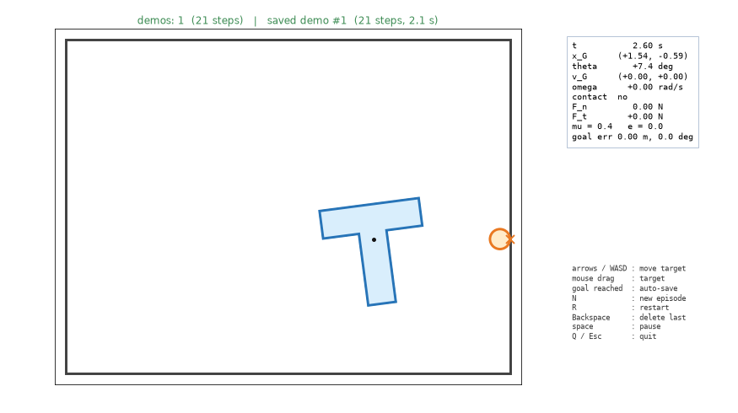
Collecting Human Demonstrations
python pusht_imitation.py collect — the keyboard simulator with a recorder added
Three rules for clean data
Fixed 10 Hz : the screen draws at 20 fps, but $(s_{t},a_{t})$ is recorded every 0.1 s — one human step = one env.step().
Idle start trimmed : time spent thinking before the first move is not recorded, so the policy never learns to stand still.
Physics fixed : friction / restitution switches are off — same state, same consequence.
Keys : N new task · R restart · Backspace delete last · Space pause
Recorder window: arrows / WASD or mouse drag move the target; reaching the goal auto-saves
Cost : one human demo takes 15–30 s, so 200 demos take 1.5–2 hours → we also need an automatic demonstrator.
Sookmyung Women’s Univ. Autonomous Mechanical Systems Lab
23

Slide 24
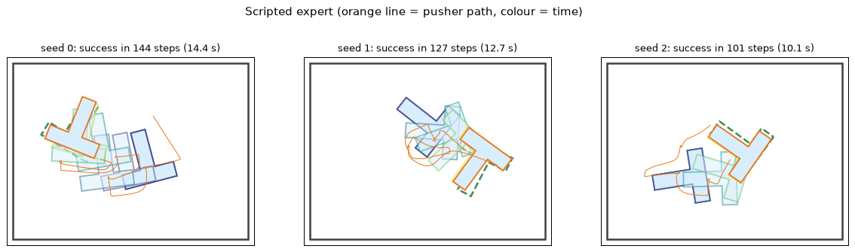
Scripted Expert: Impulse–Momentum as a Policy
A "virtual human" that chooses where to push with the lecture's impulse equations
(1) Where to push — unit impulse $n_{k}$ at candidate $C_{k}$
Candidates : 8 edges × 3 points; $d$ = desired $(Δx,Δy,L Δθ)$, $c_{k}$ = its effect.
$$Δv_{G}=\frac{n_{k}}{m}, Δω=\frac{r_{k}×n_{k}}{I}$$
(2) Approach : go to a standoff point; orbit around the T if the straight path is blocked.
$$k^{*}=arg\max_{k} \frac{c_{k}⋅d}{\left\|c_{k}\right\| \left\|d\right\|}$$
(3) Push : along $n_{k}$, slowing in proportion to the remaining error (the T slides $≈v/c_{v}$ after release).
Expert rollouts (orange: pusher path, colour: time) — success ≈ 88–91 % on random tasks
Sookmyung Women’s Univ. Autonomous Mechanical Systems Lab
24

Slide 25
Scripted Expert: Equation ↔ Code
Score each candidate push by how well its impulse response points toward the goal
Desired change ($L=0.8$)
pusht_imitation.py : ScriptedExpert.act
$$d=\left(x_{g}−x_{G}, y_{g}−y_{G}, L(θ_{g}−θ)\right)$$
e = sim.goal_pos - T.pos
d = np.array([e[0], e[1],
Response to a unit impulse at $C_{k}$
self.L * wrap_angle(sim.goal_angle - T.angle)])
for k, (c_local, out_local) in enumerate(self.cands):
$$c_{k}=\left(\frac{n_{k}}{m}, L \frac{r_{k}×n_{k}}{I}\right)$$
cw, out = T.pos + R @ c_local, R @ out_local
n_in, r = -out, cw - T.pos
c = np.array([n_in[0] / T.mass, n_in[1] / T.mass,
Cosine score
self.L * cross2(r, n_in) / T.inertia])
score = c @ d / (np.linalg.norm(c) * d_norm + 1e-9)
$$s_{k}=\frac{c_{k}⋅d}{\left\|c_{k}\right\|\left\|d\right\|}$$
for n_wall in walls:
if n_in @ np.array(n_wall) < -0.3:
score -= 0.6 # into that wall
if k == self.cur:
score += 0.1 # hysteresis
Penalty for pushing into a touching wall; +0.1 for keeping the same contact.
# push: slower when close to the goal
step = float(np.clip(0.3 * d_norm, 0.04, 0.12))
return P.pos - out * (step + 0.04)
Sookmyung Women’s Univ. Autonomous Mechanical Systems Lab
25

Slide 26
How Many Demonstrations? Reference Points
Published PushT and manipulation work uses 50–200 demonstrations per task
Source
Task
Demonstrations
Diffusion Policy (Chi et al., 2023)
PushT, fixed goal, random start
200 human (≈ 25k steps)
LeRobot pusht dataset
same task
206 episodes, 25,650 frames
ACT / ALOHA (Zhao et al., 2023)
real bimanual robot
50 per task
Suggested plan for human demonstrations (15–30 s each)
Stage
Demos
Time
Purpose
Pipeline check
10–20
10 min
save / load / train runs, loss goes down
First results
50–100
30–60 min
successes start; study the failures
Usable policy
≥ 200
1.5–2 h
Diffusion Policy paper scale
More important than the count : spread-out initial conditions, a consistent strategy, and discarded failures. Our goal is random too — harder than the original PushT.
Sookmyung Women’s Univ. Autonomous Mechanical Systems Lab
26

Slide 27
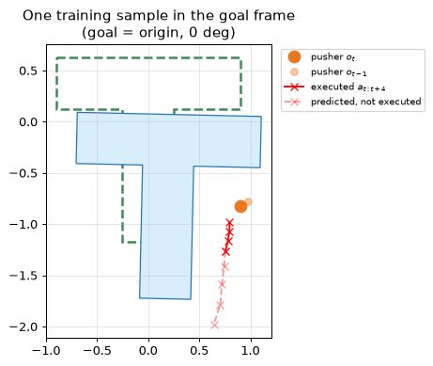
Goal Frame: Relative Motion Removes the Random Goal
Ride along with the goal — the same idea as relative motion in rigid-body kinematics
$$\tilde{p}=R(θ_{g})^{​⊤}(p−x_{g}), \tilde{θ}=θ−θ_{g}$$
$$o_{t}=\left({\tilde{x}}_{P}, {\tilde{y}}_{P}, {\tilde{x}}_{G}, {\tilde{y}}_{G}, cos\tilde{θ}, sin\tilde{θ}\right)$$
$${\tilde{a}}_{t+i}=R(θ_{g})^{​⊤}\left(a_{t+i}−x_{P}(t)\right)$$
Action representation (goal frame)
MLP-BC
Diffusion
absolute target position
26 %
20 %
offset from the current pusher
36 %
46 %
One training sample: goal at the origin, 0°
Without the goal frame : 0 % success for both models — a good representation saves data.
Sookmyung Women’s Univ. Autonomous Mechanical Systems Lab
27

Slide 28
Goal Frame: Equation ↔ Code
A rotation and a translation — written out by hand so it works on any batch shape
$$\tilde{p}=R(θ_{g})^{​⊤}(p−x_{g})=\left(\begin{matrix}c & s \\ −s & c\end{matrix}\right)v$$
pusht_imitation.py : to_goal_frame · make_obs · action_to_model
def to_goal_frame(points, state, origin=None):
c, s = math.cos(state[7]), math.sin(state[7])
v = points - (state[5:7] if origin is None else origin)
$$o_{t}=\left({\tilde{x}}_{P}, {\tilde{x}}_{G}, cos\tilde{θ}, sin\tilde{θ}\right)$$
return np.stack([ c * v[..., 0] + s * v[..., 1],
-s * v[..., 0] + c * v[..., 1]], -1)
$$\tilde{a}=R(θ_{g})^{​⊤}(a−x_{P}), a=x_{P}+R(θ_{g})\tilde{a}$$
def make_obs(state):
p = to_goal_frame(state[0:2], state)
State layout: $s=(x_{P},y_{P},x_{G},y_{G},θ,x_{g},y_{g},θ_{g})$ → indices 0–7.
T = to_goal_frame(state[2:4], state)
dth = state[4] - state[7]
return np.array([p[0], p[1], T[0], T[1],
math.cos(dth), math.sin(dth)])
def action_to_model(actions, state):
return to_goal_frame(actions, state, origin=state[0:2])
Sookmyung Women’s Univ. Autonomous Mechanical Systems Lab
28

Slide 29
Observation History and Action Chunks
See two frames, plan eight actions, execute four, then re-plan
Observe
Predict
Execute
Re-plan
$(o_{t−1}, o_{t})$, $T_{o}=2$
$a_{t:t+8}$, $H=8$ (0.8 s)
first $T_{a}=4$ actions
receding horizon
Two frames : the difference gives velocity — is the T still sliding?
Normalize : $z=(x−μ)/σ$, statistics from the training set only.
Chunks : one-step predictions change every 0.1 s and jitter; a chunk commits to a motion for a moment.
Split by episode : neighbouring steps are nearly identical — a step-wise split leaks data into validation.
Trade-off : 4 steps run open-loop, so an unexpected slide is corrected only at the next re-plan.
Sookmyung Women’s Univ. Autonomous Mechanical Systems Lab
29

Slide 30
Step 9 · Supervised Learning in One Slide
Fit a function to examples $(x,y)$ by following the gradient of a loss
Loss on a minibatch of $B$ examples
pusht_imitation.py : train
$$L(ϕ)=\frac{1}{B}\sum_{i=1}^{B}{∥}f_{ϕ}(x_{i})−y_{i}∥^{2}$$
opt = torch.optim.AdamW(model.parameters(), lr=lr)
sched = CosineAnnealingLR(opt, steps)
for it in range(1, steps + 1):
idx = torch.randint(0, len(X), (batch,))
loss = model.loss(X[idx], Y[idx])
Gradient descent
opt.zero_grad()
loss.backward() # gradient
$$ϕ←ϕ−η ∇_{ϕ}L(ϕ)$$
opt.step() # phi <- phi - lr * ...
sched.step() # lr decays to 0
Minibatch $B=256$, drawn at random every step. AdamW adapts the step per parameter. Validation set : episodes never trained on.
Loss ≠ goal : a low loss on demos does not guarantee success in closed loop — that is why every model here is evaluated by running it.
Sookmyung Women’s Univ. Autonomous Mechanical Systems Lab
30

Slide 31
Step 10 · The Network: A Multi-Layer Perceptron
Stack linear maps and nonlinearities; the weights $ϕ=\{W_{l},b_{l}\}$ are what training changes
$$h_{1}=σ(W_{1}x+b_{1})$$
pusht_imitation.py : MLP · BCPolicy
class MLP(nn.Module):
$$h_{l+1}=σ(W_{l+1}h_{l}+b_{l+1})$$
def __init__(self, d_in, d_out, width=256, depth=3):
layers, d = [], d_in
$$y=W_{\text{out}}h_{L}+b_{\text{out}}$$
for _ in range(depth):
layers += [nn.Linear(d, width), nn.Mish()]
d = width
$$\text{Mish: } σ(z)=ztanh\left(ln(1+e^{z})\right)$$
self.net = nn.Sequential(*layers, nn.Linear(d, d_out))
MLP-BC in PushT
Size
class BCPolicy(Normalized):
def loss(self, x, y): # MSE, normalized
input $(o_{t−1},o_{t})$
2 × 6 = 12
return ((self.f(self.nx(x)) - self.ny(y)) ** 2).mean()
hidden layers
3 × 512
output (8 actions × 2)
16
parameters
540,176
Why a nonlinearity : without $σ$ the whole stack collapses into one linear map — it could not represent "push left of the T here, right of it there".
Sookmyung Women’s Univ. Autonomous Mechanical Systems Lab
31

Slide 32
Step 11 · Behavior Cloning and Its Weak Spot
Behavior cloning = supervised learning with $x=$ observation and $y=$ expert action
$$\min_{ϕ} E_{(o,a^{*})∼D_{\text{expert}}}∥π_{ϕ}(o)−a^{*}∥^{2}$$
Covariate shift
Two more problems
Training states come from the expert; at test time states come from the policy itself. One small error leads to a state the demos never showed, where the next error is larger.
Multimodality : the MSE optimum is the mean of the demonstrated actions (next slides).
No recovery data : we save only successful demos, so the policy never sees how to fix a bad push.
$$\text{mistakes over }T\text{ steps: BC}∼T^{2}ϵ, \text{DAgger}∼Tϵ$$
Ross & Bagnell (2010); Ross, Gordon & Bagnell (2011)
Remedies in this course : action chunks, Diffusion Policy for multimodality — and RL fine-tuning, which learns from the policy's own states.
Sookmyung Women’s Univ. Autonomous Mechanical Systems Lab
32

Slide 33
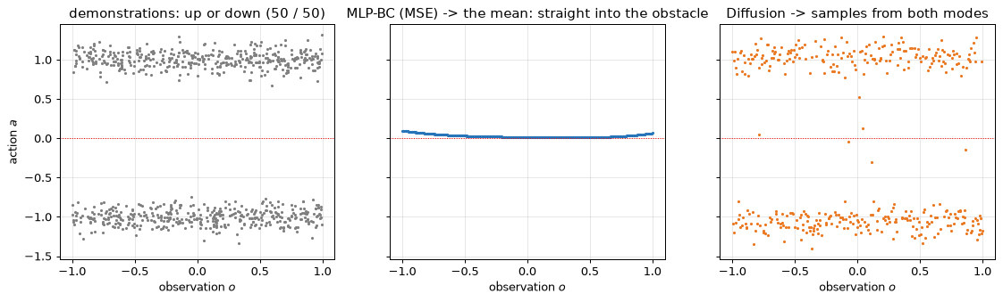
Which Model? The Multimodality Problem
MSE learns the average action — the average of two good actions can be bad
$$\min_{ϕ} E_{(o,a)∼D}∥π_{ϕ}(o)−a∥^{2} ⇒ π^{*}(o)=E[a∣o]$$
Toy problem: demonstrations avoid an obstacle up or down (50/50). MLP-BC learns $a≈0$ — straight into it; Diffusion samples both modes.
In PushT : "go around the left or the right side of the T?" — MLP-BC hesitates in between; human demos are even more multimodal.
Sookmyung Women’s Univ. Autonomous Mechanical Systems Lab
33

Slide 34
Policy Model Candidates
Learn a distribution $p(a∣o)$ instead of a single average action
Model
Output
Multimodal
Notes
MLP-BC (MSE)
one point
no (mean)
fastest, simplest — baseline
MLP-BC + action chunk
$H$ points
no
temporally consistent
GMM / MDN
$K$ Gaussians
partly
number of modes $K$ fixed in advance
VQ-BeT
discrete code + offset
yes
Transformer
ACT (CVAE + Transformer)
chunk
yes
real robot, 50 demos
Diffusion Policy
chunk, sampled
yes
standard PushT baseline, stable training
Our choice : MLP-BC as the baseline, Diffusion Policy as the main model — same MLP trunk (3 layers, width 512, Mish).
So the only difference is : learning the mean vs. learning the distribution.
Sookmyung Women’s Univ. Autonomous Mechanical Systems Lab
34

Slide 35
Diffusion Policy (DDPM) in Three Steps
Learn to remove noise from action chunks; at run time, denoise noise into actions
1. Forward process: mix noise into a clean chunk $a^{0}$
$$a^{k}=\sqrt{{\overset{‾}{α}}_{k}} a^{0}+\sqrt{1−{\overset{‾}{α}}_{k}} ϵ, ϵ∼N(0,I), k=1,…,K$$
2. Training: predict the noise
$$L=E_{k,ϵ}∥ϵ_{ϕ}(a^{k},k,o)−ϵ∥^{2}$$
3. Sampling: start from $a^{K}∼N(0,I)$, step $k=K,…,1$
$${\hat{a}}^{0}=\frac{a^{k}−\sqrt{1−{\overset{‾}{α}}_{k}} ϵ_{ϕ}}{\sqrt{{\overset{‾}{α}}_{k}}}, a^{k−1}=\frac{\sqrt{{\overset{‾}{α}}_{k−1}} β_{k}}{1−{\overset{‾}{α}}_{k}}{\hat{a}}^{0}+\frac{\sqrt{α_{k}} (1−{\overset{‾}{α}}_{k−1})}{1−{\overset{‾}{α}}_{k}}a^{k}+σ_{k}z$$
Why it is multimodal : each run starts from different noise → a different sample → different modes of the demonstrations. Cosine schedule $β_{k}$, $K=50$.
Sookmyung Women’s Univ. Autonomous Mechanical Systems Lab
35

Slide 36
Diffusion Policy: Equation ↔ Code
Training is one line of noise mixing; sampling is a loop of K = 50 denoising steps
Training
pusht_imitation.py : DiffusionPolicy.loss · predict
$$a^{k}=\sqrt{{\overset{‾}{α}}_{k}} a^{0}+\sqrt{1−{\overset{‾}{α}}_{k}} ϵ$$
def loss(self, x, y):
a0 = self.ny(y)
k = torch.randint(0, self.K, (len(a0),))
$$L={\left\|ϵ_{ϕ}(a^{k},k,o)−ϵ\right\|}^{2}$$
eps = torch.randn_like(a0)
ab = self.abar[k][:, None]
a_k = ab.sqrt() * a0 + (1 - ab).sqrt() * eps
Sampling
return ((self.eps_hat(a_k, k, self.nx(x)) - eps) ** 2).mean()
$${\hat{a}}^{0}=\frac{a^{k}−\sqrt{1−{\overset{‾}{α}}_{k}} ϵ_{ϕ}}{\sqrt{{\overset{‾}{α}}_{k}}}$$
def predict(self, x):
a = torch.randn(len(xn), self.d_act) # a^K ~ N(0, I)
for k in reversed(range(self.K)):
$$a^{k−1}=μ_{k}({\hat{a}}^{0},a^{k})+σ_{k}z$$
ab = self.abar[k]
a0 = (a - (1 - ab).sqrt() * self.eps_hat(a, kk, xn)) / ab.sqrt()
mean = (ab_prev.sqrt() * self.betas[k] / (1 - ab)) * a0 \
+ (self.alphas[k].sqrt() * (1 - ab_prev) / (1 - ab)) * a
var = self.betas[k] * (1 - ab_prev) / (1 - ab)
a = mean + var.sqrt() * torch.randn_like(a)
Sookmyung Women’s Univ. Autonomous Mechanical Systems Lab
36

Slide 37
Training Settings Found by Experiment
Diffusion needs more capacity or more steps than MLP-BC before it pays off
Setting (180 expert demos, unseen tasks)
MLP-BC
Diffusion
width 256, lr ${10}^{−3}$, no EMA, 30k steps
32 %
8 %
width 256, lr $3×{10}^{−3}$ + EMA, 30k steps
36–46 %
18–42 %
width 256, lr $3×{10}^{−3}$ + EMA, 80k steps
—
64 %
width 512, lr $3×{10}^{−3}$ + EMA, 30k steps (default)
38–59 %
54–63 %
width 512, lr $3×{10}^{−3}$ + EMA, 50k steps
—
69 %
$$ϕ_{\text{EMA}}←0.999 ϕ_{\text{EMA}}+0.001 ϕ$$
Batch 256, AdamW, cosine lr decay; about 1 min per model on GPU, 4 min on CPU.
Caution : re-running the same setting moves success by ±10 %; validation loss does not predict success (0.116 → 0.132 while 62 % → 69 %).
Sookmyung Women’s Univ. Autonomous Mechanical Systems Lab
37

Slide 38
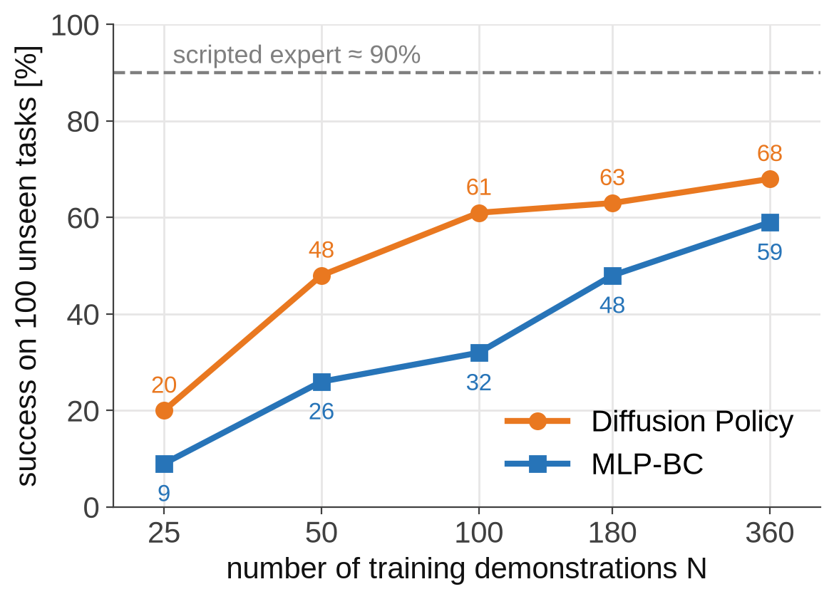
How Many Demonstrations? Measured
Diffusion reaches most of its performance at about 100 demonstrations
Experiment
400 expert demos → train on the first $N$ → width 512, 30k steps → 100 unseen tasks, closed loop.
Reading
Diffusion is ahead at every $N$, most clearly with little data.
MLP-BC needs about 3× more demos for the same success.
Human demos : aim for at least 100, ideally 200.
Reproduce : tools/imitation_experiments/full/run_scale512.sh (10 jobs, about 15 min)
Sookmyung Women’s Univ. Autonomous Mechanical Systems Lab
38

Slide 39
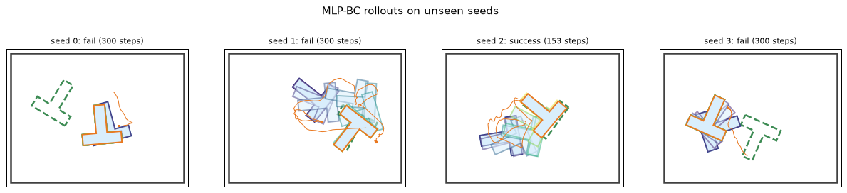
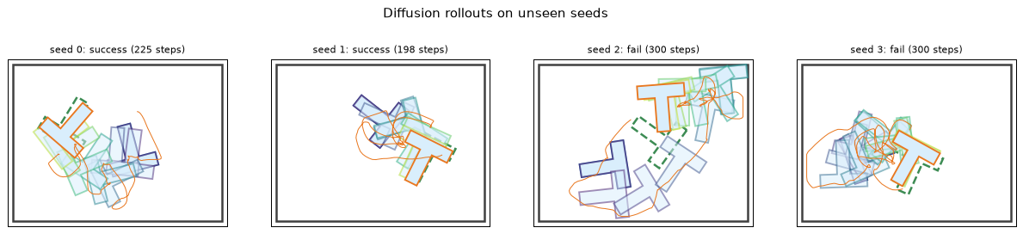
Closed-Loop Rollouts and Failure Modes
Both learned policies stay below the expert that taught them
MLP-BC : stalls or jitters beside the T — it averages between strategies.
Diffusion : commits to one strategy; fails at the final 0.15 m / 10° alignment or after one big mistake.
MLP-BC rollouts on unseen seeds
Both : covariate shift — their own errors lead to states never seen in the demos.
Diffusion Policy rollouts on the same seeds
Default run (180 demos) : expert 88 % · MLP-BC 38–59 % · Diffusion 54–63 %. Remedy: DAgger — record human corrections.
Sookmyung Women’s Univ. Autonomous Mechanical Systems Lab
39

Slide 40
Step 12 · The RL Problem: Learning from Reward
No teacher — the agent acts, and the environment answers with a new state and a reward
Agent
Environment
Feedback
policy $π_{ϕ}(a∣s)$
the simulator (Steps 1–7)
$$s_{t+1}, r_{t}$$
Markov decision process $(S,A,P,r,γ)$ for PushT
Element
PushT
state $s$
pusher, T and goal poses (+ velocities)
action $a$
where to move the pusher target
transition $P(s^{′}∣s,a)$
0.1 s of physics — deterministic here
reward $r$
progress toward the goal, bonus on success
episode
until success or 300 steps (30 s)
Markov property : the next state depends only on $(s,a)$ — that is why velocities belong in the state, or two frames in the observation.
Sookmyung Women’s Univ. Autonomous Mechanical Systems Lab
40

Slide 41
Step 13 · Return: Adding Up Future Rewards
The agent maximizes the discounted sum of rewards, not the next reward
Gt=rt+γrt+1+γ2rt+2+…=k≥0​γkrt+k
$$γ=0.99$$
Value
effective horizon $1/(1−γ)$
100 steps = 10 s
$$G_{t}=r_{t}+γ G_{t+1} (\text{recursive})$$
bonus 10 after 100 steps
$$10⋅{0.99}^{100}=3.7$$
$$J(ϕ)=E_{τ∼π_{ϕ}}\left[G_{0}\right] → \max_{ϕ}$$
bonus 10 after 50 steps
$$10⋅{0.99}^{50}=6.1$$
Discounting : a success that comes sooner is worth more — together with the −0.01 time penalty, this is why RL learns to finish faster than the expert.
$τ$ : one trajectory $(s_{0},a_{0},r_{0},s_{1},…)$ produced by running the policy.
Sookmyung Women’s Univ. Autonomous Mechanical Systems Lab
41

Slide 42
Step 14 · Value Function and Bellman Equation
How good is a state? The return the policy can expect from there
$$V^{π}(s)=E_{π}\left[G_{t}∣s_{t}=s\right]$$
pusht_rl.py : critic
# the critic V_psi(s) is another network
Bellman equation (from $G_{t}=r_{t}+γG_{t+1}$)
# trained by regression on the returns:
lv = ((model.value(Ob[idx]) - RET[idx]) ** 2).mean()
$$V^{π}(s)=E\left[r_{t}+γV^{π}(s_{t+1})∣s_{t}=s\right]$$
# TD error inside GAE
Temporal-difference (TD) error
delta = R[t] + gamma * nv * (1 - DONE[t]) - V[t]
$$δ_{t}=r_{t}+γV(s_{t+1})−V(s_{t})$$
$δ_{t}>0$ : the step went better than the critic expected.
Episode end : after success $(1−d_{t})=0$ — no future value. A time-out is not an end, so $V(s_{T})$ is added back (bootstrap).
Sookmyung Women’s Univ. Autonomous Mechanical Systems Lab
42

Slide 43
Step 15 · Advantage and GAE
Was this action better or worse than what the policy usually does in this state?
$$A^{π}(s,a)=Q^{π}(s,a)−V^{π}(s), {\hat{A}}_{t}^{(1)}=δ_{t}$$
pusht_rl.py : GAE
for t in reversed(range(n_steps)):
Generalized Advantage Estimation
nv = v_next if t == n_steps - 1 else V[t + 1]
delta = R[t] + gamma * nv * (1 - DONE[t]) - V[t]
At=l≥0​(γλ)l δt+l=δt+γλ At+1
g = delta + gamma * lam * (1 - DONE[t]) * g
adv[t] = g
RET = ADV + torch.cat(V) # critic target
ADV = (ADV - ADV.mean()) / (ADV.std() + 1e-8)
$$λ$$
Estimate
0
one-step TD: low variance, biased by the critic
1
full return − $V$: unbiased, noisy
0.95
the usual compromise (used here)
Sookmyung Women’s Univ. Autonomous Mechanical Systems Lab
43

Slide 44
Step 16 · Policy Gradient
Make better-than-usual actions more likely, and worse-than-usual ones less likely
Gaussian policy for continuous actions
pusht_rl.py
$$π_{ϕ}(a∣s)=N\left(μ_{ϕ}(s),σ^{2}\right)$$
def policy_dist(model, o):
return torch.distributions.Normal(
$$logπ_{ϕ}(a∣s)=−\frac{{\left\|a−μ_{ϕ}(s)\right\|}^{2}}{2σ^{2}}+\text{const}$$
model.mean(o), model.log_std.exp())
# training: sample -> exploration
Policy-gradient theorem
# evaluation: use model.mean(o)
$$∇_{ϕ}J=E\left[∇_{ϕ}logπ_{ϕ}(a_{t}∣s_{t}) {\hat{A}}_{t}\right]$$
$\hat{A}>0$ : move $μ_{ϕ}(s)$ toward the tried action. $\hat{A}<0$ : move it away.
Compare with BC : BC pulls $μ$ toward the expert's action; policy gradient pulls it toward the agent's own actions, weighted by how well they worked.
Sookmyung Women’s Univ. Autonomous Mechanical Systems Lab
44

Slide 45
Step 17 · From Policy Gradient to PPO
Reuse each batch for several updates — but never move the policy too far at once
$$ρ=\frac{π_{ϕ}(a∣s)}{π_{\text{old}}(a∣s)}, L^{\text{PG}}=−E[ρ\hat{A}]$$
1. Collect
64 envs × 128 steps
At $ρ=1$ its gradient is exactly the policy gradient of Step 16.
2. GAE
${\hat{A}}_{t}$, returns
$$L^{\text{clip}}=−E\left[min\left(ρ\hat{A}, clip(ρ,1−ε,1+ε)\hat{A}\right)\right]$$
3. Update × 10 epochs
actor $L^{\text{clip}}$ + critic MSE
Case
Effect of the clip ($ε=0.2$)
$$\hat{A}>0$$
stop raising the probability once $ρ>1.2$
4. Repeat
$$π_{\text{old}}←π_{ϕ}$$
$$\hat{A}<0$$
stop lowering it once $ρ<0.8$
Why the clip : one bad, too-large update can destroy a policy that works — critical when we start from the BC policy.
Sookmyung Women’s Univ. Autonomous Mechanical Systems Lab
45

Slide 46
Step 18 · Exploration and Reward Shaping
RL can only improve what it has tried — success has to happen at least sometimes
Sparse vs. shaped reward
What we measured
Sparse : +10 only at success. A random pusher practically never aligns the T within 0.15 m and 10° → no learning signal.
Start
Before
After PPO
random
0 %
0 % (16.4M steps)
BC policy
42 %
80–82 % (6M)
Shaped : $10 (c(s_{t})−c(s_{t+1}))$ every step. Potential-based, so the best policy is unchanged (Ng et al., 1999).
From scratch the return rose −14 → −2.4: the T moved closer, but the final alignment was never discovered.
Key idea : demonstrations solve exploration; RL then optimizes the reward. Imitation and RL are complementary, not competitors.
Sookmyung Women’s Univ. Autonomous Mechanical Systems Lab
46

Slide 47
From Imitation to Reinforcement Learning
RL needs no demonstrations — only a reward and a great deal of trial and error
st→ πϕ(a∣s) at→ physics st+1, rt, maxϕ Et​γtrt
Experiment
Starting point
Result (50 unseen tasks, no exploration noise)
A. RL from scratch
random network
16.4M steps (2.5 h): 0 % success
B. BC → RL
MLP-BC policy
42 % → 74 % (3M) → 80 % (6M, 80 min)
Scripted expert
hand-written rules
88 %
Why A fails : success needs a long sequence — choose a contact, go around, push, align. Random motion almost never completes it, so the success bonus is never observed (the exploration problem).
Why B works : imitation already succeeds about half the time; RL only has to polish behaviour that works.
Sookmyung Women’s Univ. Autonomous Mechanical Systems Lab
47

Slide 48
Reward Design
Turn "how far is the task from done" into one number, and reward every step of progress
Remaining cost (1 rad ≈ 0.3 m)
$$c(s)=\left\|x_{G}−x_{g}\right\|+0.3 |θ−θ_{g}|$$
Reward per step
$$r_{t}=\underset{\text{progress}}{\underset{⏟}{10\left(c(s_{t})−c(s_{t+1})\right)}}−\underset{\text{far from T}}{\underset{⏟}{0.02max(\left\|x_{P}−x_{G}\right\|−1,0)}}−\underset{\text{time}}{\underset{⏟}{0.01}}+\underset{\text{bonus}}{\underset{⏟}{10⋅1[\text{success}]}}$$
Potential-based shaping : the progress term sums to $10 (c(s_{0})−c(s_{T}))$ — a signal every step, without changing the optimal policy.
Episode end : success is terminal; at 300 steps it is truncated and bootstrapped with $V(s_{T})$.
Side effect : the time penalty makes RL finish faster than the expert, which has no such pressure.
Sookmyung Women’s Univ. Autonomous Mechanical Systems Lab
48

Slide 49
Reward: Equation ↔ Code
Two short functions — the RL training loop calls them once per environment step
$$c(s)=\left\|x_{G}−x_{g}\right\|+0.3 |θ−θ_{g}|$$
pusht_rl.py : task_cost · reward
def task_cost(sim):
$$r_{t}=10 Δc−0.02max(\left\|x_{P}−x_{G}\right\|−1,0)$$
return float(np.linalg.norm(sim.T.pos - sim.goal_pos)
+ 0.3 * abs(wrap_angle(sim.T.angle - sim.goal_angle)))
$$− 0.01+10⋅1[\text{success}]$$
def reward(c_before, c_after, sim, success):
dist_pt = float(np.linalg.norm(sim.pusher.pos - sim.T.pos))
$Δc=c(s_{t})−c(s_{t+1})$ : positive when the T moved closer to the goal pose.
return (10.0 * (c_before - c_after)
- 0.02 * max(dist_pt - 1.0, 0.0)
- 0.01
+ (10.0 if success else 0.0))
wrap_angle keeps $θ−θ_{g}$ in $(−π,π]$, so ${359}^{∘}$ counts as $1^{∘}$.
Sookmyung Women’s Univ. Autonomous Mechanical Systems Lab
49

Slide 50
PPO: Small, Clipped Policy Updates
Collect 8,192 steps, estimate advantages, update for 10 epochs — repeat
Advantage (GAE), $γ=0.99, λ=0.95$
A. scratch
B. BC → RL
δt=rt+γV(st+1)−V(st), At=l≥0​(γλ)lδt+l
Actor
2 × 256 tanh
the MLP-BC net
Initial $σ$
0.6
0.03 m
Clipped objective, $ρ=π_{ϕ}/π_{\text{old}}$
Actor lr
$$3×{10}^{−4}$$
$$3×{10}^{−5}$$
$$L=−E\left[min\left(ρ\hat{A}, clip(ρ,0.8,1.2)\hat{A}\right)\right]$$
Critic
new
new, 10 warm-up updates
Gaussian policy $N(μ_{ϕ}(s),σ^{2})$: sample while training, use the mean $μ_{ϕ}$ for evaluation.
For B : clipping, a small learning rate and small noise protect the working BC policy from being destroyed early on.
Sookmyung Women’s Univ. Autonomous Mechanical Systems Lab
50

Slide 51
PPO: Equation ↔ Code
GAE runs backwards through the rollout; the clipped loss is one line
Advantage, backwards in time
pusht_rl.py : train loop
$$δ_{t}=r_{t}+γV(s_{t+1})(1−d_{t})−V(s_{t})$$
for t in reversed(range(n_steps)): # GAE
nv = v_next if t == n_steps - 1 else V[t + 1]
$${\hat{A}}_{t}=δ_{t}+γλ(1−d_{t}){\hat{A}}_{t+1}$$
delta = R[t] + gamma * nv * (1 - DONE[t]) - V[t]
g = delta + gamma * lam * (1 - DONE[t]) * g
Clipped surrogate
adv[t] = g
RET = ADV + torch.cat(V) # critic target
$$L=−E\left[min(ρ\hat{A}, clip(ρ,0.8,1.2)\hat{A})\right]$$
for _ in range(10): # PPO epochs
...
$$ρ=exp\left(logπ_{ϕ}(a∣s)−logπ_{\text{old}}(a∣s)\right)$$
lv = ((model.value(Ob[idx]) - RET[idx]) ** 2).mean()
if it >= critic_warmup:
ratio = (policy_dist(model, Ob[idx]).log_prob(Ab[idx])
.sum(-1) - LPb[idx]).exp()
la = -torch.min(ratio * ADV[idx],
ratio.clamp(0.8, 1.2) * ADV[idx]).mean()
Sookmyung Women’s Univ. Autonomous Mechanical Systems Lab
51

Slide 52
Parallel Simulation
Pure-Python physics is slow, so 64 environments run at once on 16 CPU processes
Main process
16 workers × 4 envs
policy for 64 observations at once
physics, auto-reset on done
Benchmark (idle CPU, 20 cores)
Training wall-clock (from logs)
Steps per PPO iteration
64 × 128 = 8,192
Run
Steps
Time
Rollout (physics 3.09 s)
3.79 s
RL from scratch
16.4M
147 min
PPO update
1.91 s (33 %)
BC+PPO
0 → 6M
80 min
Env steps / s
2,159 rollout · 1,437 total
BC+PPO resumed
6 → 12M
70 min
Backend : CPU multiprocessing (fork + Pipe); the network also runs on the CPU. One environment alone would be ≈ 64× slower.
Sookmyung Women’s Univ. Autonomous Mechanical Systems Lab
52

Slide 53
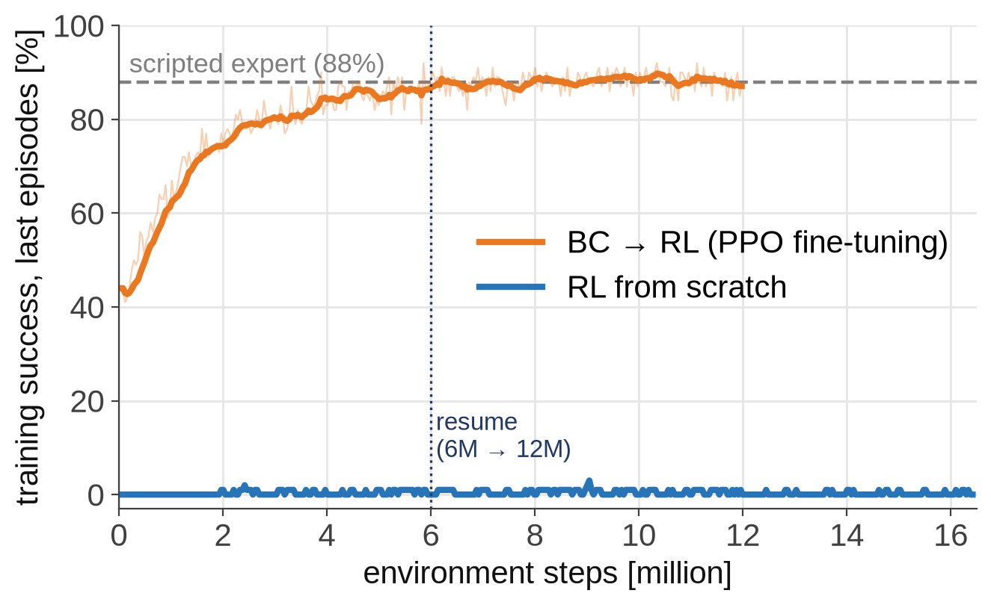
RL from Scratch vs BC → RL
Starting from imitation turns an unsolvable exploration problem into fine-tuning
From scratch : return improved −14 → −2.4, the T moves toward the goal, but 0 % success; exploration noise collapsed 0.6 → 0.03.
BC → RL : 0.44 → 0.88 in 6M steps, then a plateau at 0.87–0.90.
Training success with exploration noise (tutorial/checkpoints/rl/*/train_log*.txt)
Lesson : demonstrations solve exploration; RL then optimizes what imitation cannot — the reward itself.
Sookmyung Women’s Univ. Autonomous Mechanical Systems Lab
53

Slide 54
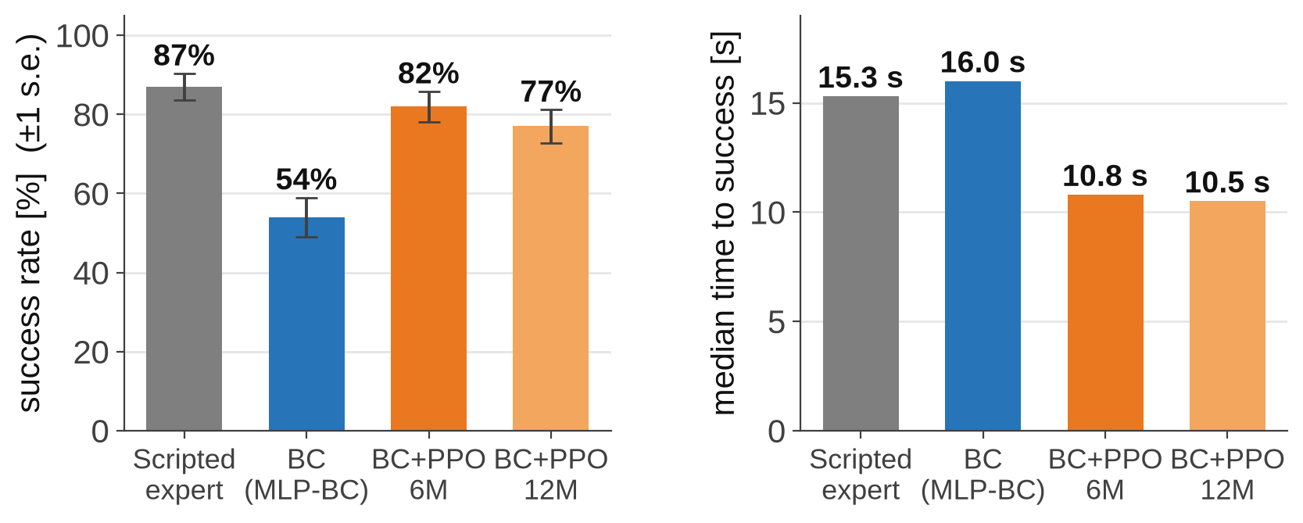
Paired Evaluation on Seeds 0–99
Same 100 unseen tasks, same start, 300 steps, deterministic actions for every policy
Scripted vs BC+PPO
6M
12M
both succeed
74
70
only scripted
13
17
only BC+PPO
8
7
both fail
5
6
McNemar $p$
0.38
0.064
median steps*
136 → 107
139 → 104
pusht_rl_eval.py → tutorial/eval_results/paired_*.csv / .json
* on seeds both solved: scripted → BC+PPO
Result : success is statistically tied with the expert, and BC+PPO is about 3–4 s faster on the same tasks.
Sookmyung Women’s Univ. Autonomous Mechanical Systems Lab
54

Slide 55
Why BC+PPO Stops Near the Expert
More training made the policy faster, not more successful
Measured
Likely structural limits (not yet tested)
Within noise : at 82 %, one standard error is about ±4 points with 100 tasks.
Less information : 12 inputs vs. the expert's full state and memory.
6M → 12M : success 82 % → 77 %, mean time 12.0 s → 11.1 s.
Conservative updates : lr $3×{10}^{−5}$, clipping, small $σ$.
Reward ≠ success test : angle weighted 0.3; success needs 0.15 m and 10°.
Plateau : training success stayed at 0.87–0.90 with noise $σ→0.005$.
One step at a time : BC drops 54 % → 34 % without chunks.
Best checkpoint : 6M, not the newest 12M.
Not a ceiling : RL optimizes the reward, not imitation — align the reward with the success test to push further.
Sookmyung Women’s Univ. Autonomous Mechanical Systems Lab
55

Slide 56
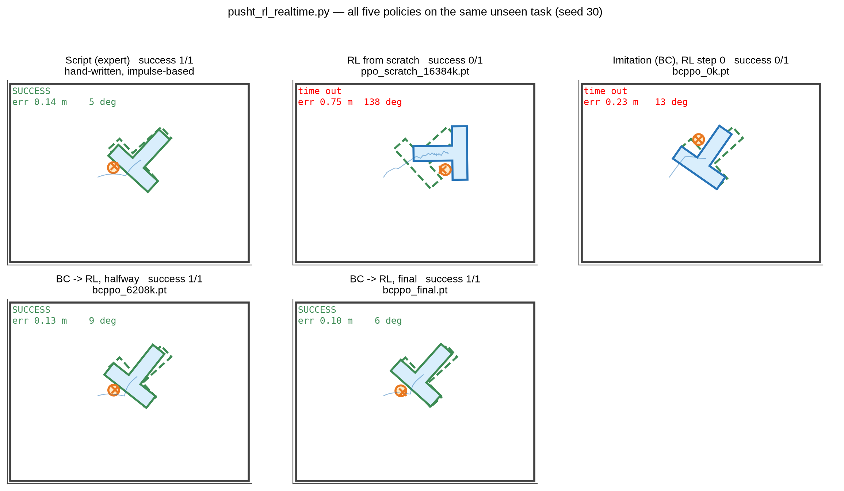
Real-Time Demo: Five Policies, One Task
python pusht_rl_realtime.py — every panel replays the same random task live
Run
cd tutorial
python pusht_rl_realtime.py
python pusht_rl_realtime.py script
python pusht_rl.py eval
python pusht_rl_eval.py
Keys
Space pause · N next task · + / − speed · Q quit
Seed 30: script 8.7 s · BC→RL 6.4 / 6.2 s · BC and RL-from-scratch time out
Sookmyung Women’s Univ. Autonomous Mechanical Systems Lab
56

Slide 57
The Whole Chain, Step by Step
From $∑F=ma$ to a policy that beats the expert's speed
Steps
Idea
Where in the code
1–3
Newton in discrete time, damping, rigid-body pose
substep, TBody
4–6
contact-point velocity, impulse, restitution, $K_{n}$
resolve_impulse
7
simulation loop with contact detection
circle_vs_T, wall_contacts
8–11
policy, supervised learning, MLP, behavior cloning
BCPolicy, train
—
multimodality → Diffusion Policy
DiffusionPolicy
12–15
MDP, return, value, advantage (GAE)
pusht_rl.py: reward, GAE
16–18
policy gradient, PPO, exploration
pusht_rl.py: PPO loop
Result : scripted 87 % · BC 54 % · BC+PPO 82 % on the same 100 unseen tasks — tied with the expert in success, 3–4 s faster.
Sookmyung Women’s Univ. Autonomous Mechanical Systems Lab
57

Slide 58
Summary
Physics gives the data, imitation gives the start, RL gives the polish
•
Imitation learning = supervised learning on $(o_{t},a_{t:t+H})$ from successful demonstrations
→
Goal frame (relative motion) and action offsets matter as much as the model
•
Data: about 100 demos for Diffusion Policy; collect 100–200 human demos
•
Model: MSE learns $E[a∣o]$; Diffusion learns the distribution and handles multimodality
→
Measured: Diffusion 20–68 % vs MLP-BC 9–59 % (25–360 demos)
•
RL from scratch: 0 % after 16M steps — the exploration problem
→
BC → PPO: 54 % → 82 % on seeds 0–99, tied with the expert (87 %) and 3–4 s faster
Sookmyung Women’s Univ. Autonomous Mechanical Systems Lab
58

Slide 59
Try It Yourself
Exercises with the tutorial code
•
Human data : collect 50, then 100 demos — does the Diffusion vs MLP-BC gap grow?
•
No goal frame : train in world coordinates — how much success is lost?
•
Chunks : vary the prediction / execution horizons (1, 4, 8, 16)
•
History : one observation frame — which mistakes appear without velocity?
•
DAgger : record your corrections in the viewer and retrain
•
Robustness : evaluate with friction 0.2 instead of 0.4 — think domain randomization
•
RL : put the 0.15 m / 10° test into the reward — does BC+PPO pass the expert?
Sookmyung Women’s Univ. Autonomous Mechanical Systems Lab
59

