Slide 1

Simulating a Digital Twin:
Spring–Mass Model and Frictional Contact
Department of Mechanical Engineering
Advanced Deep Learning 2026
Joo Yong Sim
PhysTwin and real2sim-eval read line by line — with measurements from our own experiments on a rope

Slide 2

Lecture Goals: From Video to a Simulator
A digital twin is a physics model that a robot can push, grasp and learn on
Observation
Particles
Physics
Robot learning
3 RGB-D cameras
+ spring graph
springs · contact · ground
teleop · RL · evaluation
Three questions for this lecture
Q1 — Simulation model : how does a cloud of particles behave like a rope? (springs, dashpots, drag, integrator)
Q2 — Contact model : how do the ground, the rope itself and a robot gripper push back — and how is friction written?
Q3 — Cost and consequences : what makes it slow, and what does contact do to repeatability and learning?
Sources : PhysTwin (arXiv 2503.17973) · real2sim-eval (arXiv 2511.04665) · our projects 13–21 on the released rope twin
Sookmyung Women’s Univ. Autonomous Mechanical Systems Lab
2

Slide 3
Two Simulators, One Spring Network
Same particles and springs; they differ in how the hand or gripper touches the object
PhysTwin
real2sim-eval
Purpose
fit physics to a video (system ID)
evaluate robot policies
Hand / gripper
control points welded by springs
finger triangle mesh, frictional contact
Can the object slip or drop?
no — the springs never release
yes — held only by friction
Gradients
differentiable (Warp tape)
forward only, overwritten in place
Self-collision distance
0.02 m (off for real data)
0.005 m (on)
Time step
$Δt=5×{10}^{−5}$ s, $667$ substeps per 30 fps frame (both)
Rope twin (rope_0001)
2,002 particles · 17,048 object springs · 514 mm long · 31.5 mm across
real2sim-eval §III-C : “we avoid the common but unrealistic practice of fixing object nodes to the gripper.” Everything about contact in this lecture follows from that choice.
Sookmyung Women’s Univ. Autonomous Mechanical Systems Lab
3

Slide 4
State and the Spring Graph
Every particle has $x, v, m=1$; springs join neighbours found at frame 0
Neighbour search (KD-tree)
PhysTwin qqtt/engine/trainer_warp.py : spring construction
$$S=\{(i,j): \left\|p_{i}−p_{j}\right\|<r, j∈{\text{kNN}}_{K}(i)\}$$
pcd_tree = o3d.geometry.KDTreeFlann(object_pcd)
for i in range(len(points)):
Defaults $r=0.02$ m, $K=30$; the released rope uses $r=27.4$ mm, $K=16$.
[k, idx, _] = pcd_tree.search_hybrid_vector_3d(
points[i], object_radius, object_max_neighbours)
for j in idx[1:]:
rest = np.linalg.norm(points[i] - points[j])
Rest length — frozen at frame 0
if (i, j) not in seen and rest > 1e-4:
springs.append([i, j])
$$L_{0,ij}={\left\|p_{i}−p_{j}\right\|}_{t=0}, L_{0}>{10}^{−4}$$
rest_lengths.append(rest)
masses = np.ones(len(points)) # all particles m = 1
Rope particles
Count
# repeat 2 (projects 17, 21): 4,004 particles,
tracked (from video)
1,495
# 34,090 springs; scaling tests up to 100,100
surface + interior (filled)
288 + 219
median spacing
3.06 mm
Sookmyung Women’s Univ. Autonomous Mechanical Systems Lab
4

Slide 5
Spring–Dashpot Force on Each Edge
Hooke's law on strain plus a dashpot along the spring — equal and opposite on the two ends
Unit direction and strain
real2sim-eval sim/physics/spring_mass_warp.py : eval_springs
$$d=\frac{x_{j}−x_{i}}{\left\|x_{j}−x_{i}\right\|}, ε=\frac{\left\|x_{j}−x_{i}\right\|}{L_{0}}−1$$
tid = wp.tid() # one thread per spring
if wp.exp(spring_Y[tid]) > spring_Y_min:
dis = x2 - x1
dis_len = wp.length(dis)
Spring + axial dashpot
d = dis / wp.max(dis_len, 1e-6)
spring_force = (
$$F_{ij}=k ε d+c \left[(v_{j}−v_{i})⋅d\right] d$$
wp.clamp(wp.exp(spring_Y[tid]),
low=spring_Y_min, high=spring_Y_max)
* (dis_len / rest - 1.0) * d)
$$f_{i}+=F_{ij}, f_{j}−=F_{ij}$$
v_rel = wp.dot(v2 - v1, d)
dashpot_forces = dashpot_damping * v_rel * d
$k$ multiplies a strain, so it acts like $E⋅A$, not N/m. Dashpot $c=100$.
overall_force = spring_force + dashpot_forces
wp.atomic_add(f, idx1, overall_force)
wp.atomic_sub(f, idx2, overall_force)
Note the atomics : many springs add into the same particle in parallel — the summation order is not fixed (we return to this at the end).
Sookmyung Women’s Univ. Autonomous Mechanical Systems Lab
5

Slide 6
Stiffness Is Stored as a Logarithm
One stiffness per spring, optimised in log space and clamped to a range
Parameterisation
Fitted stiffness, rope_0001
$$k_{s}=clip\left(e^{Y_{s}}, Y_{min}, Y_{max}\right)$$
Quantile
$$k$$
$$Y_{min}=0, Y_{max}={10}^{5}$$
min
11.5
p10
1,821
Why log : $k>0$ for free, and a gradient step changes $k$ by a ratio, not an amount. Initial $k=3×{10}^{4}$.
median
43,785
p90
100,797
Trap : case.spring_Y is linear, sim.wp_spring_Y is its log — exponentiate the wrong one and every spring sits at the ${10}^{5}$ clamp.
max
102,244
p10–p90 spread 55× here vs 1.05× in PhysTwin's single_push_rope — many springs ride the upper clamp.
float32 : $\left\|x\right\|/L_{0}−1$ cancels near 1 — 2.3 % force error vs float64.
Sookmyung Women’s Univ. Autonomous Mechanical Systems Lab
6

Slide 7
Gravity, Drag and Semi-Implicit Euler
Velocity first from forces, then position from the new (contact-corrected) velocity
1. Velocity from force, then drag
spring_mass_warp.py : update_vel_from_force
tid = wp.tid() # one thread per particle
$$v^{+}=\left(v+\frac{f+mg}{m}Δt\right) e^{−c_{\text{drag}}Δt}$$
v0 = v[tid]
f0 = f[tid]
m0 = masses[tid]
$c_{\text{drag}}=3$ s$​^{−1}$ : exponential decay, never overshoots zero.
drag_damping_factor = wp.exp(-dt * drag_damping)
all_force = f0 + m0 * wp.vec3(0.0, 0.0, -9.8) \
* reverse_factor # PhysTwin: z down
2. Contacts modify $v^{+}$
a = all_force / m0
v1 = v0 + a * dt
3. Position (symplectic Euler)
v2 = v1 * drag_damping_factor
v_new[tid] = v2
$$x^{+}=x+v^{+}Δt$$
$$n_{\text{sub}}=round\left(\frac{1/30}{5×{10}^{−5}}\right)=667$$
Upstream quirk : with a mesh present, mesh_collision already writes $x+vΔt$ and the ground kernel advances again — free fall measured at 2.002× analytic. The released parameters were fitted with it.
Sookmyung Women’s Univ. Autonomous Mechanical Systems Lab
7

Slide 8
Why 667 Substeps: Explicit Stability
An explicit integrator must resolve the fastest spring — the stiffest, shortest one
One spring, one mass: $ω=\sqrt{k_{\text{eff}}/m}$
Measured on the rope (projects 13, 21)
$$k_{\text{eff}}=\frac{k}{L_{0}} (\text{force per metre})$$
Substeps
$Δt$ (µs)
Result
667
50
reference
Symplectic Euler is stable for $ωΔt<2$
500
67
stable, 13.3 mm rms · 1.21×
$$Δt<2\sqrt{\frac{m L_{0}}{k}}=126.7 μ\text{s}$$
444
75
stable, 8.3 mm drift · 1.49×
400
83
stable, 18.2 mm
with $k_{max}={10}^{5}$, shortest $L_{0}=0.40$ mm. The dashpot limit $2m/c=20$ ms is far looser.
334
100
diverges (NaN)
Rerun spread of the reference itself is 16.6 mm, so 500 substeps is “free”.
Released $Δt=50 μ$s sits within 1.7× of the spring limit.
Sookmyung Women’s Univ. Autonomous Mechanical Systems Lab
8

Slide 9
PhysTwin Control: Points Welded by Springs
Tracked hand points are kinematic; springs tie them to nearby object particles
Hand points
What this boundary condition means
Grounded-SAM2 hand masks + CoTracker → lifted to 3D → farthest-point sampled.
•
A soft Dirichlet condition: prescribed motion through a compliant spring
Attachment (frame 0, never changes)
•
Pulls as hard as it pushes
$$\left\|c_{a}−p_{j}\right\|<0.04 \text{m}, ≤50 \text{per point}$$
•
Never releases, never slips
Inside a frame: linear interpolation
•
Sparse: in single_push_rope only 2 of 30 hand points are within 40 mm
$$c(s)=c_{\text{prev}}+(c_{\text{target}}−c_{\text{prev}}) \frac{s+1}{n_{\text{sub}}}$$
Code note: wp_control_v is never written, so the dashpot on control springs sees a control velocity of 0.
Good for fitting a video, wrong for robot grasping: a policy could “lift” the rope without ever squeezing it.
Sookmyung Women’s Univ. Autonomous Mechanical Systems Lab
9

Slide 10
real2sim-eval: Gripper as a Moving Mesh
Finger meshes and static scenery are one triangle mesh with a BVH, refit every substep
EEF pose
Interpolate
One wp.Mesh
BVH refit
per frame
667 finger poses
fingers + static
every substep
Rigid velocity of a finger point
Grasp is a force latch, not a weld
$$V(x)=V_{\text{finger}}+ω×(x−c_{\text{eef}})$$
•
Read normal “force” on fixed finger faces
•
Latch when both fingers exceed a threshold (3×10⁴; 4,386 after our recalibration)
xArm fingers: 88 triangles, 48 vertices. mesh_map[face] = 0 / 1 for the fingers, < 0 for static meshes.
•
Release when both drop below a low threshold
Sookmyung Women’s Univ. Autonomous Mechanical Systems Lab
10

Slide 11
One Contact Law: Restitution and Coulomb
Ground, self- and mesh contact all edit the velocity — no penalty springs
Split relative velocity along the normal $n$
Reading the scale factor $a$
$$v_{n}=(v⋅n) n, v_{t}=v−v_{n}$$
Case
Meaning
Restitution $e∈[0,1]$
$$a=0$$
stick: friction impulse can stop all sliding
$$v_{n}^{′}=−e v_{n} ⇒ |Δv_{n}|=(1+e)|v_{n}|$$
$$0<a<1$$
slip: slide slowed by exactly $μ⋅$ normal impulse
Coulomb: $|Δv_{t}|≤μ |Δv_{n}|$
$$a→1$$
grazing, $|v_{n}|≪|v_{t}|$
$$v_{t}^{′}=a v_{t}, a=max\left(0, 1−μ(1+e)\frac{|v_{n}|}{|v_{t}|}\right)$$
Clamps in the kernels
$$e∈[0,1], μ∈[0,2]$$
Same idea as the PushT impulse model — but applied per particle, per substep, with unit mass and no rotation.
Sookmyung Women’s Univ. Autonomous Mechanical Systems Lab
11

Slide 12
Ground Contact with Time of Impact
If the next step would cross $z=0$ while moving down, apply the law and split the step
Trigger
spring_mass_warp.py : integrate_ground_collision
$$z+v_{z}Δt<0 \text{and} v_{z}<−{10}^{−4}$$
normal = wp.vec3(0.0, 0.0, 1.0) * reverse_factor
next_x_z = (x_z + v_z * dt) * reverse_factor
Time of impact, then two half-moves
if next_x_z < 0.0 and v_z * reverse_factor < -1e-4:
v_normal = wp.dot(v0, normal) * normal
$$t_{c}=−\frac{z}{v_{z}}, x^{+}=x+v t_{c}+v^{′}(Δt−t_{c})$$
v_tao = v0 - v_normal
v_normal_new = -clamp_collide_elas * v_normal
a = wp.max(0.0, 1.0 - clamp_collide_fric
* (1.0 + clamp_collide_elas)
Resting particle, $e=0$
* v_normal_length / v_tao_length)
v1 = v_normal_new + a * v_tao
$$|v_{t}^{′}|=|v_{t}|−μgΔt$$
toi = -(x_z - ground_height) / v_z
else:
Gravity re-supplies $gΔt$ of normal speed each substep → constant deceleration $μg$ — textbook sliding friction.
v1 = v0; toi = 0.0
x_new[tid] = x0 + v0 * toi + v1 * (dt - toi)
Sookmyung Women’s Univ. Autonomous Mechanical Systems Lab
12

Slide 13
Self-Collision: Hash Grid, Then Impulses
Particles of different parts that approach closer than 5 mm exchange an impulse
Broad phase (once per frame)
Parameters
wp.HashGrid, cell $5d_{c}$; keep pairs with different masks and $\left\|x_{j}−x_{i}\right\|<d_{c}$ (≤ 500 per particle). Pairs already close at frame 0 are excluded.
Value
$$d_{c}$$
0.005 m (PhysTwin 0.02)
$$e_{s}, μ_{s}$$
clamped to [0,1], [0,2]
Narrow phase: approaching pairs only
$$(x_{j}−x_{i})⋅(v_{j}−v_{i})<−{10}^{−4}$$
averaging
Jacobi-style mean
$$J=\frac{−(1+e_{s}) v_{n}^{\text{rel}}+(a−1) v_{t}^{\text{rel}}}{1/m_{i}+1/m_{j}}$$
What we found
In our project-13 bridge, update_collision_graph() was never called: the kernel ran 667×/frame and looped zero times. Upstream's driver does call it.
$$v_{i}^{′}=v_{i}−\frac{1}{m_{i}} \overline{J} (\text{mean over contacts})$$
Sookmyung Women’s Univ. Autonomous Mechanical Systems Lab
13

Slide 14
Mesh Contact: Query, Respond, Project
Every particle asks the BVH: “will I be inside a finger or the table next step?”
1. Predict and query (signed distance)
spring_mass_warp.py : mesh_collision (condensed)
$$\hat{x}=x+vΔt, \text{err}=sign⋅\left\|\hat{x}−p\right\|−δ$$
next_x = x0 + v0 * dt
query = wp.mesh_query_point_sign_winding_number(
inside/outside by winding number; margin $δ$ = 5 mm (finger), 1 mm (static).
mesh, next_x, max_dist=0.02,
accuracy=3.0, threshold=0.6)
p = wp.mesh_eval_position(mesh, query.face, ...)
err = wp.length(next_x - p) * query.sign - margin
2. If err < 0: law in the finger's frame
if err < 0.0:
normal = wp.normalize(next_x - p) * query.sign
$$v^{\text{rel}}=v−V(x), v^{′}=C_{e,μ}(v^{\text{rel}})+V(x)$$
real_dynamic_velocity = dynamic_velocity[k] \
+ wp.cross(dynamic_omega[0], x0 - center)
v0 = v0 - real_dynamic_velocity
Fingers: $e=0, μ=1.0$. Static: ground values.
# ... restitution + Coulomb scale a ...
next_v = v_normal_new + a * v_tao \
3. Project out, read force
+ real_dynamic_velocity
# finger: re-predict, query again, push out
$$\hat{x}←\hat{x}−n \text{err}, F_{\text{face}}+=Δv_{n}/Δt$$
next_x = next_x - normal * err
wp.atomic_add(collision_forces, face,
delta_v_normal / dt)
Sookmyung Women’s Univ. Autonomous Mechanical Systems Lab
14

Slide 15
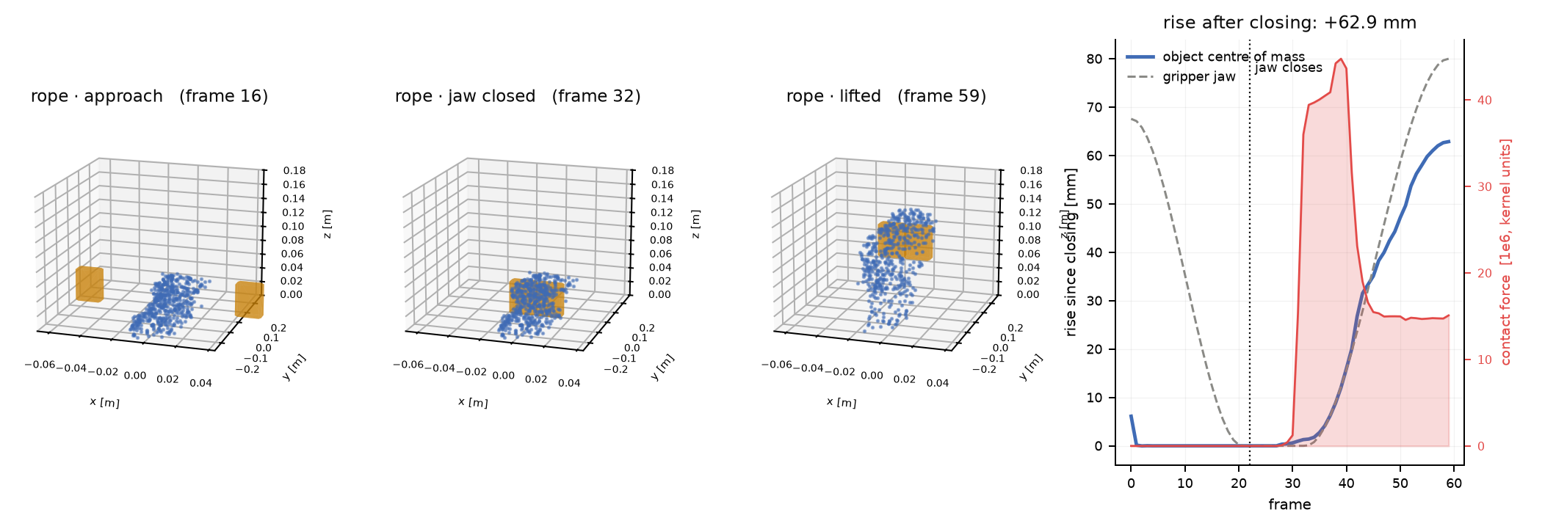
Frictional Grasp: Lifted Without a Weld
Approach, close, lift: the rope rises only through the friction its own squeeze creates
Project 13: orange = finger meshes, blue = rope particles. Right: centre-of-mass rise (+62.9 mm), jaw opening (dashed), contact force (red).
Read the plot : the force spikes when the jaw closes, then settles at the value that holds the rope's weight — grip force × $μ$ ≥ weight, or it slips.
Sookmyung Women’s Univ. Autonomous Mechanical Systems Lab
15

Slide 16
One Substep, Kernel by Kernel
Six GPU kernels and one BVH refit — repeated 667 times for each 33 ms video frame
clear
springs
velocity
self
refit
mesh
ground
$$f=0$$
per spring
$g$, drag
impulses
finger BVH
query + law
TOI, $x^{+}$
Per frame (30 fps)
Colour key
•
Once: hash grid, 667 interpolated finger poses
blue spring–mass–damper · orange object contact · purple gripper geometry · green ground + integration
•
667 × (6 kernels + 1 refit) ≈ 4,000 launches
PhysTwin: same order, no mesh stages, plus set_control_points first.
•
All kernels: one thread per spring or per particle
Sookmyung Women’s Univ. Autonomous Mechanical Systems Lab
16

Slide 17
Where the Time Goes (GPU, 4,004 Particles)
Doubling the particles costs nothing — the simulator is launch-latency bound
Part (667 substeps)
ms/frame
Share
Fit over substep counts
BVH refit (88 triangles)
29.5
28.0 %
$$t_{\text{frame}}≈8.7 \text{ms}+0.121 \text{ms}×n_{\text{sub}}$$
eval_springs (34,090)
22.0
20.8 %
2,002 vs 4,004 particles: 89.3 vs 88.8 ms.
mesh_collision
14.6
13.8 %
Grouped : gripper contact path ≈ 46 %, springs ≈ 33 %, ground ≈ 9 %.
object_collision (inert)
10.7
10.2 %
ground + integrate
9.8
9.3 %
Refitting a 48-vertex mesh costs more than 34k springs — it is pure launch overhead.
update_vel
8.5
8.1 %
set_mesh_points
6.5
6.1 %
clear_forces
4.0
3.7 %
Sookmyung Women’s Univ. Autonomous Mechanical Systems Lab
17

Slide 18
Lesson: A Broad Phase Did Not Help
Filtering particles with the gripper's box cut queries 656× — and the frame by 1.1 %
100,100 particles
AABB gate
Frame time
× 667 substeps
66.77 M → 101,796
257.1 → 254.2 ms
Cost per particle query (GPU)
Why
Case
Time
The BVH's first box test already is a broad phase. Only 3.8 % of (particle, substep) pairs are real hits, and those are what cost time.
BVH miss
0.007 ns
AABB test
0.018 ns
Profile before you optimise — the textbook fix attacked a cost that did not exist.
BVH hit
20 ns (2,933× a miss)
Sookmyung Women’s Univ. Autonomous Mechanical Systems Lab
18

Slide 19
What Actually Made It Faster
Remove launches, atomics and refits: 1.7× at 4k particles, 1.9× at 100k
Change
4,004
100,100
Two key tricks
cache $clip(e^{Y})$
+0.2 ms
−5.0 ms
Gather : each particle sums its own springs —
per-particle spring gather, no atomics
+1.6 ms
−57.6 ms
fi=j​k εij+c (vj−vi)⋅uu
fuse mesh contact + ground
−2.0 ms
−5.1 ms
Local BVH : move the particle, not the mesh —
static finger BVH in local frame
−11.8 ms
−11.6 ms
$$x_{ℓ}=R^{⊤}(x_{w}−t)$$
CUDA graph replay
−12.0 ms
−14.8 ms
total (with 500 substeps)
81.6 → 48.4
264.3 → 137.8
Result : 3,335 launches → 1 per frame, 2 kernels per substep, every rms inside the 22.9 mm upstream self-spread.
Sookmyung Women’s Univ. Autonomous Mechanical Systems Lab
19

Slide 20
CPU vs GPU: The Ranking Inverts
CPU: a spring solver with some contact — GPU: a contact solver with some springs
Role (4,004 particles)
CPU ms
GPU ms
CPU/GPU
Same change, two verdicts
spring–mass–damper
201.8 (60.5 %)
14.9 (15.4 %)
13.5×
Change
CPU
GPU
gripper contact
103.1 (30.9 %)
66.7 (68.9 %)
1.5×
cache exp
−16.2 %
−0.6 %
integration
16.6 (5.0 %)
7.3 (7.5 %)
2.3×
local BVH
+5.9 %
−16.5 %
ground
12.2 (3.7 %)
7.9 (8.2 %)
1.5×
broad phase
≈ 0
≈ 0
BVH refit alone
0.5
19.1
0.03×
GPU speed-up grows with size: 3.2× at 2k → 24× at 100k particles.
Warp's CPU backend is a serial loop, so it measures work; the GPU measures latency.
Sookmyung Women’s Univ. Autonomous Mechanical Systems Lab
20

Slide 21
Reduced Models: Fewer Degrees of Freedom
Project the physics onto a few coarse modes; treat contact as a constraint, not a force
18 — latent operator, not learned
19 — reduced contact constraint
$$K_{r}=P^{⊤}KP, M_{r}\ddot{z}=P^{⊤}f−K_{r}z−C_{r}\dot{z}$$
$$J_{r}=JP, p_{n}≥0, \left\|p_{t}\right\|≤μ p_{n}$$
6,006 DOF → 96. $K_{r}$ is the exact Schur complement (8e-14). A whole frame = one matvec with $Φ^{667}$.
Coulomb disk, solved by PGS; 4 implicit microsteps replace 667 substeps.
5.10× end-to-end at 2.32 mm (0.23 %) error.
Scene
Speed-up
resting / sliding
3.78× / 2.55×
3 cm drop
2.89×
gripper approach
1.18×, 90 mm worst — failure
Sookmyung Women’s Univ. Autonomous Mechanical Systems Lab
21

Slide 22
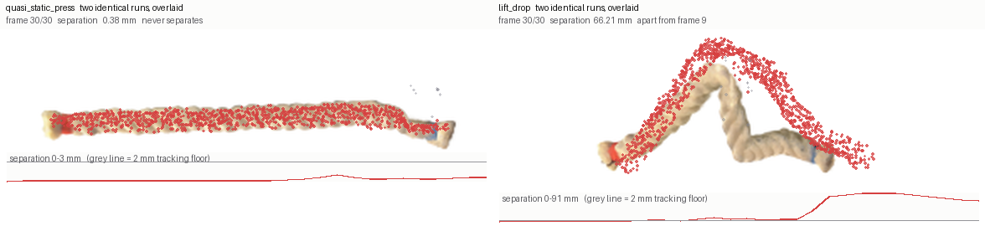
Contact Makes the Simulator Non-Repeatable
Identical inputs, different rope: atomic float sums reorder, and contact amplifies it
Project 15: two identical runs overlaid (red = second run). Left: quasi-static press, 0.38 mm. Right: lift and drop, 66 mm.
Why : $(a+b)+c≠a+(b+c)$ in float32. A tiny difference decides whether a particle is inside the 5 mm margin — a contact appears or not.
8 replays of one nominal (RL, 17) : 27.2, 30.5, 30.3, 27.7, 27.9, 50.6, 30.2, 29.3 mm. The per-particle gather is bit-reproducible.
Sookmyung Women’s Univ. Autonomous Mechanical Systems Lab
22

Slide 23
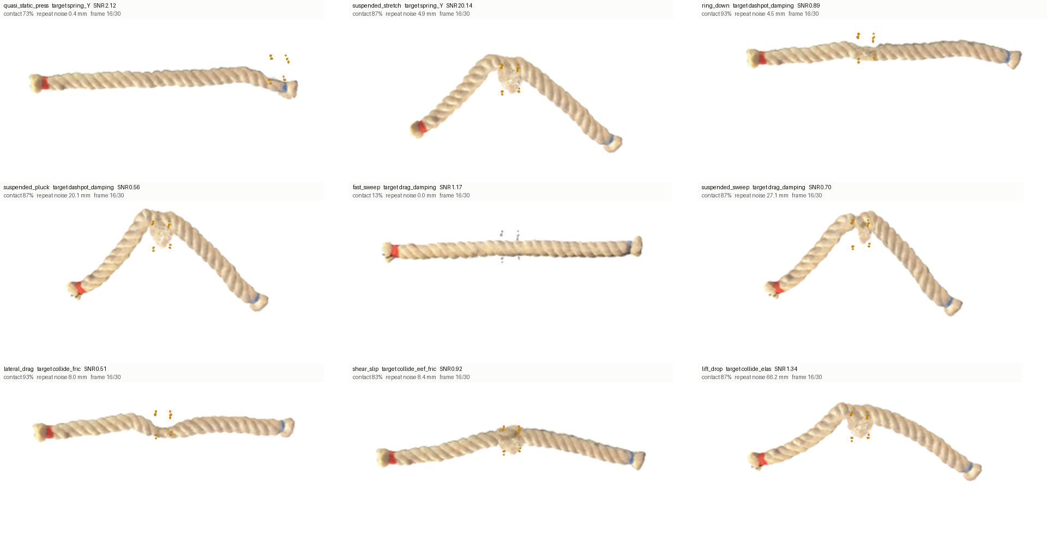
Contact Churn Limits What We Can Identify
Probes designed to excite one parameter also create the most noise
Probe
Repeat noise
quasi-static press
1.2 mm
ring-down
3.7 mm
lateral drag
7.1 mm
lift-drop
44–99 mm
Noise tracks churn (contacts forming and breaking), not contact time.
Fisher design predicted 1.19×; actual fits: random wins 5/5 (p ≈ 0.004).
Project 15: nine textbook probes, each with contact %, repeat noise, SNR
Sookmyung Women’s Univ. Autonomous Mechanical Systems Lab
23

Slide 24
Summary
A rope twin is springs + one velocity-level contact law, run 667 times per frame
•
Simulation model : log-stiffness springs with axial dashpots, exponential drag, symplectic Euler at 50 µs
→
$Δt$ is set by the stiffest, shortest spring — 1.7× below the limit
•
Boundary condition : PhysTwin welds the hand with springs; real2sim-eval uses a moving mesh with friction
→
only the second can slip, drop, and be a fair test of a grasp
•
Contact model : $v_{n}^{′}=−ev_{n}, v_{t}^{′}=av_{t}$ for ground, self and mesh
→
Coulomb friction as a velocity scale factor, plus position projection
•
Cost : on a GPU, launches and refits dominate — not arithmetic, not the broad phase
•
Consequence : contact turns float round-off into mm-scale divergence — budget for it in RL and system ID
Sookmyung Women’s Univ. Autonomous Mechanical Systems Lab
24

Slide 25
Try It Yourself
Exercises with the simulator
•
Stability : derive $Δt_{max}$ for a chain of 3 masses — when is it tighter than one spring?
•
Friction : show that $a=0$ exactly when the needed friction impulse is $≤μ(1+e)|v_{n}|$
•
Grasp : with $μ=1$, what squeeze force holds a 50 g rope? Compare with the latch threshold
•
Weld vs friction : replay one trajectory in both models — where do they disagree?
•
Determinism : run the same frame 10 times with atomics, then with the gather kernel
•
Profiling : predict the CPU and GPU ranking of each kernel before you measure it
Sookmyung Women’s Univ. Autonomous Mechanical Systems Lab
25

