Slide 1
SEO AI Search Behov
E-handel och Marknad

Slide 2
Innehåll
Bakgrund och Syfte
Behov lösningar / Options
Build vs. Buy
AI Agents (Agentic Commerce)
Bakgrund & Syfte

Slide 3
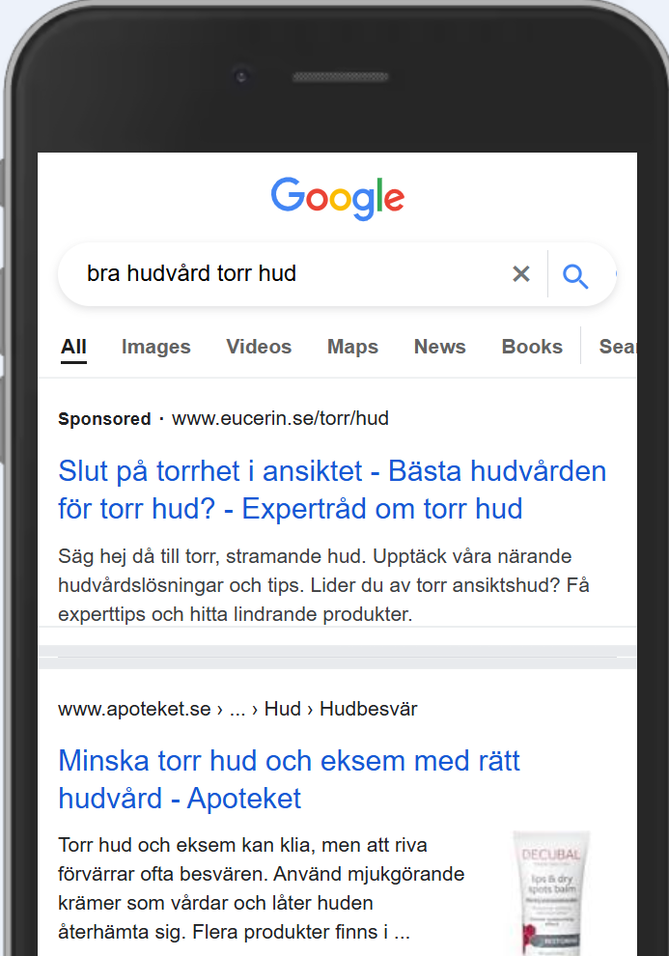
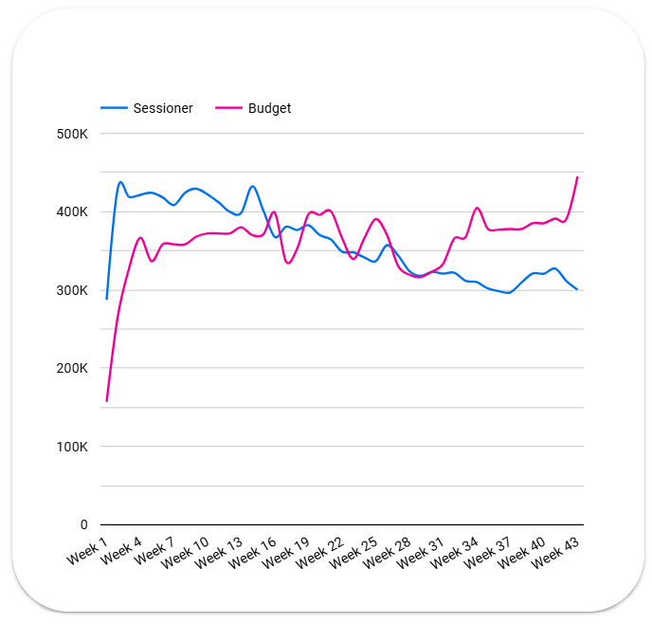
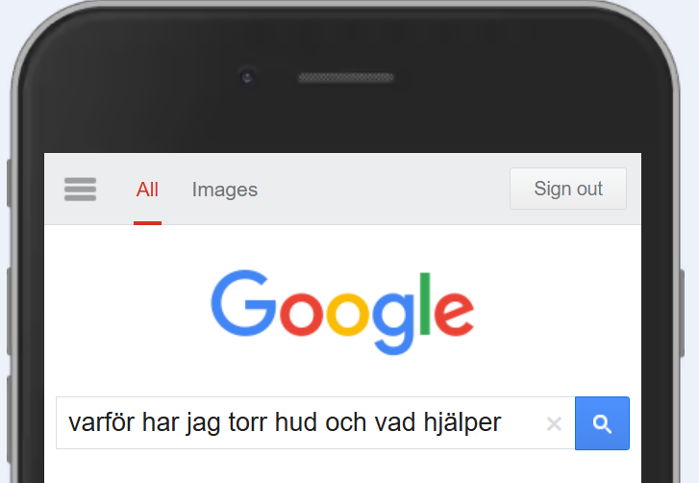
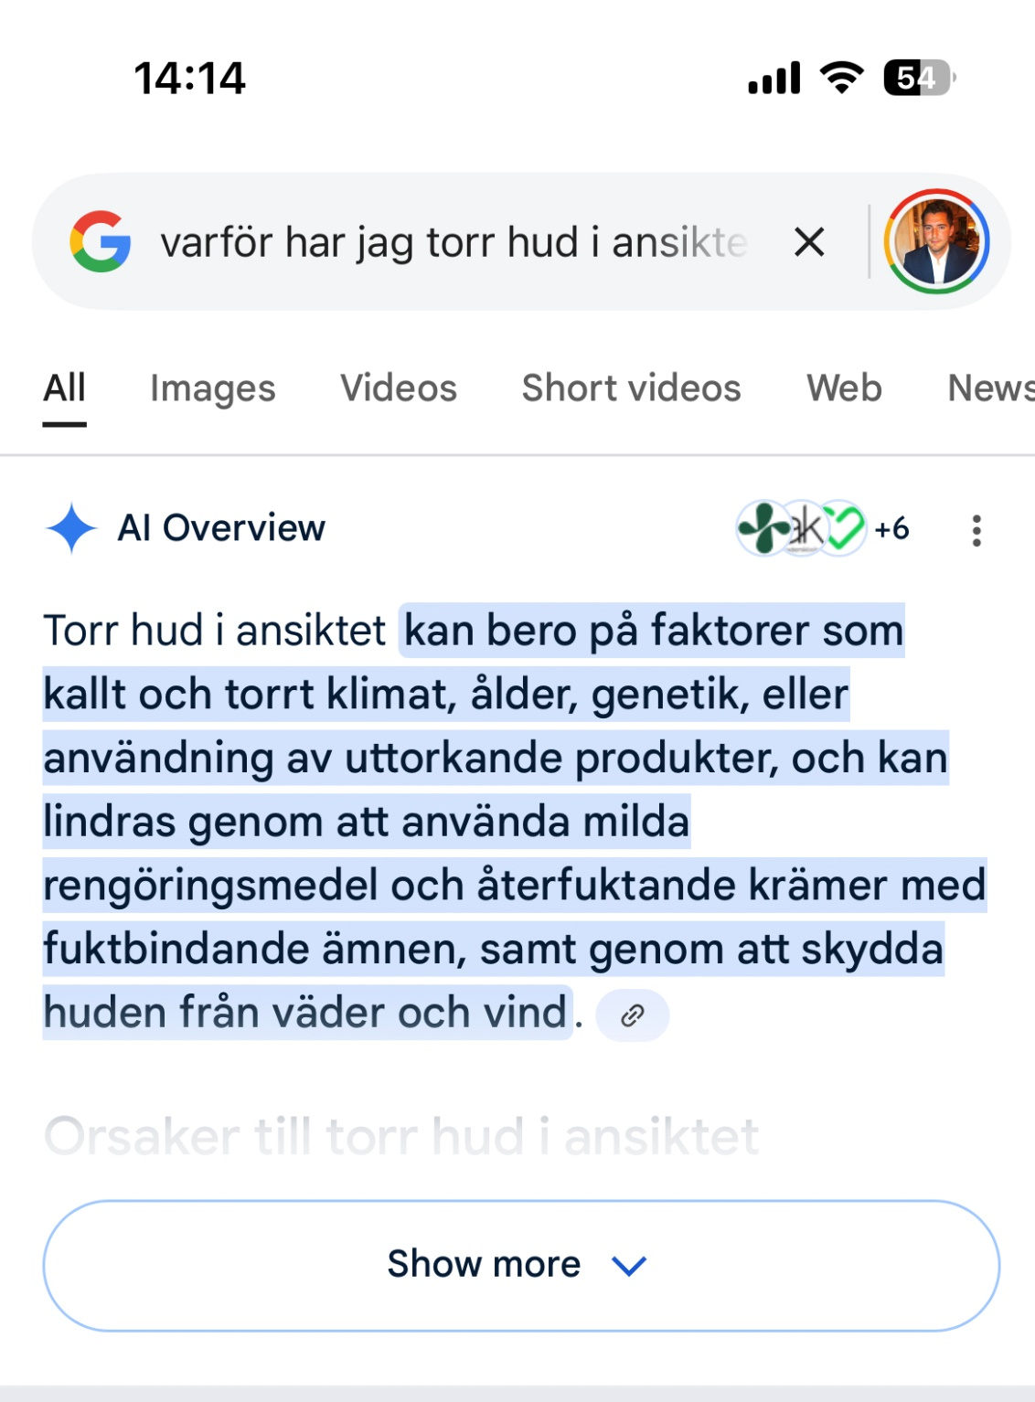
AIO
AI Overviews (AIO) förändrar kundbeteendet kopplat till sök och trafikanskaffning via tjänster som ChatGPT och Google infört.
AI Overviews ger tillräckligt med information direkt i sökresultatet, minskar klickfrekvensen organiskt till webbplatser — vilket påverkar trafik och intäkter.
Organisk trafik står för ca 30% av apoteket.se trafik och minskar sedan 19 Maj med i snitt 100 K sessioner / vecka. Det motsvarar försäljning om -3,9 MSEK (-1 MSEK BV) per vecka för både RX och EV. Motsvarande ca 4600 kvitton per vecka. Effekt på butiksförsäljning ej inräknad.
Vid motsvarande utveckling 2026 är helårseffekten estimerad till -600 MSEK.
Trafik från andra kanaler t.ex. betald sök, sociala medier, direkttrafik (via varumärkeskännedom och top-of-mind) via app blir ännu viktigare som komplement, eftersom organiskt sök inte generar lika mycket klick som tidigare, där en ökad medieinvestering från konkurrenter är tydlig. Trafiken från dessa kanaler ökar under året till apoteket.se men kompenserar inte i närheten i relation till tappet i den organiska söktrafiken. Stort fokus internt kring åtgärdsplaner där verfierade aktiviteter löpande genomförs mot bakgrund av denna utveckling.
Organisk trafik
Källa: The Guardian | Sessionsbudget 2025 2.1 › Översikt - Totalt (App + Webb)

Slide 4
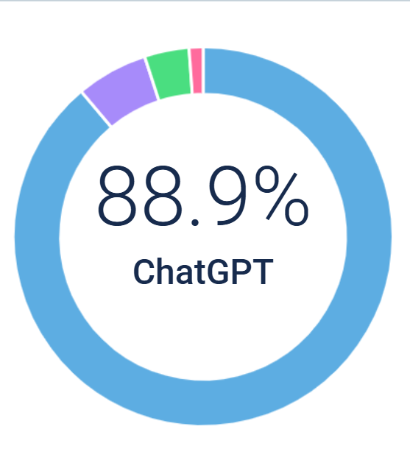
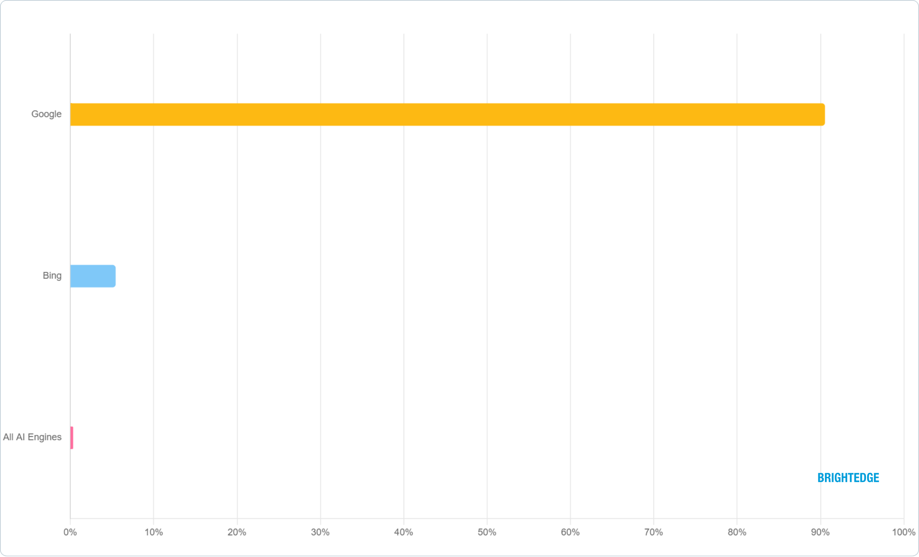
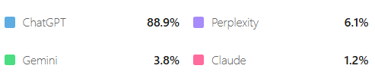
Total Search Dominance Index - Distribution of referral traffic from traditional and AI search platforms (Sep 25’). Google
AI-Specific Search Index - Distribution of referral traffic from AI platforms
(Sep 25’)
Google reversed its nine-month decline, rising from 90.54% to 90.71% market share—its first gain in nearly a year—while AI search competitors collectively lost ground despite the hype, still accounting for less than 1% of total search referrals.
Källa: AI pulse | BrightEdge

Slide 5





GenAI is the new front door to the internet –
with AI embedded across all search types
How quickly is GEO growing?
There are three primary types of GenAI Search:
1
2
3
% of Google searches w/ an AI summary
User growth timeline
Embedded AI Search –
e.g., Google AI Overview
~100%
Dec
2025
1B+ users (projected)
GenAI Chatbot Search –
e.g., ChatGPT, Perplexity, Claude
~50%
Dec
2024
400m users
Embedded in Apps Search – e.g., Microsoft Copilot, Google workplace, WhatsApp Llama, Shopify Sidekick
~1%
May 2024 Jul 2025 2027
Note: some search results across Google will
likely not have an “AI summary”
(e.g., Navigation)
Jan 2023
100m users
Nov 2022
1m users
Given the current pace of change, we expect most search results to be AI enabled by 2027
AI Overview
Source: Gartner, SEM Rush, Google, OpenAI, Press search

Slide 6



49% of consumers use AI-based search today, and
53% of those use it to guide brand discovery and purchase
AI-based search usage by task type¹, % of users³
Details available
49%
of all consumers use AI-based search today
Research and understand general topics
(e.g., Explain inflation, translate a manual, learn how something works)
69%
Guide brand discovery and purchase decisions
(e.g., discover and choose products, or services; plan a trip or special occasion)
Boomers only slightly lag behind other
53%
2
Write and improve content
(e.g., Draft emails, refine resumes, create stories)
46%
generations
(by <5 p.p.)
Access real-time or trending information
(e.g., Check the weather, get news summaries)
44%
Plan and organize tasks
(e.g., Build schedules, create checklists, generate a meal plan or study calendar)
35%
This likely underestimates users of AI- based search, not accounting for passive users using AI functionality within apps
Create visuals and creative assets
(e.g., Generate images, design logos)
32%
For details on user research, reach out to Desirae Oppong, Elizabeth Silliman, Nilay Shah and Amy Fertig
Write or debug code
(e.g., Generate code snippets, fix errors, learn programming logic)
15%
QUSAGE. For which of the following use cases have you used a GenAI search engine (e.g., ChatGPT, Google AI Overview, Gemini, Perplexity, or Microsoft Copilot) in the past 3 months?
Respondents who have used AI-based search in the past 3 months (n=1,924)
3. Total survey respondents (n = 3,945)
Source: McKinsey Gen-AI Search survey, July 2025 (n=3,945)

Slide 7



AI-powered search engines generate results by analyzing information from multiple sources
Schematic overview flow –
technical details in appendix
Answer synthesis²
Re-ranking and selection: AI search engine refines the “discovery” list, prioritizing the highest quality and most relevant sources based on user query for final use, often leveraging AI scoring
Source discovery
AI-powered search engine performs multiple searches and
retrieves the list of sources relevant to the search query:
Candidate content retrieval to gather potentially relevant information from:
Content extraction and summary: AI engine selects most important information from sources – guided by original user query (e.g., user's intent, style)
Final synthesis: AI-powered search engine synthesizes relevant information into a concise, tailored answer consistent with query style and intent
User query interpretation
AI search engine interprets¹ each search query and formulates a mix of source search queries to identify sources, based on intent detection, query expansion (adding related terms to better capture query meaning), entity linking (to known concepts) and context injection (using past conversation or session history)
Web search, e.g., through “traditional” search engines
like Google or Bing, or open-source search indices
Internal knowledge bases, e.g., pre-curated or proprietary datasets
Vector / Embeddings databases, storing semantic
representations of documents for similarity search
Pre-liminary filtering based on trust, recency and relevance
What are customers asking?
What sources are cited?
What drives LLM synthesis?
Need to understand
Leveraging its prior knowledge (from pre-training) to understand the user’s query context and intent
In extraction and synthesis, the AI engine uses it prior knowledge (from pre-training) to identify relevant information and generate a coherent, contextually accurate answer by combining retrieved data with its learned understanding

Slide 8






Each AI-powered search engine is different; making a-tailored optimization
strategy essential: each engine needs to be treated separately
Key insights
With the same prompt (and within the same model), you can receive different answers per try – as the models are statistical, not deterministic
With the same prompt, you can receive different answers per model – while conceptually similar, the models use different data and training approaches, which lead to differentiated outputs
Description
Focus on strong conversational abilities, creative content generation, and evolving multimodal features
Focus on multimodality, reasoning, contextual understanding, and integration with the Google ecosystem
Focus on accuracy, transparency through citations, and real-time web search integration
Core LLM model
GPT-5.1 and earlier GPT models (OpenAI)
Gemini multimodal model, with Google integration
Sonar Large 32K, GPT-5.1, Claude variants
1. Worldwide. // 2. Except China, Russia, Iran, North Korea, Cuba, Syria, and some African countries. // Note: self-reported sources.
Note: Outcomes shown are statistical and all generated within the same day and time (14.05.2025)
12

Slide 9


Influence is possible within days for engines with web access; continuous monitoring and improvements needed
SUBJECT TO CHANGE AS RAPIDLY EVOLVING SPACE
How quickly can we influence AI-powered search outcomes? Aren’t LLMs pre-trained?
How can we influence
AI-powered searches?
How long will the “fixes” last?
We deliver new and/or optimized content to new and/or optimized channels
That way, we provide new data for the AI-powered search engines to pick up, both for re-training current/ pre-training new LLM releases and visibility in direct web searches
Large LLMs that are generating final answers in the AI-powered searches are indeed
pre-trained on content with a certain cut-off date (update frequency: order of weeks to months)
Most search engine applications, however, leverage direct web access via an index that is updated much more frequently – meaning content updates could influence searches within days¹
For Perplexity, we observe updates being reflected within 2-3 days. Similar timelines are likely for other search engines
The dynamics of SEO+GEO are evolving rapidly, creating a competitive landscape where the ultimate trajectory remains uncertain; being a first mover could create a competitive advantage
Continuous monitoring and improvements of the content and overall web-presence are required to keep up with rapidly evolving landscape with, e.g., LLM model retrains, new LLM functionality, new use-case patterns, and model releases
GEO is not a one-off exercise but must become embedded into the operating model with a clear GEO strategy
1. Indexing timelines vary from hours to several weeks. New websites often take longer due to quality and trustworthiness assessments, while new content may be indexed faster, within hours to days, if aided by XML sitemaps, backlinks, and strong technical setup. Overall speed depends on site authority, technical health, and content quality

Slide 10












SEO in the age of GenAI is a rapidly evolving space with many
solutions for GEO flooding the market…
Illustrative NOT EXHAUSTIVE
New Players: Specialized Players: Incumbents:
Description
Reported GEO
Capabilities
Provider Types
Example Providers
Founded
SEO/Data Platforms with GEO Capabilities
SaaS platforms and tools that include generative engine optimization features alongside their traditional search optimization tools. Combine comprehensive SEO data with emerging AI search capabilities
2024
2023
2008
Specialized GEO Agencies & Consultancies
Agencies focused primarily on generative engine optimization and advanced AI SEO strategies to maximize brand visibility across AI-driven search engines, offering bespoke consulting, audits, and technical implementation
2018
2014
2009
Large MarTech &
Analytics Firms
Broader digital marketing tech stacks focused on analytics, attribution, and automation—some now layering in SEO/GEO modules within their end-to-end marketing systems
2012
2005
2013

Slide 11




…but existing tools have limited functionalities, and are lacking a
comprehensive approach to GEO beyond tooling
GEO market currently focused on tooling and limited to visibility metrics
Available Not available Partially available and/or in development
Effective GEO requires: Many providers only cover part of requirements GEO market
Data Platforms with GEO Capabilities
Specialized GEO Agencies & Consultancies
Large MarTech & Analytics Firms
McKinsey
GEO landscape is fragmented with traditional SEO firms, emerging GEO platforms, and big MarTech players exploring new metrics
GEO players focus primarily on tracking and visibility with limited/early on optimization
None offer a rewired operating model, and the closed-loop execution needed to get beyond performance tracking to top-line impact
Client Specific Domain Expertise
Operating Model Enablement
Performance Diagnostics
Solution capabilities
Opportunity identification
Surfacing and suggestion of
structural changes
Content Optimization Support
3rd Party Platform Integration
GEO Accelerator
(detailed next)
QuantumBlack, AI by McKinsey
15

Slide 12
Innehåll
Bakgrund och Syfte
Behov lösningar AI Search
Build vs. Buy
AI Agents (Agentic Commerce)
Lösningar

Slide 13
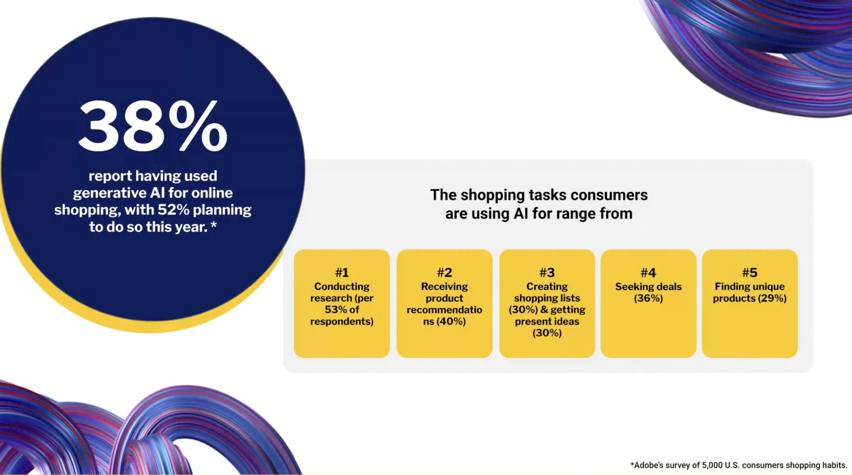
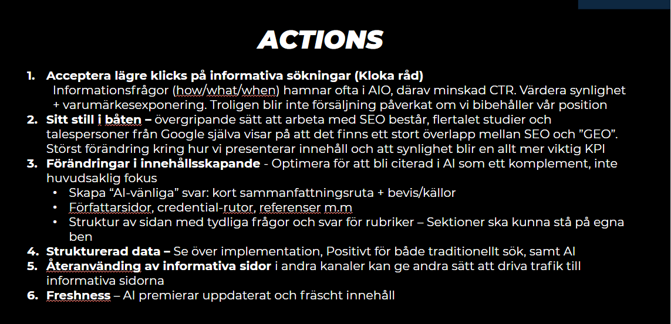
Bakgrund och Syfte
Utvecklingen av AI Search går snabbt och nya krav sätts på Apoteket för att hänga med. Inte minst i innehållskapande där större krav finns på strukturerad och uppdaterat innehåll.
För att möta behoven behöver Apoteket accelerera användningen av AI internt. Vi ser redan nu att konkurrenter har börjat integrera detta i sina plattformar, bland annat Apohem.se
PHD genomför en mätning i potential av ökning i synlighet i vardera kategori.

Slide 14
Nuläge: Innehåll
I dagsläget ser Content Teamets processer ut som följande:
4 redaktörer som har olika ansvarsområden där vi täcker kampanjuppsättning, rådgivande artiklar, välutformad produktberikning, säljande inspirationssidor samt varumärkesbyggande initiativ.
Samtliga redaktörer använder Optimizely CMS12 som publiceringsplattform = Apoteket.se
Allt innehåll som skapas/optimeras är datadrivet utifrån insikter via våra verktyg Semrush och BrightEdge som tillhandahåller analyser och rekommendationer utifrån ett SEO-perspektiv. Dem bidrar även med innehållsassistenter samt Crawl-funktionalitet som stöttar i både redaktionell samt teknisk SEO. Alla information vi får justeras manuellt av redaktörerna, inget sker automatiskt via tekniska uppsättningar.
För att följa upp innehållet som ligger uppe på Apoteket.se bidrar ContentSquare med adderat underlag kopplat till kundresa / användarbeteende. Data som vi sedan agerar på genom att ändra position på innehåll, byta ut bilder, ändra copy etc. Även här görs alla justeringar manuellt av redaktörerna.
För att stötta i redaktionell och teknisk SEO samt expertrekommendationer vid IT-releaser (som kan och har påverkat organisk trafik tidigare) tar vi hjälp av vår byrå som vi har tätt samarbete med idag.
PHD genomför en mätning i potential av ökning i synlighet i vardera kategori.

Slide 15
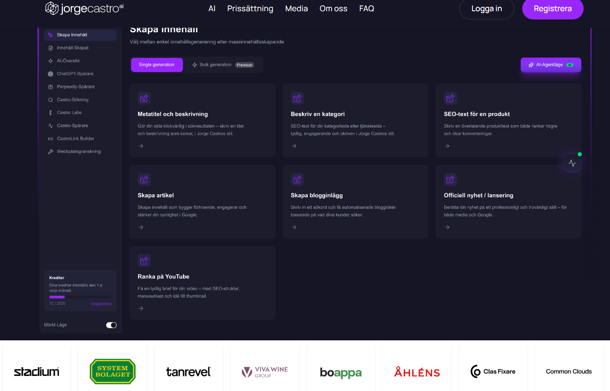
Option A Externt: One-stop-shop

Slide 16
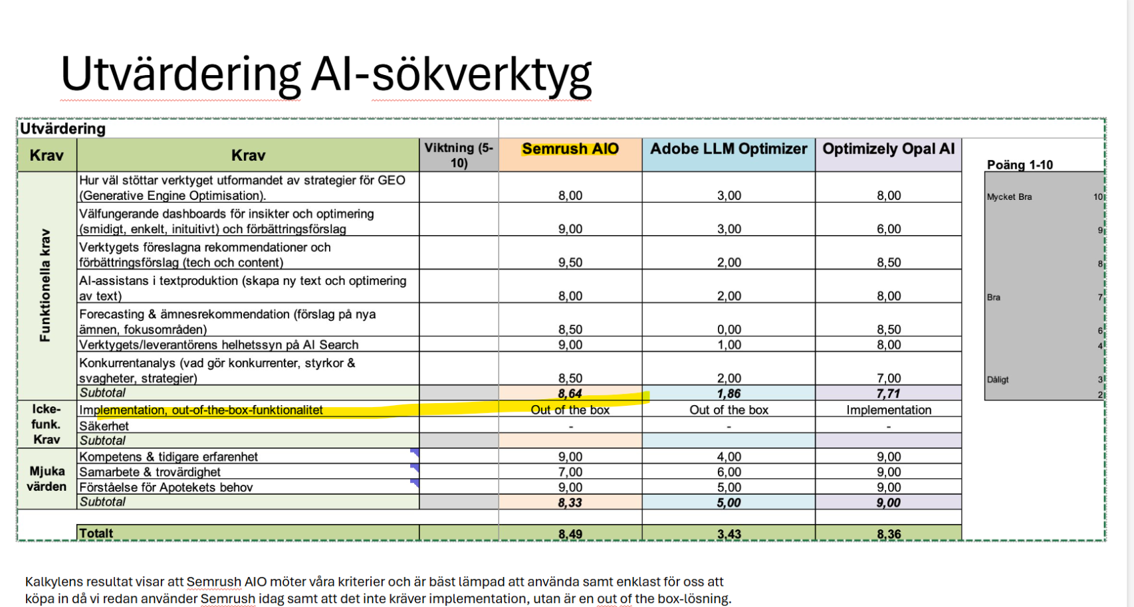
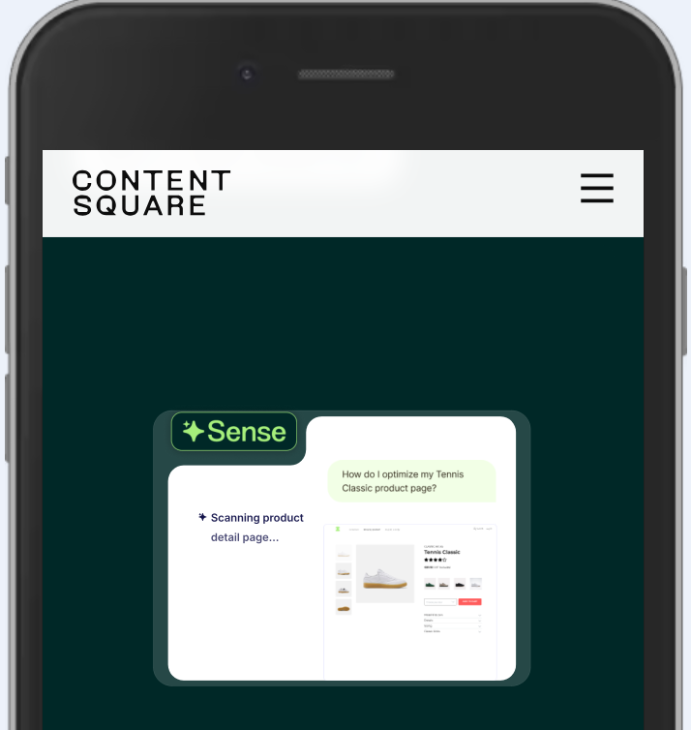
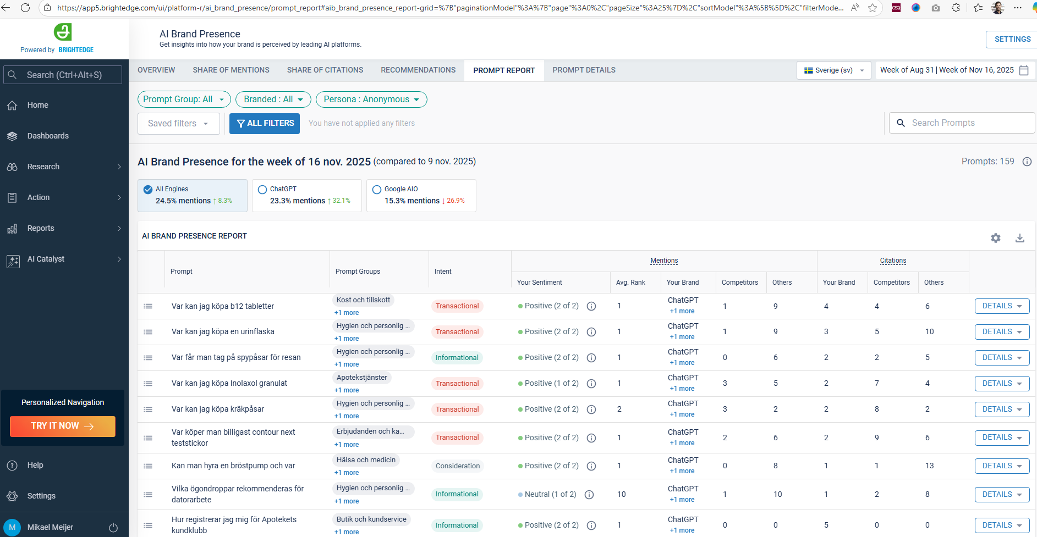

Option B: SaaS-lösningar (As-is + manuellt)
Apotekets nuvarande strategi

Slide 17
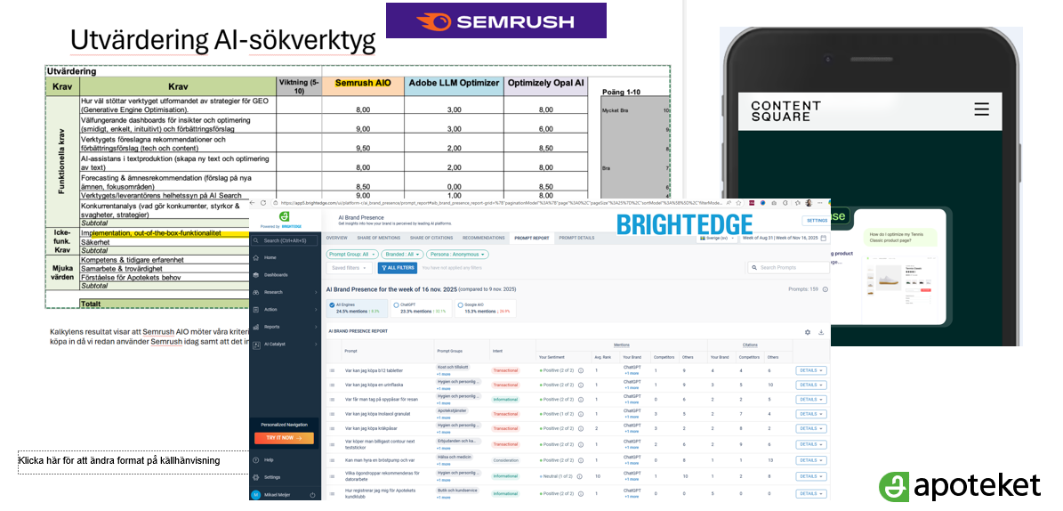
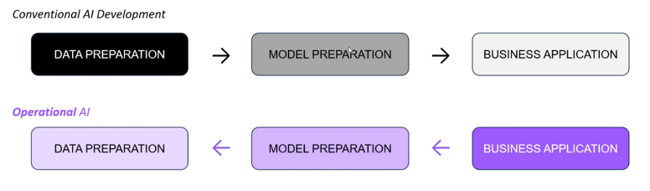

Option C: Hybrid SaaS-lösningar fort. + Automation (Retrieve – Build – Semi-automation (Hybrid)
AI (ML + Gen) integrated workflows.
Create MCP servers so that the AI can ingest patterns, coding styles, docs to improve quality and automate
Continue building prompt and instruction libraries for each intended output + as well as getting started guides
Suggest improvements and ability by human to approve changes in adjacent systems

Slide 18
Behov: Automatiserade AI-lösningar för innehåll & optimering mot AI Search case by case
1. Länkningar:
1.1Identifierar brutna länkar och automatiskt korrigerar / ger förslag på vart länkarna bör hänvisa.
1.2 Identifierar möjligheter för internlänkning och uppdaterar sidan med rätt internlänkning.
1.3 Ta bort 404-sidor och re-directa till relevant sida.
2. Innehåll:
Content AI Search auditering: Skannar content och utifrån flera datapunkter ger förslag på hur sidan ska uppdateras för att möta AI Search-krav: - Förbättra/strukturera data - Ta bort irrelevant information
Content AI Search optimering: Ger förslag på nytt content utifrån flera datapunkter och går själv in och gör enkla redigeringar som är lätta att åtgärda men tidskrävande för redaktörer. Som att: - Påminna om när en sida behöver ses över (efter ett visst tidsintervall) - Leta efter stavfel och korrigera dem - Ge alerts när en sida går över ett visst mätvärde, ex Fullmaktssidan har en bounce rate över 70%, behöver åtgärdas.
3. Dynamisk FAQ: -Skapar sidspecifik FAQ som automatiskt hämtar information om vad vår målgrupp söker på inom just det ämnet och assisterar på så viss redaktören med vilka frågor som ska adderas/tas bort utefter efterfrågan.

Slide 19
Innehåll
Bakgrund och Syfte
Behov lösningar / Options
Build vs. Buy
AI Agents (Agentic Commerce)
Bakgrund & Syfte

Slide 20
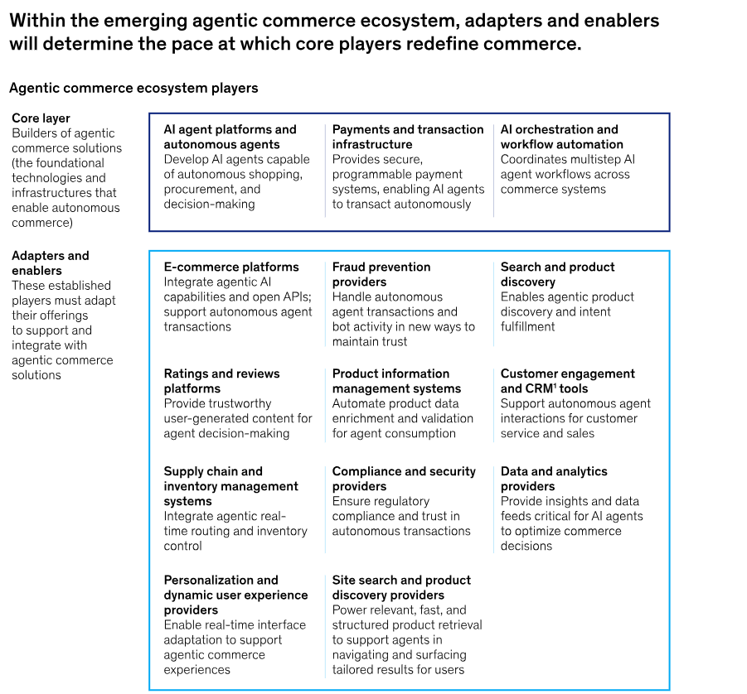
Behov AI Search - Apoteket Strategi
Hur tillgängligör vi Apotekets e-handel för AI-agenter?
Data kommer behöva delas, dialog med DSO och legal nödvändig
Agentic commerce: How agents are ushering in a new era | McKinsey

Slide 21
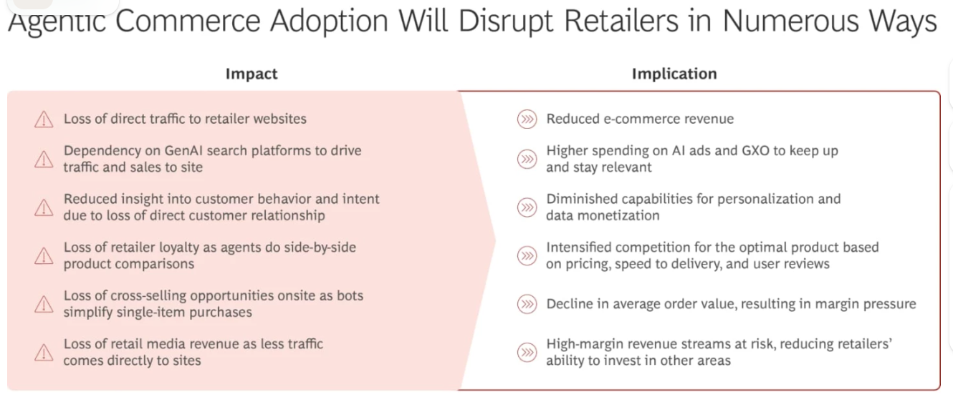
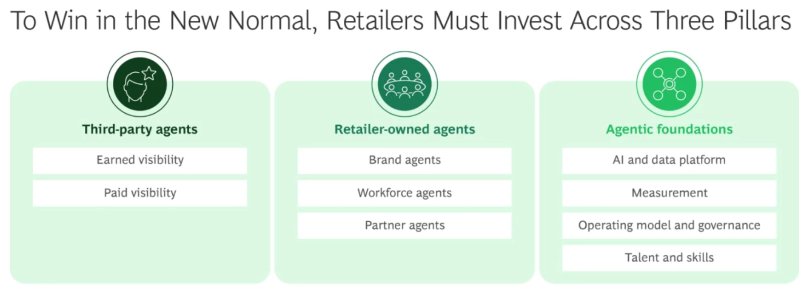
PHD genomför en mätning i potential av ökning i synlighet i vardera kategori.
Agentic Commerce is Redefining Retail - How to Respond | BCG

Slide 22
Appendix

Slide 23
IT architecture for content optimization
1. High-level goals
Centralize SEO/GEO signals (BrightEdge, Semrush, Google, Bing, analytics).
Embed SEO feedback directly into the CMS workflow (Optimizely).
Use an LLM (via MCP) to analyze and optimize content based on real data, not guesswork.
Keep integration secure, observable, and maintainable.
https://chatgpt.com/s/t_691ef0a22554819197c8d0761b87a919

