Slide 1
PG2 Web Graphics: Animation Ivo Pisařovic

Slide 2
Outline
Disney’s 12 principles of animation
Preparing a scene in Blender
Simple animation in Blender
Custom character

Slide 3
PART 1
Disney’s 12 principles of animation
Disney’s 12 principles of animation
Preparing a scene in Blender
Simple animation in Blender
Custom character

Slide 4
Notes:
Co se vám na této animaci líbí a co je divný?

Slide 5
Disney’s principles of animation
Ollie Johnston and Frank Thomas, 1981
Work of Disney animators since 1930
Useful for animating characters in movies and games but also web and mobile apps
Giving animated objects feel of natural living organism
Making animation fun and entertaining
Intentionally not realistic

Slide 6
12 principles
Squash and stretch
Anticipation
Staging
Straight ahead action and pose to pose
Follow through and overlapping action
Slow in and slow out
Arc
Secondary action
Timing
Exaggeration
Solid drawing
Appeal

Slide 7
Squash and stretch
The most important principle
Illusion of gravity, weight, flexibility
E.g. a bouncing rubber ball

Slide 8
Anticipation
Preparing for an action
A car starts from one place lineary accelerating (inefficient)
Living organism use physics to help them move
E.g. you need to bend knees before jumping

Slide 9
Staging
Use motion to guide the eyes
Draw attention
Add supporting elements to emphasize motion (arrows, glow, color)

Slide 10
Arc + Slow-in and slow-out
Respecting physics
Objects are usually not moving lineary in real world
Use a curve for easing
Use a curve for trajectory

Slide 11
Break physics
Break rules
But BE CONSISTENT
See all principles here:
https://www.creativebloq.com/advice/understand-the-12-principles-of-animation

Slide 12
PART 2
Preparing a scene in Blender
Disney’s 12 principles of animation
Preparing a scene in Blender
Simple animation in Blender
Custom character

Slide 13
Steps
Design your scene in a 3D software
Export into GLTF / OBJ (+ textures)
Import into A-Frame using an asset and GLTF loader
Fix scaling and rotation

Slide 14
PART 3
Simple animation in Blender
Disney’s 12 principles of animation
Preparing a scene in Blender
Simple animation in Blender
Custom character

Slide 15
Steps
Prepare and fine-tune your object before animating
Add initial keyframe
Change position of vertices and add the final keyframe
Optionally add intermediate keys to have non-linear animation
Add names to your animations (in Action Editor)
Export GLTF, import into scene
Play animation using animation mixer in A-Frame Extras

Slide 16
PART 4
Custom character
Disney’s 12 principles of animation
Preparing a scene in Blender
Simple animation in Blender
Custom character

Slide 17
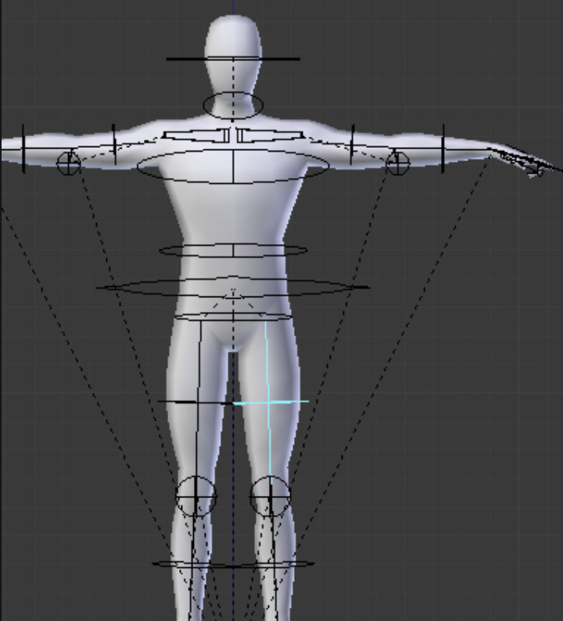
Steps
Prepare a figure with bones (it is easier to modify an existing one than creating from scratch)
Create animation like before, but move only bones
Meshes are automatically stretched/deformed to match the bones
Return to first keyframe and the default pose position
Export in Blender and load animations in A-Frame
Use fading for real transitions between animations
WARNING: take care of correctly selecting elements while animating, select bones not the object itself
WARNING: ensure you are editing the correct animation clip

Slide 18
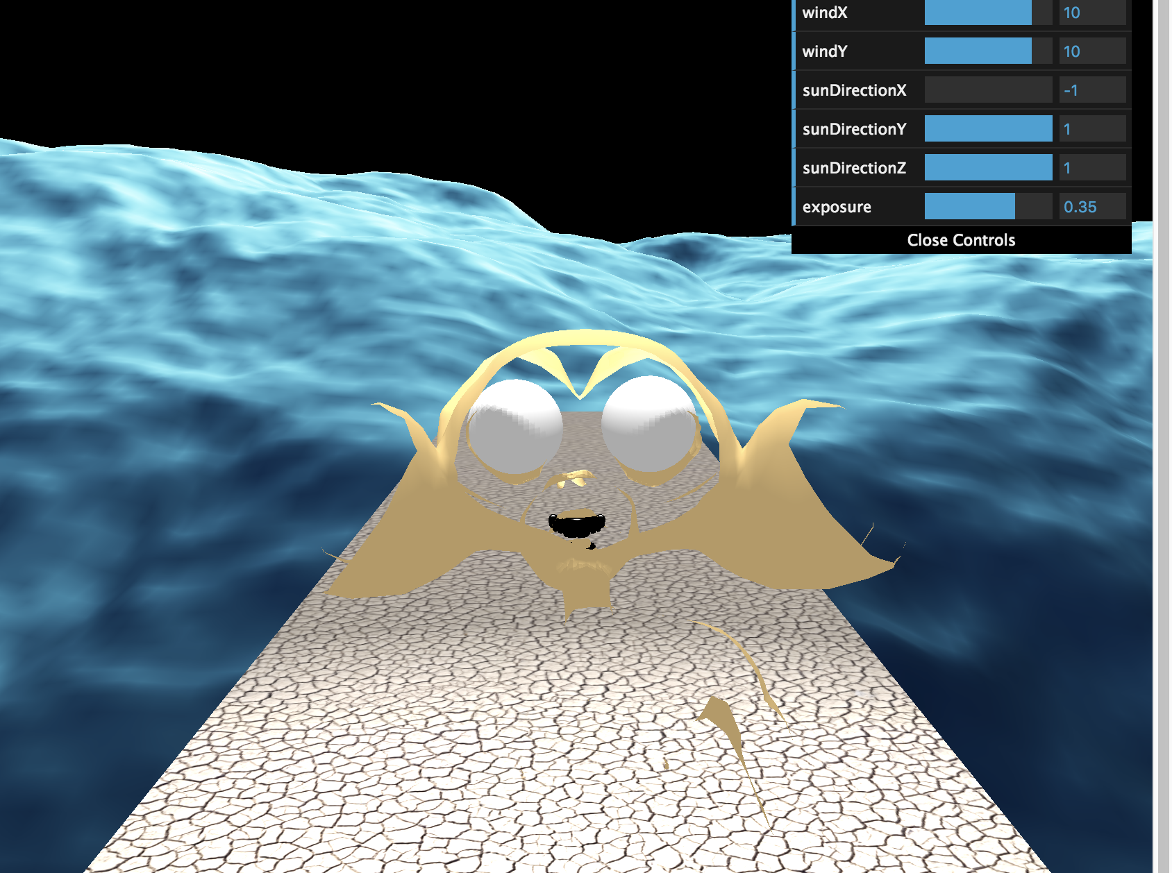
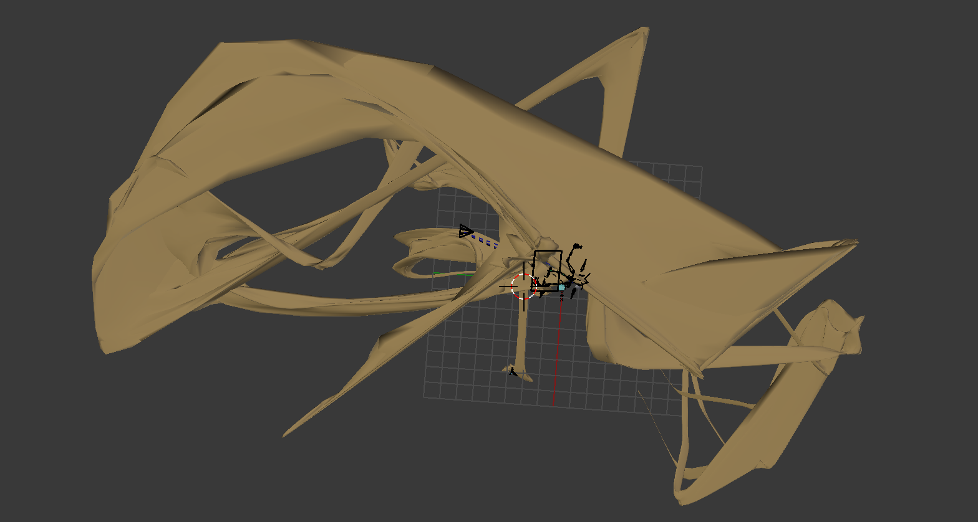
Take care to prevent nightmares
https://youtu.be/1eLqfRYLFW8

Slide 19
Links
A complex tutorial from sketching your character, modelling, animating, texturing and exporting:
http://unboring.net/workflows/animation.html
UV texture mapping in Blender, how to add a texture to a complicated mesh like a character:
https://cgi.tutsplus.com/tutorials/creating-a-low-poly-ninja-game-character-using-blender-part-2--cg-16133

Slide 20
Q&A

