Slide 1
PLC to Graph Progress
MIT Computational Design and Fabrication Group

Slide 2
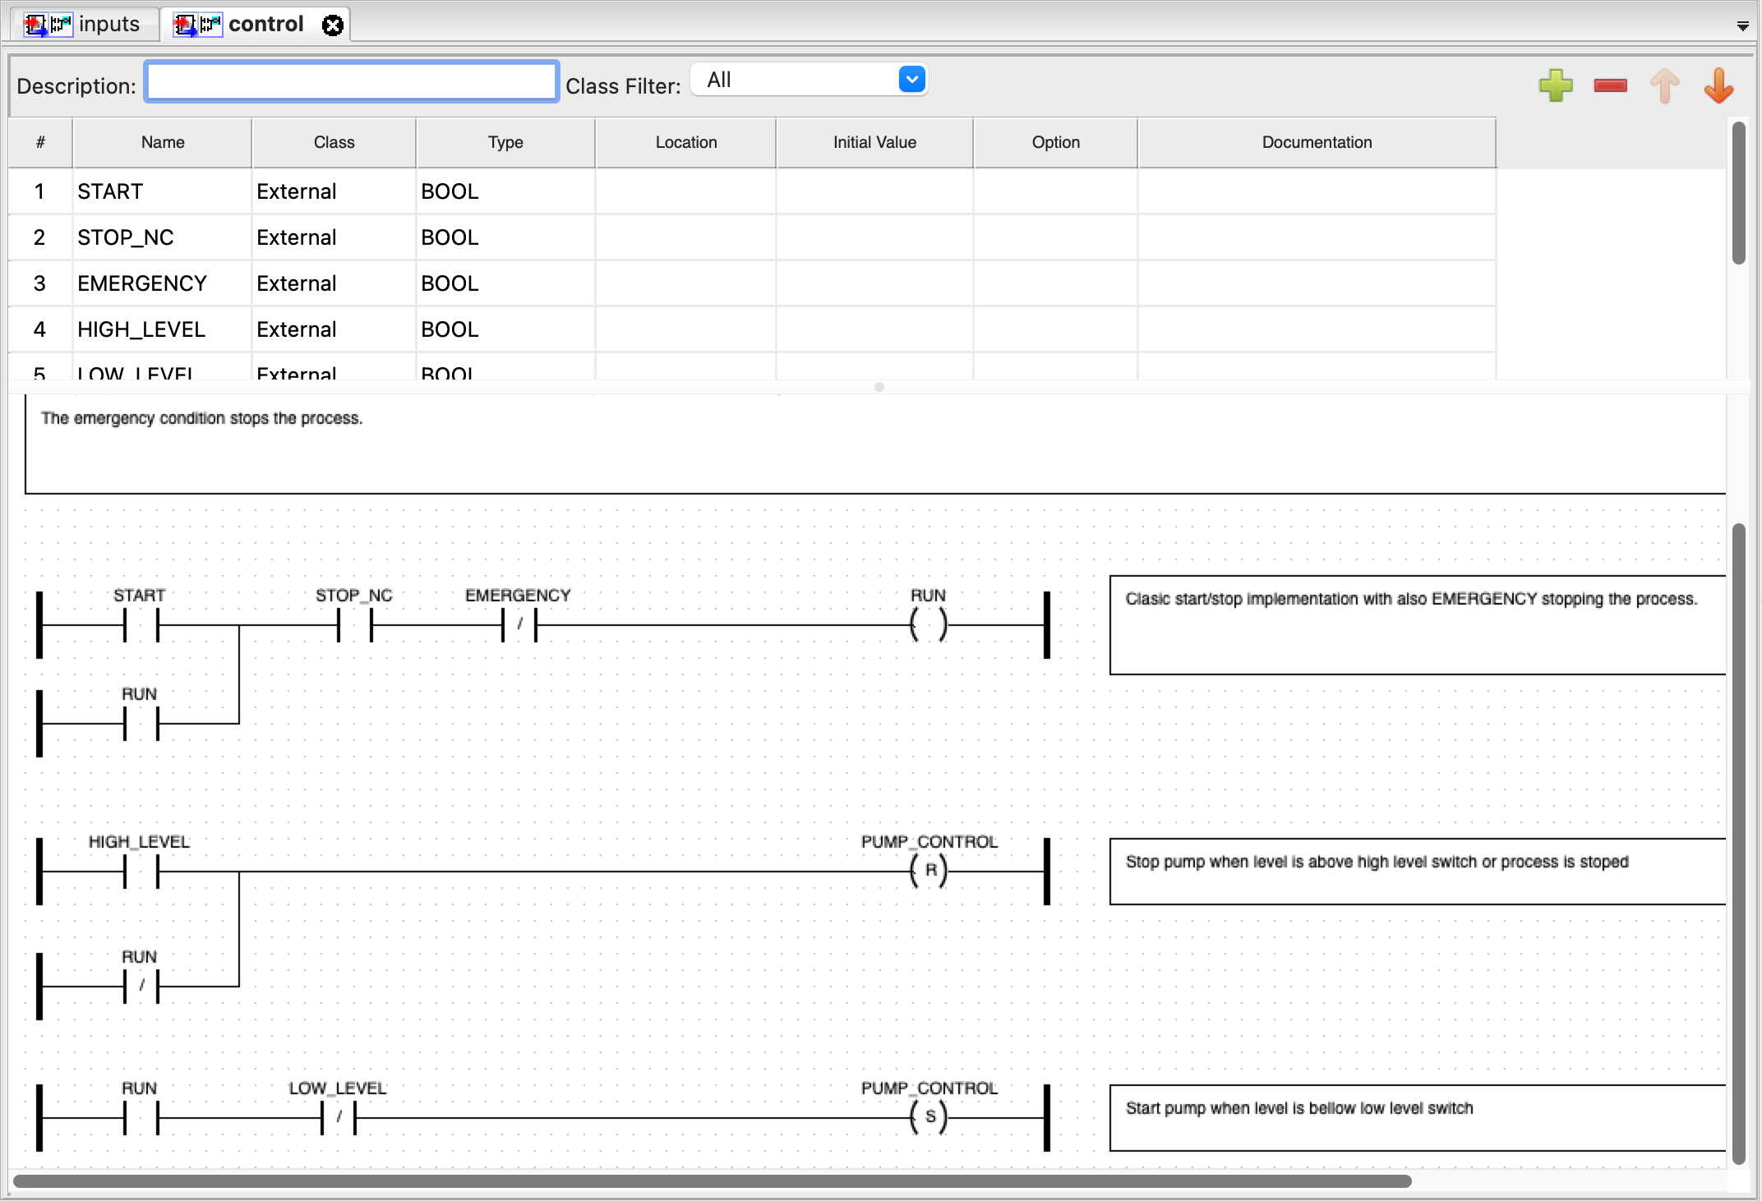
Pump Control Example
PLC ladder logic
⇔
Boolean formula/circuit

Slide 3
CNF Approach
In classical logic each propositional formula can be converted to an equivalent Conjunctive normal form (CNF) formula.
CNF = (... or … or …) and (… or …) and … AND of clauses with ORs
(A and B) or (C and D) = (A or C) and (A or D) and (B or C) and (B or D)
(A => B) (if A then B) = ((not A) or B)
(A = B) = (A => B and B => A) = (not A or B) and (not B or A)
Idea: ladder logic <--> a master CNF

Slide 4
PLCdb
Our minimal representation of ladder logic
Started writing PLC ladder code in the “factory robotics” setting
In .yaml (json-like), easy to parse for machine and human
Includes additional information (to potentially enable different approaches) such as
human-written comments (in natural language) of reason / use case, e.g., for LLM integration
Metadata, e.g., source
Created a script to help with CNF transformation

Slide 5
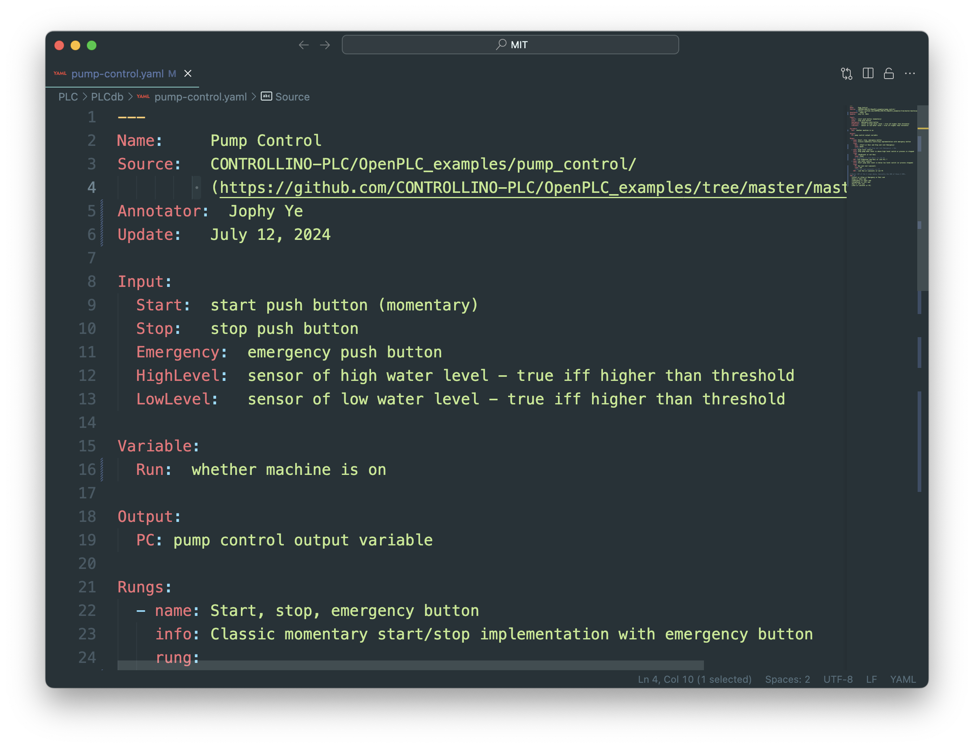
For this example…
Variable
Declaration

Slide 6
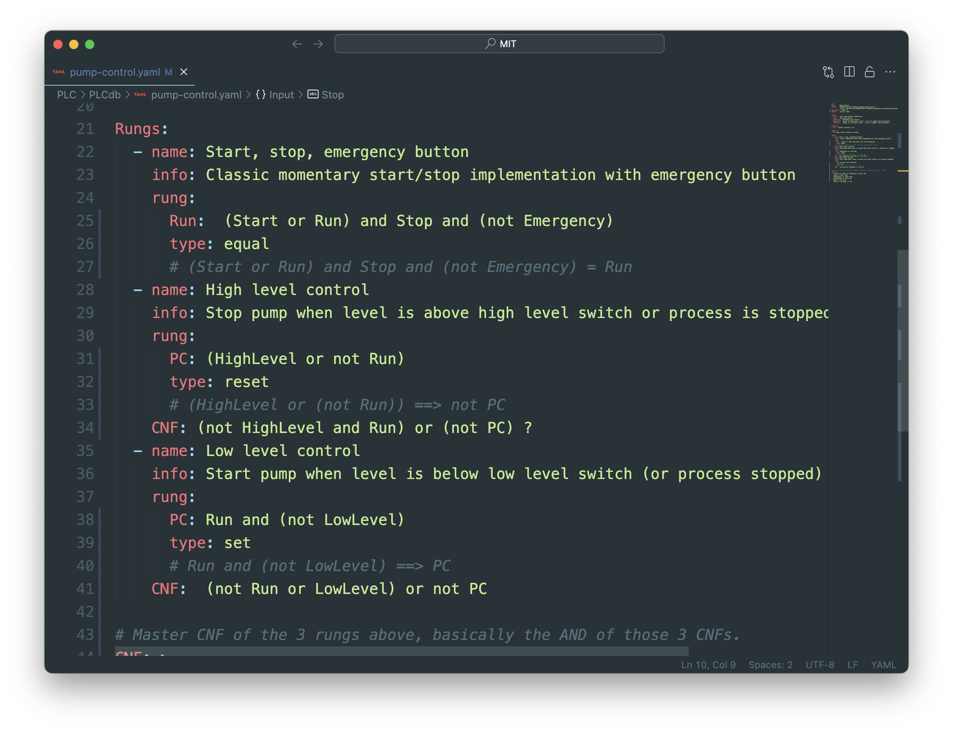
Rungs as given in the program
For this example…

Slide 7
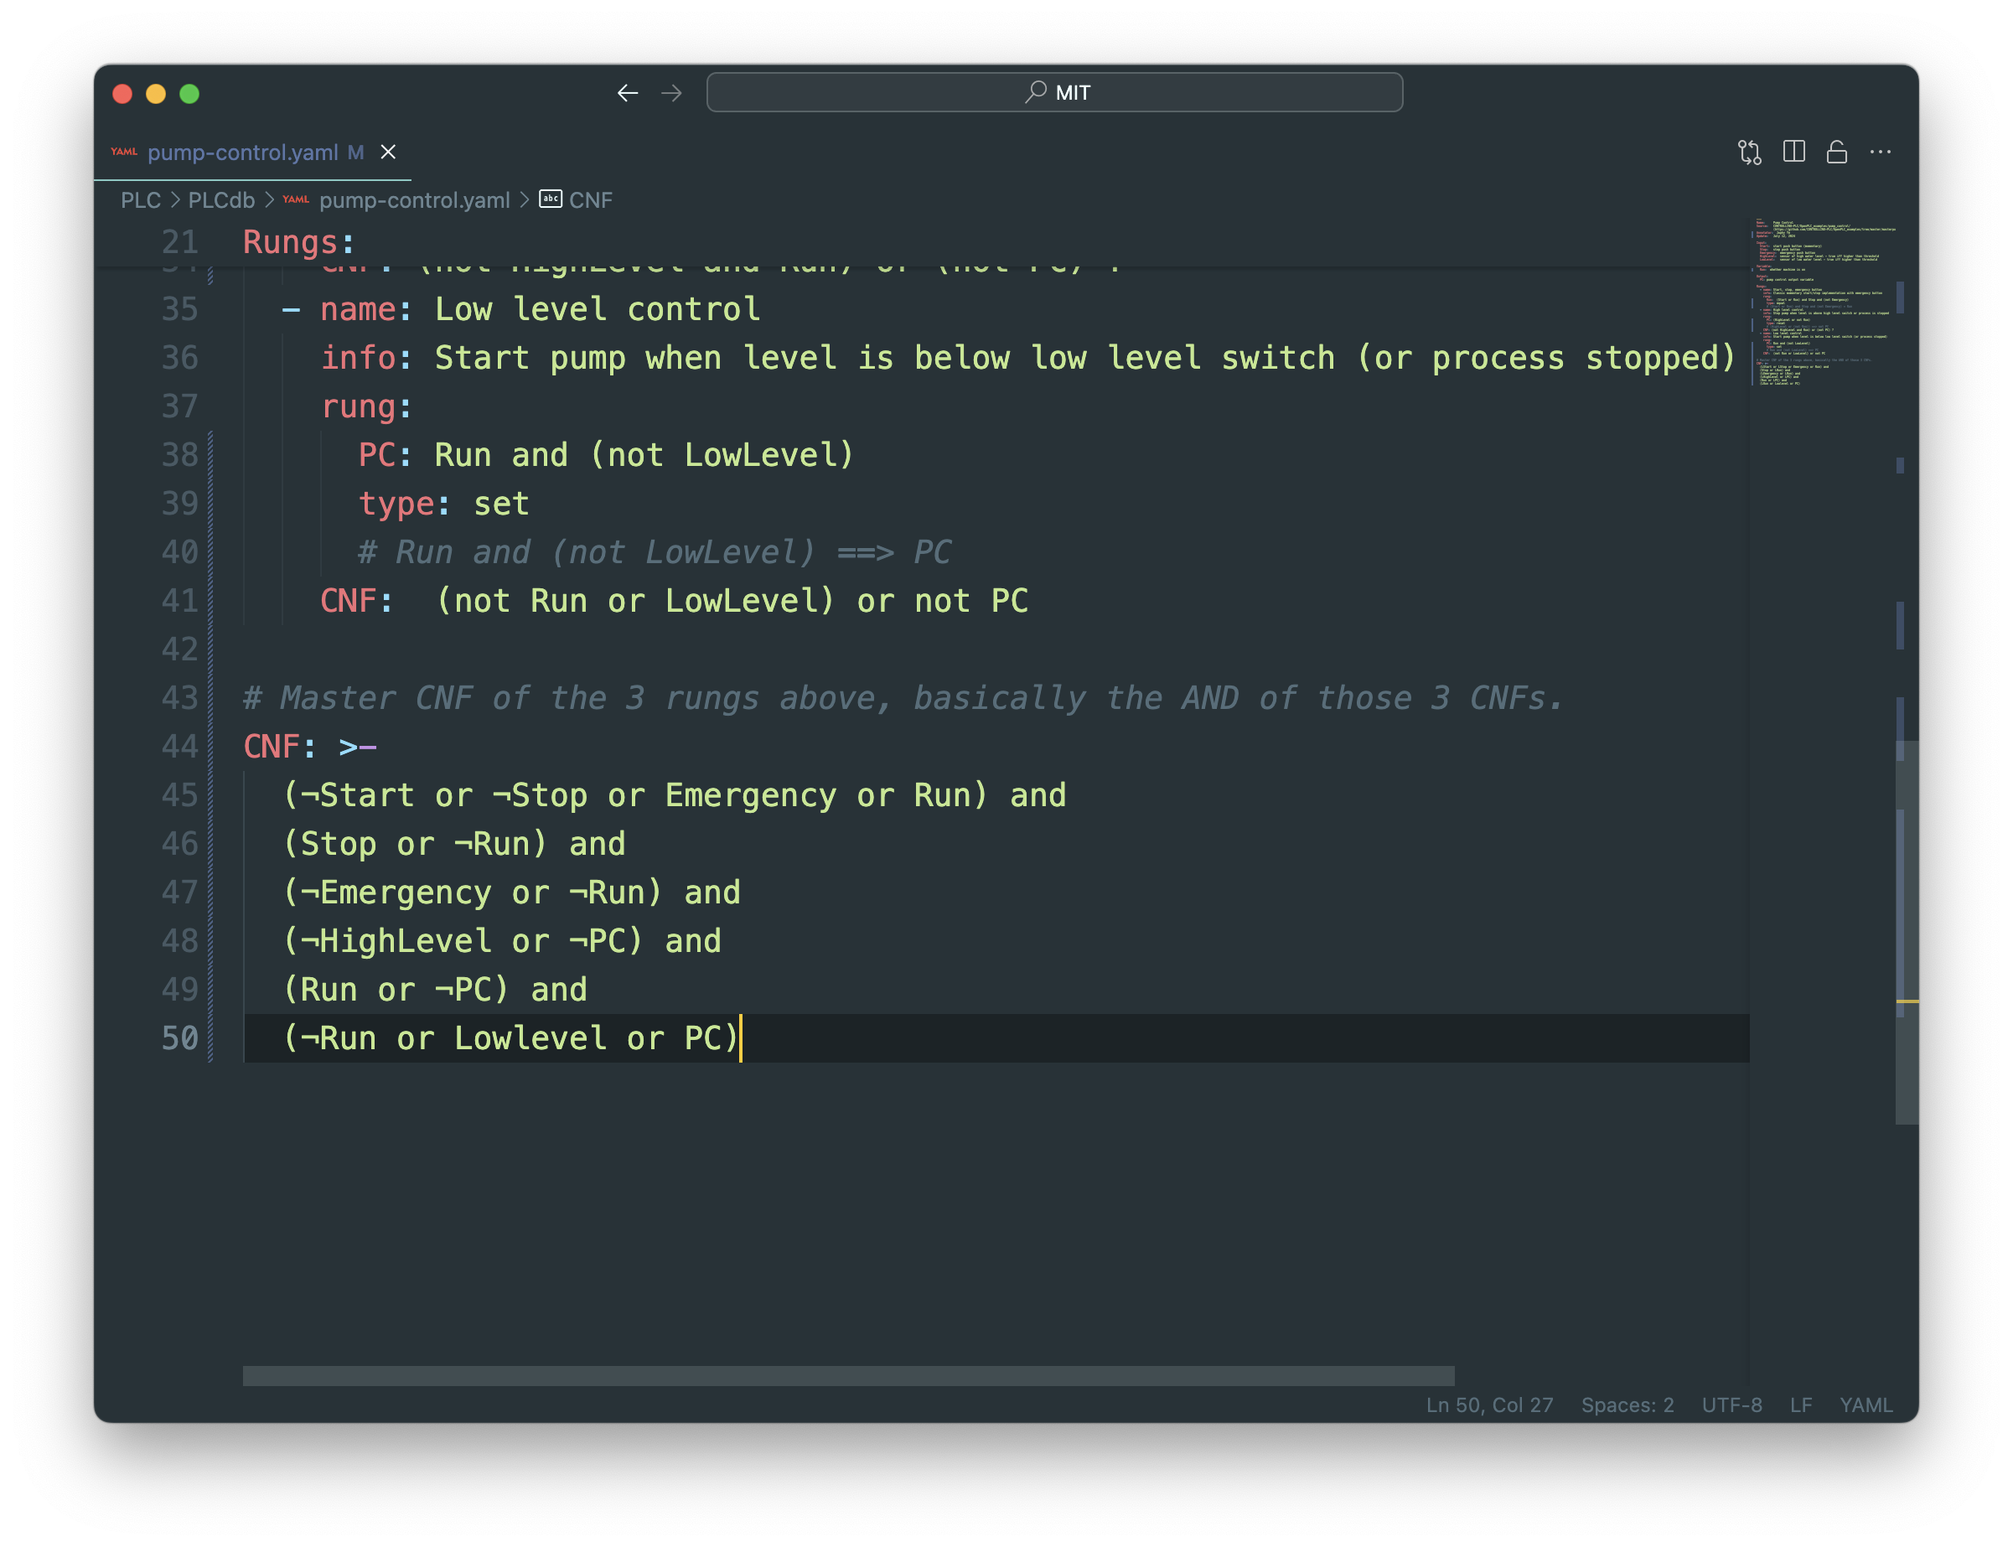
For this example…

Slide 8
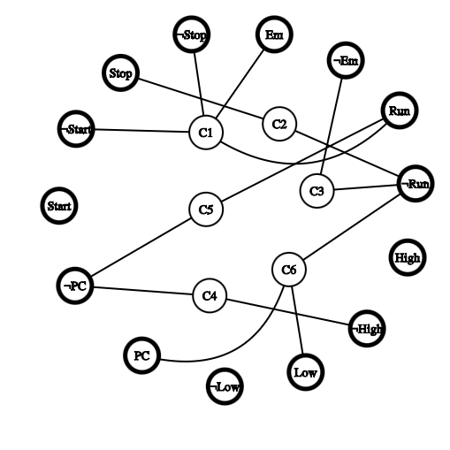
Graph Construction
Like NeuroSAT (https://arxiv.org/abs/1802.03685), make bipartite graph from CNF:
One side: each node is a clause of master CNF
Other side: all literals, i.e., all variables and their negations
Learn graph grammar from it

