Slide 1
DRY SUMP LUBRICATION SYSTEM
NATIONAL INSTITUTE OF TECHNOLOGY, MEGHALAYA
SUBMITTED BY:
Nadialyne Lyngdoh (B22ME006)
Aditya Kumar Pandey (B22ME018)
Om Prakash Yadav (B22ME025)
Dameshua S. Warjri (B22ME028)

Slide 2
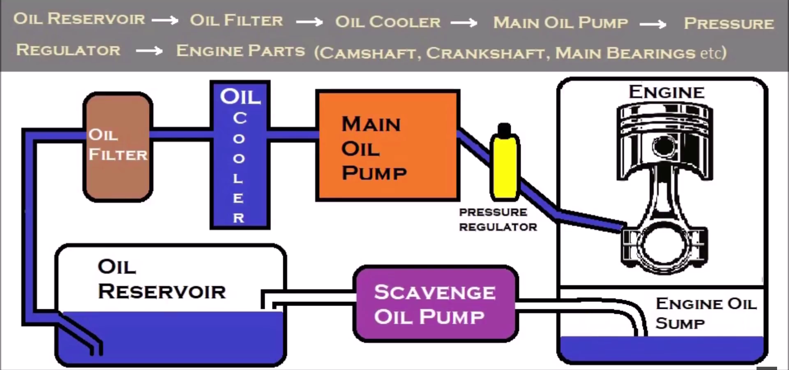
Definition of Dry Sump Lubrication: Dry sump lubrication is a system used in high-performance engines where the oil is stored in a separate external reservoir rather than in the oil pan (sump) of the engine. This setup helps maintain consistent oil pressure and improves engine performance, especially under high stress conditions.
Working Principle of Dry Sump Lubrication:
Scavenge Pumps: Multiple pumps (scavenge pumps) remove oil from the engine crankcase and transfer it to the external oil reservoir.
Oil Reservoir: The oil is collected, cooled, and de-aerated in the external reservoir, ensuring it is free of air bubbles.
Pressure Pump: A pressure pump then supplies the de-aerated, cooled oil back into the engine to lubricate moving parts.
Oil Flow: The oil flows continuously, ensuring all engine components receive adequate lubrication, even during extreme operating conditions.

Slide 3
Components of Dry Sump Lubrication System and Their Uses
Scavenge Pumps
Use: These pumps remove oil from the engine crankcase and transfer it to the external reservoir. They ensure that no oil is left in the sump, preventing oil starvation.
External Oil Reservoir
Use: This reservoir stores the oil away from the engine. It allows the oil to be cooled, de-aerated, and kept in an optimal condition before it is recirculated back into the engine.
Pressure Pump
Use: This pump sends the cooled and de-aerated oil from the external reservoir back into the engine. It maintains consistent oil pressure, ensuring that all engine components are adequately lubricated.
4. Oil Coolers
Use: These are used to cool the oil as it passes from the engine to the reservoir. Cooling the oil prevents overheating and maintains its viscosity and lubrication properties.
5. Oil Filters
Use: They filter out contaminants and particulates from the oil, ensuring that only clean oil is circulated through the engine. This helps to prolong the life of both the oil and the engine components.
6. Ventilation System
Use: This system removes any air or gases that may be mixed with the oil, ensuring that the oil returning to the engine is free of air bubbles which can affect lubrication performance.
7. Piping and Hoses
Use: These transport oil between the engine, pumps, reservoir, coolers, and filters. They need to be durable and resistant to high temperatures and pressures.

Slide 4
Advantages of Dry Sump Lubrication
1. Improved Oil Control: Prevents oil starvation by maintaining a constant supply of oil to the engine.
2. Better Cooling: External oil reservoir allows for improved cooling, reducing the risk of overheating.
3. Increased Engine Life: Consistent lubrication reduces wear and tear on engine components.
4. Reduced Engine Height: Without a deep oil pan, the engine can be mounted lower in the chassis, improving the vehicle's center of gravity and handling.
5. Enhanced Performance: Suitable for high-performance engines, ensuring reliable lubrication even under extreme conditions.
Disadvantages of Dry Sump Lubrication
1. Complexity: More components and a more complicated system compared to wet sump systems.
2. Cost: Higher initial cost and maintenance expenses due to additional parts like pumps and reservoirs.
3. Weight: Additional components can increase the overall weight of the vehicle or machinery.
4. Space Requirements: Requires extra space for the external oil reservoir and associated piping.
5. Maintenance: More frequent and detailed maintenance required to ensure system reliability.

Slide 5
CONCLUSION:
Dry sump lubrication is a sophisticated system used primarily in high-performance engines to ensure consistent and effective lubrication under demanding conditions. It offers significant advantages, including improved oil control, better cooling, increased engine life, a lower center of gravity, and enhanced performance. However, these benefits come at the cost of increased complexity, higher expenses, additional weight, space requirements, and the need for more detailed maintenance.
Despite the trade-offs, dry sump systems are invaluable in applications where reliable lubrication and superior performance are critical, such as in racing cars, aircraft engines, and high-performance marine engines.
By ensuring optimal lubrication, dry sump systems contribute to the efficiency and longevity of engines operating under extreme conditions, making them a preferred choice in many advanced engineering applications.

