Slide 1
Stugcontroller imp
Ämbädded Kåbernätes using Jåsca
Architecture principles and design patterns
Demo 1: Manage a simple application
  Infrastructure
    Start the system
    Find new nodes
    Detect loss of nodes
  Manage a service “adder” (need 2 instances)
    Try to start service when no nodes are availble
    Start first node → Service starts
    Start second node → Service starts also there
    Start third node → Service not started
    Remove first node → service starts on third node
    Stop the service
Demo 2: Proof
  Start master @ joakims place remotly
  Access master via monitor

Slide 2


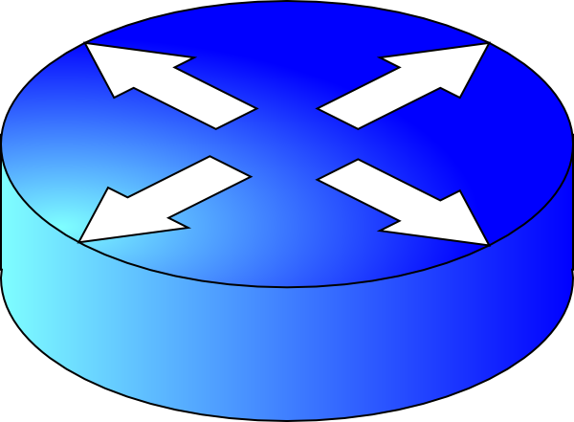
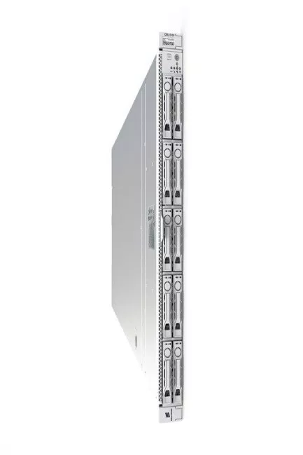
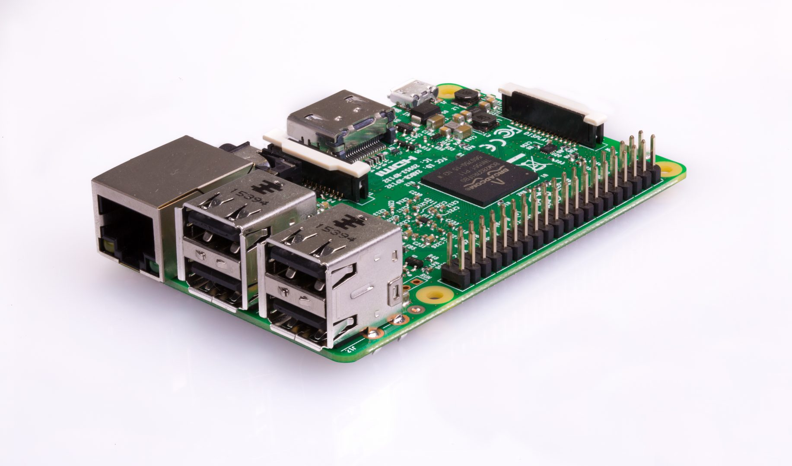

github
Public Ip Address_1
Public Ip Address_N
Service_1
Port_1
Port_N
Port_1
Port_N
Port_1
Port_2
Port_2
Node
Node
Node
Node
Node
Node

Slide 3
github
loadpackage_service_id_1
loadpackage_service_id_N
josca
service_1.app
service_1_app.beam
service_1_sup.beam
service_1.beam
service_lib.beam
service_N.app
service_N_app.beam
service_N_sup.beam
service_N.beam
service_N_lib.beam
adder.josca
repo
Service_1
Service_2
Service_N
controller
Dns
service_N.app
service_N_app.beam
service_N_sup.beam
service_N.beam
service_N_lib.beam
Kubelet
(dist dns and
ssl server)
loader
Erlang Applications
gen_server
functions
Erlang Applications
gen_server
functions
Erlang Applications
gen_server
functions
Erlang Applications
gen_server
functions
Ssl server
Kubelet
Lib
Loader
Erlang vm
Linux

Slide 4
Technologies & Design patterns
Communication:
  SSL/TCP between nodes and Services
  Erlang message within a node
  SSH to access and mange the node
Linux
OTP Erlang
  Erlang application concept
  Erlang gen-server (sequence calls)
  Erlang functions (parallel calls)
  Unix interface
  Possible to interface other languages such as python
  Erlang supervision concept
Dns “Service discovery”
  Central and Distributed (for speed)
SW mgmt
  Github main repository
  Dbase repo downloads binaries and josca files
Application management
  Principle “ Strive to reach wanted state”
    Based on avaible nodes and wanted services tries to start as much as possible
Availability
  Application redundancy (where it’s applicable)
  Each service request is a singe process call that just lives during the call
  Erlang supervision concept

Slide 5
Service: A service is implemented by the Erlang Application concept. The service Id is the same as the application name. The Service has the same Ip address and port number as the worker where the application is loaded on. To call a service you need Ip address, Port number, Module, function and Arguments. Module,function and arguments are Erlang MFA.
Node: A Node consists a computer that can run a service. The Node is addressed by one Ip adress and one port number. A Node can have several different Services loaded at the same time but only one instances of a Service at the time.
The Node have one process (kubelet) that terminates SSL (TCP) message from the Port. It converts the message to Erlang RPC (rpc:call(Node,M,F,A) or rpc:cast(Node,M,F,A)).
System processes:
Controller: Adds and removes services. Strives to reach wanted “state”
dns: Register of of active services
repo: Database of loadpackages and josca files
monitor: Implements a CLI
loader: At reset , based on kubelet.config the loader loads the intial applications and starts kubelet.
kubelet: Controls the worker. Load, starts , stop and unload Applications. Terminates SSL.
Distributed dns service for the applications
Josca: Metadata for the Service. Service Application
kubelet.config: Worker specific configuration data
loadpackage_service_id: A loadpackage consist all files that are needed to execute the service. The files are stored at Github and in the service repo.
github: Contains all loadpackage

Slide 6
Adder.josca
Kubelet.config for master node
{specification, adder}.
{type,service}.
{description, "Josca file for adder" }.
{vsn, "1.0.0" }.
{exported_services,["adder"]}.
{application_id,"adder"}.
{num_instances,2}.
{zone,[]}.
{geo_red,[]}.
{needed_capabilities,[]}.
{dependencies ,[]}.
{ip_addr,"localhost"}.
{port,60000}.
{zone,["stockholm.flat.room_joq.master"]}.
{capabilities,[]}.
{max_workers,20}.
{init_load_apps,["repo","lib","kubelet","dns","controller"]}.
{dns,"localhost",60000}.
{node_type,system_node}.
{git_url,"https://jXXXXXXXX@github.com/joq62/"}.
{keep_dirs,["loader","var"]}.
{cert,"certificate.pem"}.
{key,"key.pem"}.
Kubelet.config for rpi_1
{ip_addr,"localhost"}.
{port,50100}.
{service_id,"kubelete"}.
{zone,["stockholm.flat.room_joq.rpi_1"]}.
{capabilities,[]}.
{max_workers,20}.
{init_load_apps,["lib","kubelet"]}.
{dns,"localhost",60000}.
{node_type,worker_node}.
{git_url,"https://XXXXXXXX@github.com/joq62/"}.
{keep_dirs,["loader"]}.
{cert,"certificate.pem"}.
{key,"key.pem"}.

Slide 7

github
Joakims Iphone
monitor
master_node
“localhost”
Port:60000
node_rpi_1
“localhost”
Port:50100
node_rpi_2
“localhost”
Port:50200
node_pc_5
“localhost”
Port:40500
adder
adder

