Slide 1


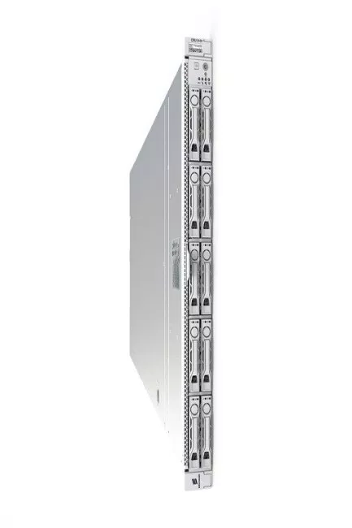
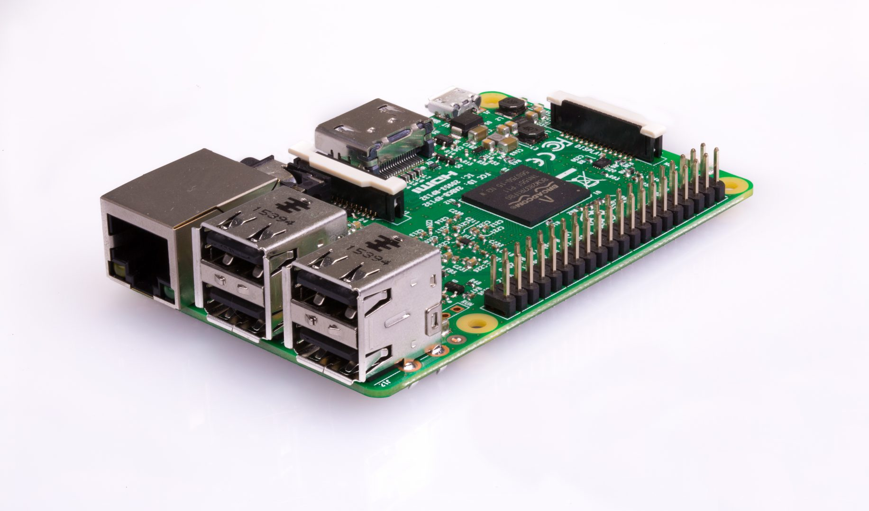

Public Ip Address_1
Public Ip Address_N
Port_1
Port_N
Port_1
Port_N
Port_1
Port_2
Port_2
Worker
Worker
Worker
Worker
Worker
Worker

Slide 2
Public Ip Address_1
Public Ip Address_N
Port_X
Port_1
Port_2
Port_N
Worker
Worker
Worker
Worker
Worker

Slide 3
Erlang Applications
gen_server
functions
Erlang Applications
gen_server
functions
Erlang Applications
gen_server
functions
Erlang Applications
gen_server
functions
Ssl server
Kubelet
Lib
Loader
Erlang vm
Linux

