Slide 1
Storage System Design
Preliminary Storage Engine Design - v3

Slide 2
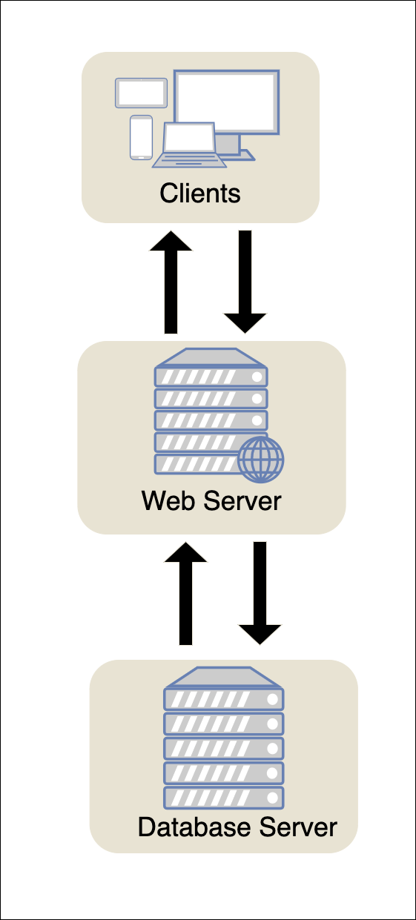
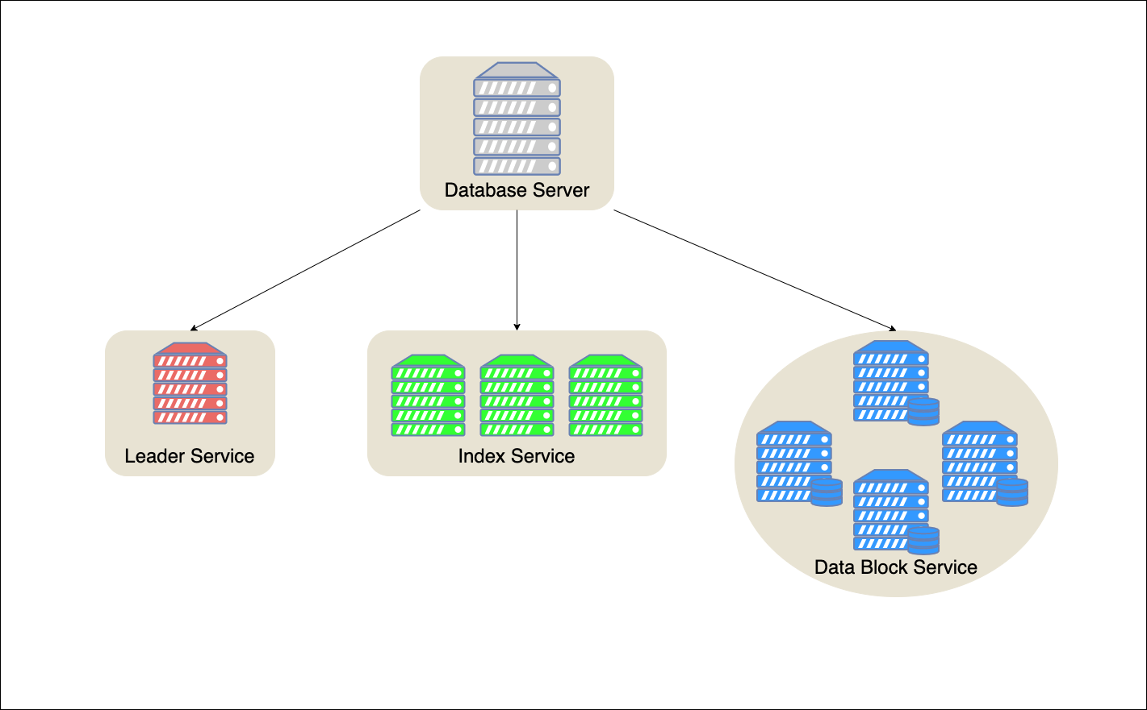

Slide 3
Memtable
WAL
Communicating directly with the client
SSTable (index block)
In-memory index
This is where the index will be hosted (will be distributed amongst these three nodes)
SSTable (Data blick)
Since the SSTable is comprised of the index block and the data block.
My plan is to split it and have the data block Service host the data block whilst the index service has the index block

Slide 4
WAL

Slide 10
asd

