Slide 1
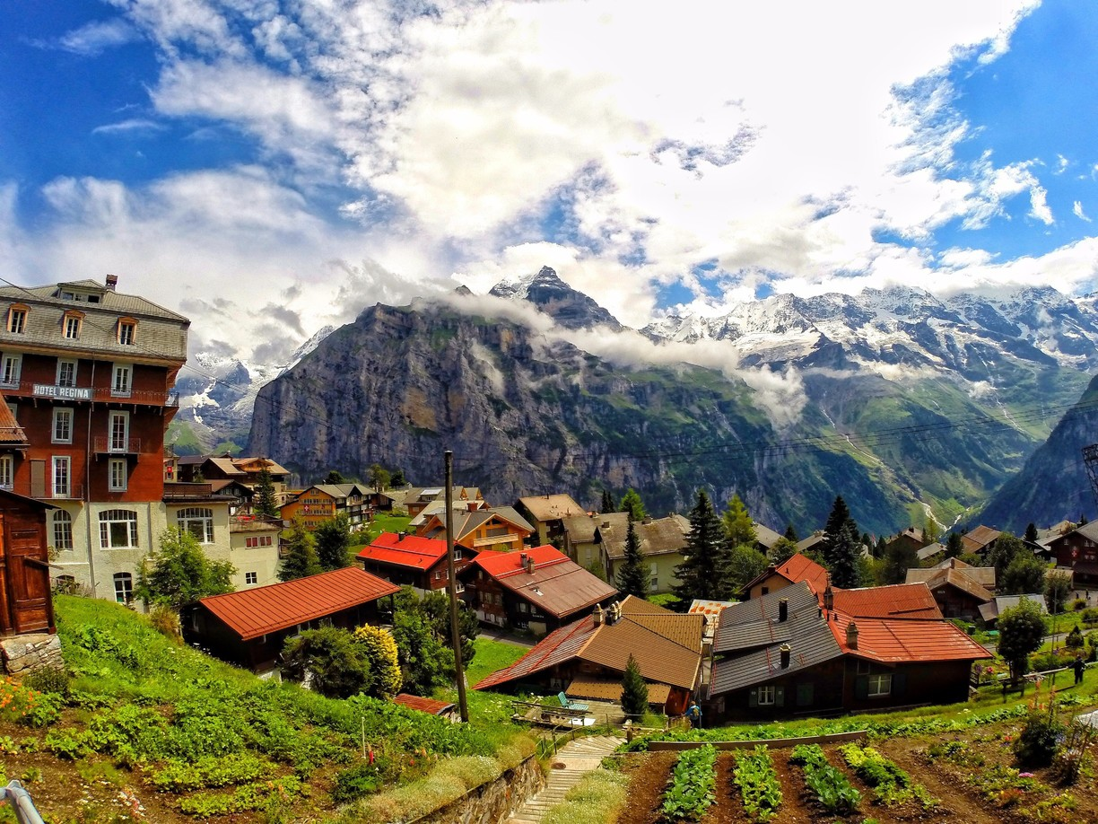
Digitalization of Business Processes SS 2019
Final Presentation Team Gimmelwald
Olten, 6th June 2019

Slide 2
Scenario
HR recruitment process in a mid-sized Swiss company
Entirely manual and very labour-intensive
Goal is to remodel the process in order to be able to digitize and automate one part of the process and thus save manual effort

Slide 3
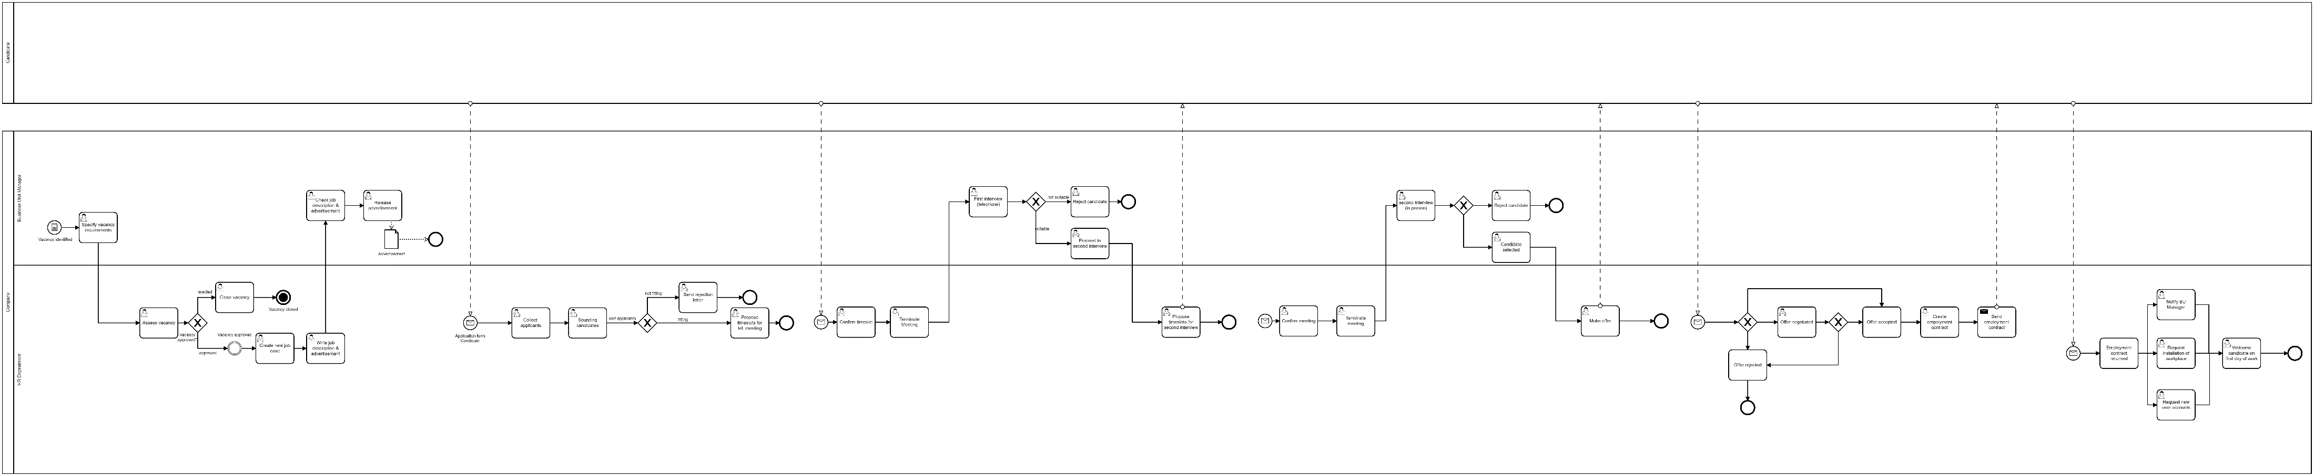
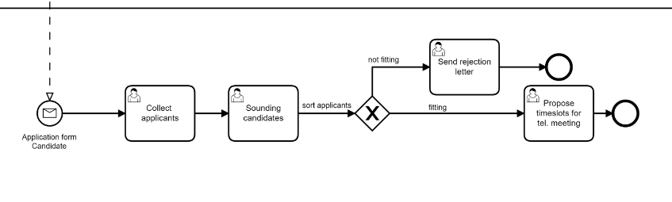
As-is Process
Subprocess to be digitized

Slide 4
Problem Statement
As-is process is lengthy and time consuming
Made up entirely of manual tasks and is very labour-intensive
Leads to high HR and recruitment costs and inefficient workflows
→ Our aim is to digitize and automate one of the most labour-intensive parts of the process in order to achieve a «quick win» in rationalizing the recruitment process.

Slide 5
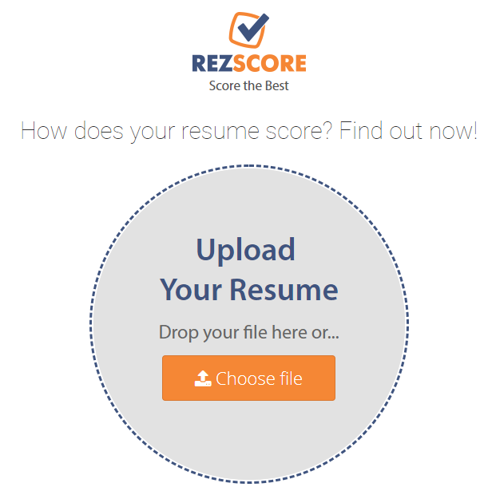
RezScore

Slide 6
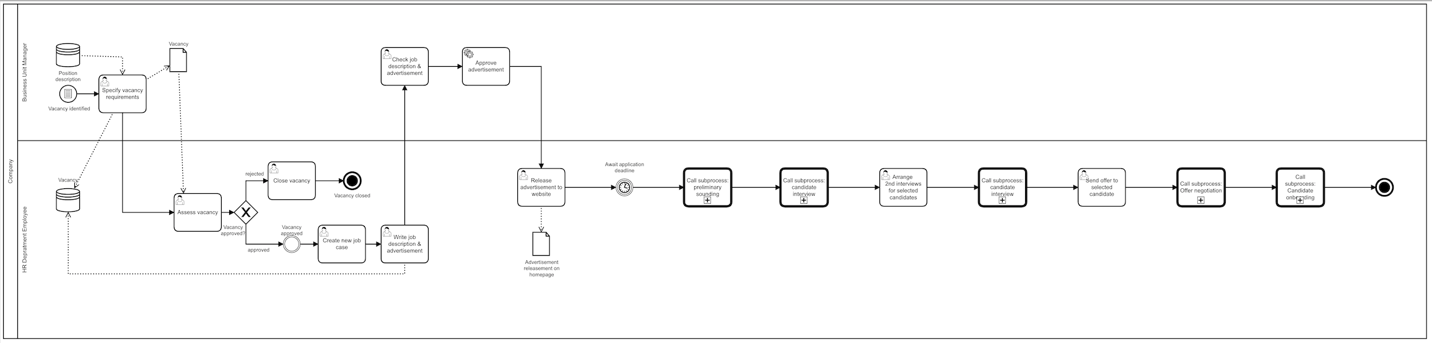
New Process Demo

Slide 7
Conclusion
This solution provides simple digitization of a key part of the recruitment process.
Manual tasks are replaced by automation, reducing manual effort.
This frees up HR resources to focus on other tasks.
Quick win in terms of simplifying and rationalizing the process.

Slide 8
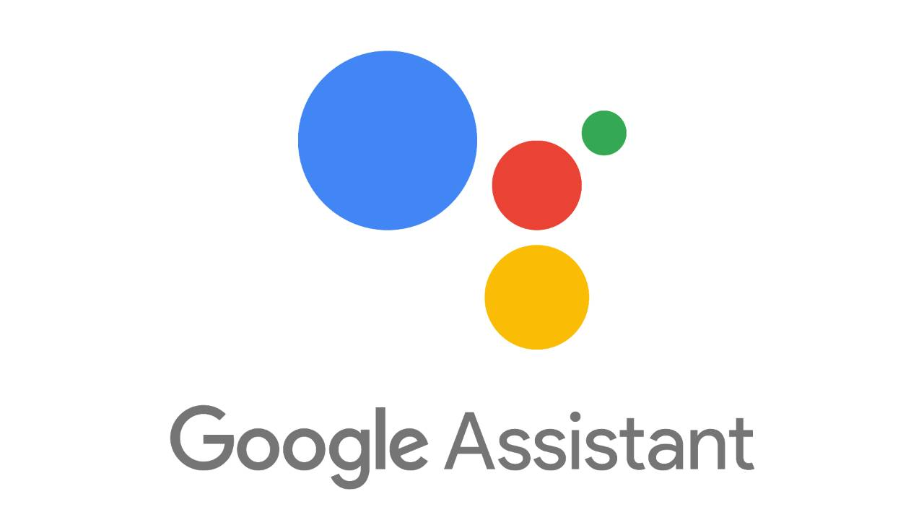
One last thing…

Slide 9
Thank you!
… any questions?

