Slide 1

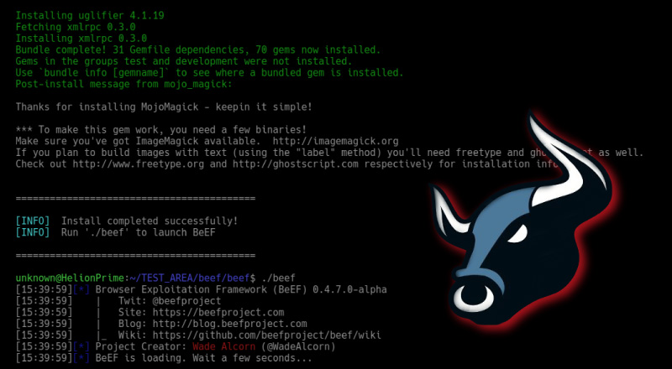
Analyze & Demo Tool
CSIA 440
Jorael Jamison

Slide 2




What is its history and background?
BeEF is a powerful and intuitive security tool.
The BeEF project was developed in 2006, soley for lawful research and penetration testing. Should be used ethically.
Provides penetration testers with client-side attack vectors.
Focuses on leveraging browser vulnerabilities.
BeEF is “open-sourced” and relies on a community of developers to maintain and improve the project.
Notes:
Now this beef differs completely from the cow, it is known as: the Browser Exploration Framework Project.
The Beef project was developed back in 2006 by a team led by Wade Alcorn, in response to growing concerns of web-based attacks against both web and mobile clients.
As a disclaimer, the Beef project is intended soley for lawful research and penetration testing, but as you can imagine, this tool can also be used criminally with malicious intent. There is a lot you can do with this tool, just make sure if you try it out for yourself, please stay ethical my friend.
Beef is essentially an open-sourced penetration testing tool that focuses on exploitation of the web browser, both on computers and mobile devices. It offers a wide variety of attack vectors that can be executed via command line or through an interactive web GUI interface. Which I will show you more on that later.
As mentioned, beef is “open-sourced,” so it does rely on the community of developers to maintain and improve the project.

Slide 3
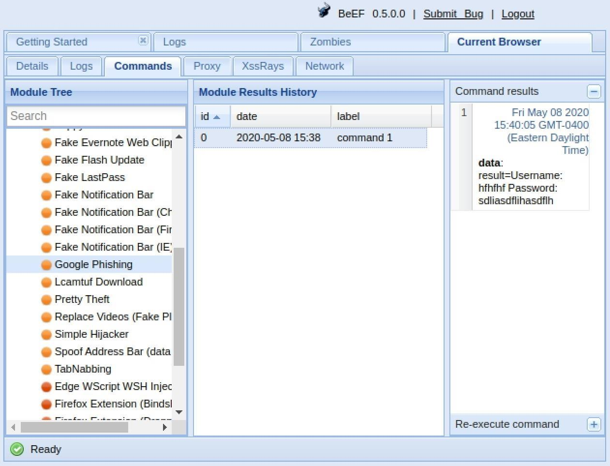
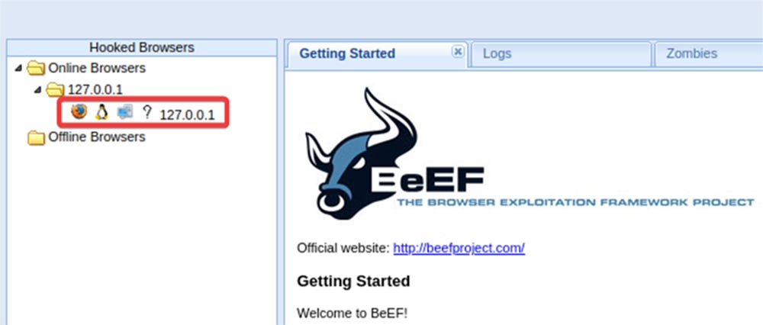
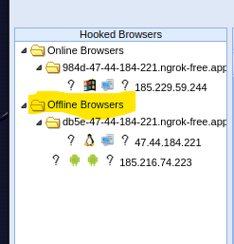
What is it used for?
BeEF features client-side attack vectors aimed at browsers.
Used to assess the vulnerabilities of a target.
Beef ‘hooks’ a browser/s and uses modules to direct command generated attacks.
Web and mobile devices are vulnerable.
Notes:
Beef works by hooking one or more web browsers to the application in order to direct - command generated attacks.
This tool can be used across many platforms. I read online that, in theory, BeEF should work on any operating system which can run Ruby 3.0+ and NodeJS. However, only MacOS and Linux are officially supported.
Once a browser is hooked, the attacker or ethical penetration tester can launch “directed command modules” and further attacks against the system, all within the target browser.
The images shown are from the GUI interface for Beef.
The image on the right is some of the modules available, and as a command is executed you can see the results and history. We will be going through this when I show how it is used.
The image on the left is a list of browser IP addresses. This is where all your hooked browsers will be displayed, and their status of either online, or offline. The browser becomes offline if the target navigates to a new page, exits the tab or browser, or clears the cache. After which they will remain offline unless the individual can be tricked again into clicking the same link or a newly generated one. There are several modules on beef that offer persistence, in which the browser will essentially remain hooked. These are more advanced features that I have not played around with yet.

Slide 4

When and where would it be used?
Anytime & Anywhere! Can be used by criminals, red and blue teams alike.
With the multitude of people using browsers every day, BeEF makes a perfect attack surface for criminals to execute their intent.
Professional Penetration Testers use to assess security and find vulnerabilities in a client’s web browser environment – to offer recommendations to better protect their sensitive data.
Notes:
BeEF can be used by both red and blue teams to offer offensive and defensive countermeasures. The attacks are implemented by luring victims into clicking on malicious links through phishing campaigns and once your browser is hooked, all sorts of directed attacks can be made against the device – or persistence can be enabled to launch further attacks down the road.

Slide 5

Why is it a good tool for an ethical hacker?
Allows professional penetration testers to assess the security of a clients’ browser environment.
Find vulnerabilities and offer recommendations to better protect businesses and clients against cyber attacks that can threaten sensitive data breaches.
Can be used by auditors to validate a zero-trust environment.
Used as part of a phishing campaign.
Validate an organizations browser configurations and hardening standards.
Notes:
As touched in the previous slide, this tool is used by both red and blue teams.
BeEF allows professional penetration testers to assess the security of a clients’ browser environment, by using directed attack modules. They are trying to find vulnerabilities and offer recommendations to better protect businesses and clients against cyber attacks that can threaten sensitive data breaches.
This tool can be detrimental to a company if compromised.
Auditors can use this tool to help validate zero-trust efforts, to test internal access to a resource, using a hooked browser can offer important data.
This tool could also be used as a part of a phishing campaign or simulation exercise or to validate your organizations browser configurations and hardening standards.

Slide 6
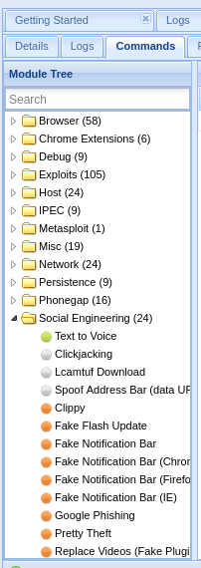
Features of BeEF
Once a browser is hooked, the attacker has limited control over the
browser tab, and can communicate directly with the user by
executing any of the commands to the right >
Limited control means the specific actions that can be taken are
limited by the type of browser, OS, and security settings in place.
Re-direct the web browser to display any content.
Attempt to launch mobile code like Java.
Request permissions to access the microphone or webcam.
Attempt to trick user into downloading malware.
Displays lots of useful device OS and browser details, plugins, cookies.
Attempt to trick user into entering login credentials on spoof sites.
And so much more…
Notes:
Once a user clicks on a website controlled by an attacker, the attacker has limited control over the browser tab, and can communicate directly with the user by executing any of the commands to the right. (Limited control means the specific actions that can be taken are limited by the type of browser, OS, and security settings in place.)
Other features include:
Re-direct the web browser to display any content.
Attempt to launch mobile code like Java.
Request permissions to access the microphone or webcam.
Attempt to trick user into downloading malware.
Displays lots of useful device OS and browser details, plugins, cookies.
Attempt to trick user into entering login credentials on spoof sites.
And so much more…

Slide 7
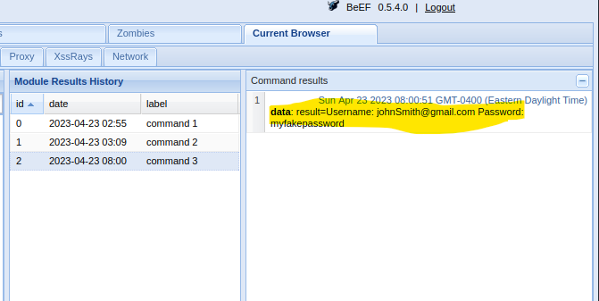
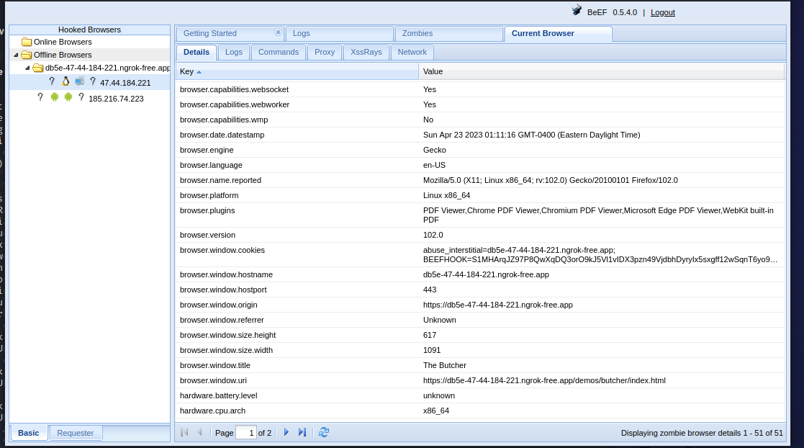
Features of BeEF
Notes:
This image shows the specific details from the hooked browser. You can see all sorts of useful information, browser version, cookies, plugins such as PDF viewers, built-in webkits, Even Operating system and hardware architecture details.
In the small image above, it shows the google phishing attack. It re-directs your page to a spoofed google login, prompting you to login. When you enter your credentials, it again re-directs you to the real google site. You think nothing of it, but in the back-end portal your details have been captured!
I will show you more on these features during my tutorial.

Slide 8
Quick tutorial on how to install
On Kali Linux:
sudo apt update && sudo apt install beef-xss
git clone https://github.com/beefproject/beef
Navigate to ./beef directory.
bundle install and ./install commands can be ran.
Ensure write permissions set for /var/lib/gems and /usr/local/bin
Sudo apt-get –y install gem (Ruby 3.0 or newer required for BeEF.
Re-run bundle install, if gem errors are shown, manually install each using:
gem install <specific dependency>
Each time you run ‘bundle install’ it may show a gem dependency error. Re-run the ‘gem install’ command each instance until all gem files are complete.
Open the config.yaml in text editor and you can change the beef username / pass. Default settings are beef / beef.
Alternative, first time you launch beef, it will prompt you to change password.
Visit: https://ngrok.com/download To download ngrok. Sign up for a free user account and add the authentication token – using the syntax shown on site.
Notes:
It took me quite some time to get BeEF up and running properly. Fortunately, there are tons of online resources to help you get started and to troubleshoot any errors you may encounter. My biggest thing was trying to get the tool to access the browser outside of my virtual environment. I finally was able to achieve this by updating the files in the beef config folder and downloading ngrok – which basically creates a secure tunnel to open access to remote systems without having to make any changes to your router or network.

Slide 9
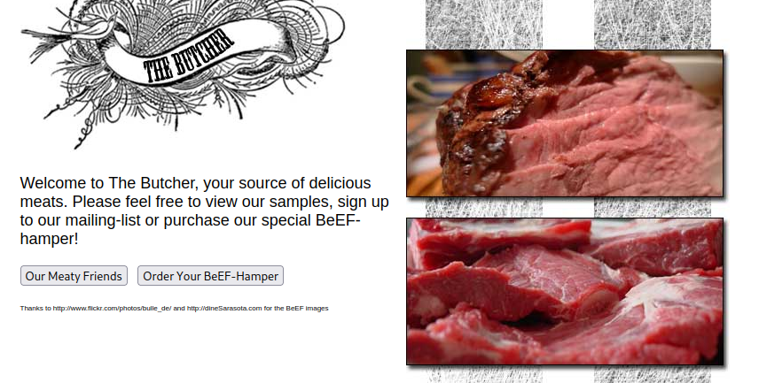
Quick tutorial on how to use
First, make sure your firewalls and antivirus software are temporarily disabled on attack and target devices.
ngrok http 3000 (starts port forwarding service)
Take the forwarding address (copy after https://) ex:
f127-47-44-184-221.ngrok-free.ap
Type ./beef
Type gedit config.yaml (or use your preferred text editor)
Remove the hash (#) for the “public:” host ports.
Copy the forwarding URL to the public host, port: “443”, and https: true
Save and enter ./beef again to start program
Copy UI URL for 127.0.0.1 network and open in attack browser
Ex: http://127.0.0.1:3000/ui/panel & login to the GUI using your beef credentials
Paste the forwarding URL from ngrok, to the beef test site url below:
http://(FORWARDING URL)/demos/butcher/index.html
Open in external target browser
If you see the butcher page appear your browser has been hooked and can start executing modules from the attack GUI interface.

Slide 10

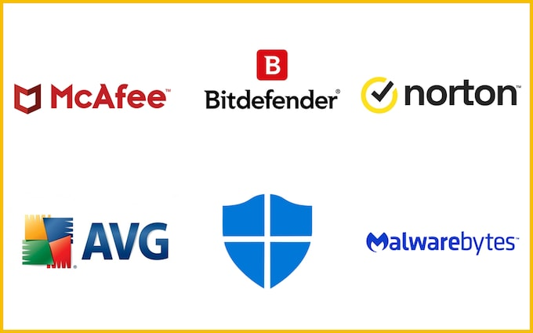
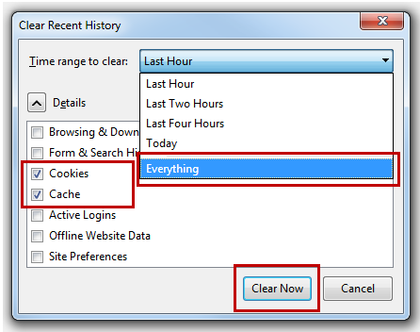

How to protect yourself
Clear cache and session cookies each time you exit the browser.
Do not click on any link or input login credentials for any untrusted source: Email, text message, browser pop-up or re-direct etc.
Verify suspicious URL links through VirusTotal.com
Download anti-virus software.
Use Firewall.
Use a VPN.
Notes:
The scary part is, you could have your browser hooked and not even have a clue you were compromised. To ensure you remain ‘offline’, clear your cache and session cookies each time you exit the browser. Utilize a VPN. Antivirus and some sort of web protection suite is needed to actively stop and warn you about these threats before you get hooked. And use smart surfing techniques, do not click on links that you are not sure are legit. You can also run these links through virustotal to see if they are malicious.
So long as you ended your browser session and do not re-click on the link, or any new link generated from BEEF, your browser should remain in the ‘Offline’ section - where they are unable to execute any commands. Unless of course, you have some persistent module executed on your system. That’s beyond my scope. One other thing can be to use a VPN as this can help further secure you as the attacker will not have your physical IP.

Slide 11



References
https://github.com/beefproject/beef/wiki
https://beefproject.com/
https://www.techtarget.com/searchsecurity/tutorial/How-to-use-BeEF-the-Browser-Exploitation-Framework
https://ngrok.com/download

