Slide 1
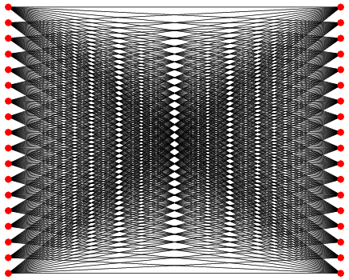
A Bipartite Graph Model of Information Flow
IFIP WG 2.3, May 2014
Gary T. Leavens (with John L. Singleton)
University of Central Florida Orlando Florida
Notes:
Essentially this is a programming problem, of how to best express information flow.
This work is supported in part by the US NSF under grant CCF-0916715, which was a joint grant with David Naumann.

Slide 2

Problem
Expressing Information Flow Security Specifications
Android applications
Applications in general
Libraries
Notes:
The aim is to give a better way to specify information flow security.

Slide 3

Why Information Flow?
ACLs and Firewalls prevent or allow access to data, but they do not control what happens after an access
Heartbleed, a defect in OpenSSL, could have been found by Information Flow analysis
Formal Methods @ UCF
Notes:
ACLs effectively reduce managing information to authorization.

Slide 4
Background: Information Flow Problem
send(company, address_book);
company = address_book;
boolean b = false;
if (address_book.get(“president”).num() .equals(“(202) 456-1111”) {
b = true; }
Formal Methods @ UCF
Notes:
The question is, when should these be permitted?

Slide 5
Background: Lattice Model of Information Flow (Denning, 1976)
Each variable given a security label (e.g., Public, User, Private, …)
Statically check all statements x = e; permitted only if label(e) ≤ label(x)
Invariant: only permitted information flows allowed
Private
User
Formal Methods @ UCF
Public
Notes:
Variables are shorthand for any kind of information store (files, …)

Slide 6
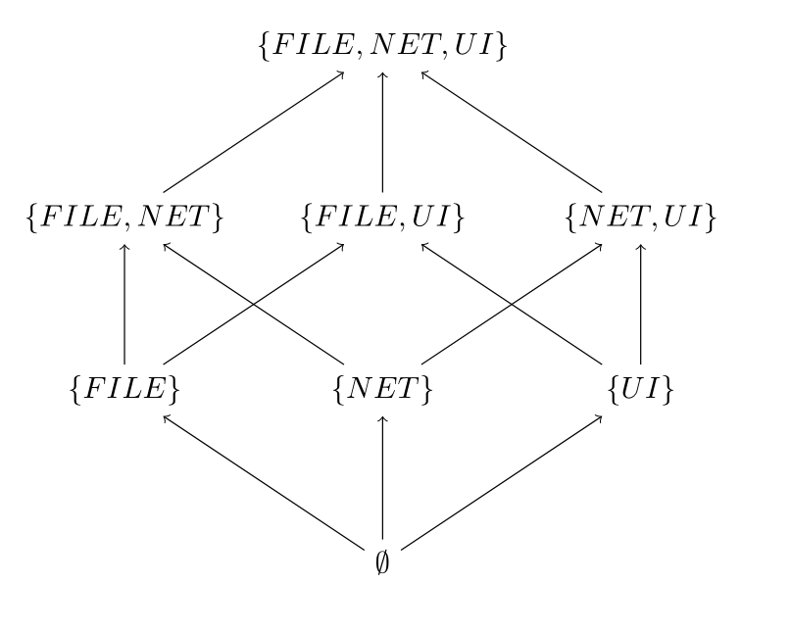
Integrity Interpretation
Where can the variable’s value come from? What can affect it?
More Influences
Notes:
The lattice doesn’t have to be composed from sets, but that is one way to do it.

Slide 7
Confidentiality Interpretation
Where can a variable’s value be sent? What can learn from it?
∅
{FILE}
{NET}
{UI}
More Confidential
{FILE, NET}
{FILE, UI}
{NET, UI}
{FILE, NET, UI}
Notes:
The top is the security class of the most private (secret) variables, which can’t be sent to a file, the net, or the UI.

Slide 8
The Decentralized Label Model (Myers & Liskov, 1998)
Each variable has two sets of labels
Sinks: where information can flow
Sources: where information can be obtained from
Rules:
x = e
Safe to REMOVE sinks from x
Safe to ADD sources to x
Formal Methods @ UCF
Notes:
Safe in the sense that the variable’s declared sinks and sources are still a conservative approximation of the permitted information flows in the program.
The terms SINK and SOURCE don’t actually appear in Myers and Liskov’s work, but it’s the most direct translation and is maybe easier to use in the context of explaining.

Slide 9
Example
@Sink({FILE}) @Source({NET}) int x;
@Sink({FILE,UI}) @Source({NET, UI}) int e;
x = e; // legal?
Formal Methods @ UCF
Notes:
This is written in the notation of SPARTA.
It’s safe to remove sinks, so that part is okay (making the value be restricted in confidentiality).
It’s not safe to remove sources however, as then we lose the fact that the value may have come from the UI

Slide 10
Key Properties of Decentralized Label Model
Label creation and propagation is not centralized.
New labels can be created dynamically.
But checking is mostly static
Formal Methods @ UCF
Notes:
Good for distributed and evolving systems.

Slide 11
Drawbacks of the Decentralized Model
Set-based labels can be cumbersome to write in programs.
Programmers must reason about 2 directions at once:
Confidentiality
Integrity
APIs must be specified once and for all
Formal Methods @ UCF

Slide 12
API Example
package android.content.res;
class AssetFileDescriptor {
@Source({FILESYSTEM}) FileInputStream createInputStream() throws IOException;
}
Notes:
In SPARTA notation. The problem is that this fixes the labels for the API.

Slide 13
Client Example
@Source({FILESYSTEM, LITERAL}) InputStream is;
is = encryptedVideoAsset.createInputStream();

Slide 14
Is the Power of the Distributed Label Model needed?
Many programs are not distributed
Even distributed programs can be logically centralized
Formal Methods @ UCF

Slide 15
Approach/Idea
The Bipartite Graph Model of Information Flow
Formal Methods @ UCF

Slide 16
Model Idea
UI
NET
Private
Encrypted Video Viewer
User
Formal Methods @ UCF
Edge Map
Public
FILE
E
Channels
Security Labels
C
L
Notes:
Edges flowing to the app are inputs, from the app are outputs.

Slide 17
Example: Encrypted Video Viewer
UI
NET
Encrypted Video Viewer
Formal Methods @ UCF
FILE
Notes:
UI, NET, and FILE are channels

Slide 18
Approach: Model
Static security labels, L
Global channels, C
API specified by channels and usage:
Arguments (I)
Results (O)
Edge mapping, E : {I,O}xC → L
Formal Methods @ UCF

Slide 19
Model Idea
UI
NET
Private
Encrypted Video Viewer
User
Formal Methods @ UCF
Edge Map
Public
FILE
E
Channels
Security Labels
C
L
Notes:
Edges flowing to the app are inputs, from the app are outputs.

Slide 20
Example Security Lattice Security.xml file
Formal Methods @ UCF
…
Notes:
This is for confidentiality

Slide 21
Example Channel Mapping Channels.xml file
Formal Methods @ UCF

Slide 22
Simple Example (Voting Booth)
public
void castVote(@Lev
el(SECRET) User u, @Level(TOPSECRET) Vote v){
..
// ok because TOPSECRET > SECRET
String
encryptedId = encryptVoterId(u.getUserId());
// ok because TOPSECRET
logVote(encryptedId, v);
// ...
}
// in the program, but described wit
h @Channels.
public
void logVote(@Channel(FILESYSTEM) id, @Channel(FILESYSTEM) vote){
//...
}
Formal Methods @ UCF
// in an API
public
@Channel(CRYPT) String encryptVoterId(@Channel(CRYPT) String voterId){
//...
}
Notes:
This example didn’t work out so well.

Slide 23
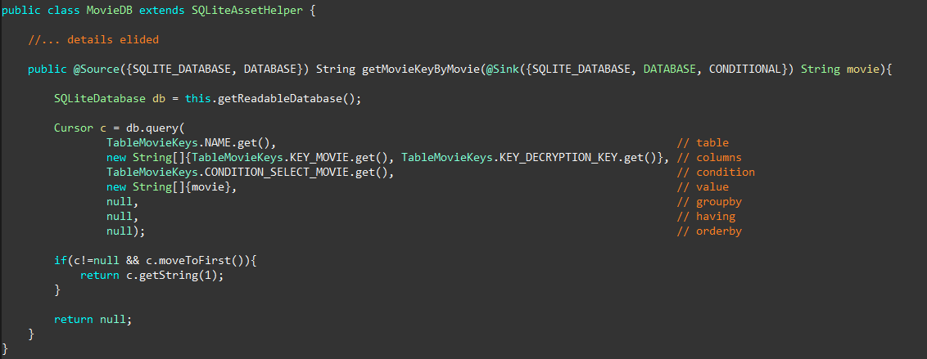
More Detailed Example Distributed Label Approach
Formal Methods @ UCF
Notes:
Font is too small.

Slide 24
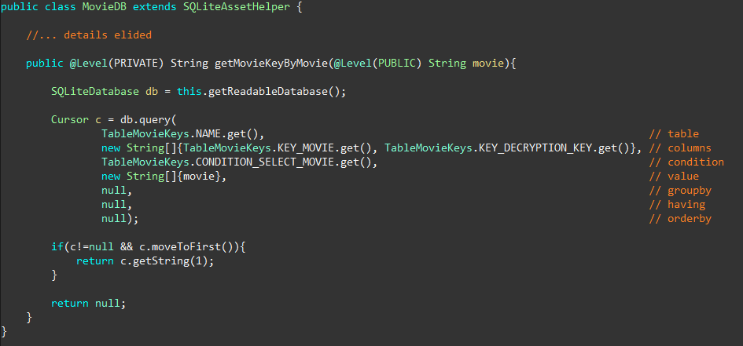
More Detailed Example Bipartite Graph Model
Formal Methods @ UCF
Notes:
This uses the security labels from the application, which are mapped from the API by the edge mapping.

Slide 25
Using the Model
User writes:
Security.xml
Channels.xml
User supplies program annotation via @Level and @Channel for APIs (“poor man’s” polymorphism)
Runs checking tool over program
Formal Methods @ UCF

Slide 26
Advantages of the Model
Can mix Channels and Labels in program:
Channels in API
Labels in client code
Compact types: channels or labels, not two sets
Can handle confidentiality and integrity separately or together.
Users can define arbitrarily complex lattices
Formal Methods @ UCF

Slide 27
Suitability for APIs
@Channel annotations specify information flow generically
Can customize
security.xml (levels) and
channels.xml (mapping)
to fit the security concerns of the application.
Notes:
These features allow API specs to be reusable although users customize security labels and mapping.

Slide 28

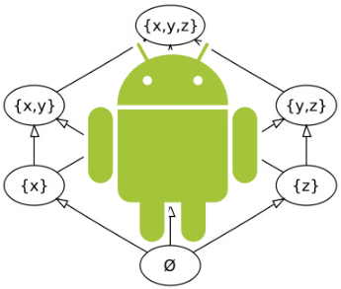
Preliminary Experimental Work
A few systems using these ideas:
CheckLT – Lattice-based taint checking for Java
http://checklt.github.io
FS4A – Flowspecs for Android (an extension to OpenJML)
Full implementation of the Bipartite Graph Model
Incorporates Conditional Release aspects

Slide 29
Conclusions
User-defined lattice to describe security levels
Fixed set of channels (centralized)
Mapping from channels to levels allows customization

