Slide 1
Program Logic for Concurrency Refinement Verification
Xinyu Feng
University of Science and Technology of China
Joint work with Hongjin Liang (USTC) and Zhong Shao (Yale)

Slide 2
Refinement
C ∝ C' iff
ObsBeh(C ) ⊆ ObsBeh(C' )
Set of observable behaviors (e.g., I/O event traces)
C：Impl
C'：Spec
Notes:
Also call I low-level code and S high-level code

Slide 3
Refinement Verification – Applications
Correctness of objects/abstract data types
Linearizability for concurrent objects
Correctness of program transformations
Compilers, program optimization, parallelization
Runtime systems and OS kernels
garbage collectors, STM algorithms, interrupt handlers

Slide 4
Example – TASLock vs. TTASLock
[Herlihy and Shavit 2008]
TTASLock
TASLock
lock() {
local b, b';
b := true;
while (b) {
b' := l;
while (b') {
b' := l;
}
b := getAndSet(&l, true);
}
}
Much cheaper read
LOCK() {
local B;
B := getAndSet(&L, true);
while (B) {
B := getAndSet(&L, true);
}
}
lock is acquired
How to prove TTASLock refines TASLock ?

Slide 5
Example – Concurrent Counter
Fine-grained impl.
Atomic spec.
inc(){
local done, tmp;
done = false;
while (!done) {
tmp = cnt;
done = cas(cnt, tmp, tmp+1);
}
}
atomic block
INC(){
<CNT++>
}
Take a snapshot
Compare and swap
Will be our running example.
Notes:
CAS means compare and swap

Slide 6
Can we have a Hoare-style program logic to verify refinement of concurrent programs?
Our work:
Rely-Guarantee-based program logic for refinement verification
Also supports reasoning about progress properties
Lock-freedom & wait-freedom
Good locality
Ongoing:
Reasoning about deadlock-freedom & starvation-freedom?

Slide 7
Development of the program logic
Step 1: partial correctness logic for refinement
Step 2: termination-preserving refinement

Slide 8
Program Logic – 1st attempt
Relational Hoare Logic / Separation Logic
[Benton’04, Yang’07]
{p} C1 , C2 {q}
Relational assertion
[p] = {(σ, Σ) | … }
Starting from related states satisfying p, the final states satisfy q (if both C1 and C2 terminate).

Slide 9
Program Logic – 1st attempt
Relational Hoare Logic / Separation Logic
[Benton’04, Yang’07]
{p} C1 , C2 {q}
{cnt=CNT} Inc_S() , INC() {cnt = CNT}
Inc_S(){
local tmp;
tmp = cnt;
tmp ++;
cnt = tmp;
}
INC(){
<CNT++>
}

Slide 10
Program Logic – 1st attempt
Relational Hoare Logic / Separation Logic
[Benton’04, Yang’07]
{p} C1 , C2 {q}
{cnt=CNT} Inc_S() , INC() {cnt = CNT}

However, not work for concurrency:
{cnt=CNT} Inc_S() ǁ Inc_S() , INC() ǁ INC() {cnt = CNT}

Slide 11
Rely-Guarantee-Based Logic – 2nd Attempt

Slide 12
One Slide Overview of Rely/Guarantee
[Jones'83]
r: acceptable environment transitions
g: state transitions made by the thread
[r] = {(σ, σ’) | … }
Thread1
Thread2
x = x’
y = y’
r1:
σ
σ’
r2:
σ
σ’
Nobody else would update y
Nobody else would update x
σ
y = y’
σ’
σ
x = x’
σ’
g1:
g2:
I guarantee I would not touch x
I guarantee I would not touch y
Compatibility (Interference Constraints):
g2 ⇒ r1 and g1 ⇒ r2
Notes:
12

Slide 13
Rely-Guarantee-Based Logic – 2nd Attempt
Relational rely/guarantee reasoning
R, G
{p} C1 , C2 {q}
Lift R/G to a binary setting
Traditional unary logic:
[Jones'83]
Σ
Σ’
C2:
[r] = {(σ, σ’) | … }
Binary setting:
Related state pair
C1:
σ
σ’
[R] = {( (σ, Σ) , (σ’, Σ’) ) | … }

Slide 14
Rely-Guarantee-Based Relational Logic – 2nd Attempt
Relational rely/guarantee reasoning
R, G
{p} C1 , C2 {q}
Example:
C2:
Σ
Σ’
((σ, Σ), (σ’, Σ’))
pq
iff
(σ, Σ)
p
and
(σ’, Σ’)
q
C1:
σ
σ’
p
(x = X = N  x’ = X’ = N’) ∧ N ≤ N’
q

Slide 15
Compositional Rules
Just like standard unary Rely/Guarantee rules, e.g.,
R∨G2, G1
{p1} C1 , C1’ {q1}
R∨G1, G2
{p2} C2 , C2’ {q2}
R, G1∨G2
{p1∧p2} C1ǁC2 , C1’ǁC2’ {q1∧q2}
R, G
{p} C1 , C1’ {r}
R, G
{r} C2 , C2’ {q}
R, G
{p} C1; C2 , C1’; C2’ {q}

Slide 16
Problem
To prove:
R, G
{p} C1;C2;C3 , C1’;C2’ {q}
Should we do:
R, G
{p} C1 , C1’ {r}
R, G
{r} C2;C3 , C2’ {q}
or:
R, G
{p} C1;C2 , C1’ {r}
R, G
{r} C3 , C2’ {q}
Sometimes cannot be statically determined.
Notes:
A disjunction rule may not work because pre- and post-conditions need to be stable.

Slide 17
Example
How to prove
R, G
{p} inc , INC {q}
?
1. inc(){
2. local done, tmp;
3. done = false;
4. while (!done) {
5. tmp = cnt;
6. done = cas(cnt, tmp, tmp+1);
7. }
}
INC(){
<CNT++>
}
Should line 6 refine skip or INC ?
Depends on the runtime value of done.

Slide 18
Example
How to prove
R, G
{p} inc , INC {q}
?
1. inc(){
2. local done, tmp;
3. done = false;
4. while (!done) {
5. tmp = cnt;
6. done = cas(cnt, tmp, tmp+1);
7. }
}
INC(){
<CNT++>
}
Cannot be handled in the binary form!
Should line 6 refine skip or INC ?
Depends on the runtime value of done.

Slide 19
Disjunction rule?
Not stable
{ cnt = CNT = tmp }
done = cas(cnt, tmp, tmp+1) , INC
{ cnt = CNT ∧done}
{ cnt =CNT ≠ tmp }
done = cas(cnt, tmp, tmp+1) , skip
{ cnt = CNT ∧ ¬done }

Slide 20
Combining Unary and Binary Rules – 3rd Attempt
Unary rules for conditional refinement
R, G
{P} C {Q}
R/G: same as binary rules
[R] = {( (σ, Σ) , (σ’, Σ’) ) | … }
P: state assertion with auxiliary (ghost) state and code
[P] = {(σ, (Σ, C’) ) | … }
Low-level state
Hi-level state
Notes:
Explain what low-level and high-level mean.

Slide 21
Combining Unary and Binary Rules – 3rd Attempt
Unary rules for conditional refinement
R, G
{P} C {Q}
R/G: same as binary rules
[R] = {( (σ, Σ) , (σ’, Σ’) ) | … }
Hi-level code (to be refined)
P: state assertion with auxiliary (ghost) state and code
[P] = {(σ, (Σ, C’) ) | … }
Low-level state
Hi-level state
Notes:
Explain what low-level and high-level mean.

Slide 22
Unary judgments – example
R, G
{P} C {Q}
P: { x = X ∧ rem(X++) }
C: x++;
Q: { x = X ∧ rem(skip) }
R, G: x = X  x = X

Slide 23
Unary judgments – example (2)
1. inc(){
2. local done, tmp;
3. done = false;
4. while (!done) {
5. tmp = cnt;
6. done = cas(cnt, tmp, tmp+1);
7. }
}
INC(){
<CNT++>
}
{ cnt = CNT ∧ rem(INC) }
done = cas(cnt, tmp, tmp+1);
{ cnt = CNT ∧ (¬done ∧rem(INC)) ∨ (done ∧rem(skip)) }
R, G:
cnt=CNT  cnt = CNT

Slide 24
Combining Unary and Binary Rules
The whole logic consists of both binary and unary rules
binary rules for compositionality.
unary rules for refinement of basic program units
Converting unary judgments to binary ones:
R, G
{p ∧ rem(C’)} C {q ∧ rem(skip)}
(U2B)
R, G
{p} C , C’ {q}

Slide 25
A new consequence rule
P  P’
R, G
{P’} C {Q’}
Q’  Q
R, G
{P} C {Q}
P  P’ iff
Make 0 or multiple steps
∀(σ, (Σ, C))
P .
∃(Σ’, C’). (C, Σ)*(C’, Σ’) ∧
(σ, (Σ’, C’))
P’
Ex: X = N ∧ rem(X++; X++)
 X=N+2 ∧ rem(skip)

Slide 26
A new consequence rule
P  P’
R, G
{P’} C {Q’}
Q’  Q
R, G
{P} C {Q}
P  P’ iff
∀(σ, (Σ, C))
P .
∃(Σ’, C’). (C, Σ)*(C’, Σ’) ∧
(σ, (Σ’, C’))
P’
This rule allows the high-level code to make moves (and we change rem(C) accordingly).

Slide 27
Soundness
C’
C
…
…
R, G
{p} C , C’ {q}
ensures that C is (weakly) simulated by C’ ,
[Liang et al. POPL’12]
which ensures C is a refinement of C’ .
However, this refinement allows:
while(true) do skip ∝ C
for any C .
Just like partial correctness in Hoare logic.

Slide 28
Development of the program logic
Step 1: partial correctness logic for refinement
Step 2: termination-preserving refinement

Slide 29
Problem
C’
C
…
…
R, G
{p} C , C’ {q}
n step
allows n steps of C to correspond to 0 step of C’ ,
and n could be ∞ (infinite) !
Therefore we could prove
while(true) do skip ∝ C
for any C .

Slide 30
Problem
C’
C
…
…
R, G
{p} C , C’ {q}
n step
allows n steps of C to correspond to 0 step of C’ ,
and n could be ω (infinite) !
Idea:
We must find some well-founded metric that decreases for each C step that corresponds to 0 step of C’.

Slide 31
Assigning tokens for loops
inc(){
local done, tmp;
done = false;
while (!done) {
…
}
}
INC(){
<CNT = CNT + 1>
}
Cannot loop forever while correspond to zero step of high-level code.
(1) Each round of loop consumes 1 token.
(2) The loop must refine at least one step of high-level code before it consumes all tokens or it ends.
(3) The num. of tokens could be reset when one high-level step is refined.

Slide 32
While rule
P ⇒ P’ * wf(1)
R, G
{P’} C {P}
R, G
{P} while B do C {P}
Number of tokens
{ wf( i ) }
while (i > 0){
{ wf (i -1) }
i -- ;
{ wf ( i ) }
}
wf(i + j) ⇔ wf(i) * wf(j)
Consumes 1 token

Slide 33
How is progress affected by environment?
Cannot be affected
Wait-freedom
E.g., contains() method in concurrent Set
Can be affected
But when the thread executes in isolation, it’ll terminate
Obstruction-freedom
Can be affected only if the env. refines a high-level step (thus the system as a whole progresses)
Lock-freedom
[Herlihy & Shavit 2008]

Slide 34
Lock-freedom – Example
Idea: if we know the environment progresses, we could reset the token.
1. inc(){
2. local done, tmp;
done = false;
{ wf(1) * ((done ∧ rem(skip))∨ (¬done ∧ rem(INC)))}
4. while (!done) {
{wf(0) * … }
5. tmp = cnt;
{tmp=cnt * wf(0) ∨ tmp ≠ cnt * wf(1) …}
6. done = cas(cnt, tmp, tmp+1);
7. }
}
Environment may update cnt, which may delay termination of the current thrd
However, the failure of one thread must be caused by the success of another. So the system as a whole progresses.

Slide 35
Lock-freedom – Example
1. inc(){
2. local done, tmp;
done = false;
{ wf(1) * ((done ∧ rem(skip))∨ (¬done ∧ rem(INC)))}
4. while (!done) {
{wf(0) * … }
5. tmp = cnt;
{tmp=cnt * wf(0) ∨ tmp ≠ cnt * wf(1) …}
6. done = cas(cnt, tmp, tmp+1);
7. }
}

Slide 36
Lock-freedom – Example
1. inc(){
2. local done, tmp;
done = false;
{ wf(1) * ( (done ∧ rem(skip))∨ (¬done ∧ rem(INC)) )}
4. while (!done) {
{wf(0) * … }
5. tmp = cnt;
{tmp=cnt * wf(0) ∨ tmp ≠ cnt * wf(1) …}
6. done = cas(cnt, tmp, tmp+1);
7. }
}
Loop invariant

Slide 37
Lock-freedom – Example
1. inc(){
2. local done, tmp;
done = false;
{ wf(1) * ( (done ∧ rem(skip))∨ (¬done ∧ rem(INC)) )}
4. while (!done) {
{wf(0) * rem(INC) … }
5. tmp = cnt;
{tmp=cnt * wf(0) ∨ tmp ≠ cnt * wf(1) …}
6. done = cas(cnt, tmp, tmp+1);
7. }
}
Loop consumes one token

Slide 38
Lock-freedom – Example
Idea: if we know the environment progresses, we could reset the token.
1. inc(){
2. local done, tmp;
done = false;
{ wf(1) * ( (done ∧ rem(skip))∨ (¬done ∧ rem(INC)) )}
4. while (!done) {
{wf(0) * rem(INC) … }
5. tmp = cnt;
{(tmp=cnt * wf(0) ∨ tmp ≠ cnt * wf(1) ) * rem(INC) …}
6. done = cas(cnt, tmp, tmp+1);
7. }
}
Env. progresses. Reset the token.

Slide 39
Lock-freedom – Example
1. inc(){
2. local done, tmp;
done = false;
{ wf(1) * ( (done ∧ rem(skip))∨ (¬done ∧ rem(INC)) )}
4. while (!done) {
{wf(0) * rem(INC) … }
5. tmp = cnt;
{(tmp=cnt * wf(0) ∨ tmp ≠ cnt * wf(1) ) * rem(INC) …}
done = cas(cnt, tmp, tmp+1);
{(wf(1) * (done∧rem(skip)) ∨ (wf(1) * (¬done∧rem(INC)) )}
7. }
}
CAS succeeds. Reset tokens.
CAS fails. Follows 2nd branch of precondition

Slide 40
Lock-freedom – Example
1. inc(){
2. local done, tmp;
done = false;
{ wf(1) * ( (done ∧ rem(skip))∨ (¬done ∧ rem(INC)) )}
4. while (!done) {
{wf(0) * rem(INC) … }
5. tmp = cnt;
{(tmp=cnt * wf(0) ∨ tmp ≠ cnt * wf(1) ) * rem(INC) …}
done = cas(cnt, tmp, tmp+1);
{(wf(1) * (done∧rem(skip)) ∨ (wf(1) * (¬done∧rem(INC)) )}
7. }
}

Slide 41
The termination-preserving program logic
Judgments are the same:
binary:
R, G
{p} C , C’ {q}
unary:
R, G
{P} C {Q}
New formulation of R/G:
[R] = {((σ, Σ) , (σ’, Σ’), b) | … }
Takes an extra Boolean tag b, to record whether this step corresponds to a high-level move.
Notes:
Could skip

Slide 42
The termination-preserving program logic
Judgments are the same:
binary:
R, G
{p} C , C’ {q}
unary:
R, G
{P} C {Q}
New formulation of R/G:
[R] = {((σ, Σ) , (σ’, Σ’), b) | … }
Explicit number of tokens in assertions
and P/Q:
[P] = {(σ, (Σ, C’), w ) | … }
Notes:
Could skip

Slide 43
The termination-preserving program logic (2)
P ⇒ P’ * wf(1)
R, G
{P’} C {P}
(while)
R, G
{P} while B do C {P}
P  P’
R, G
{P’} C {Q’}
Q’  Q
(conseq)
R, G
{P} C {Q}
P  P’ iff
∀(σ, (Σ, C), w)
P .
If n>0, no constraints for w’
∃n, (Σ’, C’), w’ . (C, Σ)^{n}(C’, Σ’) ∧
(σ, (Σ’, C’), w’)
P’
∧ ( n=0 ⇒ w’ ≤ w)

Slide 44
The termination-preserving program logic (3)
Stability in traditional rely/guarantee reasoning:
Sta(p, R) iff
if σ
p
and (σ, σ’)
R ,
then σ’
p

Slide 45
The termination-preserving program logic (3)
Stability w.r.t. rely conditions
Sta(P, R) iff
∀(σ, (Σ, C), w)
P ,
∧ ((σ, (Σ, C)), (σ’, (Σ’, C’)), b)
R .
∃w’ .
(σ’, (Σ’, C’), w’)
P
∧ ( b=false ⇒ w’ ≤ w)
If b=true, no constraints for w’

Slide 46
Infinite non-determinism
Arbitrary update of y
x = 0;
while (y > 0){
y--
}
R: x ≠ 0 ∧ y’ = N ∨ x = 0 ∧ y = y’
What would be the pre-condition if we have to specify the number of tokens?
R, G
{P} C {Q}
R, G
{|P|_{w}} C {|Q|_{w}}

Slide 47
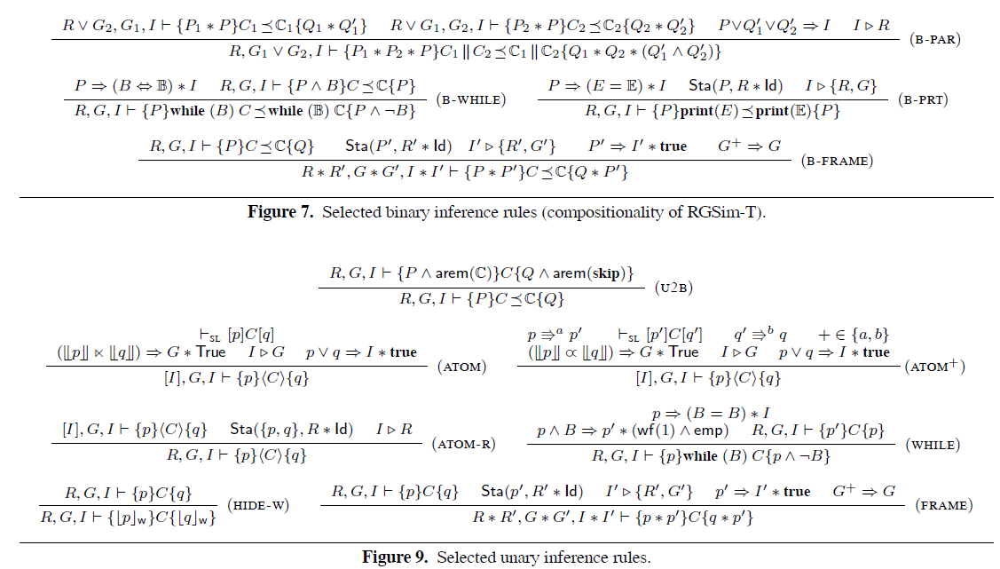

Slide 48
More on termination-preservation
NOT a total correctness logic!
Ensures low-level preserves termination of high-level
Not ensure termination of low-level/high-level code
Example:
local tmp;
while (true) {
tmp = cnt;
cas(cnt, tmp, tmp+1);
}
while (true) {
<CNT++>;
}
∝

Slide 49
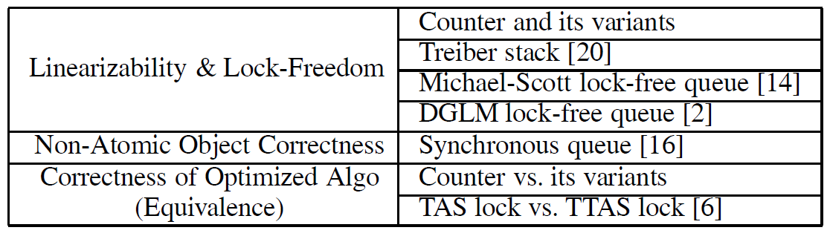
Applications of the logic

Slide 50
Summary
Relational logic for termination-preserving refinement
Rely/Guarantee based
Combination of binary and unary rules
Introduce “rem(C)”, expressive for conditional correspondence
Use tokens for termination-preservation
Supports lock-freedom
Can be easily adapted for wait-freedom
Read our CSL-LICS 2014 paper!
Ongoing
Deadlock-freedom and starvation-freedom
Similar to lock-freedom and wait-freedom
Assumes fairness – How to encode the assumption in logic?

Slide 51
Thank you!

