Slide 1
Model Counting
A Quest for Nails 2
Willem Visser
Stellenbosch University
Joint work with
Matt Dwyer (UNL, USA)
Jaco Geldenhuys (SU, RSA)
Corina Pasareanu (NASA, USA)
Antonio Filieri (Stuttgart, Germany)

Slide 2
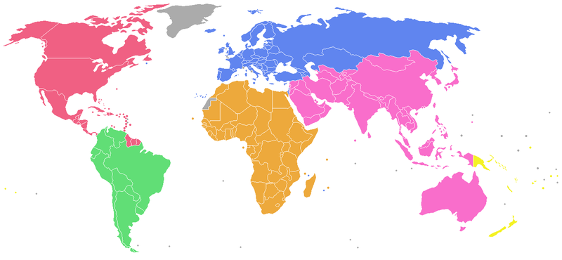
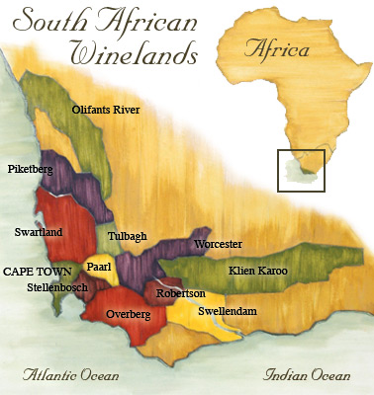

Stellenbosch?

Slide 3
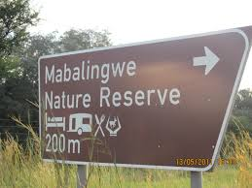
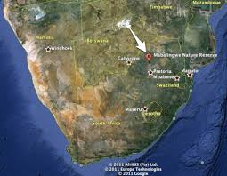
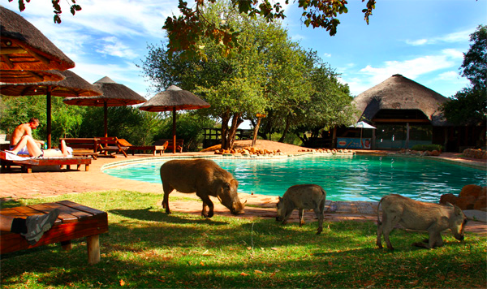

Slide 4
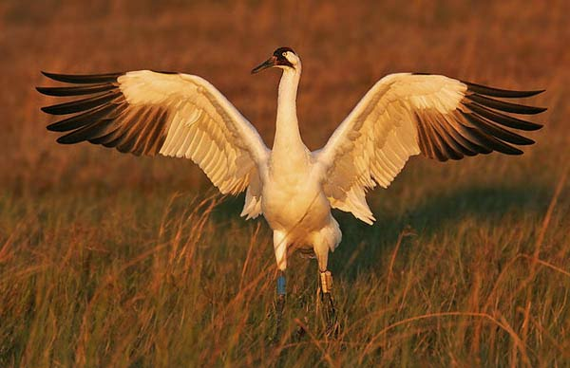
Saving the Whooping Crane

Slide 5
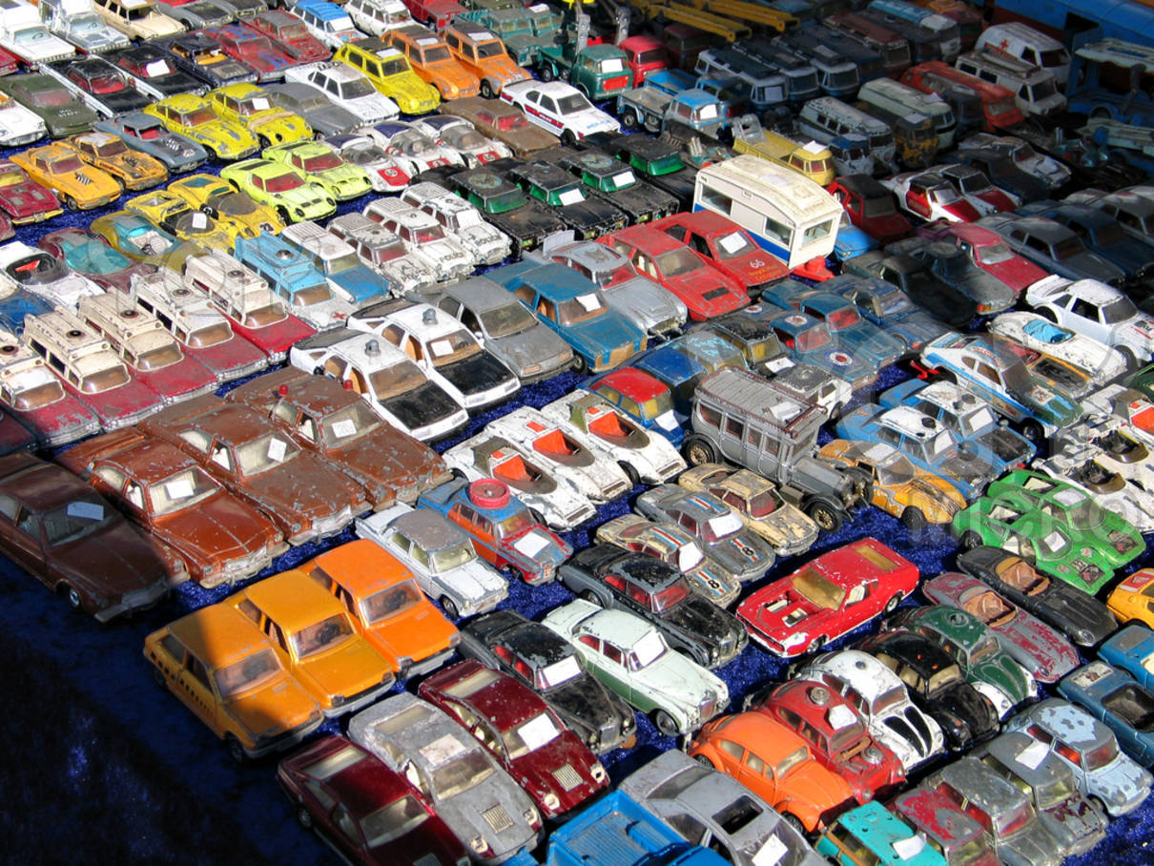
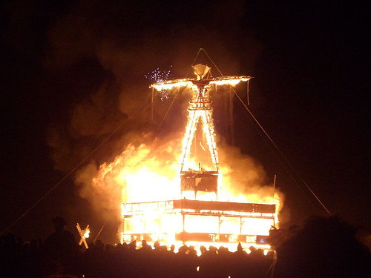
PC = C₁ & C₂ & … & C_{n}
PC solutions
PC feasibility
>0

Slide 6
Resources
ISSTA 2012
  Probabilistic Symbolic Execution
FSE 2012
  Green: Reduce, Reuse and Recycle Constraints…
ICSE 2013
  Software Reliability with Symbolic PathFinder
PLDI 2014
  Compositional Solution Space Quantification for Probabilistic Software Analysis
FSE 2014
  Statistical Symbolic Execution with Informed Sampling
ASE 2014 Submitted
  Exact and Approximate Probabilistic Symbolic Execution for Nondeterministic Programs
Implemented in Symbolic PathFinder
  Using LattE

Slide 7

In a perfect world…
only linear integer constraints
and only uniform distributions

Slide 8
Symbolic Execution
void test(int x, int y) {
if (y == x*10)
S0;
else
S1;
if (x > 3 && y > 10)
S2;
else
S3;
}
[ true ] test (X,Y)
[ Y=X*10 ] S0
[ Y!=X*10 ] S1
[ X>3 & 10<Y=X*10] S2
[ X>3 & 10<Y!=X*10] S2
[ Y=X*10 & !(X>3 & Y>10) ] S3
[ Y!=X*10 & !(X>3 & Y>10) ] S3
Test(1,10) reaches S0,S3
Test(0,1) reaches S1,S3
Test(4,11) reaches S1,S2

Slide 9


Slide 10
Paths
void test(int x, int y) {
if (y == x*10)
S0;
else
S1;
if (x > 3 && y > 10)
S2;
else
S3;
}
[ true ] test (X,Y)
[ Y=X*10 ] S0
[ Y!=X*10 ] S1
[ X>3 & 10<Y=X*10] S2
[ X>3 & 10<Y!=X*10] S2
[ Y=X*10 & !(X>3 & Y>10) ] S3
[ Y!=X*10 & !(X>3 & Y>10) ] S3

Slide 11
Paths and Rivers
void test(int x, int y) {
if (y == x*10)
S0;
else
S1;
if (x > 3 && y > 10)
S2;
else
S3;
}
[ true ]
[ Y=X*10 ]
[ Y!=X*10 ]
[ X>3 & 10<Y=X*10]
[ Y=X*10 & !(X>3 & Y>10) ]
[ Y!=X*10 & !(X>3 & Y>10) ]
[ X>3 & 10<Y!=X*10]

Slide 12
Almost Rivers
void test(int x, int y: 0..99) {
if (y == x*10)
S0;
else
S1;
if (x > 3 && y > 10)
S2;
else
S3;
}
[ true ]
y=10x
[ Y=X*10 ]
[ Y!=X*10 ]
x>3 & y>10
x>3 & y>10
Which of 1, 2, 3 or 4 is the most likely?
1
2
3
4
[ X>3 & 10<Y=X*10]
[ Y=X*10 & !(X>3 & Y>10) ]
[ X>3 & 10<Y!=X*10]
[ Y!=X*10 & !(X>3 & Y>10) ]

Slide 13
Rivers
void test(int x, int y: 0..99) {
if (y == x*10)
S0;
else
S1;
if (x > 3 && y > 10)
S2;
else
S3;
}
[ true ]
y=10x
[ Y=X*10 ]
[ Y!=X*10 ]
x>3 & y>10
x>3 & y>10
[ X>3 & 10<Y=X*10]
[ Y=X*10 & !(X>3 & Y>10) ]
[ X>3 & 10<Y!=X*10]
[ Y!=X*10 & !(X>3 & Y>10) ]

Slide 14
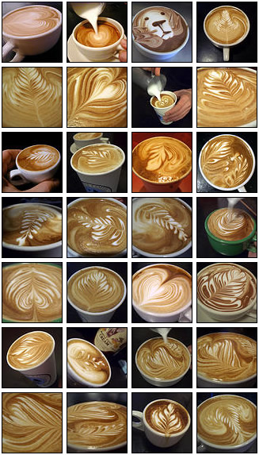
LattE Model Counter
http://www.math.ucdavis.edu/~latte/
Count solutions for
conjunction
of Linear Inequalities

Slide 15
Rivers of Values
void test(int x, int y: 0..99) {
if (y == x*10)
S0;
else
S1;
if (x > 3 && y > 10)
S2;
else
S3;
}
10⁴
[ true ]
y=10x
[ Y=X*10 ]
[ Y!=X*10 ]
10
9990
x>3 & y>10
x>3 & y>10
8538
1452
6
4
[ X>3 & 10<Y=X*10]
[ Y=X*10 & !(X>3 & Y>10) ]
[ X>3 & 10<Y!=X*10]
[ Y!=X*10 & !(X>3 & Y>10) ]

Slide 16

10⁴
[ true ]
y=10x
[ Y!=X*10 ]
Program Understanding
9990
10
[ Y=X*10 ]
x>3 & y>10
x>3 & y>10
8538
1452
6
4
[ X>3 & 10<Y=X*10]
[ Y=X*10 & !(X>3 & Y>10) ]
[ X>3 & 10<Y!=X*10]
[ Y!=X*10 & !(X>3 & Y>10) ]

Slide 17
A Path Condition defines
the constraints on the inputs
to execute a path
How likely is a PC
to be satisfied?
# solutions to the PC
Domain Size
Assuming uniform distribution of values

Slide 18
Conditional and Path Probabilities
P_{c} = Prob (c | PC)
PC
Prob (c & PC)
=
Prob (PC)
P
Prob (c & PC)
!c
c
=
P
1-P_{c}
P_{c}
P’’ = (1-P_{c}) x P
P’ = P_{c} x P

Slide 19

1
y=10x
0.001
0.999
Probabilities
x>3 & y>10
x>3 & y>10
0.855
0.145
0.6
0.4
0.0004
0.8538
0.1452
0.0006
[ X>3 & 10<Y=X*10]
[ Y=X*10 & !(X>3 & Y>10) ]
[ X>3 & 10<Y!=X*10]
[ Y!=X*10 & !(X>3 & Y>10) ]

Slide 20

1
y=10x
Reliability
0.001
0.999
x>3 & y>10
x>3 & y>10
0.9996 Reliable
0.855
0.145
0.6
0.4
0.0004
0.8538
0.1452
0.0006
[ X>3 & 10<Y=X*10]
[ Y=X*10 & !(X>3 & Y>10) ]
[ X>3 & 10<Y!=X*10]
[ Y!=X*10 & !(X>3 & Y>10) ]

Slide 21
Reliability with Symbolic Execution
void test(int x,y: 0..99) {
boolean error = false;
if (x > 0) {
if (y == hash(x))
error = true;
else
…
if (x > 3 && y > 10)
…
else
assert !error;
}
}
What is the reliability?
Uniform Distribution: 0.9908
int hash(x) {
if (0<=x<=10) return x*10;
else return 0;
}

Slide 22
Usage Profiles
domain{
x : 0,99;
y : 0,99;
};
usageProfile{
x > y : 1/10;
x <= y : 9/10;
};
Constraints must be disjoint
and
cover the complete domain
Probabilities must add to 1

Slide 23
Reliability with Symbolic Execution
void test(int x,y) {
boolean error = false;
if (x > 0) {
if (y == hash(x))
error = true;
else
…
if (x > 3 && y > 10)
…
else
assert !error;
}
}
Profile | Reliability
Uniform | 0.99080
x > y : 0.1 | 0.99766
y > x : 0.1 | 0.98407
x > 10 & y > 10: 0.99 | 0.99995
x > 10 & y > 10: 1 | 1.00000
int hash(x) {
if (0<=x<=10) return x*10;
else return 0;
}

Slide 24
UP
c₁ : p₁
c₂ : p₂
…
c_{n} : p_{n}
Calculate Probabilities
AFTER
Symbolic Execution
PC
c₁
c_{n}
c₂
…
Prob(PC | UP) = Σ_{i=1,n} Prob(PC | c_{i}) x p_{i}
Prob (PC & c_{i})
Prob(PC | c_{i}) =
Prob (c_{i})

Slide 25
NON Looping Programs
Reliability(P) = Prob^{S}(P)
n Failure Paths
m Success Paths
Prob^{S}(P) = Σ_{i=1..m} Prob(PC_{m} | UP)

Slide 26
Looping Programs => Bounded Analysis
Reliability(P) >= Prob^{S}(P)
Confidence = 1 – Prob^{G}(P)
n Failure
Unknown
m Success
Prob^{S}(P) = Σ_{i=1..m} Prob(PC_{m} | UP)
Prob^{F}(P) = Σ_{i=1..n} Prob(PC_{n} | UP)
Prob^{G}(P) = 1 - (Prob^{S}(P) + Prob^{F}(P))

Slide 27
Time
for
a
new
example

Slide 28
void unlikely(int x, int y, int z : 1..1000) {
if (x <= 50) {
S0
}
else {
if (x == 500 && y == 500 && z == 500) {
assert false;
}
S1
}
}
10⁻⁹ probability

Slide 29
Statistical Symbolic Execution
Informed
Monte Carlo Sampling of Symbolic Paths
+
Confidence and Error Bounds
based on Bayesian Estimation
Confidence = 1, i.e. exact incremental analysis

Slide 30
Monte Carlo Sampling of Symbolic Paths
Step 1: Calculate Conditional Probability for a branch
P_{c} = Prob (c | PC)
PC
Prob (c & PC)
=
Prob (PC)
#PC
# (c & PC)
!c
c
=
#PC
1-P_{c}
P_{c}

Slide 31
Monte Carlo Sampling of Symbolic Paths
Step 2: Take random value and pick c or !c direction
rand = throwDice();
If (rand <= P_{c})
pick c; //then
else
pick !c; //else
PC
#PC
!c
c
1-P_{c}
P_{c}

Slide 32
void unlikely(int x, int y, int z : 1..1000) {
if (x <= 50) {
S0
}
else {
if (x == 500 && y == 500 && z == 500) {
assert false;
}
S1
}
}
10⁹
x<=50
[ X<=50 ]
[ X>50 ]
50*10⁶
950*10⁶
More likely to be picked

Slide 33
void unlikely(int x, int y, int z : 1..1000) {
if (x <= 50) {
S0
}
else {
if (x == 500 && y == 500 && z == 500) {
assert false;
}
S1
}
}
After 1 sample
Covered only S1
After 100 samples
Will likely also cover S0
10⁹
x<=50
[ X<=50 ]
After 10⁵ samples
Will likely hit x==500
but Eagles will have to reunite
before hitting the violation
[ X>50 ]
50*10⁶
950*10⁶
More likely to be picked
x==500
[ X<=50 ]
[ X=500 ]
949*10⁶
10⁶
y==500
[ X>50 & X!=500 ]

Slide 34
void unlikely(int x, int y, int z : 1..1000) {
if (x <= 50) {
S0
}
else {
if (x == 500 && y == 500 && z == 500) {
assert false;
}
S1
}
}
Informed Sampling
[Draining the river]
10⁹
x<=50
[ X<=50 ]
[ X>50 ]
After every path
sampled remove
the path cleverly
50*10⁶
950*10⁶
x==500
[ X=500 ]
949*10⁶
10⁶
[ X>50 & X!=500 ]

Slide 35
void unlikely(int x, int y, int z : 1..1000) {
if (x <= 50) {
S0
}
else {
if (x == 500 && y == 500 && z == 500) {
assert false;
}
S1
}
}
Informed Sample 2
51*10⁶
x<=50
[ X<=50 ]
[ X>50 ]
50*10⁶
10⁶
x==500
[ X=500 ]
0
10⁶
[ X>50 & X!=500 ]

Slide 36
void unlikely(int x, int y, int z : 1..1000) {
if (x <= 50) {
S0
}
else {
if (x == 500 && y == 500 && z == 500) {
assert false;
}
S1
}
}
Informed Sample 3
10⁶
x<=50
[ X<=50 ]
[ X>50 ]
0
10⁶
x==500
[ X<=50 ]
[ X=500 ]
0
10⁶
y==500
[ X>50 & X!=500 ]

Slide 37
void unlikely(int x, int y, int z : 1..1000) {
if (x <= 50) {
S0
}
else {
if (x == 500 && y == 500 && z == 500) {
assert false;
}
S1
}
}
Informed Sample 4
10⁶
x<=50
10⁶
[ X>50 ]
x==500
10⁶
[ X==500 ]
y==500
999*10³
1*10³
[ X,Y==500 ]
[ X==500 & Y!=500 ]

Slide 38
void unlikely(int x, int y, int z : 1..1000) {
if (x <= 50) {
S0
}
else {
if (x == 500 && y == 500 && z == 500) {
assert false;
}
S1
}
}
Informed Sample 5
10³
x<=50
10³
[ X>50 ]
x==500
10³
[ X==500 ]
y==500
0
[ X,Y==500 ]
10³
[ X==500 & Y!=500 ]
z==500
1
999
[ X,Y==500 & Z!=500 ]

Slide 39
void unlikely(int x, int y, int z : 1..1000) {
if (x <= 50) {
S0
}
else {
if (x == 500 && y == 500 && z == 500) {
assert false;
}
S1
}
}
1
x<=50
1
[ X>50 ]
After 6 Informed Samples
we hit the 10⁻⁹ event
Confindence = 1, since we
explored the complete space
x==500
1
[ X==500 ]
y==500
[ X,Y==500 ]
1
z==500
1
0
[ X,Y,Z==500 ]
[ X,Y==500 & Z!=500 ]

Slide 40
Cool Feature of Informed Sampling
First samples the most likely paths
Then the slightly less likely paths
Then the even less likely paths
Until you get to the very unlikely paths

Slide 41
Multithreaded Informed Sampling
=>
Symbolic Execution
10⁴
y=10x
Only shared structure
PC => count
Run n threads, each
doing informed sampling
to reach a leave
10
9990
y=10x & x>3 & y>10
y!=10x & x>3 & y>10
When you update,
first check if any
value will become <= 0,
if so, terminate and
pick a new path from the top
8538
6
4
1452
[ X>3 & 10<Y=X*10]
[ Y=X*10 & !(X>3 & Y>10) ]
[ X>3 & 10<Y!=X*10]
[ Y!=X*10 & !(X>3 & Y>10) ]

Slide 42
Multithreaded Informed Sampling
=>
Symbolic Execution
10⁴
y=10x
10
9990
y=10x & x>3 & y>10
y!=10x & x>3 & y>10
8538
6
4
1452
T₁
T₂
[ X>3 & 10<Y=X*10]
[ Y=X*10 & !(X>3 & Y>10) ]
[ X>3 & 10<Y!=X*10]
[ Y!=X*10 & !(X>3 & Y>10) ]

Slide 43
Multithreaded Informed Sampling
=>
Symbolic Execution
10⁴
T₁
T₂
y=10x
10
1452
T₂
y=10x & x>3 & y>10
y!=10x & x>3 & y>10
0
1452
6
4
T₂
T₂
[ X>3 & 10<Y=X*10]
[ Y=X*10 & !(X>3 & Y>10) ]
[ X>3 & 10<Y!=X*10]
[ Y!=X*10 & !(X>3 & Y>10) ]

Slide 44
Multithreaded Informed Sampling
=>
Symbolic Execution
10⁴
T₁
T₂
y=10x
10
0
y=10x & x>3 & y>10
y!=10x & x>3 & y>10
0
0
6
4
[ X>3 & 10<Y=X*10]
[ Y=X*10 & !(X>3 & Y>10) ]
[ X>3 & 10<Y!=X*10]
[ Y!=X*10 & !(X>3 & Y>10) ]

Slide 45
Multithreaded Informed Sampling
=>
Symbolic Execution
10⁴
y=10x
10
0
y=10x & x>3 & y>10
y!=10x & x>3 & y>10
0
0
6
4
T₁
T₂
[ X>3 & 10<Y=X*10]
[ Y=X*10 & !(X>3 & Y>10) ]
[ X>3 & 10<Y!=X*10]
[ Y!=X*10 & !(X>3 & Y>10) ]

Slide 46
Multithreaded Informed Sampling
=>
Symbolic Execution
10⁴
T₁
T₂
y=10x
0
0
y=10x & x>3 & y>10
y!=10x & x>3 & y>10
0
0
0
0
[ X>3 & 10<Y=X*10]
[ Y=X*10 & !(X>3 & Y>10) ]
[ X>3 & 10<Y!=X*10]
[ Y!=X*10 & !(X>3 & Y>10) ]

Slide 47
Informed Sampling
as a search heuristic
for
Concolic execution
when negating constraints
pick the path with the most
values flowing down it next

Slide 48

Green: Reduce, Reuse and Recycle Constraints in Program Analysis
Willem Visser
Stellenbosch University
Joint work with Jaco Geldenhuys and Matt Dwyer

Slide 49
What is Symbolic Execution
Executing a program with symbolic inputs
Collect all constraints to execute a path through code, called Path Condition
  Stop when Path Condition becomes infeasible
Many uses
  Checking for errors, without running the code
  Solve feasible constraints to get inputs for test cases

Slide 50
Decision Procedures
Huge advances in the last 15 years
Many great tools
  Z3, Yices, CVC3, STP, …
Satisfiability is NP-complete
Worst case complexity is exponential in the size of the formula
Our goal is to make these tools even better, without changing a line of code inside them!

Slide 51
int m(int x,y) {
if (x < 0) x = -x;
if (y < 0) y = -y;
if (x < 10) {
return 1;
} else if (9 < y) {
return -1;
} else {
return 0;
}
}
[ X < 0 ]
X < 0
!(X < 0)
[ Y < 0 ]
[ Y < 0 ]
Y < 0
!(Y < 0)
[ X < 10 ]
[ X < 10 ]
-X < 10
!(-X < 10)
-X < 10
!(-X < 10)
[ 9 < Y ]
[ 9 < Y ]
9 < -Y
!(9 < -Y)
9 < Y
!(9 < Y)

Slide 52

[ X < 0 ]
X < 0
!(X < 0)
X < 0
[ Y < 0 ]
[ Y < 0 ]
Y < 0
!(Y < 0)
Y < 0
!(Y < 0)
Don’t need the complete constraint
to decide feasibility
X < 0 /\ Y < 0
[ X < 10 ]
[ X < 10 ]
[ X < 10 ]
[ X < 10 ]
-X < 10
!(-X < 10)
-X < 10
-X < 10
X < 10
!(X < 10)
X < 10
!(X < 10)
X < 0 /\ Y < 0 /\ !(-X < 10)
[ 9 < Y ]
[ 9 < Y ]
[ 9 < Y ]
[ 9 < Y ]
9 < -Y
!(9 < -Y)
9 < Y
9 < -Y
9 < -Y
!(9 < -Y)
9 < Y
!(9 < Y)
X < 0 /\ Y < 0 /\ !(-X < 10) /\ 9 < -Y

Slide 53


[ X < 0 ]
X < 0
!(X < 0)
Slicing constraints leads to the
same constraints in different places
X < 0
[ Y < 0 ]
[ Y < 0 ]
!(X < 0)
Y < 0
!(Y < 0)
Y < 0
!(Y < 0)
Y < 0
[ X < 10 ]
!(Y < 0)
[ X < 10 ]
Y < 0
[ X < 10 ]
!(Y < 0)
[ X < 10 ]
-X < 10
!(-X < 10)
-X<10
!(-X<10)
X < 10
!(X < 10)
X < 10
!(X < 10)
X < 0 /\ !(-X < 10)
[ 9 < Y ]
X < 0 /\ !(-X < 10)
[ 9 < Y ]
!(X < 0) /\ !(X < 10)
[ 9 < Y ]
!(X < 0) /\ !(X < 10)
[ 9 < Y ]
9 < -Y
!(9 < -Y)
9 < Y
9 < -Y
9 < -Y
!(9 < -Y)
9 < Y
!(9 < Y)
These two constraints are the same!
Y < 0 /\ 9 < -Y

Slide 54
Canonization of Constraints
X < 0 /\ !(-X < 10)
Y < 0 /\ 9 < -Y
X < 0 /\ -X >= 10
Y < 0 /\ Y < - 9
X < 0 /\ X <= -10
Y < 0 /\ Y + 9 < 0
X + 1 <= 0 /\ X + 10 <= 0
Y + 1 <= 0 /\ Y + 10 <= 0
V₀ + 1 <= 0 /\ V₀ + 10 <= 0
Canonical Form
ax + by + cz +…+ k {<=,=,!=} 0
Scale by -1 to transform > and >= to < and <=
Add 1 to transform < to <=

Slide 55
[ X < 0 ]
V₀+1 <= 0
[ Y < 0 ]
[ Y < 0 ]
-V₀ <= 0
V₀+1 <= 0
[ X < 10 ]
-V₀ <= 0
[ X < 10 ]
V₀+1 <= 0
[ X < 10 ]
-V₀ <= 0
[ X < 10 ]
V₀+1<=0 /\
-V₀ - 9 <=0
V₀+1<=0 /\
-V₀ - 9 <=0
-V₀<=0 /\
V₀-9 <=0
-V₀<=0 /\
V₀-9 <=0
V₀+1 <= 0 /\ V₀+10 <= 0
[ 9 < Y ]
V₀+1<=0 /\ V₀+10<=0
[ 9 < Y ]
-V₀<=0/\-V₀+10<=0
[ 9 < Y ]
-V₀<=0/\-V₀+10<=0
[ 9 < Y ]
V₀+1<=0
/\
V₀+10<=0
V₀+1<=0
/\
-V₀-9<=0
-V₀<=0
/\
-V₀+10<=0
-V₀<=0
/\
V₀-9<=0
V₀+1<=0
/\
V₀+10<=0
V₀+1<=0
/\
-V₀-9<=0
-V₀<=0
/\
-V₀+10<=0
-V₀<=0
/\
V₀-9<=0

Slide 56
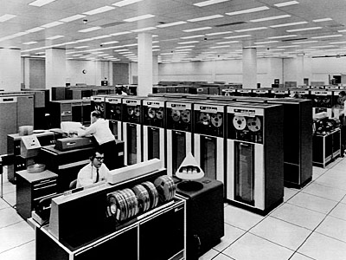
What if we store the results?
and reuse them to avoid recalculation

Slide 57
[ X < 0 ]
4
[ Y < 0 ]
1
V₀+1 <= 0
-V₀ <= 0
1
4
1
4
V₀+1 <= 0
V₀+1 <= 0
[ X < 10 ]
-V₀ <= 0
-V₀ <= 0
[ X < 10 ]
2
2
6
6
V₀+1<=0 /\
-V₀ - 9 <=0
V₀+1<=0 /\
-V₀ - 9 <=0
-V₀<=0 /\
V₀-9 <=0
-V₀<=0 /\
V₀-9 <=0
3
3
5
5
V₀+1 <= 0 /\ V₀+10 <= 0
V₀+1<=0 /\ V₀+10<=0
-V₀<=0/\-V₀+10<=0
[ 9 < Y ]
-V₀<=0/\-V₀+10<=0
[ 9 < Y ]
3
2
5
6
3
2
5
6
V₀+1<=0
/\
V₀+10<=0
V₀+1<=0
/\
-V₀-9<=0
-V₀<=0
/\
-V₀+10<=0
-V₀<=0
/\
V₀-9<=0
V₀+1<=0
/\
V₀+10<=0
V₀+1<=0
/\
-V₀-9<=0
-V₀<=0
/\
-V₀+10<=0
-V₀<=0
/\
V₀-9<=0

Slide 58
Let’s change the program!
int m(int x,y) {
if (x < 0) x = -x;
if (y < 0) y = -y;
if (x < 10) {
return 1;
} else if (9 < y) {
return -1;
} else {
return 0;
}
}
Only the last 8 constraints
are changed in the symbolic
execution tree and 4 of them
are reused.
Reusing the stored results
from the first analysis eliminates
14 decision procedure calls!
If (10 < y)

Slide 59
Green
Reduce
  Slicing + Canonization
Reuse
  Storing results
Recycle
  Across Analyses of Programs and even Tools

Slide 60
Known to be SAT
PC = knownPC /\ newPC
Slicing Algorithm
Build a constraint graph for knownPC /\ newPC
  Vertices are symbolic variables
  Edges between them if they are in the same constraint
Find all variables R reachable from variables in newPC
Return the conjunction of all the constraints
containing variables R
Classic Symbolic Execution
newPC is the last decision
on the path
knownPC is all the rest
Dynamic Symbolic Execution
newPC is the negated conjunct
knownPC are all the other
conjuncts

Slide 61
Factorizing Slicer
PC = C₁ & C₂ & … & C_{n}
Returns independent sub-constraints
PC = (C₁ & C₂) &
(C₃ & C₄ & C₅) &
(… & C_{n})

Slide 62
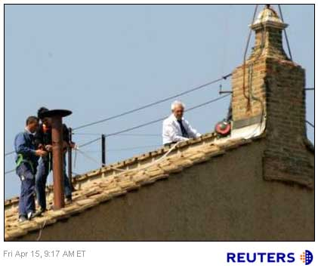
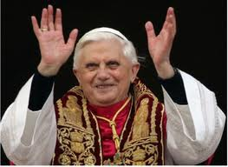
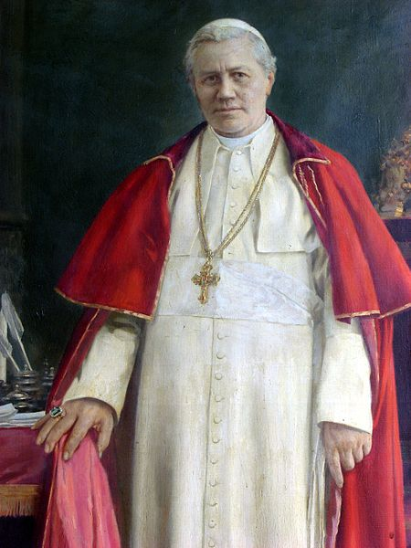
Three Parts to Canonization
Pre-Heuristic
lexicographic reordering
X > Y vs Y < X => X > Y
Normal Form
ax + by + cz +…+ k {<=,=,!=} 0
Post-Heuristic
1. lexicographic order of
constraints
2. Renaming based on order
in constraints

Slide 63

NoSQL
In-memory
key-value store
First hack took about 10 mins:
Download Redis, make, start
Find Java wrapper…Jedis
Add 5 lines of code
Viola!
Simply get(“PC”) and if not found put(“PC”,”T | F”)

Slide 64

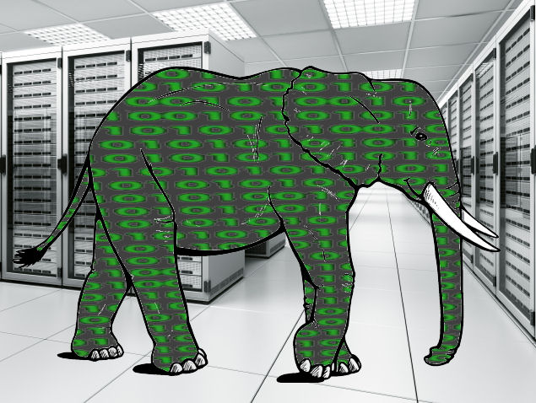
Storage is layered
Localhost
Colleague
What you don’t find locally,
look for in other stores
Results are pushed back
New local results are
pushed out
Offshore Store

Slide 65
Current State
Green
  Services
  Slicing, Canonizer, … [Filters]
  (Redis) Store
  Z3, CVC3, etc. [Solvers]
  LattE [Model Counters]

Slide 66
Results
Why Slice and Canonize?
 | -store |  | +store
 | -canon | +canon | -canon | +canon
-slice | 95506 | 94739 | 96448 | 50467
+slice | 27129 | 27369 | 20410 | 5603
Binomial Heap with all add/remove sequences of length 5
time in milliseconds

Slide 67
Reuse between programs
BinomialHeap
Only 3.1% reused
155
0
1
4
38
133
154
80.6% reused
54.5% reused
TreeMap
BinaryTree

Slide 68
Future Work
Extending Model Counting to other types
  Reference Types, Strings, Floats, etc.
Green
  Are the number of actually occurring constraints in code “finite”?
  How far can one push the Big Data idea?
  Main goal now is to get as many people as possible to use Green
Ultimate Goal: Real-time developer feedback

Slide 69
The Green Framework
http://green-solver.googlecode.com
Already integrated into
Symbolic PathFinder

