Slide 1
Extreme predicates beyond continuity
K. Rustan M. Leino
Principal Researcher Research in Software Engineering (RiSE), Microsoft Research, Redmond
Visiting Professor Department of Computing, Imperial College London
IFIP WG 2.3 meeting 57, Pasadena, CA, 11 January 2016

Slide 2
Motivation
Reasoning about predicates defined as least/greatest fixpoints
Language features that make definitions and proof look natural
Translation to automated decisions procedure
What I want:
Syntactic detection of continuity
Features that encapsulate “the workaround”

Slide 3

Even
$\frac{x = 0}{P(x)}$ $\frac{P(x−2)}{P(x)}$
{ x | 0 ≤ x ∧ x even }
where x ranges over integers

Slide 4
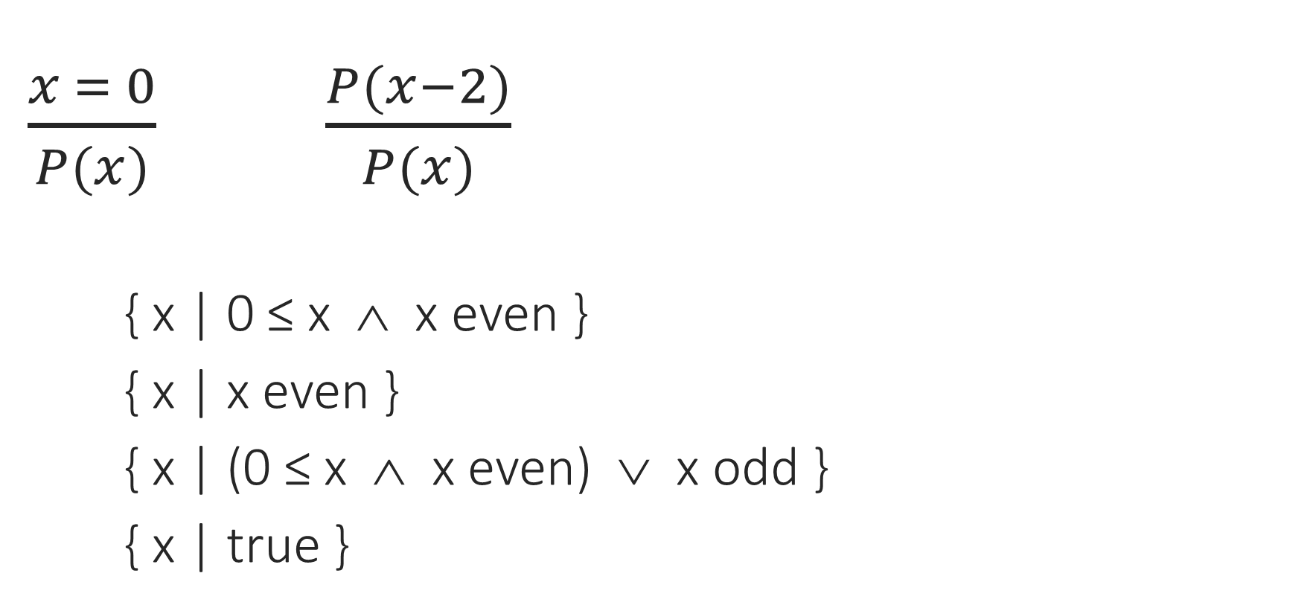
Multiple solutions
$\frac{x = 0}{P(x)}$ $\frac{P(x−2)}{P(x)}$
{ x | 0 ≤ x ∧ x even }
{ x | x even }
{ x | (0 ≤ x ∧ x even) ∨ x odd }
{ x | true }
Extreme solutions
Least solution in P
Greatest solution in P

Slide 5
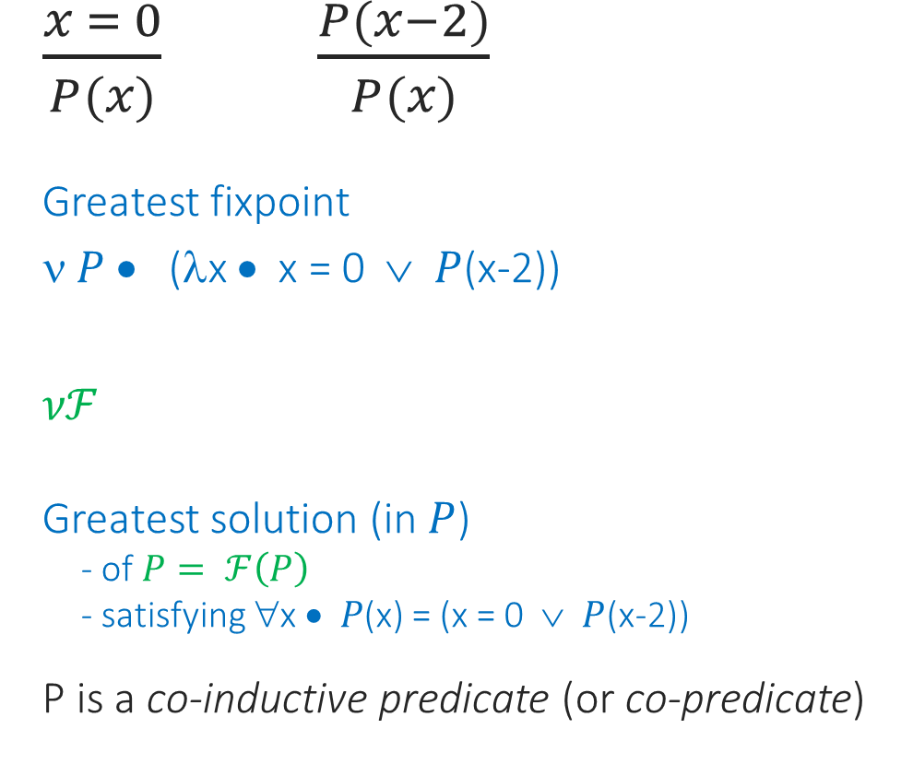
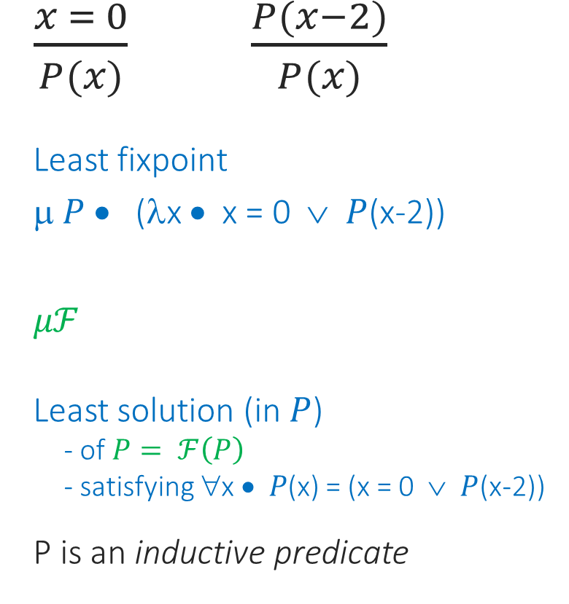

Names and notational conventions
Least solution
Greatest solution
$\frac{x = 0}{P(x)}$ $\frac{P(x−2)}{P(x)}$
Least fixpoint
μ $P$ • (λx • x = 0 ∨ $P$(x-2))
$μℱ$
Least solution (in $P$)
- of $P= ℱ\left(P\right)$
- satisfying ∀x • 𝑃(x) = (x = 0 ∨ $P$(x-2))
P is an inductive predicate
$\frac{x = 0}{P(x)}$ $\frac{P(x−2)}{P(x)}$
Greatest fixpoint
ν $P$ • (λx • x = 0 ∨ $P$(x-2))
$νℱ$
Greatest solution (in $P$)
- of $P= ℱ\left(P\right)$
- satisfying ∀x • 𝑃(x) = (x = 0 ∨ $P$(x-2))
P is a co-inductive predicate (or co-predicate)
$$ℱ(P)$$

Slide 6


Extreme predicates in Dafny
Least solution
Greatest solution
$\frac{x = 0}{P(x)}$ $\frac{P(x−2)}{P(x)}$
P is an inductive predicate
$\frac{x = 0}{P(x)}$ $\frac{P(x−2)}{P(x)}$
P is a co-inductive predicate (or co-predicate)
inductive predicate P(x: int)
{
x == 0 || P(x-2)
}
copredicate P(x: int)
{
x == 0 || P(x-2)
}

Slide 7
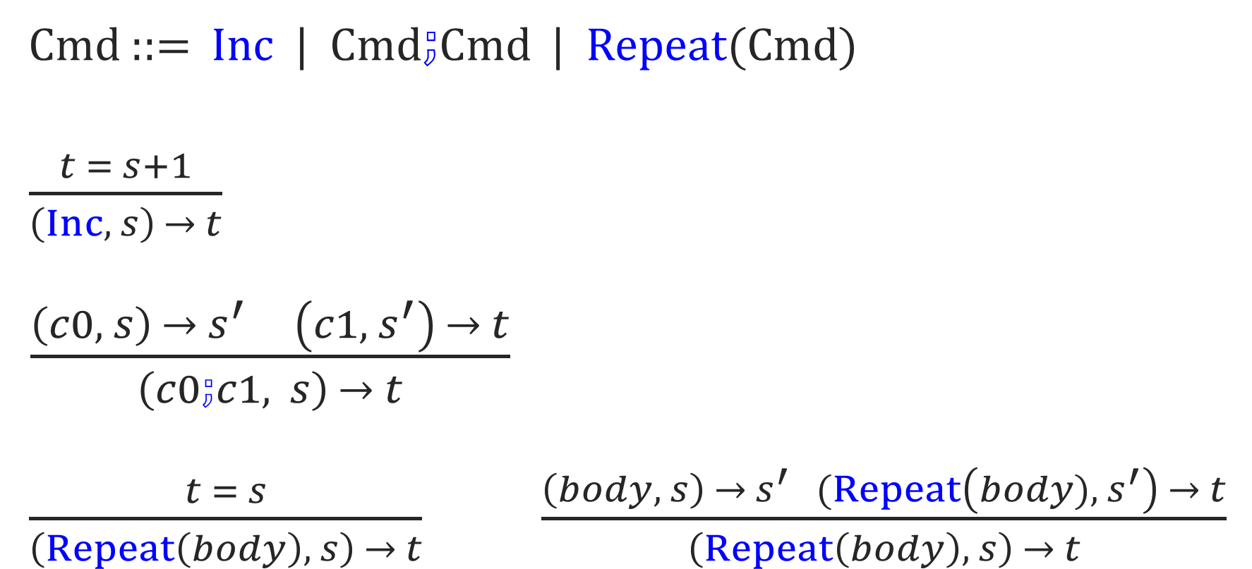
Semantics of INC
Cmd ::= Inc | Cmd$⨟$Cmd | Repeat(Cmd)
$\frac{t = s+1}{\left(Inc, s\right) → t}$
$\frac{\left(c0, s\right) → s^{′} \left(c1,{ s}^{′}\right) → t}{\left(c0⨟c1, s\right) → t}$
$\frac{t = s}{\left(Repeat\left(body\right), s\right) → t}$ $\frac{\left(body, s\right) →{ s}^{′} (Repeat\left(body), { s}^{′}\right) → t}{\left(Repeat\left(body\right), s\right) → t}$

Slide 8

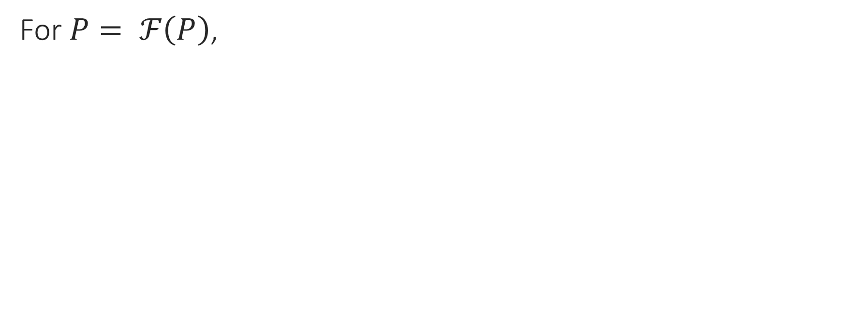
Proofs
For $P= ℱ\left(P\right)$,
What to prove | How to prove it
$$A ⟹ μℱ$$
$$μℱ⟹B$$
$$A ⟹ νℱ$$
$$νℱ⟹B$$

Slide 9

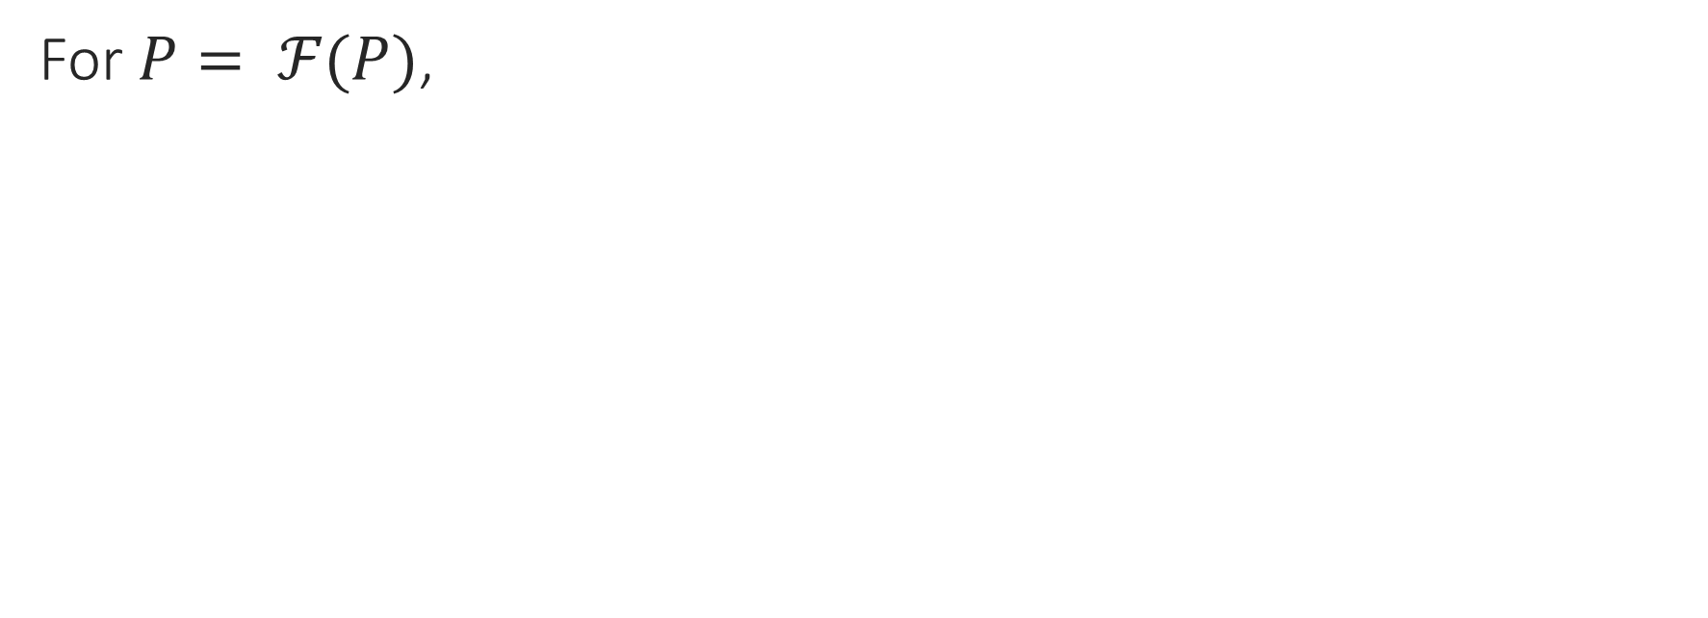
Proofs
For $P= ℱ(P)$,
What to prove | How to prove it
$$A ⟹ μℱ$$ | $$A ⟹P$$
$$μℱ⟹B$$
$$A ⟹ νℱ$$
$$νℱ⟹B$$ | $$P ⟹B$$

Slide 10

Proofs
For $P= ℱ(P)$,
What to prove | How to prove it
$$A ⟹ μℱ$$ | $$A ⟹P$$
$$μℱ⟹B$$ | via iterates
$$A ⟹ νℱ$$ | via iterates
$$νℱ⟹B$$ | $$P ⟹B$$

Slide 11

Proofs
For $P= ℱ(P)$,
What to prove | How to prove it
$$A ⟹ μℱ$$ | $$A ⟹P$$
$$μℱ⟹B$$ | inductive lemma
$$A ⟹ νℱ$$ | colemma
$$νℱ⟹B$$ | $$P ⟹B$$

Slide 12
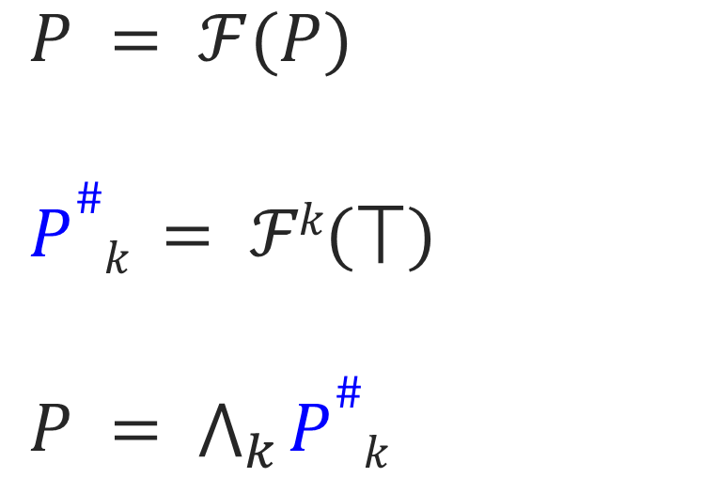
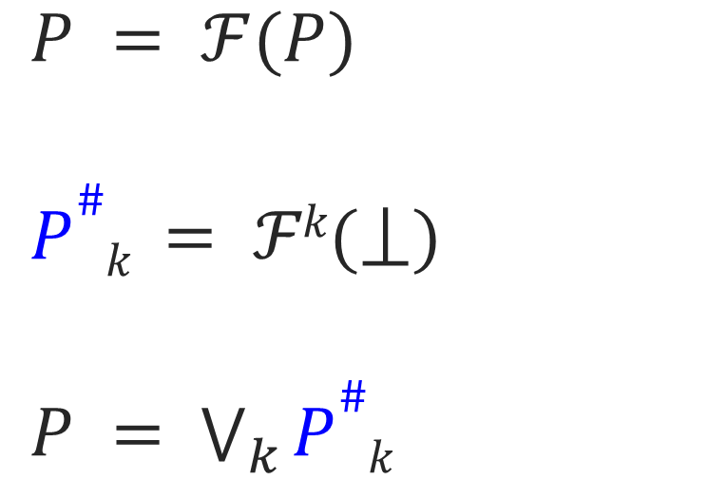

Iterates
Least solution
Greatest solution
$P = ℱ(P)$
$P\#k = ℱk\text{(}⟘\text{)}$
$P = \bigvee_{k}{P\#k}$
$P = ℱ(P)$
$P\#k = ℱk\text{(}⟙\text{)}$
$P = \bigwedge_{k}{P\#k}$
provided $ℱ$ is continuous

Slide 13
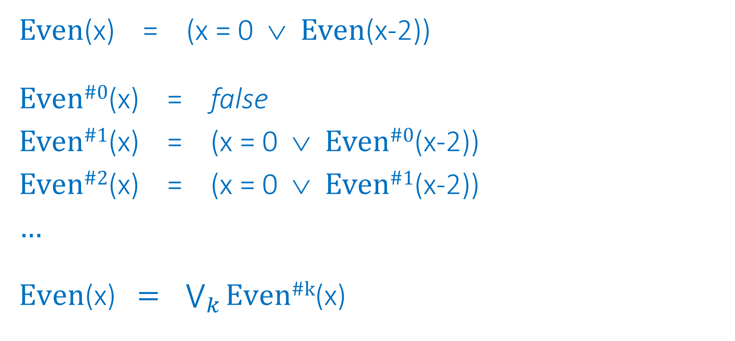
Example: Iterates of least solution of Even
Even(x) = (x = 0 ∨ Even(x-2))
Even^{#0}(x) = false
Even^{#1}(x) = (x = 0 ∨ Even^{#0}(x-2))
Even^{#2}(x) = (x = 0 ∨ Even^{#1}(x-2))
…
$\text{Eve}\text{n}\text{(}\text{x}\text{)}\text{ = }\bigvee_{k}{\text{Even}\text{\#}\text{k}\text{(}\text{x}\text{)}}$

Slide 14
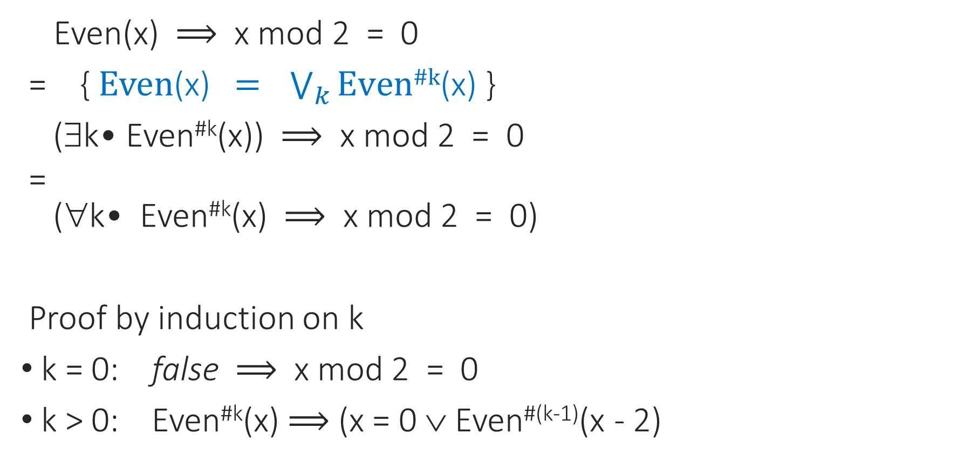

Example: Proof of the form $μℱ⟹B$
Even(x) $⟹$ x mod 2 = 0
= { $\text{Even}\text{(}\text{x}\text{)}\text{ = }\bigvee_{k}{\text{Even}\text{\#}\text{k}\text{(}\text{x}\text{)}}$ }
(∃k• Even^{#k}(x)) $⟹$ x mod 2 = 0
=
(∀k• Even^{#k}(x) $⟹$ x mod 2 = 0)
Proof by induction on k
k = 0: false $⟹$ x mod 2 = 0
k > 0: Even^{#k}(x) $⟹$ (x = 0 ∨ Even^{#(k-1)}(x - 2)

Slide 15
Show and tell
Language support: Even, INC

Slide 16
Enforcing continuity
Syntactic restrictions:
Inductive predicate is disallowed if recursive call sits inside a ∀
Co-inductive predicate is disallowed if recursive call sits inside a ∃
Example:
copredicate P(x: int)
{
P(x+1) || exists m :: 0 <= m && P(m)
}

Slide 17
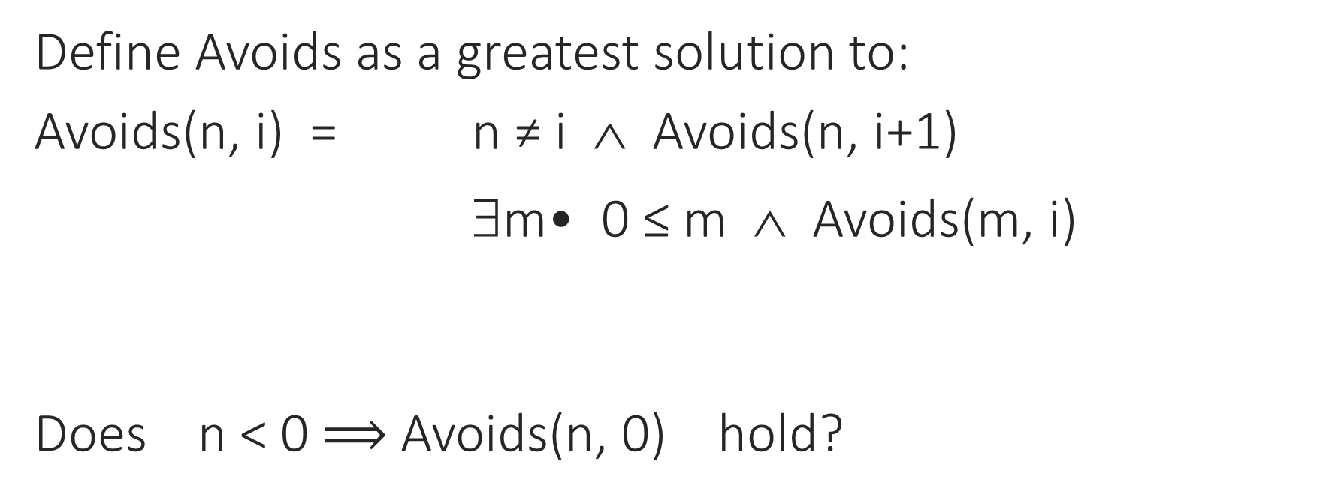
Continuity is needed
Define Avoids as a greatest solution to:
Avoids(n, i) = n ≠ i ∧ Avoids(n, i+1)
∃m• 0 ≤ m ∧ Avoids(m, i)
Does n < 0 $⟹$Avoids(n, 0) hold?
if 0 ≤ n
if n < 0

Slide 18

Problem with continuity: Co-inductive big-step semantics
Cmd ::= Inc | Cmd$⨟$Cmd | …
$\frac{t = s+1}{\left(Inc, s\right) → t}$
$\frac{\left(c0, s\right) → s^{′} \left(c1,{ s}^{′}\right) → t}{\left(c0⨟c1, s\right) → t}$
…

Slide 19
Show and tell
Continuity workaround: move the quantification out

Slide 20
Summary
Is continuity the same condition as “no recursive calls inside unbounded ∀/ ∃”?
When is the distribution workaround for continuity safe?
What language support would one want for it?

